Slide 1
Computer Architecture
A Quantitative Approach, Fifth Edition
Chapter 2
Memory Hierarchy Design

Slide 2
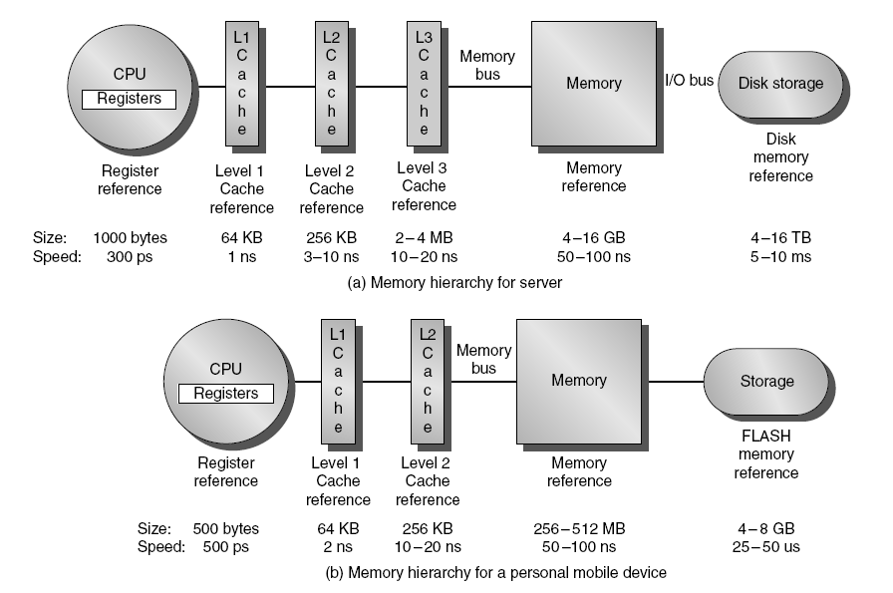
Memory Hierarchy
Introduction

Slide 3
Causes of misses
Introduction
Compulsory
First reference to a block
Capacity
Blocks discarded and later retrieved
Conflict
Program makes repeated references to multiple addresses from different blocks that map to the same location in the cache

Slide 4
Memory Hierarchy Basics
Introduction
Note that speculative and multithreaded processors may execute other instructions during a miss
Reduces performance impact of misses

Slide 5
Memory Hierarchy Basics
Introduction
Six basic cache optimizations:
Larger block size
Reduces compulsory misses
Increases capacity and conflict misses, increases miss penalty
Larger total cache capacity to reduce miss rate
Increases hit time, increases power consumption
Higher associativity
Reduces conflict misses
Increases hit time, increases power consumption
Higher number of cache levels
Reduces overall memory access time
Giving priority to read misses over writes
Use a write buffer!
Reduces miss penalty
Avoiding address translation in cache indexing
Reduces hit time

Slide 6
Advanced cache optimizations

Slide 7
1. Small and simple first level caches
Critical timing path:
addressing tag memory, then
comparing tags, then
selecting correct set
Direct-mapped caches can overlap tag compare and transmission of data
Lower associativity reduces power because fewer cache lines are accessed
Advanced Optimizations

Slide 8
2. Way Prediction
To improve hit time, predict the way to pre-set mux
Mis-prediction gives longer hit time
Prediction accuracy
> 90% for two-way
> 80% for four-way
I-cache has better accuracy than D-cache
First used on MIPS R10000 in mid-90s
Used on ARM Cortex-A8
Extend to predict block as well
“Way selection”
Increases mis-prediction penalty
Advanced Optimizations

Slide 9
3. Pipelining Cache
Pipeline cache access to improve bandwidth
Examples:
Pentium: 1 cycle
Pentium Pro – Pentium III: 2 cycles
Pentium 4 – Core i7: 4 cycles
Increases branch mis-prediction penalty
Makes it easier to increase associativity
Advanced Optimizations

Slide 10
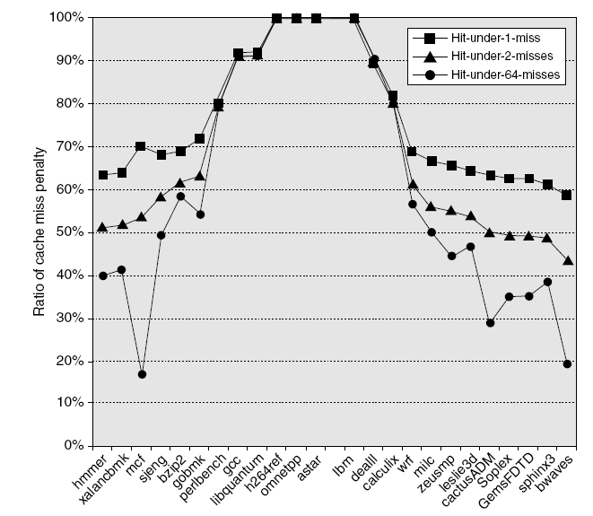
4. Nonblocking Caches
Allow hits before previous misses complete
“Hit under miss”
“Hit under multiple miss”
L2 must support this
In general, processors can hide L1 miss penalty but not L2 miss penalty
Advanced Optimizations

Slide 11
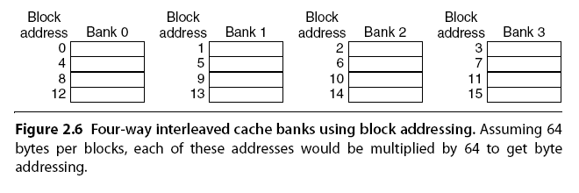
5. Multibanked Caches
Organize cache as independent banks to support simultaneous access
ARM Cortex-A8 supports 1-4 banks for L2
Intel i7 supports 4 banks for L1 and 8 banks for L2
Interleave banks according to block address
Advanced Optimizations

Slide 12
6. Critical Word First, Early Restart
Critical word first
Request missed word from memory first
Send it to the processor as soon as it arrives
Early restart
Request words in normal order
Send missed work to the processor as soon as it arrives
Effectiveness of these strategies depends on block size and likelihood of another access to the portion of the block that has not yet been fetched
Advanced Optimizations

Slide 13
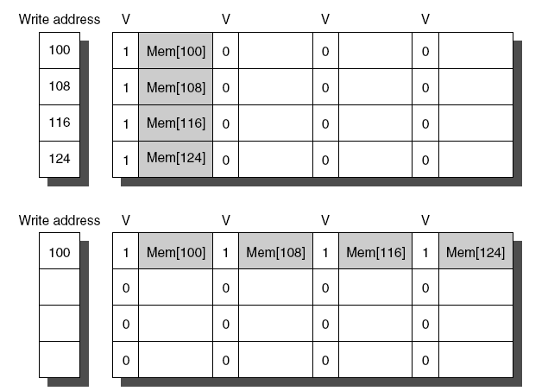
7. Merging Write Buffer
When storing to a block that is already pending in the write buffer, update write buffer
Reduces stalls due to full write buffer
Do not apply to I/O addresses
Advanced Optimizations
No write buffering
Write buffering

Slide 14
8. Compiler Optimizations
Loop Interchange
Swap nested loops to access memory in sequential order
Blocking
Instead of accessing entire rows or columns, subdivide matrices into blocks
Requires more memory accesses but improves locality of accesses
Advanced Optimizations

Slide 15
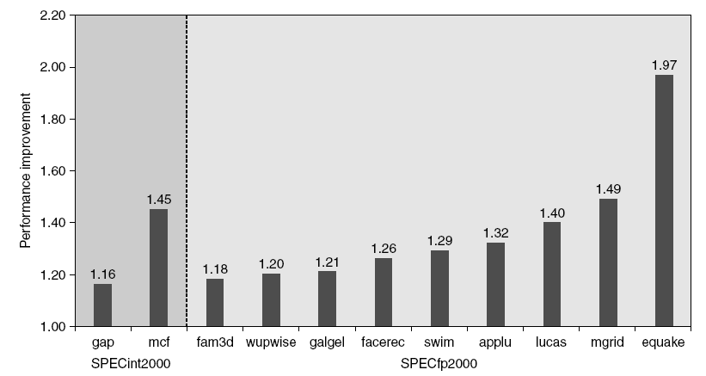
9. Hardware Prefetching
Fetch two blocks on miss (include next sequential block)
Advanced Optimizations
Pentium 4 Pre-fetching

Slide 16
10. Compiler Prefetching
Insert prefetch instructions before data is needed
Non-faulting: prefetch doesn’t cause exceptions
Register prefetch
Loads data into register
Cache prefetch
Loads data into cache
Combine with loop unrolling and software pipelining
Advanced Optimizations

Slide 17
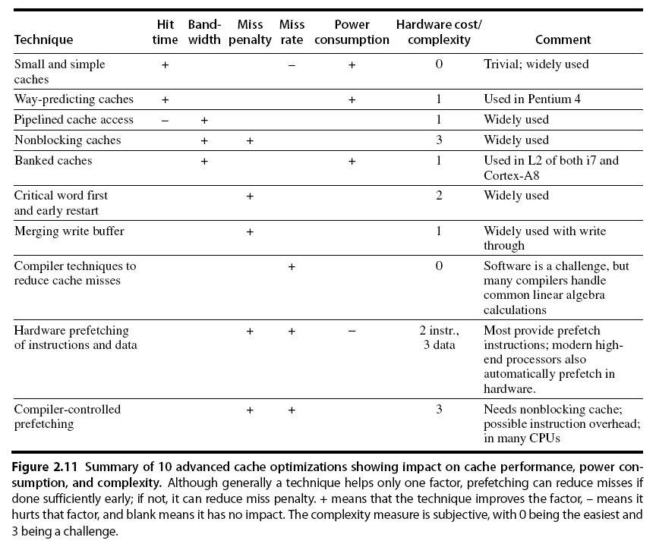
Summary
Advanced Optimizations

