Slide 1
Chapter 1
Computer Abstractions and Technology

Slide 2
The Computer Revolution
§1.1 Introduction
Progress in computer technology
  Underpinned by Moore’s Law
Makes novel applications feasible
  Computers in automobiles
  Cell phones
  Human genome project
  World Wide Web
  Search Engines
Computers are pervasive

Slide 3
Classes of Computers
Personal computers
  General purpose, variety of software
  Subject to cost/performance tradeoff
Server computers
  Network based
  High capacity, performance, reliability
  Range from small servers to building sized

Slide 4
Classes of Computers
Supercomputers
  High-end scientific and engineering calculations
  Highest capability but represent a small fraction of the overall computer market
Embedded computers
  Hidden as components of systems
  Stringent power/performance/cost constraints

Slide 5
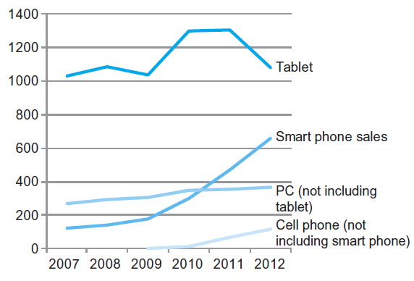
The PostPC Era

Slide 6
The PostPC Era
Personal Mobile Device (PMD)
  Battery operated
  Connects to the Internet
  Hundreds of dollars
  Smart phones, tablets, electronic glasses
Cloud computing
  Warehouse Scale Computers (WSC)
  Software as a Service (SaaS)
  Portion of software run on a PMD and a portion run in the Cloud
  Amazon AWS, Google Compute Engine, Microsoft Azure

Slide 7
Understanding Performance
Algorithm
  Determines number of operations executed
Programming language, compiler, architecture
  Determine the number of machine instructions executed per operation
Processor and memory system
  Determine how fast instructions are executed
I/O system (including OS)
  Determines how fast I/O operations are executed

Slide 8
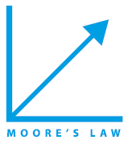






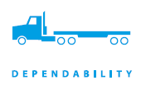
Eight Great Ideas
Design for Moore’s Law
Use abstraction to simplify design
Make the common case fast
Performance via parallelism
Performance via pipelining
Performance via prediction
Hierarchy of memories
Dependability via redundancy
§1.2 Eight Great Ideas in Computer Architecture

Slide 9
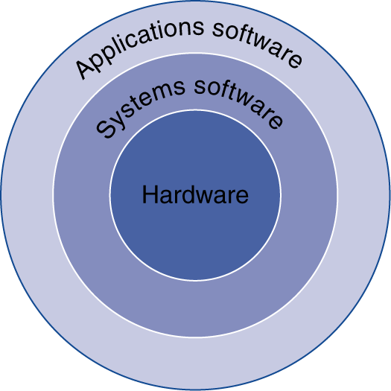
Below Your Program
Application software
  Written in high-level language
System software
  Compiler: translates HLL code to machine code
  Operating System: service code
    Handling input/output
    Managing memory and storage
    Scheduling tasks & sharing resources
Hardware
  Processor, memory, I/O controllers
§1.3 Below Your Program

Slide 10
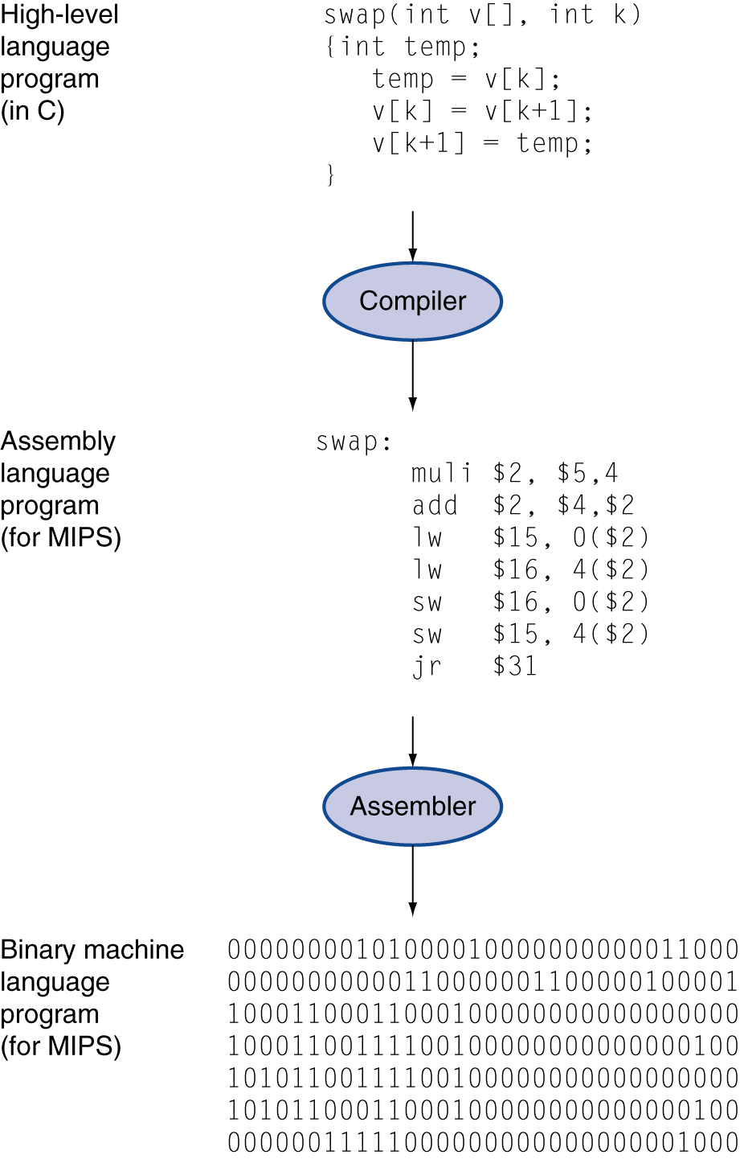
Levels of Program Code
High-level language
  Level of abstraction closer to problem domain
  Provides for productivity and portability
Assembly language
  Textual representation of instructions
Hardware representation
  Binary digits (bits)
  Encoded instructions and data

Slide 11
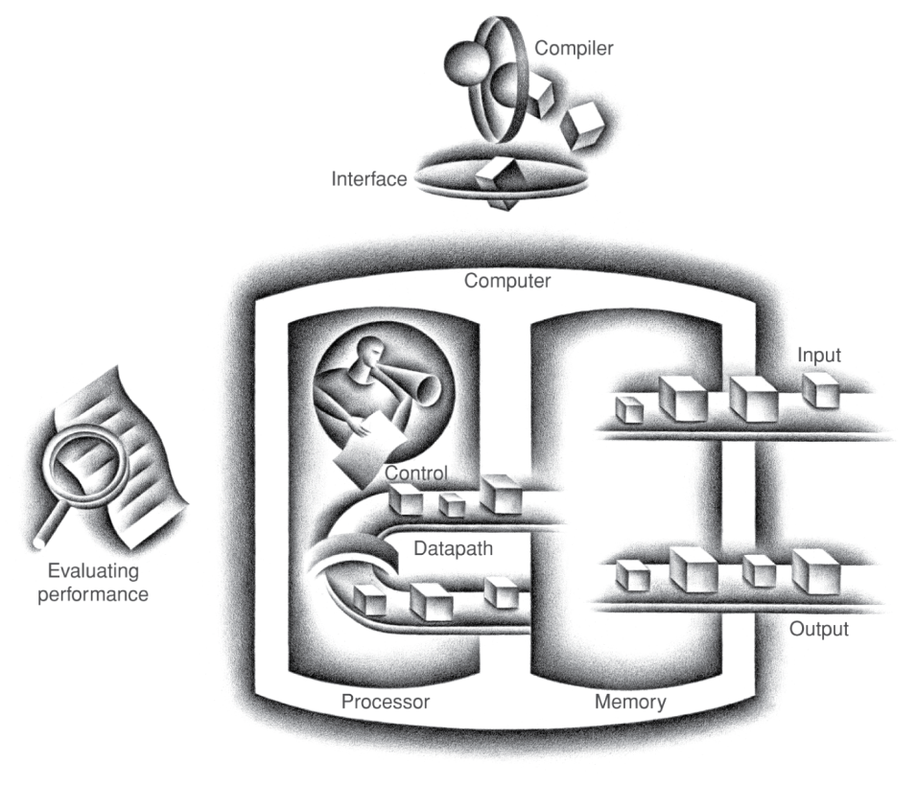
Components of a Computer
Same components for
all kinds of computer
  Desktop, server,
  embedded
Input/output includes
  User-interface devices
    Display, keyboard, mouse
  Storage devices
    Hard disk, CD/DVD, flash
  Network adapters
    For communicating with other computers
§1.4 Under the Covers
The BIG Picture

Slide 12
Abstractions
The BIG Picture
Abstraction helps us deal with complexity
  Hide lower-level detail
Instruction set architecture (ISA)
  The hardware/software interface
Application binary interface
  The ISA plus system software interface
Implementation
  The details underlying and interface

Slide 13
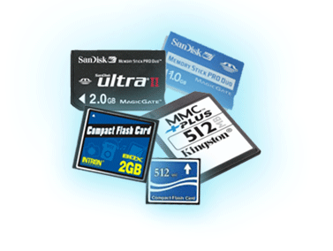
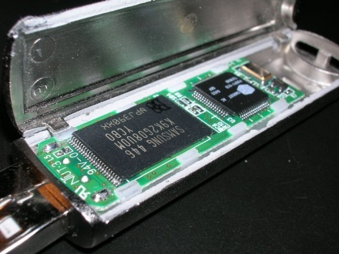
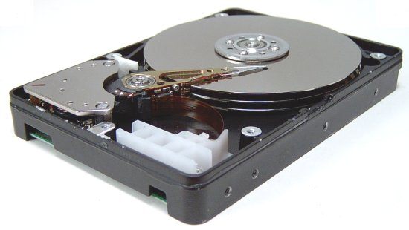
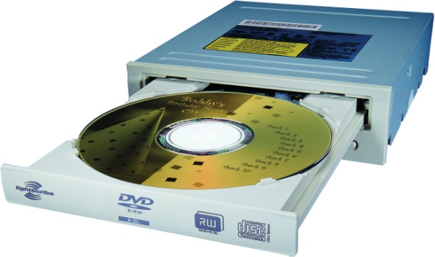
A Safe Place for Data
Volatile main memory
  Loses instructions and data when power off
Non-volatile secondary memory
  Magnetic disk
  Flash memory
  Optical disk (CDROM, DVD)

Slide 14
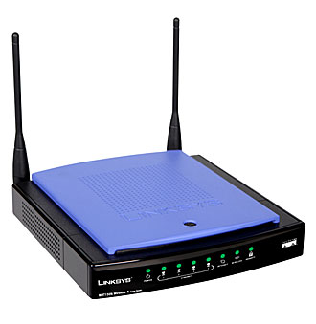
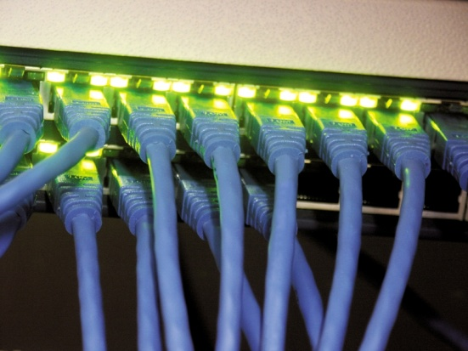
Networks
Communication, resource sharing, nonlocal access
Local area network (LAN): Ethernet
Wide area network (WAN): the Internet
Wireless network: WiFi, Bluetooth

Slide 15
Integrated Circuit Cost
Nonlinear relation to area and defect rate
  Wafer cost and area are fixed
  Defect rate determined by manufacturing process
  Die area determined by architecture and circuit design

Slide 16
Defining Performance
§1.6 Performance
Which airplane has the best performance?

Slide 17
Response Time and Throughput
Response time
  How long it takes to do a task
Throughput
  Total work done per unit time
    e.g., tasks/transactions/… per hour
How are response time and throughput affected by
  Replacing the processor with a faster version?
  Adding more processors?
We’ll focus on response time for now…

Slide 18
Relative Performance
Define Performance = 1/Execution Time
“X is n time faster than Y”
Example: time taken to run a program
  10s on A, 15s on B
  Execution Time_{B} / Execution Time_{A}
  = 15s / 10s = 1.5
  So A is 1.5 times faster than B

Slide 19
Measuring Execution Time
Elapsed time
  Total response time, including all aspects
    Processing, I/O, OS overhead, idle time
  Determines system performance
CPU time
  Time spent processing a given job
    Discounts I/O time, other jobs’ shares
  Comprises user CPU time and system CPU time
  Different programs are affected differently by CPU and system performance

Slide 20
CPU Clocking
Operation of digital hardware governed by a constant-rate clock
Clock period
Clock (cycles)
Data transfer
and computation
Update state
Clock period: duration of a clock cycle
  e.g., 250ps = 0.25ns = 250×10^{–12}s
Clock frequency (rate): cycles per second
  e.g., 4.0GHz = 4000MHz = 4.0×10⁹Hz

Slide 21
CPU Time
Performance improved by
  Reducing number of clock cycles
  Increasing clock rate
  Hardware designer must often trade off clock rate against cycle count

Slide 22
Instruction Count and CPI
Instruction Count for a program
  Determined by program, ISA and compiler
Average cycles per instruction
  Determined by CPU hardware
  If different instructions have different CPI
    Average CPI affected by instruction mix

Slide 23
CPI Example
Computer A: Cycle Time = 250ps, CPI = 2.0
Computer B: Cycle Time = 500ps, CPI = 1.2
Same ISA
Which is faster, and by how much?
A is faster…
…by this much

Slide 24
CPI in More Detail
If different instruction classes take different numbers of cycles
Weighted average CPI
Relative frequency

Slide 25
Performance Summary
The BIG Picture
Performance depends on
  Algorithm: affects IC, possibly CPI
  Programming language: affects IC, CPI
  Compiler: affects IC, CPI
  Instruction set architecture: affects IC, CPI, T_{c}

Slide 26
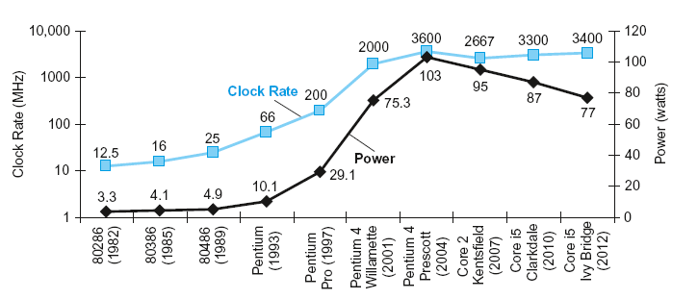
Power Trends
§1.7 The Power Wall
In CMOS IC technology
×30
5V → 1V
×1000

Slide 27
Reducing Power
Suppose a new CPU has
  85% of capacitive load of old CPU
  15% voltage and 15% frequency reduction
The power wall
  We can’t reduce voltage further
  We can’t remove more heat
How else can we improve performance?

Slide 28
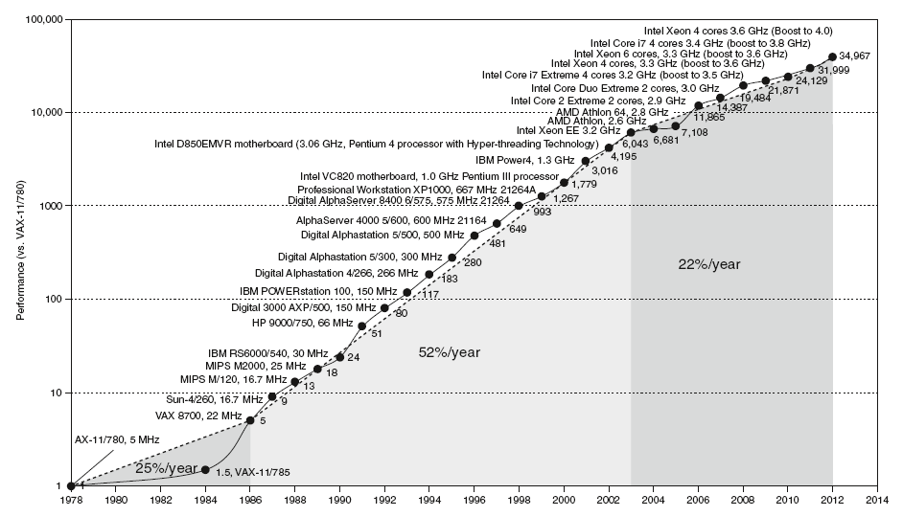
Uniprocessor Performance
§1.8 The Sea Change: The Switch to Multiprocessors
Constrained by power, instruction-level parallelism, memory latency

Slide 29
Multiprocessors
Multicore microprocessors
  More than one processor per chip
Requires explicitly parallel programming
  Compare with instruction level parallelism
    Hardware executes multiple instructions at once
    Hidden from the programmer
  Hard to do
    Programming for performance
    Load balancing
    Optimizing communication and synchronization

Slide 30
Pitfall: Amdahl’s Law
Improving an aspect of a computer and expecting a proportional improvement in overall performance
§1.10 Fallacies and Pitfalls
Example: multiply accounts for 80s/100s
  How much improvement in multiply performance to get 5× overall?
  Can’t be done!
Corollary: make the common case fast

Slide 31
Concluding Remarks
Cost/performance is improving
  Due to underlying technology development
Hierarchical layers of abstraction
  In both hardware and software
Instruction set architecture
  The hardware/software interface
Execution time: the best performance measure
Power is a limiting factor
  Use parallelism to improve performance
§1.9 Concluding Remarks

