Slide 1
The processor

Slide 2
Introduction
§4.1 Introduction
CPU performance factors
  Instruction count
    Determined by ISA and compiler
  CPI and Cycle time
    Determined by CPU hardware
We will examine two MIPS implementations
  A simplified version
  A more realistic pipelined version
Simple subset, shows most aspects
  Memory reference: lw, sw
  Arithmetic/logical: add, sub, and, or, slt
  Control transfer: beq, j

Slide 3
Instruction Execution
PC → instruction memory, fetch instruction
Register numbers → register file, read registers
Depending on instruction class
  Use ALU to calculate
    Arithmetic result
    Memory address for load/store
    Branch target address
  Access data memory for load/store
  PC ← target address or PC + 4

Slide 4
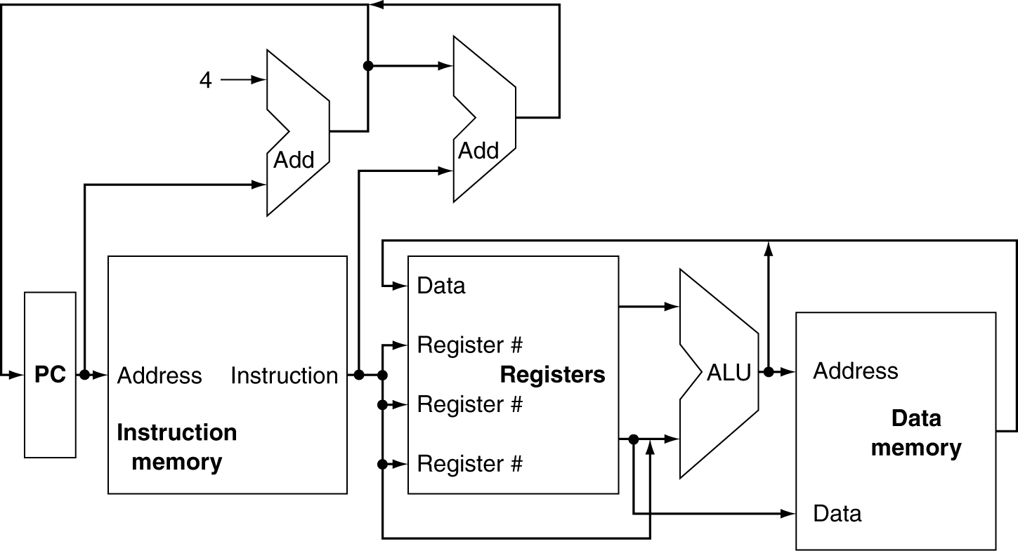
CPU Overview

Slide 5
Multiplexers
Can’t just join wires together
  Use multiplexers

Slide 6
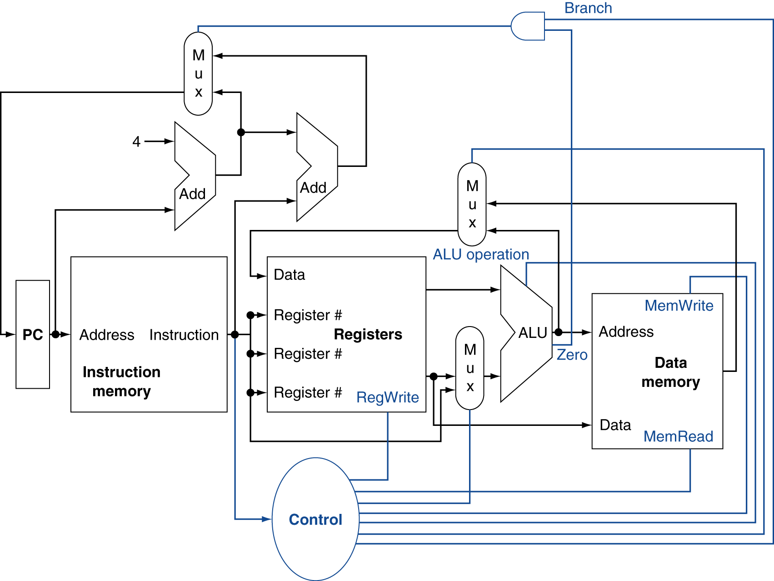
Control

Slide 7
Logic Design Basics
Information encoded in binary
  Low voltage = 0, High voltage = 1
  One wire per bit
  Multi-bit data encoded on multi-wire buses
Combinational element
  Operate on data
  Output is a function of input
State (sequential) elements
  Store information
§4.2 Logic Design Conventions

Slide 8
Combinational Elements
AND-gate
  Y = A & B
Adder
  Y = A + B
A
+
Y
B
A
Y
B
Arithmetic/Logic Unit
  Y = F(A, B)
Multiplexer
  Y = S ? I1 : I0
A
I0
M
u
x
Y
Y
ALU
I1
B
S
F

Slide 9
Sequential Elements
Register: stores data in a circuit
  Uses a clock signal to determine when to update the stored value
  Edge-triggered: update when Clk changes from 0 to 1
Clk
D
Q
D
Clk
Q

Slide 10
Sequential Elements
Register with write control
  Only updates on clock edge when write control input is 1
  Used when stored value is required later
Clk
D
Q
Write
Write
D
Clk
Q

Slide 11
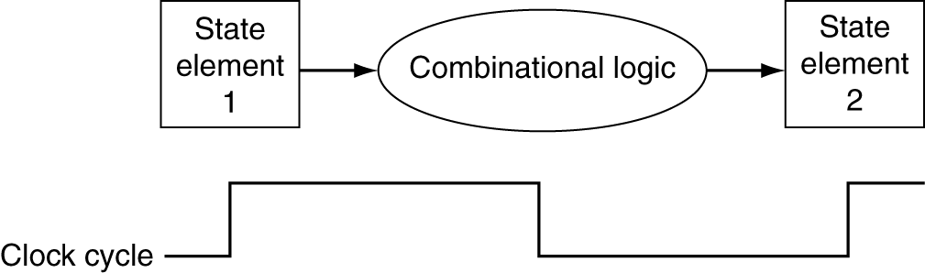
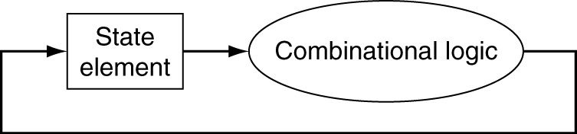
Clocking Methodology
Combinational logic transforms data during clock cycles
  Between clock edges
  Input from state elements, output to state element
  Longest delay determines clock period

Slide 12
Building a Datapath
Datapath
  Elements that process data and addresses
  in the CPU
    Registers, ALUs, mux’s, memories, …
We will build a MIPS datapath incrementally
  Refining the overview design
§4.3 Building a Datapath

Slide 13
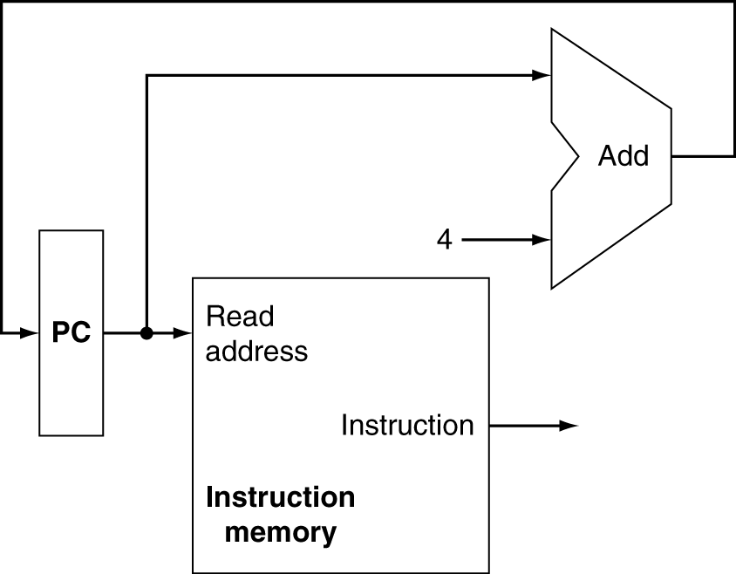
Instruction Fetch
Increment by 4 for next instruction
32-bit register

Slide 14
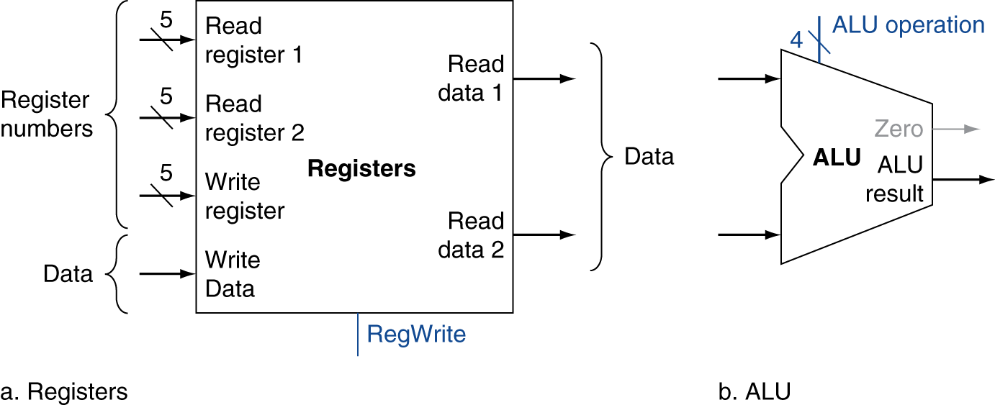
R-Format Instructions
Read two register operands
Perform arithmetic/logical operation
Write register result

Slide 15
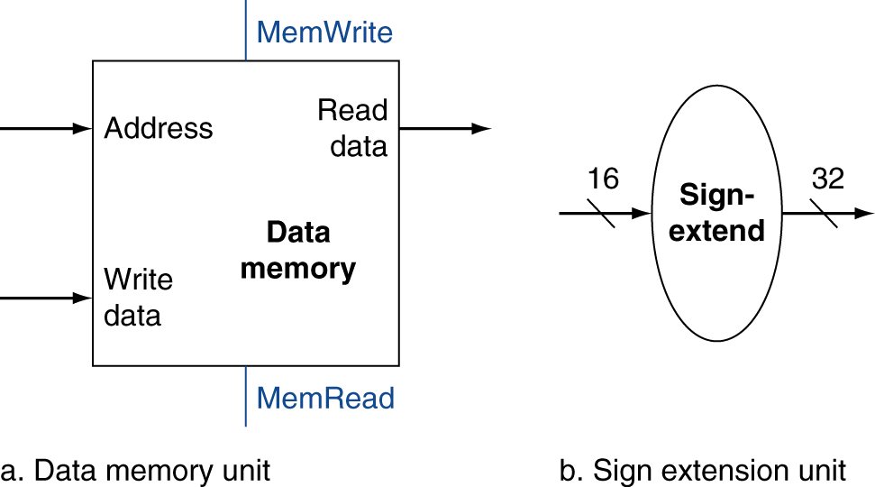
Load/Store Instructions
Read register operands
Calculate address using 16-bit offset
  Use ALU, but sign-extend offset
Load: Read memory and update register
Store: Write register value to memory

Slide 16
Branch Instructions
Read register operands
Compare operands
  Use ALU, subtract and check Zero output
Calculate target address
  Sign-extend displacement
  Shift left 2 places (word displacement)
  Add to PC + 4
    Already calculated by instruction fetch

Slide 17
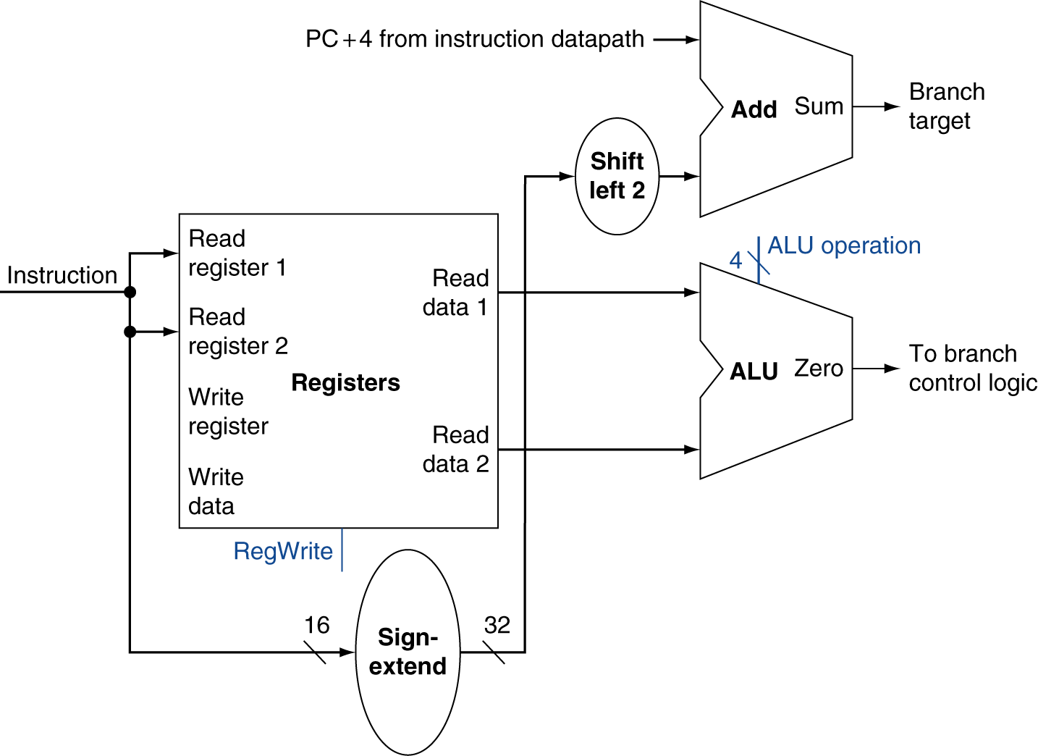
Branch Instructions
Just
re-routes wires
Sign-bit wire replicated

Slide 18
Composing the Elements
First-cut data path does an instruction in one clock cycle
  Each datapath element can only do one function at a time
  Hence, we need separate instruction and data memories
Use multiplexers where alternate data sources are used for different instructions

Slide 19
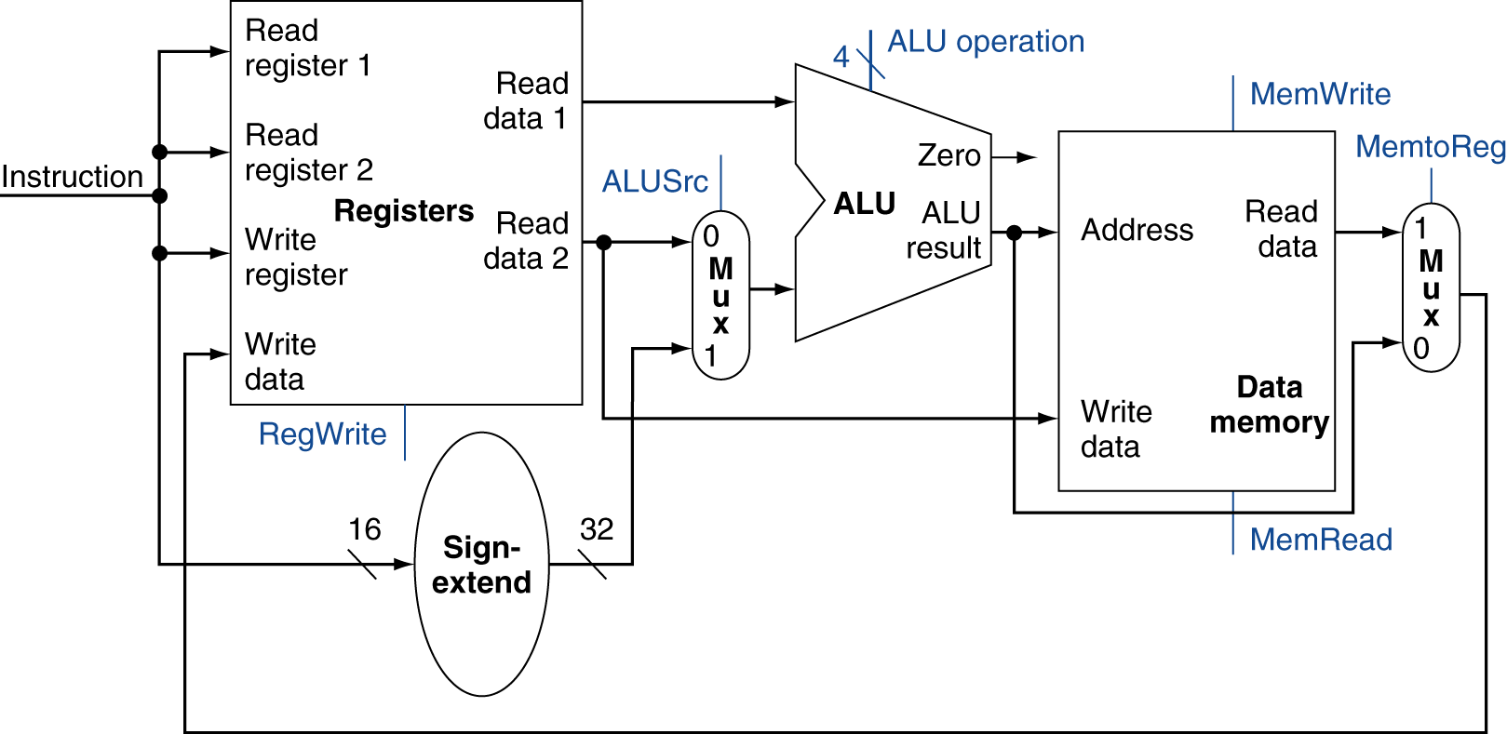
R-Type/Load/Store Datapath

Slide 20
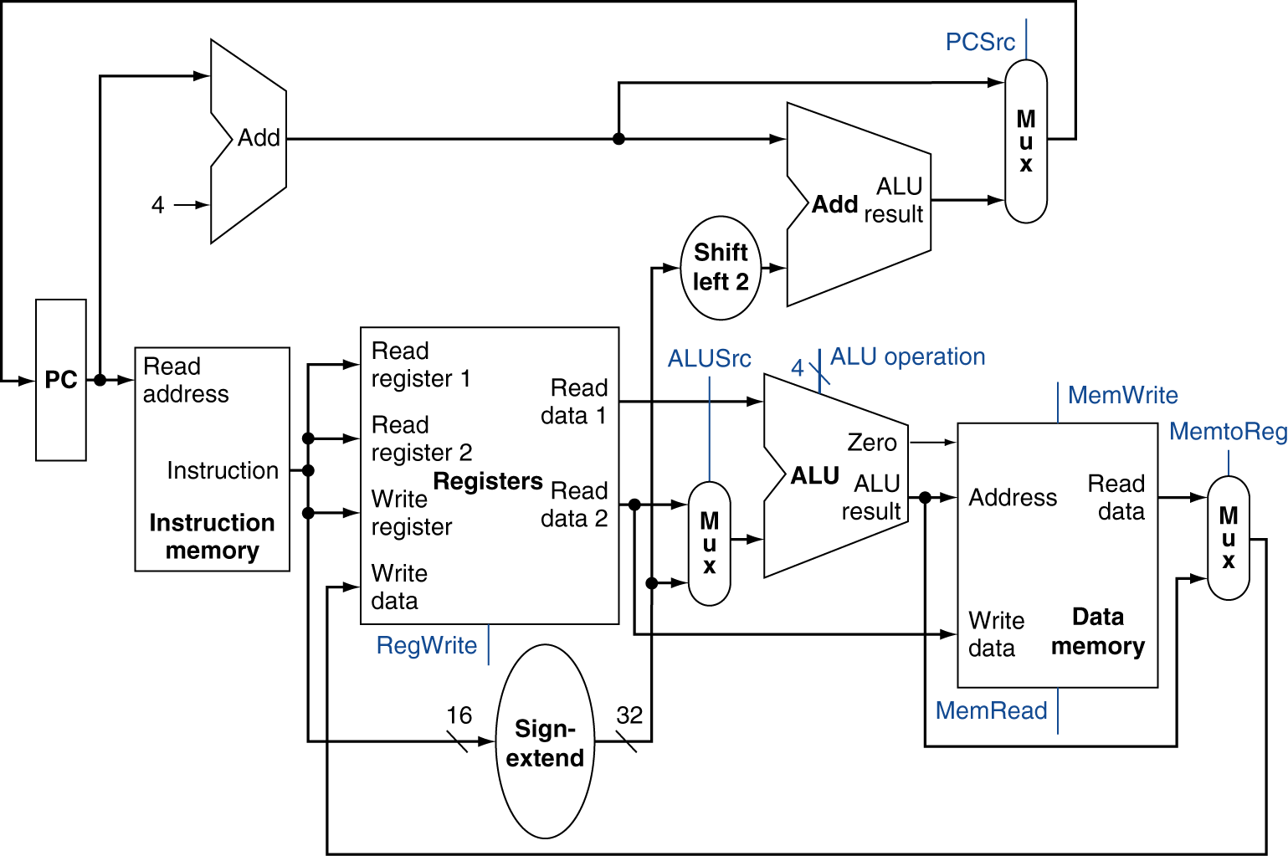
Full Datapath

Slide 21
ALU Control
ALU used for
  Load/Store: F = add
  Branch: F = subtract
  R-type: F depends on funct field
§4.4 A Simple Implementation Scheme
ALU control | Function
0000 | AND
0001 | OR
0010 | add
0110 | subtract
0111 | set-on-less-than
1100 | NOR

Slide 22
ALU Control
Assume 2-bit ALUOp derived from opcode
  Combinational logic derives ALU control
opcode | ALUOp | Operation | funct | ALU function | ALU control
lw | 00 | load word | XXXXXX | add | 0010
sw | 00 | store word | XXXXXX | add | 0010
beq | 01 | branch equal | XXXXXX | subtract | 0110
R-type | 10 | add | 100000 | add | 0010
 |  | subtract | 100010 | subtract | 0110
 |  | AND | 100100 | AND | 0000
 |  | OR | 100101 | OR | 0001
 |  | set-on-less-than | 101010 | set-on-less-than | 0111

Slide 23
The Main Control Unit
Control signals derived from instruction
R-type
0
rs
rt
rd
shamt
funct
31:26
25:21
20:16
15:11
10:6
5:0
Load/
Store
35 or 43
rs
rt
address
31:26
25:21
20:16
15:0
Branch
4
rs
rt
address
31:26
25:21
20:16
15:0
opcode
always read
read, except for load
write for R-type and load
sign-extend and add

Slide 24
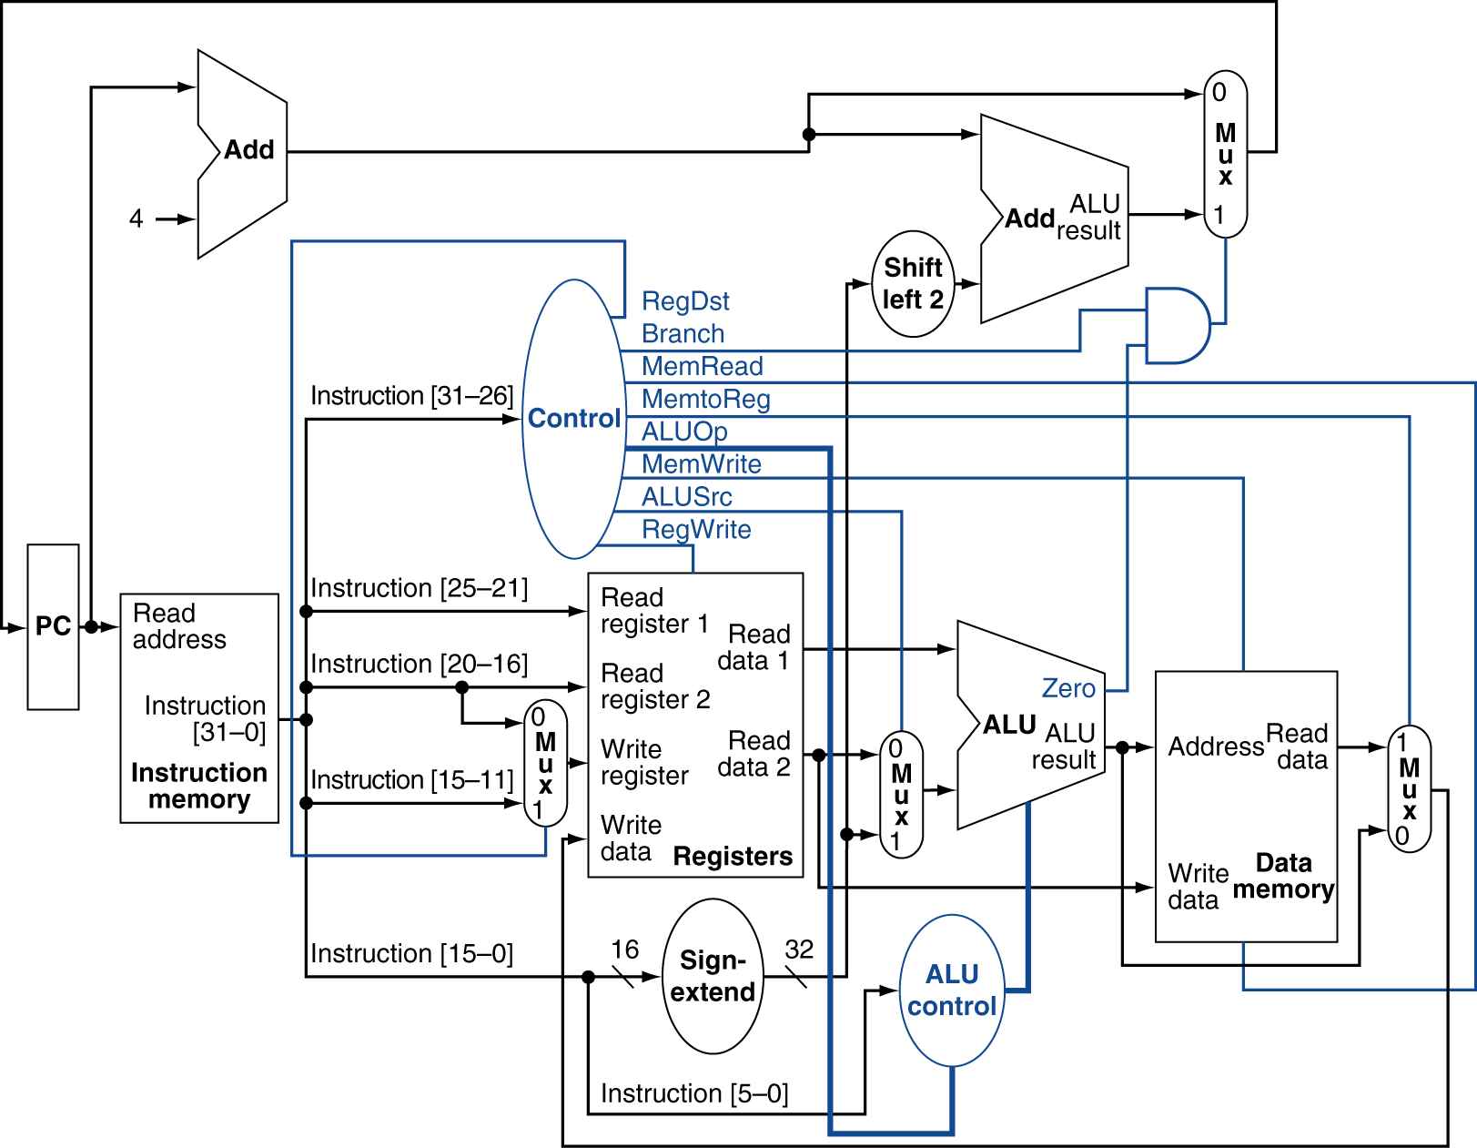
Datapath With Control

Slide 25
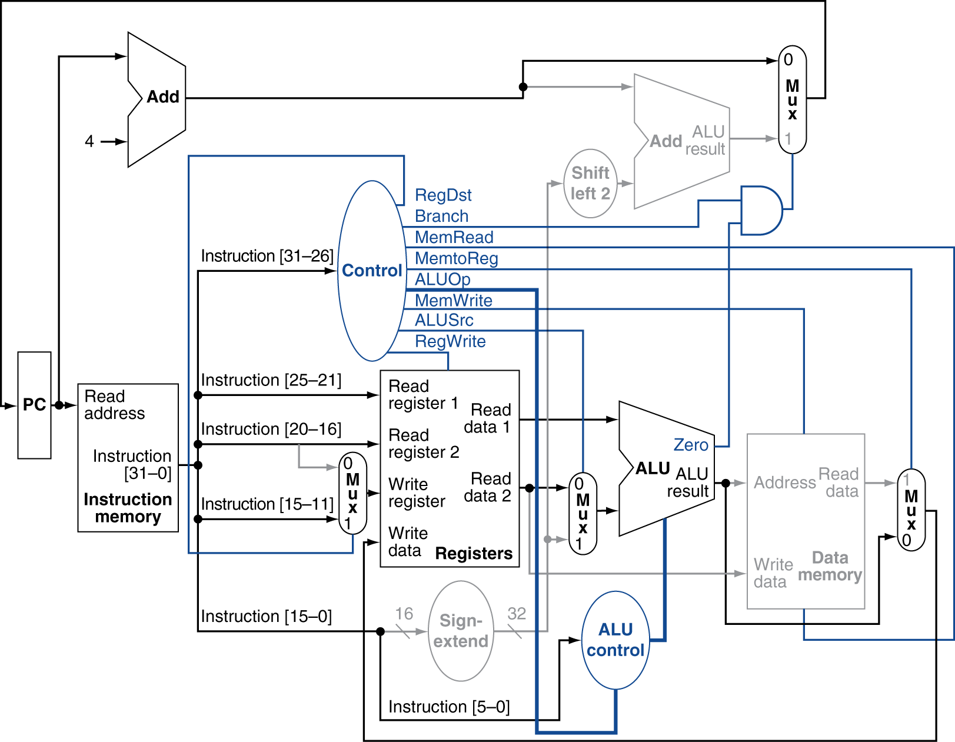
R-Type Instruction

Slide 26
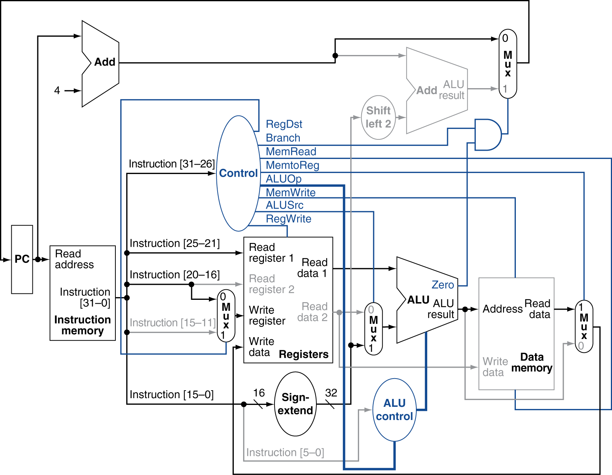
Load Instruction

Slide 27
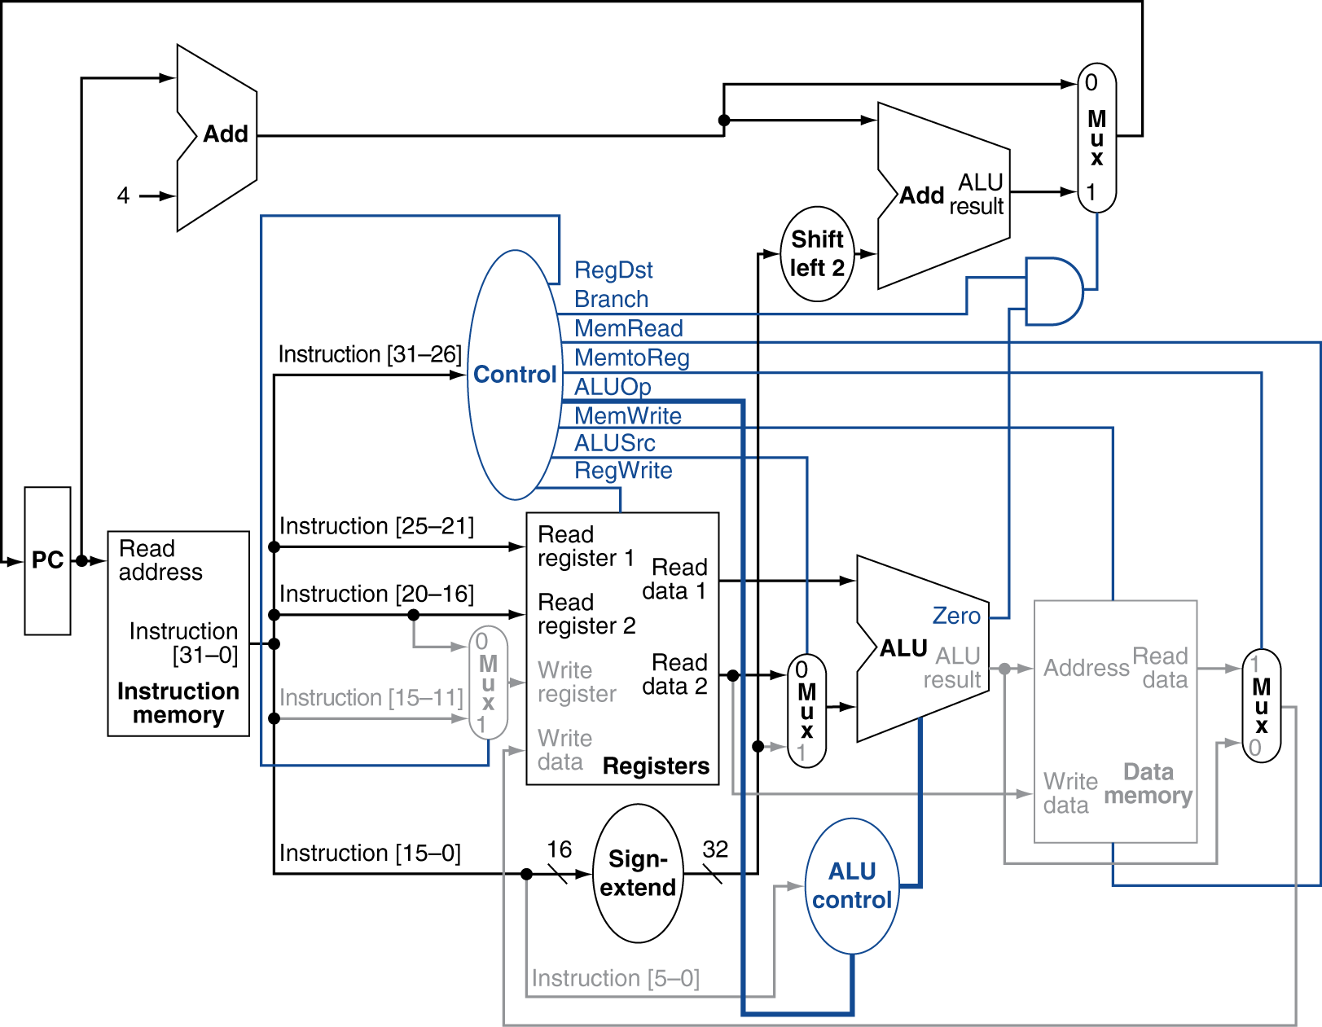
Branch-on-Equal Instruction

Slide 28
Implementing Jumps
Jump
2
address
31:26
25:0
Jump uses word address
Update PC with concatenation of
  Top 4 bits of old PC
  26-bit jump address
  00
Need an extra control signal decoded from opcode

Slide 29
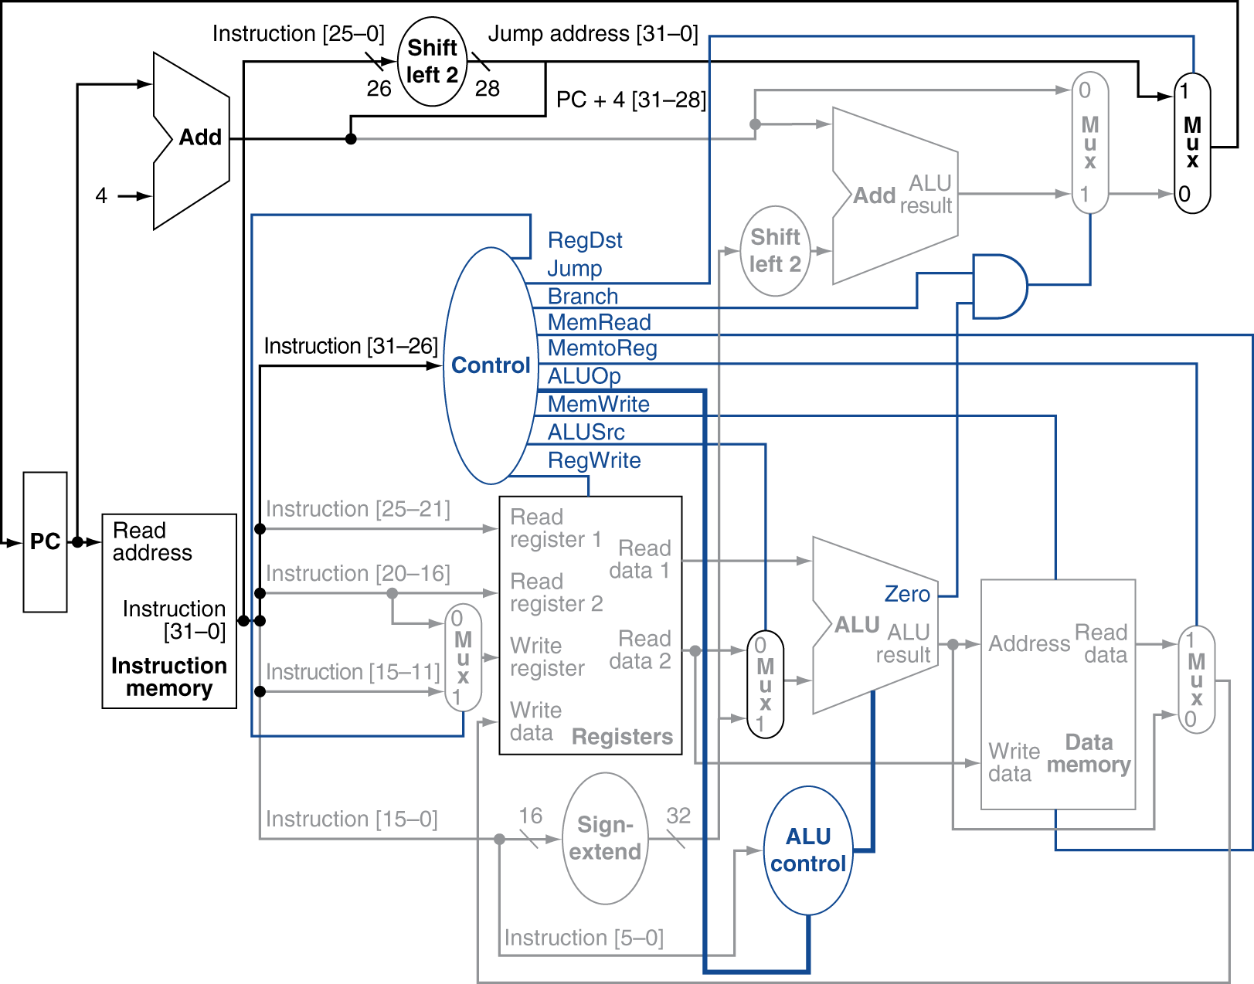
Datapath With Jumps Added

Slide 30
Performance Issues
Longest delay determines clock period
  Critical path: load instruction
  Instruction memory → register file → ALU → data memory → register file
Not feasible to vary period for different instructions
Violates design principle
  Making the common case fast
We will improve performance by pipelining

Slide 31
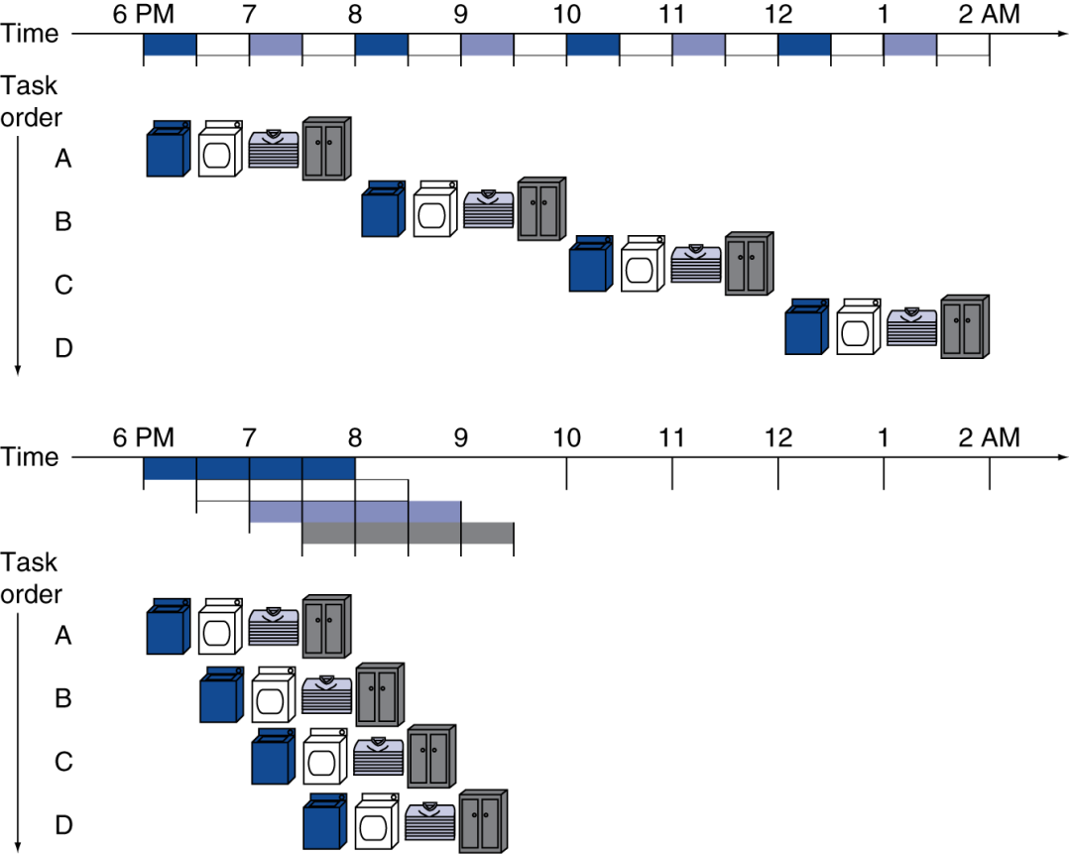
Pipelining Analogy
Pipelined laundry: overlapping execution
  Parallelism improves performance
§4.5 An Overview of Pipelining
Four loads:
  Speedup
  = 8/3.5 = 2.3
Non-stop:
  Speedup
  = 2n/0.5n + 1.5 ≈ 4
  = number of stages

Slide 32
MIPS Pipeline
Five stages, one step per stage
  IF: Instruction fetch from memory
  ID: Instruction decode & register read
  EX: Execute operation or calculate address
  MEM: Access memory operand
  WB: Write result back to register

Slide 33
Pipeline Performance
Assume time for stages is
  100ps for register read or write
  200ps for other stages
Compare pipelined datapath with single-cycle datapath
Instr | Instr fetch | Register read | ALU op | Memory access | Register write | Total time
lw | 200ps | 100 ps | 200ps | 200ps | 100 ps | 800ps
sw | 200ps | 100 ps | 200ps | 200ps |  | 700ps
R-format | 200ps | 100 ps | 200ps |  | 100 ps | 600ps
beq | 200ps | 100 ps | 200ps |  |  | 500ps

Slide 34
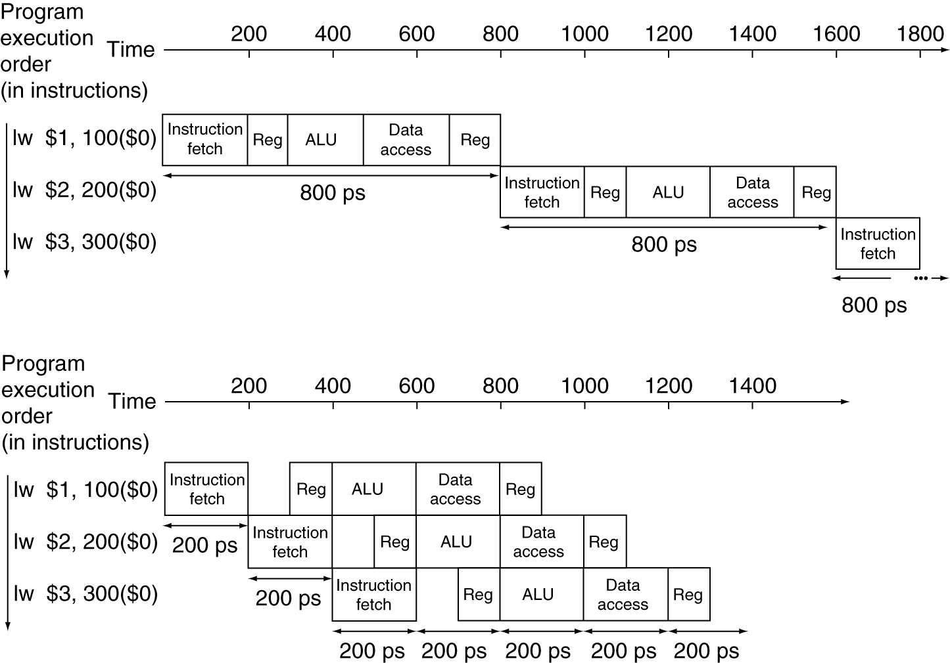
Pipeline Performance
Single-cycle (T_{c}= 800ps)
Pipelined (T_{c}= 200ps)

Slide 35
Pipeline Speedup
If all stages are balanced
  i.e., all take the same time
  Time between instructions_{pipelined}
  = Time between instructions_{nonpipelined}
  Number of stages
If not balanced, speedup is less
Speedup due to increased throughput
  Latency (time for each instruction) does not decrease

Slide 36
Pipelining and ISA Design
MIPS ISA designed for pipelining
  All instructions are 32-bits
    Easier to fetch and decode in one cycle
    c.f. x86: 1- to 17-byte instructions
  Few and regular instruction formats
    Can decode and read registers in one step
  Load/store addressing
    Can calculate address in 3rd stage, access memory in 4th stage
  Alignment of memory operands
    Memory access takes only one cycle

Slide 37
Hazards
Situations that prevent starting the next instruction in the next cycle
Structure hazards
  A required resource is busy
Data hazard
  Need to wait for previous instruction to complete its data read/write
Control hazard
  Deciding on control action depends on previous instruction

Slide 38
Structure Hazards
Conflict for use of a resource
In MIPS pipeline with a single memory
  Load/store requires data access
  Instruction fetch would have to stall for that cycle
    Would cause a pipeline “bubble”
Hence, pipelined datapaths require separate instruction/data memories
  Or separate instruction/data caches

Slide 39
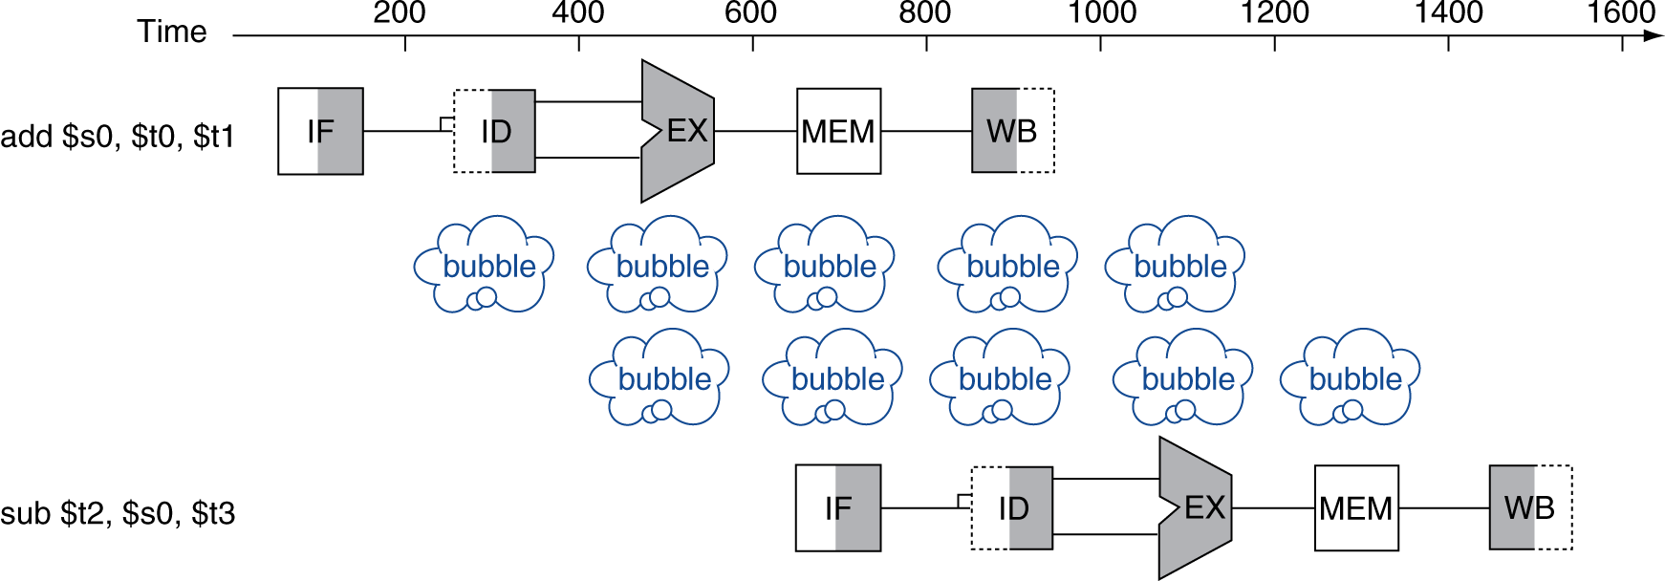
Data Hazards
An instruction depends on completion of data access by a previous instruction
  add $s0, $t0, $t1
  sub $t2, $s0, $t3

Slide 40
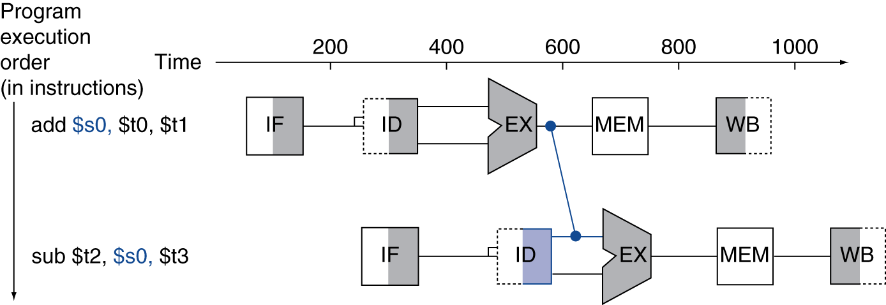
Forwarding (aka Bypassing)
Use result when it is computed
  Don’t wait for it to be stored in a register
  Requires extra connections in the datapath

Slide 41
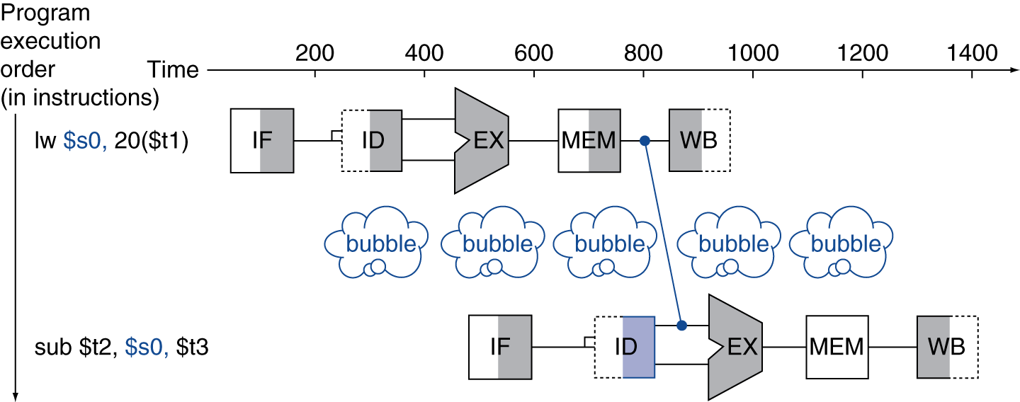
Load-Use Data Hazard
Can’t always avoid stalls by forwarding
  If value not computed when needed
  Can’t forward backward in time!

Slide 42
Code Scheduling to Avoid Stalls
Reorder code to avoid use of load result in the next instruction
C code for A = B + E; C = B + F;
lw $t1, 0($t0)
lw $t2, 4($t0)
add $t3, $t1, $t2
sw $t3, 12($t0)
lw $t4, 8($t0)
add $t5, $t1, $t4
sw $t5, 16($t0)
lw $t1, 0($t0)
lw $t2, 4($t0)
lw $t4, 8($t0)
add $t3, $t1, $t2
sw $t3, 12($t0)
add $t5, $t1, $t4
sw $t5, 16($t0)
stall
stall
13 cycles
11 cycles

Slide 43
Control Hazards
Branch determines flow of control
  Fetching next instruction depends on branch outcome
  Pipeline can’t always fetch correct instruction
    Still working on ID stage of branch
In MIPS pipeline
  Need to compare registers and compute target early in the pipeline
  Add hardware to do it in ID stage

Slide 44
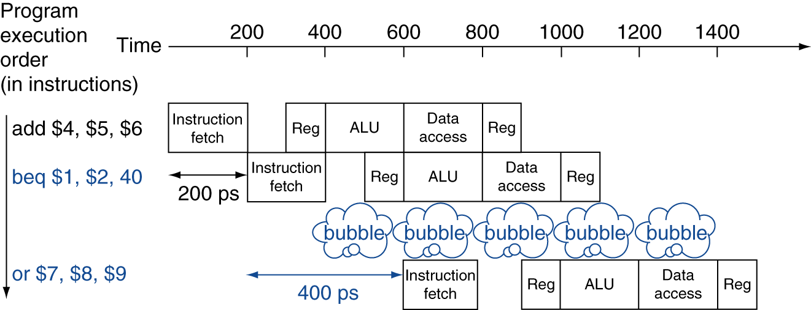
Stall on Branch
Wait until branch outcome determined before fetching next instruction

Slide 45
Branch Prediction
Longer pipelines can’t readily determine branch outcome early
  Stall penalty becomes unacceptable
Predict outcome of branch
  Only stall if prediction is wrong
In MIPS pipeline
  Can predict branches not taken
  Fetch instruction after branch, with no delay

Slide 46
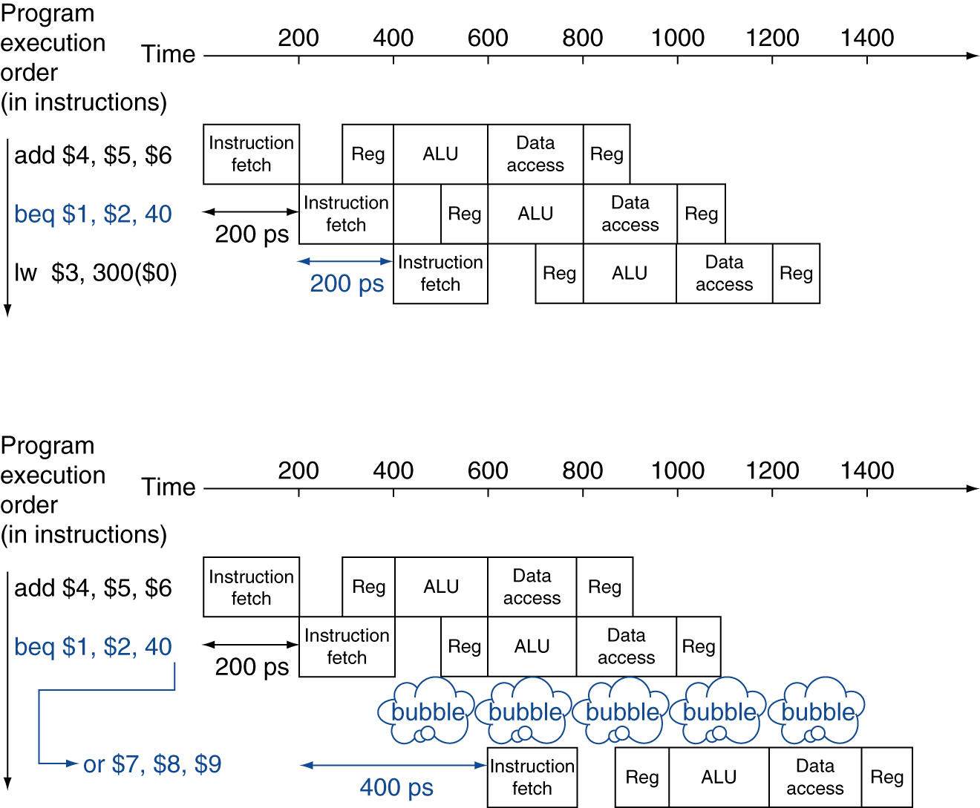
MIPS with Predict Not Taken
Prediction correct
Prediction incorrect

Slide 47
More-Realistic Branch Prediction
Static branch prediction
  Based on typical branch behavior
  Example: loop and if-statement branches
    Predict backward branches taken
    Predict forward branches not taken
Dynamic branch prediction
  Hardware measures actual branch behavior
    e.g., record recent history of each branch
  Assume future behavior will continue the trend
    When wrong, stall while re-fetching, and update history

Slide 48
Pipeline Summary
The BIG Picture
Pipelining improves performance by increasing instruction throughput
  Executes multiple instructions in parallel
  Each instruction has the same latency
Subject to hazards
  Structure, data, control
Instruction set design affects complexity of pipeline implementation

Slide 49
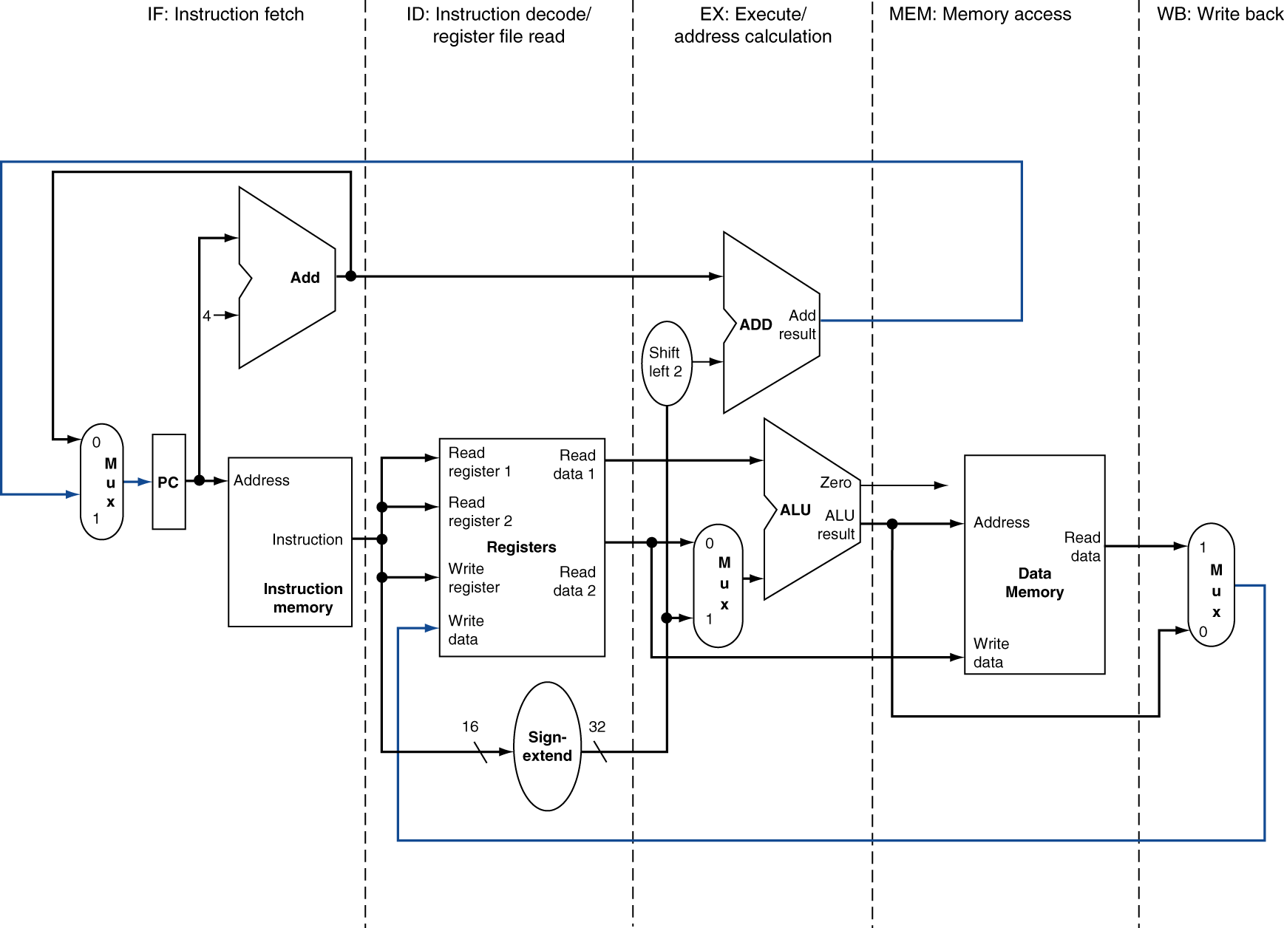
MIPS Pipelined Datapath
§4.6 Pipelined Datapath and Control
MEM
Right-to-left flow leads to hazards
WB

Slide 50
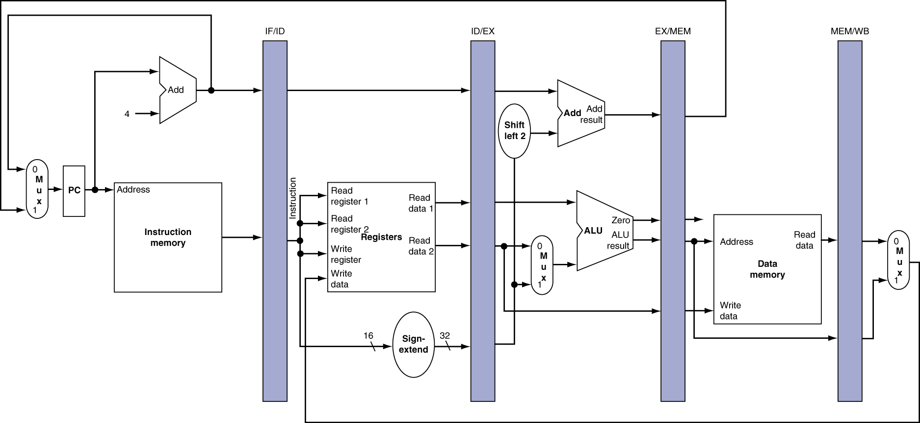
Pipeline registers
Need registers between stages
  To hold information produced in previous cycle

