Slide 1
Review 4
Large and Fast: Exploiting Memory Hierarchy

Slide 2
Principle of Locality
§5.1 Introduction
Programs access a small proportion of their address space at any time
Temporal locality
  Items accessed recently are likely to be accessed again soon
  e.g., instructions in a loop, induction variables
Spatial locality
  Items near those accessed recently are likely to be accessed soon
  E.g., sequential instruction access, array data

Slide 3
Taking Advantage of Locality
Memory hierarchy
Store everything on disk
Copy recently accessed (and nearby) items from disk to smaller DRAM memory
  Main memory
Copy more recently accessed (and nearby) items from DRAM to smaller SRAM memory
  Cache memory attached to CPU

Slide 4
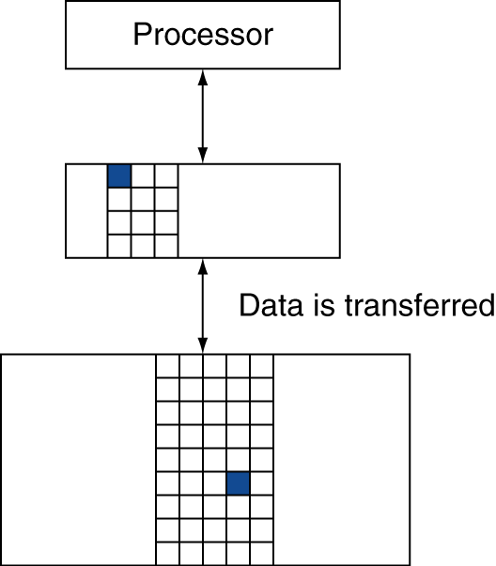
Memory Hierarchy Levels
Block (aka line): unit of copying
  May be multiple words
If accessed data is present in upper level
  Hit: access satisfied by upper level
    Hit ratio: hits/accesses
If accessed data is absent
  Miss: block copied from lower level
    Time taken: miss penalty
    Miss ratio: misses/accesses
    = 1 – hit ratio
  Then accessed data supplied from upper level

Slide 5
Memory Technology
Static RAM (SRAM)
  0.5ns – 2.5ns, $2000 – $5000 per GB
Dynamic RAM (DRAM)
  50ns – 70ns, $20 – $75 per GB
Magnetic disk
  5ms – 20ms, $0.20 – $2 per GB
Ideal memory
  Access time of SRAM
  Capacity and cost/GB of disk
§5.2 Memory Technologies

Slide 6
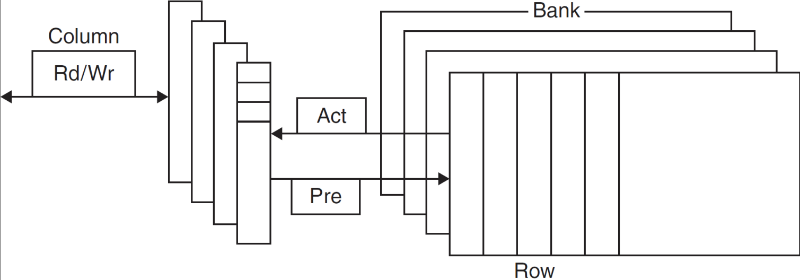
DRAM Technology
Data stored as a charge in a capacitor
  Single transistor used to access the charge
  Must periodically be refreshed
    Read contents and write back
    Performed on a DRAM “row”

Slide 7
Advanced DRAM Organization
Bits in a DRAM are organized as a rectangular array
  DRAM accesses an entire row
  Burst mode: supply successive words from a row with reduced latency
Double data rate (DDR) DRAM
  Transfer on rising and falling clock edges
Quad data rate (QDR) DRAM
  Separate DDR inputs and outputs

Slide 8
DRAM Generations
Year | Capacity | $/GB
1980 | 64Kbit | $1500000
1983 | 256Kbit | $500000
1985 | 1Mbit | $200000
1989 | 4Mbit | $50000
1992 | 16Mbit | $15000
1996 | 64Mbit | $10000
1998 | 128Mbit | $4000
2000 | 256Mbit | $1000
2004 | 512Mbit | $250
2007 | 1Gbit | $50

Slide 9
DRAM Performance Factors
Row buffer
  Allows several words to be read and refreshed in parallel
Synchronous DRAM
  Allows for consecutive accesses in bursts without needing to send each address
  Improves bandwidth
DRAM banking
  Allows simultaneous access to multiple DRAMs
  Improves bandwidth

Slide 10
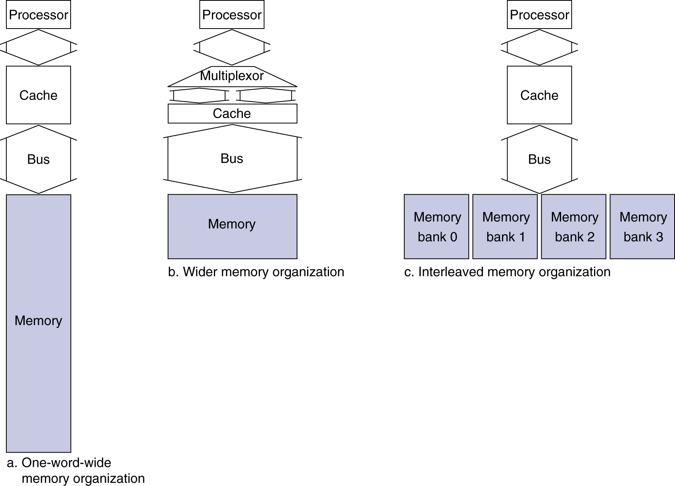
Increasing Memory Bandwidth
4-word wide memory
  Miss penalty = 1 + 15 + 1 = 17 bus cycles
  Bandwidth = 16 bytes / 17 cycles = 0.94 B/cycle
4-bank interleaved memory
  Miss penalty = 1 + 15 + 4×1 = 20 bus cycles
  Bandwidth = 16 bytes / 20 cycles = 0.8 B/cycle
Notes:
The assumption here is that the 15 are the number of cycles you need to wait until the value appears.

Slide 11

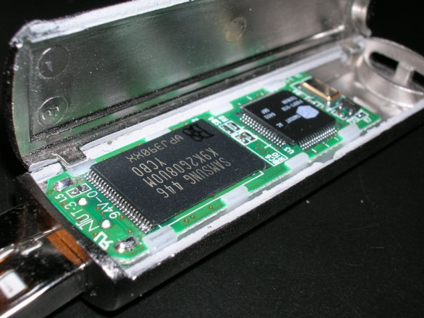
Flash Storage
§6.4 Flash Storage
Nonvolatile semiconductor storage
  100× – 1000× faster than disk
  Smaller, lower power, more robust
  But more $/GB (between disk and DRAM)

Slide 12
Flash Types
NOR flash: bit cell like a NOR gate
  Random read/write access
  Used for instruction memory in embedded systems
NAND flash: bit cell like a NAND gate
  Denser (bits/area), but block-at-a-time access
  Cheaper per GB
  Used for USB keys, media storage, …
Flash bits wears out after 1000’s of accesses
  Not suitable for direct RAM or disk replacement
  Wear leveling: remap data to less used blocks

Slide 13

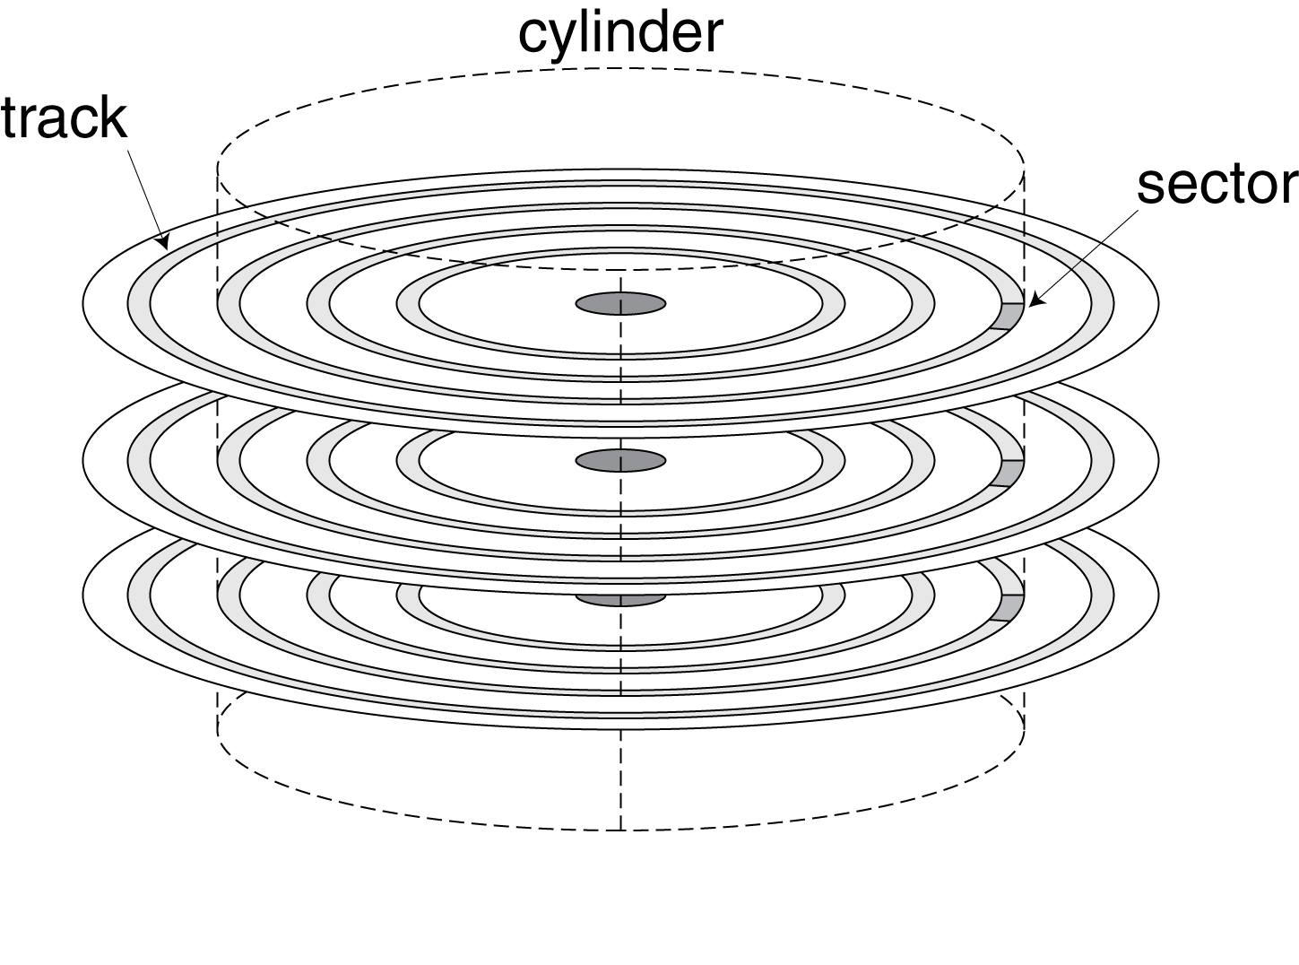
Disk Storage
§6.3 Disk Storage
Nonvolatile, rotating magnetic storage

Slide 14
Disk Sectors and Access
Each sector records
  Sector ID
  Data (512 bytes, 4096 bytes proposed)
  Error correcting code (ECC)
    Used to hide defects and recording errors
  Synchronization fields and gaps
Access to a sector involves
  Queuing delay if other accesses are pending
  Seek: move the heads
  Rotational latency
  Data transfer
  Controller overhead

Slide 15
Disk Access Example
Given
  512B sector, 15,000rpm, 4ms average seek time, 100MB/s transfer rate, 0.2ms controller overhead, idle disk
Average read time
  4ms seek time
  + ½ / (15,000/60) = 2ms rotational latency
  + 512 / 100MB/s = 0.005ms transfer time
  + 0.2ms controller delay
  = 6.2ms
If actual average seek time is 1ms
  Average read time = 3.2ms

Slide 16
Disk Performance Issues
Manufacturers quote average seek time
  Based on all possible seeks
  Locality and OS scheduling lead to smaller actual average seek times
Smart disk controller allocate physical sectors on disk
  Present logical sector interface to host
  SCSI, ATA, SATA
Disk drives include caches
  Prefetch sectors in anticipation of access
  Avoid seek and rotational delay

Slide 17
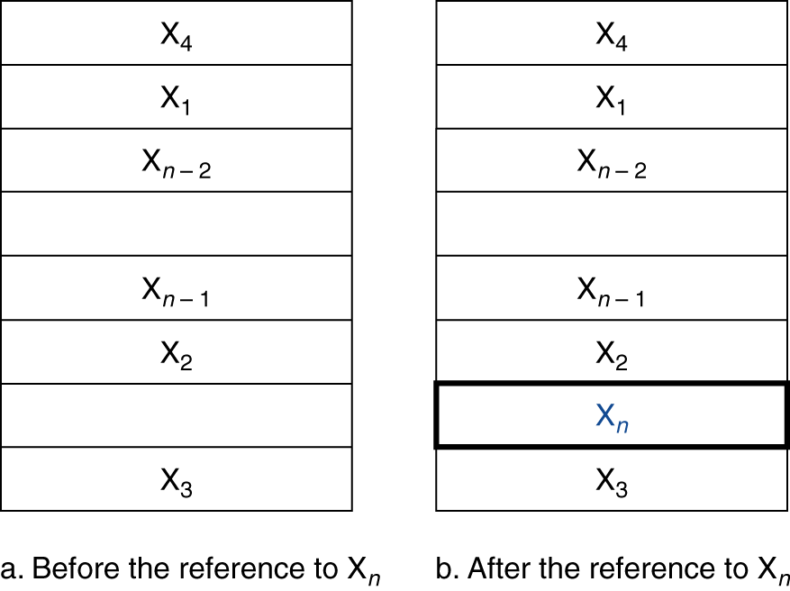
Cache Memory
Cache memory
  The level of the memory hierarchy closest to the CPU
Given accesses X₁, …, X_{n–1}, X_{n}
§5.3 The Basics of Caches
How do we know if the data is present?
Where do we look?

Slide 18
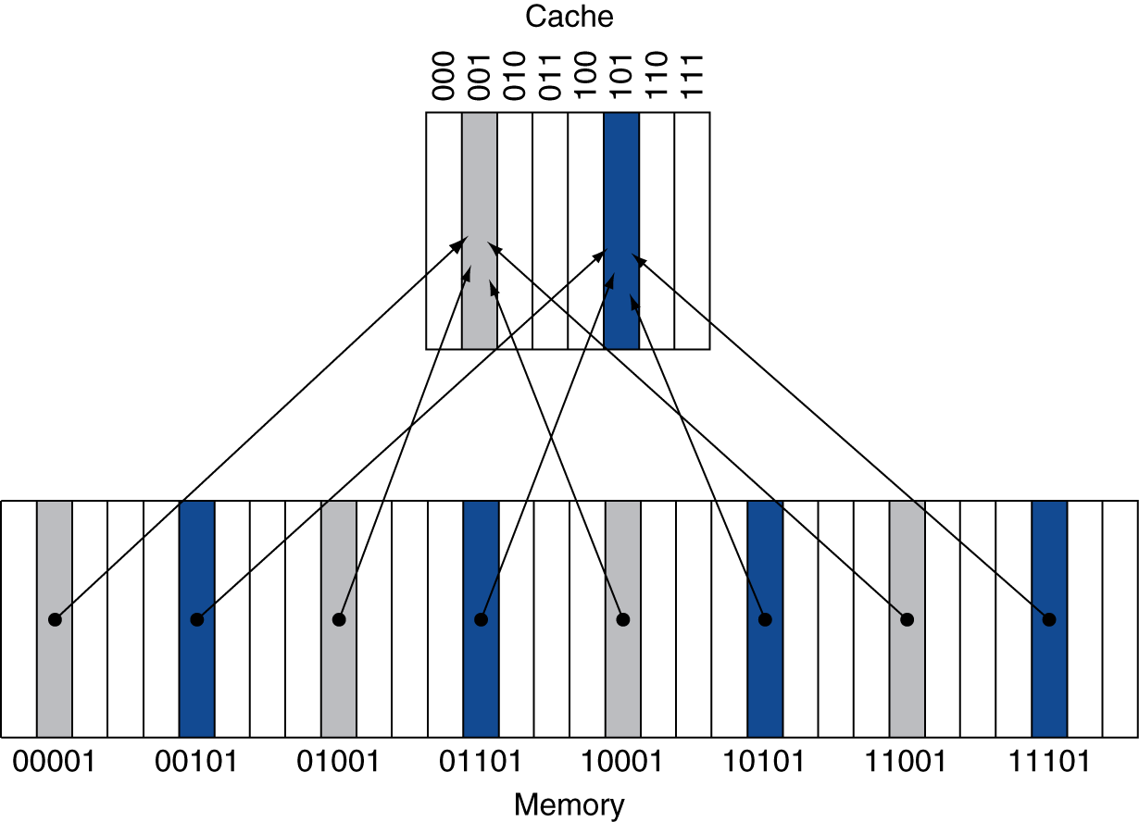
Direct Mapped Cache
Location determined by address
Direct mapped: only one choice
  (Block address) modulo (#Blocks in cache)
#Blocks is a power of 2
Use low-order address bits

Slide 19
Tags and Valid Bits
How do we know which particular block is stored in a cache location?
  Store block address as well as the data
  Actually, only need the high-order bits
  Called the tag
What if there is no data in a location?
  Valid bit: 1 = present, 0 = not present
  Initially 0

Slide 20
Cache Example
8-blocks, 1 word/block, direct mapped
Initial state
Index | V | Tag | Data
000 | N
001 | N
010 | N
011 | N
100 | N
101 | N
110 | N
111 | N

Slide 21
Cache Example
Word addr | Binary addr | Hit/miss | Cache block
22 | 10 110 | Miss | 110
Index | V | Tag | Data
000 | N
001 | N
010 | N
011 | N
100 | N
101 | N
110 | Y | 10 | Mem[10110]
111 | N

Slide 22
Cache Example
Word addr | Binary addr | Hit/miss | Cache block
26 | 11 010 | Miss | 010
Index | V | Tag | Data
000 | N
001 | N
010 | Y | 11 | Mem[11010]
011 | N
100 | N
101 | N
110 | Y | 10 | Mem[10110]
111 | N

Slide 23
Cache Example
Word addr | Binary addr | Hit/miss | Cache block
22 | 10 110 | Hit | 110
26 | 11 010 | Hit | 010
Index | V | Tag | Data
000 | N
001 | N
010 | Y | 11 | Mem[11010]
011 | N
100 | N
101 | N
110 | Y | 10 | Mem[10110]
111 | N

Slide 24
Cache Example
Word addr | Binary addr | Hit/miss | Cache block
16 | 10 000 | Miss | 000
3 | 00 011 | Miss | 011
16 | 10 000 | Hit | 000
Index | V | Tag | Data
000 | Y | 10 | Mem[10000]
001 | N
010 | Y | 11 | Mem[11010]
011 | Y | 00 | Mem[00011]
100 | N
101 | N
110 | Y | 10 | Mem[10110]
111 | N

Slide 25
Cache Example
Word addr | Binary addr | Hit/miss | Cache block
18 | 10 010 | Miss | 010
Index | V | Tag | Data
000 | Y | 10 | Mem[10000]
001 | N
010 | Y | 10 | Mem[10010]
011 | Y | 00 | Mem[00011]
100 | N
101 | N
110 | Y | 10 | Mem[10110]
111 | N

Slide 26
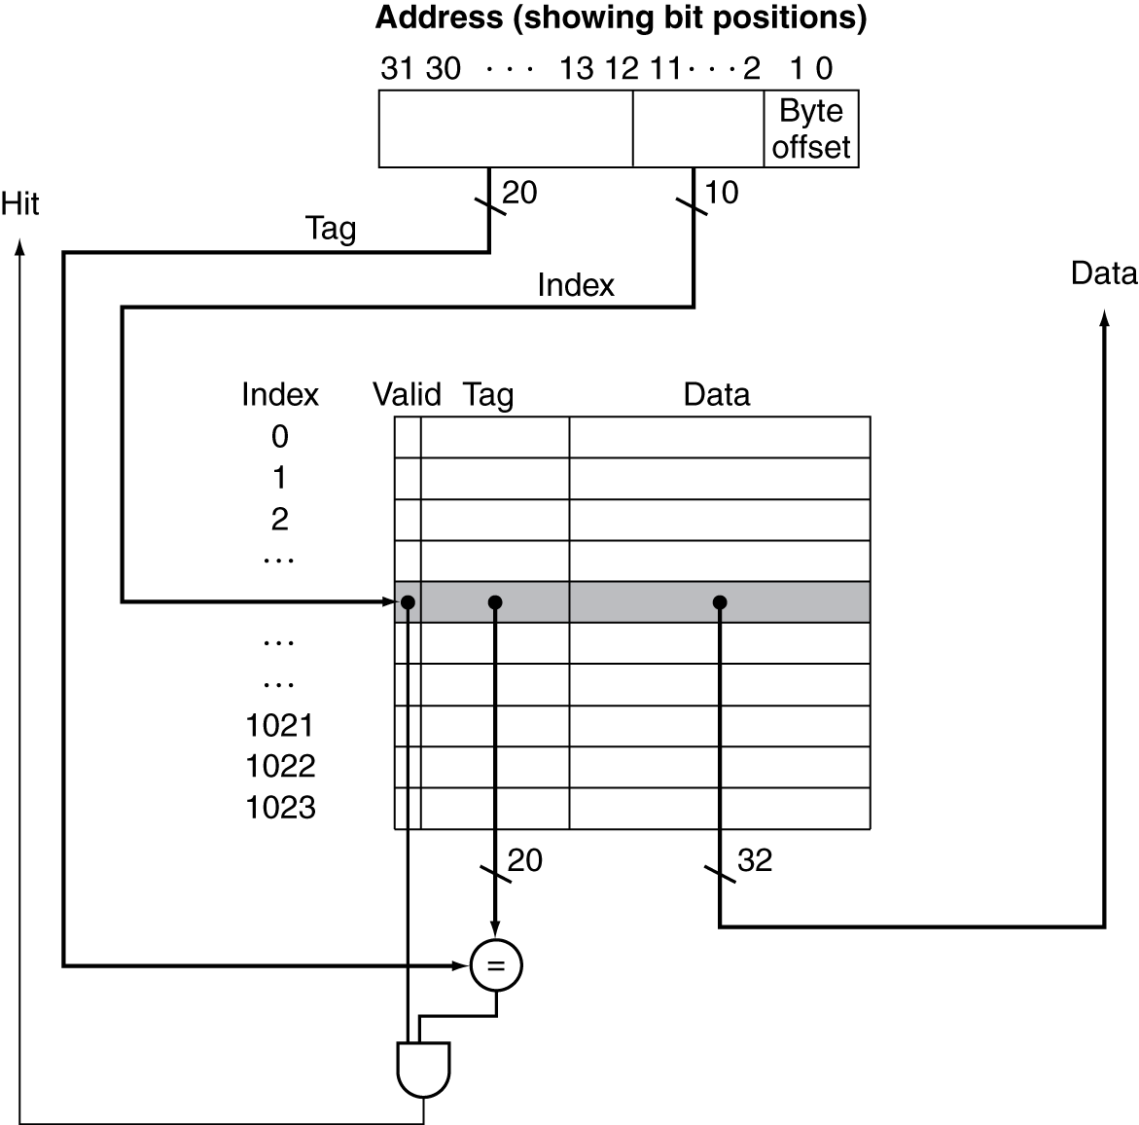
Address Subdivision

Slide 27
Example: Larger Block Size
64 blocks, 16 bytes/block
  To what block number does address 1200 map?
Block address = ⎣1200/16⎦ = 75
Block number = 75 modulo 64 = 11
31
10
9
4
3
0
Tag
Index
Offset
22 bits
6 bits
4 bits

Slide 28
Block Size Considerations
Larger blocks should reduce miss rate
  Due to spatial locality
But in a fixed-sized cache
  Larger blocks ⇒ fewer of them
    More competition ⇒ increased miss rate
  Larger blocks ⇒ pollution
Larger miss penalty
  Can override benefit of reduced miss rate
  Early restart and critical-word-first can help

Slide 29
Cache Misses
On cache hit, CPU proceeds normally
On cache miss
  Stall the CPU pipeline
  Fetch block from next level of hierarchy
  Instruction cache miss
    Restart instruction fetch
  Data cache miss
    Complete data access

Slide 30
Write-Through
On data-write hit, could just update the block in cache
  But then cache and memory would be inconsistent
Write through: also update memory
But makes writes take longer
  e.g., if base CPI = 1, 10% of instructions are stores, write to memory takes 100 cycles
    Effective CPI = 1 + 0.1×100 = 11
Solution: write buffer
  Holds data waiting to be written to memory
  CPU continues immediately
    Only stalls on write if write buffer is already full

Slide 31
Write-Back
Alternative: On data-write hit, just update the block in cache
  Keep track of whether each block is dirty
When a dirty block is replaced
  Write it back to memory
  Can use a write buffer to allow replacing block to be read first

Slide 32
Write Allocation
What should happen on a write miss?
Alternatives for write-through
  Allocate on miss: fetch the block
  Write around: don’t fetch the block
    Since programs often write a whole block before reading it (e.g., initialization)
For write-back
  Usually fetch the block

Slide 33
Example: Intrinsity FastMATH
Embedded MIPS processor
  12-stage pipeline
  Instruction and data access on each cycle
Split cache: separate I-cache and D-cache
  Each 16KB: 256 blocks × 16 words/block
  D-cache: write-through or write-back
SPEC2000 miss rates
  I-cache: 0.4%
  D-cache: 11.4%
  Weighted average: 3.2%

Slide 34
Main Memory Supporting Caches
Use DRAMs for main memory
  Fixed width (e.g., 1 word)
  Connected by fixed-width clocked bus
    Bus clock is typically slower than CPU clock
Example cache block read
  1 bus cycle for address transfer
  15 bus cycles per DRAM access
  1 bus cycle per data transfer
For 4-word block, 1-word-wide DRAM
  Miss penalty = 1 + 4×15 + 4×1 = 65 bus cycles
  Bandwidth = 16 bytes / 65 cycles = 0.25 B/cycle

Slide 35
Measuring Cache Performance
Components of CPU time
  Program execution cycles
    Includes cache hit time
  Memory stall cycles
    Mainly from cache misses
With simplifying assumptions:
§5.4 Measuring and Improving Cache Performance

Slide 36
Cache Performance Example
Given
  I-cache miss rate = 2%
  D-cache miss rate = 4%
  Miss penalty = 100 cycles
  Base CPI (ideal cache) = 2
  Load & stores are 36% of instructions
Miss cycles per instruction
  I-cache: 0.02 × 100 = 2
  D-cache: 0.36 × 0.04 × 100 = 1.44
Actual CPI = 2 + 2 + 1.44 = 5.44
  Ideal CPU is 5.44/2 =2.72 times faster

Slide 37
Average Access Time
Hit time is also important for performance
Average memory access time (AMAT)
  AMAT = Hit time + Miss rate × Miss penalty
Example
  CPU with 1ns clock, hit time = 1 cycle, miss penalty = 20 cycles, I-cache miss rate = 5%
  AMAT = 1 + 0.05 × 20 = 2ns
    2 cycles per instruction

Slide 38
Performance Summary
When CPU performance increased
  Miss penalty becomes more significant
Decreasing base CPI
  Greater proportion of time spent on memory stalls
Increasing clock rate
  Memory stalls account for more CPU cycles
Can’t neglect cache behavior when evaluating system performance

Slide 39
Associative Caches
Fully associative
  Allow a given block to go in any cache entry
  Requires all entries to be searched at once
  Comparator per entry (expensive)
n-way set associative
  Each set contains n entries
  Block number determines which set
    (Block number) modulo (#Sets in cache)
  Search all entries in a given set at once
  n comparators (less expensive)

Slide 40
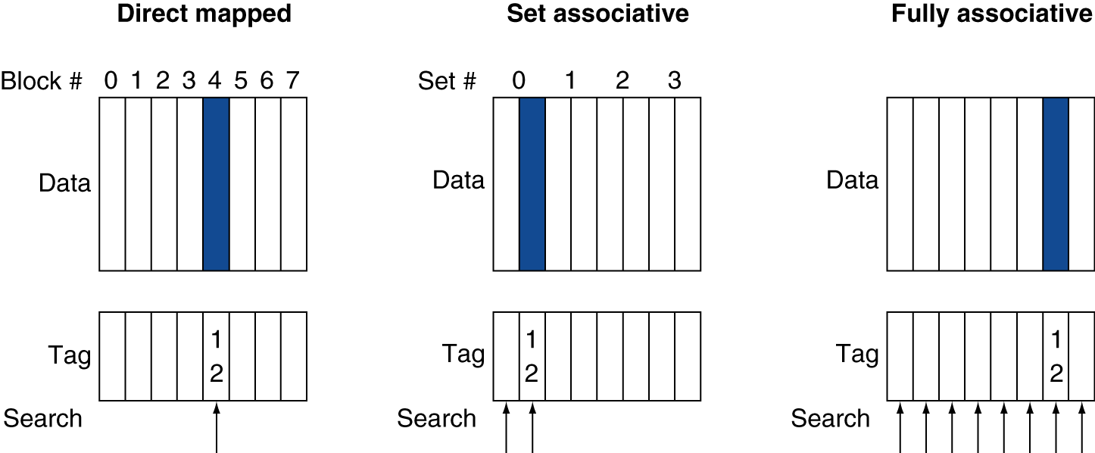
Associative Cache Example

Slide 41
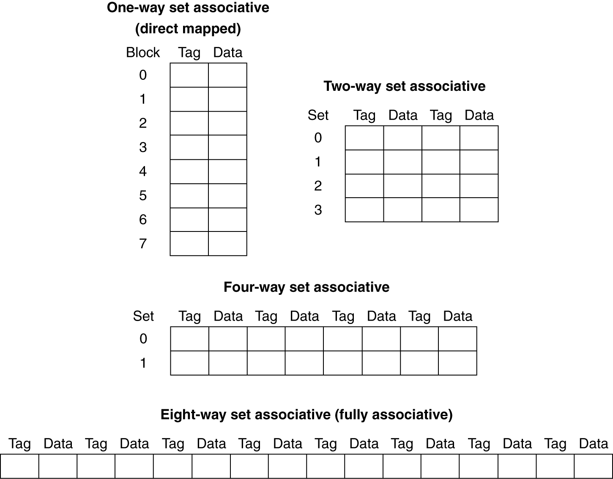
Spectrum of Associativity
For a cache with 8 entries

Slide 42
Associativity Example
Compare 4-block caches
  Direct mapped, 2-way set associative,
  fully associative
  Block access sequence: 0, 8, 0, 6, 8
Direct mapped
Block address | Cache index | Hit/miss | Cache content after access
 |  |  | 0 | 1 | 2 | 3
0 | 0 | miss | Mem[0]
8 | 0 | miss | Mem[8]
0 | 0 | miss | Mem[0]
6 | 2 | miss | Mem[0] |  | Mem[6]
8 | 0 | miss | Mem[8] |  | Mem[6]

Slide 43
Associativity Example
2-way set associative
Block address | Cache index | Hit/miss | Cache content after access
 |  |  | Set 0 |  | Set 1
0 | 0 | miss | Mem[0]
8 | 0 | miss | Mem[0] | Mem[8]
0 | 0 | hit | Mem[0] | Mem[8]
6 | 0 | miss | Mem[0] | Mem[6]
8 | 0 | miss | Mem[8] | Mem[6]
Fully associative
Block address |  | Hit/miss | Cache content after access
0 |  | miss | Mem[0]
8 |  | miss | Mem[0] | Mem[8]
0 |  | hit | Mem[0] | Mem[8]
6 |  | miss | Mem[0] | Mem[8] | Mem[6]
8 |  | hit | Mem[0] | Mem[8] | Mem[6]

Slide 44
How Much Associativity
Increased associativity decreases miss rate
  But with diminishing returns
Simulation of a system with 64KB
D-cache, 16-word blocks, SPEC2000
  1-way: 10.3%
  2-way: 8.6%
  4-way: 8.3%
  8-way: 8.1%

Slide 45
Replacement Policy
Direct mapped: no choice
Set associative
  Prefer non-valid entry, if there is one
  Otherwise, choose among entries in the set
Least-recently used (LRU)
  Choose the one unused for the longest time
    Simple for 2-way, manageable for 4-way, too hard beyond that
Random
  Gives approximately the same performance as LRU for high associativity

Slide 46
MULTILEVEL CACHES

Slide 47
Multilevel Caches
Primary cache attached to CPU
  Small, but fast
Level-2 cache services misses from primary cache
  Larger, slower, but still faster than main memory
Main memory services L-2 cache misses
Some high-end systems include L-3 cache

Slide 48
Multilevel Cache Example
Given
  CPU base CPI = 1, clock rate = 4GHz
  Miss rate/instruction = 2%
  Main memory access time = 100ns
With just primary cache
  Miss penalty = 100ns/0.25ns = 400 cycles
  Effective CPI = 1 + 0.02 × 400 = 9

Slide 49
Example (cont.)
Now add L-2 cache
  Access time = 5ns
  Global miss rate to main memory = 0.5%
Primary miss with L-2 hit
  Penalty = 5ns/0.25ns = 20 cycles
Primary miss with L-2 miss
  Extra penalty = 500 cycles
CPI = 1 + 0.02 × 20 + 0.005 × 400 = 3.4
Performance ratio = 9/3.4 = 2.6

Slide 50
Multilevel Cache Considerations
Primary cache
  Focus on minimal hit time
L-2 cache
  Focus on low miss rate to avoid main memory access
  Hit time has less overall impact
Results
  L-1 cache usually smaller than a single cache
  L-1 block size smaller than L-2 block size

Slide 51
Interactions with Advanced CPUs
Out-of-order CPUs can execute instructions during cache miss
  Pending store stays in load/store unit
  Dependent instructions wait in reservation stations
    Independent instructions continue
Effect of miss depends on program data flow
  Much harder to analyse
  Use system simulation

Slide 52
HOW WE can help the cache from software

Slide 53
Software Optimization via Blocking
Goal: maximize accesses to data before it is replaced
Consider inner loops of DGEMM:
  DGEMM: matrix multiplication subroutine in scientific computation calculates a*A*B + b*B
for (int j = 0; j < n; ++j)
{
double cij = C[i+j*n];
for( int k = 0; k < n; k++ )
cij += A[i+k*n] * B[k+j*n];
C[i+j*n] = cij;
}

Slide 54
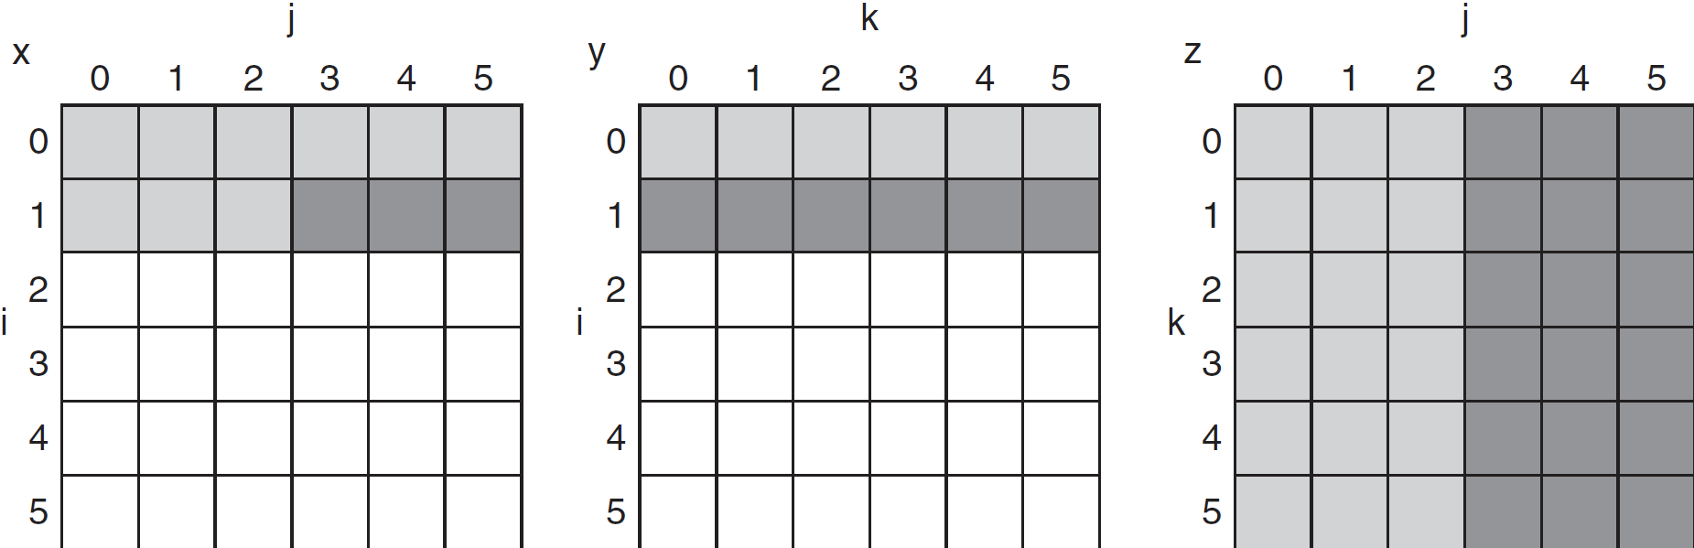
DGEMM Access Pattern
C, A, and B arrays
older accesses
new accesses

Slide 55
Cache Blocked DGEMM
1 #define BLOCKSIZE 32
2 void do_block (int n, int si, int sj, int sk, double *A, double
3 *B, double *C)
4 {
5 for (int i = si; i < si+BLOCKSIZE; ++i)
6 for (int j = sj; j < sj+BLOCKSIZE; ++j)
7 {
8 double cij = C[i+j*n];/* cij = C[i][j] */
9 for( int k = sk; k < sk+BLOCKSIZE; k++ )
10 cij += A[i+k*n] * B[k+j*n];/* cij+=A[i][k]*B[k][j] */
11 C[i+j*n] = cij;/* C[i][j] = cij */
12 }
13 }
14 void dgemm (int n, double* A, double* B, double* C)
15 {
16 for ( int sj = 0; sj < n; sj += BLOCKSIZE )
17 for ( int si = 0; si < n; si += BLOCKSIZE )
18 for ( int sk = 0; sk < n; sk += BLOCKSIZE )
19 do_block(n, si, sj, sk, A, B, C);
20 }

Slide 56
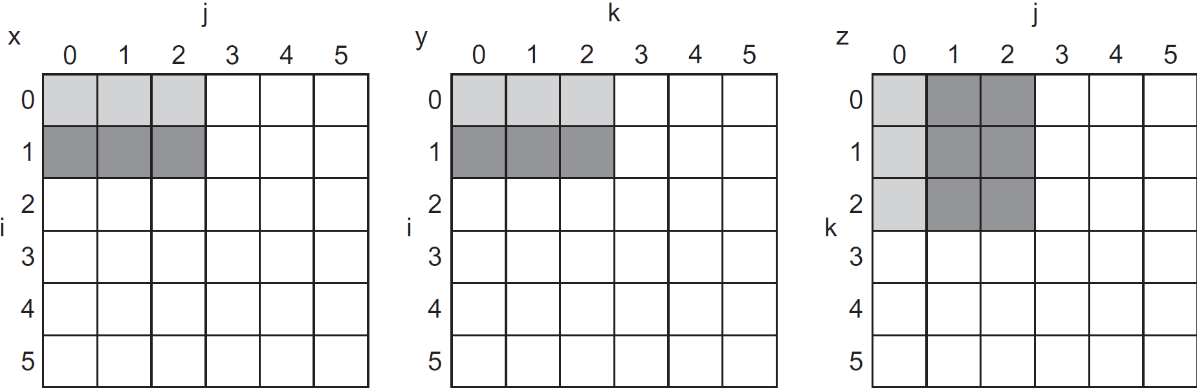
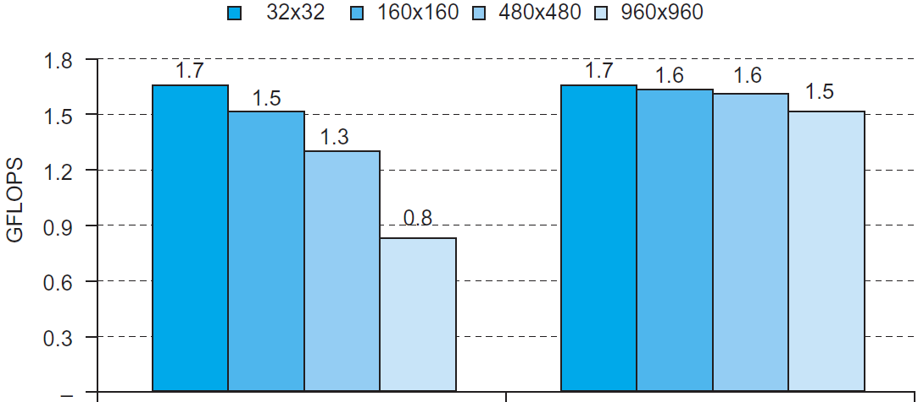
Blocked DGEMM Access Pattern
Unoptimized
Blocked

Slide 57
MEMORY PROTECTION and Virtual Machines
(and impact on computer architecture)

Slide 58
Memory Protection
Different tasks can share parts of their virtual address spaces
  But need to protect against errant access
  Requires OS assistance
Hardware support for OS protection
  Privileged supervisor mode (aka kernel mode)
  Privileged instructions
  Page tables and other state information only accessible in supervisor mode
  System call exception (e.g., syscall in MIPS)

Slide 59
Virtual Machines
Host computer emulates guest operating system and machine resources
  Improved isolation of multiple guests
  Avoids security and reliability problems
  Aids sharing of resources
Virtualization has some performance impact
  Feasible with modern high-performance comptuers
Examples
  IBM VM/370 (1970s technology!)
  VMWare
  VirtualBox, Xen, KVM
§5.6 Virtual Machines

Slide 60
Virtual Machine Monitor aka Hypervisor
Maps virtual resources to physical resources
  Memory, I/O devices, CPUs
Guest code runs on native machine in user mode
  Traps to VMM on privileged instructions and access to protected resources
Guest OS may be different from host OS
VMM handles real I/O devices
  Emulates generic virtual I/O devices for guest

Slide 61
Example: Timer Virtualization
In native machine, on timer interrupt
  OS suspends current process, handles interrupt, selects and resumes next process
With Virtual Machine Monitor
  VMM suspends current VM, handles interrupt, selects and resumes next VM
If a VM requires timer interrupts
  VMM emulates a virtual timer
  Emulates interrupt for VM when physical timer interrupt occurs

Slide 62
Instruction Set Support
User and System modes
Privileged instructions only available in system mode
  Trap to system if executed in user mode
All physical resources only accessible using privileged instructions
  Including page tables, interrupt controls, I/O registers
Renaissance of virtualization support
  Current ISAs (e.g., x86) adapting

Slide 63
VIRTUAL MEMORY
(THE UPPER LAYERS of the memory hierarchy)

Slide 64
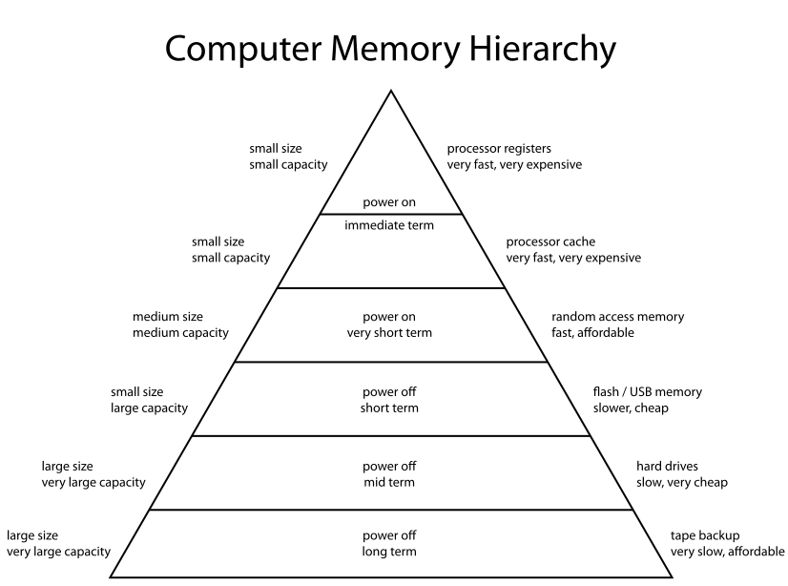
Memory hierarchy, again

Slide 65
Virtual Memory
§5.7 Virtual Memory
Use main memory as a “cache” for secondary (disk) storage
  Managed jointly by CPU hardware and the operating system (OS)
Programs share main memory
  Each gets a private virtual address space holding its frequently used code and data
  Protected from other programs
CPU and OS translate virtual addresses to physical addresses
  VM “block” is called a page
  VM translation “miss” is called a page fault

Slide 66
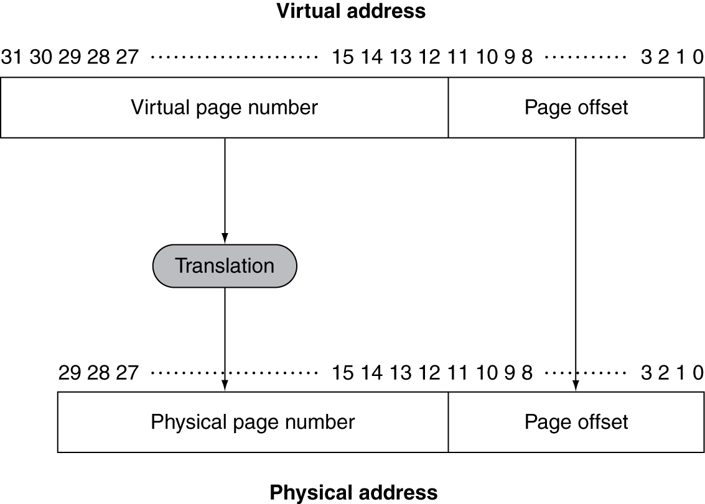
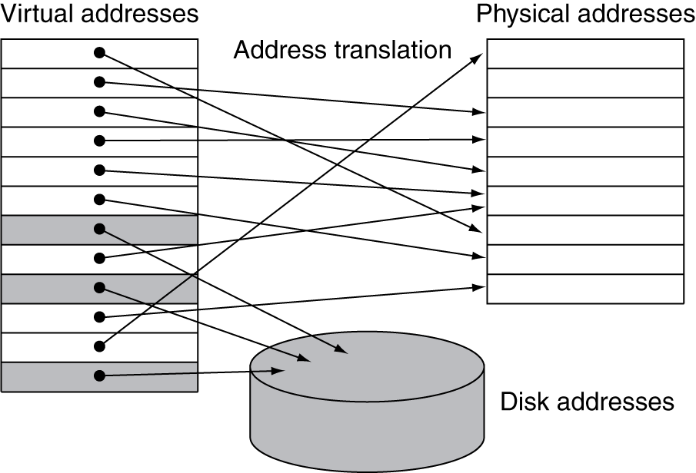
Address Translation
Fixed-size pages (e.g., 4K)

Slide 67
Page Fault Penalty
On page fault, the page must be fetched from disk
  Takes millions of clock cycles
  Handled by OS code
Try to minimize page fault rate
  Fully associative placement
  Smart replacement algorithms

Slide 68
Page Tables
Stores placement information
  Array of page table entries, indexed by virtual page number
  Page table register in CPU points to page table in physical memory
If page is present in memory
  PTE stores the physical page number
  Plus other status bits (referenced, dirty, …)
If page is not present
  PTE can refer to location in swap space on disk

Slide 69
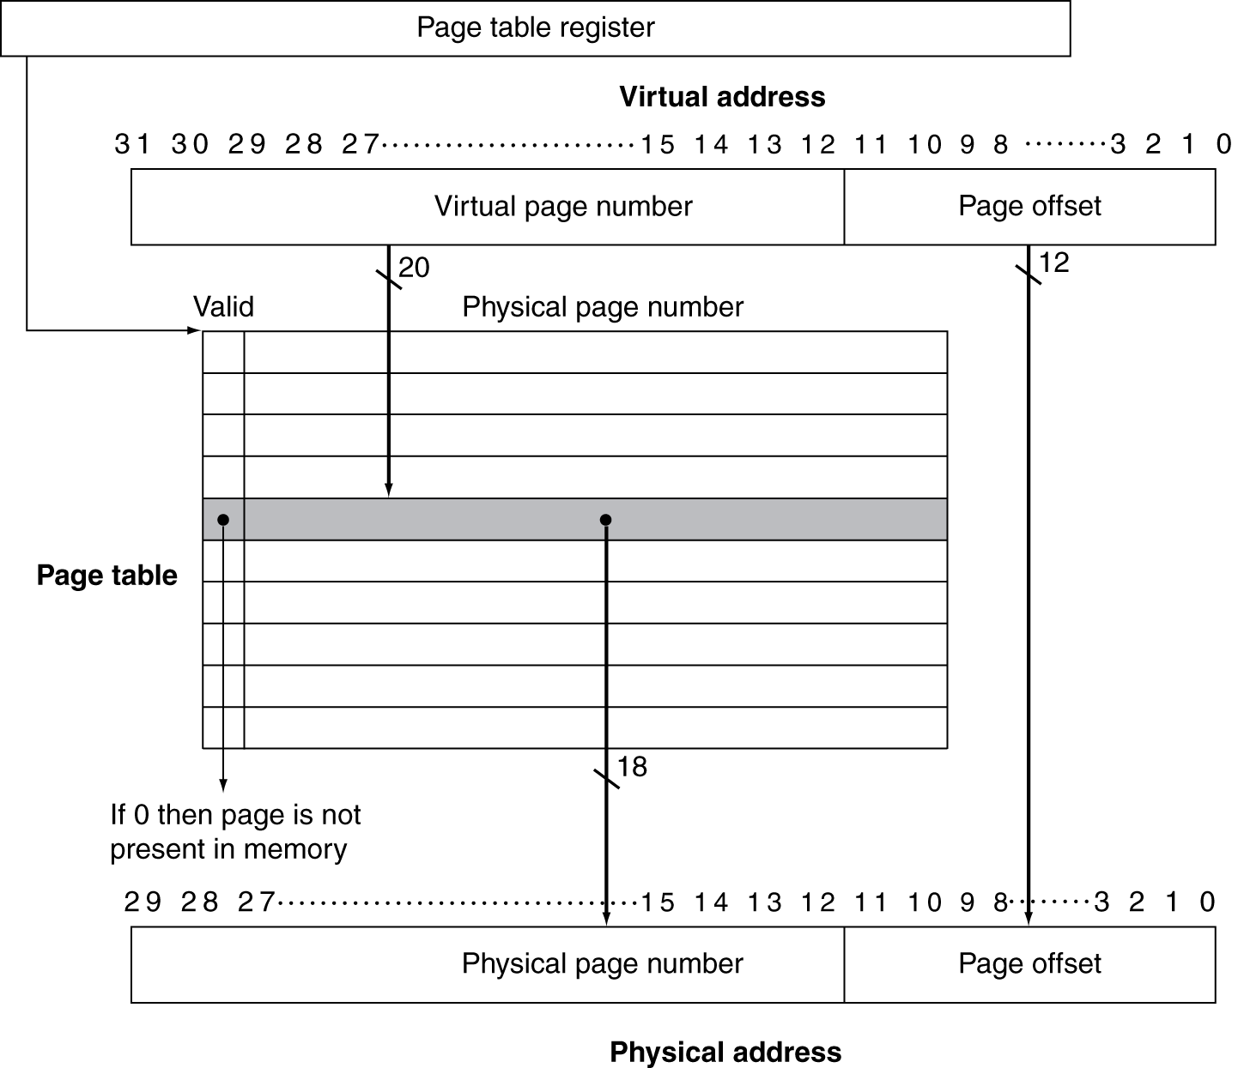
Translation Using a Page Table

Slide 70
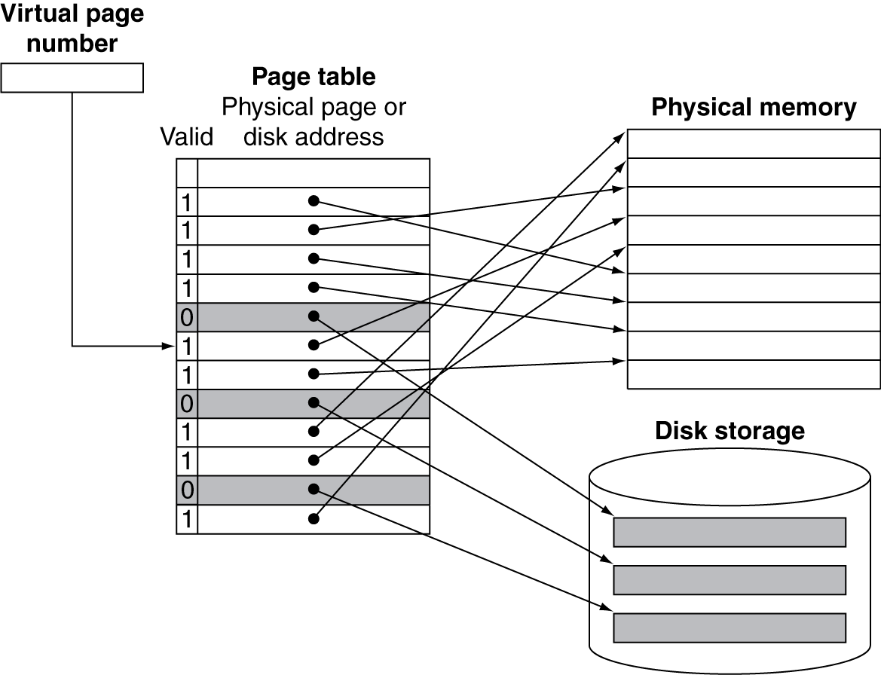
Mapping Pages to Storage

Slide 71
Replacement and Writes
To reduce page fault rate, prefer least-recently used (LRU) replacement
  Reference bit (aka use bit) in PTE set to 1 on access to page
  Periodically cleared to 0 by OS
  A page with reference bit = 0 has not been used recently
Disk writes take millions of cycles
  Block at once, not individual locations
  Write through is impractical
  Use write-back
  Dirty bit in PTE set when page is written

Slide 72
Fast Translation Using a TLB
Address translation would appear to require extra memory references
  One to access the PTE
  Then the actual memory access
But access to page tables has good locality
  So use a fast cache of PTEs within the CPU
  Called a Translation Look-aside Buffer (TLB)
  Typical: 16–512 PTEs, 0.5–1 cycle for hit, 10–100 cycles for miss, 0.01%–1% miss rate
  Misses could be handled by hardware or software

Slide 73
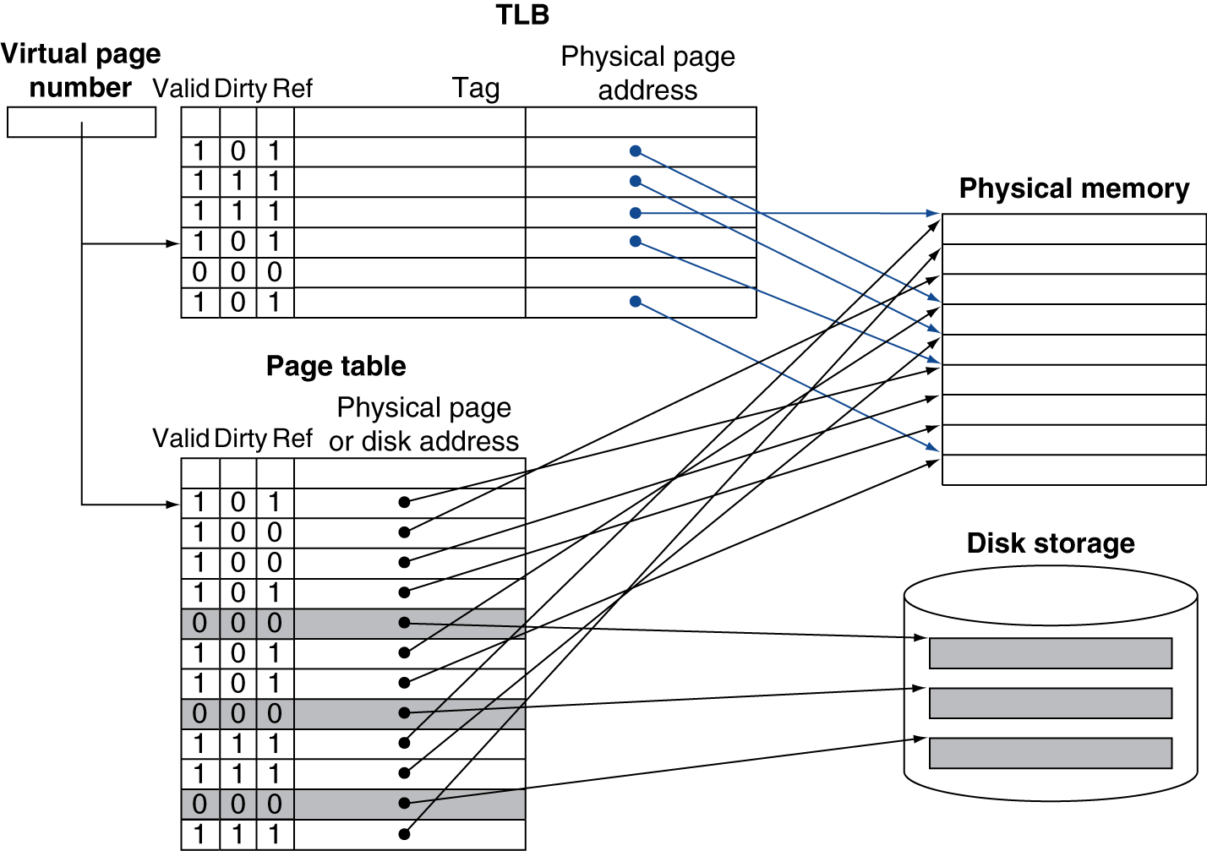
Fast Translation Using a TLB

Slide 74
TLB Misses
If page is in memory
  Load the PTE from memory and retry
  Could be handled in hardware
    Can get complex for more complicated page table structures
  Or in software
    Raise a special exception, with optimized handler
If page is not in memory (page fault)
  OS handles fetching the page and updating the page table
  Then restart the faulting instruction

Slide 75
TLB Miss Handler
TLB miss indicates
  Page present, but PTE not in TLB
  Page not preset
Must recognize TLB miss before destination register overwritten
  Raise exception
Handler copies PTE from memory to TLB
  Then restarts instruction
  If page not present, page fault will occur

Slide 76
Page Fault Handler
Use faulting virtual address to find PTE
Locate page on disk
Choose page to replace
  If dirty, write to disk first
Read page into memory and update page table
Make process runnable again
  Restart from faulting instruction

Slide 77
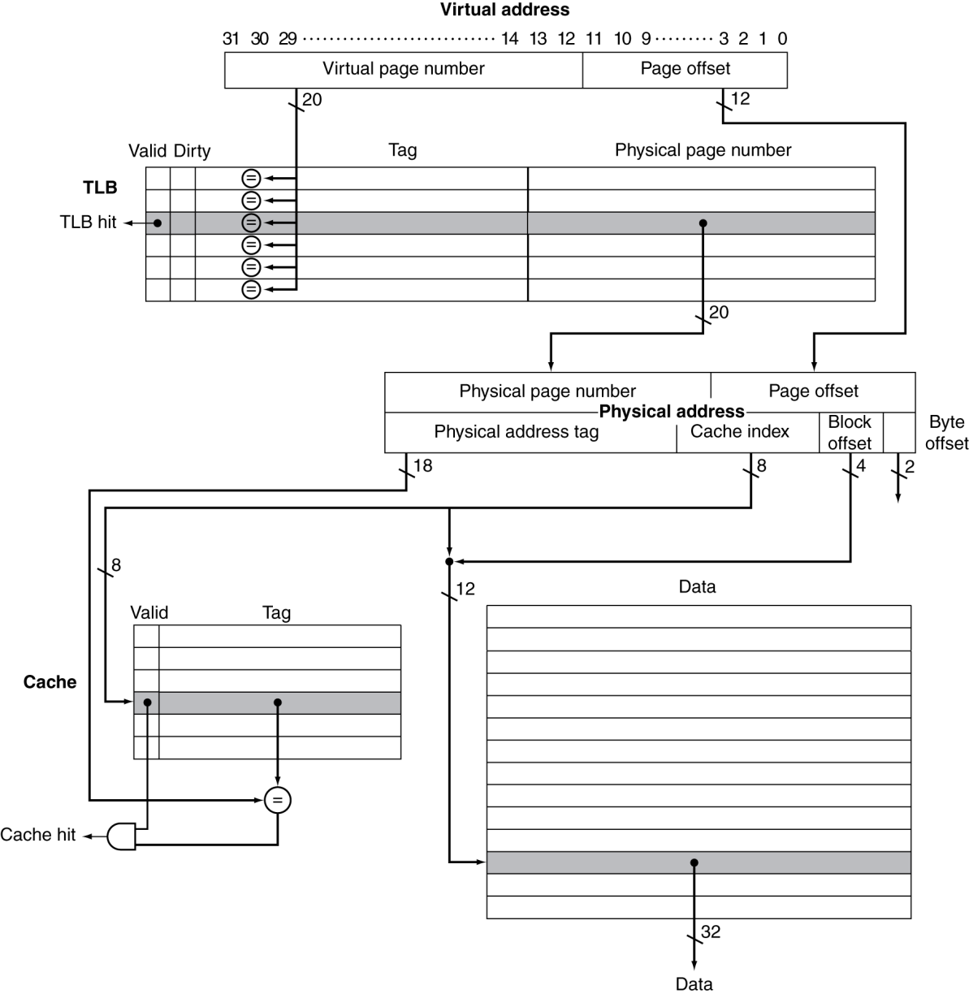
TLB and Cache Interaction
If cache tag uses physical address
  Need to translate before cache lookup
Alternative: use virtual address tag
  Complications due to aliasing
    Different virtual addresses for shared physical address

