Slide 1
Computer Architecture
A Quantitative Approach, Fifth Edition
Chapter 4
Data-Level Parallelism in Vector, SIMD, and GPU Architectures

Slide 2
Flynn’ taxonomy
Single instruction stream single data stream (SISD)
Single instruction stream, multiple data streams (SIMD)
Vector processor, Multimedia extensions on modern processors
Multiple instruction streams, single data stream (MISD)
Stream processors (somewhat…)
Exotic fault tolerance architectures (eg Space Shuttle)
Multiple instruction streams, multiple data streams (MIMD)
Multi-core systems
Multi-processor systems
Distributed systems

Slide 3
Introduction
Introduction
SIMD architectures can exploit significant data-level parallelism for:
matrix-oriented scientific computing
media-oriented image and sound processors
SIMD allows programmer to continue to think sequentially

Slide 4
VECTOR ARCHITECTURES

Slide 5
Vector Architectures
Vector Architectures
Basic idea:
Read sets of data elements into “vector registers”
Operate on those registers
Disperse the results back into memory
Registers are controlled by compiler
Used to hide memory latency
Leverage memory bandwidth

Slide 6
VMIPS
Vector Architectures
Example (fictional) architecture: VMIPS
Loosely based on Cray-1
Vector registers
Each register holds a 64-element, 64 bits/element vector
Register file has 16 read ports and 8 write ports
Vector functional units
Fully pipelined
Data and control hazards are detected
Vector load-store unit
Fully pipelined
One word per clock cycle after initial latency
Scalar registers
32 general-purpose registers
32 floating-point registers

Slide 7
VMIPS Instructions
Vector Architectures
ADDVV.D: add two vectors
ADDVS.D: add vector to a scalar
LV/SV: vector load and vector store from address
Example: DAXPY (Y = a * X + Y)
L.D F0,a ; load scalar a
LV V1,Rx ; load vector X
MULVS.D V2,V1,F0 ; vector-scalar multiply
LV V3,Ry ; load vector Y
ADDVV V4,V2,V3 ; add
SV Ry,V4 ; store the result
Requires 6 instructions vs. almost 600 for MIPS

Slide 8
Instructions (p. 266)
ADDVV.D V1,V2,V3
ADDVS.D V1,V2,F0
SUBVV.D V1,V2,V3
SUBVS.D V1,V2,F0
SUBSV.D V1,F0,V3
MULVV.D V1,V2,V3
DIVVV.D V1,V2,V3
LV V1,R1
SV R1,V1
LVWS V1,(R1,R2) Load w/ stride (R1+i*R2)
S--VV.D V1,V2 Compare elements (EQ, NE,GT…)
S--VS.D V1,F0 and set vector mask register (VM)

Slide 9
Vector Execution Time
Vector Architectures
Execution time depends on three factors:
Length of operand vectors
Structural hazards
Data dependencies
VMIPS functional units consume one element per clock cycle
Execution time is approximately the vector length

Slide 10
Challenges
Vector Architectures
Start up time
Latency of vector functional unit
Assume the same as Cray-1
Floating-point add => 6 clock cycles
Floating-point multiply => 7 clock cycles
Floating-point divide => 20 clock cycles
Vector load => 12 clock cycles
Improvements:
> 1 element per clock cycle
Non-64 wide vectors
IF statements in vector code
Memory system optimizations to support vector processors
Multiple dimensional matrices
Sparse matrices
Programming a vector computer

Slide 11
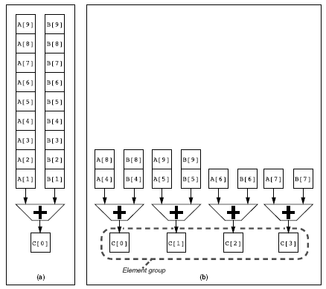
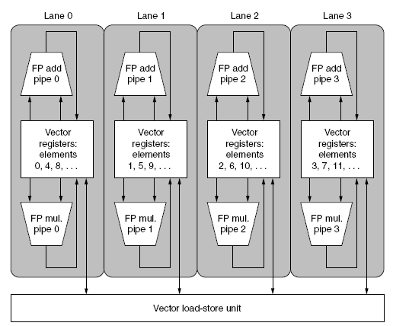
Multiple Lanes
Vector Architectures
Element n of vector register A is “hardwired” to element n of vector register B
Allows for multiple hardware lanes

Slide 12
Vector Length Register
Vector Architectures
Vector length not known at compile time?
Use Vector Length Register (VLR)
Use strip mining for vectors over the maximum length:
low = 0;
VL = (n % MVL); /*find odd-size piece using modulo op % */
for (j = 0; j <= (n/MVL); j=j+1) { /*outer loop*/
for (i = low; i < (low+VL); i=i+1) /*runs for length VL*/
Y[i] = a * X[i] + Y[i] ; /*main operation*/
low = low + VL; /*start of next vector*/
VL = MVL; /*reset the length to maximum vector length*/
}

Slide 13
Vector Mask Registers
Vector Architectures
Consider:
for (i = 0; i < 64; i=i+1)
if (X[i] != 0)
X[i] = X[i] – Y[i];
Use vector mask register to “disable” elements:
LV V1,Rx ;load vector X into V1
LV V2,Ry ;load vector Y
L.D F0,#0 ;load FP zero into F0
SNEVS.D V1,F0 ;sets VM(i) to 1 if V1(i)!=F0
SUBVV.D V1,V1,V2 ;subtract under vector mask
SV Rx,V1 ;store the result in X
GFLOPS rate decreases!

Slide 14
Memory Banks
Vector Architectures
Memory system must be designed to support high bandwidth for vector loads and stores
Spread accesses across multiple banks
Control bank addresses independently
Load or store non sequential words
Support multiple vector processors sharing the same memory
Example:
32 processors, each generating 4 loads and 2 stores/cycle
Processor cycle time is 2.167 ns, SRAM cycle time is 15 ns
How many memory banks needed?

Slide 15
Stride: handling multidimensional arrays
Vector Architectures
Consider:
for (i = 0; i < 100; i=i+1)
for (j = 0; j < 100; j=j+1) {
A[i][j] = 0.0;
for (k = 0; k < 100; k=k+1)
A[i][j] = A[i][j] + B[i][k] * D[k][j];
}
Must vectorize multiplication of rows of B with columns of D
Use non-unit stride
Loading: load non-consecutive memory locations in consecutive vector register locations
Saving…
Complicates the memory system

Slide 16
Scatter-Gather: handling sparse matrices
Vector Architectures
In sparse matrices, the elements of the vector are stored in some compacted form and accessed indirectly.
Consider:
for (i = 0; i < n; i=i+1)
A[K[i]] = A[K[i]] + C[M[i]];
Use index vector which indicates the non-zero elements of the vector, and allows to load them
LV Vk, Rk ;load K
LVI Va, (Ra+Vk) ;load A[K[]]
LV Vm, Rm ;load M
LVI Vc, (Rc+Vm) ;load C[M[]]
ADDVV.D Va, Va, Vc ;add them
SVI (Ra+Vk), Va ;store A[K[]]

Slide 17
sIMD EXTENSIONS

Slide 18
SIMD Extensions
Media applications operate on data types narrower than the native word size
Example: disconnect carry chains to “partition” adder
Limitations, compared to vector instructions:
Number of data operands encoded into op code
No sophisticated addressing modes (strided, scatter-gather)
No mask registers
SIMD Instruction Set Extensions for Multimedia

Slide 19
SIMD Implementations
Implementations:
Intel MMX (1996)
Eight 8-bit integer ops or four 16-bit integer ops
Streaming SIMD Extensions (SSE) (1999)
Eight 16-bit integer ops
Four 32-bit integer/fp ops or two 64-bit integer/fp ops
Advanced Vector Extensions (2010)
Four 64-bit integer/fp ops
Operands must be consecutive and aligned memory locations
SIMD Instruction Set Extensions for Multimedia

Slide 20
SIMD extensions today (Fall 2017)
Latest iteration of SIMD extensions – AVX-512
Available in Intel i9 series
Intel AVX-512 features include 32 vector registers each 512 bits wide, eight dedicated mask registers, 512-bit operations on packed floating point data or packed integer data, embedded rounding controls (override global settings), embedded broadcast, embedded floating-point fault suppression, embedded memory fault suppression, new operations, additional gather/scatter support, high speed math instructions, compact representation of large displacement value, and the ability to have optional capabilities beyond the foundational capabilities. It is interesting to note that the 32 ZMM registers represent 2K of register space!

