Slide 1
Chapter 5: CPU Scheduling

Slide 2
Types of schedulers
Long term scheduler
  selects process and loads it into ready queue (memory) for execution
Medium term scheduler
  Memory manager
  Swap in, Swap out from main memory non-active processes
Short term scheduler
  Deals with processes among ready processes
  Very fast, similar to action at every clock interrupt
  if a process requires a resource (or input) that it does not have, it is removed from the ready list (and enters the WAITING state)

Slide 3
Basic Concepts (CPU Burst)
CPU–I/O Burst Cycle
  Process execution begins with a CPU burst
  Process execution consists of a cycle of CPU execution and I/O wait
CPU burst distribution
  Long bursts – CPU bound
  Shorts bursts – Array bound

Slide 4
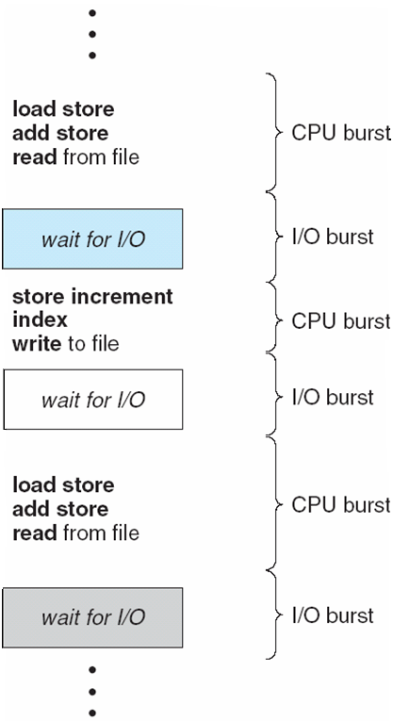
Alternating Sequence of CPU And I/O Bursts

Slide 5
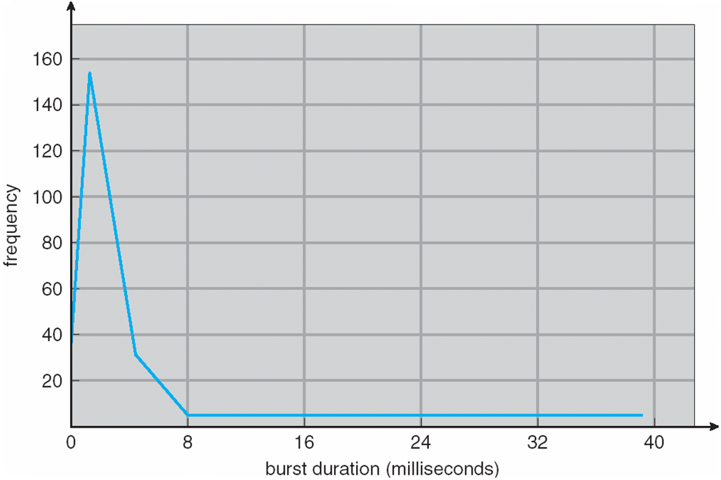
Histogram of CPU-burst Times

Slide 6
CPU Scheduler
Selects from among the processes in memory that are ready to execute, and allocates the CPU to one of them
CPU scheduling decisions may take place when a process:
  1. Switches from running to waiting state
  2. Switches from running to ready state
  3. Switches from waiting to ready
  4. Terminates
Scheduling under 1 and 4 is nonpreemptive
All other scheduling is preemptive

Slide 7
Dispatcher
Dispatcher module gives control of the CPU to the process selected by the short-term scheduler; this involves:
  switching context
  switching to user mode
  jumping to the proper location in the user program to restart that program
Dispatch latency – time it takes for the dispatcher to stop one process and start another running

Slide 8
Scheduling Criteria
CPU utilization – keep the CPU as busy as possible
Throughput – # of processes that complete their execution per time unit
Turnaround time – amount of time to execute a particular process
Waiting time – amount of time a process has been waiting in the ready queue
Response time – amount of time it takes from when a request was submitted until the first response is produced, not output (for time-sharing environment)

Slide 9
Scheduling Algorithm Optimization Criteria
Max CPU utilization
Max throughput
Min turnaround time
Min waiting time
Min response time

Slide 10
First-Come, First-Served (FCFS) Scheduling
Process Burst Time
P₁ 24
P₂ 3
P₃ 3
Suppose that the processes arrive in the order: P₁ , P₂ , P₃
The Gantt Chart for the schedule is:
Waiting time for P₁ = 0; P₂ = 24; P₃ = 27
Average waiting time: (0 + 24 + 27)/3 = 17
P₁
P₂
P₃
0
24
27
30

Slide 11
FCFS Scheduling (Cont)
Suppose that the processes arrive in the order
P₂ , P₃ , P₁
The Gantt chart for the schedule is:
Waiting time for P₁ = 6; P₂ = 0; P₃ = 3
Average waiting time: (6 + 0 + 3)/3 = 3
Much better than previous case
Example; one CPU bound and many I/O bound processes
Convoy effect short process behind long process
P₂
P₃
P₁
0
3
6
30

Slide 12
Shortest-Job-First (SJF) Scheduling
Shortest next cpu burst algorithm
  Associate with each process the length of its next CPU burst. Use these lengths to schedule the process with the shortest time
SJF is optimal – gives minimum average waiting time for a given set of processes
  The difficulty is knowing the length of the next CPU request

Slide 13
Shortest-Job-First (SJF) Scheduling
SJF can the pre-emptive and non-preemptive
Choice arises when a new process arrives at ready queue

Slide 14
Example of SJF
Process Burst Time
P₁ 6
P₂ 8
P₃ 7
P₄ 3
SJF scheduling chart
Average waiting time = (3 + 16 + 9 + 0) / 4 = 7
P₄
P₁
P₃
P₂
0
3
9
16
24

Slide 15
Example of Pre-emptive SJF
Process Arrival Time Burst Time
P₁ 0.0 8
P₂ 1.0 4
P₃ 2.0 9
P₄ 3.0 5
SJF scheduling chart
Average waiting time = (10-1) + (1-1) + (17-2) + (5-3) / 4 = 6.5ms
P₁
P₂
P₄
P₁
P₃
0
1
5
10
17
26

Slide 16
Determining Length of Next CPU Burst
Can only estimate the length
Can be done by using the length of previous CPU bursts, using exponential averaging

Slide 17
Examples of Exponential Averaging
α =0
  τ_{n+1} = τ_{n}
  Recent history does not count
α =1
  τ_{n+1} = α t_{n}
  Only the actual last CPU burst counts
If we expand the formula, we get:
    τ_{n+1} = α t_{n}+(1 - α)α t_{n} -1 + …
    +(1 - α )^{j} α t_{n} _{-j} + …
    +(1 - α )^{n +1} τ₀
Since both α and (1 - α) are less than or equal to 1, each successive term has less weight than its predecessor

Slide 18
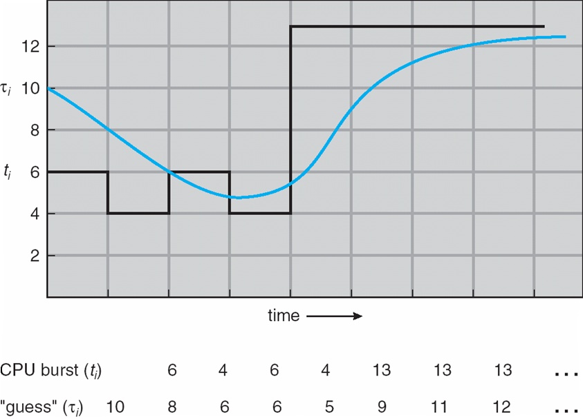
Prediction of the Length of the Next CPU Burst

Slide 19
Priority Scheduling
A priority number (integer) is associated with each process
The CPU is allocated to the process with the highest priority (smallest integer ≡ highest priority)
  Preemptive
  nonpreemptive
SJF is a priority scheduling where priority is the predicted next CPU burst time (priority inverse of prediction)
Problem ≡ Starvation – low priority processes may never execute
Solution ≡ Aging – as time progresses increase the priority of the process

Slide 20
Round Robin (RR)
Each process gets a small unit of CPU time (time quantum), usually 10-100 milliseconds. After this time has elapsed, the process is preempted and added to the end of the ready queue.
If there are n processes in the ready queue and the time quantum is q, then each process gets 1/n of the CPU time in chunks of at most q time units at once. No process waits more than (n-1)q time units.
Performance
  q large ⇒ FIFO
  q small ⇒ q must be large with respect to context switch, otherwise overhead is too high

Slide 21
Example of RR with Time Quantum = 4
Process Burst Time
P₁ 24
P₂ 3
P₃ 3
The Gantt chart is:
Typically, higher average turnaround than SJF, but better response
P₁
P₂
P₃
P₁
P₁
P₁
P₁
P₁
0
4
7
10
14
18
22
26
30

Slide 22
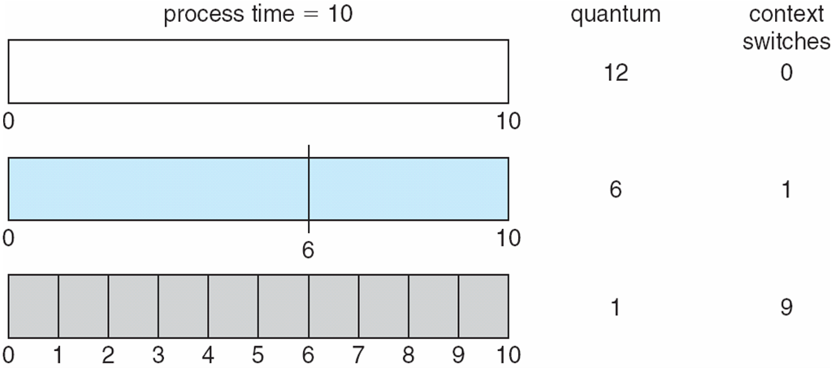
Time Quantum and Context Switch Time

Slide 23
Multilevel Queue
Ready queue is partitioned into separate queues:
foreground (interactive)
background (batch)
Each queue has its own scheduling algorithm
  foreground – RR
  background – FCFS
Scheduling must be done between the queues
  Fixed priority scheduling; (i.e., serve all from foreground then from background). Possibility of starvation.
  Time slice – each queue gets a certain amount of CPU time which it can schedule amongst its processes; i.e., 80% to foreground in RR
  20% to background in FCFS

Slide 24
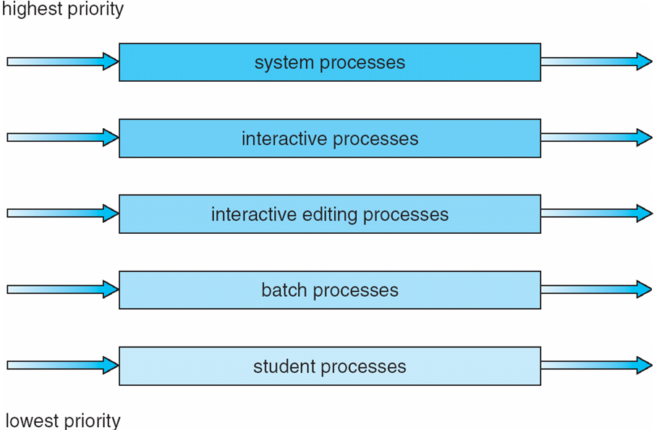
Multilevel Queue Scheduling

Slide 25
Multilevel Feedback Queue
A process can move between the various queues; aging can be implemented this way
Multilevel-feedback-queue scheduler defined by the following parameters:
  number of queues
  scheduling algorithms for each queue
  method used to determine when to upgrade a process
  method used to determine when to demote a process
  method used to determine which queue a process will enter when that process needs service

Slide 26
Example of Multilevel Feedback Queue
Three queues:
  Q₀ – RR with time quantum 8 milliseconds
  Q₁ – RR time quantum 16 milliseconds
  Q₂ – FCFS
Scheduling
  A new job enters queue Q₀ which is served FCFS. When it gains CPU, job receives 8 milliseconds. If it does not finish in 8 milliseconds, job is moved to queue Q₁.
  At Q₁ job is again served FCFS and receives 16 additional milliseconds. If it still does not complete, it is preempted and moved to queue Q₂.

Slide 27
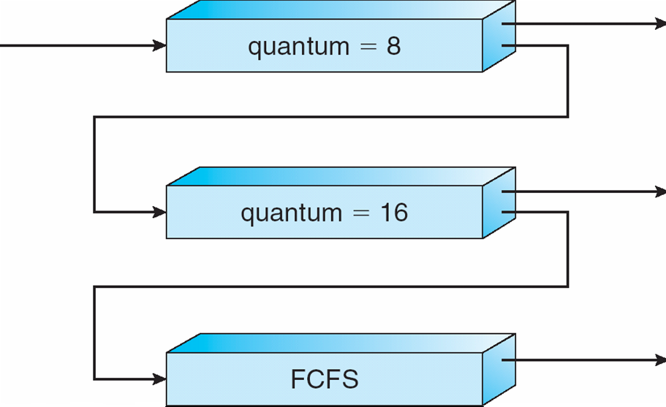
Multilevel Feedback Queues

Slide 28
Multiple-Processor Scheduling
CPU scheduling more complex when multiple CPUs are available
Homogeneous processors within a multiprocessor
Asymmetric multiprocessing – only one processor accesses the system data structures, alleviating the need for data sharing
Symmetric multiprocessing (SMP) – each processor is self-scheduling, all processes in common ready queue, or each has its own private queue of ready processes

Slide 29
Processor affinity –
  Example of process migrating from cache of one processer to another processor
Migration is avoided due to high cost of invalidating and repopulating caches.
Process has affinity for processor on which it is currently running
  soft affinity
  hard affinity

Slide 30
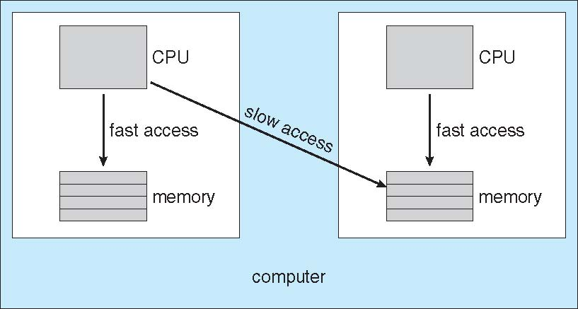
NUMA and CPU Scheduling

Slide 31
End of Chapter 5

