Slide 1
About the class
Class: M,W 3:00 – 4:15
Office hours M,W 1:30 – 3:00 (or by appointment)
Pre-requisites: Some programming experience, general familiarity with computer organization and operating systems (as a user).
Textbook:
  Operating Systems Concepts Essentials, 2013 edition by Abraham Silberschatz, Peter B. Galvin and Greg Gagne
  Other resources will be posted on webpage

Slide 2
Grading
Grading:
  Quizzes every class (2 questions, one repeated next week) (5%)
  Midterm 1 (20%)
  Midterm 2 (20%)
  Final (30%)
  Homeworks / projects (25%)
Bonus points (10..25) will be offered on midterms / homeworks
  Can be used to compensate between midterms
All midterms and exams are open book, one notes
  Textbook on Kindle, tablets ok (in airplane mode)
  No devices with a keyboard accepted at the exam

Slide 3
Chapter 1: Introduction

Slide 4
The landscape of operating systems (as of 2014)

Slide 5
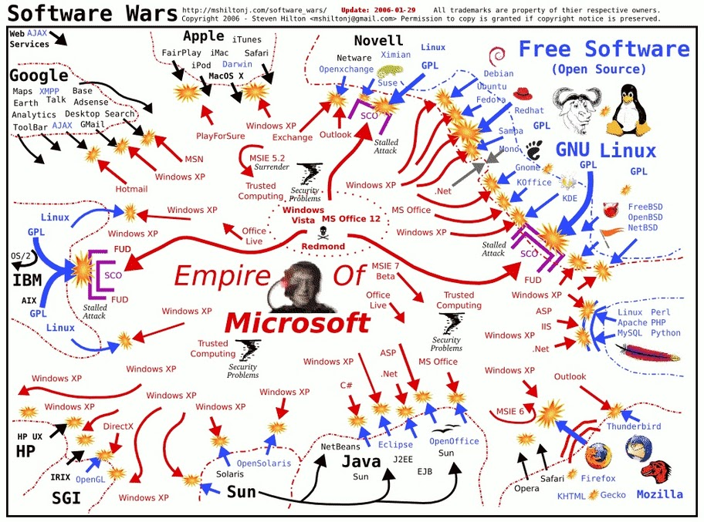
The OS wars (in 2006)

Slide 6
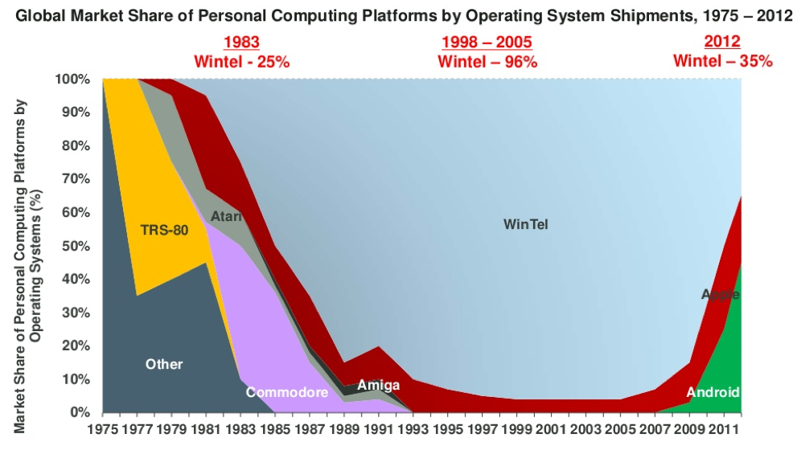
Personal computing (including mobile)

Slide 7
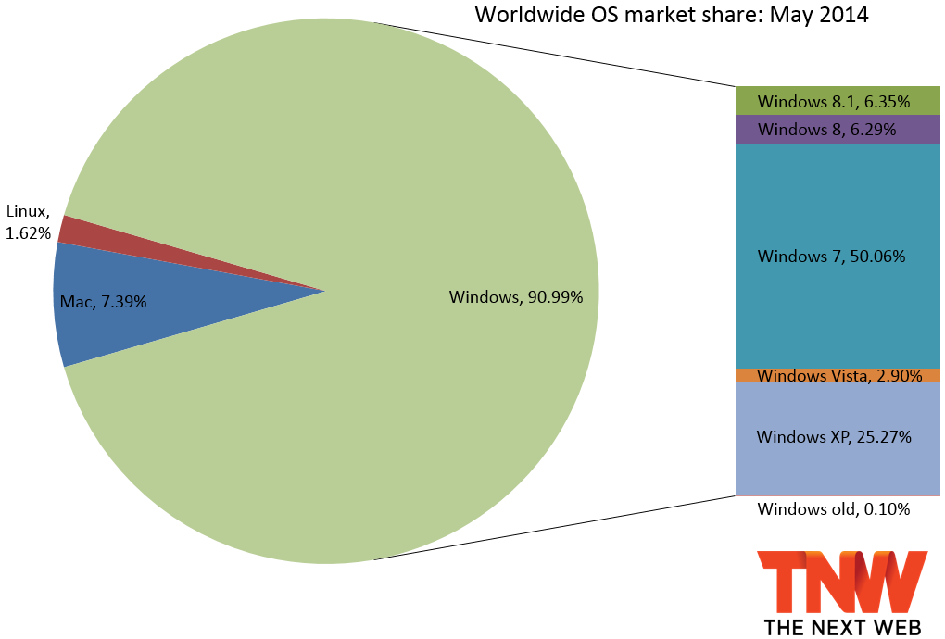
Desktop Operating Systems (internet usage May 2014)

Slide 8
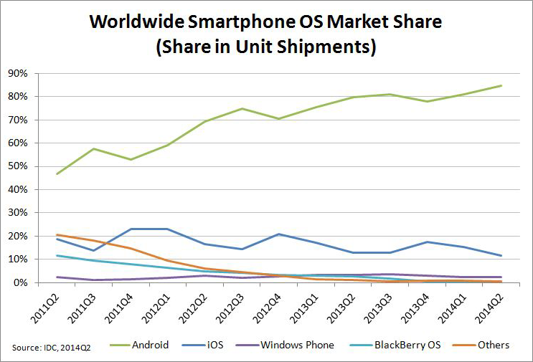
Smartphone OS

Slide 9
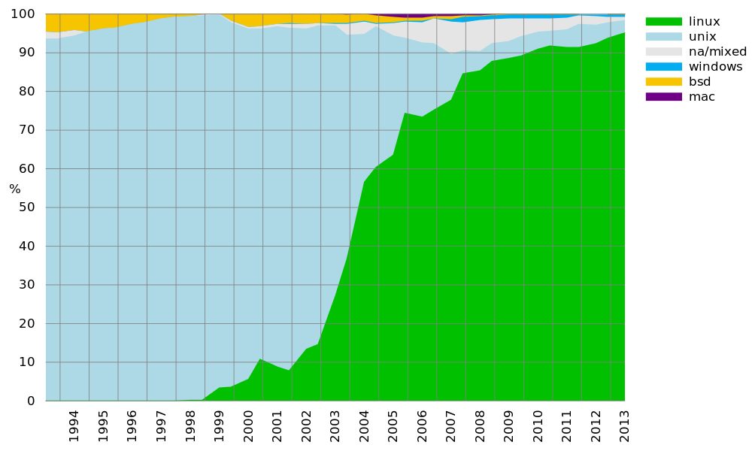
Operating systems on supercomputers

Slide 10
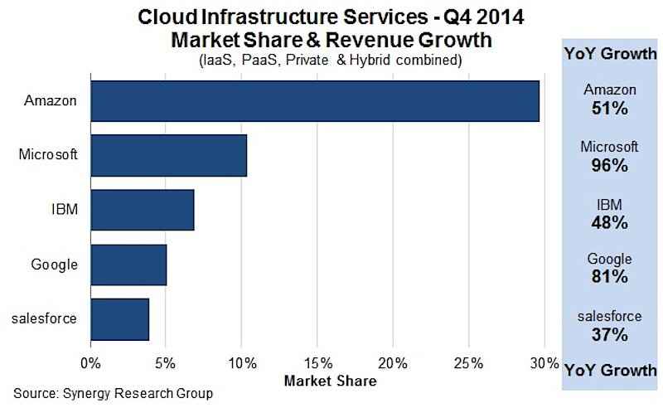
Operating systems in the cloud
Basically, the 10% on Microsoft Azure is mostly Windows, everybody else does Linux.

Slide 11
Some preliminary notions

Slide 12
N1: “Naming” in computer science
Computer systems manipulate objects
  Files, webpages, memory locations, memory blocks, users, sockets, procedures, etc.
We can deal with them in two different ways:
  Pass them (or copies of them) around (by value)
  Refer to them using a name.
Resolving a name in a context:
  Value = resolve(name, context)
Some possible properties of naming schemes
  Universal naming scheme: no context is needed to resolve
  Unique identifier name space: names will never be reused
  Stable binding: names will not change
  Unique name: if an object can have at most one name

Slide 13
N1: Naming in computer science (applications)
Examples:
  Memory addresses (00BH)
  File names (“hello.c”, “/usr/bin/ls”)
  Resource names (“/dev/mouse”)
  Web URIs (www.google.com)
Many aspects in OS can be seen as naming manipulation

Slide 14
N2: Caching
General concept:
  We want to repeatedly access (read or write) a remote object
  To speed up access, keep a closer copy
  When accessing we can have:
    Cache hit: we have a close copy
    Cache miss: we don’t have a close copy. Usually, we need to create one.
General problems:
  What happens at write?
    Update the original right away: write-through
    Update the original later: write-back
  What happens if there are multiple caches of the same item?
    Cache coherence algorithms.

Slide 15
N2: Caching (application)
CPU cache
Translation lookaside buffer (for virtual memory)
Disk cache
Web cache
Content delivery networks (CDNs)

Slide 16
N3: Abstract data types
Abstract data type: a data type defined by its operations, without caring about the structure:
  Stack:
    Push()
    Pull()
  Array
    setAt(i, value)
    value = getAt(i)

Slide 17
N3: Abstract data types (application)
Abstract data types are the basis of many simplifying assumption in operating systems. Consider, for instance the following abstract data type:
  Open()
  Close()
  Data = Read()
  Write(Data)
  Seek(location)
This can represent:
  Files (local, remote)
  Devices (mouse, keyboard, screen)
  Network connections (tcp socket, http connection…)
  Access into a compressed “zip” archive
  Access into an encrypted repository…

Slide 18
Defining the field

Slide 19
Definition 1: Intermediary
A program that acts as an intermediary between a user of a computer and the computer hardware

Slide 20
Intermediary (cont’d)
Computer system can be divided into four components
  Hardware – provides basic computing resources
    CPU, memory, I/O devices
  Operating system
    Controls and coordinates use of hardware among various applications and users
  Application programs – define the ways in which the system resources are used to solve the computing problems of the users
    Word processors, compilers, web browsers, database systems, video games
  Users
    People, machines, other computers

Slide 21
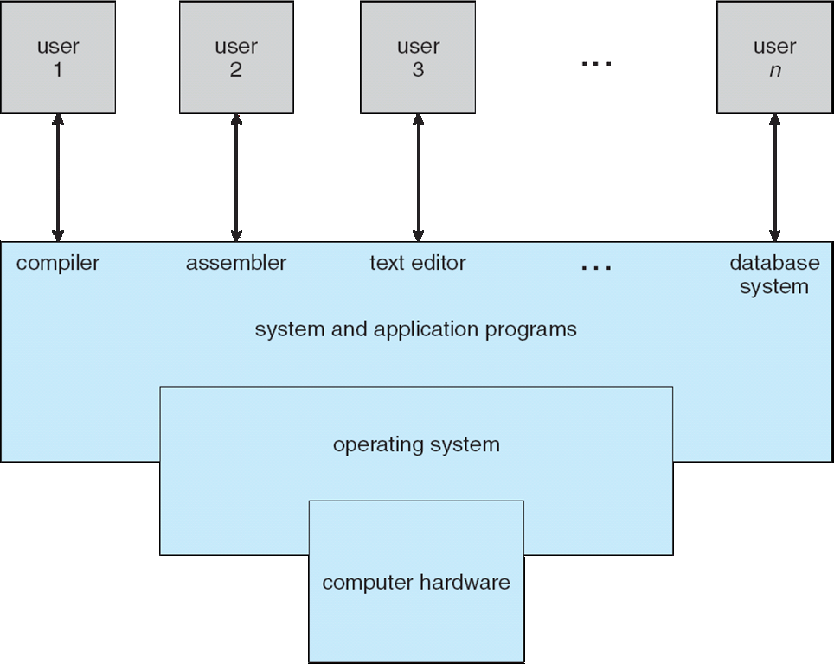
Intermediary (cont’d)

Slide 22
Definition 2: Resource allocator
OS is a resource allocator
  Manages all resources
  Decides between conflicting requests for efficient and fair resource use
What is a resource?
  Anything you can run out of…
  Computing power, memory, storage space
  Energy
  Network bandwidth
  Money (!)

Slide 23
Definition 3: Control program
OS is a control program
  Controls execution of programs to prevent errors and improper use of the computer

Slide 24
Reviewing definitions
No universally accepted definition
“Everything a vendor ships when you order an operating system” is good approximation
  But varies wildly
“The one program running at all times on the computer” is the kernel. Everything else is either a system program (ships with the operating system) or an application program

Slide 25
A bagload of definitions
This is that we talk about when we are talk about OSs

Slide 26
Computer Startup
bootstrap program is loaded at power-up or reboot
  Typically stored in ROM or EPROM, generally known as firmware
  Initializes all aspects of system
  Determine where to boot from (harddisk, CD/DVD-ROM, USB, network)
  Loads operating system kernel and starts execution
On PC-class systems
  BIOS (Basic Input Output)
  UEFI (Unified Extensible Firmware Interface)
The firmware bootstrap often hands it over to another bootstrap program on the disk (second stage boot loaders):
  GRUB
  NTLDR – for Windows

Slide 27
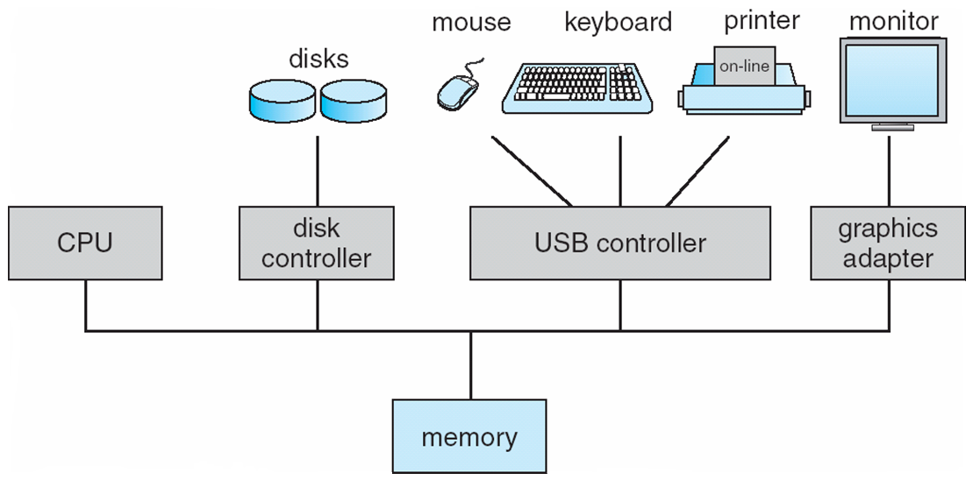
Computer System Organization
Computer-system operation
  One or more CPUs, device controllers connect through common bus providing access to shared memory
  Concurrent execution of CPUs and devices competing for memory cycles

Slide 28
Computer-System Operation
I/O devices and the CPU can execute concurrently
Each device controller is in charge of a particular device type
Each device controller has a local buffer
CPU moves data from/to main memory to/from local buffers
I/O is from the device to local buffer of controller
Device controller informs CPU that it has finished its operation by causing an interrupt

Slide 29
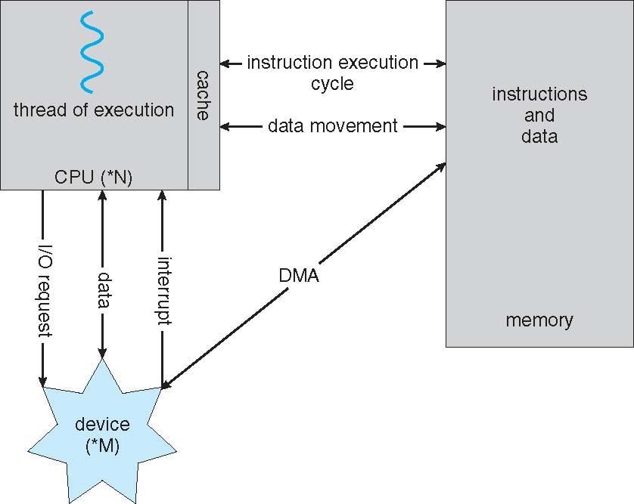
How a Modern Computer Works
A von Neumann architecture

Slide 30
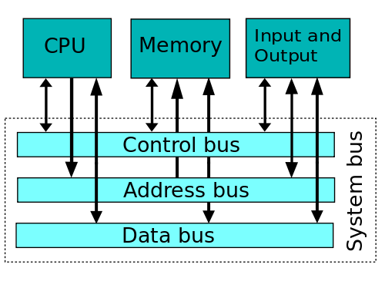
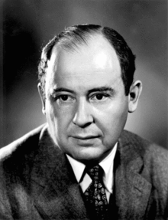
Von Neumann (Princeton) architecture
Von Neumann architecture (or Princeton architecture)
  Processor (or processors)
  One common memory for data and code
  Buses used to access memory and input output
  Direct Memory Access – going from I/O to Memory directly
Majority of modern general purpose GPUs (Intel, AMD, MIPS, most ARM etc)

Slide 31
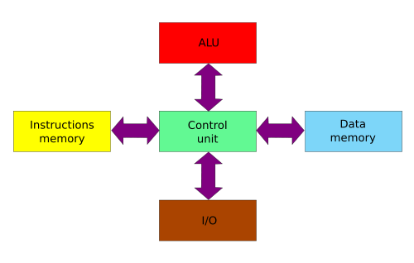
Harvard architecture
Strict separation of Instruction memory, Data memory, ALU and I/O
Advantage: simultaneous access to data and code
Modified Harvard: relax the strict separation requirements
Current applications: Digital Signal Processors (DSP), microcontrollers

Slide 32
Common Functions of Interrupts
Interrupt transfers control to the interrupt service routine generally, through the interrupt vector, which contains the addresses of all the service routines
Interrupt architecture must save the address of the interrupted instruction
Incoming interrupts are disabled while another interrupt is being processed to prevent a lost interrupt
A trap is a software-generated interrupt caused either by an error or a user request
An operating system is interrupt driven

Slide 33
Interrupt Handling
The operating system preserves the state of the CPU by storing registers and the program counter
Determines which type of interrupt has occurred:
  polling
  vectored interrupt system
Separate segments of code determine what action should be taken for each type of interrupt

Slide 34
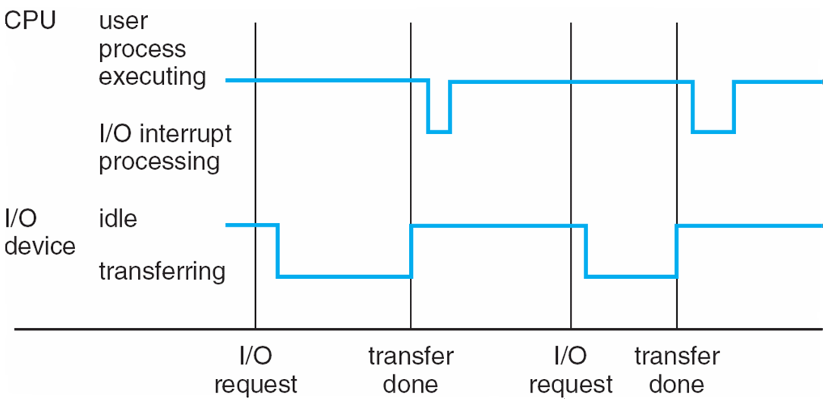
Interrupt Timeline

Slide 35
Two types of I/O calls
Blocking call: After I/O starts, control returns to user program only upon I/O completion
  Wait instruction idles the CPU until the next interrupt
  Wait loop (contention for memory access)
  At most one I/O request is outstanding at a time, no simultaneous I/O processing
Non-blocking call: After I/O starts, control returns to user program without waiting for I/O completion
  System call – request to the operating system to allow user to wait for I/O completion
  Device-status table contains entry for each I/O device indicating its type, address, and state
  Operating system indexes into I/O device table to determine device status and to modify table entry to include interrupt

Slide 36
Direct Memory Access
Direct memory access: special type of non-blocking call
Used for high-speed I/O devices able to transmit information at close to memory speeds
Device controller transfers blocks of data from buffer storage directly to main memory without CPU intervention
Only one interrupt is generated per block, rather than the one interrupt per byte

Slide 37
Storage Structure
Main memory (primary storage)
  Directly accessible by the CPU
  Volatile
  Typical implementation: Dynamic RAM
Secondary storage – extension of main memory that provides large nonvolatile storage capacity.
  Non-volatile
  Frequently accessed during the course of regular operation
  Typical implementation:
    Magnetic disks (hard drives)
    Solid state drives (flash drives)
Tertiary storage
  Not normally accessed during the course of regular operation

Slide 38
Storage Hierarchy
Storage systems organized in hierarchy
  Speed
  Cost
  Volatility
Caching – copying information into faster storage system; main memory can be viewed as a last cache for secondary storage

Slide 39
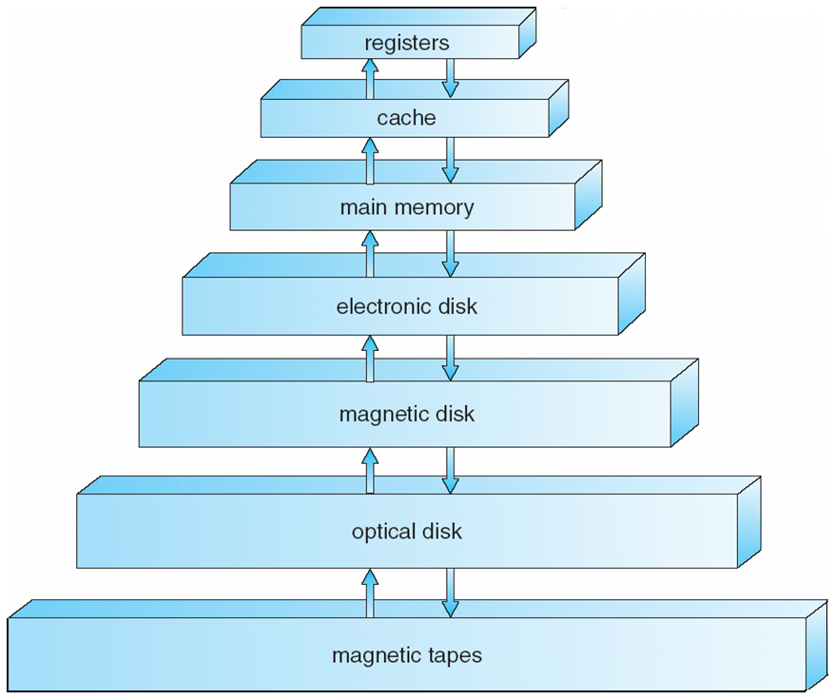
Storage-Device Hierarchy

Slide 40
Caching
Important principle, performed at many levels in a computer (in hardware, operating system, software)
Information in use copied from slower to faster storage temporarily
Faster storage (cache) checked first to determine if information is there
  If it is, information used directly from the cache (fast)
  If not, data copied to cache and used there
Cache smaller than storage being cached
  Cache management important design problem
  Cache size and replacement policy

Slide 41
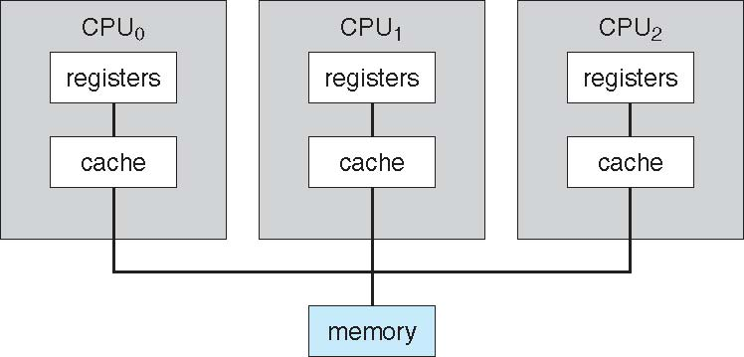
Symmetric Multiprocessing Architecture
The memory is the same distance from all CPUs.

Slide 42
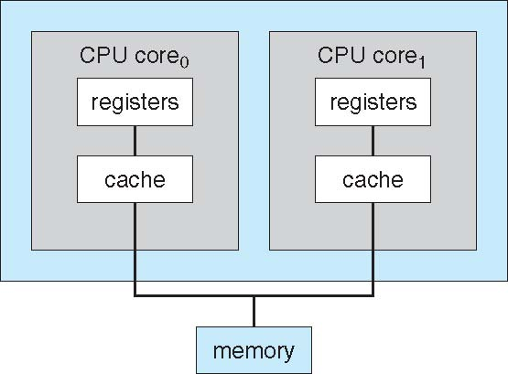
Multi-Core Designs
Still qualifies as SMP, only embedded in a single chip.
Examples:
  Intel Core i5: 2 cores,
  Core i7: 4 cores
  Some Core i7 “extreme” 6 cores
  Some Xeon: 10 cores

Slide 43
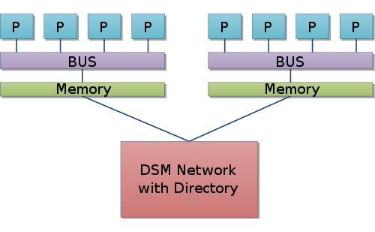
Non-uniform memory architecture (NUMA)
One can still access the whole memory
But the speed of access depends whether memory is local or remote
Contrast this with message based systems where remote memory can not be accessed as “memory” i.e. instead of read/write you need to use send/receive.

Slide 44
Operating System Structure
Multiprogramming needed for efficiency
  Single user cannot keep CPU and I/O devices busy at all times
  Multiprogramming organizes jobs (code and data) so CPU always has one to execute
  A subset of total jobs in system is kept in memory
  One job selected and run via job scheduling
  When it has to wait (for I/O for example), OS switches to another job
Timesharing (multitasking) is logical extension in which CPU switches jobs so frequently that users can interact with each job while it is running, creating interactive computing
  Response time should be < 1 second
  Each user has at least one program executing in memory process
  If several jobs ready to run at the same time  CPU scheduling
  If processes don’t fit in memory, swapping moves them in and out to run
  Virtual memory allows execution of processes not completely in memory

Slide 45
Process Management
A process is a program in execution. It is a unit of work within the system. Program is a passive entity, process is an active entity.
Process needs resources to accomplish its task
  CPU, memory, I/O, files
  Initialization data
Process termination requires reclaim of any reusable resources
Single-threaded process has one program counter specifying location of next instruction to execute
  Process executes instructions sequentially, one at a time, until completion
Multi-threaded process has one program counter per thread
Typically system has many processes, some user, some operating system running concurrently on one or more CPUs
  Concurrency by multiplexing the CPUs among the processes / threads

