Slide 1
Chapter 8: Main Memory

Slide 2
Background
Von Neumann architecture:
Program and data is in the same memory (code is data)
Harvard architecture:
Physically separate memory for code and data
Program must be brought (from disk) into memory and placed within a process for it to be run
Main memory and registers are only storage CPU can access directly
Register access in one CPU clock (or less)
Main memory can take many cycles
Cache sits between main memory and CPU registers
Protection of memory required to ensure correct operation

Slide 3
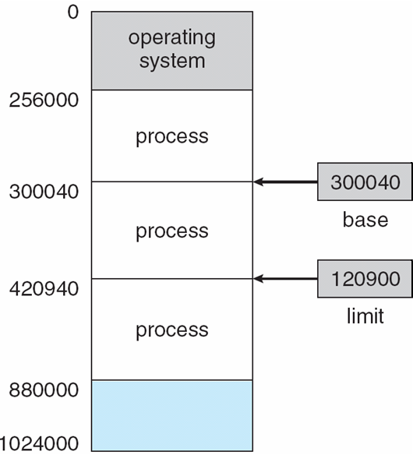
An example of limiting memory access
A pair of base and limit registers define the logical address space

Slide 4
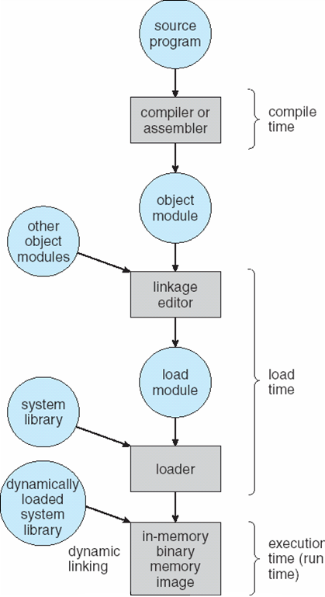
Multistep Processing of a User Program

Slide 5
Binding of Instructions and Data to Memory
Address binding of instructions and data to memory addresses can happen at three different stages
Compile time: If memory location known a priori, absolute code can be generated; must recompile code if starting location changes
(eg. DOS *.com programs)
Load time: Must generate relocatable code if memory location is not known at compile time
Execution time: Binding delayed until run time if the process can be moved during its execution from one memory segment to another. Need hardware support for address maps (e.g., base and limit registers)

Slide 6
Dynamic Loading
Routine is not loaded until it is called
Better memory-space utilization; unused routine is never loaded
Useful when large amounts of code are needed to handle infrequently occurring cases
No special support from the operating system is required implemented through program design
Example of a modern system implementing this: Java class loader
Loading can be very complex, for instance, loading from the network etc.

Slide 7
Dynamic Linking
Linking postponed until execution time
Small piece of code, stub, used to locate the appropriate memory-resident library routine
Stub replaces itself with the address of the routine, and executes the routine
Operating system needed to check if routine is in processes’ memory address
Dynamic linking is particularly useful for libraries
System also known as shared libraries
Examples:
.DLL libraries in Windows (PE/COFF)
.SO dynamic link libraries in Linux (ELF)
Mach-O in MacOS

Slide 8
Swapping
A process can be swapped temporarily out of memory to a backing store, and then brought back into memory for continued execution
Backing store – fast disk large enough to accommodate copies of all memory images for all users; must provide direct access to these memory images
Roll out, roll in – swapping variant used for priority-based scheduling algorithms; lower-priority process is swapped out so higher-priority process can be loaded and executed
Major part of swap time is transfer time; total transfer time is directly proportional to the amount of memory swapped
Modified versions of swapping are found on many systems (i.e., UNIX, Linux, and Windows)
System maintains a ready queue of ready-to-run processes which have memory images on disk

Slide 9
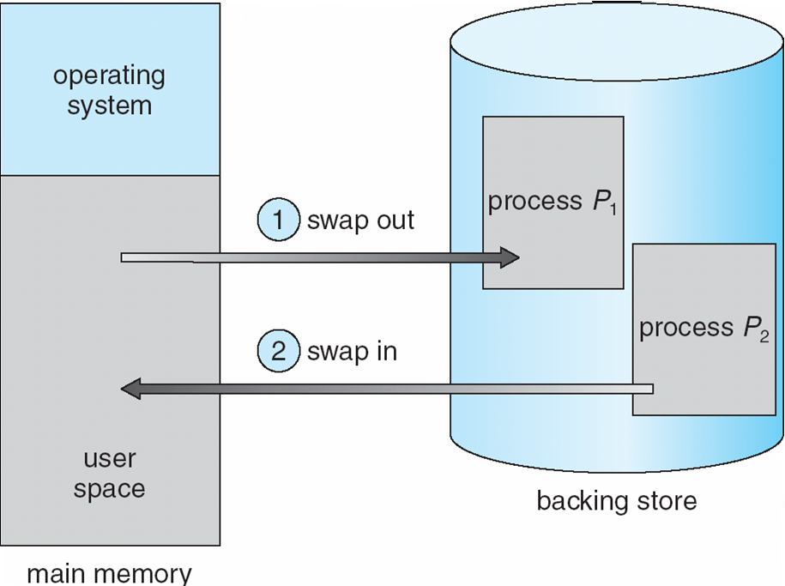
Schematic View of Swapping

Slide 10
Logical vs. Physical Address Space
The concept of a logical address space that is bound to a separate physical address space is central to proper memory management
Logical address – generated by the CPU; also referred to as virtual address
Physical address – address seen by the memory unit
Compile time + Load time address binding:
Logical address = physical address
Execution time address binding:
Logical (virtual) address != physical address

Slide 11
Memory-Management Unit (MMU)
Hardware device that maps virtual to physical address
In MMU scheme, the value in the relocation register is added to every address generated by a user process at the time it is sent to memory
The user program deals with logical addresses; it never sees the real physical addresses

Slide 12
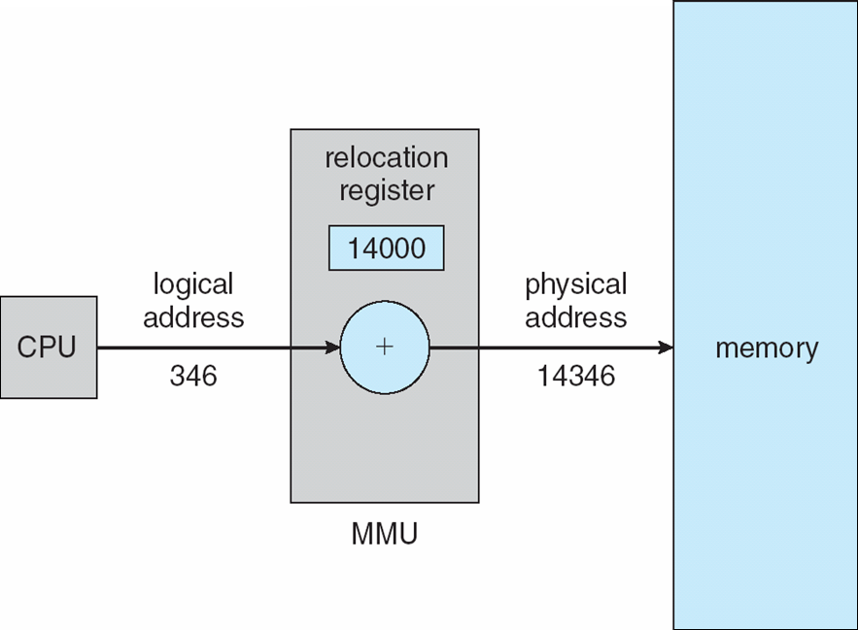
Simplest example of MMU: dynamic relocation using a relocation register

Slide 13
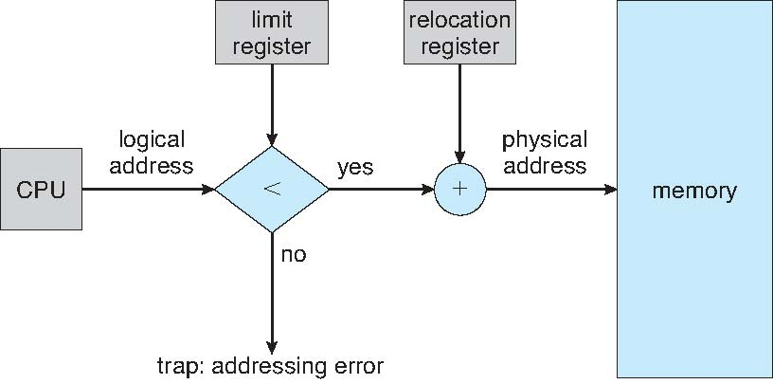
Hardware Support for Relocation and Limit Registers

Slide 14
Contiguous allocation
The following slides will make the assumption that the program in your computer is allocated memory in a single piece.
This is not the case in any modern operating system
… but it will allow us to introduce some important concepts

Slide 15
Contiguous Allocation in an OS
Main memory usually divided into two partitions:
Resident operating system, usually held in low memory with interrupt vector
User processes then held in high memory
Example: MS-DOS
Relocation registers used to protect user processes from each other, and from changing operating-system code and data
Base register contains value of smallest physical address
Limit register contains range of logical addresses – each logical address must be less than the limit register
MMU maps logical address dynamically
Note: although it is possible to do advanced relocation, protection etc. with contiguous allocation, there are no widely used examples of OS-s which do this.

Slide 16
Contiguous Allocation (Cont)
Multiple-partition allocation
Hole – block of available memory; holes of various size are scattered throughout memory
When a process arrives, it is allocated memory from a hole large enough to accommodate it
Operating system maintains information about: a) allocated partitions b) free partitions (hole)
OS
OS
OS
OS
process 5
process 5
process 5
process 5
process 9
process 9
process 8
process 10
process 2
process 2
process 2
process 2

Slide 17
Dynamic Storage-Allocation Problem
How to satisfy a request of size n from a list of free holes
First-fit: Allocate the first hole that is big enough
Best-fit: Allocate the smallest hole that is big enough; must search entire list, unless ordered by size
Produces the smallest leftover hole
Worst-fit: Allocate the largest hole; must also search entire list
Produces the largest leftover hole
First-fit and best-fit better than worst-fit in terms of speed and storage utilization

Slide 18
Fragmentation
External Fragmentation: the allocated blocks have holes between them
Potential problem: total memory space exists to satisfy a request, but it is not contiguous
Internal Fragmentation: the allocated block is larger than the requested memory, so there is a hole inside the block
Potential problem: overall waste of space
Reduce external fragmentation by compaction
Shuffle memory contents to place all free memory together in one large block
Compaction is possible only if relocation is dynamic, and is done at execution time

Slide 19
Paging

Slide 20
Paging
Logical address space of a process can be noncontiguous; process is allocated physical memory whenever the latter is available
Divide physical memory into fixed-sized blocks called frames (size is power of 2, between 512 bytes and 8,192 bytes)
Divide logical memory into blocks of same size called pages
Keep track of all free frames
To run a program of size n pages, need to find n free frames and load program
Set up a page table to translate logical to physical addresses
Internal fragmentation

Slide 21
Address Translation Scheme
Address generated by CPU is divided into:
Page number (p) – used as an index into a page table which contains base address of each page in physical memory
Page offset (d) – combined with base address to define the physical memory address that is sent to the memory unit
For given logical address space 2^{m} and page size 2^{n}
page number
page offset
p
d
m - n
n

Slide 22
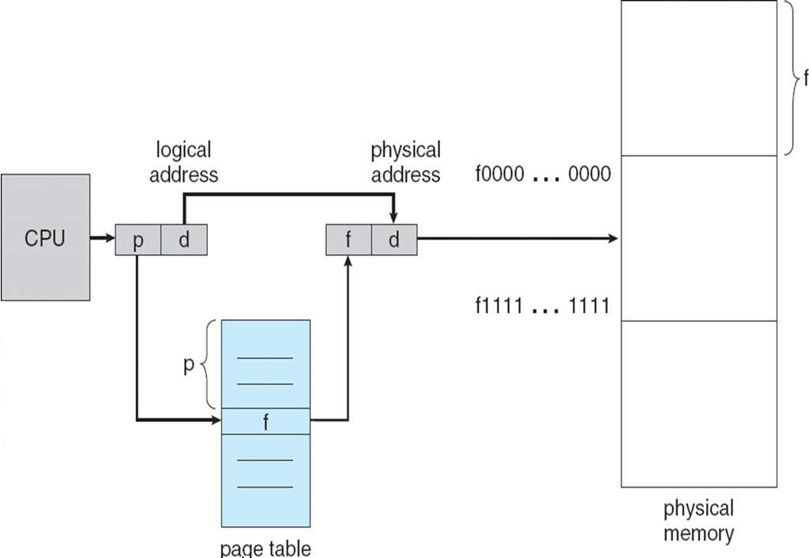
Paging Hardware

Slide 23
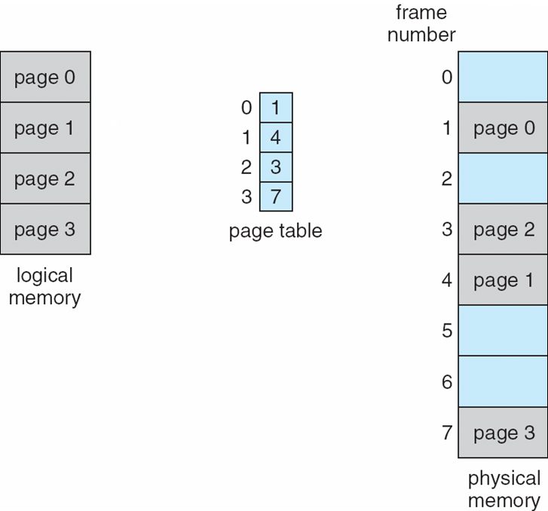
Paging Model of Logical and Physical Memory

Slide 24
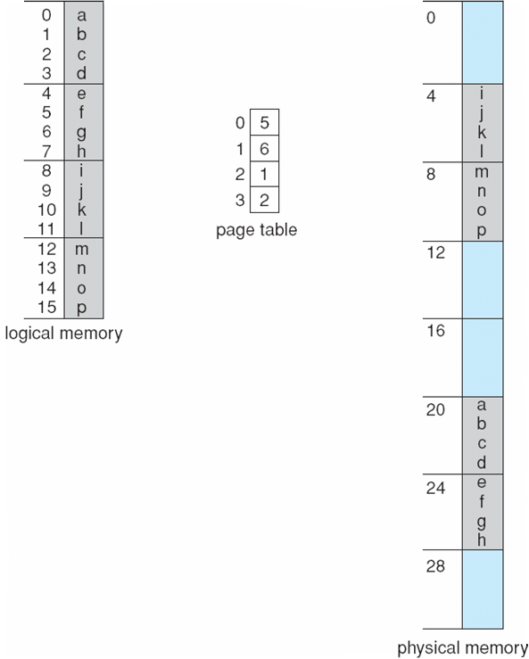
Paging Example
32-byte memory and 4-byte pages

Slide 25
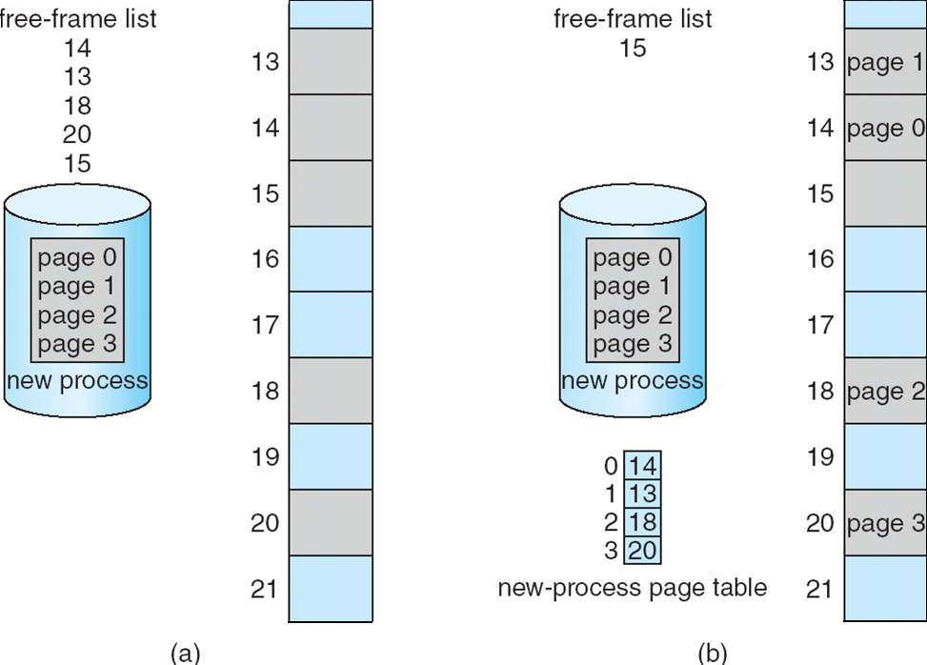
Free Frames
Before allocation
After allocation

Slide 26
Implementation of Page Table
Page table is kept in main memory
Page-table base register (PTBR) points to the page table
Page-table length register (PRLR) indicates size of the page table
In this scheme every data/instruction access requires two memory accesses. One for the page table and one for the data/instruction.
The two memory access problem can be solved by the use of a special fast-lookup hardware cache called associative memory or translation look-aside buffers (TLBs)
Some TLBs store address-space identifiers (ASIDs) in each TLB entry – uniquely identifies each process to provide address-space protection for that process

Slide 27
Associative Memory
Associative memory – parallel search
Address translation (p, d)
If p is in associative register, get frame # out
Otherwise get frame # from page table in memory
Page #
Frame #

Slide 28
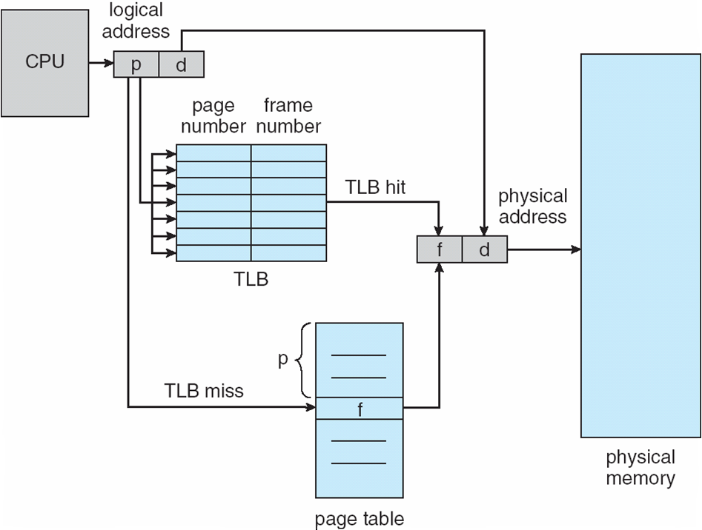
Paging Hardware With TLB

Slide 29
Effective Access Time
Associative Lookup = ε time unit
Assume memory cycle time is 1 microsecond
Hit ratio – percentage of times that a page number is found in the associative registers; ratio related to number of associative registers
Hit ratio = α
Effective Access Time (EAT)
EAT = (1 + ε) α + (2 + ε)(1 – α)
= 2 + ε – α

Slide 30
Memory Protection
Memory protection implemented by associating protection bit with each frame
Valid-invalid bit attached to each entry in the page table:
“valid” indicates that the associated page is in the process’ logical address space, and is thus a legal page
“invalid” indicates that the page is not in the process’ logical address space

Slide 31
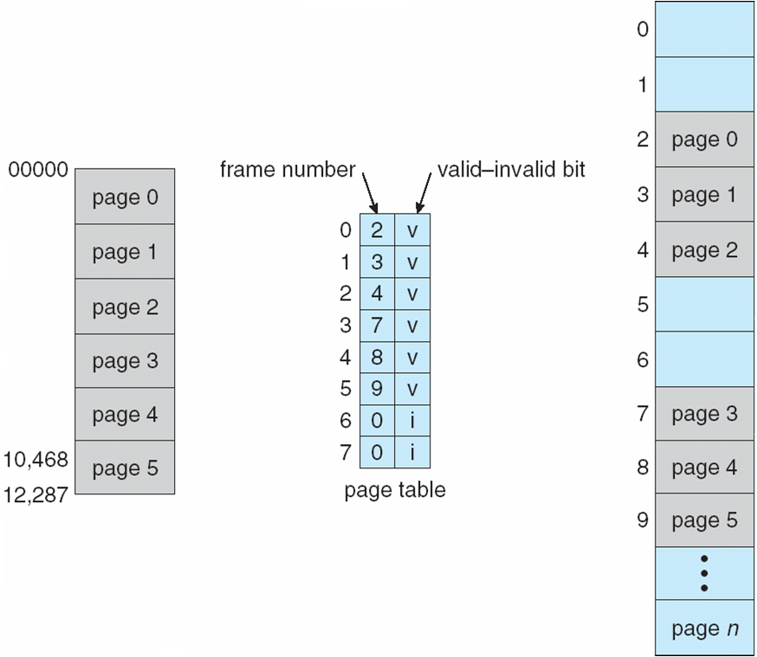
Valid (v) or Invalid (i) Bit In A Page Table

Slide 32
Structure of the Page Table
Hierarchical Paging
Hashed Page Tables
Inverted Page Tables

Slide 33
Hierarchical Page Tables
Break up the logical address space into multiple page tables
A simple technique is a two-level page table

Slide 34
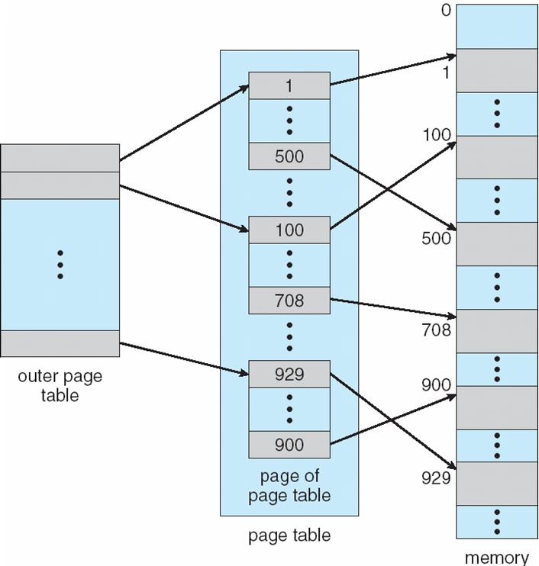
Two-Level Page-Table Scheme

Slide 35
Two-Level Paging Example
A logical address (on 32-bit machine with 1K page size) is divided into:
a page number consisting of 22 bits
a page offset consisting of 10 bits
Since the page table is paged, the page number is further divided into:
a 12-bit page number
a 10-bit page offset
Thus, a logical address is as follows: where p_{i} is an index into the outer page table, and p₂ is the displacement within the page of the outer page table
page number
page offset
p_{i}
p₂
d
12
10
10

Slide 36
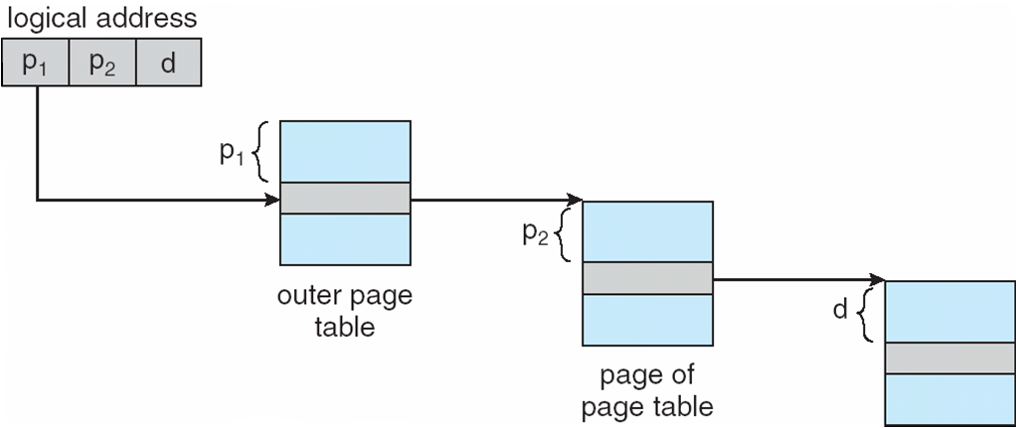
Address-Translation Scheme

Slide 37
Three-level Paging Scheme

Slide 38
Hashed Page Tables
Common in address spaces > 32 bits
The virtual page number is hashed into a page table
This page table contains a chain of elements hashing to the same location
Virtual page numbers are compared in this chain searching for a match
If a match is found, the corresponding physical frame is extracted

Slide 39
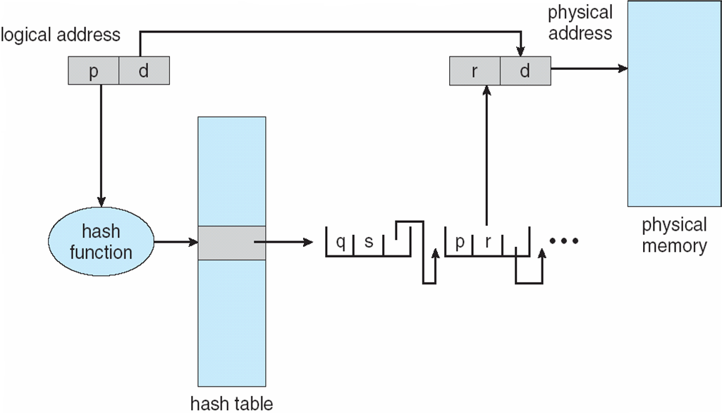
Hashed Page Table

Slide 40
Inverted Page Table
One entry for each real page of memory
Entry consists of the virtual address of the page stored in that real memory location, with information about the process that owns that page
Decreases memory needed to store each page table, but increases time needed to search the table when a page reference occurs
Use hash table to limit the search to one — or at most a few — page-table entries

Slide 41
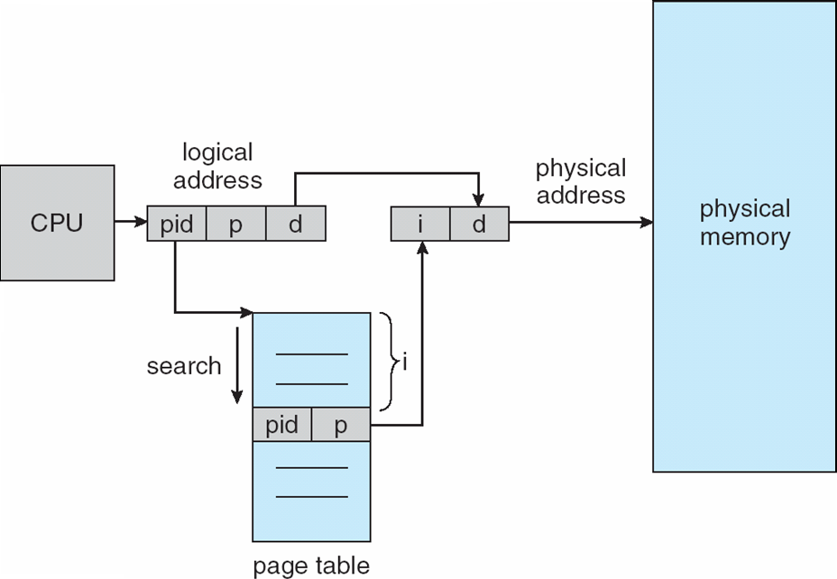
Inverted Page Table Architecture

Slide 42
Segmentation

Slide 43
Segmentation
Memory-management scheme that supports user view of memory
A program is a collection of segments
A segment is a logical unit such as:
main program
procedure
function
method
object
local variables, global variables
common block
stack
symbol table
arrays

Slide 44
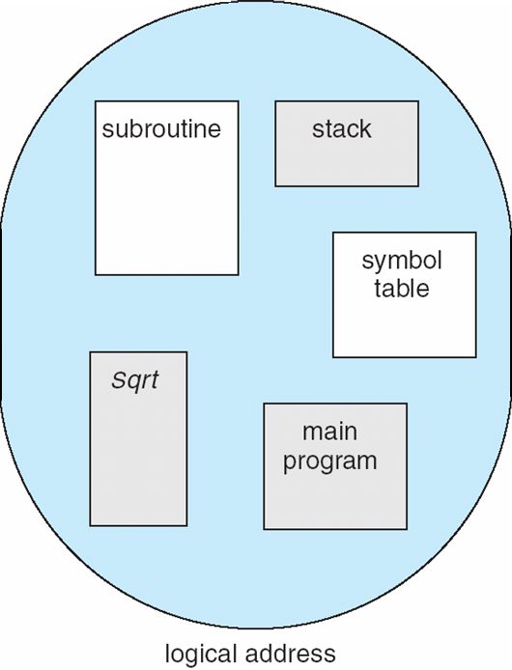
User’s View of a Program

Slide 45
Logical View of Segmentation
1
1
4
2
3
4
2
3
user space
physical memory space

Slide 46
Segmentation Architecture
Logical address consists of a two tuple:
<segment-number, offset>,
Segment table – maps two-dimensional physical addresses; each table entry has:
base – contains the starting physical address where the segments reside in memory
limit – specifies the length of the segment
Segment-table base register (STBR) points to the segment table’s location in memory
Segment-table length register (STLR) indicates number of segments used by a program;
segment number s is legal if s < STLR

Slide 47
Segmentation Architecture (Cont.)
Protection
With each entry in segment table associate:
validation bit = 0 ⇒ illegal segment
read/write/execute privileges
Protection bits associated with segments; code sharing occurs at segment level
Since segments vary in length, memory allocation is a dynamic storage-allocation problem
A segmentation example is shown in the following diagram

Slide 48
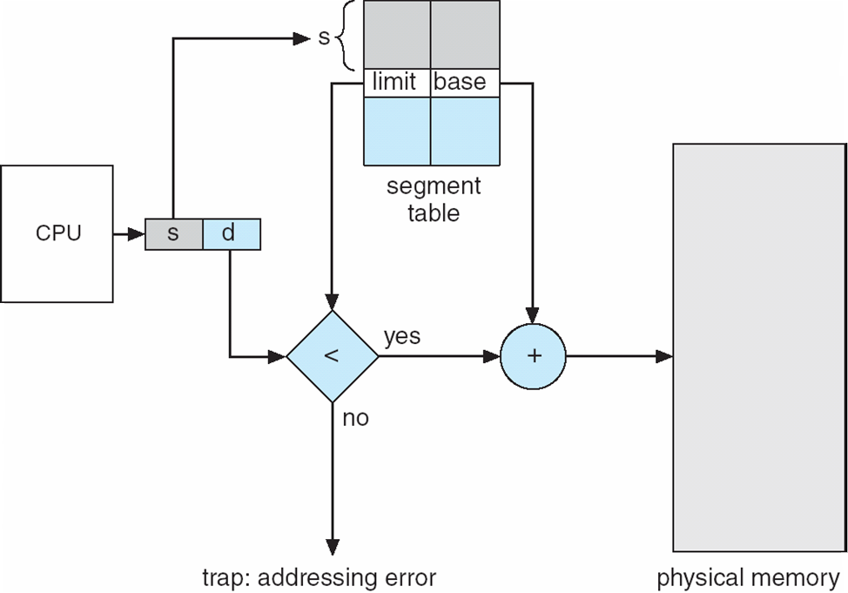
Segmentation Hardware

Slide 49
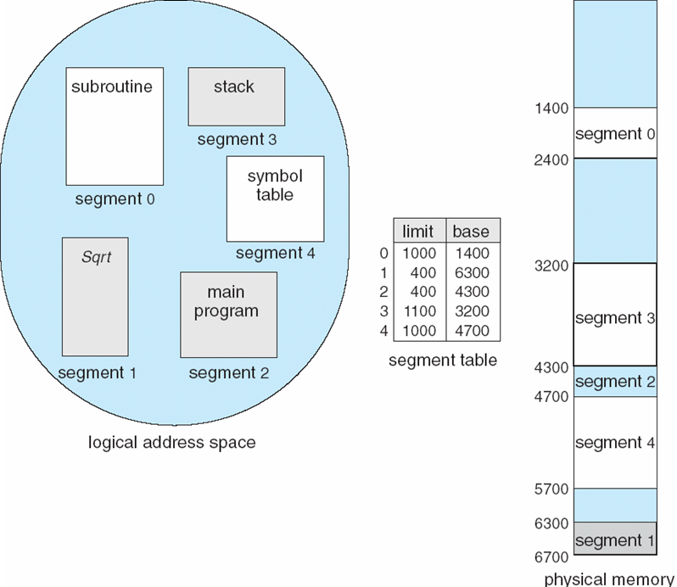
Example of Segmentation

Slide 50
Example: The Intel Pentium
Supports both segmentation and segmentation with paging
CPU generates logical address
Given to segmentation unit
Which produces linear addresses
Linear address given to paging unit
Which generates physical address in main memory
Paging units form equivalent of MMU

Slide 51
Logical to Physical Address Translation in Pentium

Slide 52
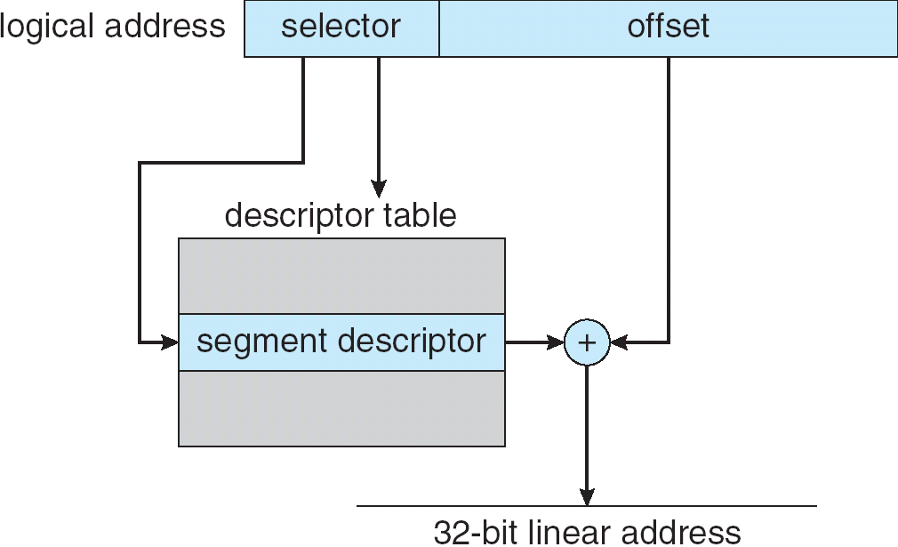
Intel Pentium Segmentation

Slide 53
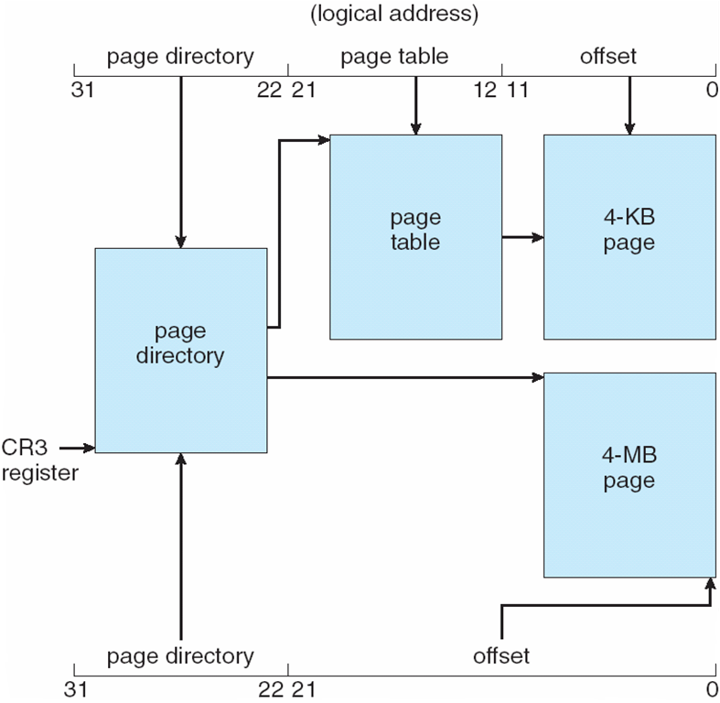
Pentium Paging Architecture

Slide 54
Segmentation and paging on Linux
Segmentation:
Linux only uses segmentation on the Intel x86 architecture
Very limited way
4 segments: user code, user data, kernel code, kernel data
Paging
Three paging levels (up to kernel 2.6.11)
Four paging levels (from 2.6.11)

Slide 55
Linear Address in Linux
Broken into four parts:

Slide 56
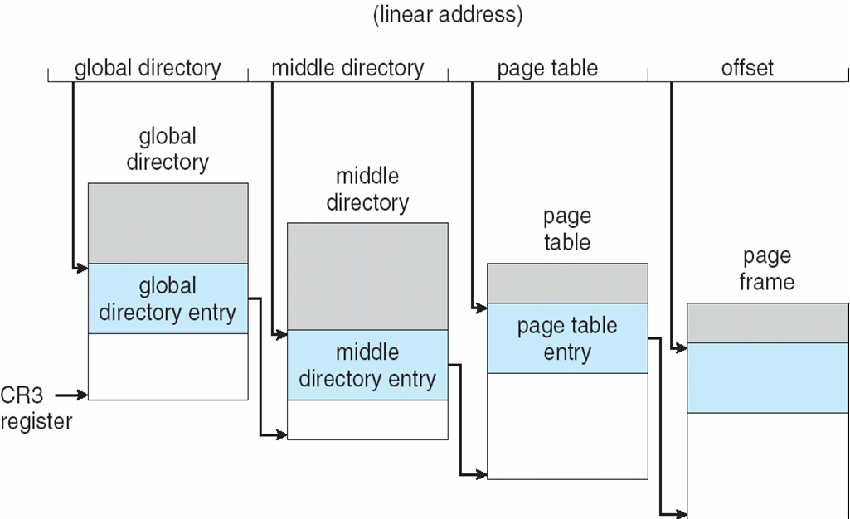
Three-level Paging in Linux

Slide 57
End of Chapter 8

