Slide 1
Chapter 3: Processes

Slide 2
Processes
Program: while it sits on the disk, not executing
When it is executed (or scheduled to be executed)
  In batch systems: jobs
  On time-shared systems: processes, tasks (Linux term)
A process includes:
  Identifier
  Memory:
    Code, data, stack
  Registers:
    Program counter, stack pointer, flags
  Other data:
    State, files, access rights etc.
  Not all the data associated with a process is accessible to the running process itself!!!

Slide 3
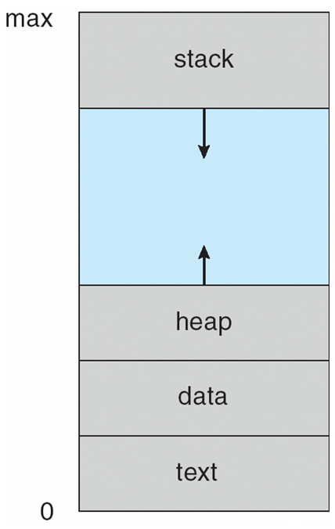
Memory organization of a process

Slide 4
Process State
As a process executes, it changes state
  new: The process is being created
  running: Instructions are being executed
  waiting: The process is waiting for some event to occur
  ready: The process is waiting to be assigned to a processor
  terminated: The process has finished execution

Slide 5
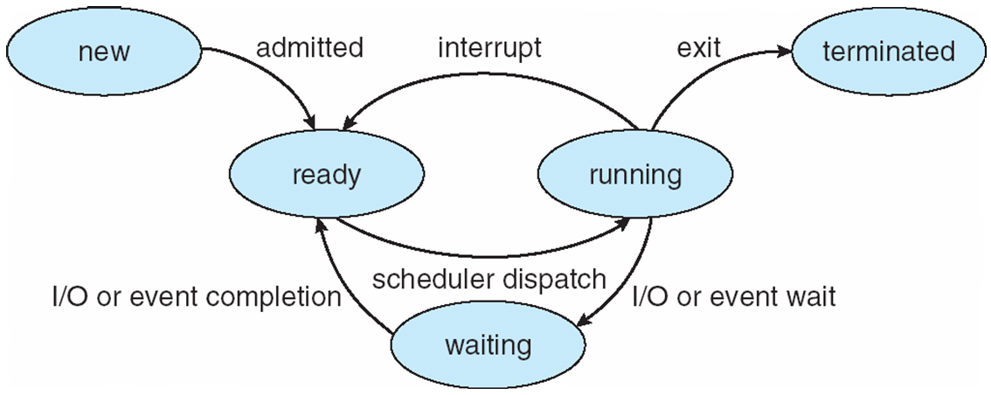
Diagram of Process State

Slide 6
Process Control Block (PCB)
Information associated with each process
Process state
Program counter
CPU registers
CPU scheduling information
Memory-management information
Accounting information
I/O status information

Slide 7
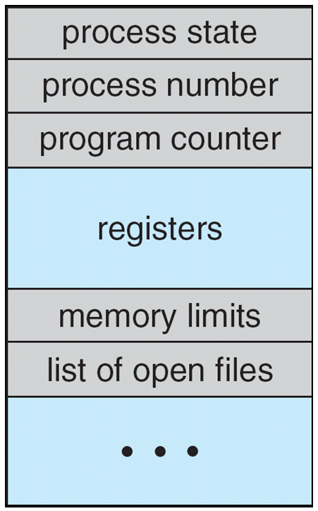
Process Control Block (PCB)

Slide 8
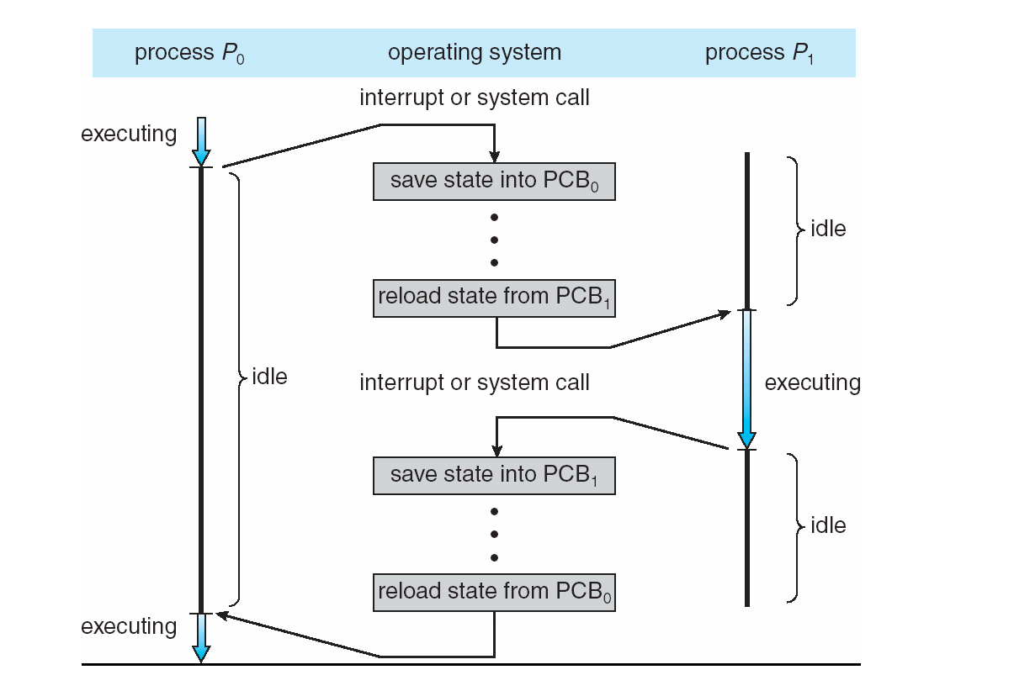
CPU Switch From Process to Process

Slide 9
Process Scheduling Queues
Job queue – set of all processes in the system
Ready queue – set of all processes residing in main memory, ready and waiting to execute
Device queues – set of processes waiting for an I/O device
Processes migrate among the various queues

Slide 10
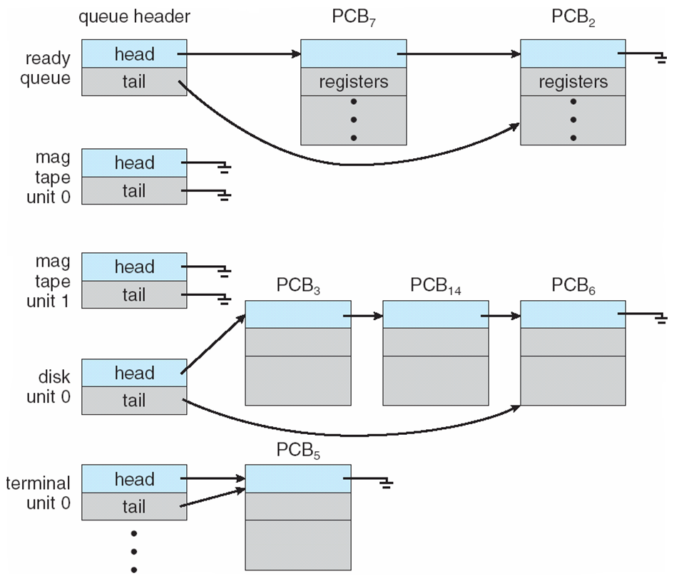
Ready Queue And Various I/O Device Queues

Slide 11
Schedulers
Long-term scheduler (or job scheduler) – selects which processes should be brought into the ready queue
Short-term scheduler (or CPU scheduler) – selects which process should be executed next and allocates CPU

Slide 12
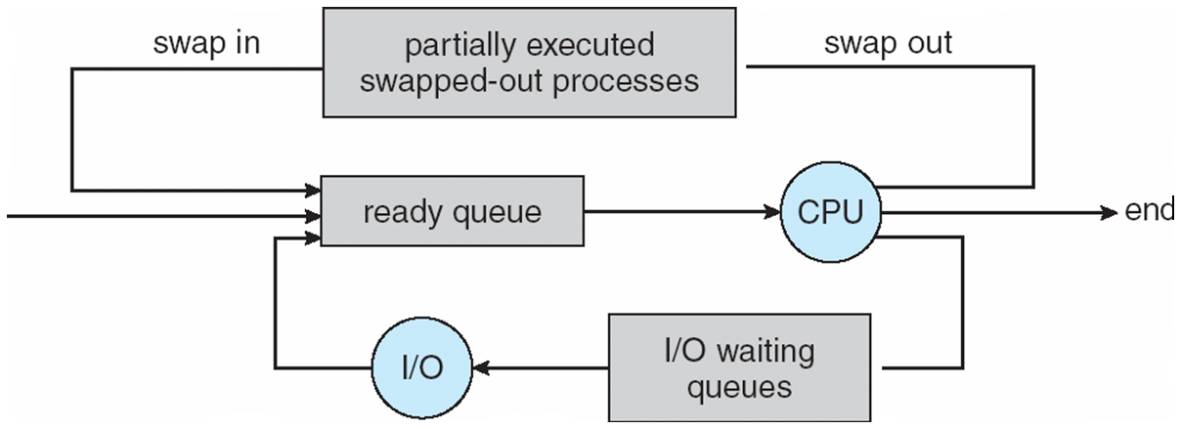
Addition of Medium Term Scheduling

Slide 13
Schedulers (Cont)
Short-term scheduler is invoked very frequently (milliseconds) ⇒ (must be fast)
Long-term scheduler is invoked very infrequently (seconds, minutes) ⇒ (may be slow)
The long-term scheduler controls the degree of multiprogramming
Processes can be described as either:
  I/O-bound process – spends more time doing I/O than computations, many short CPU bursts
  CPU-bound process – spends more time doing computations; few very long CPU bursts

Slide 14
Context Switch
When CPU switches to another process, the system must save the state of the old process and load the saved state for the new process via a context switch
Context of a process represented in the PCB
Context-switch time is overhead; the system does no useful work while switching
Time dependent on hardware support

Slide 15
Process Creation
Parent process create children processes, which, in turn create other processes, forming a tree of processes
Generally, process identified and managed via a process identifier (pid)
Resource sharing
  Parent and children share all resources
  Children share subset of parent’s resources
  Parent and child share no resources
Execution
  Parent and children execute concurrently
  Parent waits until children terminate

Slide 16
Process Creation (Cont)
Address space
  Child duplicate of parent
  Child has a program loaded into it
UNIX examples
  fork system call creates new process
  exec system call used after a fork to replace the process’ memory space with a new program

Slide 17
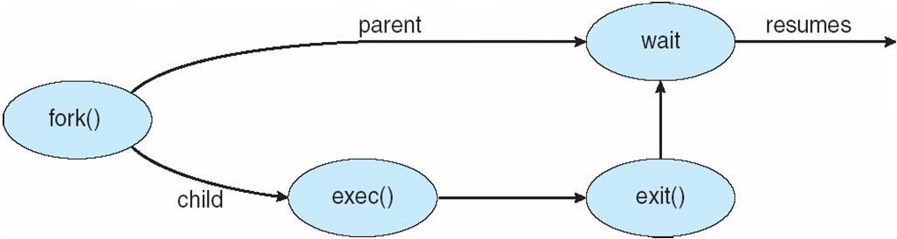
Process Creation

Slide 18
C Program Forking Separate Process
int main()
{
pid_t pid;
/* fork another process */
pid = fork();
if (pid < 0) { /* error occurred */
fprintf(stderr, "Fork Failed");
exit(-1);
}
else if (pid == 0) { /* child process */
execlp("/bin/ls", "ls", NULL);
}
else { /* parent process */
/* parent will wait for the child to complete */
wait (NULL);
printf ("Child Complete");
exit(0);
}
}

Slide 19
Process Termination
Process executes last statement and asks the operating system to delete it (exit)
  Output data from child to parent (via wait)
  Process’ resources are deallocated by operating system
Parent may terminate execution of children processes (abort)
  Child has exceeded allocated resources
  Task assigned to child is no longer required
  If parent is exiting
    Some operating system do not allow child to continue if its parent terminates
      All children terminated - cascading termination

