Slide 1
Chapter 2: Operating-System Structures

Slide 2
System calls and APIs

Slide 3
System Calls and APIs
Programming interface to the services provided by the OS
Typically written in a high-level language (C or C++)
Mostly accessed by programs via a high-level Application Program Interface (API) rather than direct system call use
Three most common APIs are
Win32 API for Windows,
POSIX API for POSIX-based systems (including virtually all versions of UNIX, Linux, and Mac OS X)
Java API for the Java virtual machine (JVM)
Why use APIs rather than system calls?
(Note that the system-call names used throughout this text are generic)

Slide 4
System Call Implementation
Typically, a number associated with each system call
System-call interface maintains a table indexed according to these numbers
The system call interface invokes intended system call in OS kernel and returns status of the system call and any return values
The caller need know nothing about how the system call is implemented
Just needs to obey API and understand what OS will do as a result call
Most details of OS interface hidden from programmer by API
Managed by run-time support library (set of functions built into libraries included with compiler)

Slide 5
Example of system call (DOS)
MOV DI,1000H
MOV AH,01H
LOOP INT 21H
CMP AL,0DH
JE END
MOV [DI],AL
INC DI
JMP LOOP
END
This code reads from the console using system call 01H the characters until the end-of-line character (0D = 10) will be encountered and puts it to the location 1000H.

Slide 6
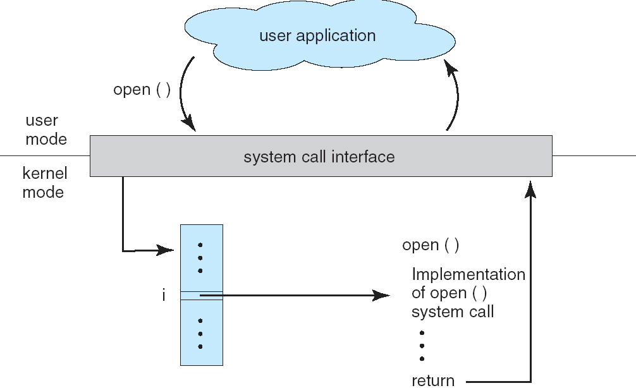
API – System Call – OS Relationship

Slide 7
Example of Standard API
Consider the ReadFile() function in the
Win32 API—a function for reading from a file
A description of the parameters passed to ReadFile()
HANDLE file—the file to be read
LPVOID buffer—a buffer where the data will be read into and written from
DWORD bytesToRead—the number of bytes to be read into the buffer
LPDWORD bytesRead—the number of bytes read during the last read
LPOVERLAPPED ovl—indicates if overlapped I/O is being used

Slide 8
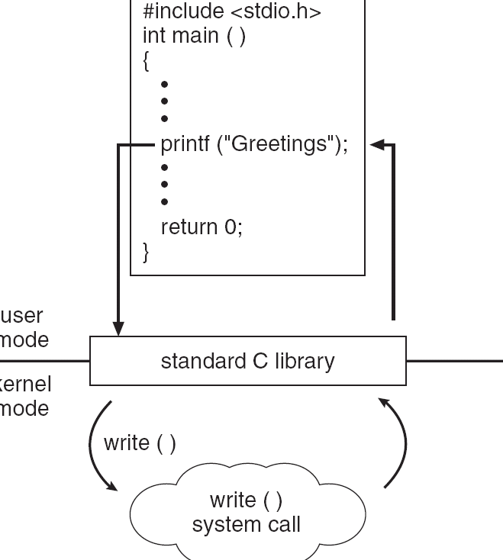
Standard C Library Example
C program invoking printf() library call, which calls write() system call

Slide 9
System Call Parameter Passing
Often, more information is required than simply identity of desired system call
Exact type and amount of information vary according to OS and call
Three general methods used to pass parameters to the OS
Simplest: pass the parameters in registers
In some cases, may be more parameters than registers
Parameters stored in a block, or table, in memory, and address of block passed as a parameter in a register
This approach taken by Linux and Solaris
Parameters placed, or pushed, onto the stack by the program and popped off the stack by the operating system
Block and stack methods do not limit the number or length of parameters being passed

Slide 10
Types of System Calls
Process control
File management
Device management
Information maintenance
Communications
Protection

Slide 11
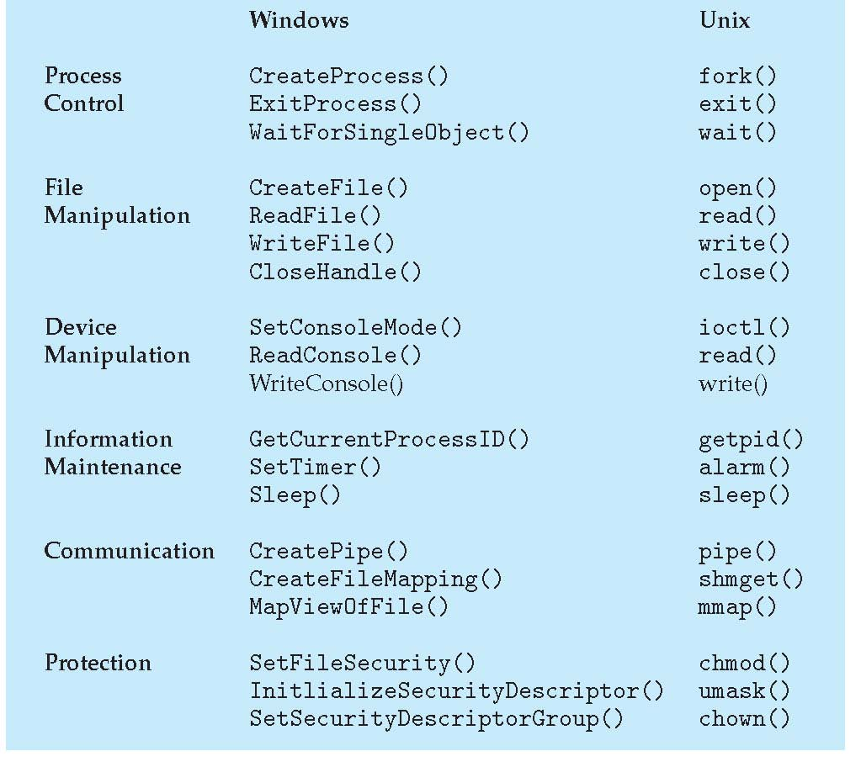
Examples of Windows and Unix System Calls

Slide 12
Kernels + Monolithic vs. microkernel models

Slide 13
Operating-System Operations
Interrupt driven by hardware
Software error or request creates exception or trap
Division by zero, request for operating system service
Other process problems include infinite loop, processes modifying each other or the operating system
Dual-mode operation allows OS to protect itself and other system components
User mode and kernel mode
Mode bit provided by hardware
Provides ability to distinguish when system is running user code or kernel code
Some instructions designated as privileged, only executable in kernel mode
System call changes mode to kernel, return from call resets it to user

Slide 14
Kernel based systems
Kernel-space
Sensitive stuff, controlled only by the OS
Provides the file system, CPU scheduling, memory management, and other operating-system functions;
a large number of functions for one level
An error in the kernel can crash the OS
User-space
Applications programs
Whatever they do, they cannot bring down the OS

Slide 15
Transition from User to Kernel Mode

Slide 16
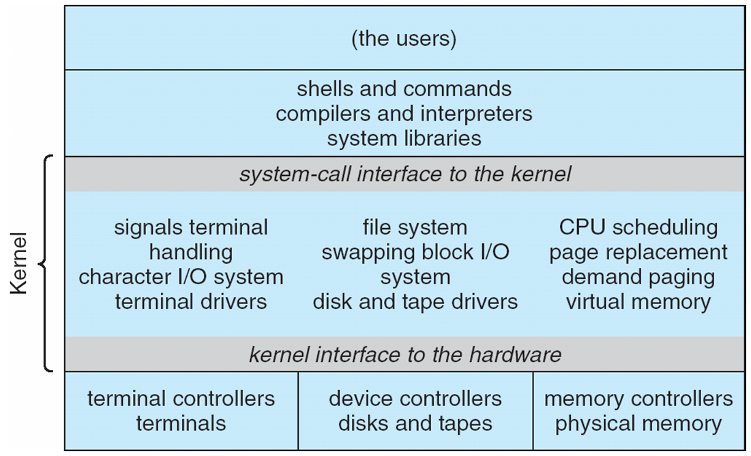
Traditional UNIX System Structure

Slide 17
Monolithic kernel
Idea: make the kernel self sufficient
All the basic functions go into the core OS
All the code that runs in the OS process lies in the same address space.
(Claimed) benefits:
Writing logic is fairly easy.
Code runs faster
Detriments:
Not easy to port the operating system to new architectures
Very fragile

Slide 18
Monolithic kernel vs. microkernel

Slide 19
Microkernels
Idea: make the kernel small
Moves as much from the kernel into “user” space
Communication takes place between user modules using message passing
(Claimed) benefits:
Easier to extend a microkernel
Easier to port the operating system to new architectures
More reliable (less code is running in kernel mode)
More secure
Detriments:
Performance overhead of user space to kernel space communication

Slide 20
Microkernel – the glory and the fall
In the 1990s micro-kernels have been thought as the logical evolution of OS
http://en.wikipedia.org/wiki/Tanenbaum-Torvalds_debate
In practice, they turned out very difficult to program
None of the current OS-s are properly microkernel
Linux: monolithic kernel and proud of it
Windows: “Windows-NT” - a so called hybrid kernel – very small parts outside the kernel
MacOS: “XNU” – also hybrid kernel

Slide 21
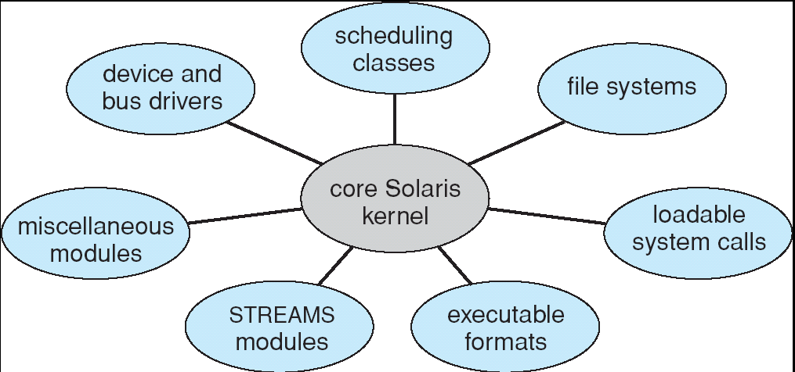
Kernel modules
Most modern operating systems implement kernel modules
Uses object-oriented approach
Each core component is separate
Each talks to the others over known interfaces
Each is loadable as needed within the kernel
Kernel modules are not making an OS microkernel
They run inside the kernel, not outside it
… but obviously achieve some of the same modularity

Slide 22
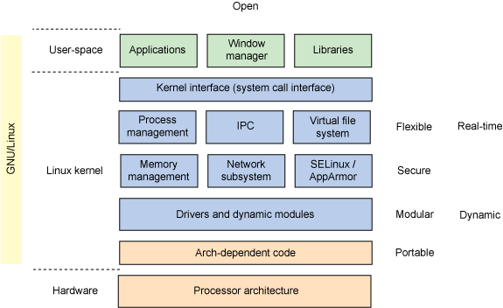
Linux Kernel

Slide 23
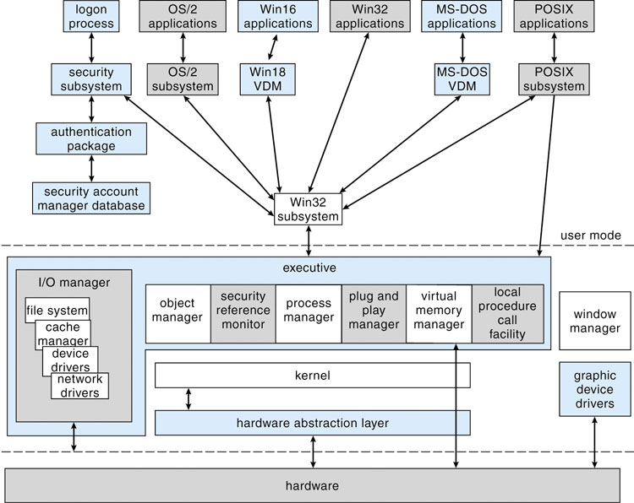
Microsoft Windows Structure

Slide 24
Virtual machines

Slide 25
Virtual Machines
A virtual machine: treats hardware and the operating system kernel as though they were all hardware
A virtual machine provides an interface identical to the underlying bare hardware
The operating system host creates the illusion that a process has its own processor and (virtual memory)
Each guest provided with a (virtual) copy of underlying computer

Slide 26
Virtual Machines History and Benefits
First appeared commercially in IBM mainframes in 1972
Fundamentally, multiple execution environments (different operating systems) can share the same hardware
Protect from each other
Some sharing of file can be permitted, controlled
Commutate with each other, other physical systems via networking
Useful for development, testing
Consolidation of many low-resource use systems onto fewer busier systems
“Open Virtual Machine Format”, standard format of virtual machines, allows a VM to run within many different virtual machine (host) platforms
Took off around 2005 in enterprise environments
VMware
AWS EC2
Openstack

Slide 27
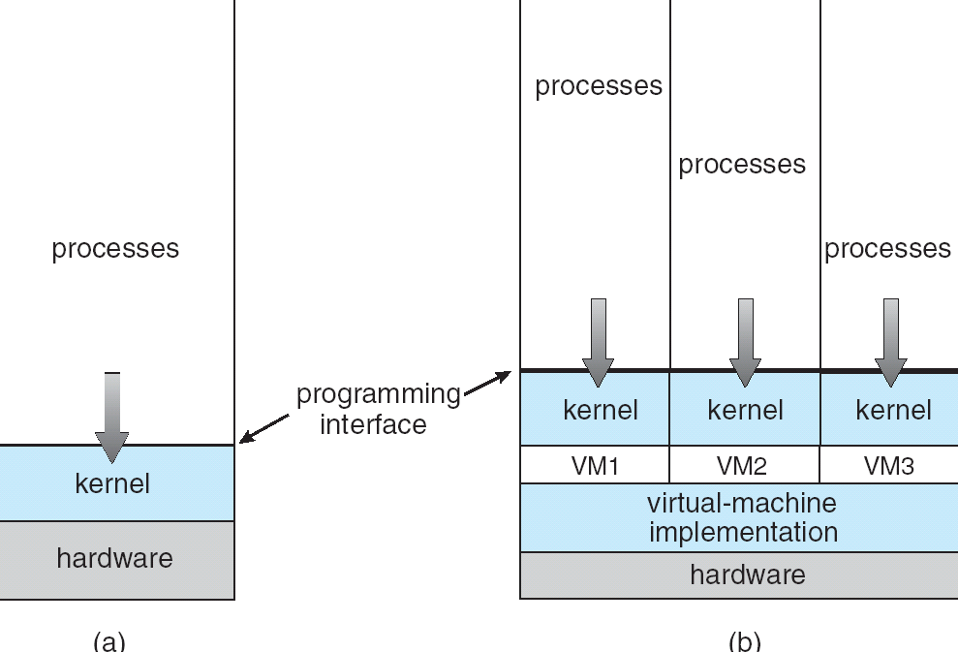
Virtual Machines (Cont)
(a) Non-virtual machine (b) virtual machine
Non-virtual Machine
Virtual Machine

Slide 28
Some virtual machine terminologies
Full virtualization
Simulate enough hardware to allow running an unmodified guest OS
Can even do different hardware
Hardware assisted virtualization
Use the hardware (primarily, the CPU) to help in virtualizing
Eg. KVM, Xen, Parallels Desktop for Mac, Vmware Fusion, Vmware Workstation
Software based virtualization
Virtualization without the help of the hardware. Normally, you cannot do full virtualization.
Eg. VirtualBox
Operating system level virtualization
Linux containers (LXC)
Docker

Slide 29
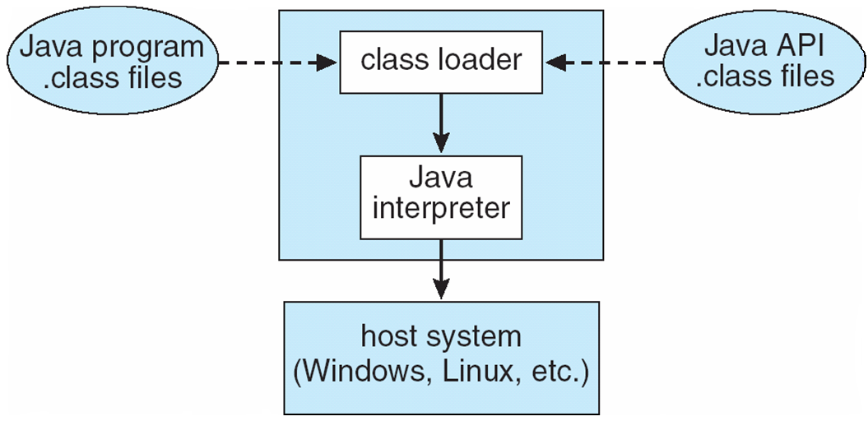
The Java Virtual Machine

