Slide 1
Chapter 1: Introduction

Slide 2
What is an Operating System?
A program that acts as an intermediary between a user of a computer and the computer hardware
Operating system goals:
  Execute user programs and make solving user problems easier
  Make the computer system convenient to use
  Use the computer hardware in an efficient manner

Slide 3
Computer System Structure
Computer system can be divided into four components:
  Hardware – provides basic computing resources
    CPU, memory, I/O devices
  Operating system
    Controls and coordinates use of hardware among various applications and users
  Application programs – define the ways in which the system resources are used to solve the computing problems of the users
    Word processors, compilers, web browsers, database systems, video games
  Users
    People, machines, other computers

Slide 4
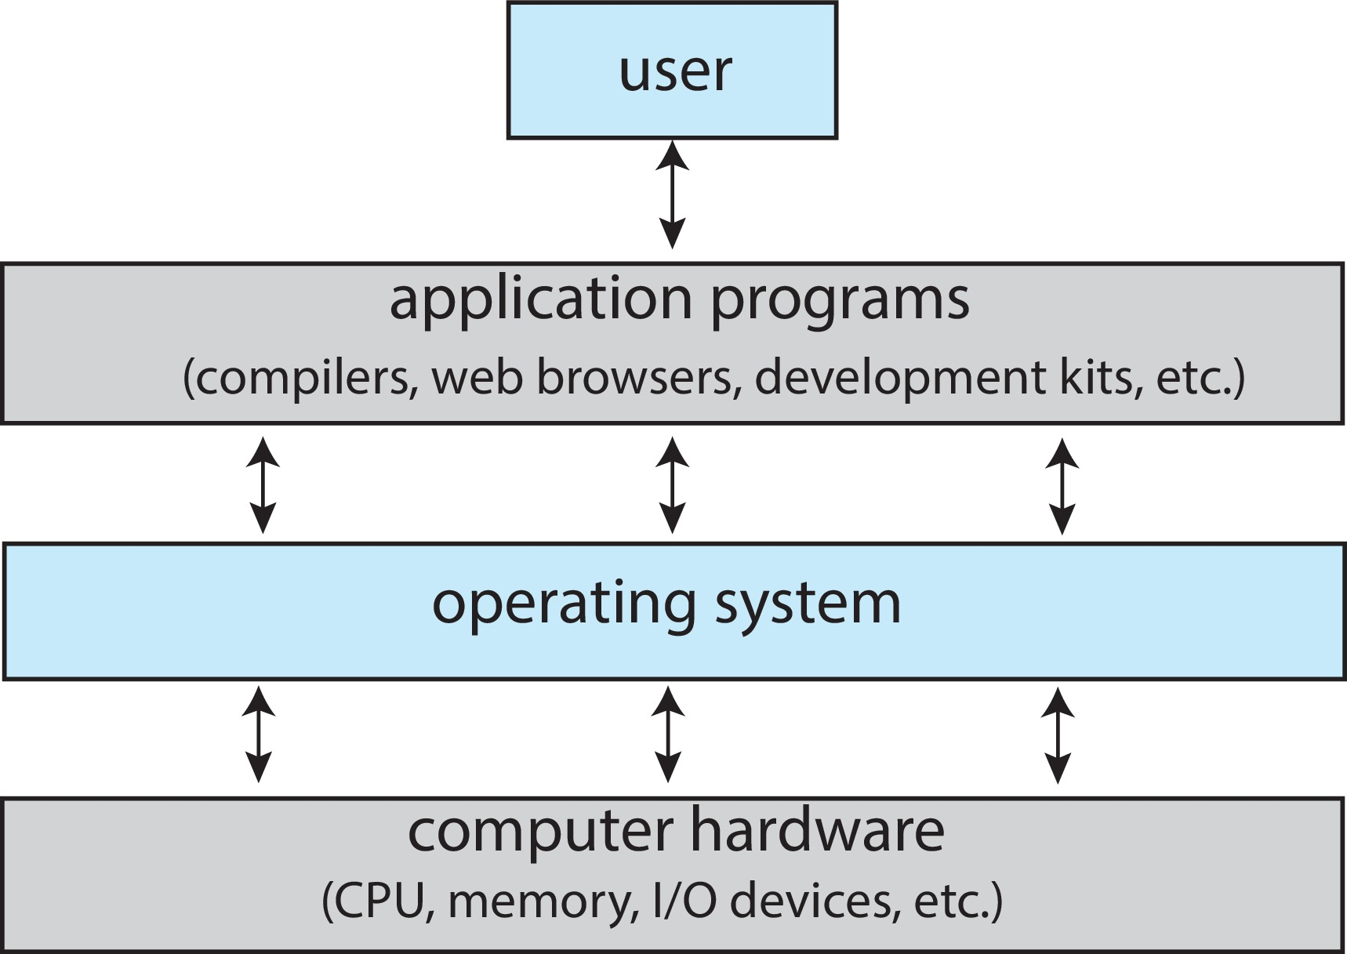
Abstract View of Components of Computer

Slide 5
What Operating Systems Do
Depends on the point of view
Users want convenience, ease of use and good performance
  Don’t care about resource utilization
But shared computer such as mainframe or minicomputer must keep all users happy
  Operating system is a resource allocator and control program making efficient use of HW and managing execution of user programs
Users of dedicate systems such as workstations have dedicated resources but frequently use shared resources from servers
Mobile devices like smartphones and tables are resource poor, optimized for usability and battery life
  Mobile user interfaces such as touch screens, voice recognition
Some computers have little or no user interface, such as embedded computers in devices and automobiles
  Run primarily without user intervention

Slide 6
Operating System Definition
No universally accepted definition
“Everything a vendor ships when you order an operating system” is a good approximation
  But varies wildly
“The one program running at all times on the computer” is the kernel, part of the operating system
Everything else is either
  A system program (ships with the operating system, but not part of the kernel) , or
  An application program, all programs not associated with the operating system
Today’s OSes for general purpose and mobile computing also include middleware – a set of software frameworks that provide addition services to application developers such as databases, multimedia, graphics

Slide 7
  Overview of Computer System Structure

Slide 8
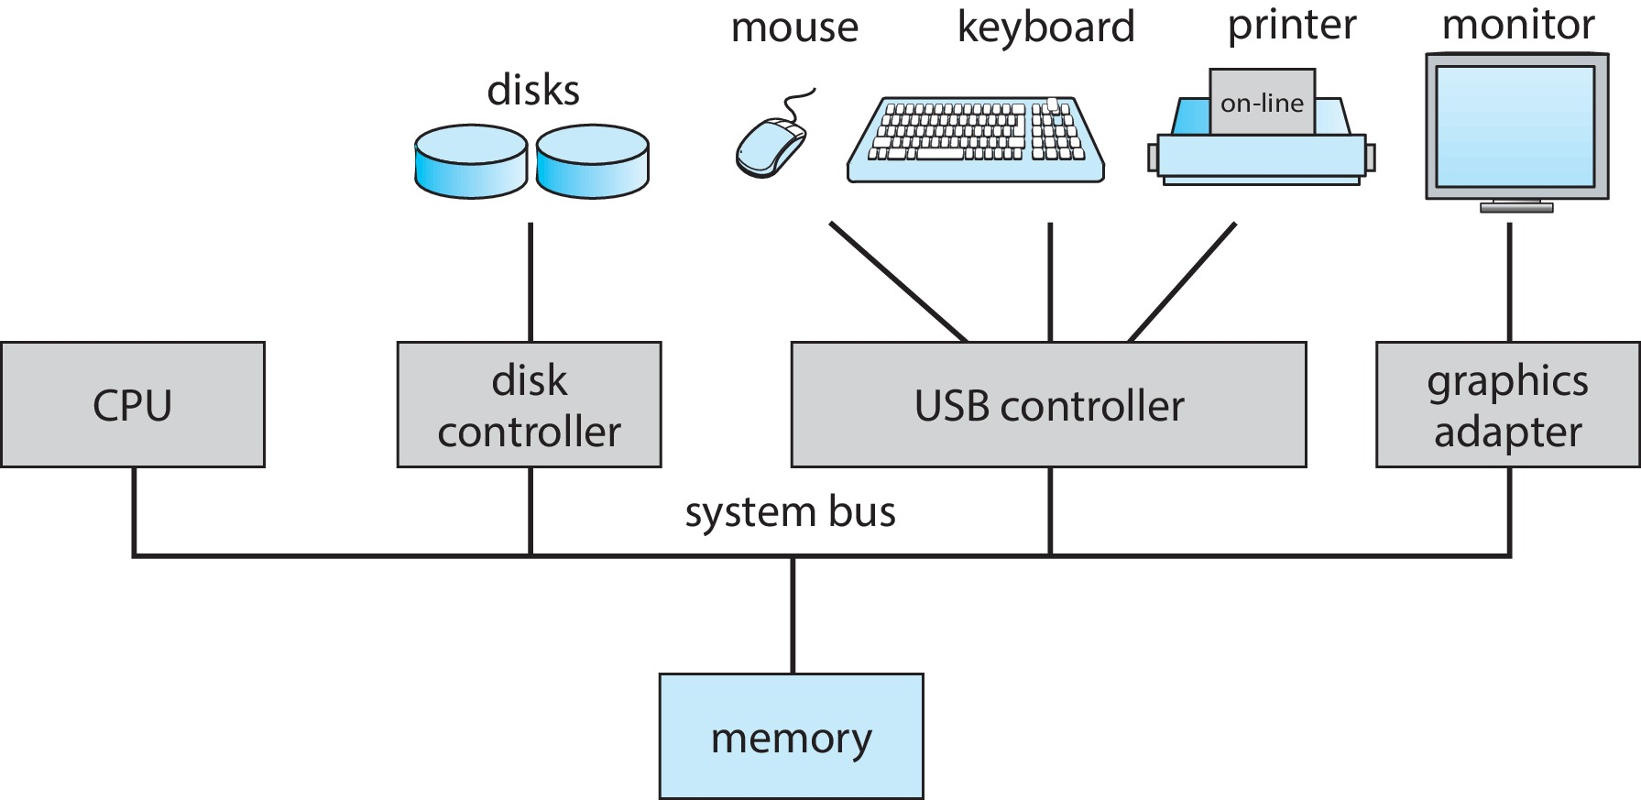
Computer System Organization
Computer-system operation
  One or more CPUs, device controllers connect through common bus providing access to shared memory
  Concurrent execution of CPUs and devices competing for memory cycles

Slide 9
Computer-System Operation
I/O devices and the CPU can execute concurrently
Each device controller is in charge of a particular device type
Each device controller has a local buffer
Each device controller type has an operating system device driver to manage it
CPU moves data from/to main memory to/from local buffers
I/O is from the device to local buffer of controller
Device controller informs CPU that it has finished its operation by causing an interrupt

Slide 10
Common Functions of Interrupts
Interrupt transfers control to the interrupt service routine generally, through the interrupt vector, which contains the addresses of all the service routines
Interrupt architecture must save the address of the interrupted instruction
A trap or exception is a software-generated interrupt caused either by an error or a user request
An operating system is interrupt driven

Slide 11
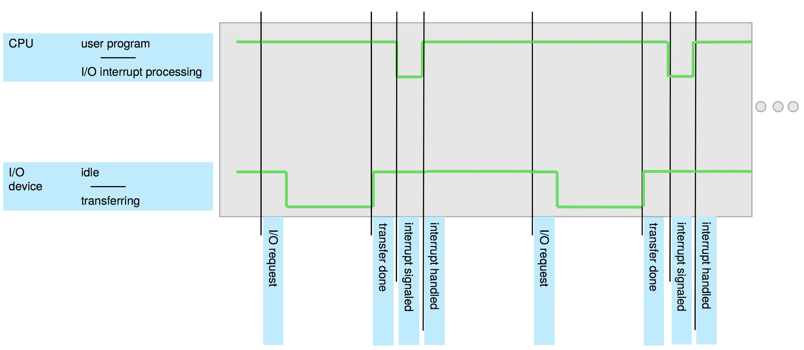
Interrupt Timeline

Slide 12
Interrupt Handling
The operating system preserves the state of the CPU by storing the registers and the program counter
Determines which type of interrupt has occurred:
Separate segments of code determine what action should be taken for each type of interrupt

Slide 13
Interrupt-drive I/O Cycle

Slide 14
I/O Structure
Two methods for handling I/O
  After I/O starts, control returns to user program only upon I/O completion
  After I/O starts, control returns to user program without waiting for I/O completion

Slide 15
I/O Structure (Cont.)
After I/O starts, control returns to user program only upon I/O completion
  Wait instruction idles the CPU until the next interrupt
  Wait loop (contention for memory access)
  At most one I/O request is outstanding at a time, no simultaneous I/O processing
After I/O starts, control returns to user program without waiting for I/O completion
  System call – request to the OS to allow user to wait for I/O completion
  Device-status table contains entry for each I/O device indicating its type, address, and state
  OS indexes into I/O device table to determine device status and to modify table entry to include interrupt

Slide 16
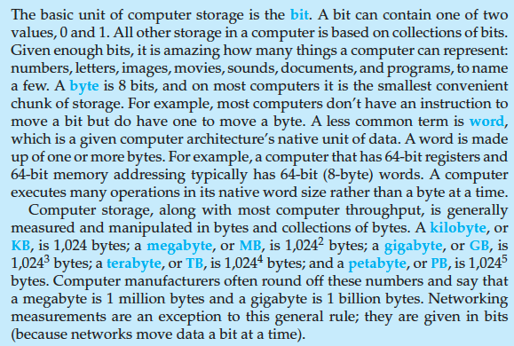
Storage Definitions and Notation Review
The basic unit of computer storage is the bit. A bit can contain one of two
values, 0 and 1. All other storage in a computer is based on collections of bits.
Given enough bits, it is amazing how many things a computer can represent:
numbers, letters, images, movies, sounds, documents, and programs, to name
a few. A byte is 8 bits, and on most computers it is the smallest convenient
chunk of storage. For example, most computers don’t have an instruction to
move a bit but do have one to move a byte. A less common term is word,
which is a given computer architecture’s native unit of data. A word is made
up of one or more bytes. For example, a computer that has 64-bit registers and
64-bit memory addressing typically has 64-bit (8-byte) words. A computer
executes many operations in its native word size rather than a byte at a time.
Computer storage, along with most computer throughput, is generally
measured and manipulated in bytes and collections of bytes. A kilobyte, or
KB , is 1,024 bytes; a megabyte, or MB, is 1,024² bytes; a gigabyte, or GB, is
1,024³ bytes; a terabyte, or TB, is 1,024⁴ bytes; and a petabyte, or PB, is 1,024⁵
bytes. Computer manufacturers often round off these numbers and say that
a megabyte is 1 million bytes and a gigabyte is 1 billion bytes. Networking
measurements are an exception to this general rule; they are given in bits
(because networks move data a bit at a time).

Slide 17
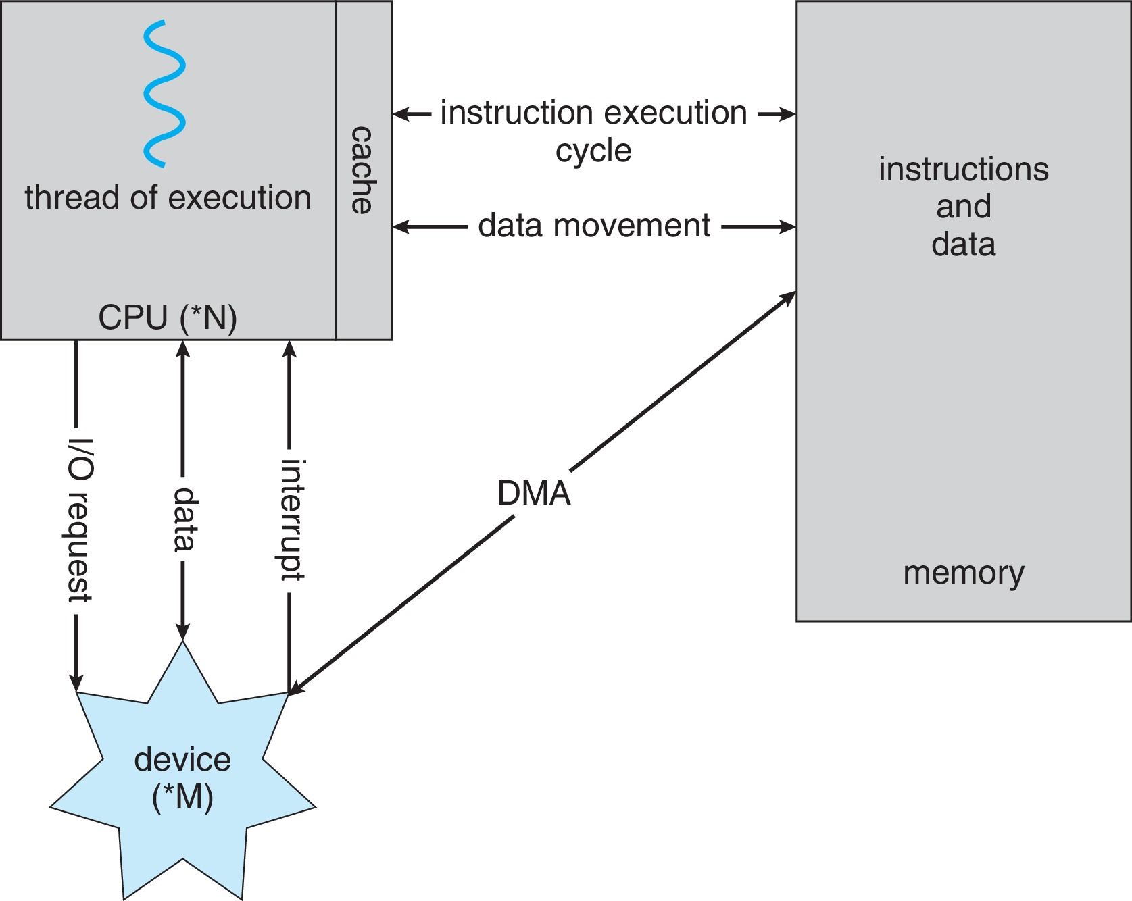
How a Modern Computer Works
A von Neumann architecture

Slide 18
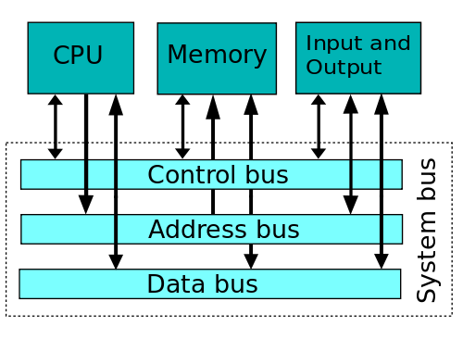
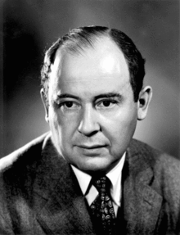
Von Neumann (Princeton) architecture
Von Neumann architecture (or Princeton architecture)
  Processor (or processors)
  One common memory for data and code
  Buses used to access memory and input output
  Direct Memory Access – going from I/O to Memory directly
Majority of modern general purpose GPUs (Intel, AMD, MIPS, most ARM etc)

Slide 19
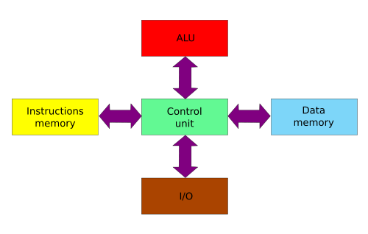
Harvard architecture
Strict separation of Instruction memory, Data memory, ALU and I/O
Advantage: simultaneous access to data and code
Modified Harvard: relax the strict separation requirements
Current applications: Digital Signal Processors (DSP), microcontrollers

Slide 20
Direct Memory Access Structure
Used for high-speed I/O devices able to transmit information at close to memory speeds
Device controller transfers blocks of data from buffer storage directly to main memory without CPU intervention
Only one interrupt is generated per block, rather than the one interrupt per byte

Slide 21
Operating-System Operations
Bootstrap program – simple code to initialize the system, load the kernel
Kernel loads
Starts system daemons (services provided outside of the kernel)
Kernel interrupt driven (hardware and software)
  Hardware interrupt by one of the devices
  Software interrupt (exception or trap):
    Software error (e.g., division by zero)
    Request for operating system service – system call
    Other process problems include infinite loop, processes modifying each other or the operating system

Slide 22
Multiprogramming (Batch system)
Single user cannot always keep CPU and I/O devices busy
Multiprogramming organizes jobs (code and data) so CPU always has one to execute
A subset of total jobs in system is kept in memory
One job selected and run via job scheduling
When job has to wait (for I/O for example), OS switches to another job

Slide 23
Multitasking (Timesharing)
A logical extension of Batch systems– the CPU switches jobs so frequently that users can interact with each job while it is running, creating interactive computing
  Response time should be < 1 second
  Each user has at least one program executing in memory  process
  If several jobs ready to run at the same time  CPU scheduling
  If processes don’t fit in memory, swapping moves them in and out to run
  Virtual memory allows execution of processes not completely in memory

Slide 24
Dual-mode Operation
Dual-mode operation allows OS to protect itself and other system components
  User mode and kernel mode
Mode bit provided by hardware
  Provides ability to distinguish when system is running user code or kernel code.
  When a user is running  mode bit is “user”
  When kernel code is executing  mode bit is “kernel”
How do we guarantee that user does not explicitly set the mode bit to “kernel”?
  System call changes mode to kernel, return from call resets it to user
Some instructions designated as privileged, only executable in kernel mode

Slide 25
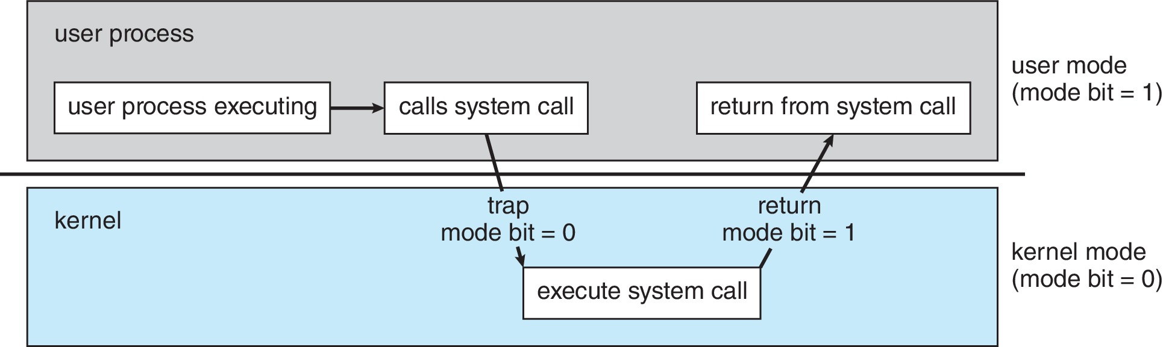
Transition from User to Kernel Mode

Slide 26
Virtualization
Allows operating systems to run applications within other OSes
  Vast and growing industry
Emulation used when source CPU type different from target type (i.e. PowerPC to Intel x86)
  Generally slowest method
  When computer language not compiled to native code – Interpretation
Virtualization – OS natively compiled for CPU, running guest OSes also natively compiled
  Consider VMware running WinXP guests, each running applications, all on native WinXP host OS
  VMM (virtual machine Manager) provides virtualization services

Slide 27
Virtualization (cont.)
Use cases involve laptops and desktops running multiple OSes for exploration or compatibility
  Apple laptop running Mac OS X host, Windows as a guest
  Developing apps for multiple OSes without having multiple systems
  Quality assurance testing applications without having multiple systems
  Executing and managing compute environments within data centers
VMM can run natively, in which case they are also the host
  There is no general-purpose host then (VMware ESX and Citrix XenServer)

Slide 28
Computing Environments - Virtualization

Slide 29
  Computer System Environments

Slide 30
Cloud Computing
Delivers computing, storage, even apps as a service across a network
Logical extension of virtualization because it uses virtualization as the base for it functionality.
  Amazon EC2 has thousands of servers, millions of virtual machines, petabytes of storage available across the Internet, pay based on usage

Slide 31
Cloud Computing (Cont.)
Many types
  Public cloud – available via Internet to anyone willing to pay
  Private cloud – run by a company for the company’s own use
  Hybrid cloud – includes both public and private cloud components
  Software as a Service (SaaS) – one or more applications available via the Internet (i.e., word processor)
  Platform as a Service (PaaS) – software stack ready for application use via the Internet (i.e., a database server)
  Infrastructure as a Service (IaaS) – servers or storage available over Internet (i.e., storage available for backup use)

Slide 32
Cloud Computing (cont.)
Cloud computing environments composed of traditional OSes, plus VMMs, plus cloud management tools
  Internet connectivity requires security like firewalls
  Load balancers spread traffic across multiple applications

Slide 33
Real-Time Embedded Systems
Real-time embedded systems most prevalent form of computers
  Vary considerable, special purpose, limited purpose OS, real-time OS
  Use expanding
Many other special computing environments as well
  Some have OSes, some perform tasks without an OS
Real-time OS has well-defined fixed time constraints
  Processing must be done within constraint
  Correct operation only if constraints met

Slide 34
Free and Open-Source Operating Systems
Operating systems made available in source-code format rather than just binary closed-source and proprietary
Counter to the copy protection and Digital Rights Management (DRM) movement
Started by Free Software Foundation (FSF), which has “copyleft” GNU Public License (GPL)
  Free software and open-source software are two different ideas championed by different groups of people
    http://gnu.org/philosophy/open-source-misses-the-point.html/
Examples include GNU/Linux and BSD UNIX (including core of Mac OS X), and many more
Can use VMM like VMware Player (Free on Windows), Virtualbox (open source and free on many platforms - http://www.virtualbox.com)
  Use to run guest operating systems for exploration

