Slide 1
Chapter 3: Processes

Slide 2
Process Concept
An operating system executes a variety of programs that run as a process.
Process – a program in execution; process execution must progress in sequential fashion. No parallel execution of instructions of a single process
Multiple parts
  The program code, also called text section
  Current activity including program counter, processor registers
  Stack containing temporary data
    Function parameters, return addresses, local variables
  Data section containing global variables
  Heap containing memory dynamically allocated during run time

Slide 3
Process Concept (Cont.)
Program is passive entity stored on disk (executable file); process is active
  Program becomes process when an executable file is loaded into memory
Execution of program started via GUI mouse clicks, command line entry of its name, etc.
One program can be several processes
  Consider multiple users executing the same program

Slide 4
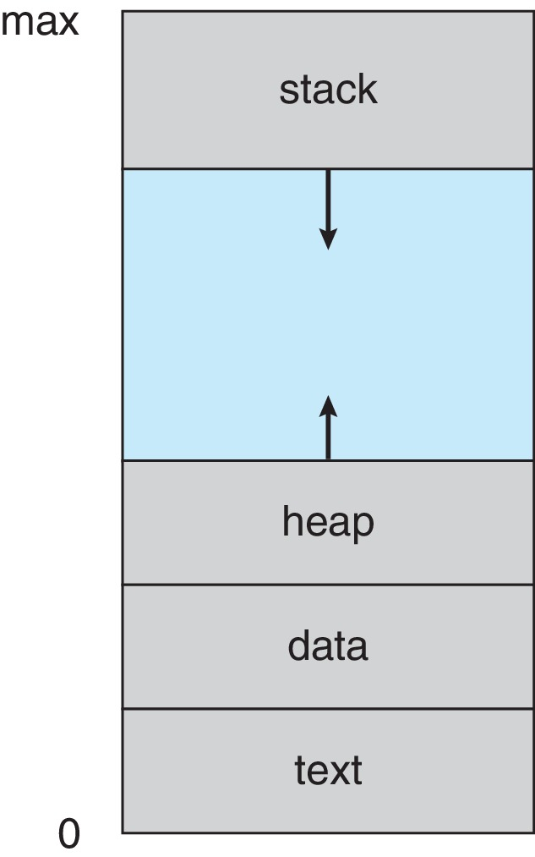
Process in Memory

Slide 5
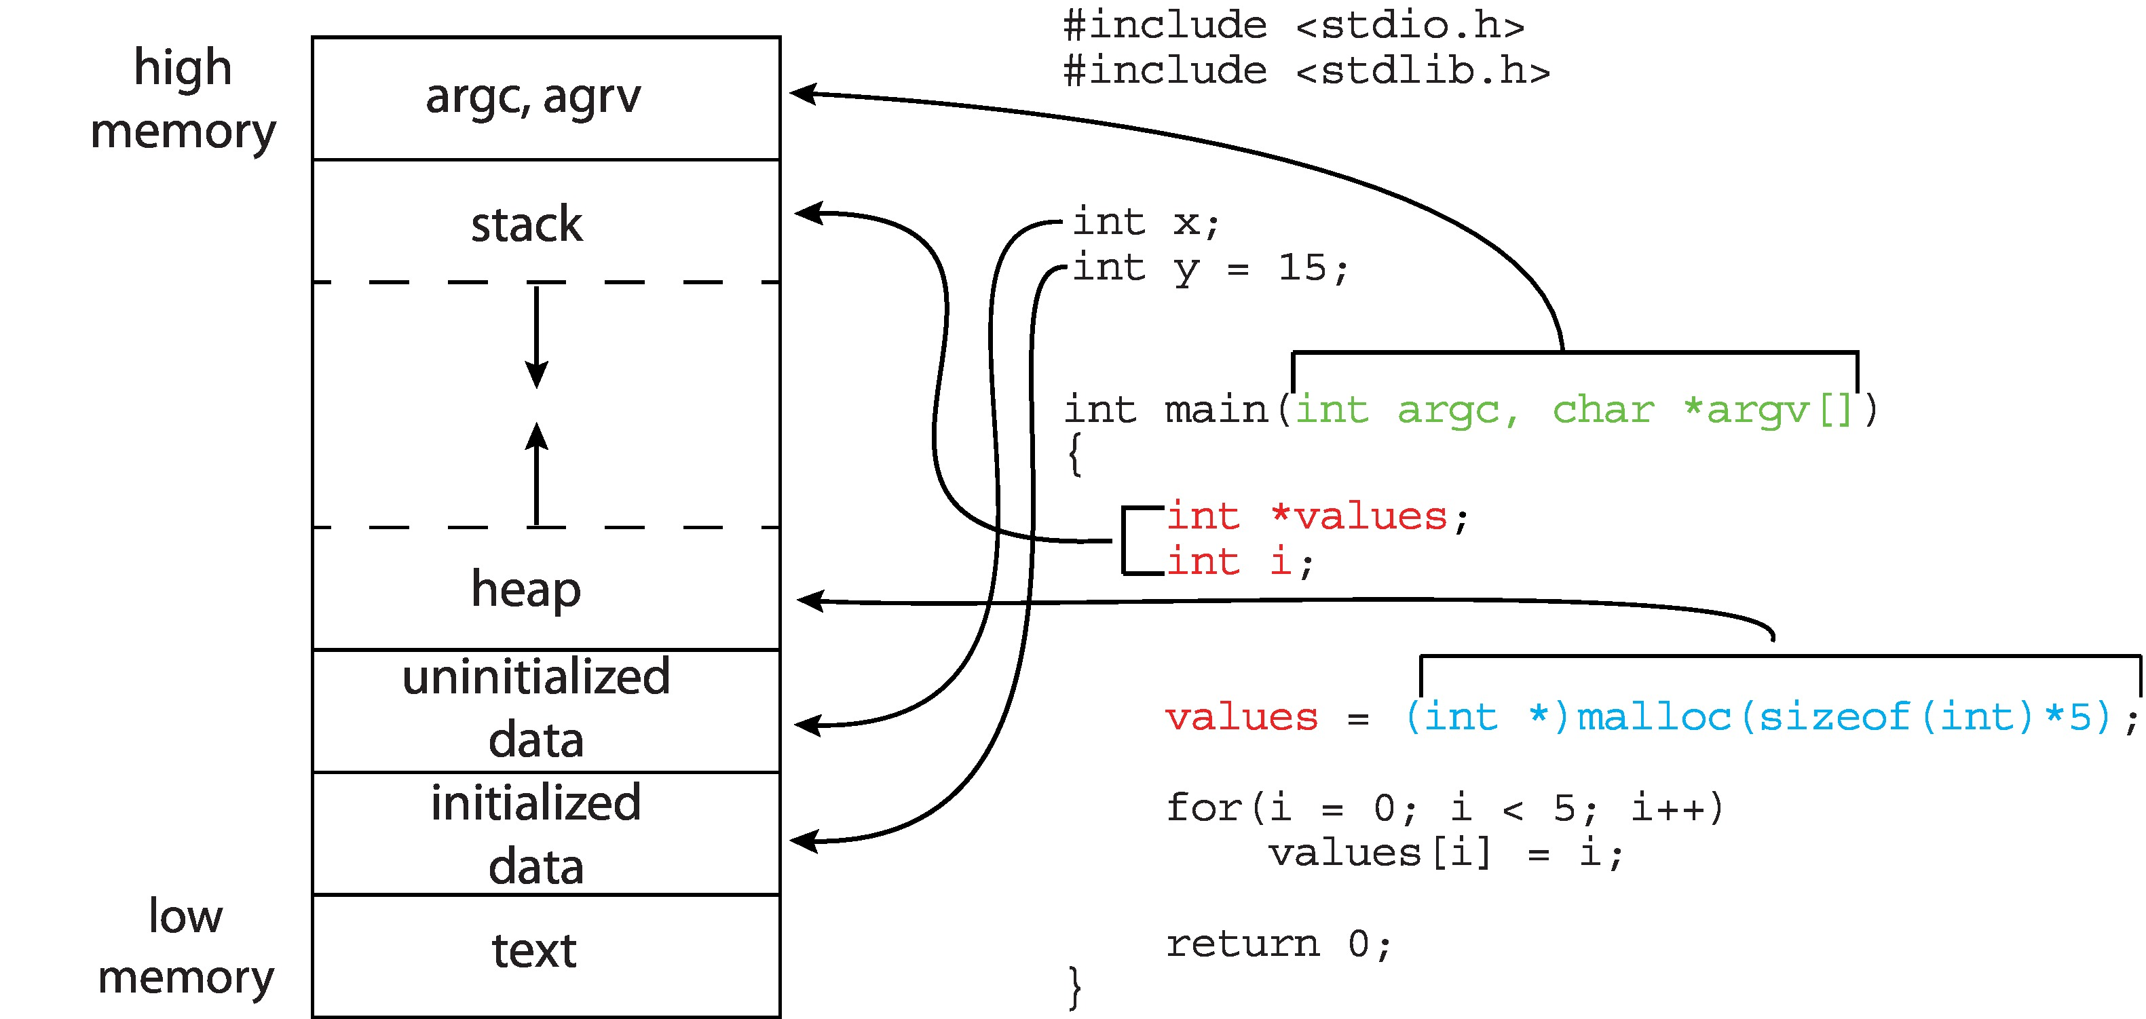
Memory Layout of a C Program

Slide 6
Process State
As a process executes, it changes state
  New: The process is being created
  Running: Instructions are being executed
  Waiting: The process is waiting for some event to occur
  Ready: The process is waiting to be assigned to a processor
  Terminated: The process has finished execution

Slide 7
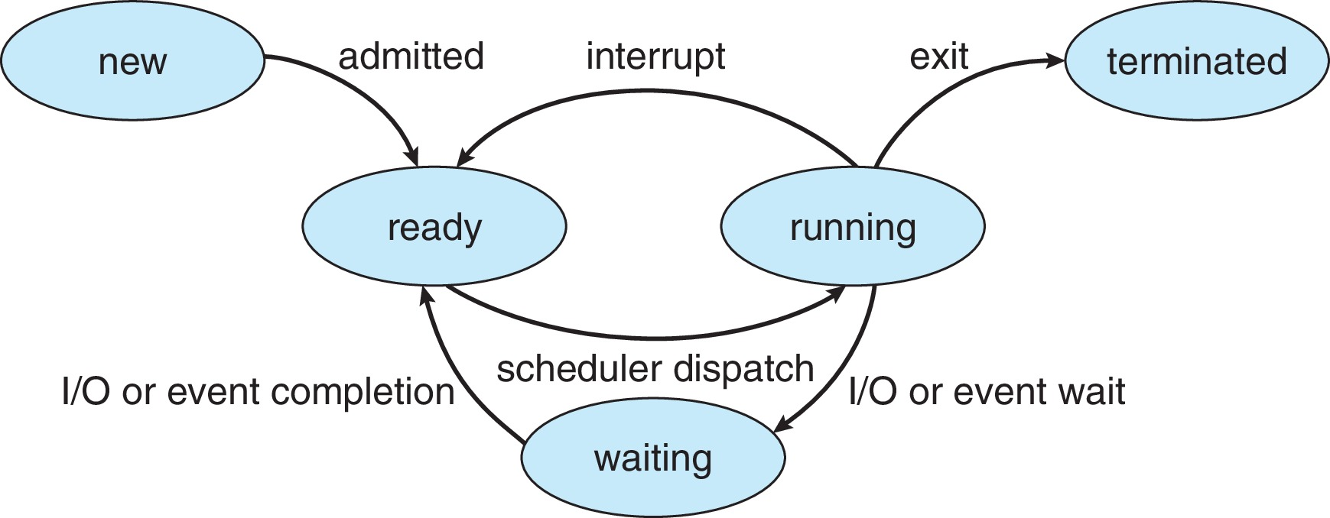
Diagram of Process State

Slide 8
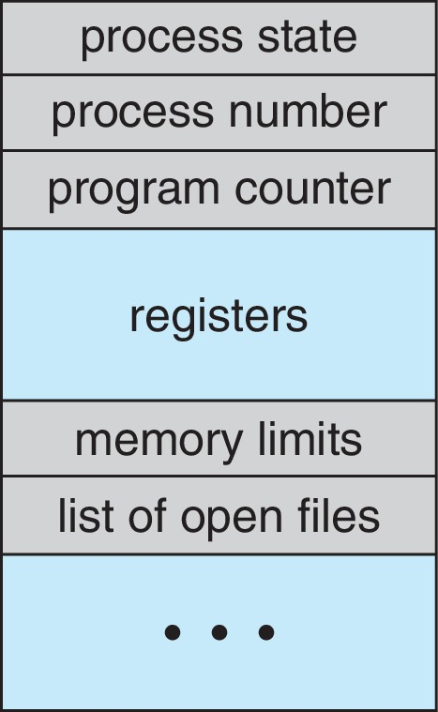
Process Control Block (PCB)
Information associated with each process(also called task control block)
Process state – running, waiting, etc.
Program counter – location of instruction to next execute
CPU registers – contents of all process-centric registers
CPU scheduling information- priorities, scheduling queue pointers
Memory-management information – memory allocated to the process
Accounting information – CPU used, clock time elapsed since start, time limits
I/O status information – I/O devices allocated to process, list of open files

Slide 9
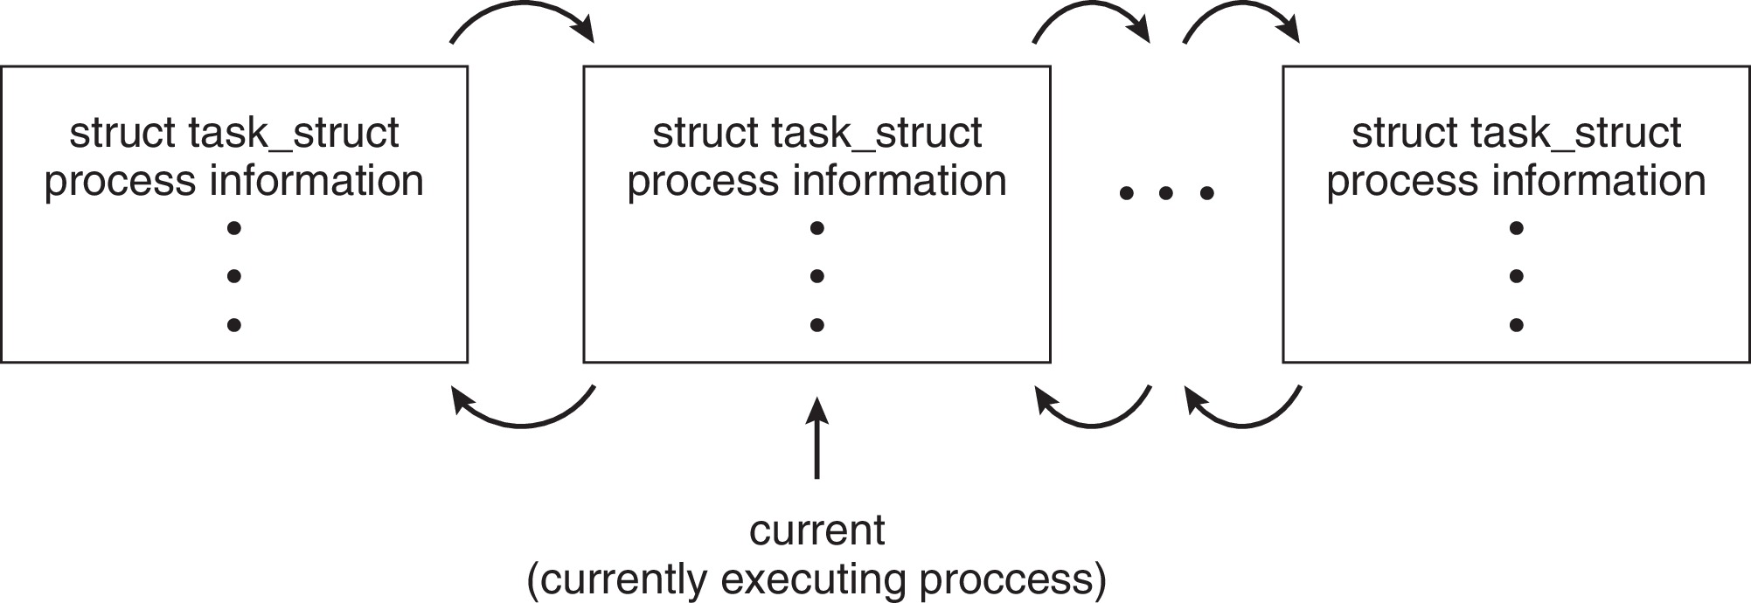
Process Representation in Linux
Represented by the C structure task_struct
pid t_pid; /* process identifier */
long state; /* state of the process */
unsigned int time_slice /* scheduling information */
struct task_struct *parent;/* this process’s parent */
struct list_head children; /* this process’s children */
struct files_struct *files;/* list of open files */
struct mm_struct *mm; /* address space of this process */

Slide 10
Process Scheduling
Process scheduler selects among available processes for next execution on CPU core
Goal -- Maximize CPU use, quickly switch processes onto CPU core
Maintains scheduling queues of processes
  Ready queue – set of all processes residing in main memory, ready and waiting to execute
  Wait queues – set of processes waiting for an event (i.e., I/O)
  Processes migrate among the various queues

Slide 11
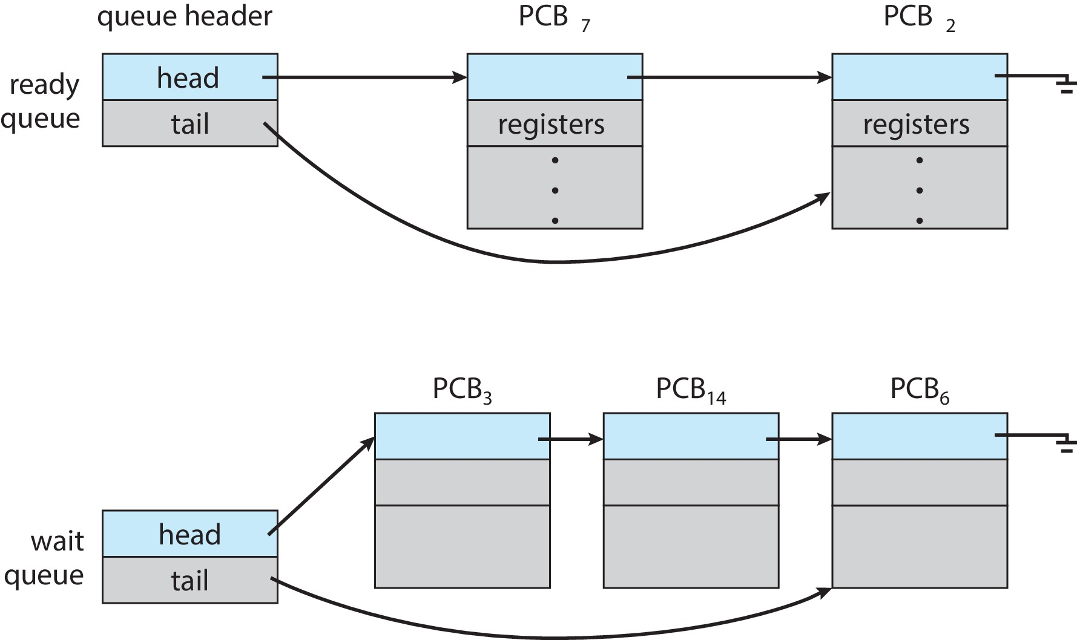
Ready and Wait Queues

Slide 12
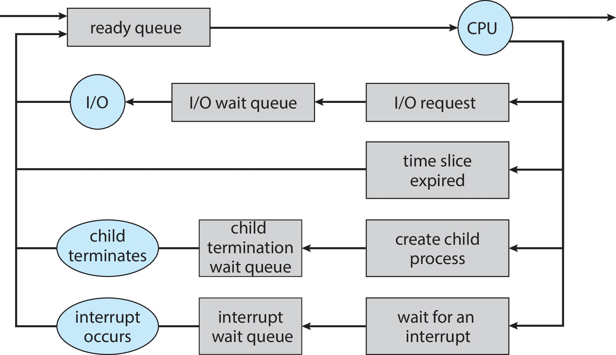
Representation of Process Scheduling

Slide 13
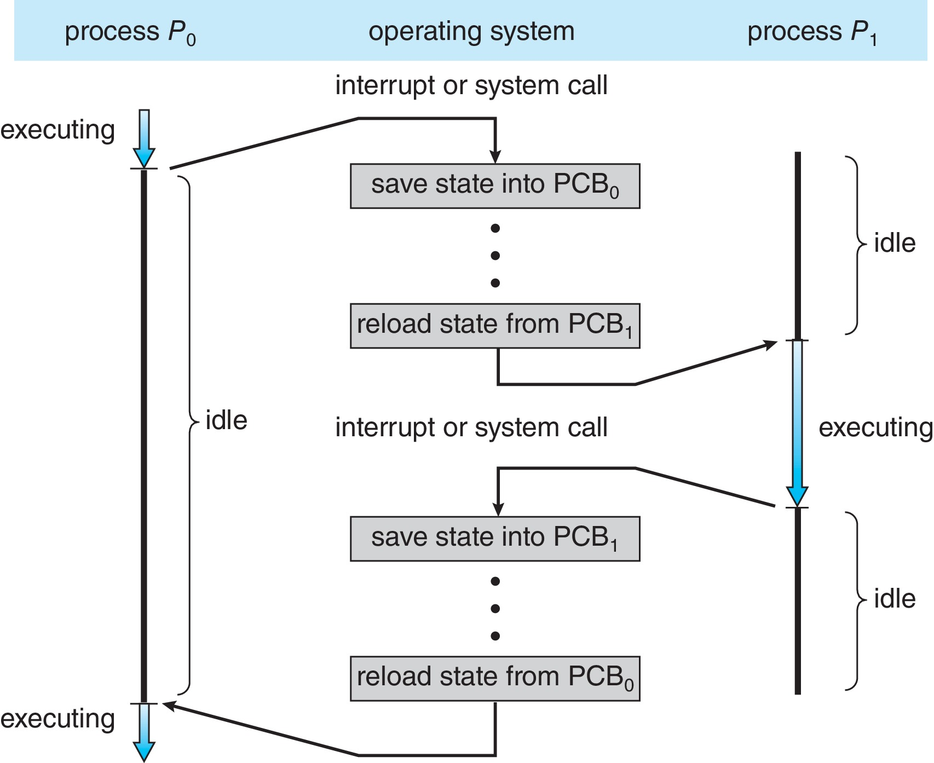
CPU Switch From Process to Process
A context switch occurs when the CPU switches from one process to another.

Slide 14
Context Switch
When CPU switches to another process, the system must save the state of the old process and load the saved state for the new process via a context switch
Context of a process represented in the PCB
Context-switch time is pure overhead; the system does no useful work while switching
  The more complex the OS and the PCB ➔ the longer the context switch
Time dependent on hardware support
  Some hardware provides multiple sets of registers per CPU ➔ multiple contexts loaded at once

Slide 15
Operations on Processes
System must provide mechanisms for:
  Process creation
  Process termination

Slide 16
Process Creation
Parent process create children processes, which, in turn create other processes, forming a tree of processes
Generally, process identified and managed via a process identifier (pid)
Resource sharing options
  Parent and children share all resources
  Children share subset of parent’s resources
  Parent and child share no resources
Execution options
  Parent and children execute concurrently
  Parent waits until children terminate

Slide 17
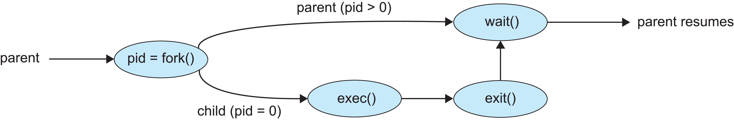
Process Creation (Cont.)
Address space
  Child duplicate of parent
  Child has a program loaded into it
UNIX examples
  fork() system call creates new process
  exec() system call used after a fork() to replace the process’ memory space with a new program
  Parent process calls wait()waiting for the child to terminate

Slide 18
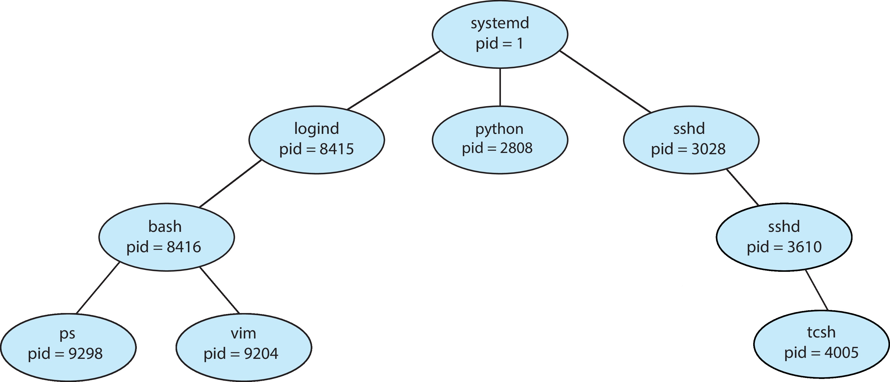
A Tree of Processes in Linux

Slide 19
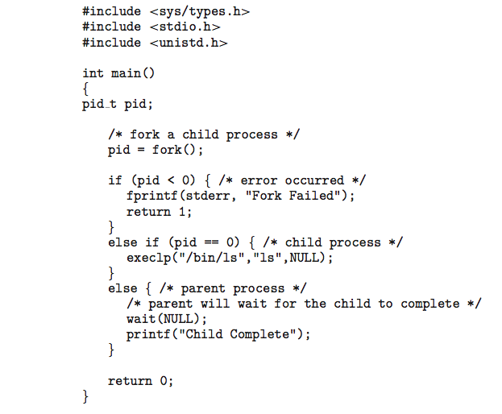
C Program Forking Separate Process

Slide 20
Process Termination
Process executes last statement and then asks the operating system to delete it using the exit() system call.
  Returns status data from child to parent (via wait())
  Process’ resources are deallocated by operating system
Parent may terminate the execution of children processes using the abort() system call. Some reasons for doing so:
  Child has exceeded allocated resources
  Task assigned to child is no longer required
  The parent is exiting, and the operating systems does not allow a child to continue if its parent terminates

Slide 21
Process Termination
Some operating systems do not allow child to exists if its parent has terminated. If a process terminates, then all its children must also be terminated.
  cascading termination. All children, grandchildren, etc., are terminated.
  The termination is initiated by the operating system.
The parent process may wait for termination of a child process by using the wait()system call. The call returns status information and the pid of the terminated process
pid = wait(&status);
If no parent waiting (did not invoke wait()) process is a zombie
If parent terminated without invoking wait(), process is an orphan

Slide 22
Interprocess Communication
Processes within a system may be independent or cooperating
Cooperating process can affect or be affected by other processes, including sharing data
Reasons for cooperating processes:
  Information sharing
  Computation speedup
  Modularity
  Convenience
Cooperating processes need interprocess communication (IPC)
Two models of IPC
  Shared memory
  Message passing

Slide 23
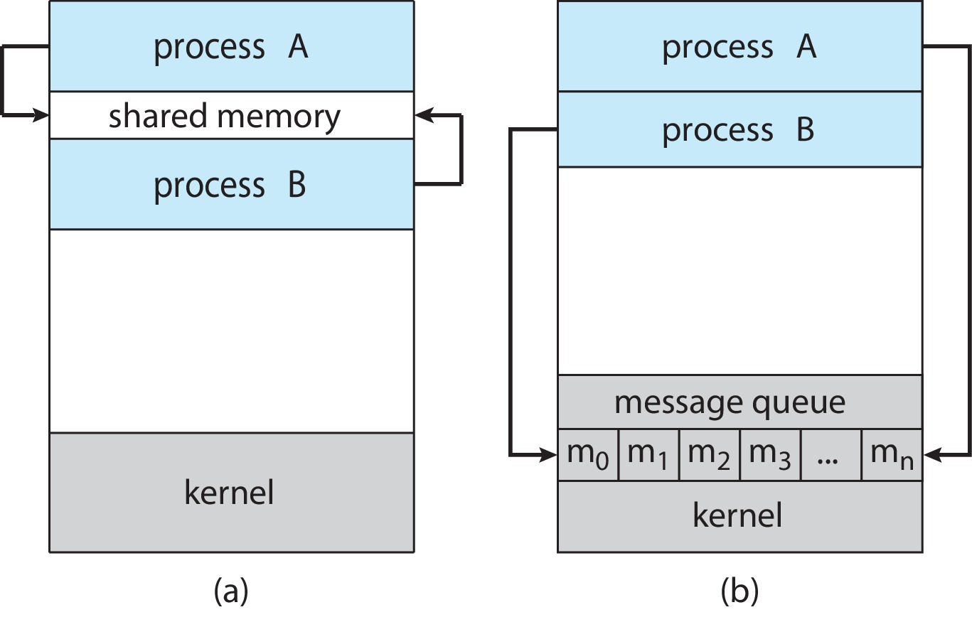
Communications Models
(a) Shared memory. (b) Message passing.

Slide 24
Producer-Consumer Problem
Paradigm for cooperating processes:
  producer process produces information that is consumed by a consumer process
Two variations:
  unbounded-buffer places no practical limit on the size of the buffer:
    Producer never waits
    Consumer waits if there is no buffer to consume
  bounded-buffer assumes that there is a fixed buffer size
    Producer must wait if all buffers are full
    Consumer waits if there is no buffer to consume

Slide 25
IPC – Shared Memory
An area of memory shared among the processes that wish to communicate
The communication is under the control of the users processes not the operating system.
Major issues is to provide mechanism that will allow the user processes to synchronize their actions when they access shared memory.
Synchronization is discussed in great details in Chapters 6 & 7.

Slide 26
Bounded-Buffer – Shared-Memory Solution
Shared data
      #define BUFFER_SIZE 10
      typedef struct {
      . . .
      } item;
      item buffer[BUFFER_SIZE];
      int in = 0;
      int out = 0;
Solution is correct, but can only use BUFFER_SIZE-1 elements

Slide 27
Producer Process – Shared Memory
item next_produced;
while (true) {
/* produce an item in next produced */
while (((in + 1) % BUFFER_SIZE) == out)
; /* do nothing */
buffer[in] = next_produced;
in = (in + 1) % BUFFER_SIZE;
}

Slide 28
Consumer Process – Shared Memory
item next_consumed;
while (true) {
while (in == out)
; /* do nothing */
next_consumed = buffer[out];
out = (out + 1) % BUFFER_SIZE;
/* consume the item in next consumed */
}

Slide 29
What about Filling all the Buffers?
Suppose that we wanted to provide a solution to the consumer-producer problem that fills all the buffers.
We can do so by having an integer counter that keeps track of the number of full buffers.
Initially, counter is set to 0.
The integer counter is incremented by the producer after it produces a new buffer.
The integer counter is and is decremented by the consumer after it consumes a buffer.

Slide 30
Producer
while (true) {
/* produce an item in next produced */
while (counter == BUFFER_SIZE)
; /* do nothing */
buffer[in] = next_produced;
in = (in + 1) % BUFFER_SIZE;
counter++;
}

Slide 31
Consumer
while (true) {
while (counter == 0)
; /* do nothing */
next_consumed = buffer[out];
out = (out + 1) % BUFFER_SIZE;
counter--;
/* consume the item in next consumed */
}

Slide 32
Race Condition
counter++ could be implemented as
register1 = counter
register1 = register1 + 1
counter = register1
counter-- could be implemented as
register2 = counter
register2 = register2 - 1
counter = register2
Consider this execution interleaving with “count = 5” initially:
  S0: producer execute register1 = counter {register1 = 5}
  S1: producer execute register1 = register1 + 1 {register1 = 6}
  S2: consumer execute register2 = counter {register2 = 5}
  S3: consumer execute register2 = register2 – 1 {register2 = 4}
  S4: producer execute counter = register1 {counter = 6 }
  S5: consumer execute counter = register2 {counter = 4}

Slide 33
Race Condition (Cont.)
Question – why was there no race condition in the first solution (where at most N – 1) buffers can be filled?
More in Chapter 6.

Slide 34
IPC – Message Passing
Processes communicate with each other without resorting to shared variables
IPC facility provides two operations:
  send(message)
  receive(message)
The message size is either fixed or variable

Slide 35
Message Passing (Cont.)
If processes P and Q wish to communicate, they need to:
  Establish a communication link between them
  Exchange messages via send/receive
Implementation issues:
  How are links established?
  Can a link be associated with more than two processes?
  How many links can there be between every pair of communicating processes?
  What is the capacity of a link?
  Is the size of a message that the link can accommodate fixed or variable?
  Is a link unidirectional or bi-directional?

Slide 36
Implementation of Communication Link
Physical:
  Shared memory
  Hardware bus
  Network
Logical:
  Direct or indirect
  Synchronous or asynchronous
  Automatic or explicit buffering

Slide 37
Direct Communication
Processes must name each other explicitly:
  send (P, message) – send a message to process P
  receive(Q, message) – receive a message from process Q
Properties of communication link
  Links are established automatically
  A link is associated with exactly one pair of communicating processes
  Between each pair there exists exactly one link
  The link may be unidirectional, but is usually bi-directional

Slide 38
Indirect Communication
Messages are directed and received from mailboxes (also referred to as ports)
  Each mailbox has a unique id
  Processes can communicate only if they share a mailbox
Properties of communication link
  Link established only if processes share a common mailbox
  A link may be associated with many processes
  Each pair of processes may share several communication links
  Link may be unidirectional or bi-directional

Slide 39
Indirect Communication (Cont.)
Operations
  Create a new mailbox (port)
  Send and receive messages through mailbox
  Delete a mailbox
Primitives are defined as:
  send(A, message) – send a message to mailbox A
  receive(A, message) – receive a message from mailbox A

Slide 40
Indirect Communication (Cont.)
Mailbox sharing
  P₁, P₂, and P₃ share mailbox A
  P₁, sends; P₂ and P₃ receive
  Who gets the message?
Solutions
  Allow a link to be associated with at most two processes
  Allow only one process at a time to execute a receive operation
  Allow the system to select arbitrarily the receiver. Sender is notified who the receiver was.

Slide 41
Synchronization
Message passing may be either blocking or non-blocking
Blocking is considered synchronous
  Blocking send -- the sender is blocked until the message is received
  Blocking receive -- the receiver is blocked until a message is available
Non-blocking is considered asynchronous
  Non-blocking send -- the sender sends the message and continue
  Non-blocking receive -- the receiver receives:
    A valid message, or
    Null message
Different combinations possible
  If both send and receive are blocking, we have a rendezvous

Slide 42
Producer-Consumer: Message Passing
Producer
message next_produced;
while (true) {
/* produce an item in next_produced */
send(next_produced);
}
Consumer
message next_consumed;
while (true) {
receive(next_consumed)
/* consume the item in next_consumed */
}

Slide 43
Buffering
Queue of messages attached to the link.
Implemented in one of three ways
  1. Zero capacity – no messages are queued on a link.
  Sender must wait for receiver (rendezvous)
  2. Bounded capacity – finite length of n messages
  Sender must wait if link full
  3. Unbounded capacity – infinite length
  Sender never waits

Slide 44
Pipes
Acts as a conduit allowing two processes to communicate
Issues:
  Is communication unidirectional or bidirectional?
  In the case of two-way communication, is it half or full-duplex?
  Must there exist a relationship (i.e., parent-child) between the communicating processes?
  Can the pipes be used over a network?
Ordinary pipes – cannot be accessed from outside the process that created it. Typically, a parent process creates a pipe and uses it to communicate with a child process that it created.
Named pipes – can be accessed without a parent-child relationship.

Slide 45
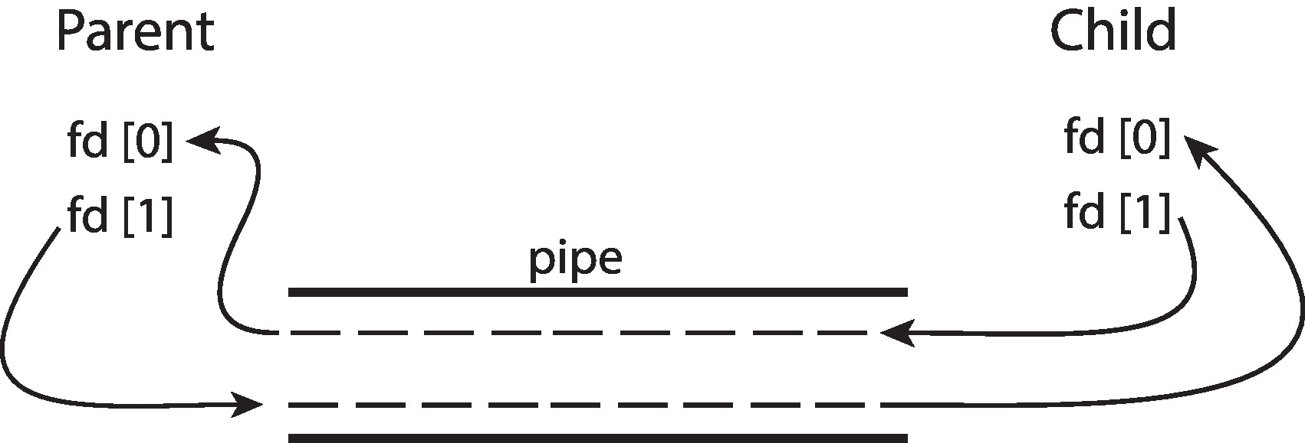
Ordinary Pipes
Ordinary Pipes allow communication in standard producer-consumer style
Producer writes to one end (the write-end of the pipe)
Consumer reads from the other end (the read-end of the pipe)
Ordinary pipes are therefore unidirectional
Require parent-child relationship between communicating processes
Windows calls these anonymous pipes

Slide 46
Named Pipes
Named Pipes are more powerful than ordinary pipes
Communication is bidirectional
No parent-child relationship is necessary between the communicating processes
Several processes can use the named pipe for communication
Provided on both UNIX and Windows systems

Slide 47
Communications in Client-Server Systems
Sockets
Remote Procedure Calls

Slide 48
Sockets
A socket is defined as an endpoint for communication
Concatenation of IP address and port – a number included at start of message packet to differentiate network services on a host
The socket 161.25.19.8:1625 refers to port 1625 on host 161.25.19.8
Communication consists between a pair of sockets
All ports below 1024 are well known, used for standard services
Special IP address 127.0.0.1 (loopback) to refer to system on which process is running

Slide 49
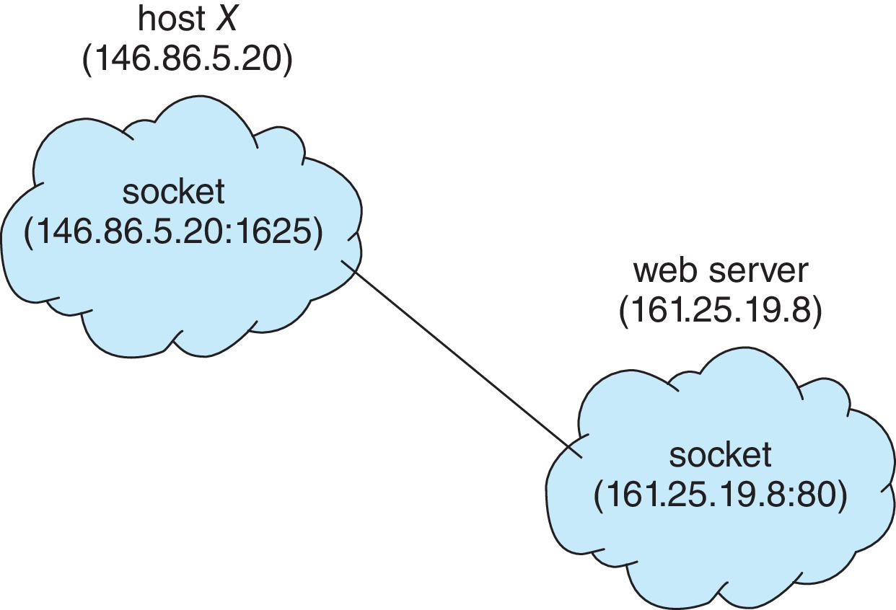
Socket Communication

Slide 50
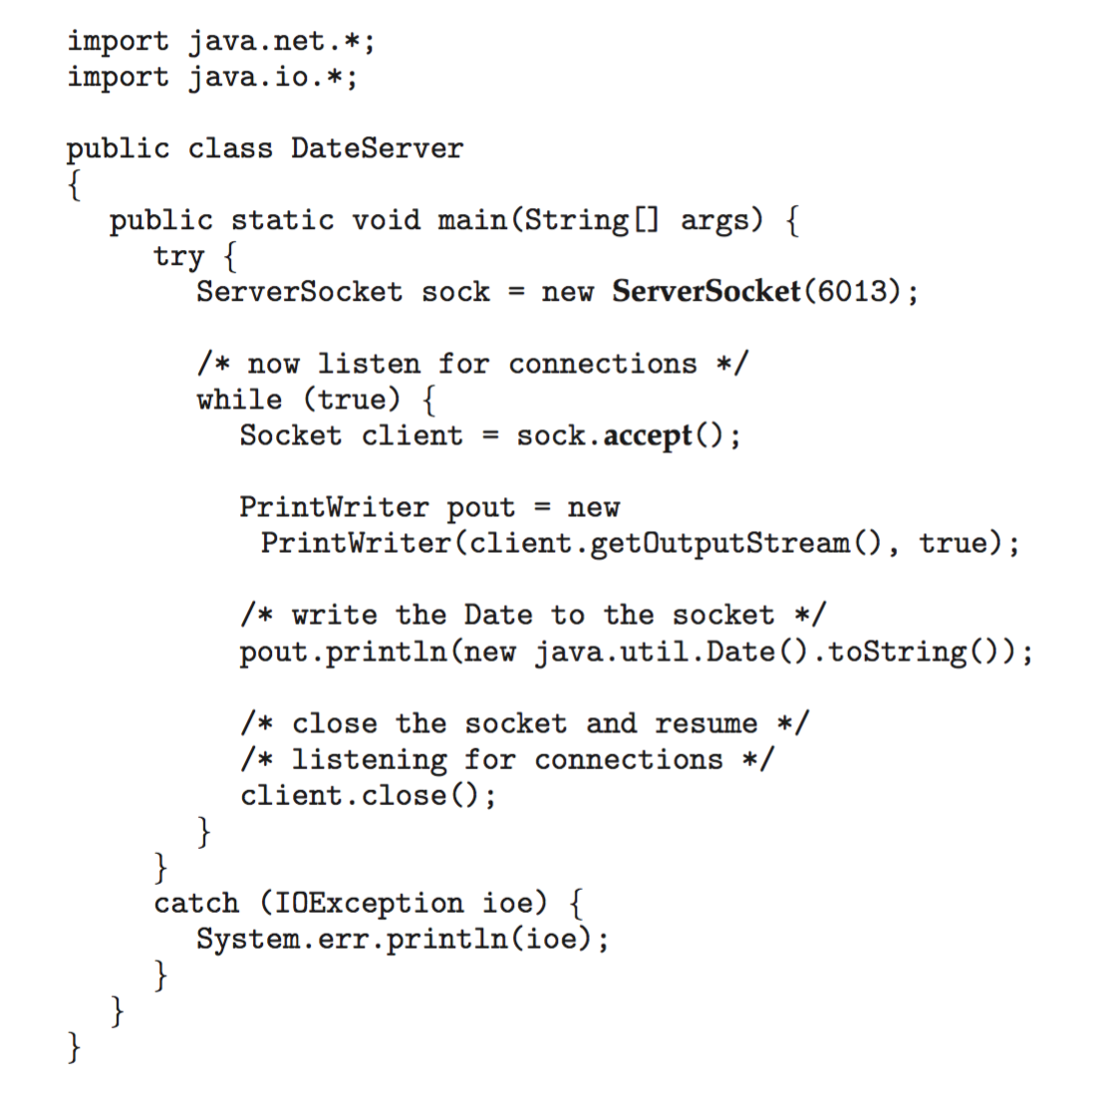
Sockets in Java
Three types of sockets
  Connection-oriented (TCP)
  Connectionless (UDP)
  MulticastSocket class– data can be sent to multiple recipients
Consider this “Date” server in Java:

Slide 51
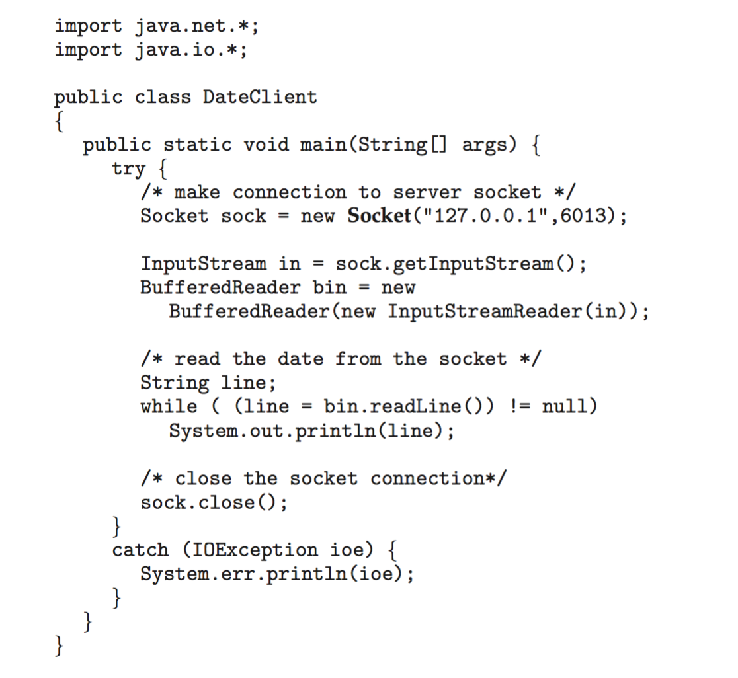
Sockets in Java
The equivalent Date client

Slide 52
Remote Procedure Calls
Remote procedure call (RPC) abstracts procedure calls between processes on networked systems
  Again uses ports for service differentiation
Stubs – client-side proxy for the actual procedure on the server
The client-side stub locates the server and marshalls the parameters
The server-side stub receives this message, unpacks the marshalled parameters, and performs the procedure on the server
On Windows, stub code compile from specification written in Microsoft Interface Definition Language (MIDL)

Slide 53
Remote Procedure Calls (Cont.)
Data representation handled via External Data Representation (XDL) format to account for different architectures
  Big-endian and little-endian
Remote communication has more failure scenarios than local
  Messages can be delivered exactly once rather than at most once
OS typically provides a rendezvous (or matchmaker) service to connect client and server

Slide 54
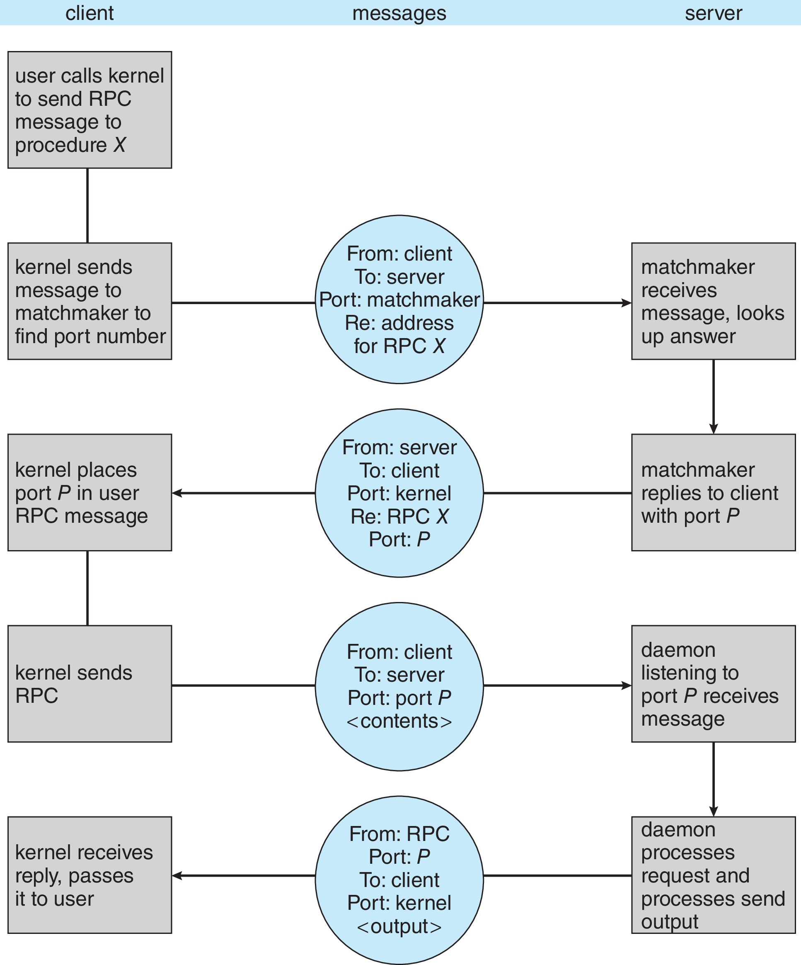
Execution of RPC

Slide 55
End of Chapter 3

Slide 56
Producer-Consumer Problem
Paradigm for cooperating processes:
  producer process produces information that is consumed by a consumer process
Two variations:
  unbounded-buffer places no practical limit on the size of the buffer:
    Producer never waits
    Consumer waits if there is no buffer to consume
  bounded-buffer assumes that there is a fixed buffer size
    Producer must wait if all buffers are full
    Consumer waits if there is no buffer to consume

Slide 57
Cooperating Processes
Independent process cannot affect or be affected by the execution of another process
Cooperating process can affect or be affected by the execution of another process
Advantages of process cooperation
  Information sharing
  Computation speed-up
  Modularity
  Convenience

Slide 58
Synchronization
Message passing may be either blocking or non-blocking
  Blocking is considered synchronous
    Blocking send -- the sender is blocked until the message is received
    Blocking receive -- the receiver is blocked until a message is available
  Non-blocking is considered asynchronous
    Non-blocking send -- the sender sends the message and continue
    Non-blocking receive -- the receiver receives:
    A valid message, or
    Null message
  Different combinations possible
    If both send and receive are blocking, we have a rendezvous

