Slide 1
Chapter 11: File System Implementation

Slide 2
File-System Structure
File structure
Logical storage unit
Collection of related information
File system resides on secondary storage (disks)
Provided user interface to storage, mapping logical to physical
Provides efficient and convenient access to disk by allowing data to be stored, located retrieved easily
Disk provides in-place rewrite and random access
I/O transfers performed in blocks of sectors (usually 512 bytes)
File control block – storage structure consisting of information about a file
Device driver controls the physical device
File system organized into layers

Slide 3
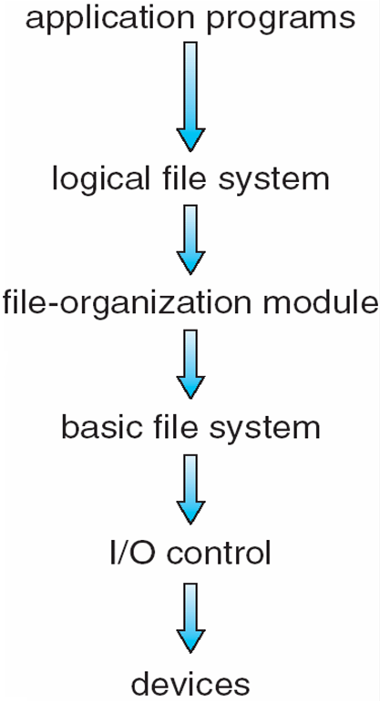
Layered File System

Slide 4
File System Layers
Device drivers manage I/O devices at the I/O control layer
Given commands like “read drive1, cylinder 72, track 2, sector 10, into memory location 1060” outputs low-level hardware specific commands to hardware controller
Basic file system given command like “retrieve block 123” translates to device driver
Also manages memory buffers and caches (allocation, freeing, replacement)
Buffers hold data in transit
Caches hold frequently used data
File organization module understands files, logical address, and physical blocks
Translates logical block # to physical block #
Manages free space, disk allocation

Slide 5
File System Layers (Cont.)
Logical file system manages metadata information
Translates file name into file number, file handle, location by maintaining file control blocks (inodes in UNIX)
Directory management
Protection
Layering useful for reducing complexity and redundancy, but adds overhead and can decrease performance
Logical layers can be implemented by any coding method according to OS designer

Slide 6
File System Layers (Cont.)
Many file systems, sometimes many within an operating system
Each with its own format (CD-ROM is ISO 9660; Unix has UFS, FFS; Windows has FAT, FAT32, NTFS as well as floppy, CD, DVD Blu-ray, Linux has more than 40 types, with extended file system ext2, ext3, ext4 leading; plus distributed file systems, etc.)
New ones still arriving – ZFS, GoogleFS, Oracle ASM, FUSE

Slide 7
File-System Implementation
We have system calls at the API level, but how do we implement their functions?
On-disk and in-memory structures
Boot control block contains info needed by system to boot OS from that volume
Needed if volume contains OS, usually first block of volume
Volume control block (superblock, master file table) contains volume details
Total # of blocks, # of free blocks, block size, free block pointers or array
Directory structure organizes the files
Names and inode numbers, master file table

Slide 8
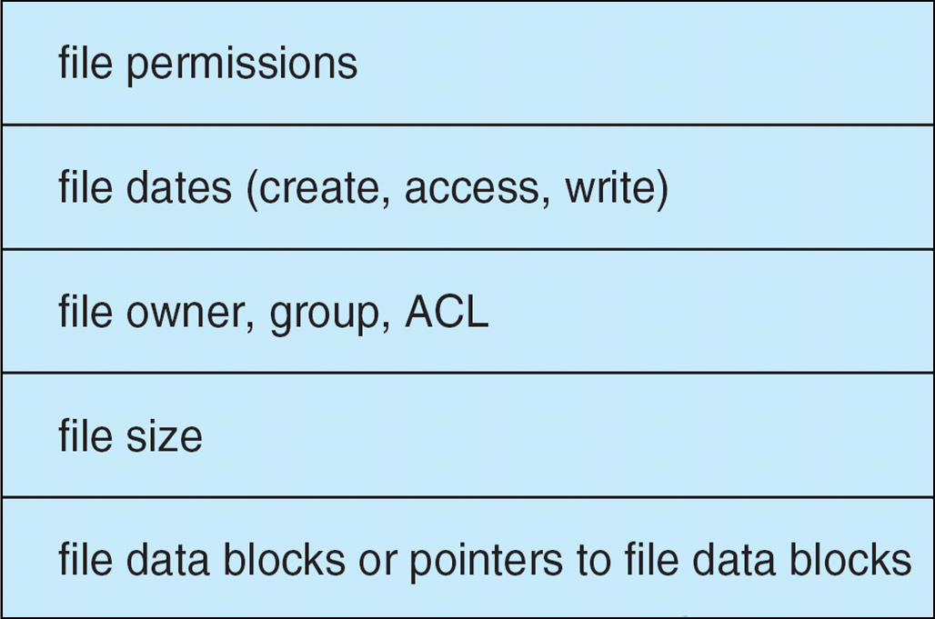
File-System Implementation (Cont.)
Per-file File Control Block (FCB) contains many details about the file
inode number, permissions, size, dates
NFTS stores into in master file table using relational DB structures

Slide 9
In-Memory File System Structures
Mount table storing file system mounts, mount points, file system types
The following figure illustrates the necessary file system structures provided by the operating systems
Figure 12-3(a) refers to opening a file
Figure 12-3(b) refers to reading a file
Plus buffers hold data blocks from secondary storage
Open returns a file handle for subsequent use
Data from read eventually copied to specified user process memory address

Slide 10
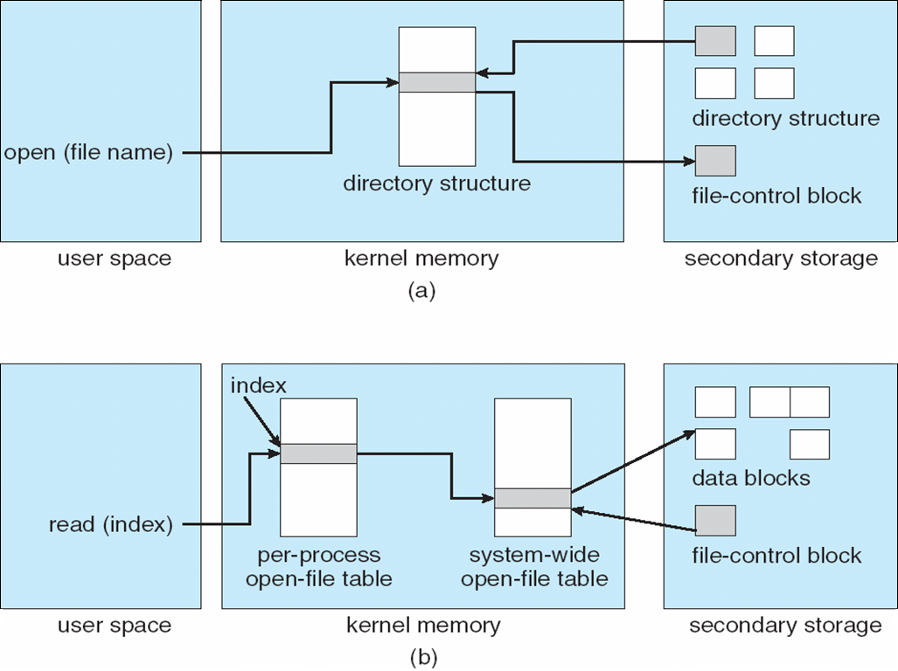
In-Memory File System Structures

Slide 11
Virtual File Systems
Virtual File Systems (VFS) provide an object-oriented way of implementing file systems.
VFS allows the same system call interface (the API) to be used for different types of file systems.
The API is to the VFS interface, rather than any specific type of file system.

Slide 12
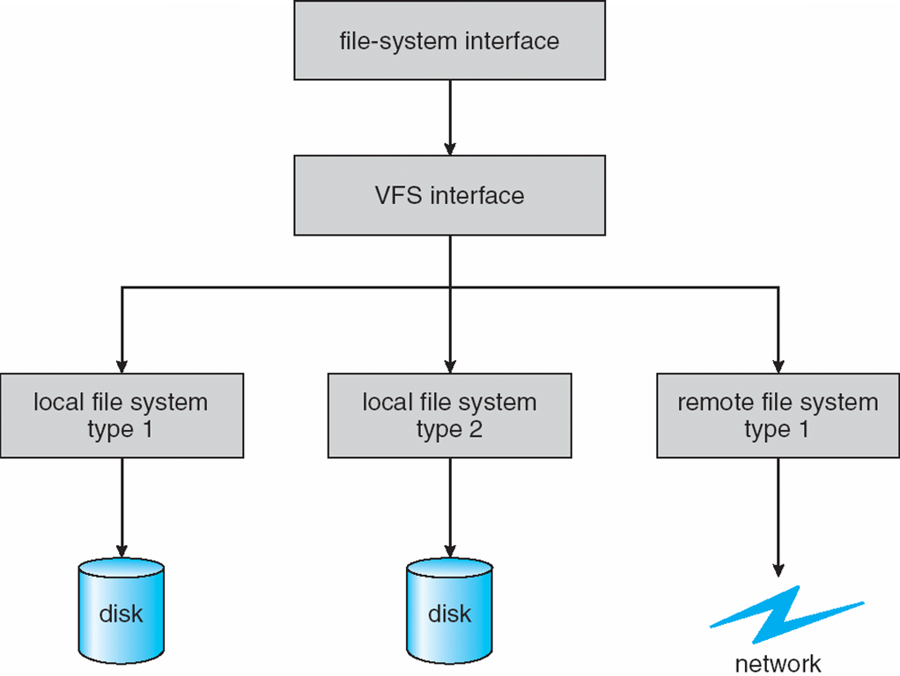
Schematic View of Virtual File System

Slide 13
Directory Implementation
Linear list of file names with pointer to the data blocks.
simple to program
time-consuming to execute
Hash Table – linear list with hash data structure.
decreases directory search time
collisions – situations where two file names hash to the same location
fixed size

Slide 14
Allocation methods

Slide 15
Allocation Methods
An allocation method refers to how disk blocks are allocated for files:
Contiguous allocation
Linked allocation
Indexed allocation

Slide 16
Contiguous Allocation
Each file occupies a set of contiguous blocks on the disk
Simple – only starting location (block #) and length (number of blocks) are required
Random access in constant time
It is easy to calculate which block you need to read in order to read a specific location in the file.
Wasteful of space (dynamic storage-allocation problem)
Files cannot grow
… unless it happens that there is empty space at the end of the file.

Slide 17
Contiguous Allocation
Mapping from logical to physical
Q
LA/512
R
Block to be accessed = ! + starting address
Displacement into block = R

Slide 18
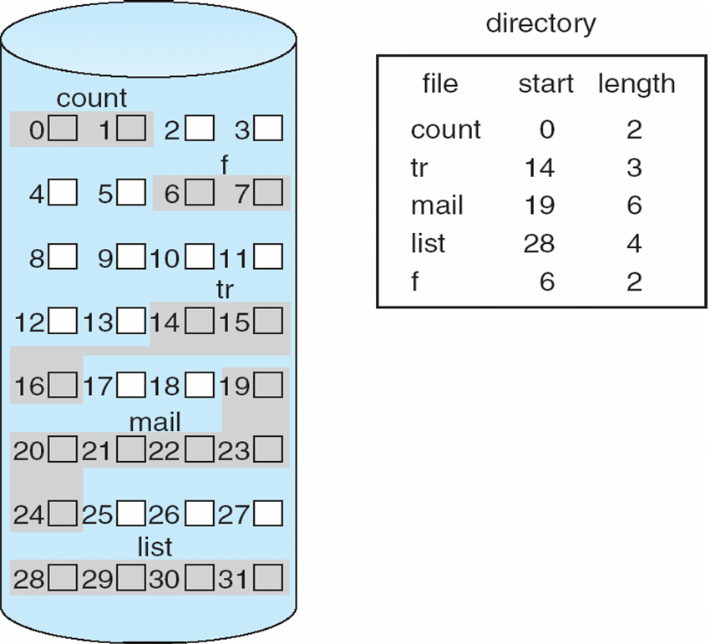
Contiguous Allocation of Disk Space

Slide 19
Extent-Based Systems
Many newer file systems use a modified contiguous allocation scheme
Extent-based file systems allocate disk blocks in extents
An extent is a contiguous block of disk
Extents are allocated for file allocation
A file consists of one or more extents.
Most modern file systems support it:
Linux: Ext4, Reiser4
Windows: NTFS
Apple: HFS Plus

Slide 20
Linked Allocation
Each file is a linked list of disk blocks: blocks may be scattered anywhere on the disk.
block =
pointer

Slide 21
Linked Allocation (Cont.)
Simple – need only starting address
Free-space management system – no waste of space
No random access
You need to go block by block to reach a certain location
Mapping
Q
LA/511
R
Block to be accessed is the Qth block in the linked chain of blocks representing the file.
Displacement into block = R + 1

Slide 22
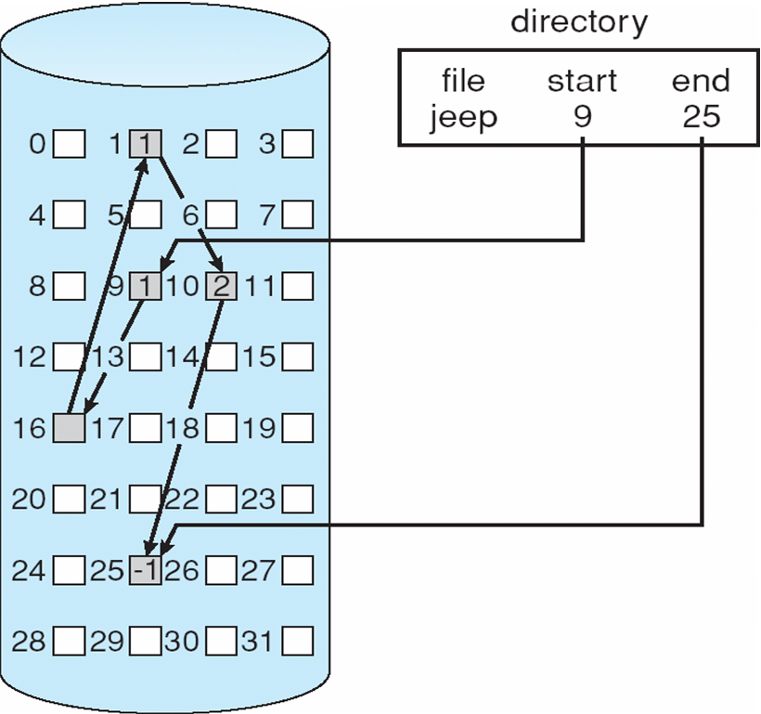
Linked Allocation

Slide 23
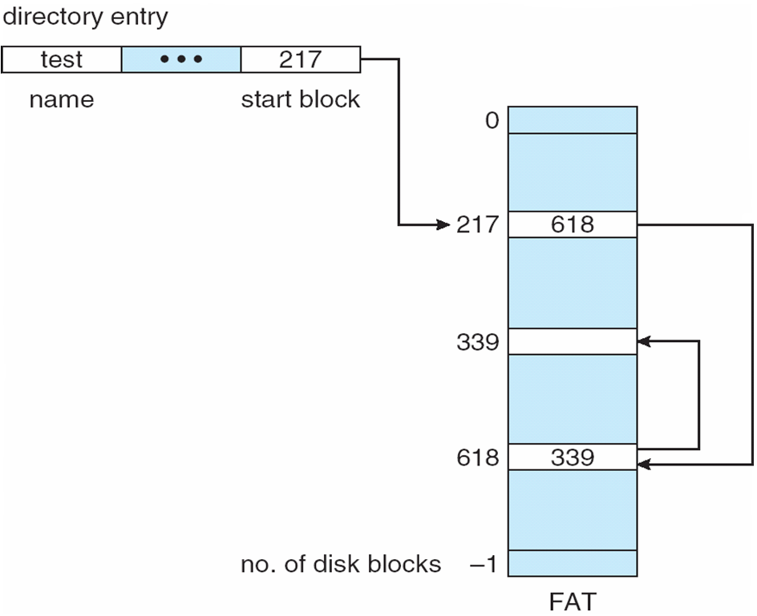
File-Allocation Table
File-allocation table (FAT) – disk-space allocation used by MS-DOS and OS/2.
Similar to linked allocation, but the pointers are in a table, not in the blocks themselves.

Slide 24
Indexed Allocation
Brings all pointers together into the index block.
Logical view.
index table

Slide 25
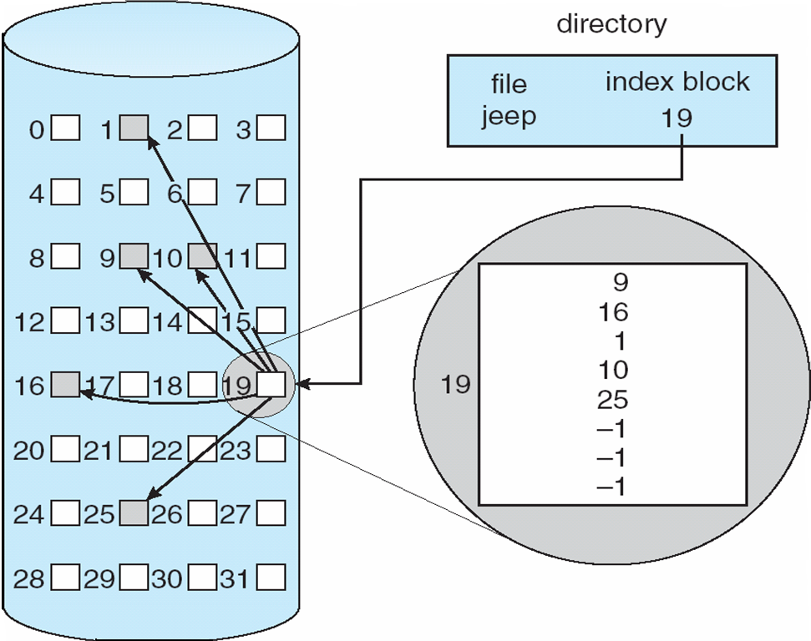
Example of Indexed Allocation

Slide 26
Indexed Allocation (Cont.)
Need index table
Random access
Dynamic access without external fragmentation, but have overhead of index block.
Mapping from logical to physical in a file of maximum size of 256K words and block size of 512 words. We need only 1 block for index table.
Q
LA/512
R
Q = displacement into index table
R = displacement into block

Slide 27
Indexed Allocation – Mapping (Cont.)
Mapping from logical to physical in a file of unbounded length (block size of 512 words).
Linked scheme – Link blocks of index table (no limit on size).
Q₁
LA / (512 x 511)
R₁
Q₁ = block of index table
R₁ is used as follows:
Q₂
R₁ / 512
R₂
Q₂ = displacement into block of index table
R₂ displacement into block of file:

Slide 28
Indexed Allocation – Mapping (Cont.)
Two-level index (maximum file size is 512³)
Q₁
LA / (512 x 512)
R₁
Q₁ = displacement into outer-index
R₁ is used as follows:
Q₂
R₁ / 512
R₂
Q₂ = displacement into block of index table
R₂ displacement into block of file:

Slide 29
Indexed Allocation – Mapping (Cont.)

outer-index
index table
file

Slide 30
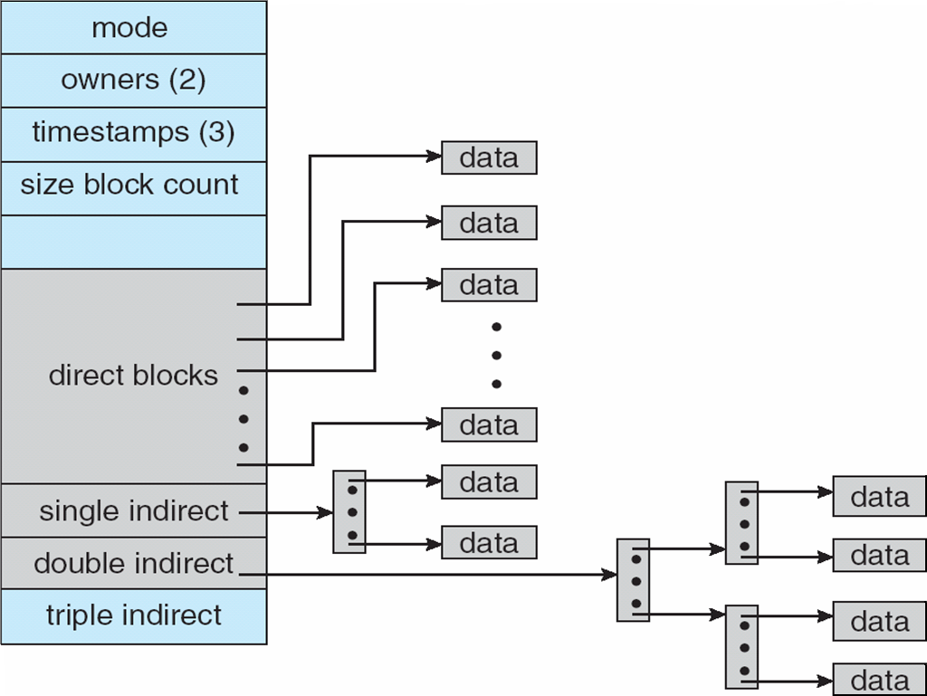
Combined scheme: the Unix inode
Unix file system, various current file systems used in Linux (e.g. ext3/4)

Slide 31
Free-Space Management
Bit vector (n blocks)
0
1
2
n-1
…
0 ⇒ block[i] free
1 ⇒ block[i] occupied
bit[i] =

Block number calculation (how to find the first free block)
(number of bits per word) *
(number of 0-value words) +
offset of first 1 bit

Slide 32
Free-Space Management (Cont.)
Bit map requires extra space
Example:
block size = 2¹² bytes
disk size = 2³⁰ bytes (1 gigabyte)
n = 2³⁰/2¹² = 2¹⁸ bits (or 32K bytes)
Easy to get contiguous files
Linked list (free list)
Cannot get contiguous space easily
No waste of space
Grouping
Counting

Slide 33
Free-Space Management (Cont.)
Bugs in the free space management implementation can have system-wide consequences. Certain types of failures are worse than others.
Need to protect:
Pointer to free list
Bit map
Must be kept on disk
Copy in memory and disk may differ
Cannot allow for block[i] to have a situation where bit[i] = 1 in memory and bit[i] = 0 on disk
Because after a system crash, you will end up overwriting an some portion of a previously safe file!
Solution:
Set bit[i] = 1 in disk
Allocate block[i]
Set bit[i] = 1 in memory

Slide 34
Directory Implementation
Linear list of file names with pointer to the data blocks
simple to program
time-consuming to execute
Hash Table – linear list with hash data structure
decreases directory search time
collisions – situations where two file names hash to the same location
fixed size

Slide 35
Recovery
Consistency checking – compares data in directory structure with data blocks on disk, and tries to fix inconsistencies
Use system programs to back up data from disk to another storage device (floppy disk, magnetic tape, other magnetic disk, optical)
Recover lost file or disk by restoring data from backup

Slide 36
Crash consistency
To write a piece of data, you need to update in three places on the disk
Data, Inode, Bitmap
What happens if the system crash:
Data only: no consistency problem (but lost data)
Inode only: garbage readings…
Bitmap only: space leak
Inode and bitmap only: garbage in the file
Inode and data only: inconsistency, data not mapped as occupied…
Bitmap and data only: we don’t know where it belongs, data only
One solution: file system consistency check (fsck Unix, chkdsk Windows)

Slide 37
Log Structured File Systems
Log structured (or journaling) file systems record each metadata update to the file system as a transaction
All transactions are written to a log
A transaction is considered committed once it is written to the log (sequentially)
Sometimes to a separate device or section of disk
However, the file system may not yet be updated
The transactions in the log are asynchronously written to the file system structures
When the file system structures are modified, the transaction is removed from the log
If the file system crashes, all remaining transactions in the log must still be performed
Faster recovery from crash, removes chance of inconsistency of metadata

