Slide 1
Chapter 10: File-System Interface

Slide 2
File Concept
Contiguous logical address space
Types:
  Data
    numeric
    character
    binary
  Program

Slide 3
File Structure
None - sequence of words, bytes
Simple record structure
  Lines
  Fixed length
  Variable length
Complex Structures
  Formatted document
  Relocatable load file
Can simulate last two with first method by inserting appropriate control characters
Who decides:
  Operating system
  Program

Slide 4
File Attributes
Name – only information kept in human-readable form
Identifier – unique tag (number) identifies file within file system
Type – needed for systems that support different types
Location – pointer to file location on device
Size – current file size
Protection – controls who can do reading, writing, executing
Time, date, and user identification – data for protection, security, and usage monitoring
Information about files are kept in the directory structure, which is maintained on the disk

Slide 5
File Operations
File is an abstract data type
Create
Write
Read
Reposition within file
Delete
Truncate
Open(F_{i}) – search the directory structure on disk for entry F_{i}, and move the content of entry to memory
Close (F_{i}) – move the content of entry F_{i} in memory to directory structure on disk

Slide 6
Open Files
Several pieces of data are needed to manage open files:
  File pointer: pointer to last read/write location, per process that has the file open
  File-open count: counter of number of times a file is open – to allow removal of data from open-file table when last processes closes it
  Disk location of the file: cache of data access information
  Access rights: per-process access mode information

Slide 7
Open File Locking
Provided by some operating systems and file systems
Mediates access to a file
Mandatory or advisory:
  Mandatory – access is denied depending on locks held and requested
  Advisory – processes can find status of locks and decide what to do

Slide 8
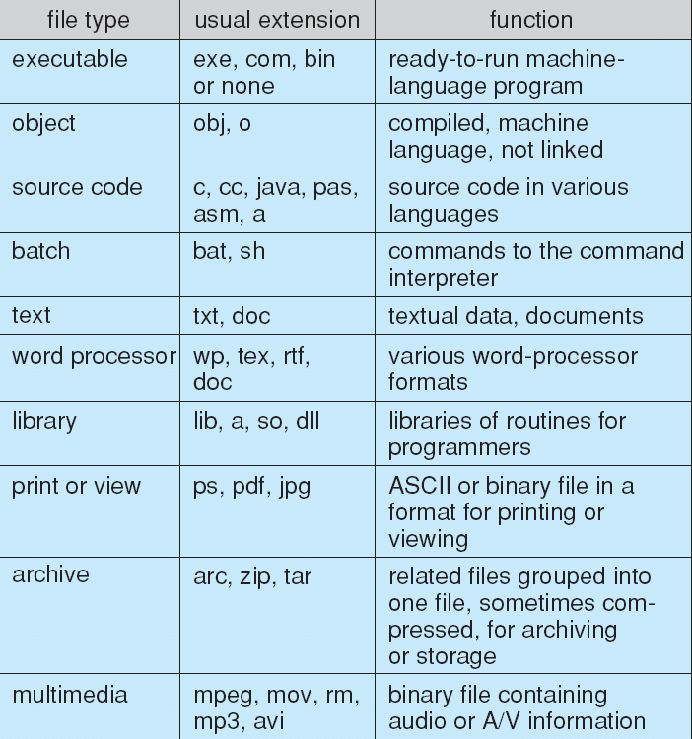
File Types – Name, Extension

Slide 9
Access Methods
Sequential Access
read next
write next
reset
no read after last write
(rewrite)
Direct Access
read n
write n
position to n
read next
write next
rewrite n
n = relative block number

Slide 10
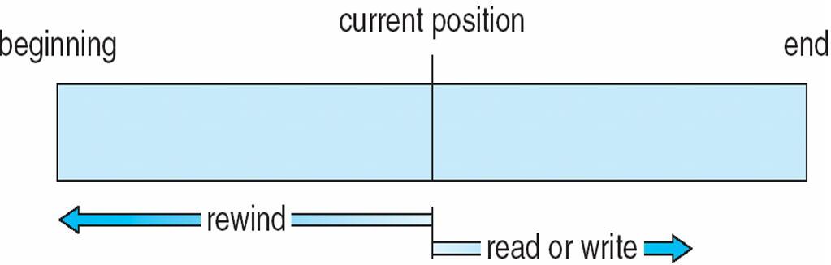
Sequential-access File

Slide 11
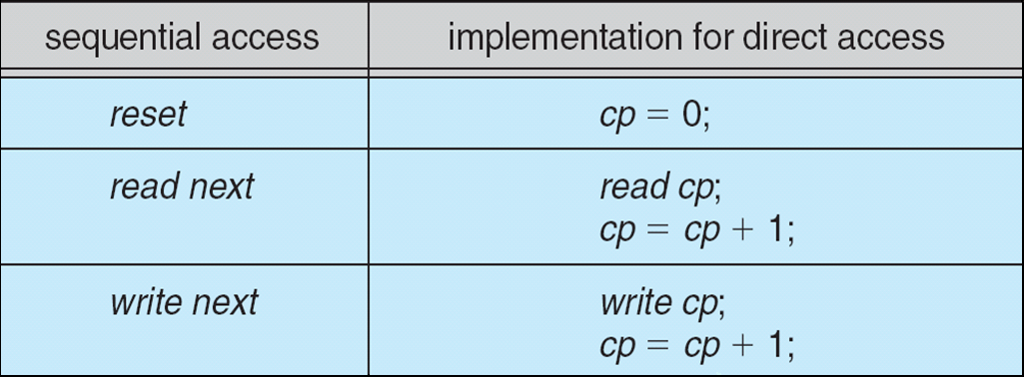
Simulation of Sequential Access on Direct-access File

Slide 12
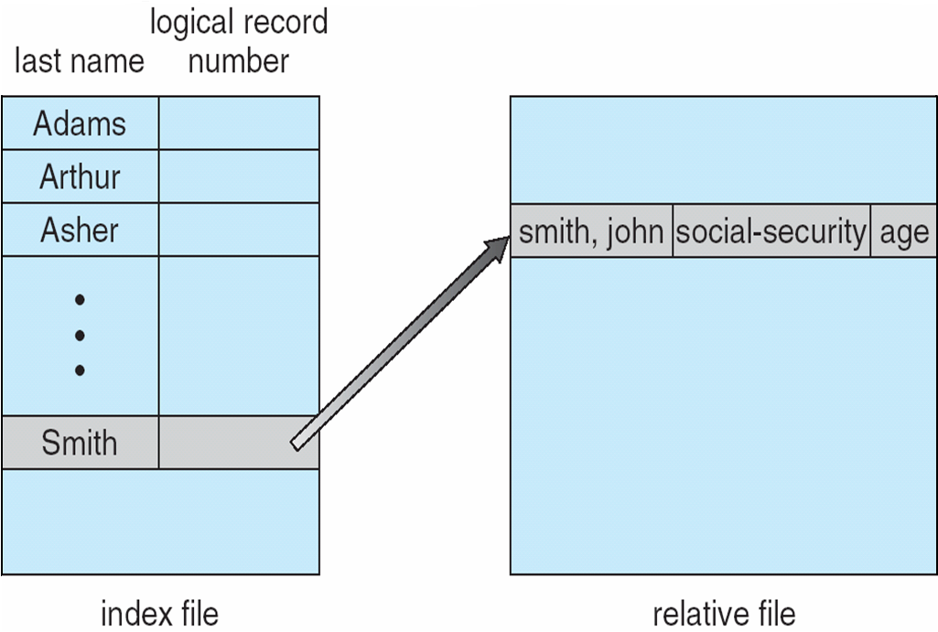
Example of Index and Relative Files
Indexing allows accessing specific locations in the file without having to read through the whole (large) file.
  Jump to a specific location in a video
  Select certain type of customers from a large database
These days, it is primarily done at the application level
Operating systems create indexes for their informal keyword search functionality.

Slide 13
Directory Structure
A collection of nodes containing information about all files
Directory
Files
F 1
F 2
F 3
F 4
F n
Both the directory structure and the files reside on disk
Backups of these two structures are kept on tapes

Slide 14
Disk Structure
Disk can be subdivided into partitions
  Also known as minidisks, slices
Disks or partitions can be RAID protected against failure
Disk or partition can be used raw – without a file system, or formatted with a file system
  Formatting means to create the necessary information for the organization of a file system: directory, list of free blocks etc.
Entity containing a file system known as a volume
Each volume containing file system also tracks that file system’s info in device directory or volume table of contents
As well as general-purpose file systems there are many special-purpose file systems, frequently all within the same operating system or computer

Slide 15
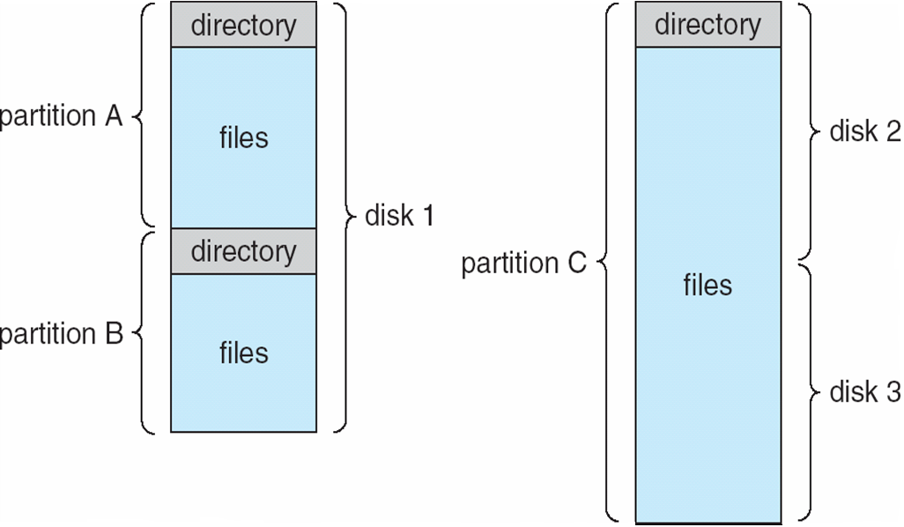
File-system organization examples
You can have one physical disk with multiple partitions
Or partitions spanning multiple disks

Slide 16
Operations Performed on Directory
Just like a file, the directory is also an abstract data type
Search for a file
Create a file
Delete a file
List a directory
Rename a file
Traverse the file system

Slide 17
Organize the Directory (Logically) to Obtain
Efficiency – locating a file quickly
Naming – convenient to users
  Two users can have same name for different files
  The same file can have several different names
Grouping – logical grouping of files by properties, (e.g., all Java programs, all games, …)

Slide 18
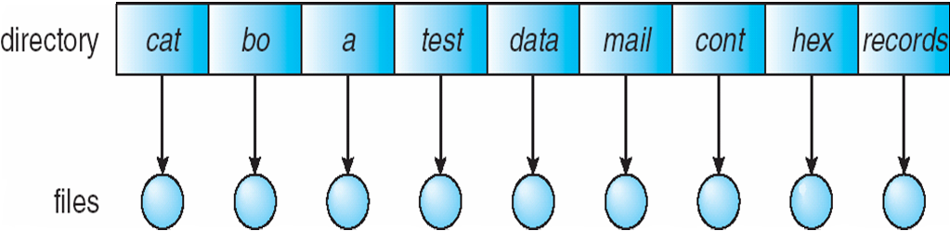
Single-Level Directory
A single directory for all users
Naming problem
Grouping problem

Slide 19
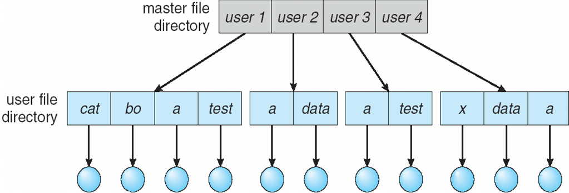
Two-Level Directory
Separate directory for each user
Path name
Can have the same file name for different user
Efficient searching
No grouping capability

Slide 20
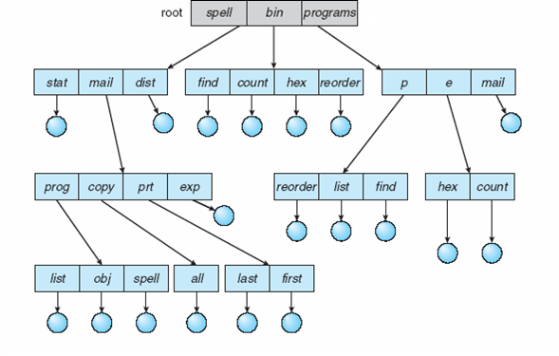
Tree-Structured Directories

Slide 21
Tree-Structured Directories (Cont)
Efficient searching
Grouping Capability
Current directory (working directory)
  cd /spell/mail/prog
  It is a system variable, kept in the current shell!!!
Absolute or relative path name
  /home/john/pictures/funnycat.jpg – absolute name
  if current dir is /home/john/pictures
    funnycat.jpg or ./funnycat.jpg
  if current dir is /home/john/music
    ../pictures/funnycat.jpg

Slide 22
Tree-Structured Directories (Cont)
Creating a new file is done in current directory
Delete a file
rm <file-name>
Creating a new subdirectory is done in current directory
  mkdir <dir-name>
Example: if in current directory /mail
mkdir count
mail
prog
copy
prt
exp
count
Deleting “mail” ⇒ deleting the entire subtree rooted by “mail”

Slide 23
Acyclic-Graph Directories (Cont.)
Files and directories can have multiple different names (aliasing)
New directory entry type
  Link – another name (pointer) to an existing file
  Resolve the link – follow pointer to locate the file

Slide 24
File System Mounting
A file system must be mounted before it can be accessed
This is a concern for users for file systems on portable drives, disks, network mounted drives etc.
  The main files systems are usually mounted at startup by the OS and only unmounted at shutdown
File systems with different underlying organization are mounted in a shared hierarchy.
A unmounted file system (i.e. Fig. 11-11(b)) is mounted at a mount point
  Mount point is usually a directory but…

Slide 25
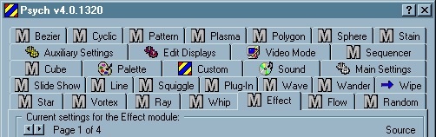
More about mounting… fun, fun, fun
Windows ← MS-DOS ← CP/M
  A:, B:, C: etc.
  A: and B: floppy drives in CP/M (1974)
  C: the hard disk on IBM PC XT (1983, first personal computer with a hard drive)
  Windows automatically mounts most file systems you insert
  But you need to unmount them with the “safely remove hardware and eject media” item which is carefully hidden in the system tray, such that nobody can find it
MAC OS:
  … Unmounting by dragging to trash
They both qualify to the
User interface hall of shame

Slide 26
File Sharing
Sharing of files on multi-user systems is desirable
Sharing may be done through a protection scheme
User IDs identify users, allowing permissions and protections to be per-user
Group IDs allow users to be in groups, permitting group access rights

Slide 27
Protection
File owner/creator should be able to control:
  what can be done
  by whom
Types of access
  Read
  Write
  Execute
  Append
  Delete
  List

Slide 28
File Sharing – Remote File Systems
Accessing files between systems
  Manually via programs like FTP
  Automatically, seamlessly using distributed file systems
  Semi automatically via the world wide web
Client-server model allows clients to mount remote file systems from servers
  Server can serve multiple clients
  Client and user-on-client identification is insecure or complicated
  NFS is standard UNIX client-server file sharing protocol
  CIFS is standard Windows protocol
  Standard operating system file calls are translated into remote calls
GoogleFS and Hadoop Distributed File System (HDFS)
  File systems for very large distributed systems e.g. Facebook 100PB=100,000 TB HDFS system in 2012

Slide 29
File Sharing – Failure Modes
Remote file systems add new failure modes, due to network failure, server failure
Recovery from failure can involve state information about status of each remote request
Stateless protocols such as NFS include all information in each request, allowing easy recovery but less security

Slide 30
End of Chapter 10

Slide 31
File Sharing – Consistency Semantics
Consistency semantics specify how multiple users are to access a shared file simultaneously
  Similar to Ch 7 process synchronization algorithms
    Tend to be less complex due to disk I/O and network latency (for remote file systems
  Andrew File System (AFS) implemented complex remote file sharing semantics
  Unix file system (UFS) implements:
    Writes to an open file visible immediately to other users of the same open file
    Sharing file pointer to allow multiple users to read and write concurrently
  AFS has session semantics
    Writes only visible to sessions starting after the file is closed

Slide 32
Access Lists and Groups
Mode of access: read, write, execute
Three classes of users
RWX
a) owner access 7 ⇒ 1 1 1
RWX
b) group access 6 ⇒ 1 1 0
RWX
c) public access 1 ⇒ 0 0 1
Ask manager to create a group (unique name), say G, and add some users to the group.
For a particular file (say game) or subdirectory, define an appropriate access.
owner
group
public
chmod
761
game
Attach a group to a file
chgrp G game

Slide 33
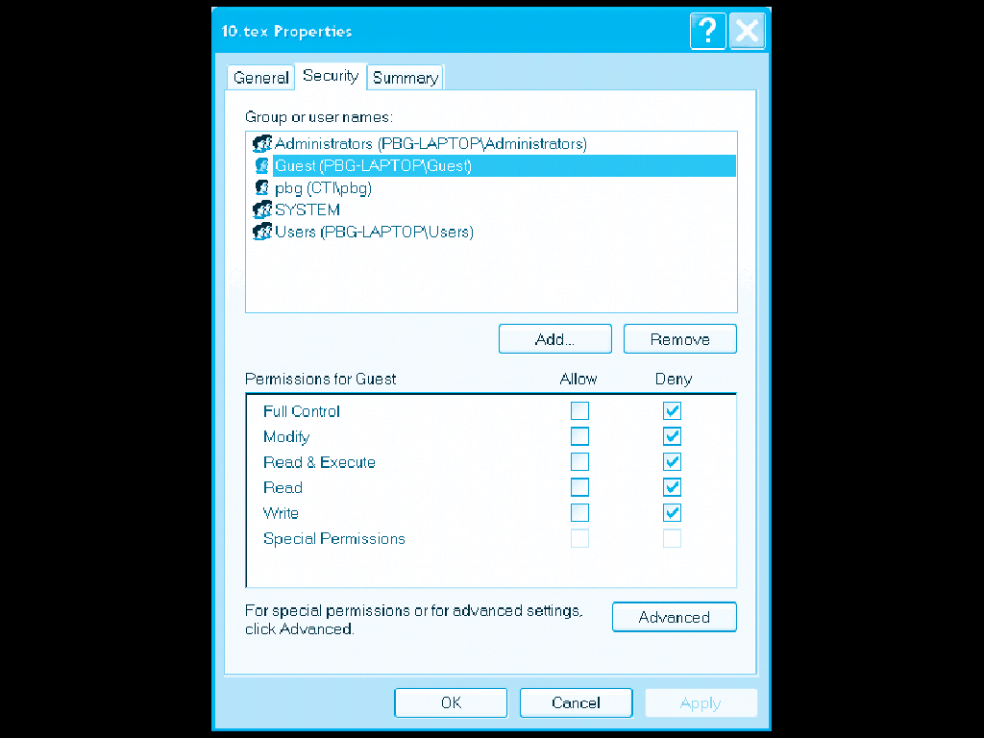
Windows XP Access-control List Management

Slide 34
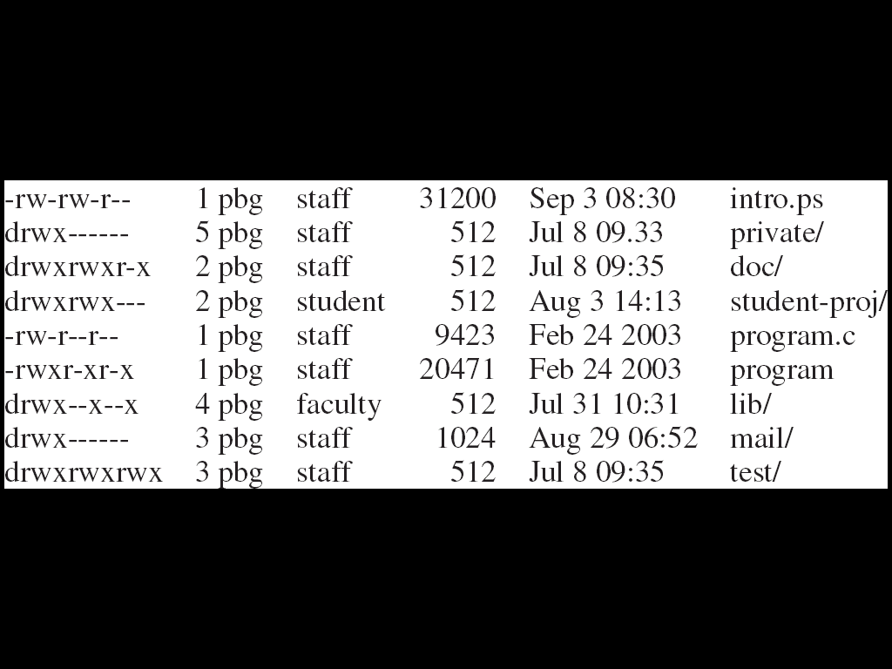
A Sample UNIX Directory Listing

