Slide 1
Chapter 1: Introduction

Slide 2
The landscape of operating systems

Slide 3
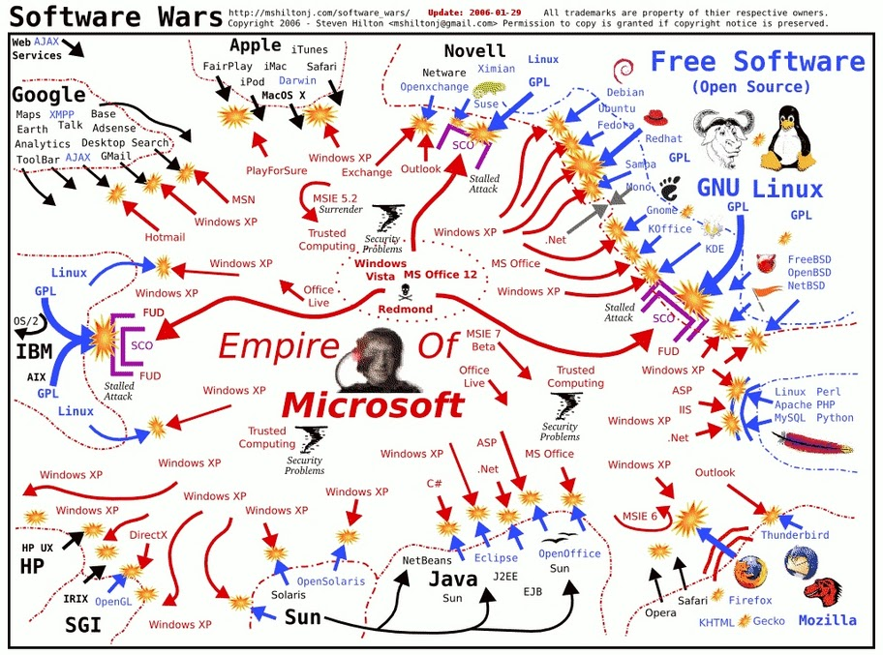
The OS wars (in 2006)

Slide 4
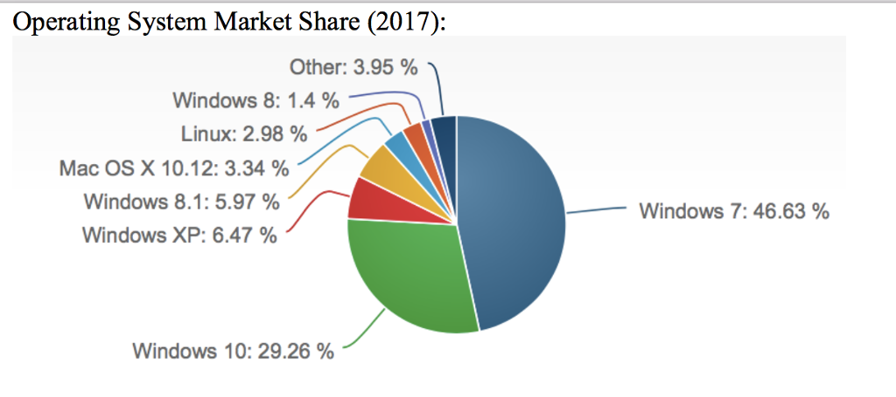
OS market share 2017

Slide 5
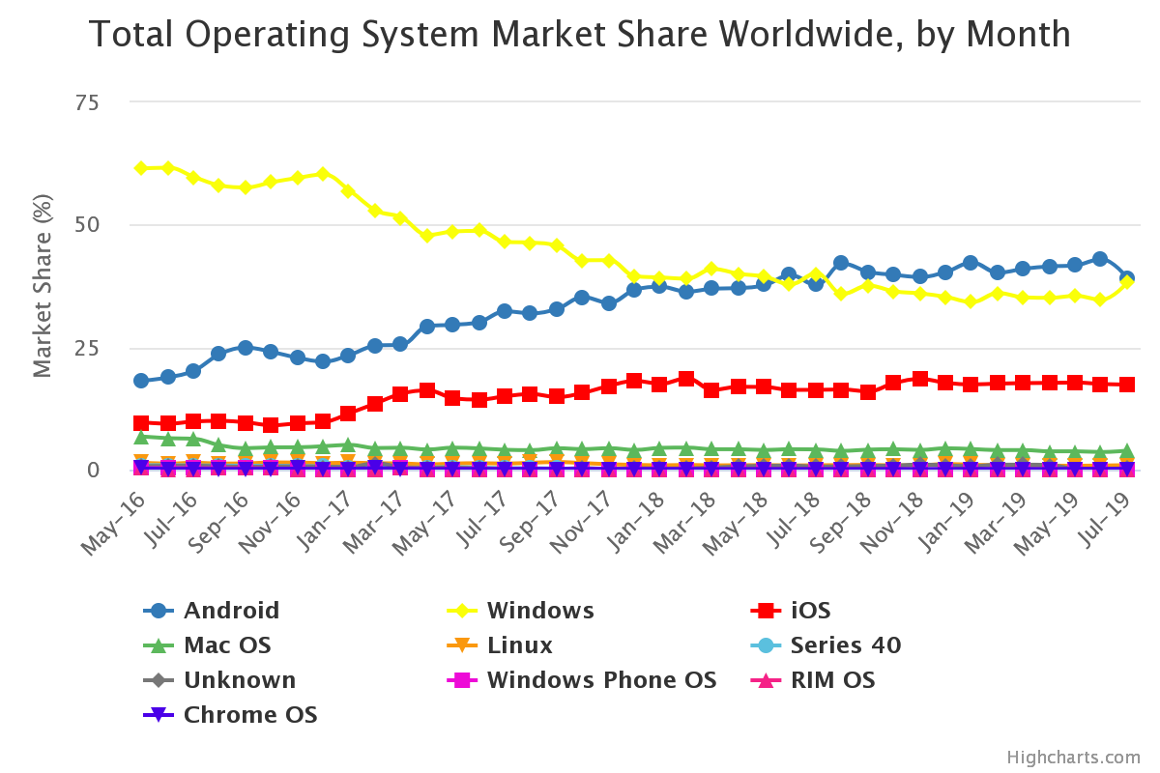
If we include mobile

Slide 6
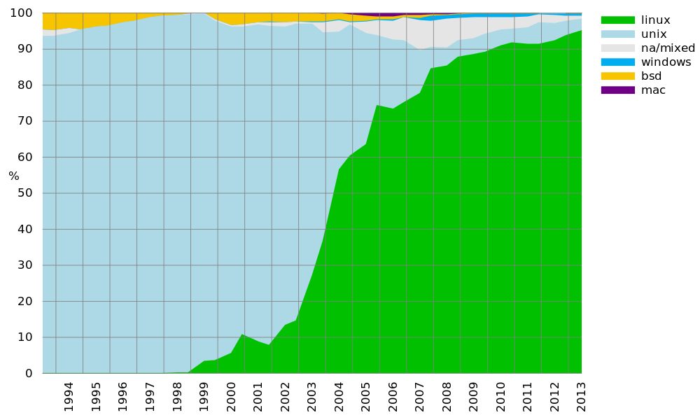
Operating systems on supercomputers

Slide 7
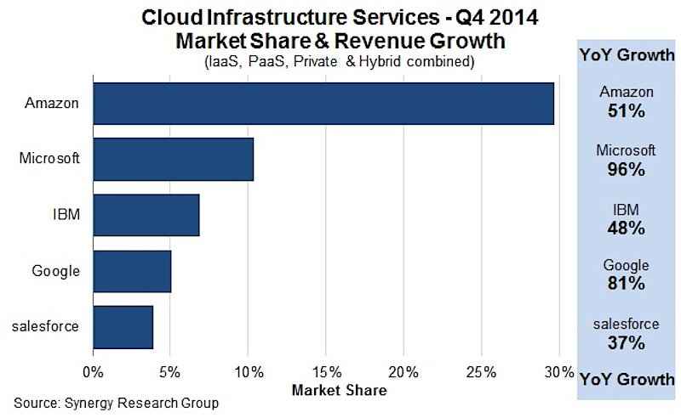
Operating systems in the cloud
Basically, the 10% on Microsoft Azure is mostly Windows, everybody else does Linux.

Slide 8
Defining the field

Slide 9
Definition 1: Intermediary
A program that acts as an intermediary between a user of a computer and the computer hardware

Slide 10
Intermediary (cont’d)
Computer system can be divided into four components
  Hardware – provides basic computing resources
    CPU, memory, I/O devices
  Operating system
    Controls and coordinates use of hardware among various applications and users
  Application programs – define the ways in which the system resources are used to solve the computing problems of the users
    Word processors, compilers, web browsers, database systems, video games
  Users
    People, machines, other computers

Slide 11
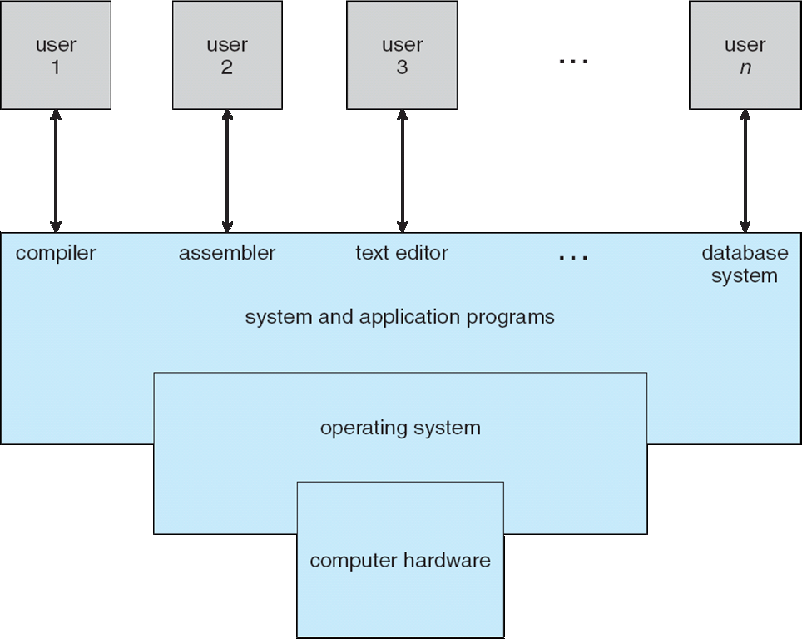
Intermediary (cont’d)

Slide 12
Definition 2: Resource allocator
OS is a resource allocator
  Manages all resources
  Decides between conflicting requests for efficient and fair resource use
What is a resource?
  Anything you can run out of…
  Computing power, memory, storage space
  Energy
  Network bandwidth
  Money (!)

Slide 13
Definition 3: Control program
OS is a control program
  Controls execution of programs to prevent errors and improper use of the computer

Slide 14
Reviewing definitions
No universally accepted definition
“Everything a vendor ships when you order an operating system” is good approximation
  But varies wildly
“The one program running at all times on the computer” is the kernel. Everything else is either a system program (ships with the operating system) or an application program

Slide 15
A bagload of definitions
This is that we talk about when we are talk about OSs

Slide 16
Computer Startup
bootstrap program is loaded at power-up or reboot
  Typically stored in ROM or EPROM, generally known as firmware
  Initializes all aspects of system
  Determine where to boot from (harddisk, CD/DVD-ROM, USB, network)
  Loads operating system kernel and starts execution
On PC-class systems
  BIOS (Basic Input Output)
  UEFI (Unified Extensible Firmware Interface)
The firmware bootstrap often hands it over to another bootstrap program on the disk (second stage boot loaders):
  GRUB
  NTLDR – for Windows

Slide 17
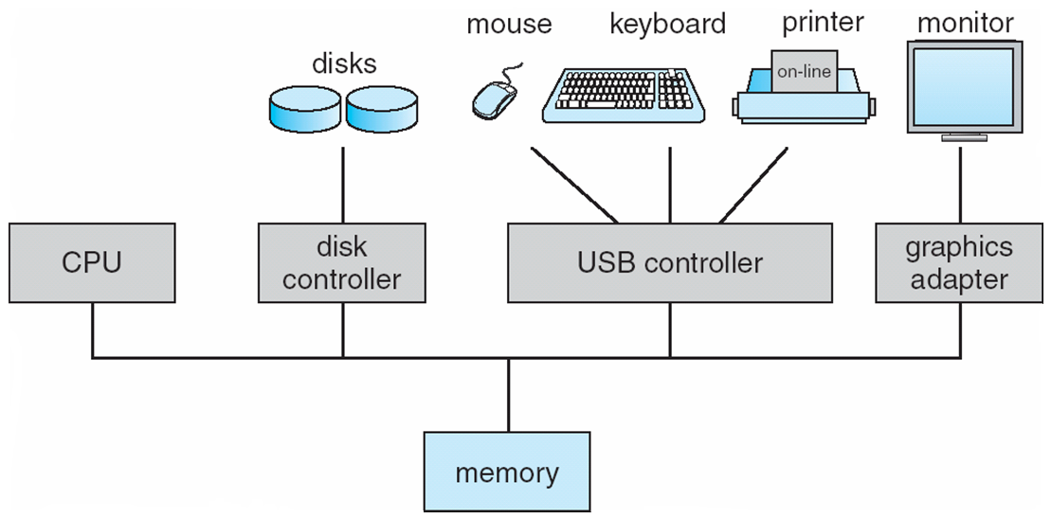
Computer System Organization
Computer-system operation
  One or more CPUs, device controllers connect through common bus providing access to shared memory
  Concurrent execution of CPUs and devices competing for memory cycles

Slide 18
Computer-System Operation
I/O devices and the CPU can execute concurrently
Each device controller is in charge of a particular device type
Each device controller has a local buffer
CPU moves data from/to main memory to/from local buffers
I/O is from the device to local buffer of controller
Device controller informs CPU that it has finished its operation by causing an interrupt

Slide 19
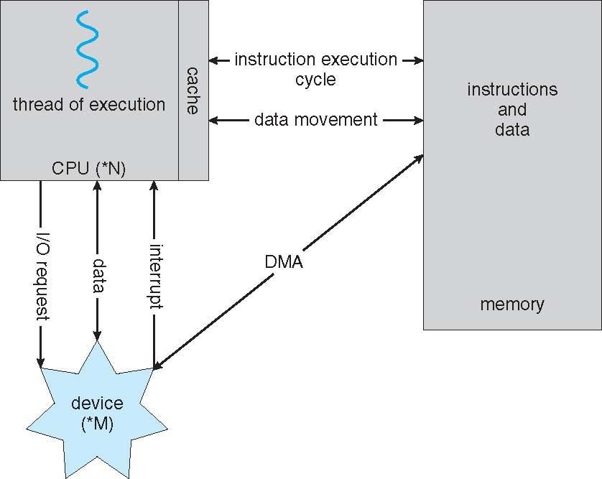
How a Modern Computer Works
A von Neumann architecture

Slide 20
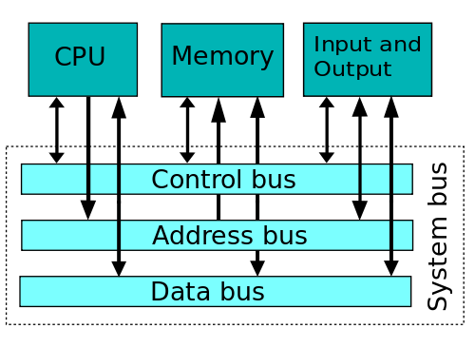
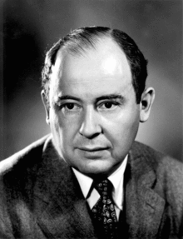
Von Neumann (Princeton) architecture
Von Neumann architecture (or Princeton architecture)
  Processor (or processors)
  One common memory for data and code
  Buses used to access memory and input output
  Direct Memory Access – going from I/O to Memory directly
Majority of modern general purpose GPUs (Intel, AMD, MIPS, most ARM etc)

Slide 21
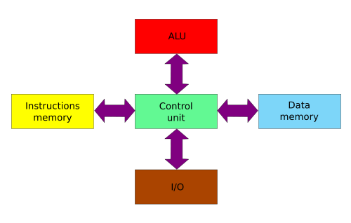
Harvard architecture
Strict separation of Instruction memory, Data memory, ALU and I/O
Advantage: simultaneous access to data and code
Modified Harvard: relax the strict separation requirements
Current applications: Digital Signal Processors (DSP), microcontrollers

Slide 22
Common Functions of Interrupts
Interrupt transfers control to the interrupt service routine generally, through the interrupt vector, which contains the addresses of all the service routines
Interrupt architecture must save the address of the interrupted instruction
Incoming interrupts are disabled while another interrupt is being processed to prevent a lost interrupt
A trap is a software-generated interrupt caused either by an error or a user request
An operating system is interrupt driven

Slide 23
Interrupt Handling
The operating system preserves the state of the CPU by storing registers and the program counter
Determines which type of interrupt has occurred:
  polling
  vectored interrupt system
Separate segments of code determine what action should be taken for each type of interrupt

Slide 24
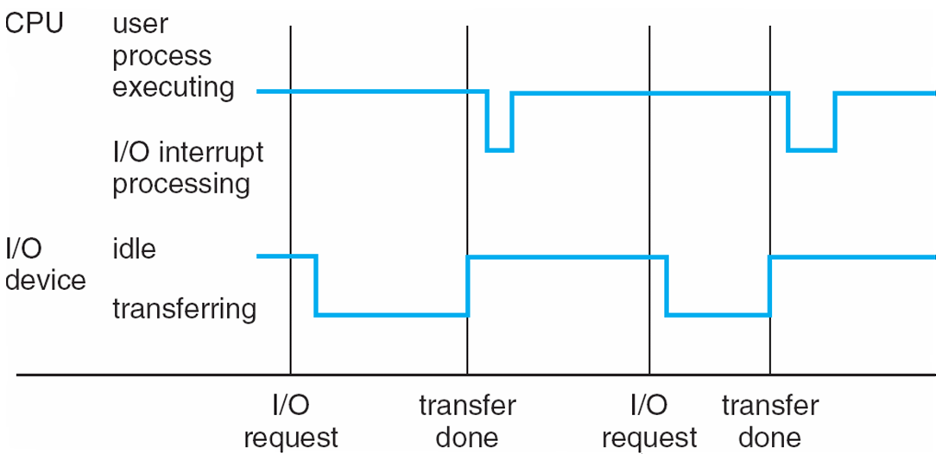
Interrupt Timeline

Slide 25
Aspects of Hardware Relevant to OS design

Slide 26
Input / Output
While we call them computers, they are not all computation
We need to handle inputs:
  From keyboard and mouse
  From files
  From network
  From sensors etc.
And outputs
  To screen (text, graphics)
  To files
  To network
These devices are connected to the CPU and memory through bus(es)

Slide 27
Two types of I/O calls
Blocking call
  User process is blocked waiting for the I/O to finish
  E.g. wait for a keystroke
Non-blocking call: After I/O starts, control returns to user program without waiting for I/O completion
  E.g. start printing, return to the editor before it finishes.
Notes:
  A naïve way to implement a blocking call is through an infinite polling loop (blocks the whole computer!)
  We can do better:
    Block the current process
    Do something else (eg switch to another process)
    Switch back when I/O is done

Slide 28
Direct Memory Access
Traditional way to read from a file:
  Under CPU control, read byte-by-byte from a I/O location and write to a memory location
  Inefficient, it blocks the CPU!
Direct memory access:
  A special type of non-blocking call
  Used for high-speed I/O devices able to transmit information at close to memory speeds
  Device controller transfers blocks of data from buffer storage directly to main memory without CPU intervention
  Only one interrupt is generated per block, rather than the one interrupt per byte

Slide 29
Storage

Slide 30
Storage Hierarchy
A modern computer system has a number of components that can store and retrieve information
  Different hardware technologies
  Different way to organize information
  Different addressing schemes
Storage systems can be seen as organized in hierarchy
  Speed
  Cost
  Volatility
Caching – copying information into faster storage system; main memory can be viewed as a last cache for secondary storage

Slide 31
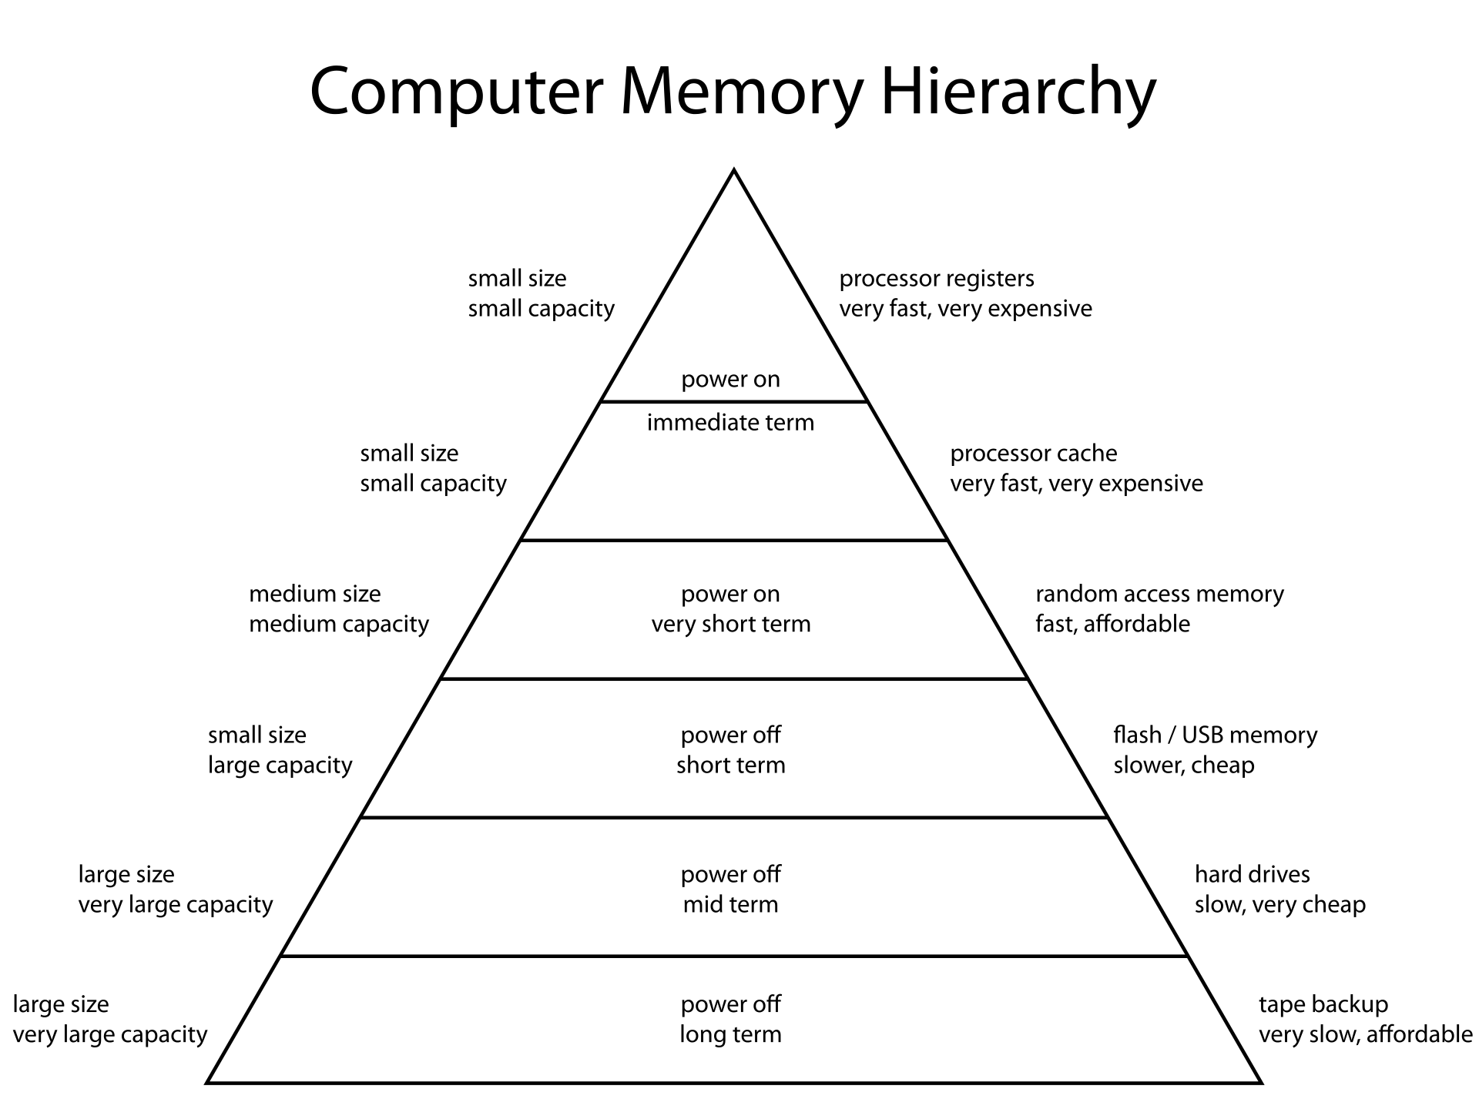
Storage hierarchy

Slide 32
Storage types of relevance to OS
Main memory (primary storage)
  Directly accessible by the CPU – through a numerical address space
  Volatile
  Typical implementation: Dynamic RAM
Secondary storage – extension of main memory that provides large nonvolatile storage capacity.
  Access through a file system
  Non-volatile
  Frequently accessed during the course of regular operation
  Typical implementation:
    Magnetic disks (hard drives)
    Solid state drives (flash drives)

Slide 33
Caching
Important principle, performed at many levels in a computer (in hardware, operating system, software)
Information in use copied from slower to faster storage temporarily
Faster storage (cache) checked first to determine if information is there
  If it is, information used directly from the cache (fast)
  If not, data copied to cache and used there
Cache smaller than storage being cached
  Cache management important design problem
  Cache size and replacement policy

Slide 34
Processor parallelism

Slide 35
Running multiple programs
You can image an OS as a library:
  Compile all the necessary code into a program
  Run only that single program and take care of everything.
  Had been done in the early years of computers (batch processing)
Most current computers must simultaneously run multiple processes at the same time (multiprocessing)
  This is not because they have multiple CPUs – it should work even if there is only one CPU.
  The secret is to quickly switch between the processes and the operating system kernel, to give you the impression that they are running in parallel
  The reason why this usually works is that most processes, most of the time, are waiting on I/O.

Slide 36
What if you have multiple processors
Most modern computers will have multiple processing cores in some kind of architecture
  The critical question: how are these communicating?
Shared memory computers
  Symmetric multiprocessing
  Multi-core processors
  Non-uniform memory architecture
Message passing computers
  Cluster computing
  Cloud…
  Message-passing supercomputing architectures…

Slide 37
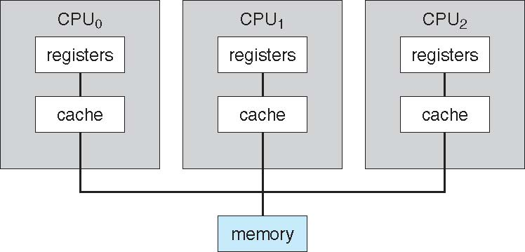
Symmetric Multiprocessing Architecture
The memory is the same distance from all CPUs.
Each CPU is on a separate die, probably also separate integrated circuits.
They are seen as independent devices.

Slide 38
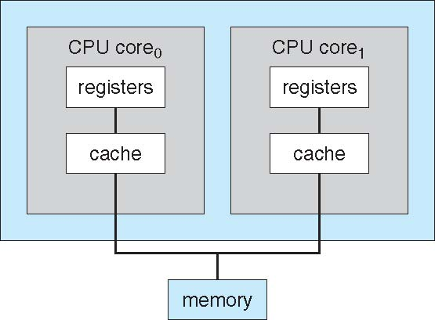
Multi-Core Designs
Still qualifies as SMP, only embedded in a single chip.
Examples:
  Intel Core i5-8259U - 4 cores (high performance laptop processor)
  Ryzen Threadripper 3990X – 64 cores (high performance desktop processor)

Slide 39
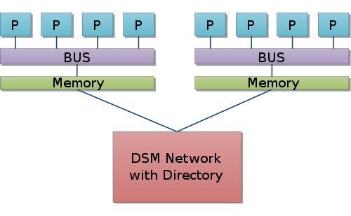
Non-uniform memory architecture (NUMA)
One can still access the whole memory
But the speed of access depends whether memory is local or remote
Contrast this with message-based systems where remote memory can not be accessed as “memory” i.e. instead of read/write you need to use send/receive.

Slide 40
Operating System Structure
Multiprogramming needed for efficiency
  Single user cannot keep CPU and I/O devices busy at all times
  Multiprogramming organizes jobs (code and data) so CPU always has one to execute
  A subset of total jobs in system is kept in memory
  One job selected and run via job scheduling
  When it has to wait (for I/O for example), OS switches to another job
Timesharing (multitasking) is logical extension in which CPU switches jobs so frequently that users can interact with each job while it is running, creating interactive computing
  Response time should be < 1 second
  Each user has at least one program executing in memory process
  If several jobs ready to run at the same time  CPU scheduling
  If processes don’t fit in memory, swapping moves them in and out to run
  Virtual memory allows execution of processes not completely in memory

Slide 41
Process Management
A process is a program in execution. It is a unit of work within the system. Program is a passive entity, process is an active entity.
Process needs resources to accomplish its task
  CPU, memory, I/O, files
  Initialization data
Process termination requires reclaim of any reusable resources
Single-threaded process has one program counter specifying location of next instruction to execute
  Process executes instructions sequentially, one at a time, until completion
Multi-threaded process has one program counter per thread
Typically system has many processes, some user, some operating system running concurrently on one or more CPUs
  Concurrency by multiplexing the CPUs among the processes / threads

