Slide 1
Chapter 3: Processes

Slide 2
Processes
Program: while it sits on the disk, not executing
When it is executed (or scheduled to be executed)
In batch systems: jobs
On time-shared systems: processes, tasks (Linux term)
A process includes:
Identifier
Memory:
Code, data, stack
Registers:
Program counter, stack pointer, flags
Other data:
State, files, access rights etc.
Not all the data associated with a process is accessible to the running process itself!!!

Slide 3
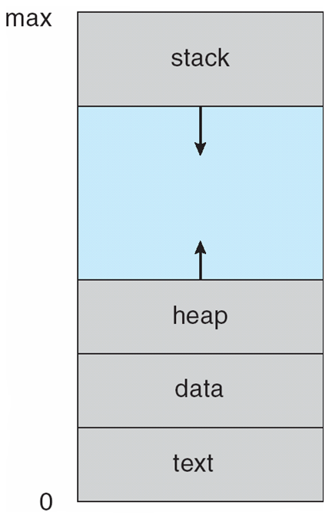
Memory organization of a process

Slide 4
Process State
As a process executes, it changes state
new: The process is being created
running: Instructions are being executed
waiting: The process is waiting for some event to occur
ready: The process is waiting to be assigned to a processor
terminated: The process has finished execution

Slide 5
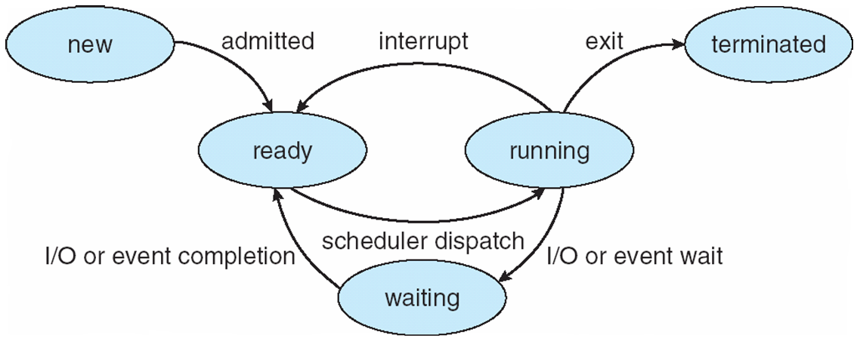
Diagram of Process State

Slide 6
Process Control Block (PCB)
Every operating system needs to keep and maintain the information associated with each process such as:
Process state
Program counter
CPU registers
CPU scheduling information
Memory-management information
Accounting information
I/O status information
This might be called something like Process Control Block
Or task control block, or process table entry etc.
Created when the process is created, destroyed when the process is terminated.

Slide 7
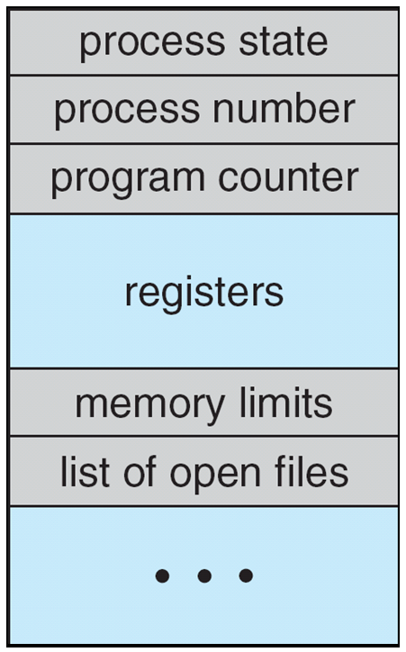
Process Control Block (PCB)

Slide 8
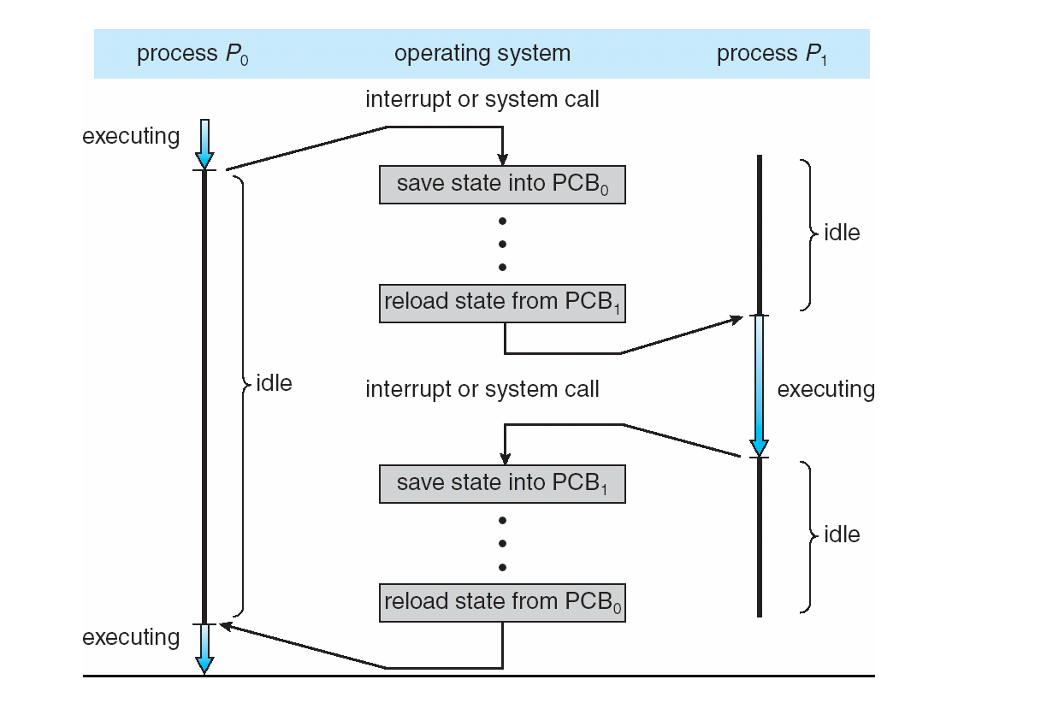
CPU Switch From Process to Process

Slide 9
Process Scheduling Queues
Job queue – set of all processes in the system
Ready queue – set of all processes residing in main memory, ready and waiting to execute
Device queues – set of processes waiting for an I/O device
Processes migrate among the various queues

Slide 10
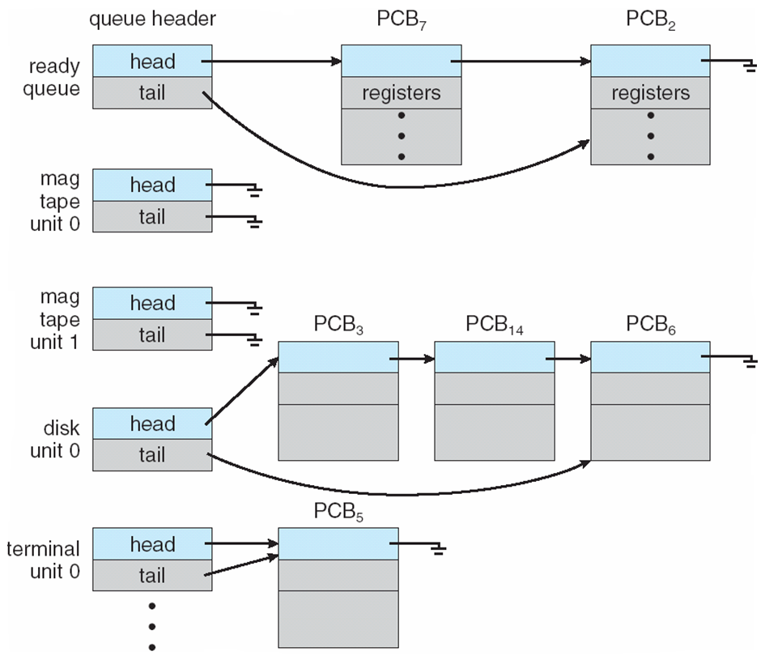
Ready Queue And Various I/O Device Queues

Slide 11
Schedulers
Long-term scheduler (or job scheduler) – selects which processes should be brought into the ready queue
This is mostly relevant for batch processing systems
Time frame: seconds, minutes, hours
Short-term scheduler (or CPU scheduler) – selects which process should be executed next and allocates CPU
This is what we are mainly concerned in a desktop or mobile OS.
Time frame: microseconds - milliseconds

Slide 12
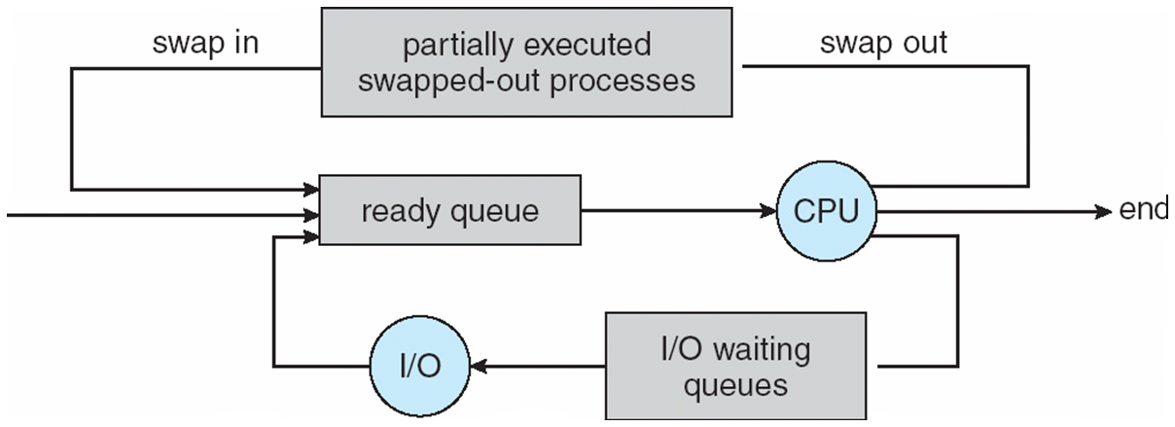
Addition of Medium Term Scheduling

Slide 13
Schedulers (Cont)
Short-term scheduler is invoked very frequently (milliseconds) ⇒ (must be fast)
Long-term scheduler is invoked very infrequently (seconds, minutes) ⇒ (may be slow)
The long-term scheduler controls the degree of multiprogramming
Processes can be described as either:
I/O-bound process – spends more time doing I/O than computations, many short CPU bursts
CPU-bound process – spends more time doing computations; few very long CPU bursts

Slide 14
Context Switch
When CPU switches to another process, the system must save the state of the old process and load the saved state for the new process via a context switch
The context of a process represented in the PCB
Context-switch time is overhead; the system does no useful work while switching
Time dependent on hardware support

Slide 15
The Unix way of process creation
The most natural way to create a new process would be to ask the operating system to run a new program in a new process
This is what both the desktop and the command line metaphors make you believe that it happens
This is what CreateProcess does in Windows
fork system call creates new process
Child duplicate of parent
The only difference is that:
In the parent, fork returns the PID of the child
In the child, fork returns 0
exec system call used after a fork to replace the memory space of the process with a new program
What remains, is the file handles for in, out and err

Slide 16
Process Creation

Slide 17
More about fork and exec
Why did they do this? This is crazy!
There are some reasons:
Resource sharing: open files and redirections are kept
Organizes the processes in a try hierarchy about who started what...
Although this is not really visible for most users and even developers
Parent can wait on the child process, it already has the ID
Fork can be made very cheap
With copy on write
… thus fork can be made a poor man’s threading
Not everybody is that convinced that this is the right way to do it, but we got used to it.

Slide 18
C Program Forking Separate Process
int main()
{
pid_t pid;
/* fork another process */
pid = fork();
if (pid < 0) { /* error occurred */
fprintf(stderr, "Fork Failed");
exit(-1);
}
else if (pid == 0) { /* child process */
execlp("/bin/ls", "ls", NULL);
}
else { /* parent process */
/* parent will wait for the child to complete */
wait (NULL);
printf ("Child Complete");
exit(0);
}
}

Slide 19
The Unix way of process termination
Process executes last statement and asks the operating system to delete it (exit)
Output data from child to parent (via wait)
The resources of the process are deallocated by operating system
Parent may terminate execution of children processes (abort) for several reasons:
Child has exceeded allocated resources
Task assigned to child is no longer required
If parent is exiting
Some operating systems do not allow child to continue if its parent terminates
All children terminated - cascading termination

