Slide 1
Chapter 14: Protection

Slide 2
Chapter 14: Protection
Goals of Protection
Principles of Protection
Domain of Protection
Access Matrix
Implementation of Access Matrix
Access Control
Revocation of Access Rights
Capability-Based Systems
Language-Based Protection

Slide 3
Objectives
Discuss the goals and principles of protection in a modern computer system
Explain how protection domains combined with an access matrix are used to specify the resources a process may access
Examine capability and language-based protection systems

Slide 4
Goals of Protection
Operating system consists of a collection of objects, hardware or software
Each object has a unique name and can be accessed through a well-defined set of operations.
Protection problem - ensure that each object is accessed correctly and only by those processes that are allowed to do so.

Slide 5
Principles of Protection
Guiding principle – principle of least privilege
  Programs, users and systems should be given just enough privileges to perform their tasks

Slide 6
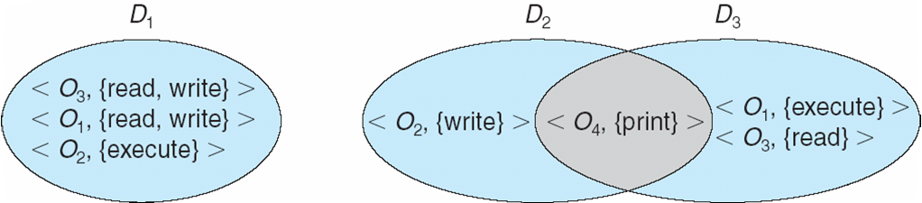
Domain Structure
Access-right = <object-name, rights-set>
where rights-set is a subset of all valid operations that can be performed on the object.
Domain = set of access-rights

Slide 7
Domain Implementation (UNIX)
System consists of 2 domains:
  User
  Supervisor
UNIX
  Domain = user-id
  Domain switch accomplished via file system.
    Each file has associated with it a domain bit (setuid bit).
    When file is executed and setuid = on, then user-id is set to owner of the file being executed. When execution completes user-id is reset.

Slide 8
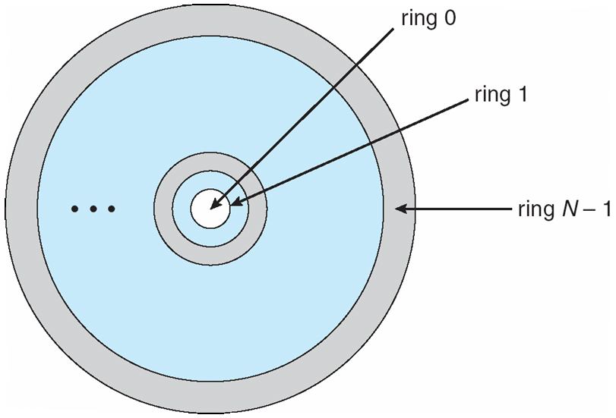
Domain Implementation (MULTICS)
Let D_{i} and D_{j} be any two domain rings.
If j < I ⇒ D_{i} ⊆ D_{j}

Slide 9
Access Matrix
Theoretical model introduced by Butler Lampson in 1971
  Not implemented quite in this way, it mostly gives you a language to talk about protection in general
View protection as a matrix (access matrix)
Rows represent domains
Columns represent objects
Access(i, j) is the set of operations that a process executing in Domain_{i} can invoke on Object_{j}

Slide 10
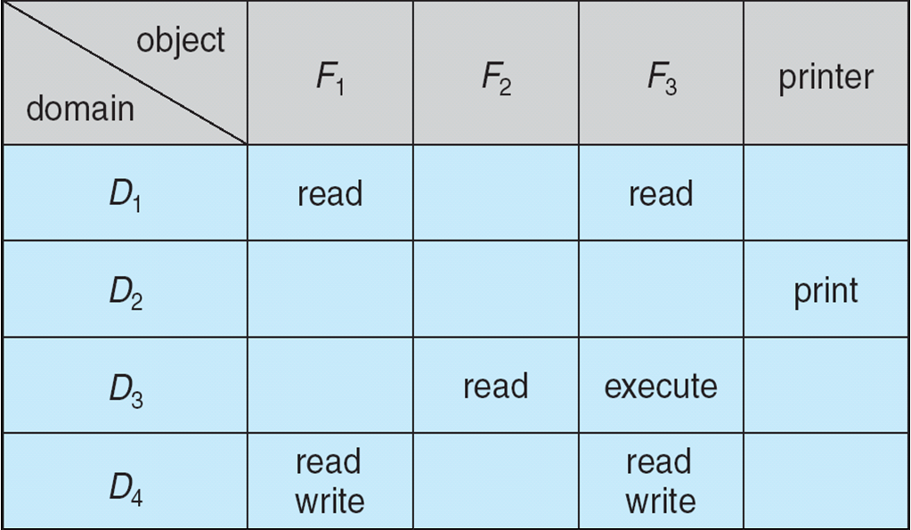
Access Matrix

Slide 11
Use of Access Matrix
If a process in Domain D_{i} tries to do “op” on object O_{j}, then “op” must be in the access matrix.
Can be expanded to dynamic protection.
  Operations to add, delete access rights.
  Special access rights:
    owner of O_{i}
    copy op from O_{i} to O_{j}
    control – D_{i} can modify D_{j} access rights
    transfer – switch from domain D_{i} to D_{j}

Slide 12
Use of Access Matrix (Cont.)
Access matrix design separates mechanism from policy.
  Mechanism
    Operating system provides access-matrix + rules.
    If ensures that the matrix is only manipulated by authorized agents and that rules are strictly enforced.
  Policy
    User dictates policy.
    Who can access what object and in what mode.

Slide 13
Protection models
Access control lists
Capability based models
Role based models

Slide 14
Access control list
List of permissions attached to an object (what user can do what to the object)
  Can be seen as one slice of the access matrix
  Stored with the object
Object can be:
  File system objects (files, directories)
  Devices (in Unix, they are files!)
  Processes
From a practical point of view, it frequently does not list all the users, but refer to them as groups
  Owner, group, other is a typical one
Requires trust in the user authentication

Slide 15
Capability-Based Systems
Capability (or key)
  Communicatable, unforgable token of authority
    An object + access rights
  The granting and distributing access rights happens through the distribution of capability tokens
  You need to pass the token along the function call to show that you have access
Historical systems:
  Hydra
  Cambridge CAP System etc.
Current relevance
  Symbian
  Some level of support in POSIX, extensions under work (see Capsicum at U. Cambridge)
  Protection in web browsers (e.g. sandboxing)

Slide 16
Role-based Access Control (RBAC)
Large organizations: it is difficult to specify the rights of every user / every object on a fine-grain level
Users are not assigned permissions directly:
  They can be assigned one or more roles.
  Permissions are attached to active roles.
The permissions are usually assigned at higher level than in ACLs
  ACL: can read, can write
  RBAC: can create a new account, etc.
This way if a user is promoted, he acquires new roles
In large organizations, you usually want to have a hierarchy of roles

Slide 17
Language-Based Protection
What we have seen up to now is protection happening at the OS level
Protection at the programming language level:
  Objects of protection are finer grain: down to the level of objects and method calls in an object oriented language
  What can you access?
How is the protection enforced:
  By the execution environment: you must trust that the VM does the right thing.
  For some things, it might fall back to whatever protection system is provided by the hardware and the operating system.

Slide 18
Protection in Java 2
Protection is handled by the Java Virtual Machine (JVM)
A class is assigned a protection domain when it is loaded by the JVM.
The protection domain indicates what operations the class can (and cannot) perform.
If a library method is invoked that performs a privileged operation, the stack is inspected to ensure the operation can be performed by the library.
  Note that you need to trust the stack!

Slide 19
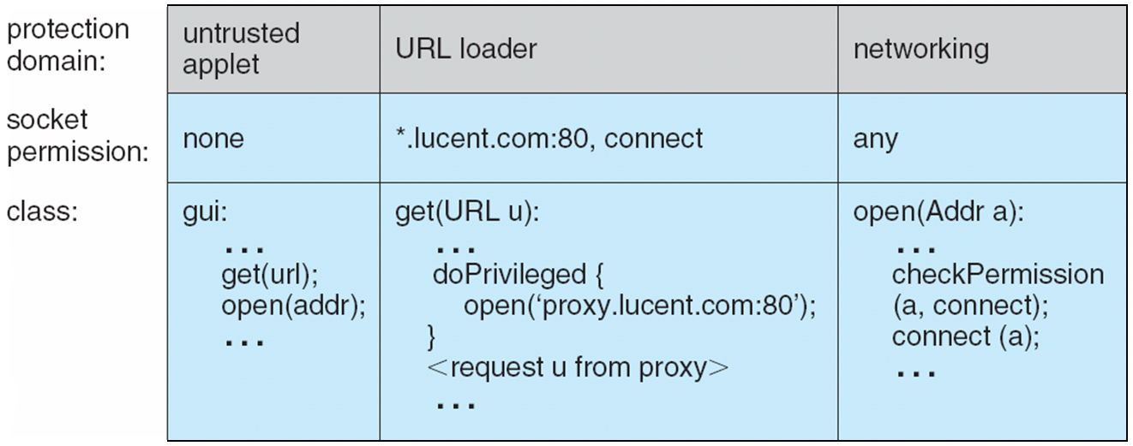
Stack Inspection

Slide 20
End of Chapter 14

