Slide 1
Chapter 2: Operating-System Structures

Slide 2
A very brief history
Cut here to the slide deck on early history
Punch card reader
https://www.youtube.com/watch?v=se0F1bLfFKY
Unix
https://en.wikipedia.org/wiki/History_of_Unix
Creation of Linux
https://en.wikipedia.org/wiki/History_of_Linux#The_creation_of_Linux

Slide 3
System calls and APIs

Slide 4
System calls
We could use the operating system as a library, and just compile it together with the application.
Then, all the operations involving I/O could be simple function calls.
This had been done before. If you only want to run a single program, it is ok.
For multiple programs: bad idea! Safety, reliability…
We want to separate the OS and the application programs
Instead of a regular function call, which would allow the program unlimited access to the OS functions …
We have a system call – the program asks the OS to do something, then it hands over the control to the OS.
The OS might or might not do it.

Slide 5
System Call Implementation
Typically, a number associated with each system call
System-call interface maintains a table indexed according to these numbers
The system call interface invokes intended system call in OS kernel and returns status of the system call and any return values
The typical way to request a system call is through a trap (software interrupt)
Usually involves assembly language programming, as you need to transfer information in registers, memory blocks etc
The caller need know nothing about how the system call is implemented
Just needs to obey API and understand what OS will do as a result call
Most details of OS interface hidden from programmer by API
Managed by run-time support library (set of functions built into libraries included with compiler)

Slide 6
Example of system call (MS-DOS)
MOV DI,1000H
MOV AH,01H
LOOP INT 21H
CMP AL,0DH
JE END
MOV [DI],AL
INC DI
JMP LOOP
END
This code reads from the console using system call 01H the characters until the end-of-line character (0D = 10) will be encountered and puts it to the location 1000H.

Slide 7
System Call Parameter Passing
Often, more information is required than simply identity of desired system call
Exact type and amount of information vary according to OS and call
Three general methods used to pass parameters to the OS
Simplest: pass the parameters in registers
In some cases, may be more parameters than registers
Parameters stored in a block, or table, in memory, and address of block passed as a parameter in a register
This approach taken by Linux and Solaris
Parameters placed, or pushed, onto the stack by the program and popped off the stack by the operating system
Block and stack methods do not limit the number or length of parameters being passed

Slide 8
System Calls and APIs
The operating systems usually provide a standard library of higher level APIs which wrap the raw system call into something more managable
Typically written in a high-level language (C or C++)
Might be further wrapped in language specific interfaces
The collection of the APIs define the operating systems programming model:
As long as you stick to them, your programs will be portable (but might need to be recompiled)
Three most common APIs are
Win32 API for Windows,
POSIX API for POSIX-based systems (including virtually all versions of UNIX, Linux, and Mac OS X)
Java API for the Java virtual machine (JVM)
For the rest of the class, we will usually call the wrapped call in the API as a “system call”

Slide 9
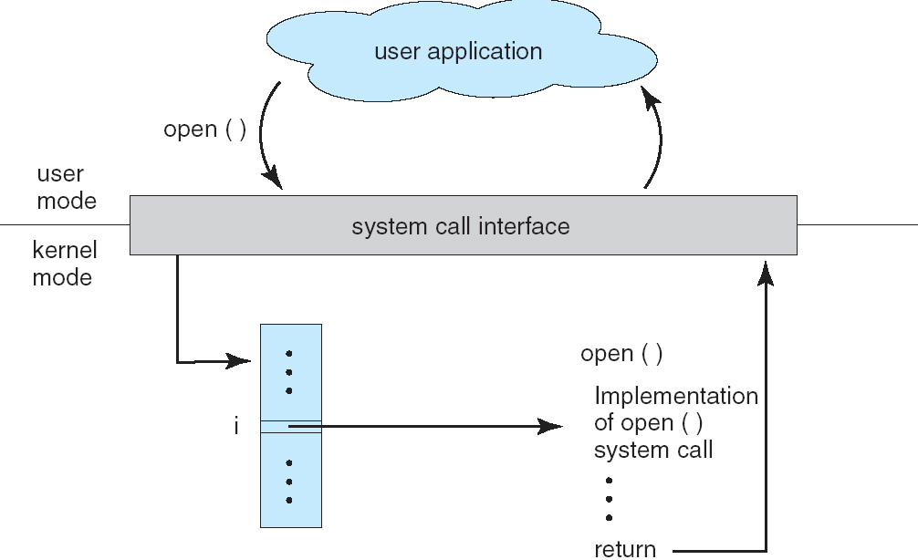
API – System Call – OS Relationship

Slide 10
Example of Standard API
Consider the ReadFile() function in the Win32 API—a function for reading from a file
A description of the parameters passed to ReadFile()
HANDLE file—the file to be read
LPVOID buffer—a buffer where the data will be read into and written from
DWORD bytesToRead—the number of bytes to be read into the buffer
LPDWORD bytesRead—the number of bytes read during the last read
LPOVERLAPPED ovl—indicates if overlapped I/O is being used

Slide 11
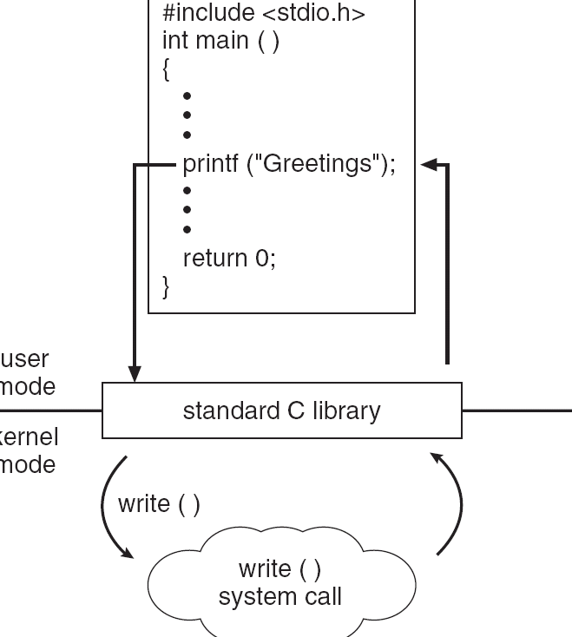
Standard C Library Example
C program invoking printf() library call, which calls write() system call

Slide 12
Types of System Calls
Process control
File management
Device management
Information maintenance
Communications
Protection

Slide 13
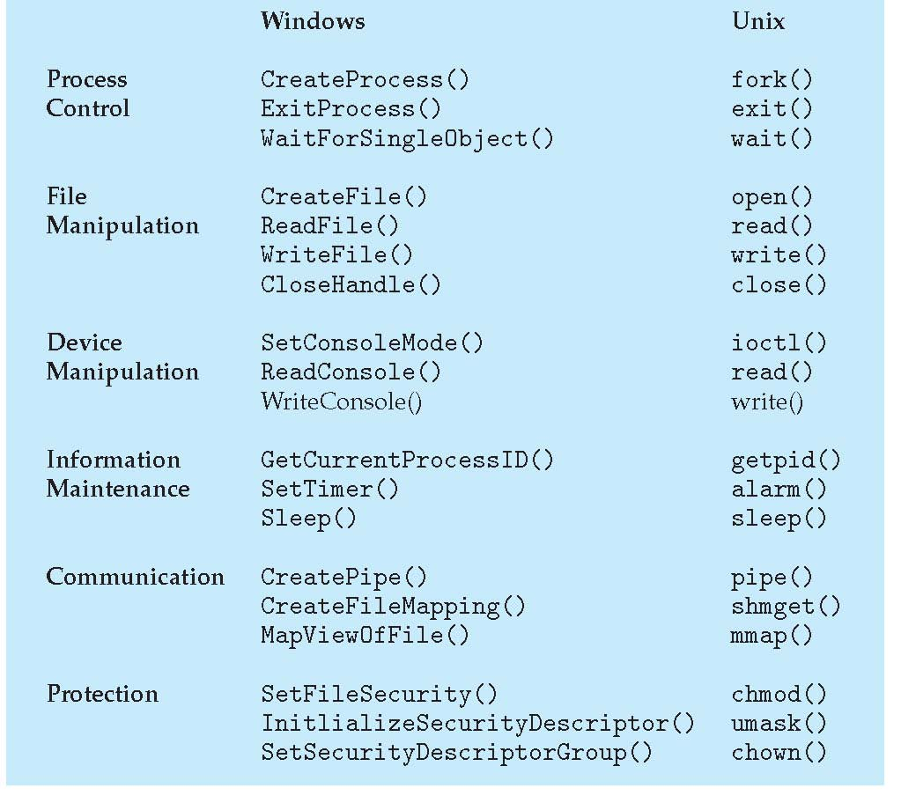
Examples of Windows and Unix System Calls

Slide 14
Kernels + Monolithic vs. microkernel models

Slide 15
Kernel based systems
Kernel-space
Sensitive stuff, controlled only by the OS
Provides the file system, CPU scheduling, memory management, and other operating-system functions;
a large number of functions for one level
An error in the kernel can crash the OS
User-space
Applications programs
Whatever they do, they cannot bring down the OS

Slide 16
User mode and kernel mode
We need support from the hardware in order the separate the kernel and the user application
Without this, we cannot ensure that a (possibly malicious) software won’t override kernel memory
Mode bit provided by hardware
Provides ability to distinguish when system is running user code or kernel code
Some instructions designated as privileged, only executable in kernel mode
System call changes mode to kernel, return from call resets it to user
From user mode to kernel mode:
Hardware interrupt: e.g external signal such as timer
Trap (software interrupt): you provide a number, but the OS determines where it is going to jump and how it will handle it.
From kernel mode to user mode:
Return from interrupt

Slide 17
Transition from User to Kernel Mode

Slide 18
What goes into the kernel?
There is no requirement that as soon as we call an API function, we immediately enter kernel mode.
Maybe most of the work could be done outside the kernel!

Slide 19
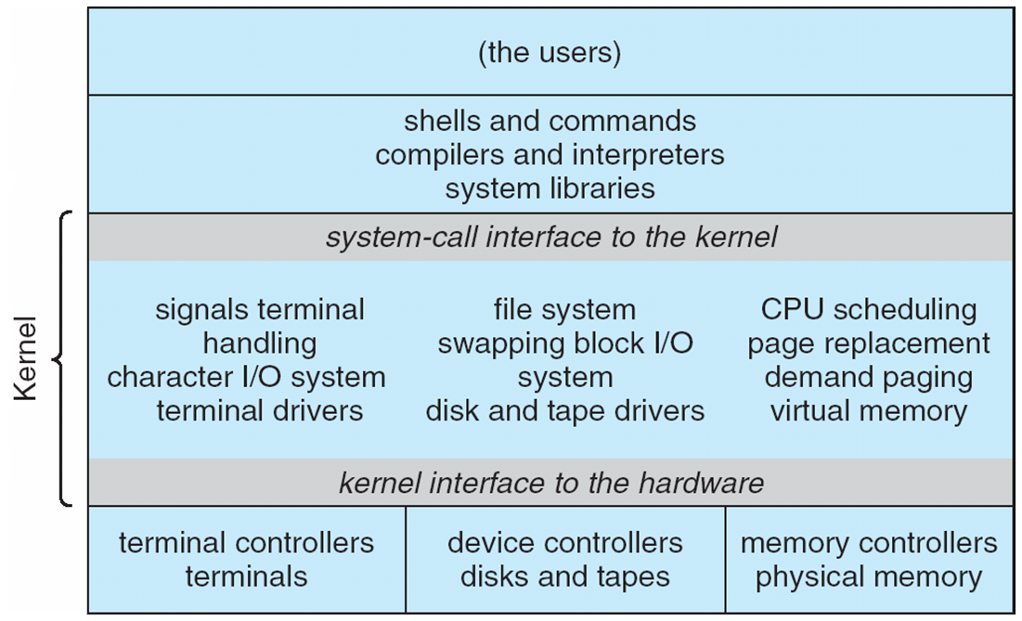
Traditional UNIX System Structure

Slide 20
Monolithic kernel
Idea: make the kernel self sufficient
All the basic functions go into the core OS
All the code that runs in the OS process lies in the same address space.
(Claimed) benefits:
Writing logic is fairly easy
Once you are in the kernel, it is just regular function calls.
Code runs faster
Once you are in the kernel, no more context switches
(Claimed) drawbacks:
Not easy to port the operating system to new architectures
You need to port a lot of stuff
Very fragile (whatever that means)
A lot of code in kernel mode, a lot of things can go wrong.

Slide 21
Monolithic kernel vs. microkernel

Slide 22
Microkernels
Idea: make the kernel small
Moves as much as possible from the kernel into “user” space
Communication takes place between user modules using message passing
(Claimed) benefits:
Easier to extend a microkernel
Easier to port the operating system to new architectures
More reliable (less code is running in kernel mode)
More secure
Drawbacks:
Performance overhead of user space to kernel space communication
Programming complexity

Slide 23
Microkernel – the glory and the fall
In the 1990s micro-kernels have been thought as the logical evolution of OS
http://en.wikipedia.org/wiki/Tanenbaum-Torvalds_debate
The Mach kernel was long seen as the replacement for the traditional Unix kernel
In practice, they turned out very difficult to program
Massive performance problems…. (1997 – Mach based system 50% slower than native Unix kernel)
Hard to know now whether this could have been fixed
None of the current OS-s are properly microkernel
Linux: monolithic kernel and proud of it
Windows: “Windows-NT” - a so called hybrid kernel – very small parts outside the kernel
MacOS: “XNU” – also hybrid kernel

Slide 24
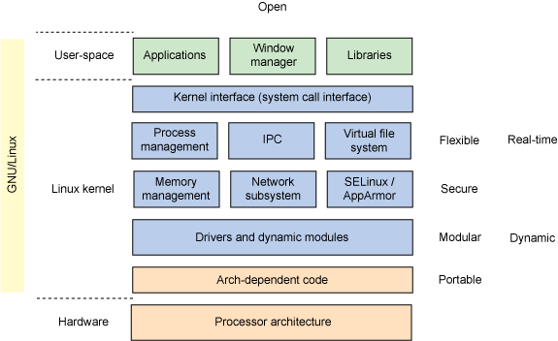
Linux Kernel

Slide 25
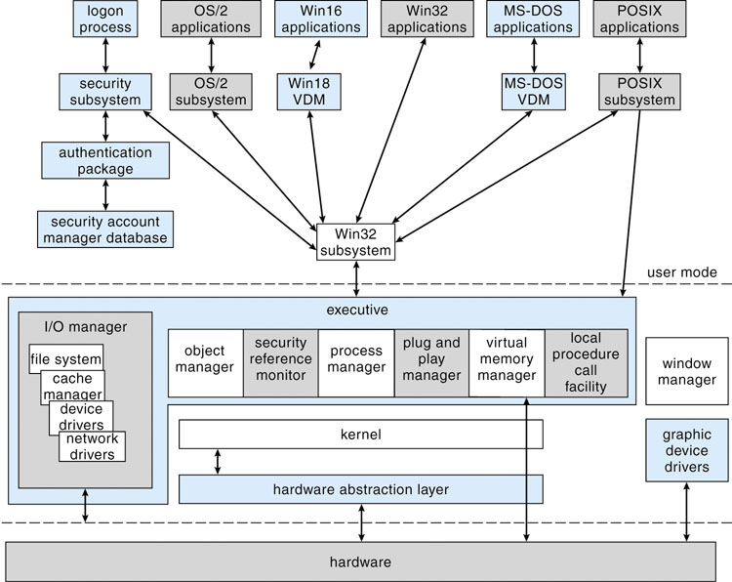
Microsoft Windows Structure

Slide 26
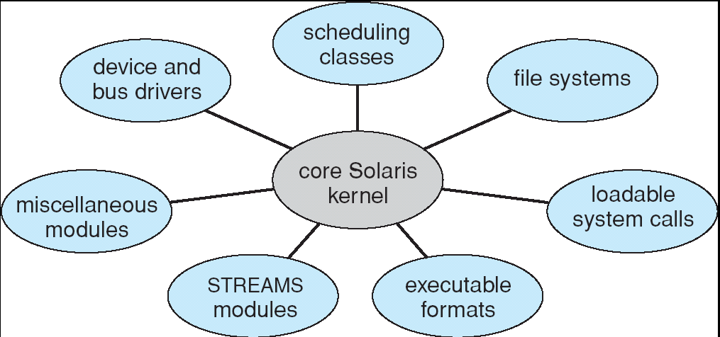
Kernel modules
Most modern operating systems implement kernel modules
An object-oriented approach
Each core component is separate
Each talks to the others over known interfaces
Each is loadable as needed within the kernel
Kernel modules are not making an OS microkernel
They run inside the kernel, not outside it
… but obviously achieve some of the same modularity

Slide 27
User-space drivers
I/O drivers that operate in the user space (“userland”) as an idea clearly did not go away
In fact, it is preferable to implement drivers in user space for many devices and OS components:
Windowing systems (e.g. X11)
Audio drivers
Some graphics components
Even some file system drivers (“fuse” – file system in userspace)
E.g. encrypted file systems, distributed file systems etc. can be implemented like this

Slide 28
Virtual machines

Slide 29
Virtual Machines
We will call the physical machine the physically implemented computer system: processor, instruction set, memory etc.
The operating system runs on the machine
A virtual machine emulates a physical machine
Has processor, instruction set, memory etc.
These might or might not differ from the features of the underlying physical machine.
It can run an operating system, programs etc.
The OS and programs might or might not know that they are running on a physical or virtual hardware.

Slide 30
Virtual Machines History
First appeared commercially in IBM mainframes in 1972
Fundamentally, multiple execution environments (different operating systems) can share the same hardware
Protected from each other
Some sharing of file can be permitted, controlled
Communicate with each other, other physical systems via networking
Consolidation of many low-resource use systems onto fewer busier systems

Slide 31
VMs, enterprise and cloud computing
Took off around 2005 in enterprise environments
Vmware
Openstack
Basically, directly running an OS on the hardware (“bare metal”) is almost unheard off in a data center.
E.g. League of Legends servers by Riot Games
Cloud systems provide VMs paid by the hour
AWS EC2 (Amazon Elastic Compute Cloud)
Microsoft Azure VM instances
Google Cloud VM instances
Provisioning a new computer used to take weeks:
Order the hardware, install it, install software etc.
Now it takes seconds!
Notes:
The only customer we encountered who wanted bare metal was Riot Games of League of Legends fame.

Slide 32
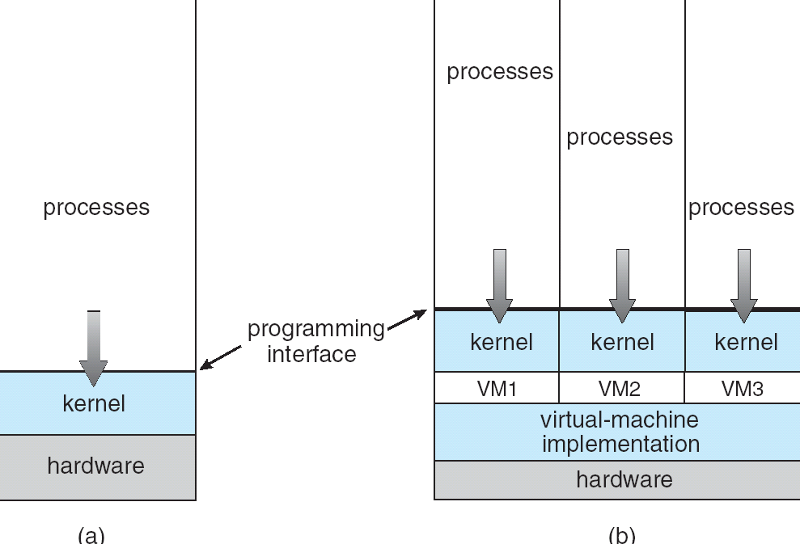
Virtual Machines (Cont)
(a) Non-virtual machine (b) virtual machine
Non-virtual Machine
Virtual Machine

Slide 33
Some virtual machine terminologies
Full virtualization
Simulate enough hardware to allow running an unmodified guest OS
Can even do different hardware
Hardware assisted virtualization
Use the hardware (primarily, the CPU) to help in virtualizing
Eg. KVM, Xen, Parallels Desktop for Mac, Vmware Fusion, Vmware Workstation
Software based virtualization
Virtualization without the help of the hardware. Normally, you cannot do full virtualization.
Eg. VirtualBox
Operating system level virtualization (not exactly virtual machines, but they approximate it)
Linux containers (LXC)
Docker

Slide 34
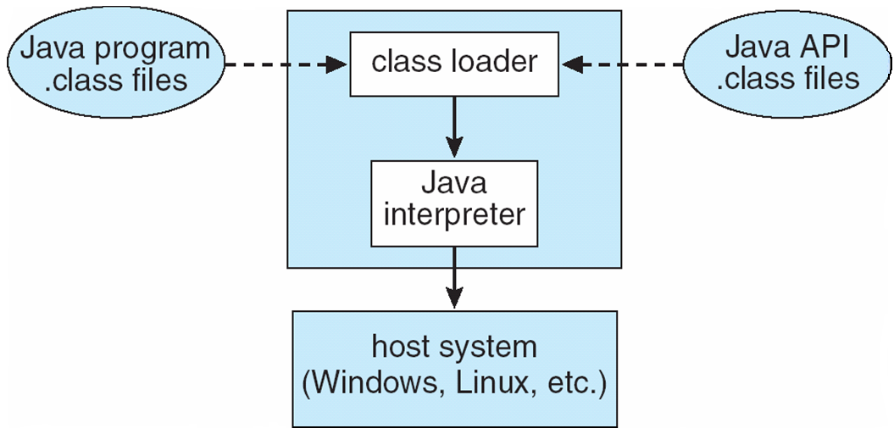
The Java Virtual Machine

Slide 35
Java VM
JVM creates a machine which is different from the processor architectures it is running on.
It is _very_ different from both the Intel, MIPS and ARM instruction sets
It is a mixture of a stack machine and register machine
Attempts to implement it in hardware were not commercially successful
It is a machine which is essentially always emulated!

