Slide 1
Layering

Slide 2
Skrodes
  “The skrodes (…) are devices which can be made everywhere in the Beyond (…) but their design is clearly High Beyond or Transcendent. (…). He had looked at the design diagrams – dissections really – of skrodes. On the outside, it was a mechanical device, with moving parts even. And the text claimed that it can be made with the simplest of factories (…). And yet the electronics was a seemingly random mass of components without any trace of hierarchical design or modularity. It worked, and far more efficiently than something designed by human equivalent minds, but repair and debugging of the cyber component – was out of question.”
  Vernor Vinge: A fire upon the deep

Slide 3
Why layering?
All human engineering is based on components.
  A single human cannot wrap its mind around the complete picture
  So everything we do is based on components
  Thus, your car mechanic does not need a PhD! (not that a single PhD would be enough).
  All the software engineering techniques (structured programming, object oriented, component oriented, agent oriented, aspect oriented: are just different ways to slice and dice the components.
Components imply:
  Encapsulation of a relatively easily understood functionality
  Narrowly defined external interfaces
Layering is just one way to do components
  Allows us to wrap our mind around

Slide 4
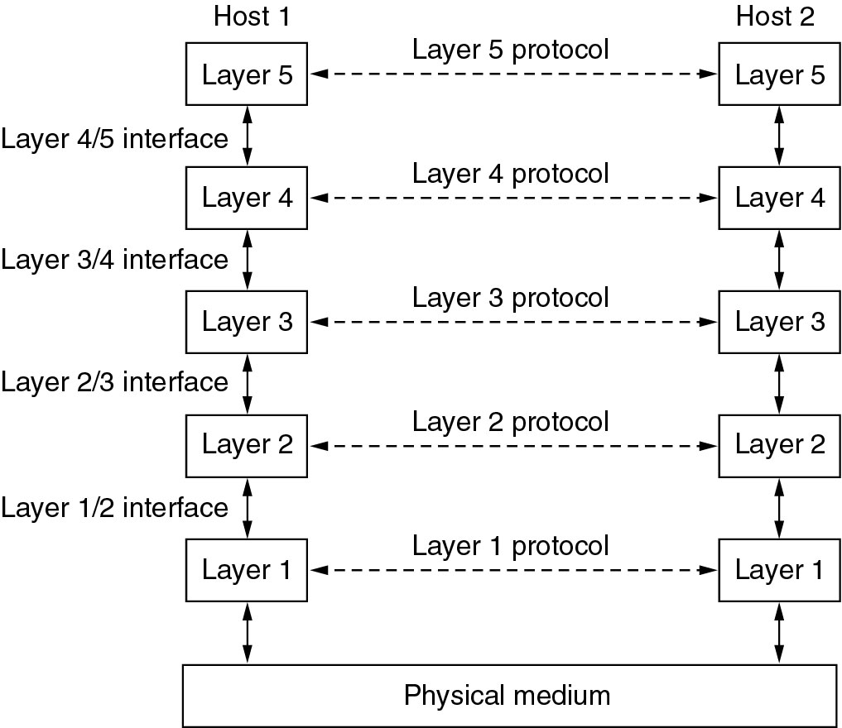
Network Software
Protocol Hierarchies
Layers, protocols, and interfaces.

Slide 5
Protocol Hierarchies (2)
The philosopher-translator-secretary architecture.

Slide 6
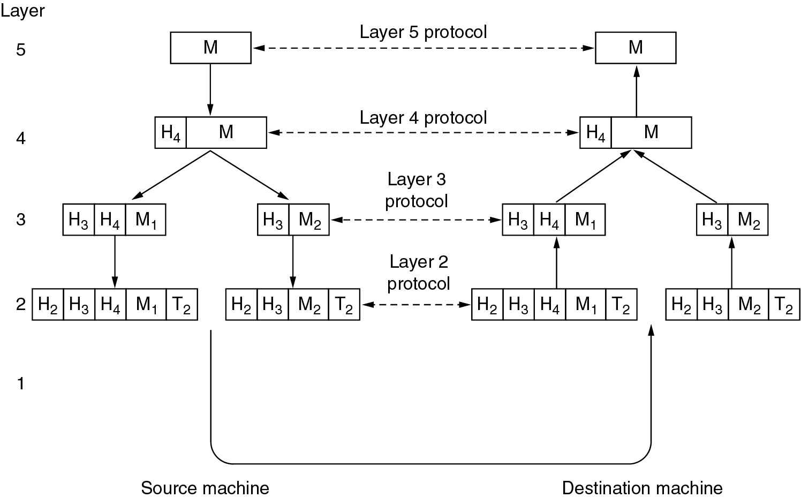
Protocol Hierarchies (3)
Example information flow supporting virtual communication in layer 5.

Slide 7
Design Issues for the Layers
Addressing
  If multiple nodes on the same network
Error Control
  Error detecting and error correcting codes
  Reassembly after out of order delivery
Flow Control
  Slow receiver, fast sender needs to slow down
  Also for avoiding the overload of intermediary nodes
Multiplexing
  Sharing a single connection
Routing

Slide 8
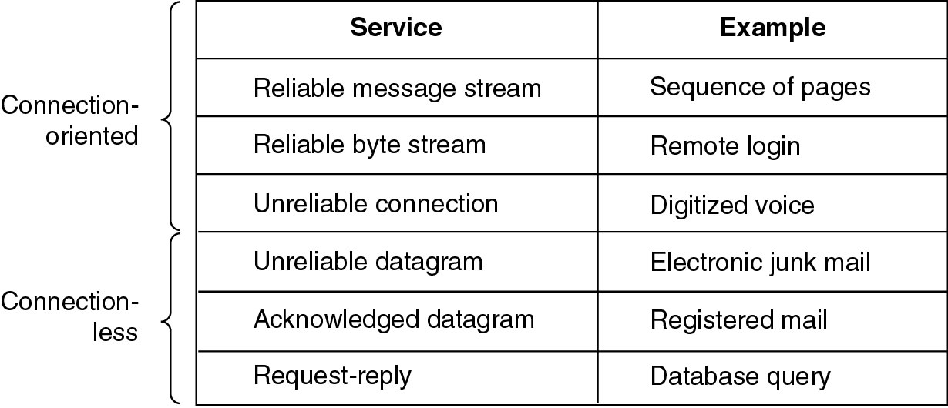
Connection-Oriented and Connectionless Services
Six different types of service.

Slide 9
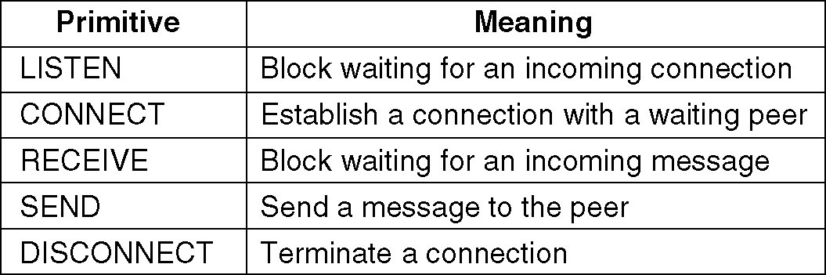
Service Primitives
Five service primitives for implementing a simple connection-oriented service.

Slide 10
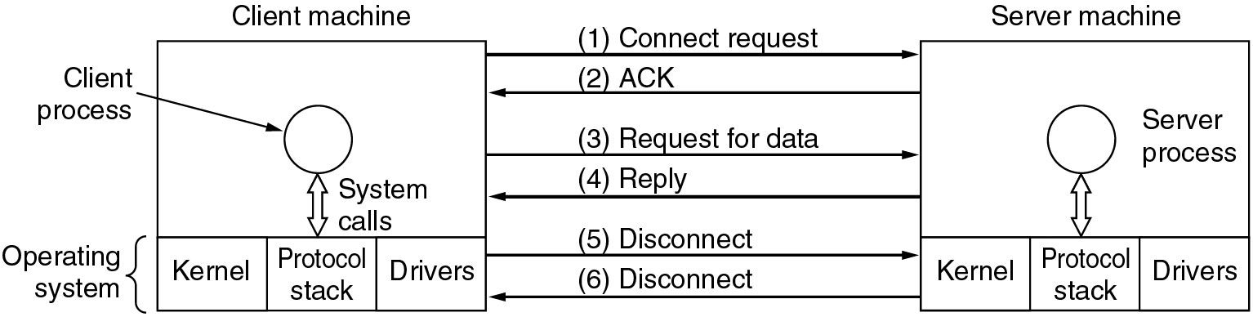
Service Primitives (2)
Packets sent in a simple client-server interaction on a connection-oriented network.

Slide 11
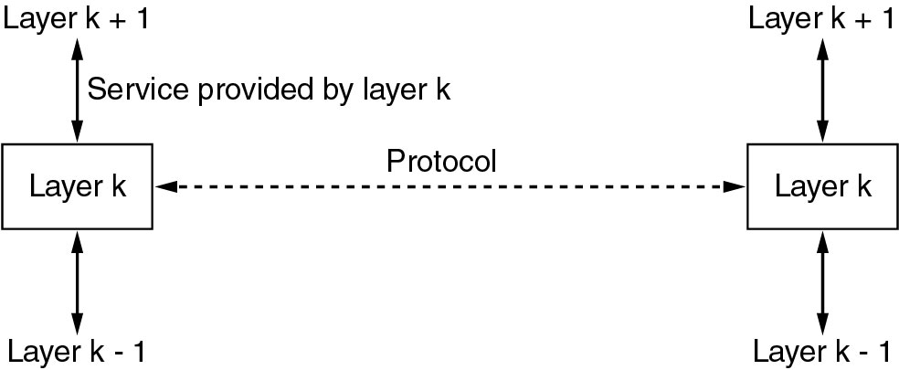
Services to Protocols Relationship
The relationship between a service and a protocol.

Slide 12
Reference Models
The OSI Reference Model
The TCP/IP Reference Model
A Comparison of OSI and TCP/IP
A Critique of the OSI Model and Protocols
A Critique of the TCP/IP Reference Model

Slide 13
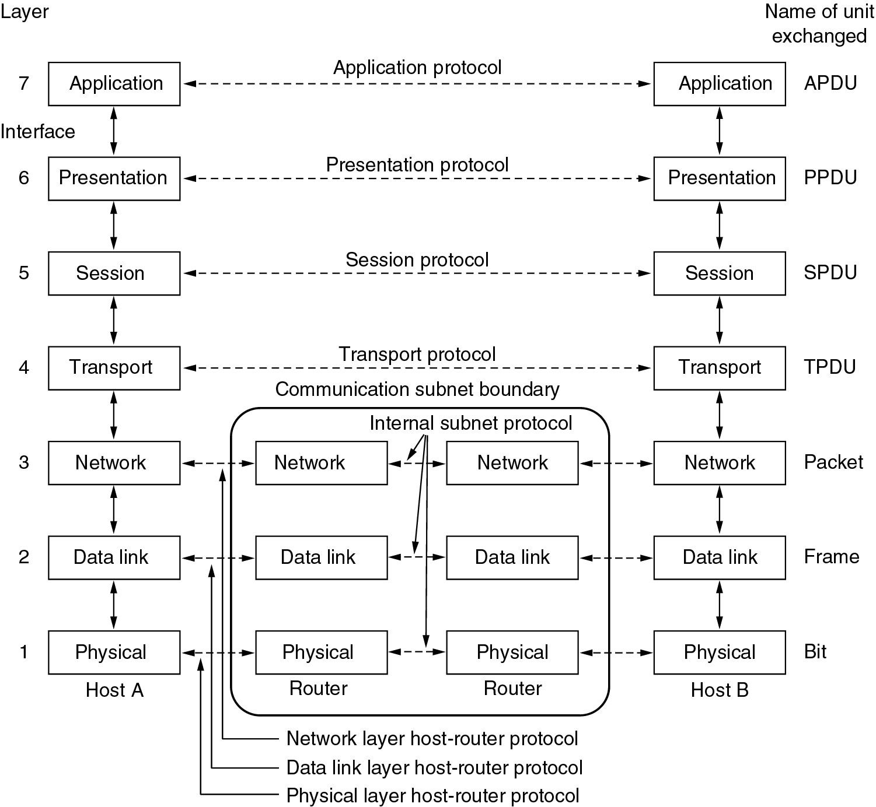
Reference Models
The OSI reference model.

Slide 14
OSI layers (cont’d)
Physical layer
  Transmitting raw bits over a communication channel
  Encoding of the data on the physical media (wire, optic fiber, air)
  How many pins does a network connector have
Data link layer
  Transform the raw connection into a line which appears free of (undetected) transmission errors
  Breaking the data into frames
  Acknowledgements
  Broadcast networks have an additional problem: how to control access to the shared channel: the medium access control sublayer.

Slide 15
OSI layers (cont’d)
Network layer
  Controls the operation of a subnet
  Routing from source to destination
Transport layer
  Accepting data from above, split it in smaller units, guarantee arrival and in-order assembly
  What type of service to provide to the higher layers?
    A pipe of infinite bandwidth and zero latency… (keep dreaming)
    A message transport abstraction, with guaranteed delivery
    A pipe with limited bandwidth and high latency
    A pipe with low latency, but no error free guarantee

Slide 16
OSI layers (cont’d)
Session layer
  Establish sessions
  Dialog control (who is sending next)
  Token management (actions which can only be performed by a single party)
  Synchronization
  All these things are normally done at the application layer
Presentation layer
  Syntax and semantics of the information transmitted
  Done at the application layer
Application layer
  This is what the user sees.
  There might be standards shared among applications: e-mail (SMTP), web (HTTP) etc.

Slide 17
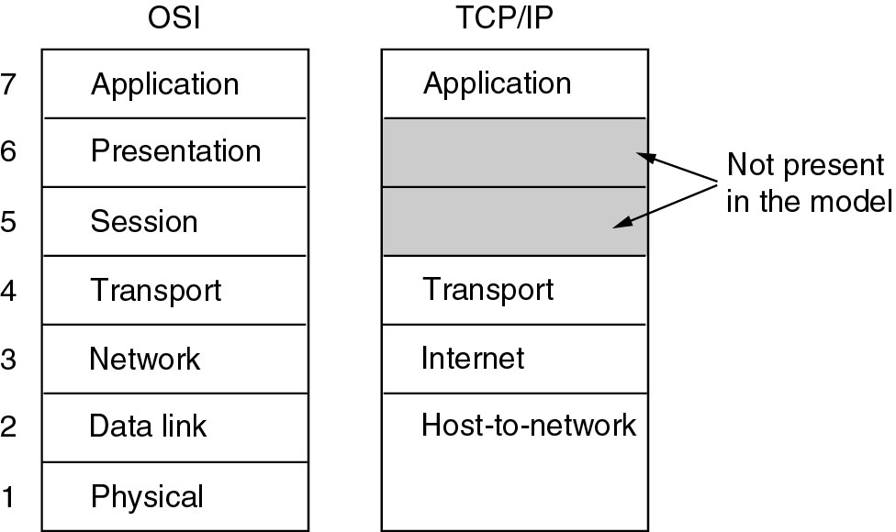
Reference Models (2)
The TCP/IP reference model.

Slide 18
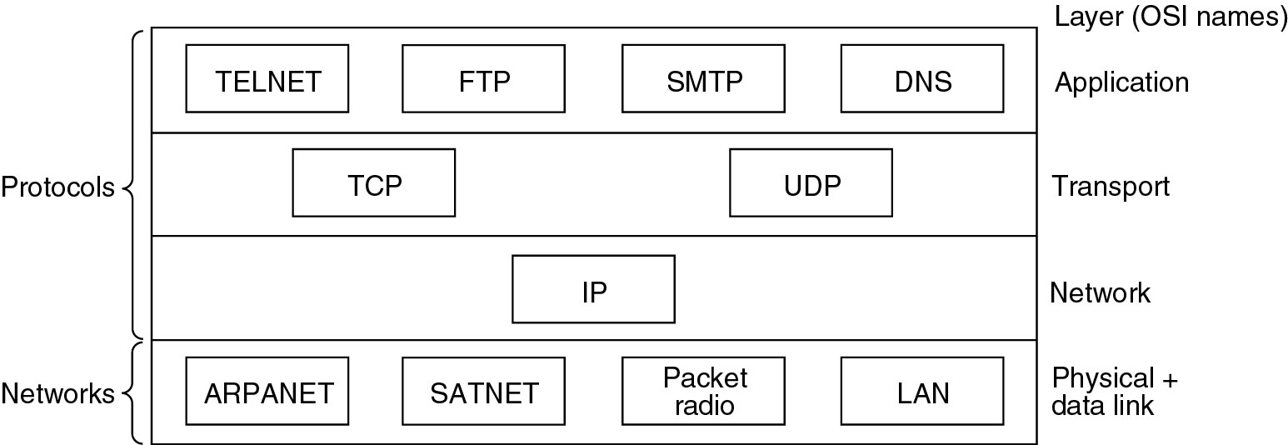
Reference Models (3)
Protocols and networks in the TCP/IP model initially.

Slide 19
TCP/IP model
Internet layer: IP protocol
  Addressing, routing
Transport layer:
  TCP (transmission control protocol)– provides an error free pipe, congestion control, limited bandwidth and relatively large latency
  UDP (user datagram protocol) – best effort delivery (packets can get lost), no congestion or bandwidth control, usually lower latency than TCP

Slide 20
Comparing OSI and TCP/IP Models
Concepts central to the OSI model
Services
Interfaces
Protocols

Slide 21
A Critique of the OSI Model and Protocols
Why OSI did not take over the world
Bad timing
Bad technology
Bad implementations
Bad politics

Slide 22
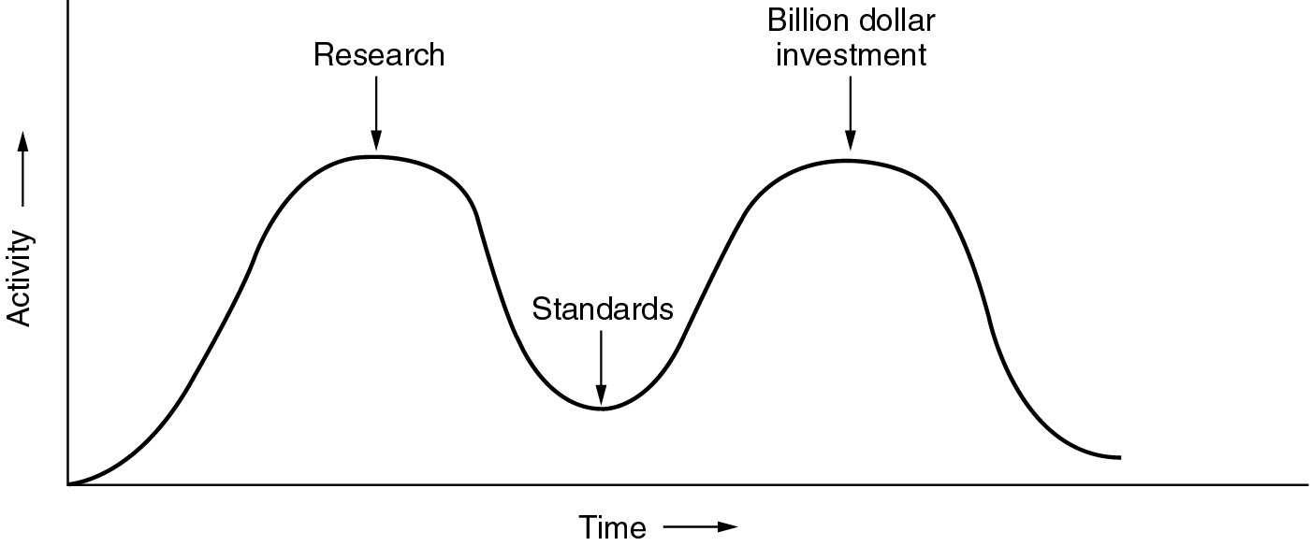
Bad Timing
The apocalypse of the two elephants.

Slide 23
A Critique of the TCP/IP Reference Model
Problems:
Service, interface, and protocol not distinguished
Not a general model
Host-to-network “layer” not really a layer
No mention of physical and data link layers
Minor protocols deeply entrenched, hard to replace

Slide 24
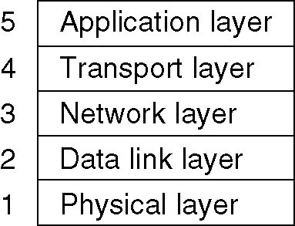
Hybrid Model
The hybrid reference model to be used in this book.

Slide 25
Internet Usage
Traditional applications (1970 – 1990)
  E-mail
  News
  Remote login (telnet, ssh)
  File transfer (ftp)
The World Wide Web (1990-2002)
  HTTP and HTML
  E-commerce
  Early client side attempts: Java Applets, ActiveX, Javascript
Web 2
  Dynamically generated pages, client side manipulation
  AJAX, related technologies

Slide 26
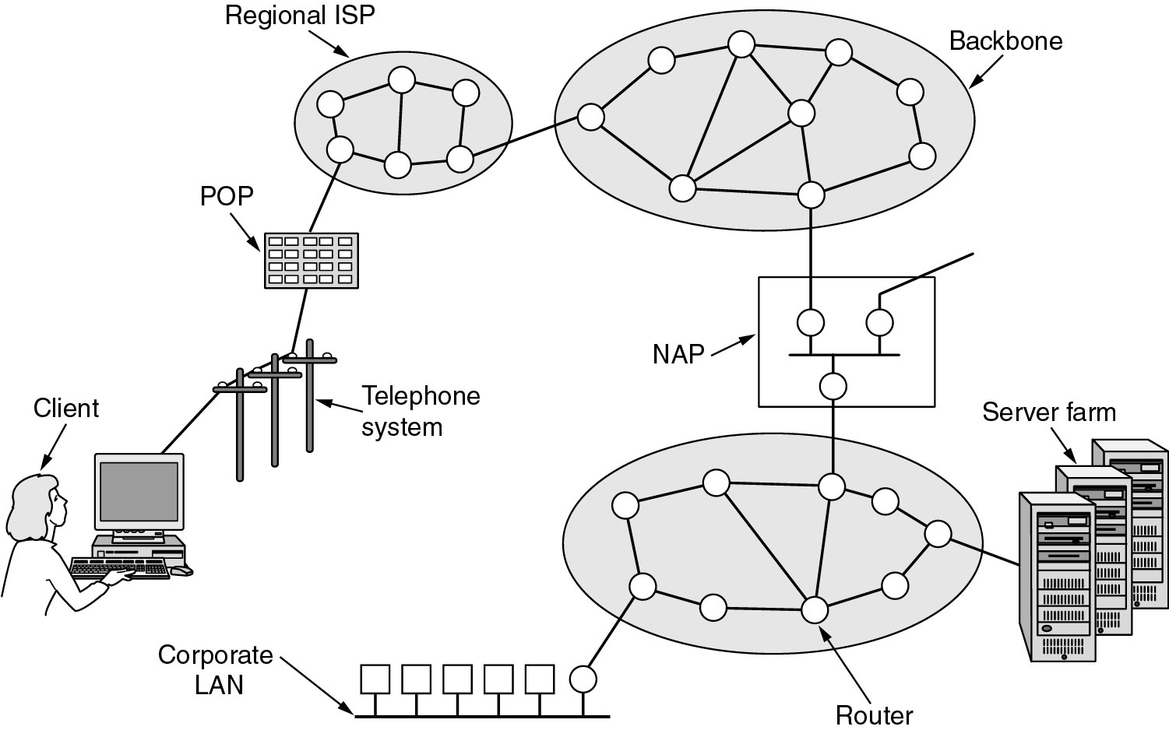
Architecture of the Internet
POP: ISP point of presence
NAP: network access point – interconnection of backbones

Slide 27
ATM: Asynchronous Transfer Mode
Designed in early 1990s (well past the internet) and under an incredible hype.
Strong corporate support from telephony companies.
It was seen as an alternative of the whole internet hierarchy.
What remains:
  Use inside telephone companies, often acting as the lower levels
  It is somewhat misleading, as the ATM standards were assumed to cover all the layers, and they have control structures looking more like the high level protocols.

Slide 28
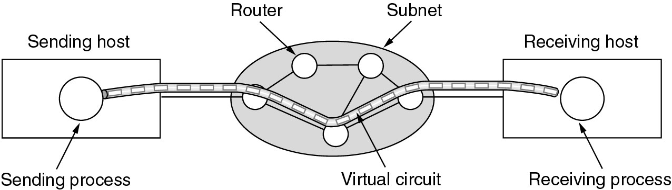
ATM Virtual Circuits
A virtual circuit.

Slide 29
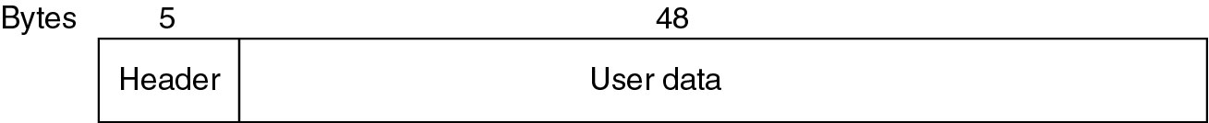
ATM Virtual Circuits (2)
An ATM cell.

Slide 30
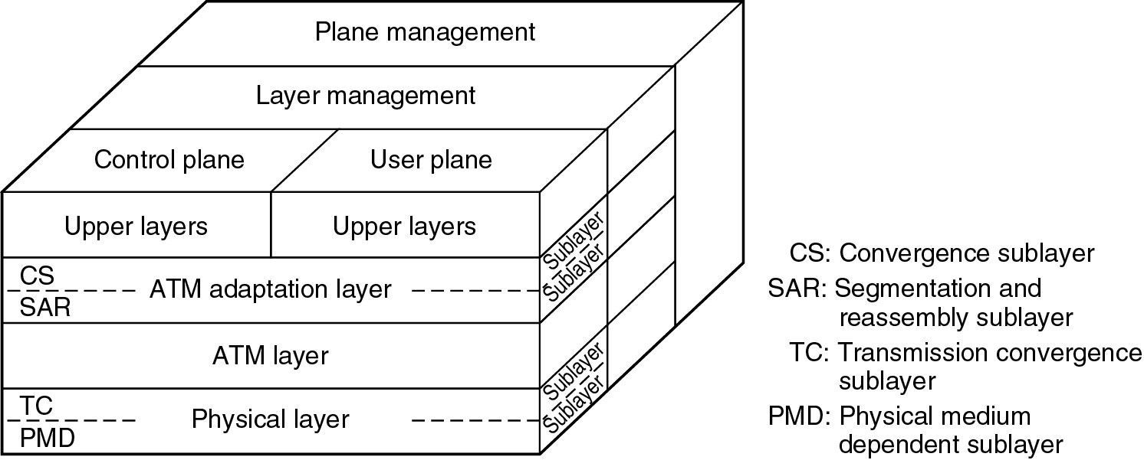
The ATM Reference Model
The ATM reference model.

Slide 31
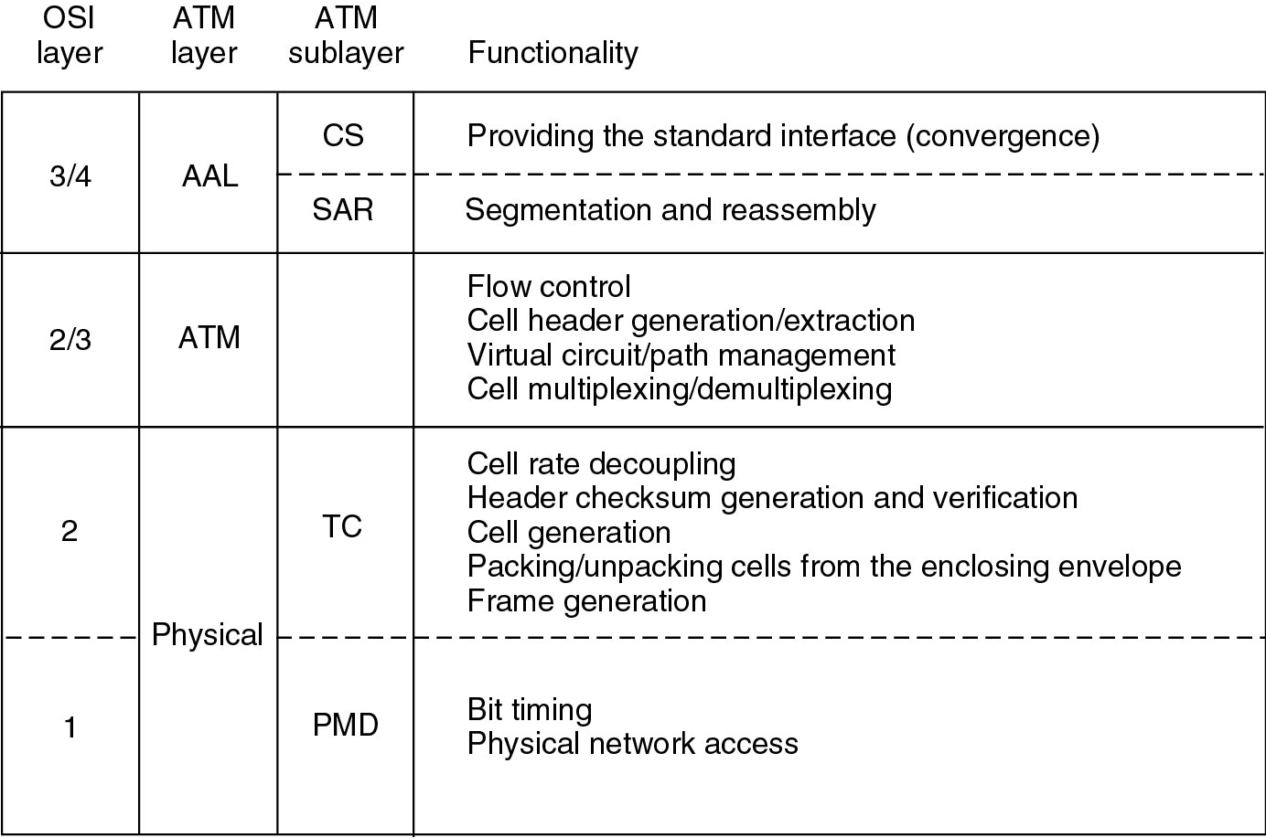
The ATM Reference Model (2)
The ATM layers and sublayers and their functions.

Slide 32
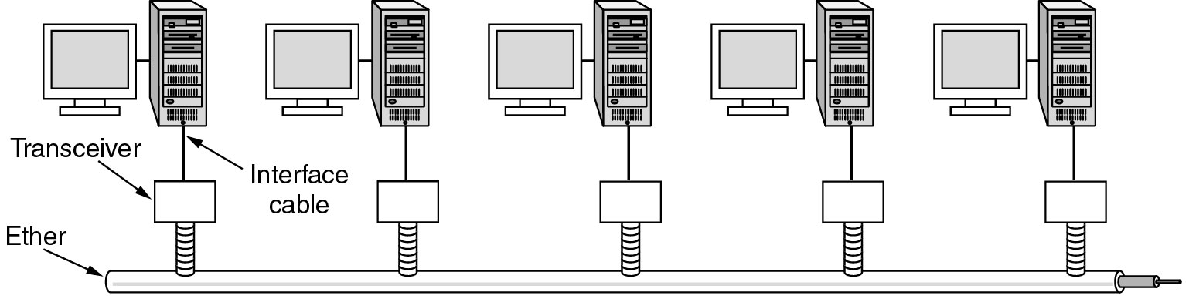
Ethernet
Architecture of the original Ethernet.

Slide 33
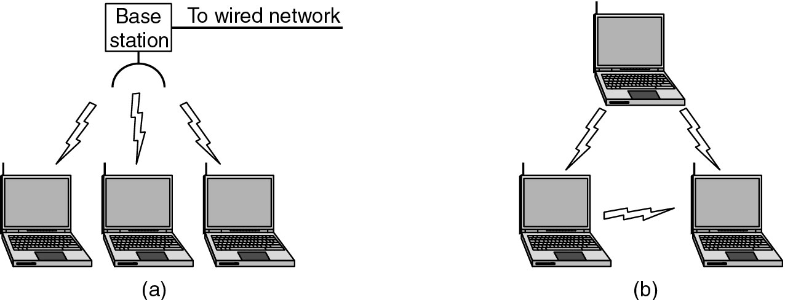
Wireless LANs
(a) Wireless networking with a base station.
(b) Ad hoc networking.

Slide 34
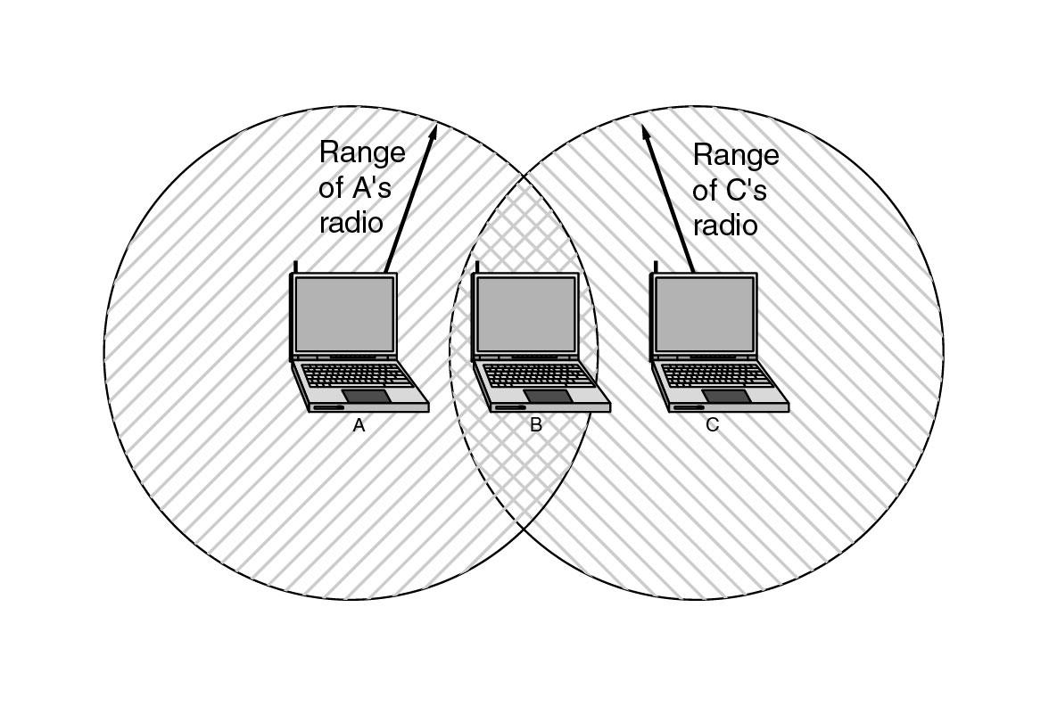
Wireless LANs (2)
The range of a single radio may not cover the entire system.

Slide 35
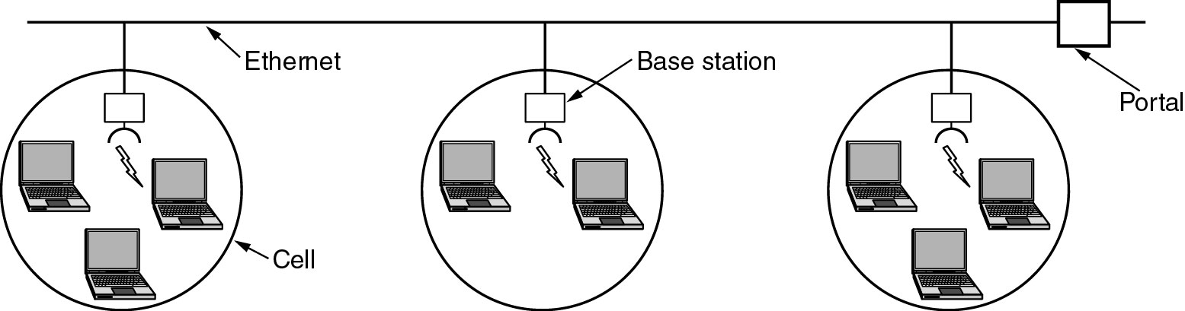
Wireless LANs (3)
A multicell 802.11 network.

Slide 36
Network Standardization
Who’s Who in the Telecommunications World
Who’s Who in the International Standards World
Who’s Who in the Internet Standards World

Slide 37
ITU
Main sectors
  Radiocommunications
  Telecommunications Standardization
  Development
Classes of Members
  National governments
  Sector members
  Associate members
  Regulatory agencies

Slide 38
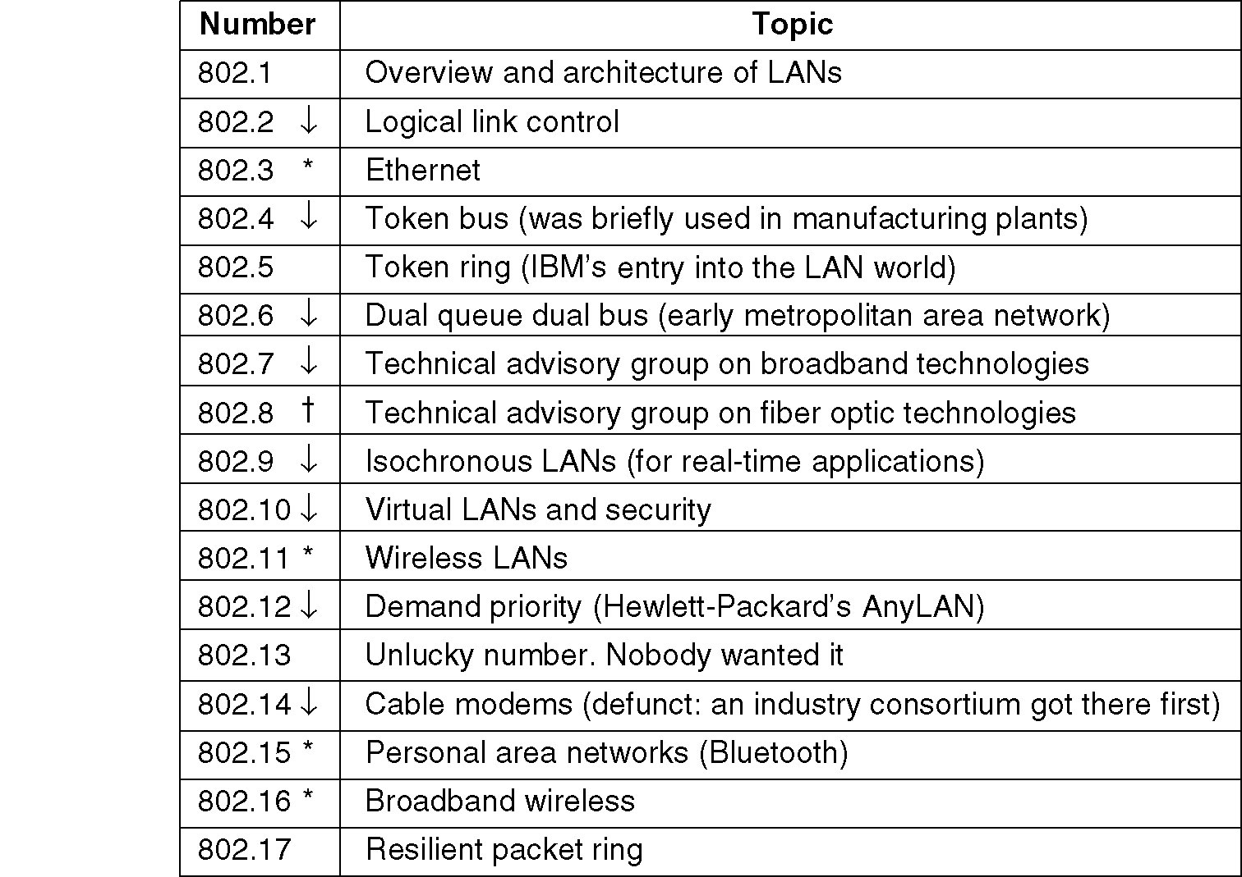
IEEE 802 Standards
The 802 working groups. The important ones are marked with *. The ones marked with ↓ are hibernating. The one marked with † gave up.

Slide 39
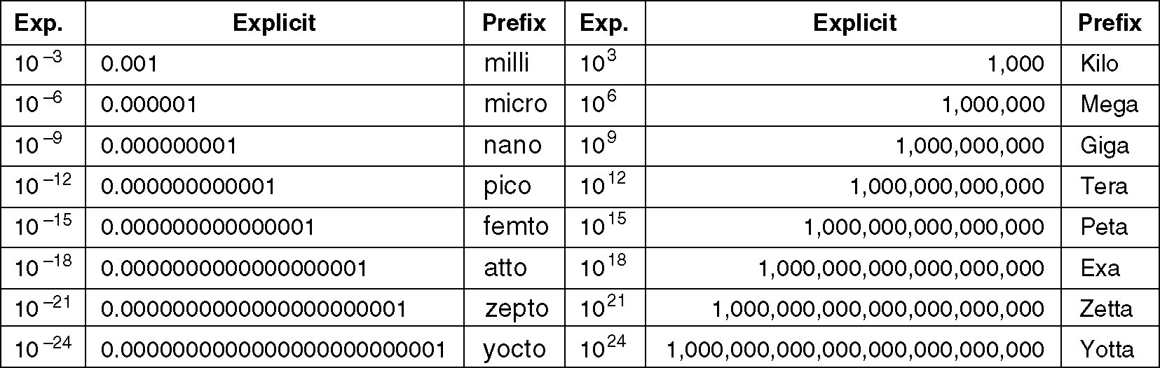
Metric Units
The principal metric prefixes.

