Slide 1
Content
Error detection and correction
MAC sub-layer
Ethernet
Token Ring

Slide 2
Access Protocols
Who gets to use the channel next?
  Fixed/Static assignment
  Demand assignment
  Contention
  Turn-Based

Slide 3
Contention Access Protocols
No coordination between hosts
Control is completely distributed
Outcome is probabilistic
Examples: ALOHA, CSMA, CSMA/CD

Slide 4
Contention Access (cont’d)
Advantages:
  Short delay for bursty traffic
  Simple (due to distributed control)
  Flexible to fluctuations in the number of hosts
  Fairness

Slide 5
Contention Access (cont’d)
Disadvantages:
  Can not be certain who will acquire the media/channel
  Low channel efficiency with a large number of hosts
  Not good for continuous traffic (e.g., voice)
  Cannot support priority traffic
  High variance in transmission delays

Slide 6
Contention Access Methods
Pure ALOHA
Slotted ALOHA
CSMA
  1-Persistent CSMA
  Non-Persistent CSMA
  P-Persistent CSMA
CSMA/CD

Slide 7
Slotted ALOHA
Assumptions
all frames same size
time is divided into equal size slots, time to transmit 1 frame
nodes start to transmit frames only at beginning of slots
nodes are synchronized
if 2 or more nodes transmit in slot, all nodes detect collision
Operation
when node obtains fresh frame, it transmits in next slot
no collision, node can send new frame in next slot
if collision, node retransmits frame in each subsequent slot with prob. p until success

Slide 8
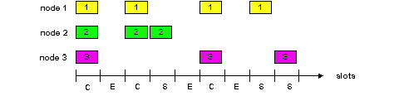
Slotted ALOHA
Pros
single active node can continuously transmit at full rate of channel
highly decentralized: only slots in nodes need to be in sync
simple
Cons
collisions, wasting slots
idle slots
nodes may be able to detect collision in less than time to transmit packet
clock synchronization

Slide 9
Slotted Aloha efficiency
For max efficiency with N nodes, find p* that maximizes
Np(1-p)^{N-1}
For many nodes, take limit of Np*(1-p*)^{N-1} as N goes to infinity, gives 1/e = .37
Efficiency is the long-run
fraction of successful slots
when there are many nodes, each with many frames to send
Suppose N nodes with many frames to send, each transmits in slot with probability p
prob that node 1 has success in a slot = p(1-p)^{N-1}
prob that any node has a success = Np(1-p)^{N-1}
At best: channel
used for useful
transmissions 37%
of time!

Slide 10
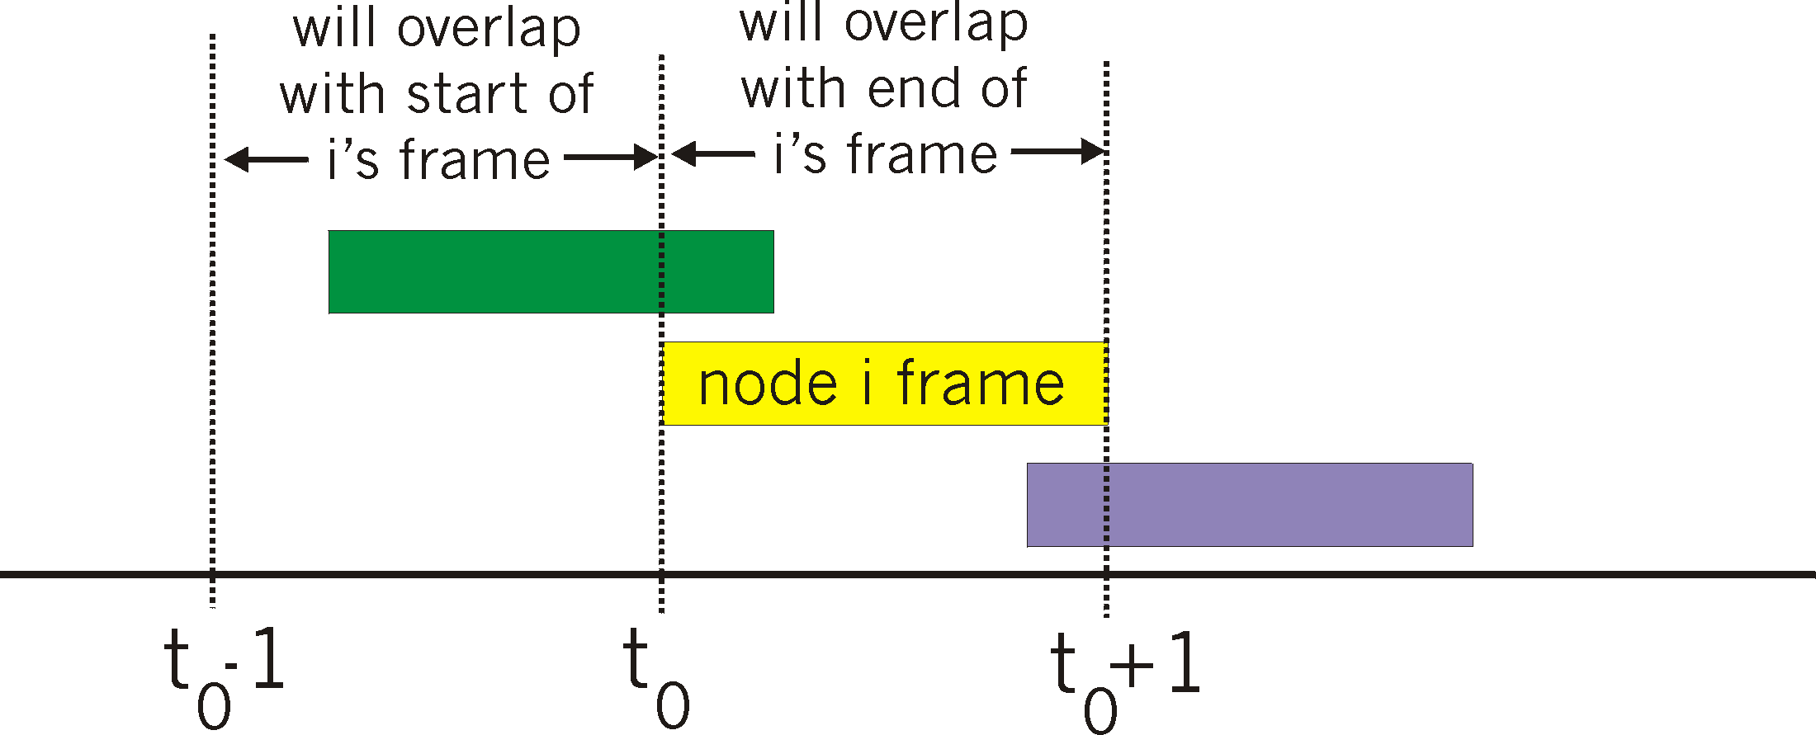
Pure (unslotted) ALOHA
unslotted Aloha: simpler, no synchronization
when frame first arrives
  transmit immediately
collision probability increases:
  frame sent at t₀ collides with other frames sent in [t₀-1,t₀+1]

Slide 11
Pure Aloha efficiency
P(success by given node) = P(node transmits) .
P(no other node transmits in [p₀-1,p₀] .
P(no other node transmits in [p₀-1,p₀]
= p . (1-p)^{N-1 .} (1-p)^{N-1}
= p . (1-p)^{2(N-1)}
… choosing optimum p and then letting n -> infty ...
^{= 1/(2e) = .18}
Even worse !

Slide 12
Carrier Sense Multiple Access (CSMA)
We could achieve better throughput if we could listen to the channel before transmitting a packet
This way, we would stop avoidable collisions.
To do this, we need “Carrier Sense Multiple Access,” or CSMA, protocols

Slide 13
Assumptions with CSMA Networks
1. Constant length packets
2. No errors, except those caused by collisions
3. No capture effect
4. Each host can sense the transmissions of all other hosts
5. The propagation delay is small compared to the transmission time

Slide 14
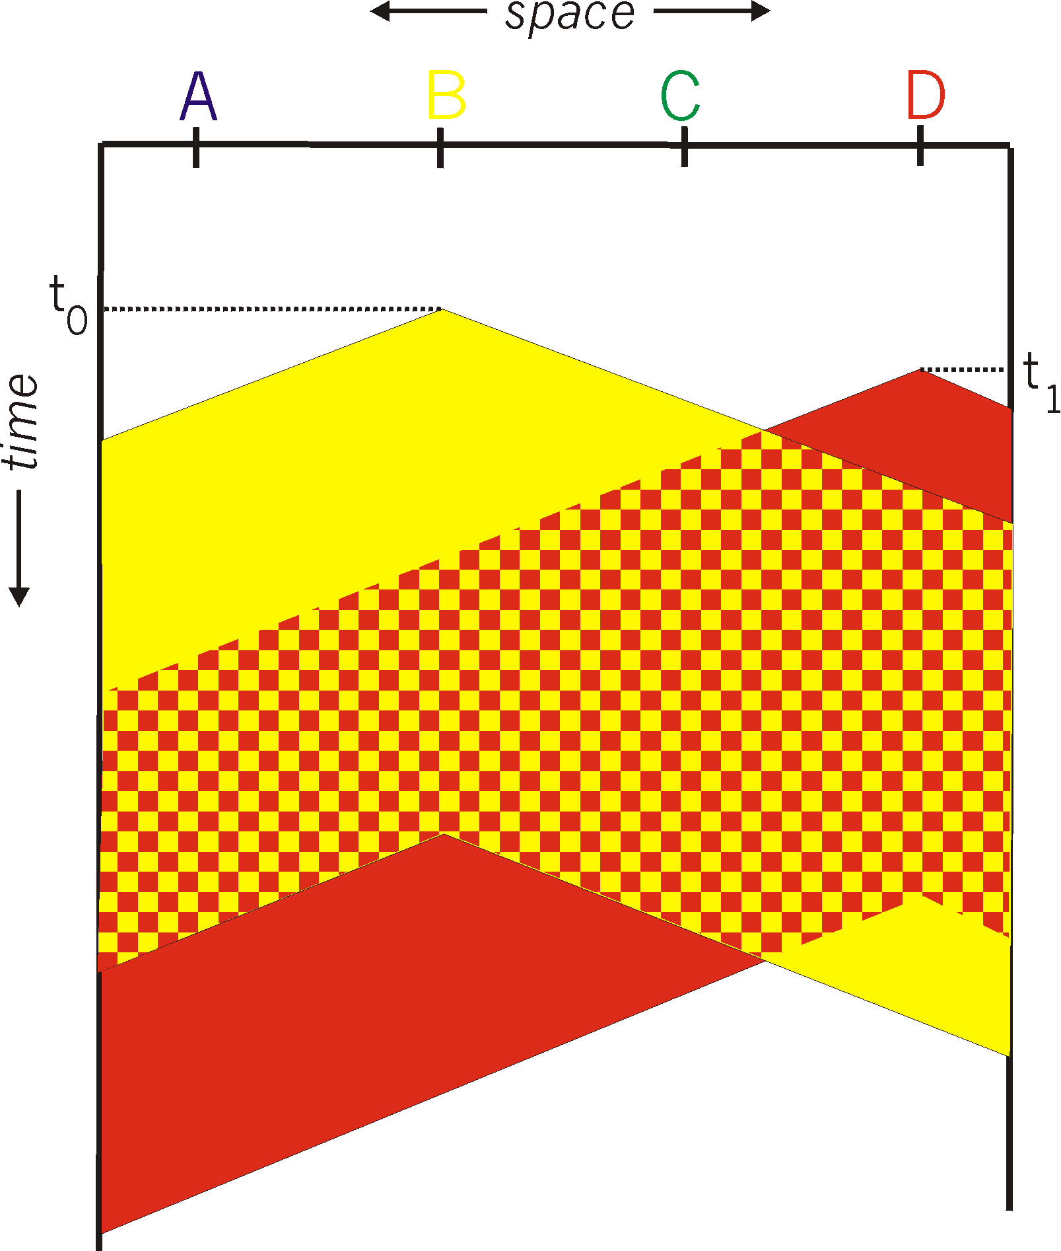
CSMA collisions
spatial layout of nodes
collisions can still occur:
propagation delay means
two nodes may not hear
each other’s transmission
collision:
entire packet transmission
time wasted
note:
role of distance & propagation delay in determining collision probability

Slide 15
CSMA (cont’d)
There are several types of CSMA protocols:
  1-Persistent CSMA
  Non-Persistent CSMA
  P-Persistent CSMA

Slide 16
1-Persistent CSMA
Sense the channel.
  If busy, keep listening to the channel and transmit immediately when the channel becomes idle.
  If idle, transmit a packet immediately.
If collision occurs,
  Wait a random amount of time and start over again.

Slide 17
1-Persistent CSMA (cont’d)
The protocol is called 1-persistent because the host transmits with a probability of 1 whenever it finds the channel idle.

Slide 18
The Effect of Propagation Delay on CSMA
packet
A
B
carrier sense = idle
Transmit a packet
Collision

Slide 19
Propagation Delay and CSMA
Contention (vulnerable) period in Pure ALOHA
  two packet transmission times
Contention period in Slotted ALOHA
  one packet transmission time
Contention period in CSMA
  up to 2 x end-to-end propagation delay
Performance of CSMA >
Performance of Slotted ALOHA >
Performance of Pure ALOHA

Slide 20
1-Persistent CSMA (cont’d)
Even if prop. delay is zero, there will be collisions
Example:
  If stations B and C become ready in the middle of A’s transmission, B and C will wait until the end of A’s transmission and then both will begin transmitted simultaneously, resulting in a collision.
If B and C were not so greedy, there would be fewer collisions

Slide 21
Non-Persistent CSMA
Sense the channel.
  If busy, wait a random amount of time and sense the channel again
  If idle, transmit a packet immediately
If collision occurs
  wait a random amount of time and start all over again

Slide 22
Tradeoff between 1- and Non-Persistent CSMA
If B and C become ready in the middle of A’s transmission,
  1-Persistent: B and C collide
  Non-Persistent: B and C probably do not collide
If only B becomes ready in the middle of A’s transmission,
  1-Persistent: B succeeds as soon as A ends
  Non-Persistent: B may have to wait

Slide 23
P-Persistent CSMA
Optimal strategy: use P-Persistent CSMA
Assume channels are slotted
One slot = contention period (i.e., one round trip propagation delay)

Slide 24
P-Persistent CSMA (cont’d)
1. Sense the channel
  If channel is idle, transmit a packet with probability p
    if a packet was transmitted, go to step 2
    if a packet was not transmitted, wait one slot and go to step 1
  If channel is busy, wait one slot and go to step 1.
2. Detect collisions
  If a collision occurs, wait a random amount of time and go to step 1

Slide 25
P-Persistent CSMA (cont’d)
Consider p-persistent CSMA with p=0.5
  When a host senses an idle channel, it will only send a packet with 50% probability
  If it does not send, it tries again in the next slot.

Slide 26
Comparison of CSMA and ALOHA Protocols
(Number of Channel Contenders)

Slide 27
CSMA/CD
In CSMA protocols
  If two stations begin transmitting at the same time, each will transmit its complete packet, thus wasting the channel for an entire packet time
In CSMA/CD protocols
  The transmission is terminated immediately upon the detection of a collision
  CD = Collision Detect

Slide 28
CSMA/CD (Collision Detection)
collision detection:
  easy in wired LANs: measure signal strengths, compare transmitted, received signals
  difficult in wireless LANs: receiver shut off while transmitting
human analogy: the polite conversationalist

Slide 29
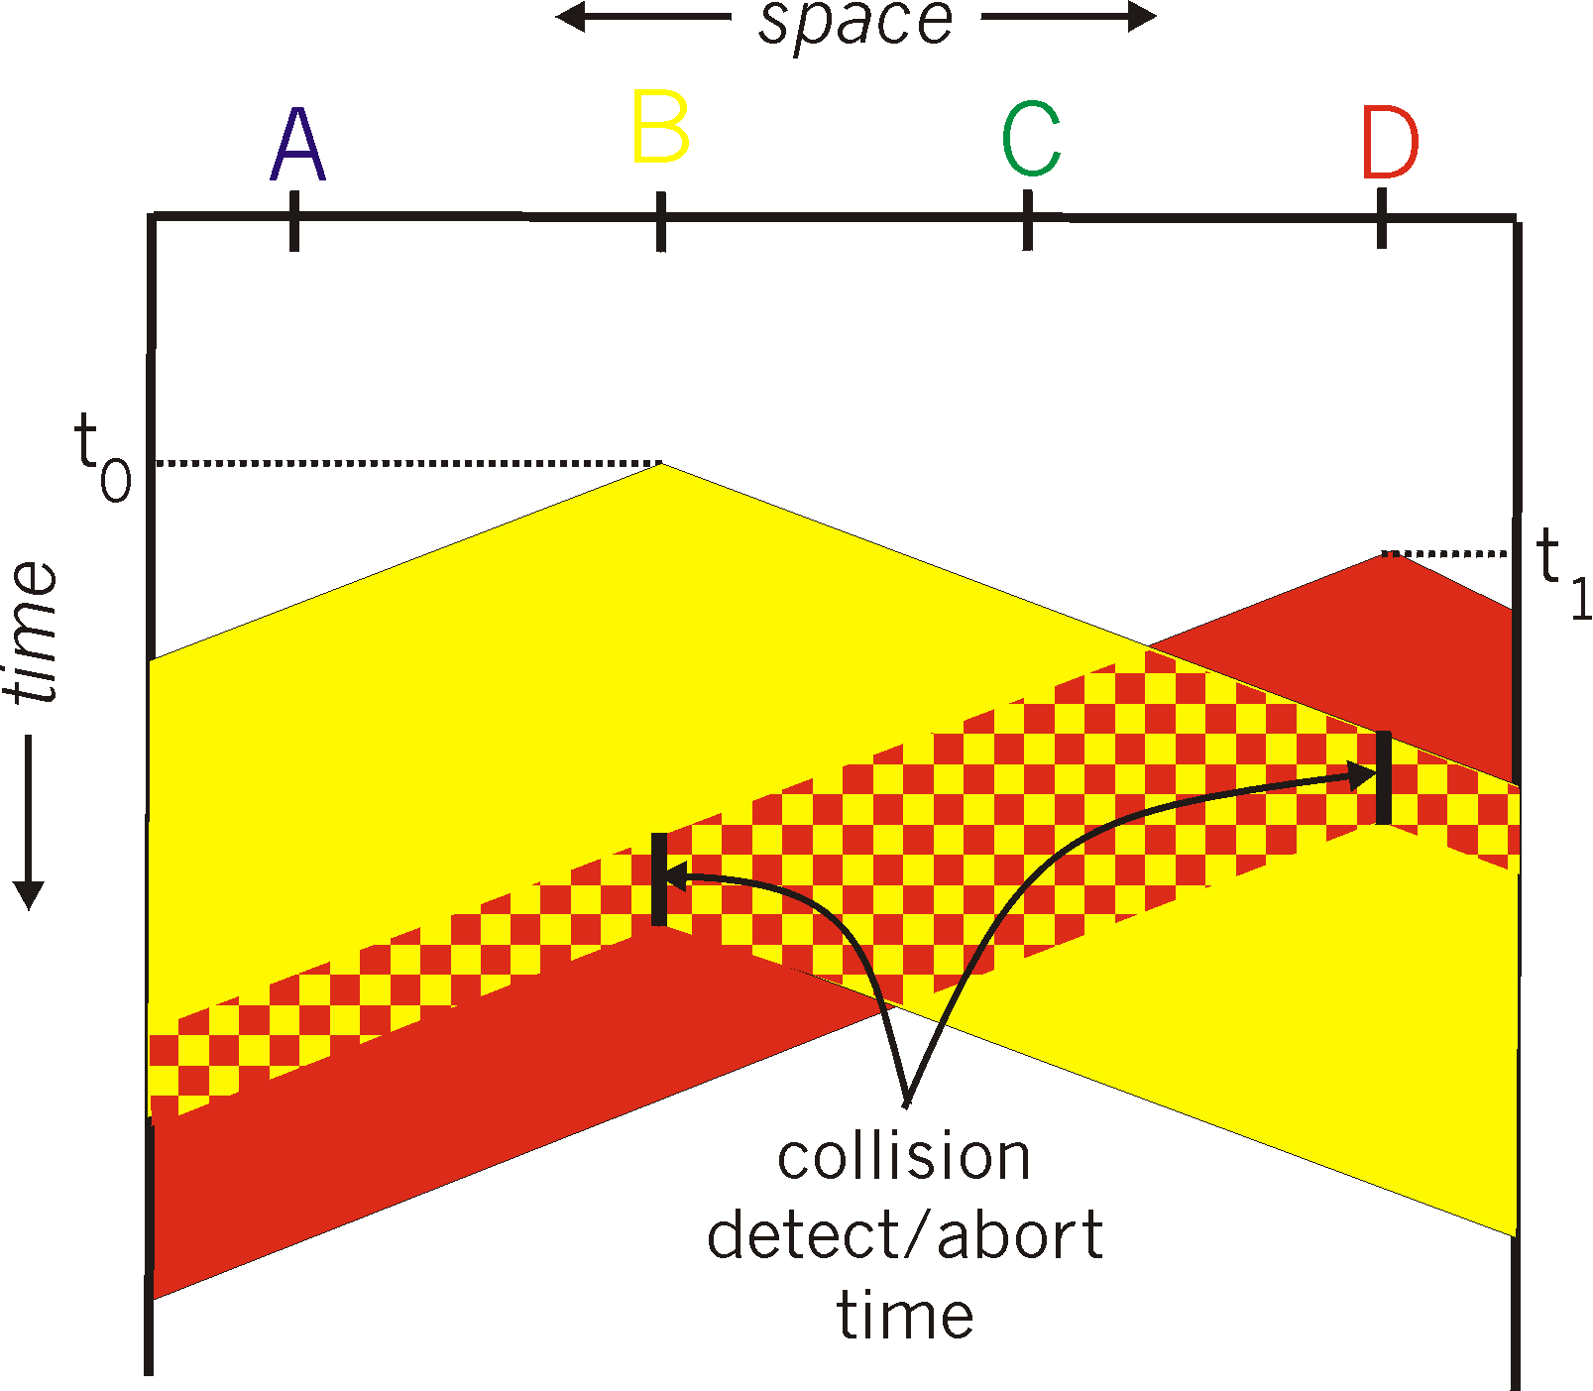
CSMA/CD collision detection

Slide 30
CSMA/CD
Sense the channel
  If idle, transmit immediately
  If busy, wait until the channel becomes idle
Collision detection
  Abort a transmission immediately if a collision is detected
  Try again later after waiting a random amount of time

Slide 31
CSMA/CD (cont’d)
Carrier sense
  reduces the number of collisions
Collision detection
  reduces the effect of collisions, making the channel ready to use sooner

Slide 32
Collision detection time
How long does it take to realize there has been a collision?
Worst case: 2 x end-to-end prop. delay
packet
A
B

Slide 33
Turn-Based Access Protocols
A
B
D
C

Slide 34
IEEE 802 LANs
LAN: Local Area Network
What is a local area network?
  A LAN is a network that resides in a geographically restricted area
  LANs usually span a building or a campus

Slide 35
Characteristics of LANs
Short propagation delays
Small number of users
Single shared medium (usually)
Inexpensive

Slide 36
Common LANs
Bus-based LANs
  Ethernet (*)
  Token Bus (*)
Ring-based LANs
  Token Ring (*)
Switch-based LANs
  Switched Ethernet
  ATM LANs
(*) IEEE 802 LANs

Slide 37
IEEE 802 Standards
802.1: Introduction
802.2: Logical Link Control (LLC)
802.3: CSMA/CD (Ethernet)
802.4: Token Bus
802.5: Token Ring
802.6: DQDB
802.11: CSMA/CA (Wireless LAN)

Slide 38
IEEE 802 Standards (cont’d)
802 standards define:
  Physical layer protocol
  Data link layer protocol
    Medium Access (MAC) Sublayer
    Logical Link Control (LLC) Sublayer

Slide 39
OSI Layers and IEEE 802
OSI layers
IEEE 802 LAN standards
Higher Layers
Higher Layers
802.2 Logical Link Control
802.3 802.4 802.5
Medium Access Control
Data Link Layer
Physical Layer
CSMA/CD Token-passing Token-passing
bus bus ring

Slide 40
IEEE 802 LANs (cont’d)
Ethernet
Token Ring

Slide 41
Ethernet (CSMA/CD)
IEEE 802.3 defines Ethernet
Layers specified by 802.3:
  Ethernet Physical Layer
  Ethernet Medium Access (MAC) Sublayer

Slide 42
Ethernet (cont’d)
Possible Topologies:
1. Bus
2. Branching non-rooted tree for large Ethernets

Slide 43
Minimal Bus Configuration
Coaxial Cable
Transceiver
Terminator
Transceiver
Cable
Host

Slide 44
Typical Large-Scale Configuration
Repeater
Host
Ethernet
segment

Slide 45
Ethernet Physical Layer
Transceiver
Transceiver Cable
  4 Twisted Pairs
  15 Pin Connectors
Channel Logic
  Manchester Phase Encoding
  64-bit preamble for synchronization

Slide 46
Ethernet Cabling Options
10Base5: Thick Coax
10Base2: Thin Coax (“cheapernet”)
10Base-T: Twisted Pair
10Base-F: Fiber optic
Each cabling option carries with it a different set of physical layer constraints (e.g., max. segment size, nodes/segment, etc.)

Slide 47
Ethernet Physical Configuration
For thick coaxial cable
  Segments of 500 meters maximum
  Maximum total cable length of 1500 meters between any two transceivers
  Maximum of 2 repeaters in any path
  Maximum of 100 transceivers per segment
  Transceivers placed only at 2.5 meter marks on cable

Slide 48
Manchester Encoding
Data stream
Encoded
bit pattern
1 0 1 1 0 0
1 bit = high/low voltage signal
0 bit = low/high voltage signal

Slide 49
Differential Manchester Encoding
1 0 0 1 1
Transitions take place at midpoint of interval
1 bit: the initial half of the bit interval carries the same polarity as the second half of the previous interval
0 bit: a transition takes place at both the beginning and the middle of the bit interval
Differential Manchester is more efficient than standard Manchester encoding

Slide 50
Ethernet Synchronization
64-bit frame preamble used to synchronize reception
7 bytes of 10101010 followed by a byte containing 10101011
Manchester encoded, the preamble appears like a sine wave

Slide 51
Ethernet: MAC Layer
Data encapsulation
  Frame Format
  Addressing
  Error Detection
Link Management
  CSMA/CD
  Backoff Algorithm

Slide 52
MAC Layer Ethernet Frame Format
Multicast bit
Destination
(6 bytes)
Source
(6 bytes)
Length (2 bytes)
Data
(46-1500 bytes)
Pad
Frame Check Seq.
(4 bytes)

Slide 53
Ethernet MAC Frame
Address Field
Destination and Source Addresses:
  6 bytes each
Two types of destination addresses
  Physical address: Unique for each user
  Multicast address: Group of users
  First bit of address determines which type of address is being used
    0 = physical address
    1 = multicast address

Slide 54
Ethernet MAC Frame
Other Fields
Length Field
  2 bytes in length
  determines length of data payload
Data Field: between 0 and 1500 bytes
Pad: Filled when Length < 46
Frame Check Sequence Field
  4 bytes
  Cyclic Redundancy Check (CRC-32)

Slide 55
CSMA/CD
Recall:
  CSMA/CD is a “carrier sense” protocol.
    If channel is idle, transmit immediately
    If busy, wait until the channel becomes idle
  CSMA/CD can detect collections.
    Abort transmission immediately if there is a collision
    Try again later according to a backoff algorithm

Slide 56
Ethernet Backoff Algorithm:
Binary Exponential Backoff
If collision,
  Choose one slot randomly from 2^{k} slots, where k is the number of collisions the frame has suffered.
  One contention slot length = 2 x end-to-end propagation delay
This algorithm can adapt to changes in network load.

Slide 57
Binary Exponential Backoff (cont’d)
slot length = 2 x end-to-end delay = 50 μs
A
B
t=0μs: Assume A and B collide (k_{A} = k_{B} = 1)
A, B choose randomly from 2¹ slots: [0,1]
Assume A chooses 1, B chooses 1
t=100μs: A and B collide (k_{A} = k_{B} = 2)
A, B choose randomly from 2² slots: [0,3]
Assume A chooses 2, B chooses 0
t=150μs: B transmits successfully
t=250μs: A transmits successfully

Slide 58
Binary Exponential Backoff (cont’d)
In Ethernet,
  Binary exponential backoff will allow a maximum of 15 retransmission attempts
  If 16 backoffs occur, the transmission of the frame is considered a failure.

Slide 59
Ethernet Performance

Slide 60
Ethernet Features and Advantages
1. Passive interface: No active element
2. Broadcast: All users can listen
3. Distributed control: Each user makes own decision
Simple
Reliable
Easy to reconfigure

Slide 61
Ethernet Disadvantages
Lack of priority levels
Cannot perform real-time communication
Security issues

Slide 62
Hubs, Switches, Routers
Hub:
  Behaves like Ethernet
Switch:
  Supports multiple collision domains
  A collision domain is a segment
Router: operates on level-3 packets

Slide 63
Why Ethernet Switching?
LANs may grow very large
  The switch has a very fast backplane
  It can forward frames very quickly to the appropriate subnet
Cheaper than upgrading all host interfaces to use a faster network

Slide 64
Ethernet Switching
Connect many Ethernet through an “Ethernet switch”
Each Ethernet is a “segment”
Make one large, logical segment
to segment 4
to segment 1
to segment 3
to segment 2

Slide 65
Collision Domains
D
A
switch
B
E
A,B,C
D,E,F
F
C
Host
Z
Each segment runs a standard
CMSA protocol
G
H
Ethernet
Hub

Slide 66
Layer-2 routing tables
D
A
switch
B
E
A,B,C
D,E,F
F
C
Host
Z
Switch must forward packets from
A,B,C to the other segment
Switch builds a large table
For each packet, look up in table
and maybe forward the packet
G
H
Ethernet
Hub

Slide 67
Learning MAC addresses
D
A
switch
B
E
A,B,C
D,E,F
F
C
Host
Z
Per-port routing
table
G
Switch adds hosts to
routing table when it
sees a packet with a
given source address
H
Ethernet
segment

Slide 68
Spanning Trees
Want to allow multiple switches to connect together
What If there is a cycle in the graph of switches connected together?
  Can’t have packets circulate forever!
  Must break the cycle by restricting routes

Slide 69
Spanning Trees
D
A
switches
B
E
1
2
F
C
Host
Z
J
G
H
k
3

Slide 70
Spanning Trees
D
A
switches
B
E
1
2
F
C
Host
Z
J
G
H
k
3
no cycles
in the graph of switches

Slide 71
Spanning Tree Protocol
Each switch periodically sends a configuration message out of every port. A message contains: (ID of sender, ID of root, distance from sender to root).
Initially, every switch claims to be root and sends a distance field of 0.
A switch keeps sending the same message (periodically) until it hears a “better” message.
“Better” means:
  A root with a smaller ID
  A root with equal ID, but with shorter distance
  The root ID and distance are the same as we already have, but the sending bridge has a smaller ID.
When a switch hears a better configuration message, it stops generating its own messages, and just forwards ones that it receives (adding 1 to the distance).
If the switch realizes that it is not the designated bridge for a segment, it stops sending configuration messages to that segment.
Eventually:
  Only the root switch generates configuration messages,
  Other switches send configuration messages to segments for which they are the designated switch

