Slide 1
The Pulse of UCF
James Doty
EEL 6788
University of Central Florida
19 April 2010

Slide 2
Introduction
The primary goal of the Pulse of UCF project was to create a mobile application that would help find certain locations on campus:
  Busiest
  Most exciting
  Most popular place to study
It was designed for the iPhone

Slide 3
Requirements
Capture data from an iPhone app:
  Latitude
  Longitude
  Noise level (% maximum)
  Time of Day
  Device ID
Log data to a server wirelessly

Slide 4
Requirements
Provide a website that would allow a user to find the three locations previously mentioned
Provide the same data through the iPhone application
Provide a map view of the data collected

Slide 5
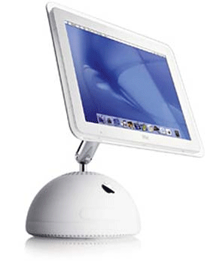
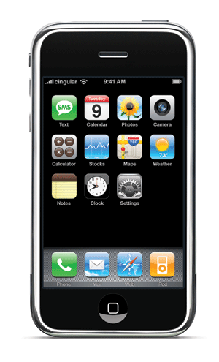

Design – High Level
Raw Data
Analyzed
Locations

Slide 6
iPhone App
Designed on a custom PC running OSX Leopard (10.5.7)
  Xcode 3.1.4
  Needed an x86 processor, so couldn’t just use the iMac G4
iPhone OS 3.1.3
  iPhone 3GS on AT&T
Written in Objective-C

Slide 7
iPhone App Block Diagram
AppDelegate
SCListener
View Controller
Location Service
CoreLocation API

Slide 8
iPhone App Description
CoreLocation API provides location only on move event
  Must register a callback
Location Service class handles this
View Controller (main GUI class) has a timer that “ticks” every 5 seconds
Each tick, the current location is pulled from the Location Service and the noise is pulled from the SCListener class
  Sent out with HTTP POST
  GUI elements are updated

Slide 9
Web Server
iMac G4
  Apache
  MySQL
  Since OSX is a unix variant, minimal work needed to get server up and running
Programming done in Python

Slide 10
Web Server Block Diagram
postdata.py
exciting.py
MySQL DB
index.html
busiest.py
getpulse.py
study.py

Slide 11
Database Tables
data
  id integer unique primary key
  udid char(40)
  latitude double
  longitude double
  noise double
  tod time
TOD calculated on the server side with now() function
campus
  grid unique primary key
  latmax double
  latmin double
  lonmax double
  lonmin double
Divides campus into a grid of plots about 30m x 30m

Slide 12
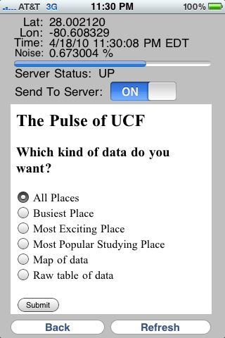
Functionality
Displays data from sensors
Indicates server status
Allows the user to temporarily stop sending data to the server
Displays a web view of the data analysis site

Slide 13
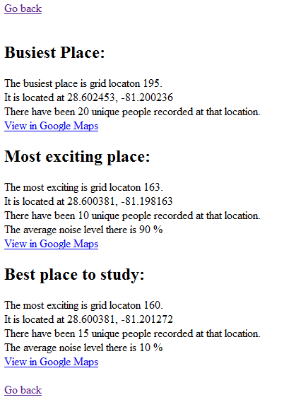
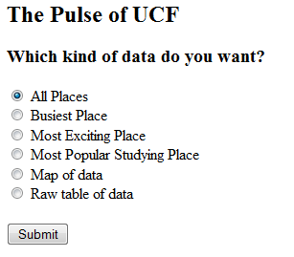
Web View

Slide 14
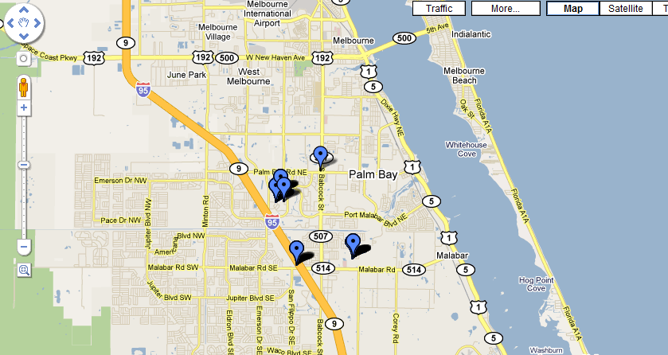
Data Map

Slide 15
Data Map
Generated as a KML (Google Earth XML) file
Can be viewed in Google Earth or Google Maps
Google Earth view updates every 5 seconds to show a live view of data being gathered
Each point is clickable to show the measured noise level

Slide 16
Challenges – Objective C
Difficult language to learn, especially coming from a C++/C# background
  I’ve never used Smalltalk before
  The syntax was odd
iPhone development requires an Intel Mac, so my old PPC iMac wouldn’t cut it
  Had to get OSX to install on a non-Apple PC
  AMD processor made things more difficult
    Apple kernel built only for Intel

Slide 17
Challenges - Databases
Gathering data and storing it was simple
Interpreting it was a challenge
My SQL experience didn’t extend far beyond simple queries and table joins
  As a result, most actual data processing was done in the Python CGI scripts
Had to determine a simple way to group points by location fast enough to process in real-time

Slide 18
Technical Limitations
30m by 30m grids are fixed
  Small grid would increase processing time, potentially miss big spread out groups
  Larger grid would have the opposite problem
iPhone GPS is not 100% accurate
iPhone microphone levels vary widely based on how the phone is carried
App must be running to gather data
  Shortens battery life
No privacy or security implemented
  Each device UDID is recorded – identity can be determined based on locations visited

Slide 19
Future Work
Make grid worldwide, not just UCF
Display color-coded grid map rather than just individual points
Anonymize device UDID
Improve UI
Allow time filtering on searches
  Find most crowded place right now
  Find most crowded place on a typical Saturday night
Find lonliest/least crowded places
  Challenging because low crowds mean minimal data

Slide 20
Commercialization
Since it depends entirely on voluntary user data collection, the app would most likely have to be free
  Any business plan would either be based on selling advertisements in-program or selling the collected data to other data-mining companies
Without at least a minimal number of users, the app is useless
  Would need some sort of advertising blitz to get people interested
  Maybe pay students a minimal amount of money to gather initial data

Slide 21
Demo

