Slide 1
The Tree Census Project
by
Linda Mohaisen
Mike Zielinski

Slide 2
What it is
We are counting the number of trees and taking pictures of them and their GPS location
We store the information in MySQL and display markers for the trees on a Google map.
Naturalists and cities can use this information to track diseases in trees. Also damage from wind storms.

Slide 3
Android Platform
Open source
Can get access to hardware
Supported by Google
Doesn’t need a Mac

Slide 4
Fancy Phone
The Droid
5 Megapixel Camera
GPS sensor
Wifi and 3G
Android 2.1

Slide 5
What our software does
It displays the GPS information in a readable format on the phone
It captures a picture taken with the phone and stores it on the server.
Then when Add Tree is clicked it displays a marker on the map and adds GPS information and picture to the database.

Slide 6
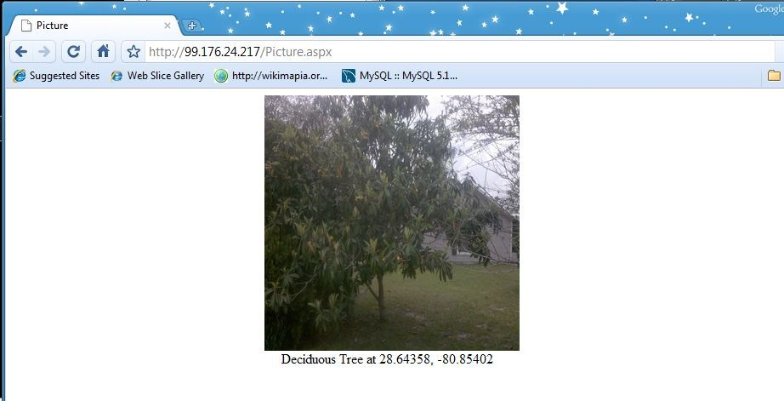
Sample Picture

Slide 7
Used ASP.Net and Java
Used ASP.Net for the web pages
Used Java for Android and to send picture from phone to server
Use JavaScript for Google Map API
Problem! Communicating between JavaScript and ASP.NET.
ASP.NET provides a way called callbacks.

Slide 8
Solutions
ASP.NET provides several solutions:
client-side click methods – used for Add Tree
JavaScript callbacks – used for database access and adding pictures
Asynchronous Postbacks of a region – used so
Used all of these to solve problems we encountered

Slide 9
GUI
User interface consists of a WebView which is a mini-web browser. It is used to view the web pages.
To load a URL it has a loadUrl method which can display a local html file or an internet location
Need to give it Internet Permissions to access the internet in the manifest.

Slide 10
Camera View
Adapted CameraPreview sample from the samples provided
Instantiated GUI on the fly
To activate CameraPreview sent an intent to launch new activity:
Intent startCamera= new Intent();
startCamera.setClassName("com.codingzebra.TreeCensus2" ,
"com.codingzebra.TreeCensus2.TakePicture");
startActivity(startCamera);
To take and send picture used following code:

Slide 11
Code to take picture and send picture
mCamera.takePicture(null, null, new Camera.PictureCallback(){
public void onPictureTaken(byte[] jpegData, Camera camera)
{
create Socket
get its output stream
send number of bytes in jpegData
send picture in jpegData
}

Slide 12
The marker
Marker is a square GPolygon
It is clickable, to process the click must add an EventListener with GEvent.addListener.
The listener calls the server code to retrieve the picture from the database and displays it
The picture is stored as a mediumblob in the database as bytes
The location of the tree is stored in the marker’s value element so the database can retrieve the picture by the coordinates

Slide 13
View Trees
Can view all trees or selected type of tree
Use ODBC to connect to MySQL
OdbcDataReader reader = getAlltrees.ExecuteReader();
while (reader.Read())
{
Get latitude from reader
Get longitude from reade
Get treeType from reader
coordinate = coordinate +treeType+";"+ latitude
+ "," + longitude +";";
}
return coordinate;

Slide 14
View Trees Client Side
function AddMarkers(args)
{
Clear map by creating a new map
var splitExpression = /[;]/; //used to split by ;
var urlStrings= args.split(splitExpression);
for( var i=0;i<urlStrings.length-1;i+=2)
{
// first parameter is type of tree second parameter is
location
addMarker(urlStrings[i],urlStrings[i+1]);
}
}

Slide 15
Demo
codingzebra'sLab

Slide 16
Future Plans
Allow for more than one phone at a time to take picture.
Ability to display more than one picture at a time
Speed up transmission of picture
Clean up GUI

