Slide 1
OnCampus
Interactive Campus-Centric Mobile Application

Slide 2
Establish Problem Space
Transfer of knowledge among students and other persons can be hit-or-miss
Multiple sources required to obtain relevant information
Saturation of non-relevant information from large scale applications
Notes:
shaun

Slide 3
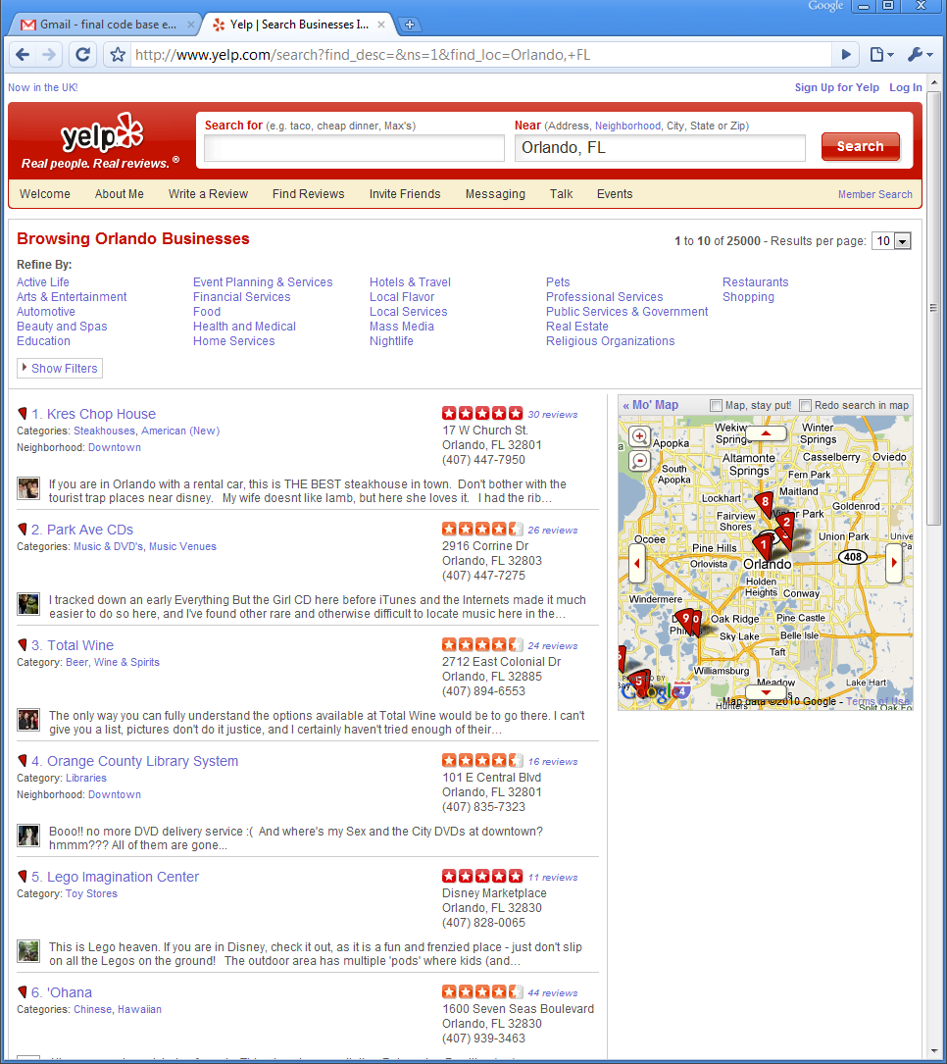
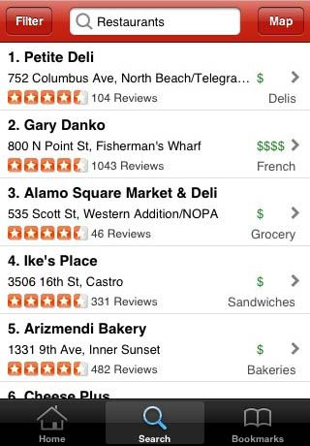
Yelp!
Locations of places nearby
Directions from current location
User participation
Ratings
Comments
Wide area
Notes:
matt

Slide 4
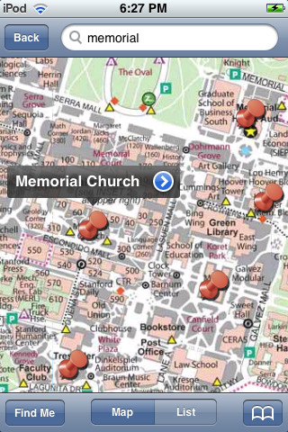
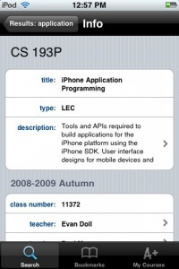
iStanford
Search the Stanford directory, search campus map, find and bookmark courses, and get scores, schedules, and news
Now a commercial application
Blackboard Mobile
Notes:
shaun

Slide 5
Pitfalls
Don’t allow for fine-grain knowledge transfer
Unable to customize software
Yelp! is too broad for a “small” location
Students need more than restaurants and businesses listed on Yelp!
iStanford does not incorporate user feedback
Notes:
shared

Slide 6
Goals/Objectives
Create mobile interactive environment to promote knowledge transfer among students and visitors on a college campus
Promote “best practices” among users through use of ratings
Notes:
shared

Slide 7
Requirements
Localized to a campus
Incorporate user feedback (ratings/reviews)
Utilize geo-positioning to map on campus directions

Slide 8
High-Level Design
Notes:
shaun

Slide 9
Platform Selection
Android
iphone
Multiple HW
Open source
Eclipse IDE
Java
Tightly-coupled with hardware
Closed source (paid developer license)
Apple-controlled ID
Objective-C
Lots of apps
Notes:
matt

Slide 10
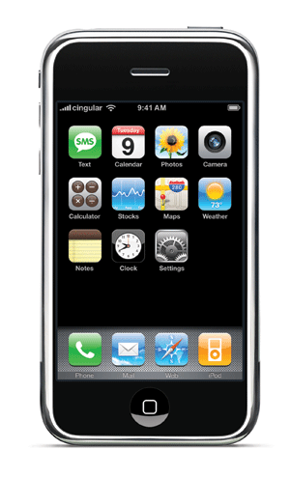
Platform Selection
For this project, the iPhone OS chosen
Pros:
Widely used
Mac environment
Hardware is known
Cons:
Licenses needed (for dev on phone)
Learning curve for Objective-C

Slide 11
Server-Side Applications
PHP
General purpose scripting language to provide interaction with server applications
MySQL
Database software, used for information storage
Apache
Webserver
XML
ASCII format of data exported from the MySQL database
TouchXML
Library used for XML parsing on the iPhone
Notes:
shaun

Slide 12
Design Decision: MySQL vs. SQLite
MySQL
SQLite
Increased server/network workload
Allows for always up-to-date information
Higher requirement for backend hardware/software
Minimizes requirements for server/network usage
Requires application updates to introduce new data
Notes:
shaun

Slide 13
Basic Dataflow
Database Read
Request from Mobile Application
To Mobile Application
Server
PHP
MySQL
XML
Database Write
Request from Mobile Application
To Mobile Application
Server
PHP
MySQL
XML
Notes:
shaun

Slide 14
Database Layout
Two primary tables
placesTable
Contains location information, static description, etc
ratingsTable
Contains placesID associated with the comment, numeric rating(1-5), comments, count of “likes” and “dislikes”
Notes:
shaun

Slide 15
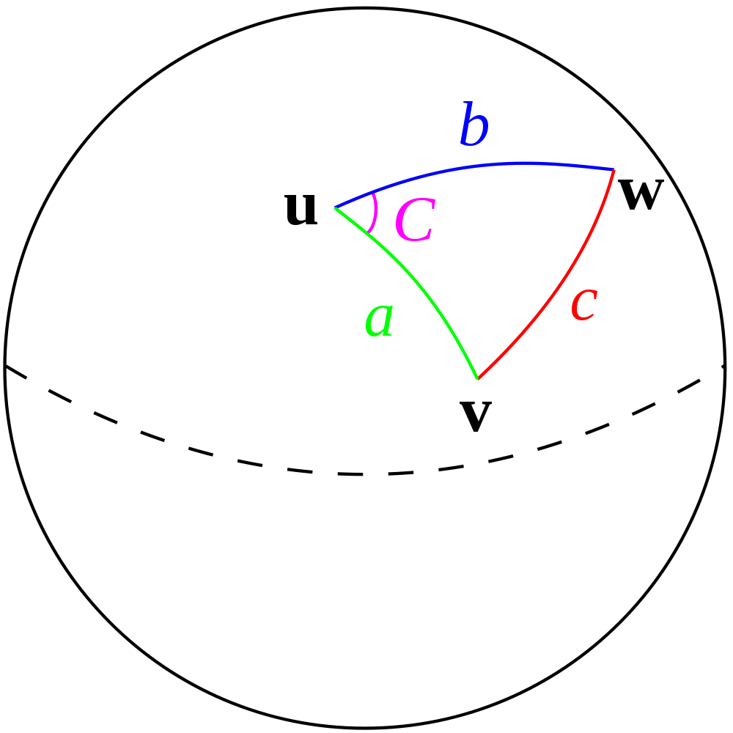
Distance Formulas for Lat/Long
Spherical Law of Cosines:
Our project (doubles needed):
Haversine (more accurate)
Even more accurate:
Notes:
matt

Slide 16
PHP
3 end user functions needed:
getLocation(myLatitude, myLongtitude)
SQL: SELECT *, (3959 * acos( cos( radians($LAT) ) * cos( radians(latitude)) * cos(radians(longitude) - radians($LON) ) + sin( radians($LAT)) * sin(radians(latitude)))) AS distance FROM placesTable ORDER BY distance ASC LIMIT 25
getRating(locationKey)
SQL: SELECT * FROM onCampusDB.ratingsTable WHERE placesID = $KEY
addRating(locationKey, rating, comment)
SQL: INSERT INTO ratingsTable(id, placesID, rating, comment) VALUES ('NULL', '$myKey', '$myNumericRating', '$myComment')
Notes:
matt

Slide 17
Usage scenarios

Slide 18
Case A
Bob wants to find the nearest Subway
Request sent by mobile application
Supported by Bob’s current location
University’s server returns subset of information from database server
Notes:
shaun

Slide 19
Case B
Bob had a terrible time at Subway in the gym ands wants to let everyone know
Creates review/rating on mobile application
Sent to university servers
Available immediately to user-base
Notes:
shaun

Slide 20
Case C
Bob wants to see what everyone thinks of the Engineering Computer Lab
Request of reviews sent to University servers
Subset of information about requested location downloaded to mobile application for review
Notes:
shaun

Slide 21
The Application

Slide 22
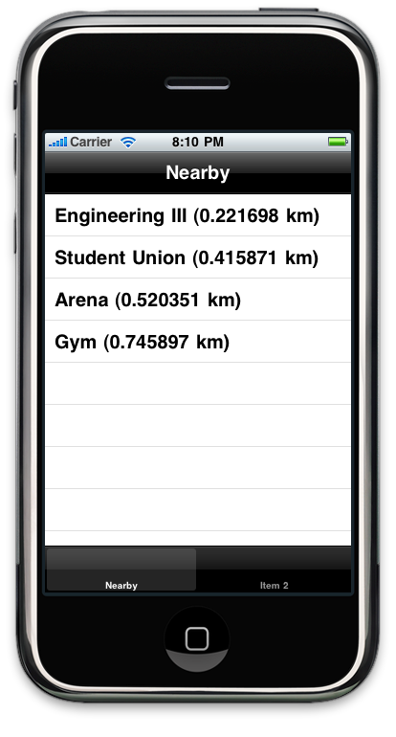
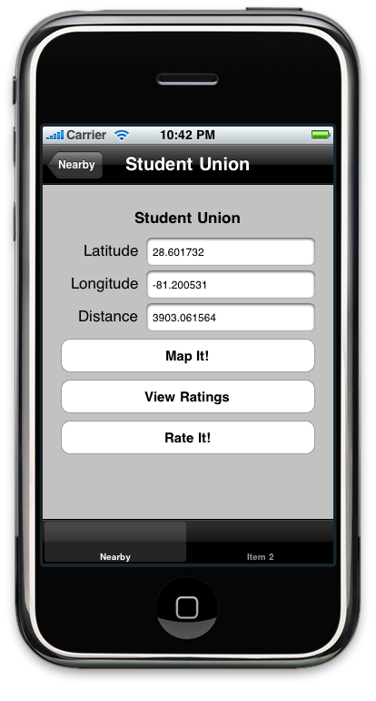
View a Place
Sorted by distance to current location, closest locations first
Displays basic information
Latitude
Longitude
Distance
Buttons for additional functions
Map It! – map directions from your current location to the place in view
View Ratings – view ratings for the current place
Rate It! – rate the current place
Notes:
shaun

Slide 23
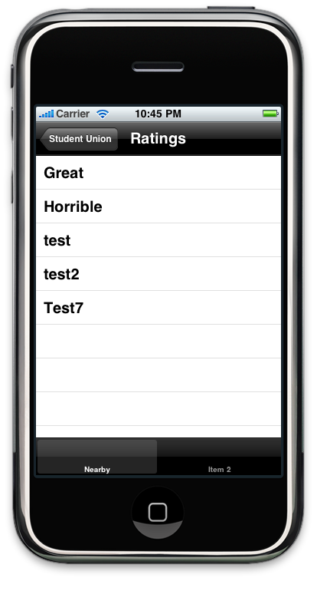
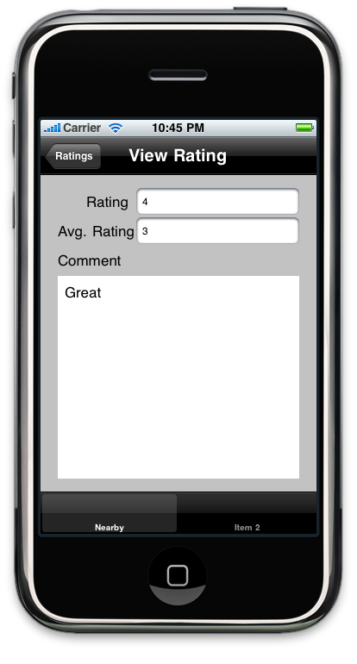
View Ratings
List ratings for the current place
View the numeric rating, average rating and comment contents
Notes:
shaun

Slide 24
Testing/Development
Server-Side Emulation
Mobile Application Emulation
MAMP – Mac, Apache, MySQL, PHP server designed for local web-development
Developed, debugged in Apple Xcode
Run in iPhone simulator on development machine

Slide 25
Expansion and Refinement

Slide 26
Tips/Natural Selection
Morph the ratings section into a “tips”
Tips are rated by users
By “natural selection” the best tips float to the top
Facilitates knowledge transfer
Notes:
shaun

Slide 27
Deployment Strategy
In phases:
Test groups of users (such as focus groups)
Small subset of users on a single campus
Full rollout onto a single campus
Gradual rollouts into other schools
Important to work with college administration
Notes:
matt

Slide 28
Other
Pictures
Real webserver
Notes:
Matt/shared

Slide 29
Demo

Slide 30
Conclusion
A need has been identified
A proposed solution has been presented
Future works can make this marketable
Notes:
shared

