Slide 1

Personal Environmental Impact Report
Juan C. Carcheri Jr.
EEL 6788
02/10/2010

Slide 2

Agenda
What is PEIR?
History and Background
PEIR Science
Demo
Future Development
Video
Questions
Resources

Slide 3
What is PEIR?
PEIR - Personal Environmental Impact Report
“Mobile-to-web” app that allows you to use your GPS-equipped Smartphone to explore, measure and share your own environmental footprint and how the environment impacts you.
Uses location data that is regularly and securely uploaded from your mobile phone to create personalized report about your environmental impact and exposure.
Inspired by the Environmental Impact Reports (EIR’s) required for construction and public work projects.

Slide 4
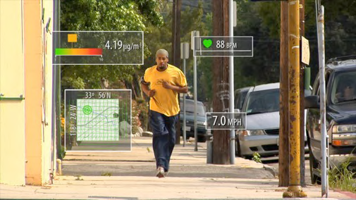
PEIR Goals
Provide participants with near real-time feedback on their environmental impact and exposure.
Designed to bring specific environmental aspects of our personal lives to light.
Help people understand how they can reduce environmental impact by changing their daily behavior.

Slide 5



History & Background
Project collaboration between UCLA (University of California, Los Angeles) and Nokia researchers. Also sponsored by the National Science Foundation (NSF)
Under development for about a little over a year at UCLA.
PEIR has been running under “pilot production mode” since June 2008 with thirty trial users using the system periodically.

Slide 6
PEIR Capabilities
Uses the mobile phone’s GPS and cell towers to record and upload your location approximately every thirty seconds.
Based on your location trace, the system infers your activity (walking, staying still, driving) and logs it throughout the day.
PEIR maps this combination of location, time, and activity to regional air quality and weather data to calculate your personal carbon footprint and your exposure to fine particulate matter (PM 2.5) in the air
Results are presented to participants in an interactive graphical user interface (GUI).
Metrics can also be shared and compared with other users using a unique Facebook application.

Slide 7
PEIR Science
The impact and exposure measures are computed record-by-record. Each record consists of the following:
  Participant's system ID
  Vehicle Type
  Current location and speed (derived from a users GPS)
  Activity class.

Slide 8
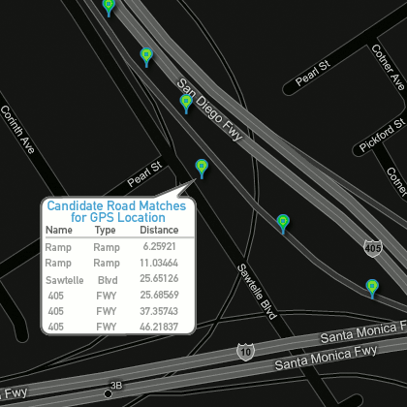
Activity Classification
Multi-step activity classification:
  Filter out anomalous GPS points
  Match to verify if on a freeway.
  Calculate speed.
  Classify using decision tree.
  Classify using Hidden Markov Model.
  Classify trips: A traveling from one place to the other where a user stays for more than 10 min.
  Annotate trace with activity. (e.g. still, walk, drive).

Slide 9
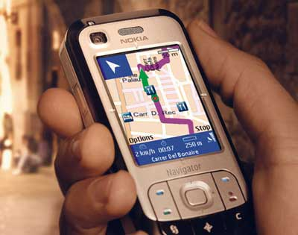
Location Tracing
Location traces are gathered from mobile phones using GPS and cell towers.
GPS records are sampled at approximately every 30 seconds .
Based on these time-location traces, the PEIR system can assume your activities (walking, still, driving) and log them throughout the day.

Slide 10
Trace Correction
Under-sampled location traces are corrected and interpreted using techniques such as map matching.
Uses road network and building data to determine if a user is on a freeway or not.
Accuracy increases from 40% to 82% when using the freeway annotation information obtained from the map matching technique.
PEIR first implemented a modified naive map-matching scheme called “Intersection-based map-matching”.
After several months, a new algorithm referred to as “Intersection w/ nearest road and substitution” was developed.

Slide 11
Intersection-Based Map-Matching Algorithm
Steps:
  Find the two nearest roads for each data point.
  If distances from a GPS data point to the two roads are less than .04 miles, label the GPS data point as the pre-intersection. Otherwise, add it to the buffer of data points. Continue until the next intersection point is identified, referred to as the post-intersection.
  Compare the pre- and post-intersections and identify the road that appears in both intersections as the correct match for the buffered data points. If no common road is found, consider the subsequent GPS data points to identify an alternative post-intersection.

Slide 12
Intersection w/ Nearest Road And Substitution Algorithm
Modified the previous algorithm to include two new mechanisms:
  Consider the nearest road within .04 miles as a possible intersection point when looking for a common road segment between two consecutive intersection points.
    Helps correct for the situation when the captured GPS data points are not near intersections and therefore miss turning points that occur in between the captured GPS data points.
  Replace both pre- and post-intersections when there is no common road between two consecutive intersections.
    Assigns the post-intersection as the new pre-intersection, and using a subsequent intersection as the new post-intersection.

Slide 13
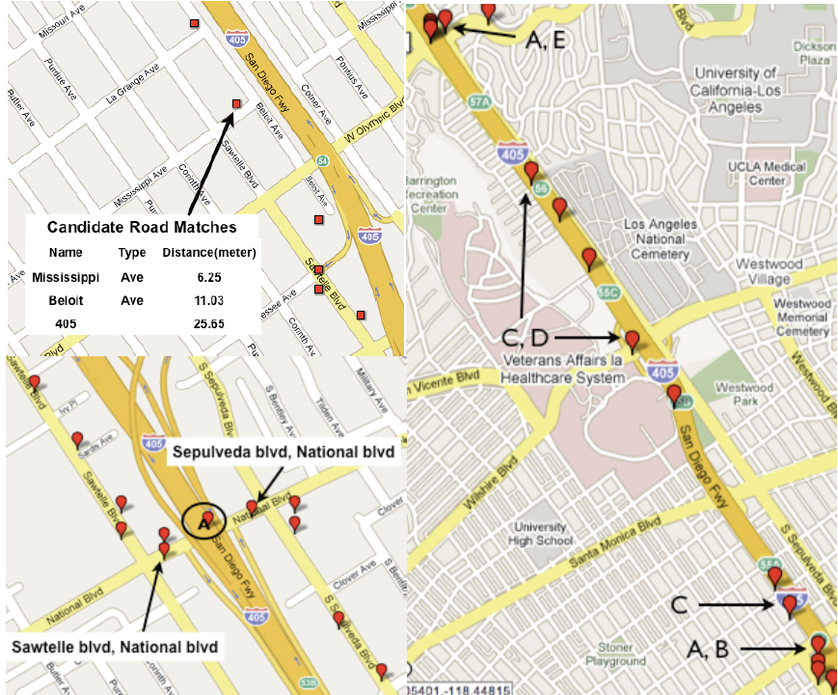
Map-Matching Example
Intersection w/ nearest road and substitution
Naïve map-matching
Intersection-based map-matching

Slide 14
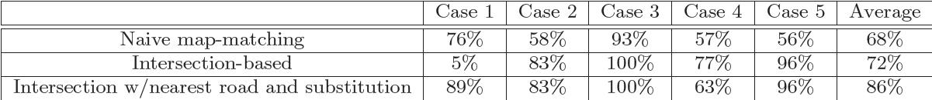
Comparison of Accuracy
Five cases were included when determining accuracy:
  Case 1 – Crossing under highways with several turning points
  Cases 2 & 4 – Getting on and off highways
  Case 3 – Driving on straight paths
  Case 5 – Switching highways
*
* Algorithm gets confused by highway segments that lie right above surface streets
Takeaway:
The improved intersection algorithm with nearest road and substitution mechanisms added performs the best with the average accuracy of 86%.

Slide 15

PEIR Science (Cont.)
PEIR provides users with information for two types of environmental impact, and two types of environmental exposure.
  Carbon Impact
  Sensitive Site Impact
  Particulate Exposure
  Fast Food Exposure

Slide 16
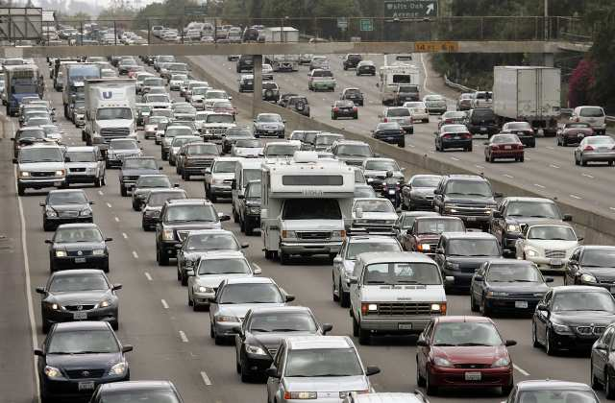
Carbon Impact
A measure of transportation-related carbon (CO2) footprint, a greenhouse gas implicated in climate change, in grams.
Calculated only for records classified with the activity driving.
PEIR uses the Emissions Factors Model (EMFAC), a FORTRAN program developed by the California Air Resources Board (CARB), to calculate carbon dioxide emissions by a user in units of grams. The model computes vehicle emissions based on current weather conditions (temperature and relative humidity), and the speed and type of vehicle.
  Temperature and humidity are grabbed from the closest weather station to a participants location that reported data in the last hour.
  Speed is derived from a user’s trace (using GPS)
  Type of vehicle is collected at sign-up

Slide 17

Sensitive Site Impact
A measure of the user's transportation-related airborne particulate matter emissions (PM 2.5) near sites with populations sensitive to it, such as hospitals and schools.
Pollutants also estimated using EMFAC model.
Only calculated when user is within 200m of a sensitive site.
The total amount of particulate pollution (in grams) you emit per trip near sensitive sites is reported in your profile.

Slide 18

Particulate Exposure
A measure of the user's transportation-related exposure to particulate matter emissions from other vehicles.
Also using the EMFAC model, PEIR calculates the quantity of particulate pollution generated by traffic on roads within 200 meters.
Exposure is divided into three categories:
  Low – Fewer than 15 micrograms per cubic meter
  Medium – Between 15 and 65 micrograms per cubic meter
  High – Over 65 micrograms per cubic meter

Slide 19



Fast Food Exposure
The proximity to fast-food eating establishments.
Determines whether a fast food establishment is within a quarter mile.
The records of a trip are annotated with a flag indicating whether a fast food joint was nearby.
PEIR then gathers the total amount of time near a fast food restaurant per trip.
Exposure is divided into three categories:
  Low – 3 or fewer restaurants
  Medium – Between 3 and 5 restaurants
  High – Over 5 restaurants

Slide 20
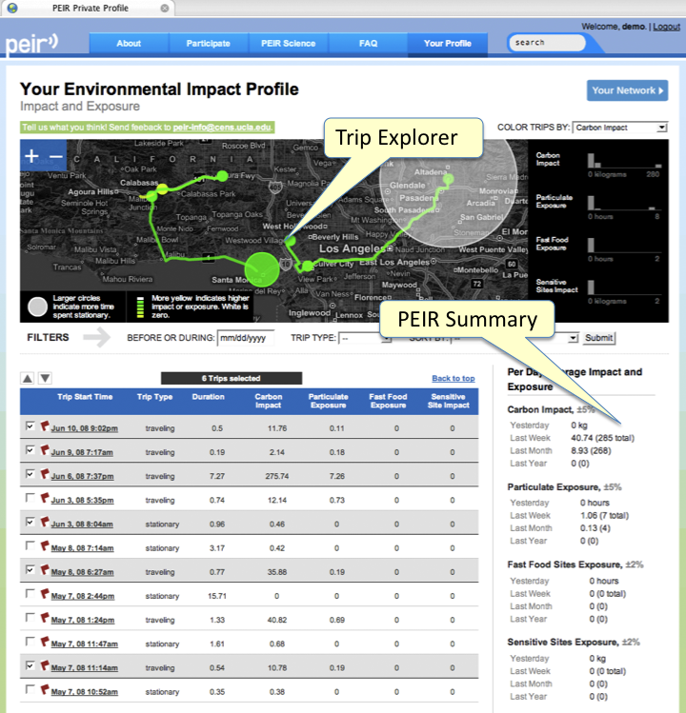

Slide 21
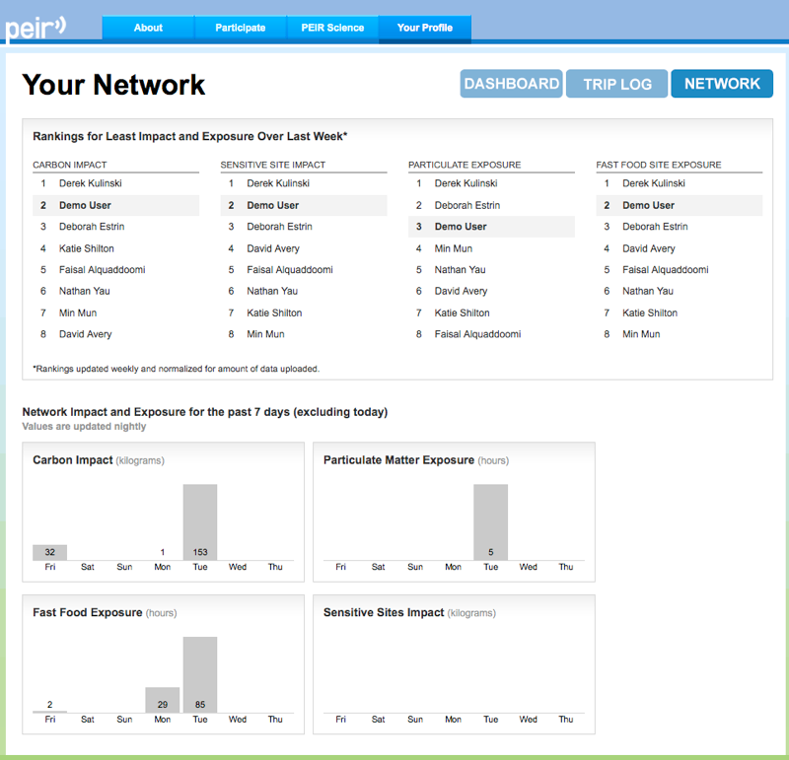
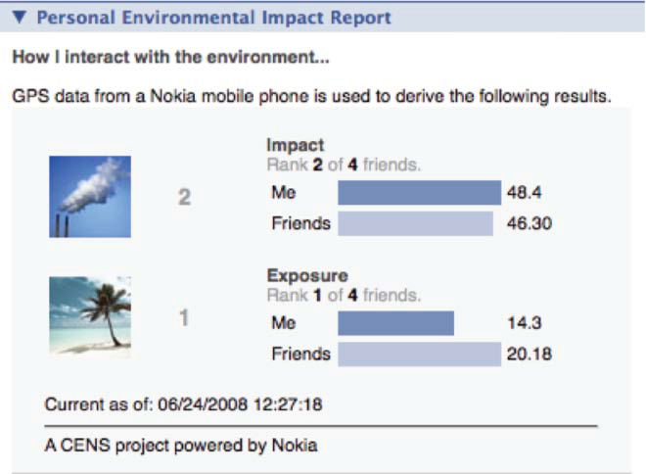
Sharing PEIR Data
A user can compare impact and exposure to other PEIR users via network rankings and the PEIR Facebook application.
Facebook Widget
Network Rankings

Slide 22
Demo

Slide 23
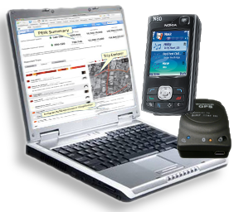
PEIR Participation
PEIR is currently in private beta
To participate in PEIR you’ll need the following:
  Mobile phone with a data plan
  GPS capability (either built in to the phone or via an external GPS device)
  Web access
The current release of PEIR requires:
  Nokia N80 with external GPS device, or
  Nokia N95 with built in GPS

Slide 24
Future Development
Adding the ability for users to upload their location traces (GPS information) via GPX (GPS exchange format). This will allow people who do not have the phones mentioned in the previous slide to participate.
Add device-level authentication and explore taking advantage of WiFi and Bluetooth stumbling to enhance location trace.
Add accelerometer data that most of these client platforms are capable of capturing to enhance activity classification accuracy.
Become a public branded application

Slide 25
Current Deployment Example
Over 100 students and teenagers in San Francisco, California, are currently using this service to monitor their “greenness”.
  Students keep a log of their activity on their mobile device.
    Personalized profile allows them to track their carbon emissions based on their transportation choices.
  Students use the application running in their Facebook profile so that they can use their mobile devices to regularly update and compare their scores with friends.
  The students reduced their carbon impact by an average of 20% through an increased use of public transportation, biking, and carpooling

Slide 26
Video
URL

Slide 27

Questions

Slide 28
Resources
PEIR. Web. 08 Feb. 2010. http://peir.cens.ucla.edu/
Urban Sensing. Web. 08 Feb. 2010. http://urban.cens.ucla.edu/
"Program helps kids find their carbon impact." San Francisco Bay Area News, Sports, Business, Entertainment, Classifieds: SFGate. Web. 08 Feb. 2010. http://www.sfgate.com/cgi-bin/article.cgi?f=/c/a/2009/04/06/BUHM16SDAE.DTL
Mun, M., Reddy, S., Shilton, K., Yau, N., Burke, J., Estrin, D., Hansen, M., Howard, E., West, R., and Boda, P. 2009. PEIR, the personal environmental impact report, as a platform for participatory sensing systems research. In Proceedings of the 7th international Conference on Mobile Systems, Applications, and Services (KrakÃ³w, Poland, June 22 - 25, 2009). MobiSys '09. ACM, New York, NY

