Slide 1
Sensing Meets Mobile Social Networks: The Design,
Implementation and Evaluation of the CenceMe
Application
Emiliano Miluzzo, Nicholas D. Lane, Kristóf Fodor, Ronald Peterson, Hong Lu,
Mirco Musolesi, Shane B. Eisenman, Xiao Zheng, Andrew T. Campbell
A review by Fahad Shah

Slide 2
Outline
Introduction
Constraints
  Mobile phone limitations
  Architectural issues
Implementation
  Phone software
  Backend software
Classifiers
  Phone
  Backend
Performance
  Classifiers
  Power
  Resources
User study
conclusions

Slide 3
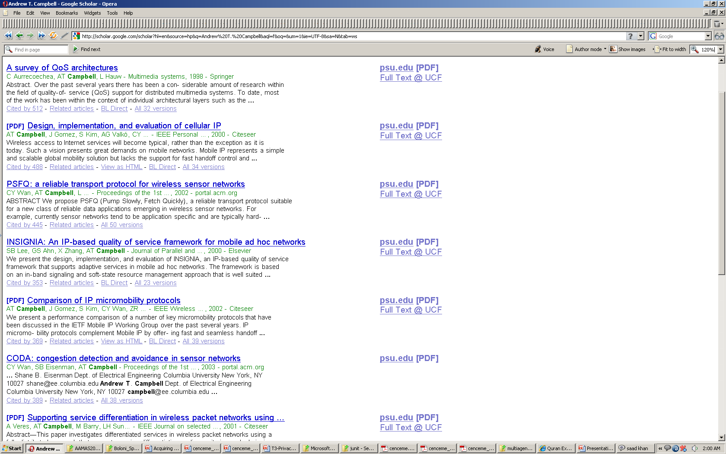
Group Introduction
Andrew T. Campbell – head of Dartmouth Sensor Lab

Slide 4
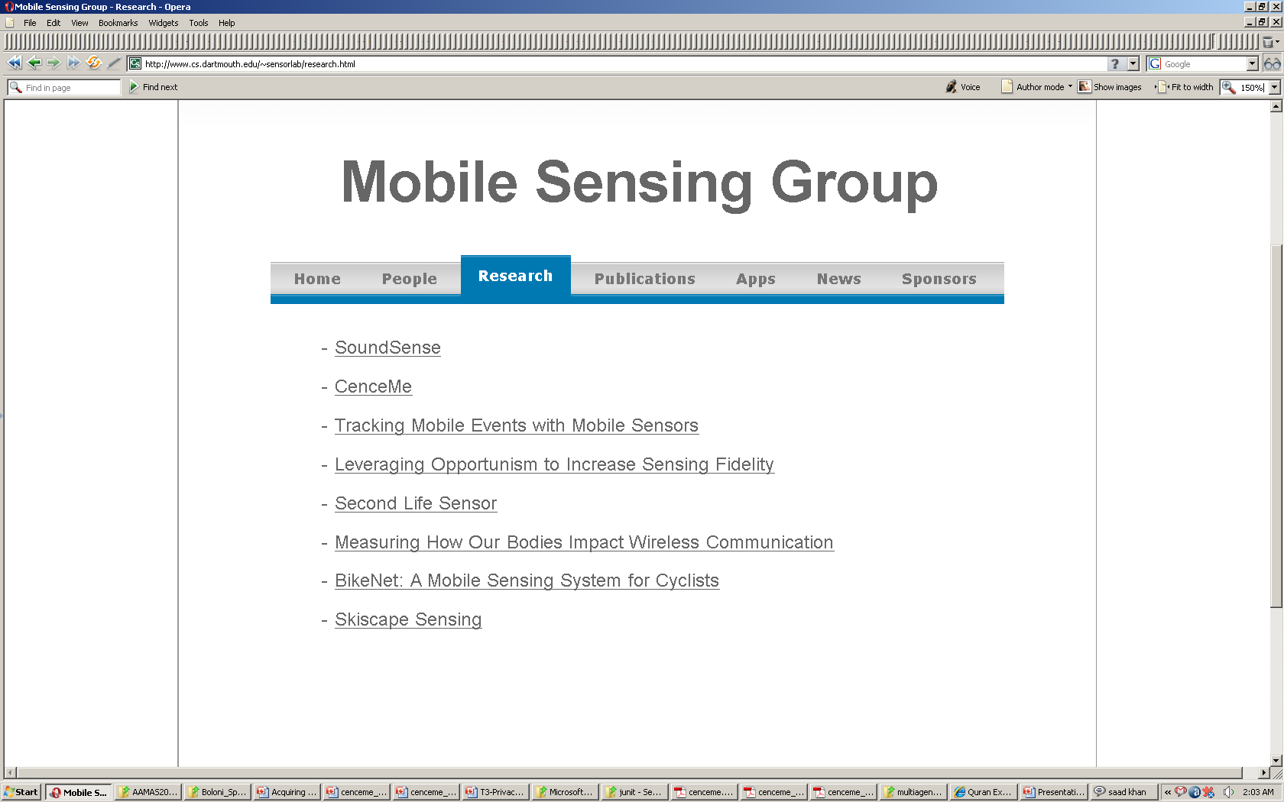
Group Introduction

Slide 5
Introduction
User centered social app
Two critical questions
  Where are you
  What are you doing
Use existing hardware (Mobile Phone’s like iPhone, Nokia N95 etc.)
social networking website integration (Facebook, twitter)

Slide 6
Design Considerations
Mobile Phone Limitations
  1. OS Limitations
limited in terms of the programmability and resource usage control offered to the developer
third party applications running on the phone may be denied resource requests and must be designed to allow interruption at any time so as not to disrupt regular operation of the phone.
  2. API and Operational Limitations
JME implements a reduced set of the Java Standard Edition APIs for use on mobile phones.
the Symbian OS and JME must be ported to each phone which typically results in missing or malfunctioning APIs for important new or existing components, such as an accelerometer or GPS.
a missing JME API to access the N95 internal accelerometer
JME audio API that exhibits a memory leak

Slide 7
Design Considerations
  3. Security Limitations
phone manufacturers and cellular network operators control access to critical components, including the APIs for access to the file system, multimedia features, Bluetooth, GPS, and communications via GPRS or WiFi, through a rights management system.
Properly signed keys from a Certificate Authority
  4. EnergyManagement Limitations
Power conservation
the phone’s Bluetooth, GPS, and GPRS radios are responsible for draining most of the battery power when CenceMe is running
Data upload via GPRS - the Symbian version of JME does not provide APIs to power cycle (i.e., toggle on and off) the Bluetooth and GPS radios to implement an efficient radio duty-cycle strategy.
Sensing and classification algorithms that run on the phone can also consume a considerable amount of energy if left unchecked.
sampling the phone’s microphone and running a discrete Fourier transform on the sound sample uses more power than sampling the accelerometer and classifying the accelerometer data
the only way to reduce energy at the application layer is to design a sensing duty-cycle that samples sensors less frequently and avoids the use of the radios for communications or acquisition of satellite signals for location coordinates.

Slide 8
Design Considerations
Architectural Design Issues
Split-Level Classification
task of classifying streams of sensor data from a large number of mobile phones is computationally intensive
Split some classification to the phone and some to the backend servers
Primitives, the output of the classification process on the phone
The classification operation on the backend returns, Facts
ADV
  supports customized tags
  provides resiliency to cellular/WiFi radio dropouts - provides resiliency to cellular/WiFi radio dropouts.
  Minimizes the sensor data the phone sends to the backend servers improving the system efficiency by only uploading classification derived-primitives rather than higher bandwidth raw sensed data
  reduces the energy consumed by the phone and therefore monetary cost for the data cellular connection by merging consecutive uploads of primitives
  negates the need to send raw sensor data to the backend - enhancing the user’s privacy and data integrity

Slide 9
Design Considerations
2. Power Aware Duty-Cycle
  To extend the battery lifetime of the phone when running the CenceMe - scheduled sleep techniques to both the data upload and the sensing components.
  how long can the sensors, Bluetooth, GPS, and communications upload be in a sleep mode given that the larger the sleep interval the lower the classification responsiveness of the system?
  current implementation the introduced delay varies according to the type of presence being inferred.
  makes sense - the goal of CenceMe to allow buddies in social networks to casually view each other’s sensing presence.
  knowing that a buddy is in a conversation one minute after the actual conversation began seems reasonable
  people remain at parties for periods typically greater than five minutes or more
  senses at an even lower duty cycle on average but temporarily increases the sensing rate when a buddy’s page is accessed.

Slide 10
Design Considerations
3. Software Portability
  push as much as we can to JME.
  a number of components need to be implemented directly using native Symbian APIs to support the necessary features

Slide 11
CENCEME IMPLEMENTATION
The CenceMe application and system support consists of a software suite running on Nokia N95 mobile phones and backend infrastructure hosted on server machines.
  The software installed on the phones performs the following operations:
  sensing,
  classification of the raw sensed data to produce primitives,
  presentation of people’s presence directly on the phone, and
  the upload of the primitives to the backend servers.

Slide 12
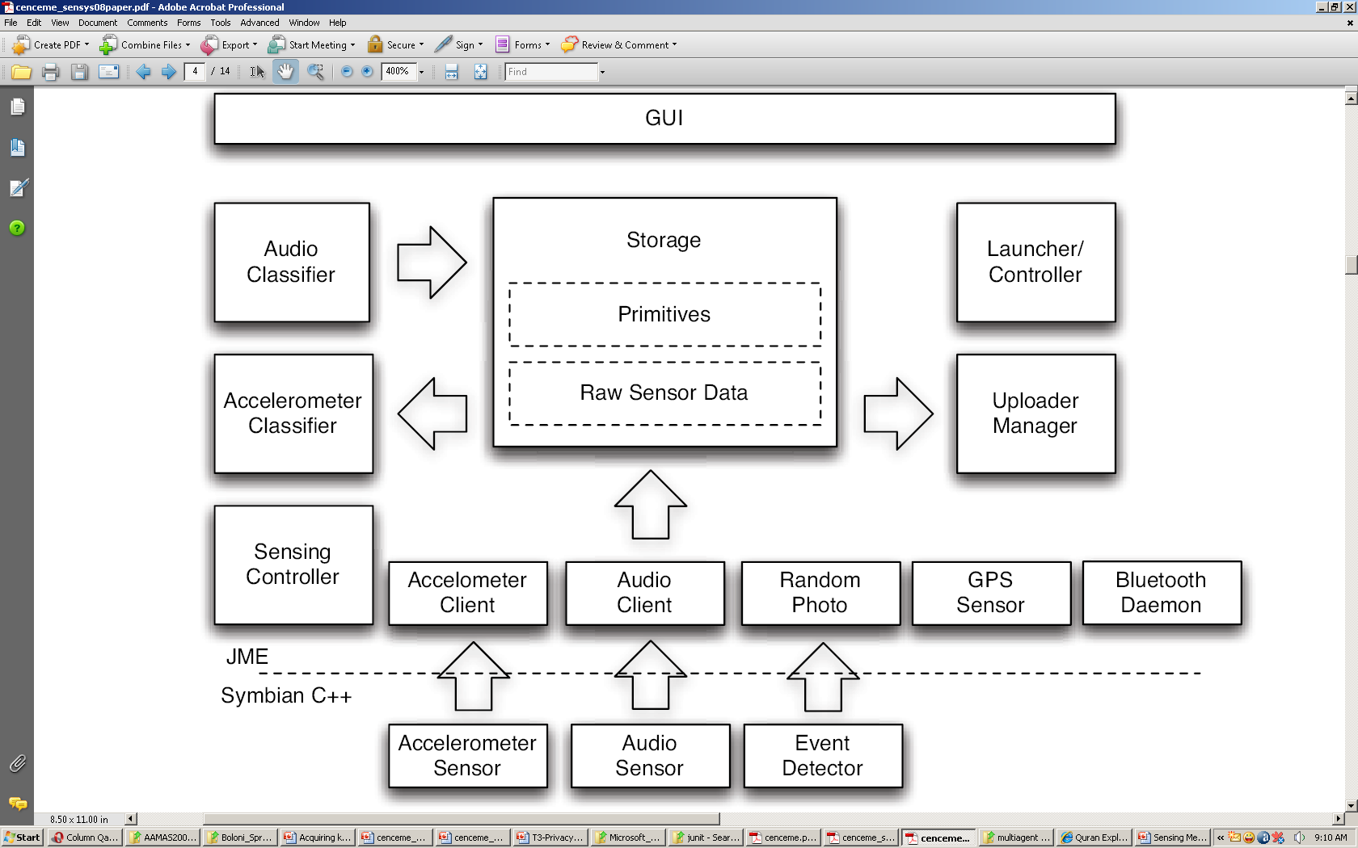
Phone Software
Architecture of the CenceMe phone software

Slide 13
Phone Software
Primitives are the result of
  the classification of sound samples from the phone’s microphone using a discrete Fourier transform (DFT) technique and a machine learning algorithm to classify the nature of the sound;
  the classification of on board accelerometer data to determine the activity, (e.g., sitting, standing, walking, running);
  scanned Bluetooth MAC addresses in the phone’s vicinity;
  GPS readings; and
  random photos, where a picture is taken randomly when a phone keypad key is pressed or a call is received.

Slide 14
Phone Software
Symbian Servers
The accelerometer sensor, audio sensor, and event detector sensor are Symbian C++ modules that act as daemons producing data for corresponding JME client methods.
Their function is
  polling the on board accelerometer sensor,
  sampling the phone’s microphone, and
  detecting incoming/outgoing calls and keypad key presses.
  Events detected are used by the random photo module at the JME level to
    generate random pictures,
    to trigger a photo upon an incoming phone call or
    to signal the application that it has to restart after a phone call for reliability reasons.
The sensed data is sent to the JME methods through a socket.

Slide 15
Phone Software
Bluetooth Daemon
  resides at the JME level
  used to perform an inquiry over the Bluetooth radio to retrieve the MAC addresses of any neighboring Bluetooth nodes. (used to determine if there are CenceMe phones in the area at the time of the inquiry).
Accelerometer Client
  written in JME
  connects through a socket to the accelerometer sensor to retrieve the accelerometer data byte stream.
  The byte stream is stored in local storage and retrieved by the activity classifier to compute the activity primitive.
Audio Client
  JME client component
  connects through a socket to the Symbian audio server to retrieve the audio byte stream that carries the PCM encoded representation of the sound sample.
  The byte stream is stored in local storage and retrieved by the audio classifier to compute the audio primitive.

Slide 16
Phone Software
Random Photo
  This JME module
  designed to trigger the capture of a photo upon detection of incoming calls or pressed keypad keys.
  The events are received through a socket from the event detector daemon.
  When the picture is taken it is stored locally until the next upload session.
GPS
  JME Module
  The JME GPS implementation supplies a callback method that is periodically called by the Nokia GPS daemon to provide the geographical location of the phone.
  The GPS coordinates are stored locally and then uploaded to the backend servers.
Sensing Controller
  This component is responsible for orchestrating the underlying JME sensing components.
  The sensing controller starts, stops, and monitors the sensor clients and the Bluetooth manager and GPS daemon to guarantee the proper operation of the system

Slide 17
Phone Software
Local Storage
  stores the raw sensed data records to be processed by the phone classifiers.
  As the classification of raw data records is performed, the data records are discarded
  This is particularly important to address the integrity of the data and the privacy of the person
  Primitives, GPS coordinates, and Bluetooth scanned MAC addresses are stored in local storage as well, waiting for an upload session to start.
Upload Manager
  establishing connections to the backend servers in an opportunistic way, depending on radio link availability which can be either cellular or WiFi.
  It also uploads the primitives from local storage and tears down the connection after the data is transferred.
Privacy Settings GUI
  allows the user to enable and disable the five sensing modalities supported on the phone, (viz. audio, accelerometer, Bluetooth, random photo, and GPS).
  Users can control the privacy policy settings from the phone and the CenceMe portal.
  users determine what parts of their presence to share and who they are willing to share sensing presence with.

Slide 18
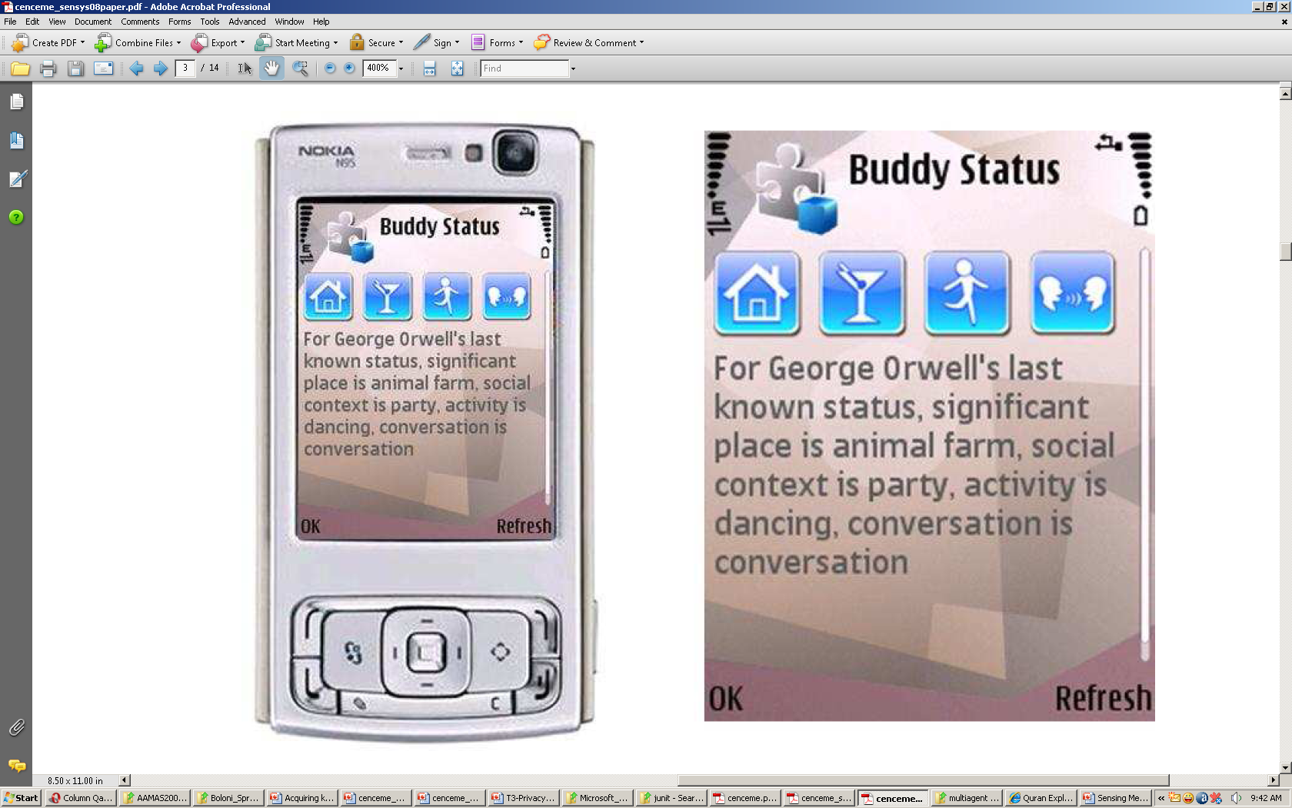
Phone Software
ClickStatus
To complement the full visualization of current and historical sensing presence available via the CenceMe portal
a visualization client that runs on the mobile phone.
The sensing presence is rendered as both icons and text on the phone GUI.
The presence rendered by ClickStatus is subject to the same privacy policies settings as when viewed using the CenceMe portal.
After a user logs in with their CenceMe credentials, they are presented with a list of their CenceMe buddies downloaded from the CenceMe server.
user has the ability to refresh their buddy list at any time via a menu command option.
By highlighting and selecting a buddy from buddy list, a user triggers ClickStatus to fetch via GPRS or WiFi the latest known sensing presence for the selected buddy from the CenceMe server.

Slide 19
Phone Software
WatchTasks
restart any process that fails.
other purposes include:
  launching CenceMe when the phone is turned on;
  starting the CenceMe application software components in the correct order;
  restarting the CenceMe midlet after a phone call is complete. This is detected when the event detector daemon exits, signaling the end of a call;
  restarting all support daemons when CenceMe fails.
  restarting all the CenceMe software components at a preset interval to clear any malfunctioning threads.
The CenceMe phone suite uses a threaded architecture where each JME component is designed to be a single thread.
This ensures that component failure does not compromise or block other components.

Slide 20
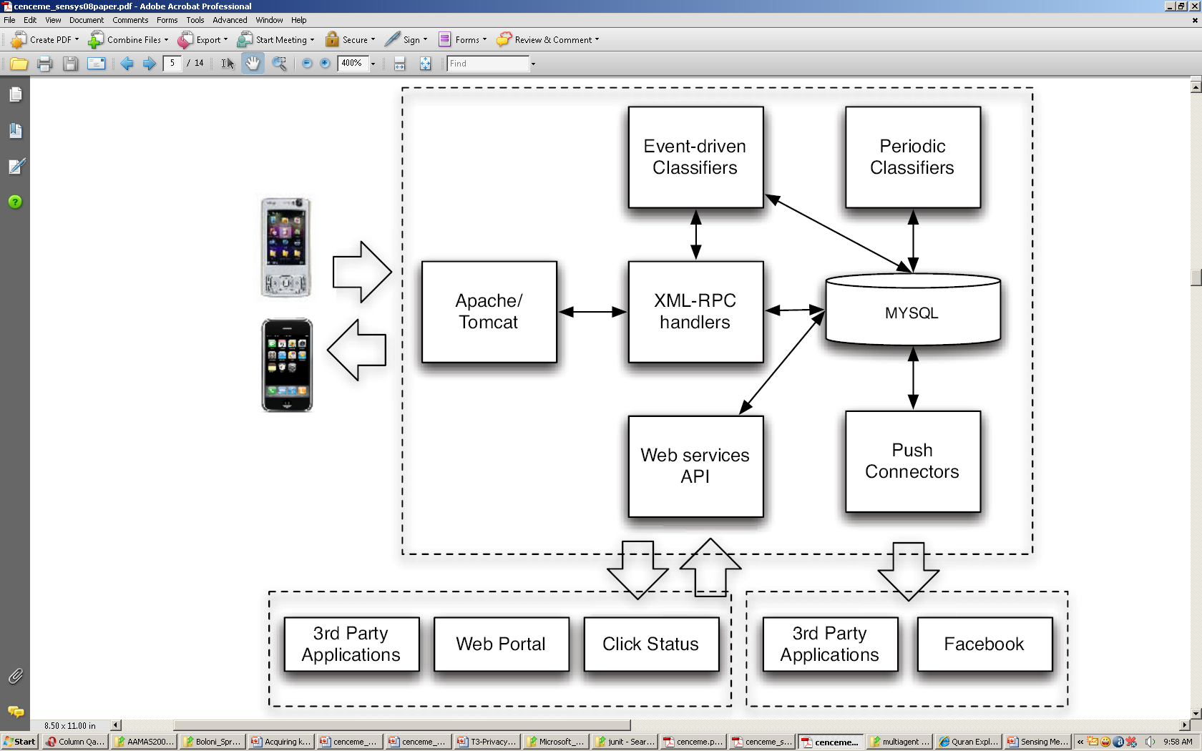
Backend Software
Software architecture of the CenceMe backend.

Slide 21
Backend Software
All software components are written in Java and use Apache 2.2 and Tomcat 5.5 to service primitives from phones and the application requests from the CenceMe portal, ClickStatus, and Facebook.
Communications between the phone and the backend uses remote procedure calls implemented by the Apache XML-RPC library on the server.
Requests are handled by Java servlets in combination with a MySQL database for storage.

Slide 22
Backend Software
Phone - Backend Communications
Data exchange between the phone and the backend is initiated by the phone at timed intervals whenever the phone has primitives to upload.
Primitives are uploaded through XML-RPC requests.
at the backend they are inserted into the MySQL database.
Backend-to-phone communications are piggybacked on both:
  the return message from XML-RPC requests initiated by the phone for primitive upload or periodic ping messages that the phone sends with an ad-hoc XML-RPC control message; and
  the XML-RPC acknowledgment sent to the phone in response to a primitive upload.

Slide 23
Backend Software
Presence Representation and Publishing
CenceMe presence is represented through a set of icons that capture the actual presence of a person in an intuitive way.
If a person is driving a car they are represented by the car icon;
if a person is engaged in a conversation, anicon of two people talking represents the state.
CenceMe publishes presence by means of either a “pull” or “push” approach.
The CenceMe backend supports pull-based data publishing by exposing a standard web service based API. This API is also used to support the data needs of CenceMe components such as ClickStatus and the CenceMe portal.
Push-based publishing is supported by the PushConnector component that handles the generic operation of pushing CenceMe presence based on user preferences to a number of applications.
Three Facebook widgets are offered to expose a subset of the functionality available on the portal:
  Buddy SP is a buddy list replacement widget that lists CenceMe friends for user navigation. It is the same as the standard widget that lists friends within Facebook but augments this list with a mini-sensor presence icon view.
  Sensor Status provides automated textual status message updates such as “Joe is at work, in a conversation, standing”.
  Sensor Presence provides a simplified version of the user’s current status through an iconized representation of the user’s presence.

Slide 24
CENCEME CLASSIFIERS
Phone Classifiers
Audio classifier
retrieves the PCM sound byte stream from the phone’s local storage and outputs the audio primitive resulting from the classification.
This audio primitive indicates whether the audio sample represents human voice and is used by backend classifiers such as the conversation classifier
The audio classification on the phone involves two steps:
  feature extraction from the audio sample and
  classification.

Slide 25
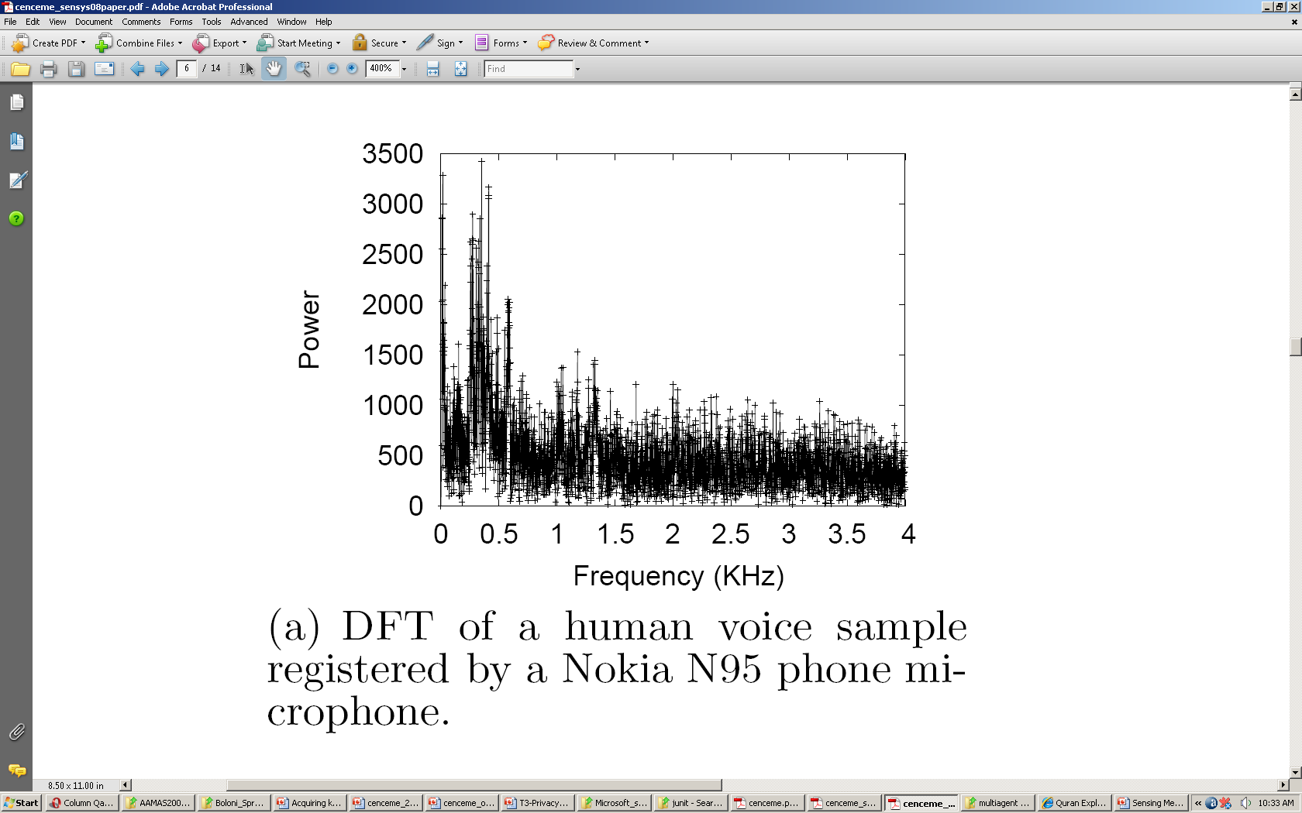
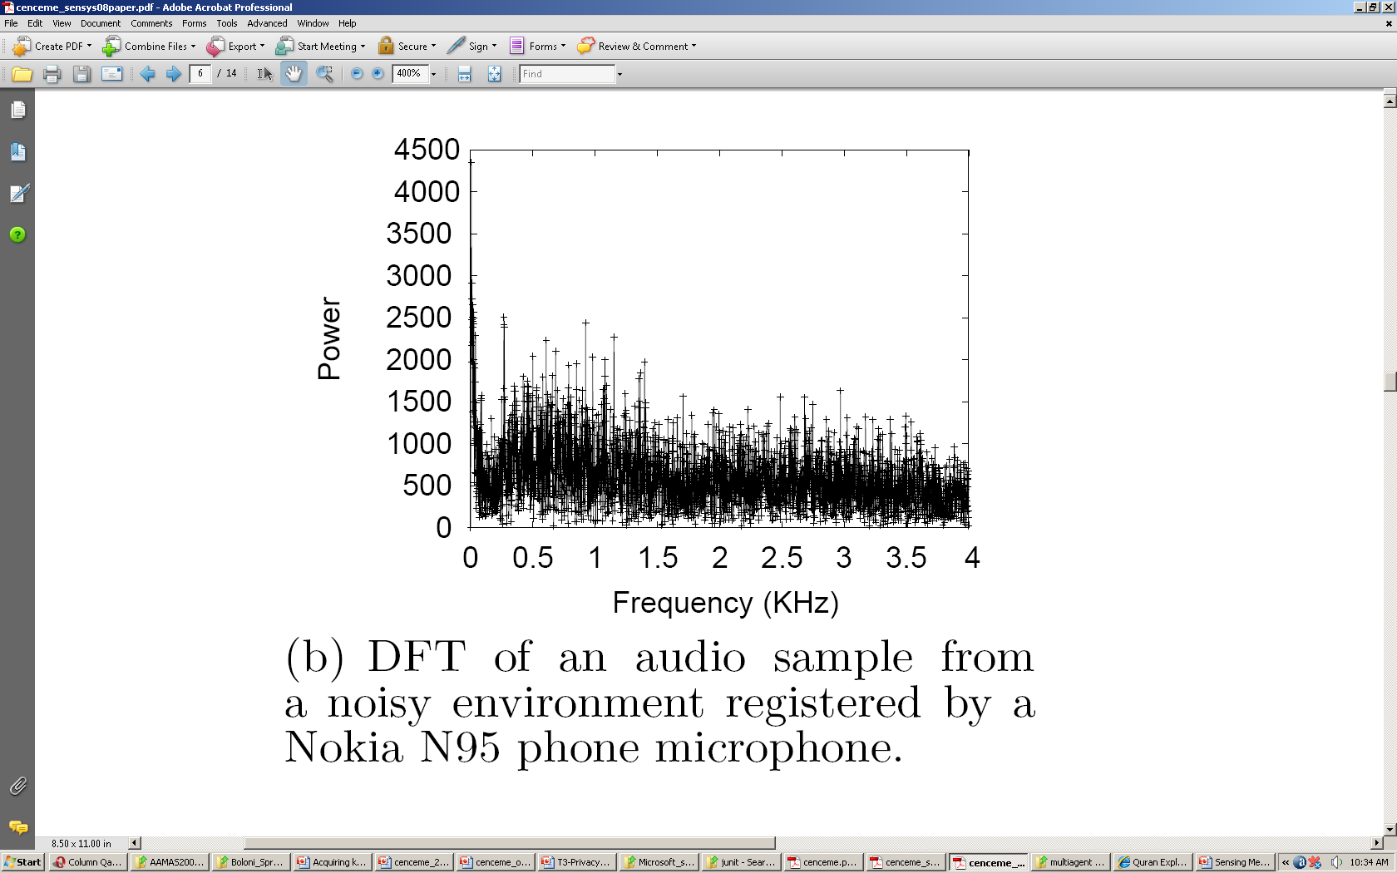
CENCEME CLASSIFIERS
The feature extraction is performed by running a 4096 bin size DFT algorithm.
An extensive a-priori analysis of several sound samples from different people speaking indicated that Nokia N95 sound streams associated with human voice present most of their energy within a narrow portion of the 0-4 KHz spectrum
in the voice case most of the power concentrates in the portion of spectrum between 250 Hz and 600 Hz.

Slide 26
CENCEME CLASSIFIERS
Classification follows feature extraction based on a machine learning algorithm using the supervised learning technique of discriminant analysis.
training set: large set of human voice samples from over twenty people, and a set of audio samples for various environmental conditions including quiet and noisy settings
The classifier’s feature vector is composed of
  the mean and
  standard deviation of the DFT power.
The mean is used because the absence of talking shifts the mean lower.
The standard deviation is used because the variation of the power in the spectrum under analysis is larger when talking is present,

Slide 27
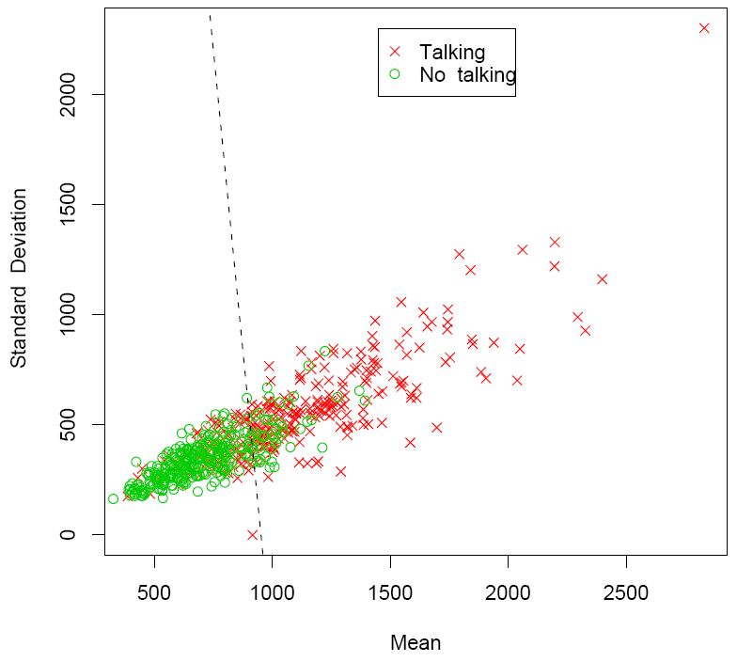
CENCEME CLASSIFIERS
clustering that results from the discriminant analysis algorithm
The equation of the dashed line in Figure is used by the audio classifier running on the phone to discern whether the sound samples comes from human voice or a noisy/quite environment with 22% misclassification rate.
Audio samples misclassified as voice are filtered out by a rolling window technique used by the conversation classifier that runs on the backend
This boosts the performance fidelity of the system for conversation recognition.

Slide 28
CENCEME CLASSIFIERS
Activity classifier
fetches the raw accelerometer data from the phone’s local storage and classifies this data in order to return the current activity, namely, sitting, standing, walking, and running.
The activity classifier consists of two components:
  the preprocessor and
  the classifier itself.
The preprocessor fetches the raw data from the local storage component and extracts features (i.e., attributes).
Given the computational and memory constraints of mobile phones, we use a simple features extraction technique using the mean, standard deviation, and number of peaks of the accelerometer readings along the three axes of the accelerometer.

Slide 29
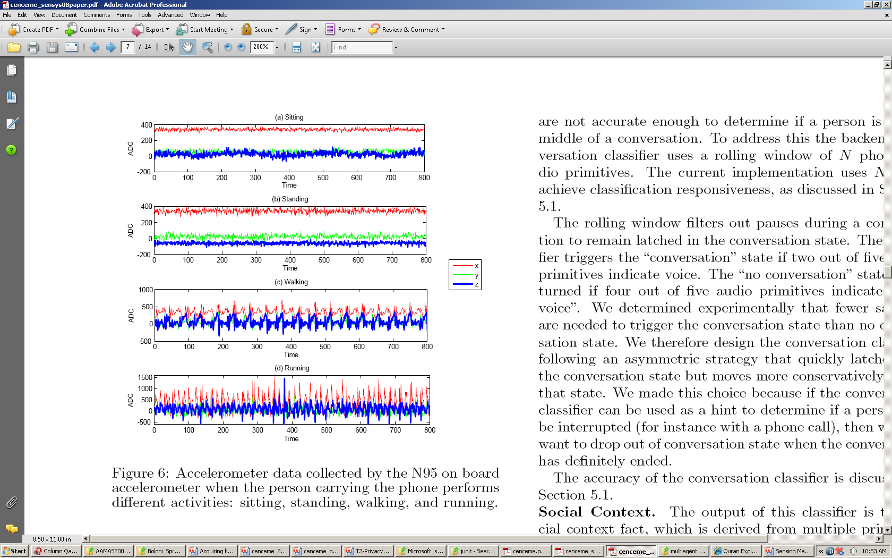
CENCEME CLASSIFIERS
the sitting and standing traces are flatter than when the person is walking and running.
When standing, the deviation from the mean is slightly larger because typically people tend to rock a bit while standing.
The peaks in the walking and running traces are a good indicator of footstep frequency.
When the person runs a larger number of peaks per second is registered than when people walk.
The standard deviation is larger for the running case than walking.

Slide 30
CENCEME CLASSIFIERS
classification algorithm is based on a decision tree technique
The training process of the classifier is run off-line on desktop machines because it is computationally costly.
To maximize the positive inference of an individual’s activity, prior work suggests that the best place on the body to carry a phone is the hip.
After interviewing the participants in user study: most of people carry their phones in their pants pockets, clipped to a belt or in a bag.
collected training data from ten people that randomly placed the mobile phone inside the front and back pockets of their pants for several days.
The time needed by the preprocessor and the classifier to complete the classification process is < 1 sec. on avg. running on Nokia N95

Slide 31
Backend Classifiers
Generate facts based on primitives provided by the phone or facts produced by other backend classifiers.
Facts represent higher level forms of classification including social context (meeting, partying, dancing), social neighborhood, significant places, and statistics over a large group of data (e.g., does a person party more than others, or, go to the gym more than others?).
Some of the classifiers (e.g., conversation and CenceMe neighborhood) will eventually be pushed down to the phone to increase the system classification responsiveness.
In this case, the primitives would still be uploaded to the backend in order to make them available to other backend classifiers.

Slide 32
Backend Classifiers
Backend classifier processing is invoked in two ways:
  either event triggered or
  periodic
An example of an event triggered classifier is the “party” classifier: it receives as input the primitives from the phone that contain the volume of an audio sample and the activity of the user and returns whether the person is at a party and dancing.
periodically executed classifiers example “Am I Hot” classifier runs periodically according to the availability of data in a window of time, (day long data chunk sizes).

Slide 33
Backend Classifiers
Conversation Classifier
Binary classifier - to determine whether a person is in a conversation or not, taking as input the audio primitives from the phone.
Given the nature of a conversation, which represents a combination of speech and silences, and the timing of sampling, the audio primitive on the phone could represent a silence during a conversation- the phone’s audio primitives are not accurate enough to determine if a person is in the middle of a conversation
This is addressed using a backend conversation classifier that uses a rolling window of N phone audio primitives.
The current implementation uses N=5 to achieve classification responsiveness,

Slide 34
Backend Classifiers
The rolling window filters out pauses during a conversation to remain latched in the conversation state.
The classifier triggers the “conversation” state if two out of five audio primitives indicate voice.
The “no conversation” state is returned if four out of five audio primitives indicate a “no voice”.
experimentally determined that fewer samples are needed to trigger the conversation state than no conversation state.
therefore the conversation classifier by design follows an asymmetric strategy that quickly latches into the conversation state but moves more conservatively out of that state.
if the conversation classifier can be used as a hint to determine if a person can be interrupted (for instance with a phone call), then we only want to drop out of conversation state when the conversation has definitely ended.

Slide 35
Backend Classifiers
Social Context
The output of this classifier is the social context fact, which is derived from multiple primitives and facts provided by the phone and other backend classifiers.
The social context of a person consists of:
  neighborhood conditions, determines if there are any CenceMe buddies in a person’s surrounding area or not.
    The classifier checks whether the Bluetooth MAC addresses scanned by the phone, and transmitted to the backend as a primitive are from devices belonging to CenceMe buddies
  social status, builds on the output of the conversation and activity classifiers, and detected neighboring CenceMe buddies to determine if a person is gathered with CenceMe buddies, talking (for example at a meeting or restaurant), alone, or at a party

Slide 36
Backend Classifiers
Social status also includes the classification of partying and dancing.
In this case a combination of sound volume and activity is used.
Using audio volume threshold to infer that a person is at a party or not with training for this is based on a few hours of sound clips from live parties using the N95 microphone.
Similarly dancing is identified if the person is in the “party” state and the activity level is close to running, given that the accelerometer data trace for running is close to dancing.

Slide 37
Backend Classifiers
Mobility Mode Detector
Employs GPS location estimates as input to a mobility mode classifier
This classification is currently only binary in its output, classifying the mobility pattern as being either traveling in a vehicle or not (i.e., being stationary, walking, running).
Uses a simple feature vector based on multiple measures of speed; that is, using multiple distance/time measurements for variable sizes of windowed GPS samples and the built-in speed estimation of the GPS device itself.
The classifier is built with the JRIP rule learning algorithm, based upon manually labeled traces of GPS samples.
We compensate for any inaccuracy in GPS samples by filtering based on the quality measures (i.e., horizontal dilution of precision and satellite counts) and outlier rejection relative to the estimates of previous and subsequent GPS samples.

Slide 38
Backend Classifiers
Location Classifier
classify the location estimates of users for use by other backend classifiers.
GPS samples are filtered based on quality to produce a final location estimate.
Classification is driven based on bindings maintained between a physical location and a tuple containing:
  a short textual description;
  an appropriate icon representation; and
  a generic class of location type (i.e., restaurant, library, etc.). Bindings are sourced from GIS databases and CenceMe users.
Wikimapia is used for GIS data to support user-created bindings
  Relying solely on GIS information limits the richness of shared presence.
  Typically, people tend to spend a larger proportion of their time in relatively few locations.
CenceMe allows users to insert their own bindings via either the portal or the phone. Using the phone, users can manually bind a location when they visit it.
New bindings learned by the system are based on the mobility pattern of the user.

Slide 39
Backend Classifiers
k-means clustering is performed on the GPS data, where the parameters of the clustering algorithm are determined experimentally.
Once a potential significant place is discovered the next time the person enters that location the phone prompts the person’s mobile phone to confirm or edit the details of the location.
Default labels and icons are initially based upon the most popular nearest known existing binding defined by the user or CenceMe buddies.

Slide 40
Backend Classifiers
Am I Hot
Meaningful metrics that relate historical trends in user data to either recognizable social stereotypes or desirable behavioral patterns.
These metrics are calculated on a daily basis and users view patterns in their own data and compare themselves with their buddies.
The metrics include the following:
  nerdy, based on individuals with behavioral trends such as being alone (from the Bluetooth activity registered by the person’s phone), spending large fractions of time in certain locations (e.g., libraries) and only infrequently engaging in conversation;
  party animal, based on the frequency and duration with which people attend parties and also takes into account the level of social interaction;
  cultured, being driven by the frequency and duration of visits to locations such as theaters and museums;
  healthy, based upon physical activities of the user (e.g., walking, jogging, cycling, going to the gym); and finally,
  greeny, identifies users having low environmental impact, penalizing those who drive their cars regularly while rewarding those who regularly walk/cycle

Slide 41
SYSTEM PERFORMANCE
Classifiers Performance
Examine the classifiers performance based on a small-scale supervised experiments.
The results are based on eight users who annotate their actions over a one week period at intervals of approximately 15 to 30 minutes.
Annotations act as the ground truth for comparison with classifier outputs.
The ground truth data is correlated to the inference made by the CenceMe classifiers.
data is collected at different locations and by carrying the mobile phone in various positions on the body.

Slide 42
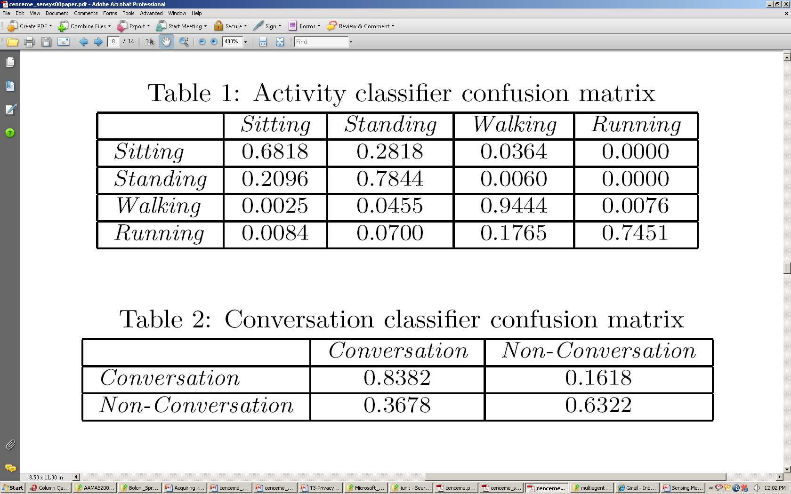
SYSTEM PERFORMANCE
classifier has difficulty differentiating sitting and standing given the similarity in the raw accelerometer traces,

Slide 43
SYSTEM PERFORMANCE
conversation classification accuracy suffers from a relatively high rate of false positives.
This is due to a combination of classifier design and “mis-annotation” by participants.

Slide 44
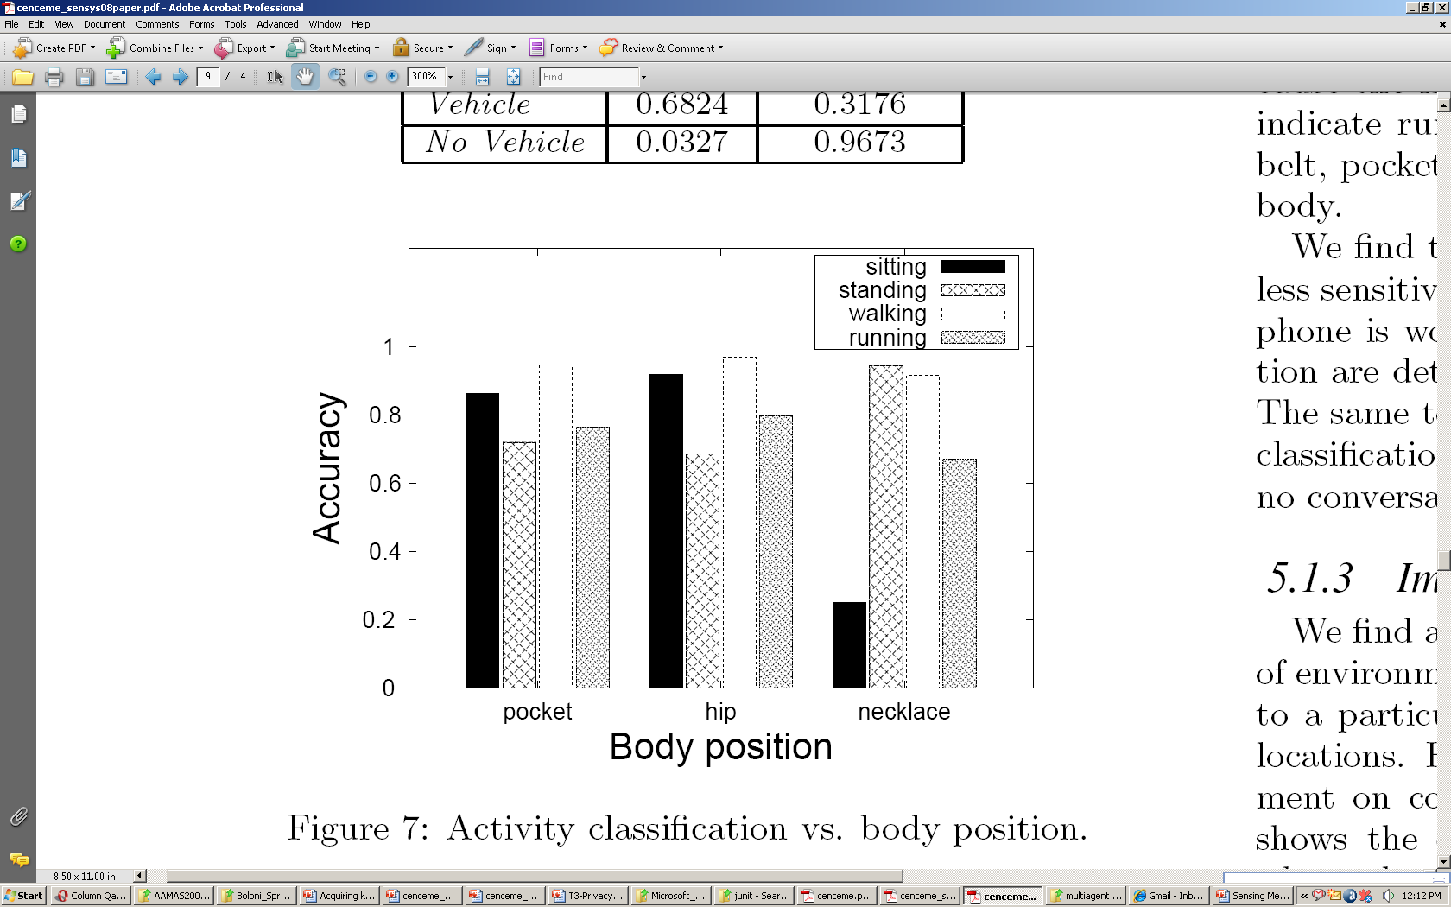
SYSTEM PERFORMANCE
Impact of Phone Placement on the Body
the impact on classification when the Nokia N95 is placed at different places on the body, in a pocket, on a lanyard, and clipped to a belt.
conversation classification accuracy is much less sensitive, when the phone is worn as a lanyard, conversation and no conversation are detected with 88% and 72% accuracy, respectively.
The same test repeated with the phone in a pocket yields a classification accuracy of 82% for conversation and 71% for no conversation

Slide 45
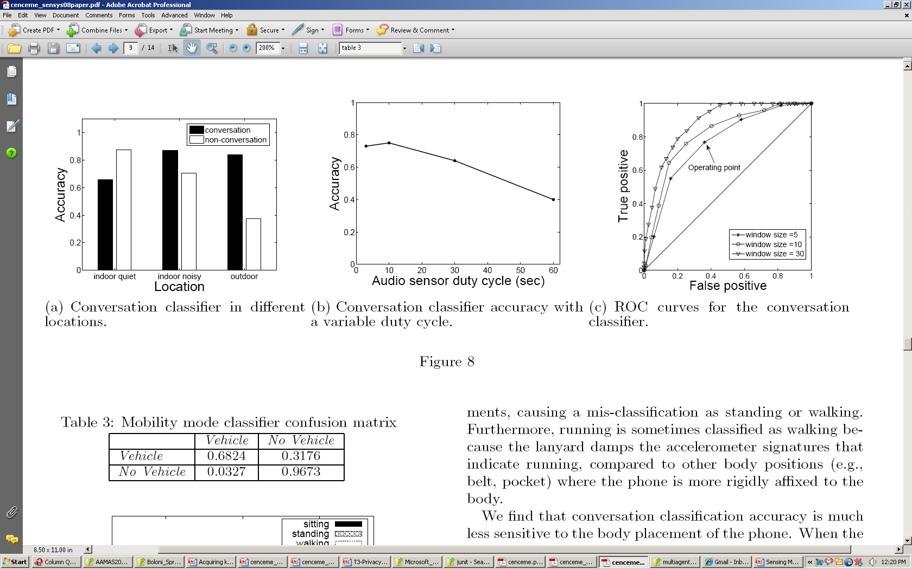
SYSTEM PERFORMANCE
Impact of Environment
activity classification accuracy independent of environment.
Mobility classification is inherently not tied to a particular location but rather on transitions between locations.
An impact from the environment on conversation classification accuracy
Lower conversation detection accuracy in very quiet indoor environments occurs because the classifier is trained with the average case background noise.

Slide 46
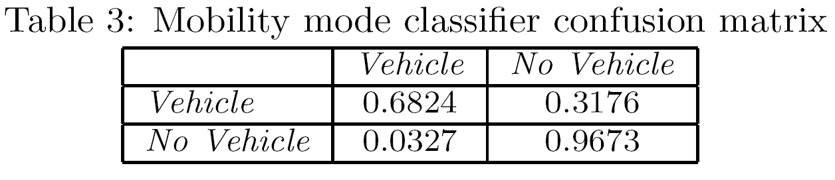
SYSTEM PERFORMANCE
Impact of Duty Cycle
Applying a sleep scheduling strategy to the sensing routine is needed in order to increase the battery lifetime with a ten minute inter-sample time
this has a negative impact on the performance of the classifiers, particularly in detecting short-term (i.e., duration) events that occur between samples

Slide 47
SYSTEM PERFORMANCE
To investigate the impact of duty cycling on conversation classification, an experiment was setup with eight users that periodically reprogrammed their phones with different duty cycles while keeping a diary
The performance of the phone’s conversation classifier as the microphone sensing duty cycle varies.
Each value represents the average of five trials.
there is little benefit in adopting a sleeping time smaller than 10 seconds.
Longer duty cycles impact performance.
Only a 40% accuracy using the conversation classification for a 60 second duty-cycle, which is the longest duty-cycle considered experimentally

Slide 48
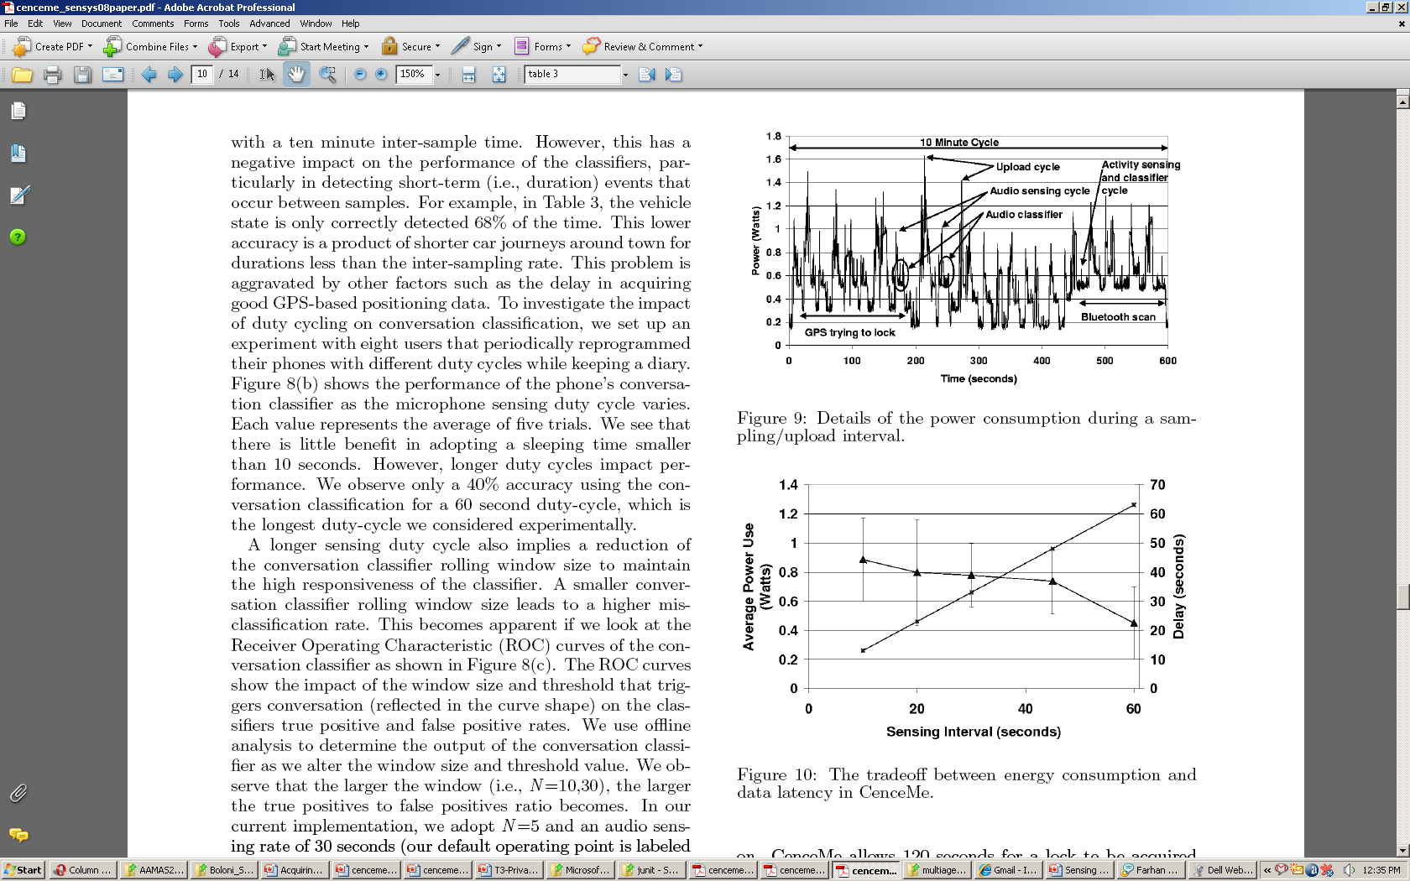
SYSTEM PERFORMANCE
Power Benchmarks
Power measurements of CenceMe are made using the Nokia Energy Profiler, measuring battery voltage, current, and temperature approximately every third of a second
Bluetooth proximity detection requires a 120 second scan period to capture neighboring MAC addresses due to the cache flushing limitations of the Bluetooth API in JME.
GPS location detection is inherently power hungry and takes time to acquire“a lock”when turned on.
CenceMe allows 120 seconds for a lock to be acquired and then the N95 keeps the GPS activated for another 30 seconds .

Slide 49
SYSTEM PERFORMANCE
The highest spikes shown on the plot are due to the upload of data which uses the cellular radio.
The next highest spikes are due to sampling of audio data.
The period of several seconds following the audio sample is where the audio classifier runs, using a relatively high amount of energy to compute a DFT.
The accelerometer sampling and activity classification are fast and use little power.

Slide 50
SYSTEM PERFORMANCE
Energy consumption measured with the profiler for sampling intervals ranging from 10 seconds to 60 seconds with power in Watts on the vertical axis.
The second line and axis in the graph shows the latency in getting the facts to the backend as a function of the sample interval including the sample interval itself, classifier latency, and network delay.
The audio classifier latency is actually a multiple of three times the values on this line since the classifier needs at least three facts from the phone in order to detect conversation and social setting.
The horizontal axis shows the sampling interval for the accelerometer and audio.
proximity and GPS sensors are sampled at ten times the x-axis value

Slide 51
SYSTEM PERFORMANCE
The combination of the two lines show the tradeoff between energy use and data latency for any particular sampling interval.
There is no optimal sampling interval since users will have different requirements at different times.
Overall battery lifetime running the entire CenceMe software suite on a fully charged N95 is measured five times by running the battery to depletion under normal use conditions while using no other applications on the phone.
This results in 6.22 +/- 0.59 hours of usage

Slide 52
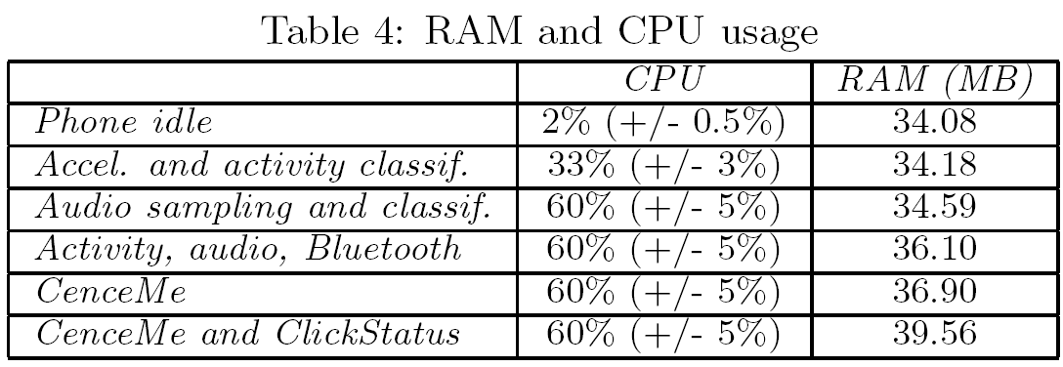
Memory and CPU Benchmarks
We also carried out benchmark experiments to quantify the RAM and CPU usage of the CenceMe software running on the N95 using the Nokia Energy Profiler tool.
audio sampling and feature vector extraction require more computation than the other components.
memory foot print does not grow much as components are added. Together CenceMe and ClickStatus occupy 5.48MB of RAM.

Slide 53
USER STUDY
The experiment conducted over a three week period involved 22 people.
Participants were each given a Nokia N95 with the CenceMe software (including ClickStatus) and a free voice/data plan.
Users had server side accounts and access to the CenceMe portal.
While some of the users were friends we placed all users in the same buddy list as a means to create some community
The pool of candidates picked within the population of students and staff at Dartmouth university was composed of 12 undergraduate students, 1 research assistant, 1 staff engineer, 7 graduate students, and 1 professor.
The research assistant and four undergraduates have little computer science background.
Sixteen participants are active Facebook users

Slide 54
USER STUDY
Almost all of the participants liked using CenceMe and its features.
  One user wrote: “it’s a new way to be part of a social network”.
Facebook users are particularly active in terms of willingness to share detailed status and presence information with their friends.
Privacy could be a concern but users are fine with sharing their presence status as long as they have the means to easily and efficiently control their privacy settings.
CenceMe stimulates curiosity among users. Users want to know what other people are doing while on the move.
CenceMe can aid people in learning their own activity patterns and social status.

Slide 55
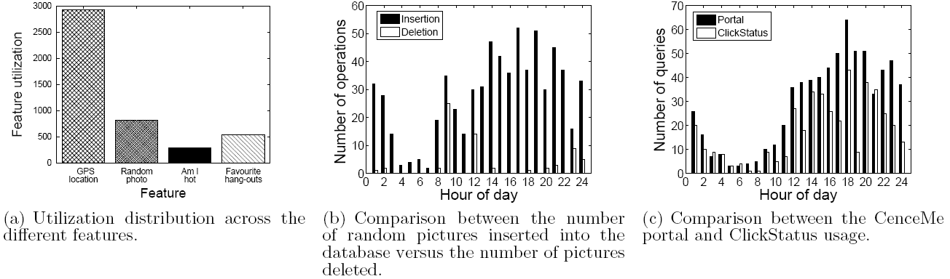
USER STUDY
A new way to connect people. Almost all the participants find the idea of providing and viewing detailed information about people they are close to compelling, useful, and fun.
Potential CenceMe demographic - Few participants (4 out of 22) disabled the random photo for the entire duration

Slide 56
USER STUDY
Learn about yourself and your friends.
  “CenceMe made me realize I’m lazier than I thought and encouraged me to exercise a bit more”.
My friends always with me.
  The study highlights that the participants enjoyed retrieving their friends’ presence on the mobile phone with ClickStatus in addition to checking the portal.
  The average number of times per day they checked presence was 4 ± 3 times, where 3 is the standard deviation.

Slide 57
Conclusion
Implementation, evaluation, and user experiences of the CenceMe application
one of the first applications to automatically retrieve and publish sensing presence to social networks using Nokia N95 mobile phones.
a number of important design decisions needed to resolve various limitations that are present when trying to deploy an always-on sensing application on a commercial mobile phone

Slide 58
Future Work
An improved CenceMe software module on the phone that prolongs the battery life (48 hrs)
An enhanced version of the portal to provide finer grained privacy policy settings as well as an enhanced ClickStatus user interface
A shorter classification time for primitives and facts because many of the participants believe that real time access to buddies’ sensing presence should be one of the features of the system.

Slide 59
References
http://www.cs.dartmouth.edu/~sensorlab/people.html
http://www.cs.dartmouth.edu/~sensorlab/research.html
http://www.youtube.com/watch?v=aAKplAaPAHE&NR=1

Slide 60
Thank you
Questions??

