Slide 1
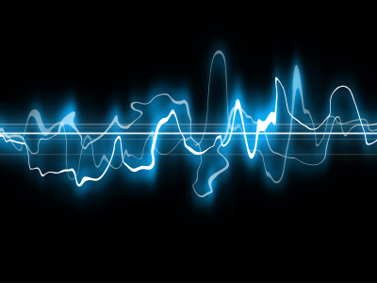
SoundSense
by
Andrius Andrijauskas

Slide 2
Introduction
Today’s mobile phones come with various embedded sensors such as GPS, WiFi, compass, etc.
Arguably, one of the most overlooked sensors, available on every device, is the microphone.
Sound captured by a mobile phone’s microphone can be a rich source of information.
Notes:
that can be used to make accurate inferences about the person carrying the phone, their environment, and social events.

Slide 3
Introduction
From the captured sound various inferences can be made about the person carrying the phone.
Conversation detection
Activity recognition
Location classification

Slide 4
Challenges
Scaling
Robustness
Device integration
Notes:
Scaling - it is difficult to scale to a large number of people because each person has different everyday environments.
Robustness – physical phone location matters, is the person carrying the phone in hand, is the phone in the pocket, or is it in the backpack? All of these will affect the sound received by the microphone differently.
Device integration – algorithms must be simple enough not to require a lot of computing power and resources, they must not hinder phone’s primary function, they must also safeguard the privacy of the user.

Slide 5
Scaling
People live in different environments, containing a wide variety of everyday sounds.
Typically, sounds encountered by a student will be different from those encountered by a truck driver.
It is no feasible to collect every possible sound and classify it.

Slide 6
Robustness
People carry phones in a number of different ways; for example, in the pocket, on a belt, in a bag.
Location of the phone with respect to the body presents various challenges because in the same environment sound levels will vary based on the phone’s location.

Slide 7
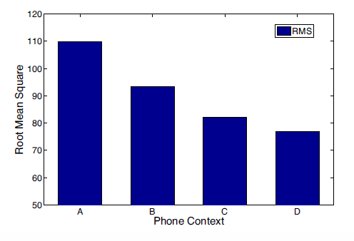
Robustness
Phone context alters the volume:
A – in hand of a user facing source
B – in pocket of a user facing source
C – in hand of a user facing away from the source
D in pocket of a user facing away from the source
Notes:
A -

Slide 8
Device Integration
Algorithms that perform sound sensing must be integrated in a way not to hinder phone’s primary function.
Algorithms must be simple enough to run on a mobile device.
Captured audio data may be privacy sensitive, so user privacy must be protected.

Slide 9
SoundSense
SoundSense – scalable sound sensing framework for mobile phones.
It is the first general purpose sound event classification system designed specifically to address scaling, robustness, and device integration.

Slide 10
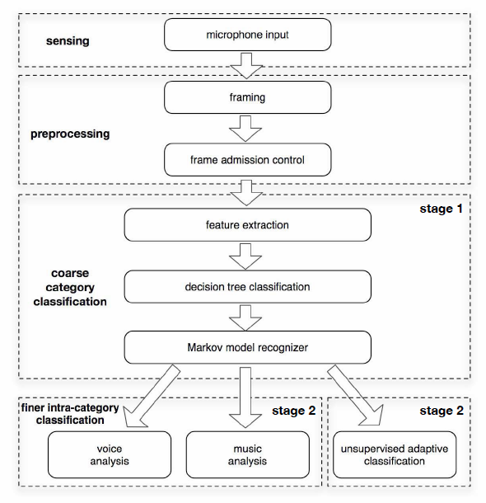
Architecture

Slide 11
Sensing and Preprocessing
Audio stream is segmented into uniform frames.
Frame admission control is required since frames may or may not contain “interesting” audio content.
Uninteresting audio content can be white noise, silence, or insufficient amount of signal captured. How is this determined?

Slide 12
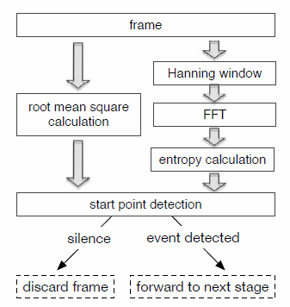
Sensing and Preprocessing
Determining “interesting” audio content.
Notes:
RMS is a quadratic mean of a continuous time waveform.
Frame admission is done on the basis of energy level and spectral entropy. Low energy level indicates silence or undesirable phone context, which prevents meaningful classification.
Spectral entropy gives cues about the frequency pattern of the sound. A flat spectrum (silence or white noise) results in high entropy. A low value indicates a strong pattern in the spectrum.
Entropy helps differentiate “informative low volume” samples from the non-informative ones.
Two thresholds – rms_threshold and entropy_threshold are used for frame admission control. If the frame fails both of this criteria it is discarded.

Slide 13
Architecture

Slide 14
Feature Extraction
Zero Crossing Rate
Low Energy Frame Rate
Spectral Flux
Spectral Rolloff
Bandwidth
Spectral Centroid

Slide 15
Feature Extraction - ZCR
Zero Crossing Rate – is a number of time domain crossings within a frame.
Human voice consists of voiced and unvoiced sounds.
Voiced frames – high ZCR value.
Unvoiced frames – low ZCR values.
Human voice will have high ZCR variation.
Typically music does not have high ZCR variation
Notes:
Feature extraction limitation – clipping at 8kHz

Slide 16
Feature Extraction – Low Energy Frame Rate
Low Energy Frame Rate – number of frames within a frame window that have an RMS value less than 50% of the mean RMS for the entire window.
Because human voice has voiced and unvoiced frames, this feature will he higher for speech than for music and constant noise.

Slide 17
Feature Extraction – Spectral Flux
Spectral flux – measure how quickly the spectrum of the signal is changing.
Calculated by comparing the power spectrum for one frame against the power spectrum from the previous frame.
Speech generally switches quickly between voiced and unvoiced frames, resulting in a higher SF value.

Slide 18
Feature Extraction – Spectral Rolloff
Spectral Rolloff is a measure of the skewedness of the spectral distribution.
Right skewed (higher frequency) distribution will have higher spectral rolloff values.
Music will typically have high spectral rolloff values

Slide 19
Feature Extraction – Spectral Centroid
Spectral Centroid indicates where the “center of mass” of the spectrum is.
Music usually involves high frequency sounds which means it will have higher spectral centroid values.

Slide 20
Feature Extraction – Bandwidth
Bandwidth – range of frequencies that the signal occupies.
In this case, it shows if the spectrum is concentrated around the spectral centroid or spread out over the whole spectrum.
Most ambient sound consists of a limited range of frequencies.
Music often consists of a broader mixture of frequencies than voice and ambient sound.

Slide 21
Feature Extraction – Normalized Weighted Phase Deviation
Normalized Weighted Phase Deviation – shows the phase deviations of the frequency bins.
Usually ambient sound and music will have a smaller phase deviation than voice.

Slide 22
Feature Extraction – Relative Spectral Entropy
Relative spectral entropy - differentiates speech and other sounds.

Slide 23
Architecture

Slide 24
Decision tree classification
Extracted featured are then fed to one of the following models:
Gaussian Mixture Model
K-Nearest Neighbors
Hidden Markov Model
Essentially these are machine learning / pattern recognition type models that in this case help us classify sounds (as voice, music, or ambient sound) based on the extracted features.
All three models yielded about 80% classification accuracy.
Notes:
The models are way too complex to get into any detail.
Essentially these are machine learning / pattern recognition type models that in this case help us classify sounds based on the extracted features.

Slide 25
Architecture

Slide 26
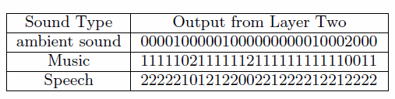
Markov Recognizer
Decision tree classification sampleoutput:
0 – ambient sound
1 – music
2 - speech

Slide 27
Markov Recognizer
Contains Markov models for each of the three categories.
The models were trained to learn pair-wise transition probabilities.
A sample output from classifier is fed directly to the Markov models to calculate the maximum probability for a particular sound event.

Slide 28
Architecture

Slide 29
Unsupervised Adaptive Classification
Unsupervised Adaptive Classification components copes with all ambient sound events.
The objective of this component is to discover over time environmental sounds that are significant in every day life in addition to voice and music.
Notes:
MFCC Provides fine details in the frequent bands to which human ear is most sensitive, while also capturing coarser information over the other spectral ranges.
MFCC based algorithm is unsupervised and is processed on the go.
MFCC Provides fine details in the frequency bands to which human ear is most sensitive, while also capturing coarser information over the other spectral ranges.

Slide 30
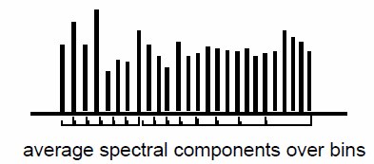
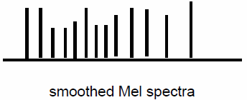
Mel Frequency Cepstral Coefficient (MFCC)
Waveform
Convert to Frames
DFFT
Take Log of amplitude spectrum
Mel-scaling and smoothing
Discrete Cosine Transform
MFCC Features
Notes:
Mel-scaling and smoothing – this step is used to emphasize perceptually meaningful frequencies. This is achieved by collecting (say) 256 spectral components into (say) 40 frequency bins.
Although one would expect these bins to be equally spaced in frequency, it has been found that for speech, the lower frequencies are perceptually more important than higher frequencies. Therefore the bin spacing follows the so-called “Mel” frequency scale.
Spectral components are averaged over Mel-spaced bins to produce a smoother spectrum.
Discrete cosine transform is used to “clean up” the signal, and finally MFCC features are obtained.

Slide 31
Unsupervised Adaptive Classification
Once the event is classified as ambient sound, UAC algorithm starts to run.
UAC algorithm extracts MFCC features of the sound event.
System checks if the event has already been classified.
If not then user is asked to label the unknown sound event.
System can store up to 100 of these events.

Slide 32
Implementation
SoundSense prototype is implemented as a self sustained piece of software that runs on the Apple iPhone.
Contains approximately 5,500 lines of code.
Written mostly in C/C++ and then implemented in Objective C.
Complete package is about 300KB.

Slide 33
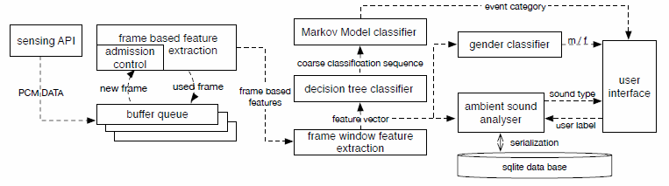
Implementation

Slide 34
Evaluation
In the quiet environment , the system adopts a long duty cycle, the CPU usage is less than 5%.
Once acoustic processing starts CPU usage increases to about 25%.
Maximum memory usage (with all bins being used) is about 5MB.

Slide 35
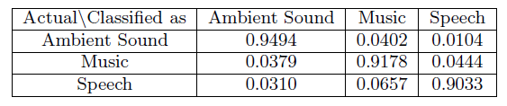
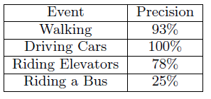
Evaluation
Ambient sound, music, and speech classification accuracy:
Unsupervised Adaptive Classification accuracy:

Slide 36
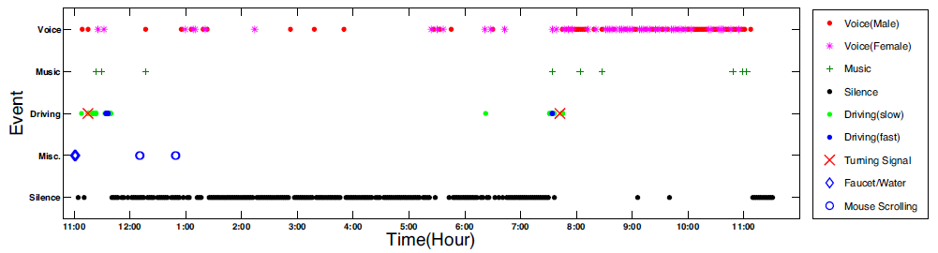
Evaluation
Participant’s activities recognized by SoundSense on a Friday

Slide 37
Evaluation
SoundSense in everyday life
http://metrosense.cs.dartmouth.edu/projects.html

Slide 38
Conclusions
SoundSense is light-weight scalable framework capable of recognizing a broad set of sound events.
In contrast to traditional audio context recognition systems that are offline, SoundSense performs online classification at a lower computational cost and yields results that are comparable to the offline systems.

Slide 39
END
Questions…

Slide 40
References
SoundSense: Scalable Sound Sensing for People-Centric Applications on Mobile Phones
Mel Frequency Cepstral Coefficients for Music Modeling
Wikipedia

