Slide 1
Cooperative Techniques Supporting Sensor-based People-centric Inferencing
Nicholas D. Lane, Hong Lu, Shane B. Eisenman, and Andrew T. Campbell
Presenter: Pete Clements

Slide 2
Background
MetroSense
    Andrew T. Campbell
    Collaboration between labs at Dartmouth & Columbia University
    Projects Include
      SoundSense
      CenceMe
      Sensor Sharing
      BikeNet
      AnonySense
      Second Life Sensor

Slide 3
Problem
People-centric sensor-based applications need models to provide custom experience
Learning inference models is hampered by
  Lack of labeled training data
    Insufficient training data
    Disincentive due to time and effort
  Appropriate feature inputs
    Heterogeneous devices
    Insufficient data inputs
Notes:
Individual models based not only on raw sensor input (camera, microphone, accelerometer,) but on higher level inferences (location, activity, mood)

Slide 4
Proposed Solution
Opportunistic feature vector merging
Social-network-driven sharing of
  Model training data
  Models themselves

Slide 5
Related Work
Sharing training sets in machine learning nomenclature known as co-training
Several successful systems using collaborative filtering (similar users can predict for each other)
However, none keyed specifically on sharing data of users in same social network

Slide 6
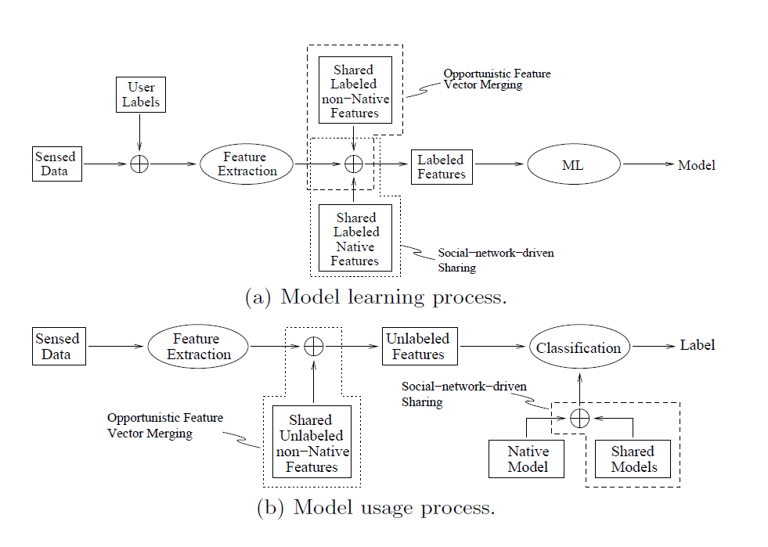
Integration Points

Slide 7
Opportunistic Feature Vector Merging
Motivation - the accuracy of models increase as the sensor inputs from more capable cell phones are used to generate better models
Shareable Capabilities
  Sensor configuration
  Available memory
  CPU/DSP characteristics
  Anything not highly person, device or location specific
Essentially necessary sensor data not available through low end phone is opportunistically borrowed from more capable phone

Slide 8
Opportunistic Feature Vector Merging
Direct Sharing
  Borrowed from user in proximity
  Lender broadcasts data sources, not features
  Borrowers request features of specific data source
Indirect Sharing
  By matching common features to similar users with more capable features
  Central server collects data, looks for merging opportunities

Slide 9
Opportunistic Feature Vector Merging
Challenges
  Sharing not available when you need it
    Maintain multiple models based on feature availability
    Use algorithms more resilient to missing data
  Privacy
    User configures shareable features
    Truly anonymous data exchange ongoing research

Slide 10
Social Network Driven Sharing
Motivation
  Accurate models require lots of training data, and sharing data reduces this load
Challenges
  Sharing data reduces accuracy
  Uncontrolled collection method
  Heterogeneous devices
  Simple global model not the answer

Slide 11
Social Network Driven Sharing
Training Data Sharing
  Assume known social graphs
  Models trained from individual data and high ranking people in individual social graph
  Label consistency issues addressed with clustering
Model sharing
  Test models in social network to discover best performing
  Mix and match model components

Slide 12
Proof of Concept Experiment
Significant places classifier that infers and tags locations of importance to a user based on sensor data gathered from cell phones
Phone capabilities ignored as needed to produce four capability classes
  Bluetooth Only
  Bluetooth + WiFi
  Bluetooth + GPS
  Bluetooth + WiFi + GPS
Notes:
Significant Places Classifier
1st Phase: various features are extracted from raw data to infer significant places
2nd Phase: the significant places are labeled
3rd Phase: classifier is run to recognize significant places

Slide 13
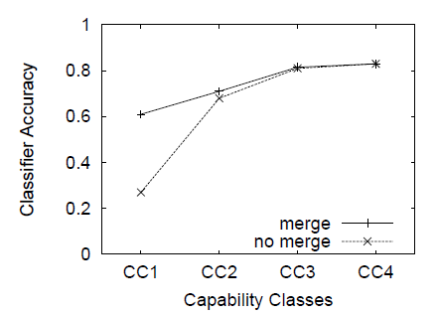
Results

Slide 14
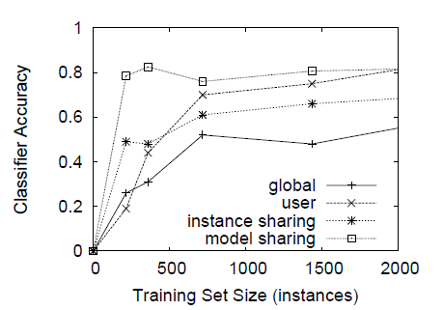
Results
Global Model
  Pools training data from all participants equally
User Model
  Training data sourced from user only
Instance Sharing
  Training data source from user and users from social graph
Model Sharing
  Selects best performing per-user model from self, global and users from social graph

Slide 15
Results
Phone survey results indicate higher label recognition among members of same social group

Slide 16
Conclusions
There is opportunity to leverage both device heterogeneity, and social relationships when sharing data and models in the support of more accurate and timely model building

Slide 17
Questions?
Thank You

