Slide 1
Participatory Urbanism
Thompson, S. 2009. University of Central Florida EECS

Slide 2
Definition: Urban Computing
Urban computing is an emerging field of study that focuses on the use of technology in public environments such as cities, parks, forests and suburbs. It also studies the interaction between humans and such environments, which is becoming increasingly common as access to computing devices extends beyond home and office

Slide 3
Definition: Participatory Urbanism
Participatory Urbanism is the open authoring, sharing, and remixing of new or existing urban technologies marked by, requiring, or involving participation, especially affording the opportunity for individual citizen participation, sharing, and voice.

Slide 4
The Concept

Slide 5
Areas (not) to focus on
Home
Office
Social
Mobile

Slide 6
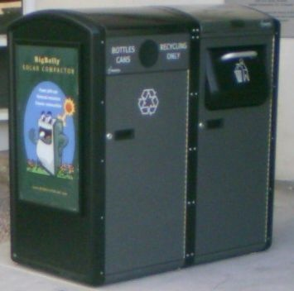
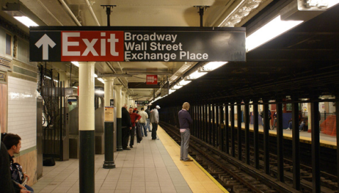
Areas to focus on
More than 50% of world’s the population lives in cities
Change how we interact with “ordinary” events and objects
Recast mobile devices as “networked mobile personal measurement instruments”

Slide 7
Sensor Taxonomy
Onboard
Left behind
Scattered
Infrastructure

Slide 8
Examples of Participatory Urbanism
Providing mobile toolkits for non-experts to become authors of new urban objects
What is important to you?
Group needs based dialogue tools
What is important to a group?
Empowering citizen to collect and share data
What kind of data does everyone care about?

Slide 9
Project Legacy

Slide 10
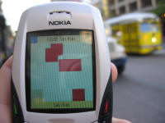
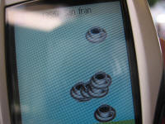
Jabberwocky
Encounter your familiar strangers, people we see frequently, but choose to ignore
Mobile phone application that renders participants the immediate area, identification using Bluetooth
http://www.urban-atmospheres.net/Jabberwocky/info.htm

Slide 11
Hullabaloo
Place based ringtones to get an idea of who is around you
Each user selects their own ringtone
Bluetooth identification mechanism
http://www.urban-atmospheres.net/Hullabaloo/index.html

Slide 12
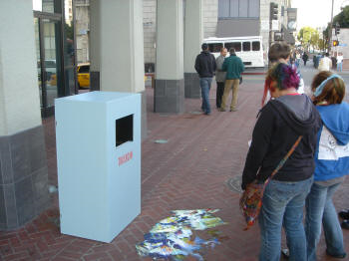
Jetsam
Project recently thrown away trash
Provide new experience and mechanism for everyday urban items

Slide 13
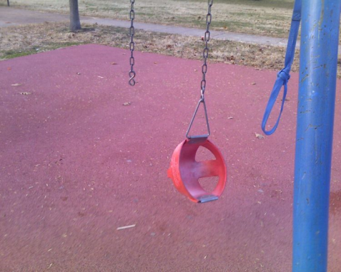
Currently Deployed
Hollabacknyc.com
Parkscan.org
Phone photos of street harassers
Phone photo of broken parks, etc.
Sent directly to city work request system

Slide 14
Demo
Parkscan.org Search

Slide 15
Ergo
Static sensors that report on air quality for a zip-code when they receive an SMS
Positive feedback from persons with respiratory issues
Over 10,000 reports generated (2007)

Slide 16
Participatory Urbanism
Based on “Sensing Atmosphere” by Paulos, et. al.

Slide 17
Motivation
The World Health Organization estimates that 2 million deaths each year can be attributed to air pollution
2005 Report

Slide 18
Deployment Strategy
Series of static sensors in common locations
Sensors attached to personal mobile devices for data capture
Positions citizens as the driving element behind data collection and reporting

Slide 19
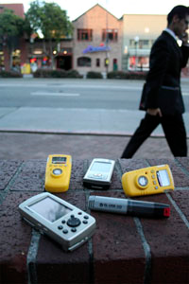
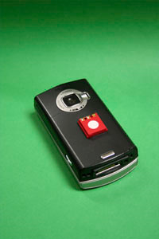
Accra, Ghana Field Study
Personal mobile air-quality measurement
Two weeks of data collection in Ghana
Carbon monoxide readings (top left)
Debunk theory that mobile devices are solely for communication

Slide 20
Accra, Ghana Field Study
7 cab drivers (tube), 3 students (mobile pack)
Sensor pack included
GPS logger
Carbon monoxide sensor
Sulfur dioxide or nitrogen oxide sensor
Areas of high concentration
Airport (highlighted)
Large neighborhoods

Slide 21
Sensors
Cab sensor package
Individual sensor package

Slide 22
Hardware
Based on “N-SMARTS: Networked Suite of Mobile Atmospheric Real-time Sensors” by Paulos, et. al.

Slide 23
The Ideal Platform (sort of)
Cell phone ideal for environmental sensing
Co-located with user
GPS
Communication network
Ubiquitous (and relatively low-cost)
Problem areas
Sensor calibration
Storage practices (pocket, handbag)
Power management

Slide 24
N-SMARTS and CommonSense
Shared goals of N-SMARTS (Berkley) and CommonSense (Intel)
Develop platform to understand challenges of mobile sensing platforms
Does this information affect individual/group behavior?
Scalable architecture
Develop algorithms to promote accurate sensing despite typical user habits

Slide 25
N-SMARTS
Record cell phone signal strength to build coverage map

Slide 26
N-SMARTS COTS Platform
COTS Platform used for initial testing
Lascar EL-USB-CO Carbon Monoxide data logger
Garmin Qwest GPS
NO2, SO2 or O3 data logger from BW Tech.
Synchronized clocks
Else data skew occurs
Deployed in Ghana study

Slide 27
N-SMARTS Integrated Platform
Integrate directly with phone
CO and Nox sensors
Temperature sensor (for calibration)
Accelerometer for activity inference
Bluetooth radio for communication w/phone
On board A-GPS used for location

Slide 28
N-SMARTS Integrated Platform
Phones with MSM chips and Assisted-GPS
Nokia N95
Allows for fast cold starts, indoor location fixes
MEMS PM2.5
Measures particle matter by depositing aerosol particles on a thin-film bulk acoustic resonator (FBAR) oscillation @ 1.6Ghz

Slide 29
CommonSense
Based on “Common Sense: Mobile Environmental Sensing Platforms to Support Community Action and Citizen Science” by Aoki, et. al.

Slide 30
CommonSense
Deployment of N-SMARTS test boards on street sweepers in San Francisco
City Technology Micro CF carbon monoxide sensor
A MICS dual No2/Co2 Sensor
An Analog Devices ADXL330 3-axis accelerometer
National Semiconductor LM60 temperature sensor

Slide 31
CommonSense
Data transmitted via GSM text messages
Web-based visualization tools
Currently deployed handheld devices
Flickr

Slide 32
Future Areas of Work
Automatic Calibration
Gaussian process models suggest sensors in close proximity can be calibrated to one another or accurate references in the environment
Context Inference
Inferring the context of the phone, obstructions, location, action, activity, etc.
Super Sampling
Increase system precision in sensor rich environments
Social Impact

Slide 33
In Closing
Our future mobile devices:
(1) that they will be equipped with more sensing and processing capabilities
(2) that they will also be driven by an architecture of participation and democracy that encourages users to add value to their tools and applications as they use them
http://www.youtube.com/watch?v=WCSYeoG3OSk @ 37:05

Slide 34
Citations, etc.

Slide 35
Citations and Credits
Based largely on research by the “Urban Atmospheres” Team
Eric Paulos (Intel Research Berkeley)
Ian Smith (Intel Research Seattle)
RJ Honicky (UC Berkeley)
et al.
http://www.urban-atmospheres.net/
http://www.citris-uc.org/CRE-Feb14-2007
http://www.youtube.com/watch?v=WCSYeoG3OSk

Slide 36
Paper Citations
N-SMARTS: Networked Suite of Mobile Atmospheric Real-Time Sensors R.J. Honicky, Eric Brewer, Eric Paulos, Richard White, In Networked Systems for Developing Regions 2008, a workshop of SIGCOMM
Sensing Atmosphere Eric Paulos, RJ Honicky, and Elizabeth Goodman, Workshop position paper for the Sensing on Everyday Mobile Phones in Support of Participatory Research at ACM SenSys 2008, November 2007
P.M. Aoki, R.J. Honicky, A. Mainwaring, C. Myers, E. Paulos, S. Subramanian, and A. Woodruff. Common Sense: Mobile Environmental Sensing Platforms to Support Community Action and Citizen Science (demonstration). Adjunct Proceedings Ubicomp 2008, Sep. 2008, 59-60.

Slide 37
Related Projects
Urban Sensing (CENS / UCLA)
SensorPlanet (Nokia)
AIR (Preemptive Media)
SenseWeb (Microsoft)
The Urban Pollution Monitoring Project (Equator UK)
CommonSense

