Slide 1
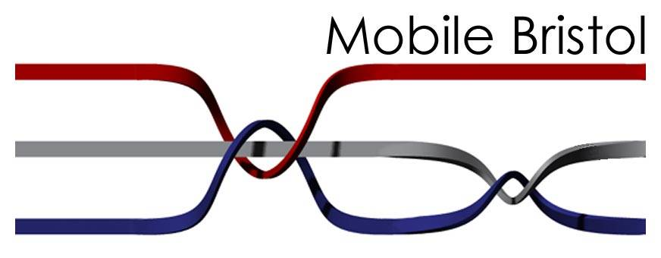
An Experiment in Located Media Experiences
Ed Leland

Slide 2
Introduction

Slide 3
What is the Mobile Bristol Project?
Experimental testbed for pervasive mobile media located in Bristol, UK from November 2002 – August 2005
Focused on both technology and user value research
Collaborative activity between industry, universities, content providers and government
Funded by the UK Department for Trade and Industry (DTI) from November 2002 – August 2005

Slide 4
Purpose
    To investigate how mobile devices and wireless technology can be used to enhance the ways in which residents and visitors experience and interact with their physical environment and with each other in urban and public spaces

Slide 5
Vision: A Platform for Situated Experiences
Provide a digital canvas over the city onto which rich digital experiences can be painted and new commercial ventures can be explored
  Wireless & wired Networks
  Context-sensitive clients, services and experiences
  Right thing at the right time, in the right place, in the right way
  Creating another Dimension
  City as a showcase, canvas and lab

Slide 6



Participants
Principal founders:
  Hewlett Packard Laboratories
  University of Bristol
  Appliance Studio
Other participants
Arnolfini
@Bristol
Wolverhampton University
Bath University
Watershed
Ashton Gate Primary School
Southville Community Development Association
Environmental Agency/BBC
BBC NHU
nestafuturelab
Ordnance Survey
University of the West of England
Bristol University dept. of Geographical Science
Open University
Proboscis
Node
Panasonic & GWR
Qinetiq
Adshel/Cityspace
Vodafone

Slide 7
Goals
Technology
  Client architectures
  Authoring tools
  Network Integration
  Trusted Networks
  Scalable Media Delivery
  Technology & Lifestyle Integration
Methods
  Experience Design Methodology
Businesses
  Ecosystem insights
Technology/Lifestyle insights
  Eclectic perspectives on pervasive computing
A City-based accessible infrastructure
Notes:
This paper follows the first one. Mention this is also the foundations utilized by YouTube, Wikipedia, and Facebook.

Slide 8
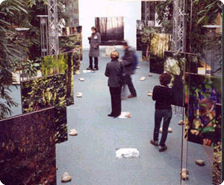
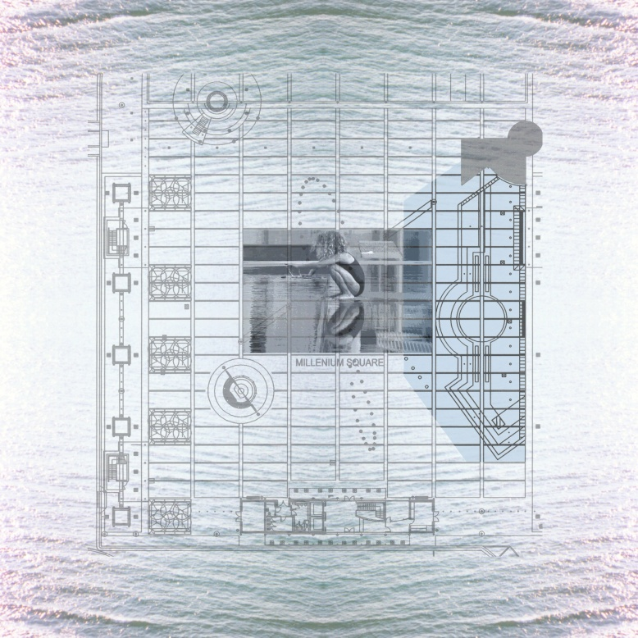
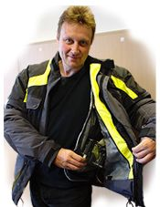
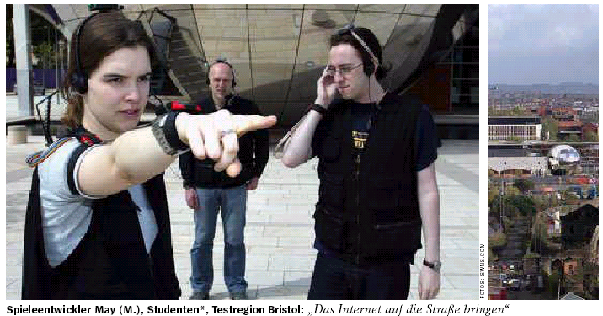
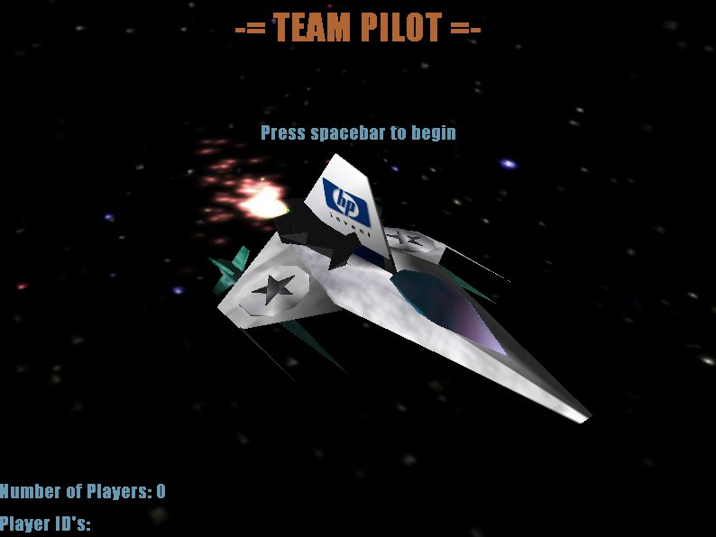
Origins: HPL & Bristol University 2001-2002
Notes:
This paper follows the first one. Mention this is also the foundations utilized by YouTube, Wikipedia, and Facebook.

Slide 9
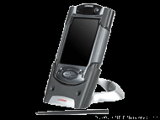
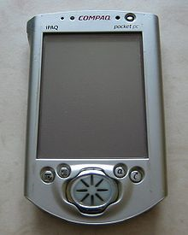
State of the Art 2002
iPaq 3970
  OS: Pocket PC 2002
  64MB RAM
  48MB ROM
  400 MHz PXA250 Processor
  1 SD card slot
  240x320 screen
  Bluetooth 1.1
  No WiFi
  Price: $750
Notes:
This paper follows the first one. Mention this is also the foundations utilized by YouTube, Wikipedia, and Facebook.

Slide 10
Research Strands

Slide 11
Lifestyle Research
    Seeks to understand the intricacies of life for different kinds of people with an eye toward the design of new technologies.
    Goal is to use this understanding to develop new technology concepts, and to help shape and direct other technologies currently under development in ways that people will find valuable.
    Context sensitive based on what “User Group” is involved
    Initial research focused on working parents

Slide 12
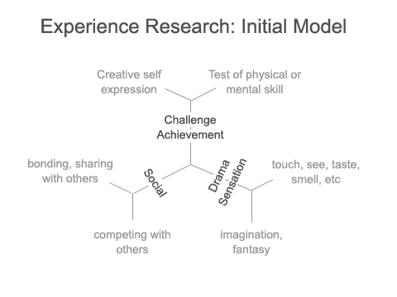
Experience Design Research
    Centered on two main questions:
      What makes a technology experience compelling?
      How do you design situated technology experiences?
Single Site, Single Application (Fusion) | Multiple Sites, Single Application (Roaming)
Single Site, Multiple Applications (Discovery) | Multiple Sites, Multiple Applications (Integration)

Slide 13
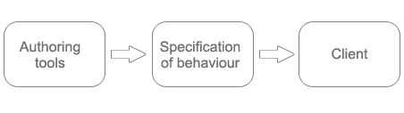
Application Framework
    The framework reflects an emerging, mixed-reality metaphor for Mobile Bristol applications and consists of three main components:
      An XML based specification language for laying out the virtual world of the application and defining how client devices should respond to events
      A PC-based graphical authoring tool for creating application specifications in this language
      Portable client hardware and software that can download and interpret such specifications

Slide 14
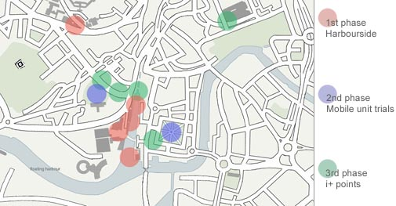
Infrastructure Rollout
    The goal for the Mobile Bristol network is to establish as wide a coverage of wireless LAN as possible in the center of Bristol
    Three tiers of access:
      Tier 1: 802.11 access points to BMEX backbone
      Tier 2: 802.11 access points to Internet
      Tier 3: Mobile Phone network access to Internet

Slide 15
Application Projects

Slide 16

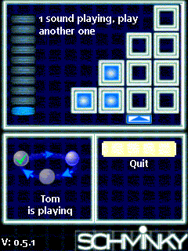
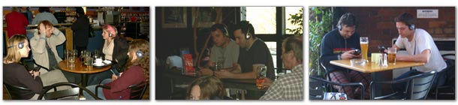
Public launch (March 2003)
Players use an iPaq handheld computer to solve musical puzzles.
Users can play individually or invite other users in the bar to join in a group game.
Designed to promote social interaction and test acceptability of new technologies in social spaces

Slide 17

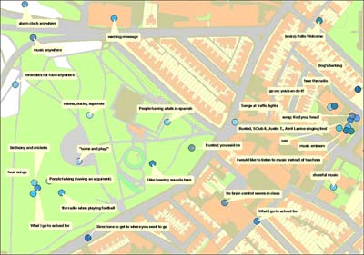
Implemented May-July 2003
Used 36 children, ages 9-10 to provide input.
The children gave their thoughts and feelings about Old Chapel Park, a familiar outdoor space
They were then given a set of hardware and software tools to create soundscapes in that space.

Slide 18
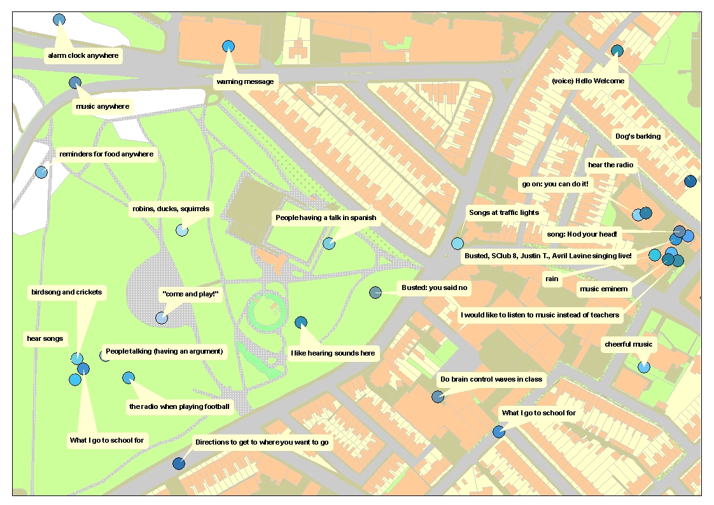

Slide 19

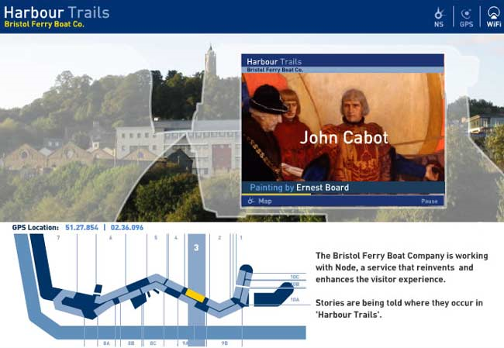
Fielded July- November 2003
Uses portable, handheld technology to access location specific information
Focused on the rich history of the Bristol docks
Allows for interaction with other users and the ferry staff
Designed as an example of an ‘Open Space’ tourism service, suitable for a park, castle or city district.

Slide 20

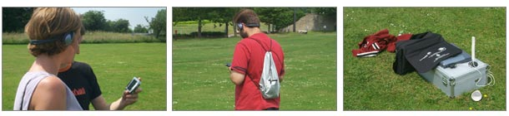
Proof of concept test – Autumn 2003
Futurelab saw the opportunity in utilizing the Mobile Bristol framework for educational purposes when they participated in our first set of workshops with local schools. Savannah is a collaborative project that explores whether children can learn about ecology and ethology by 'being an animal'.
The project is motivated by the question of what innovation and creativity mobile technologies and rich media delivery can bring to ways of learning in a game play environment.
The idea of the game is for participants to learn what it is like to be a lion by walking around in a virtual Savannah and encountering sounds of other animals or things in the environment.

Slide 21

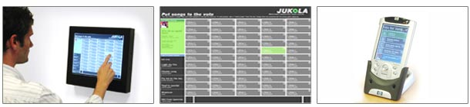
Field trail and user evaluation (October 2003)
The interactive Jukebox is designed to allow a community of people in a public space (e.g. a bar or café) to all partake in the choice of music playing
Owners of the bar/cafe create MP3 music collections from which candidate tracks are nominated to be voted on by the clientele.
People in the bar use wireless iPAQ handheld to view nominated tracks, find out further information about the tracks and submit their votes
Votes are collated across all the iPAQs to determine the next track providing a democratic choice over the music played

Slide 22

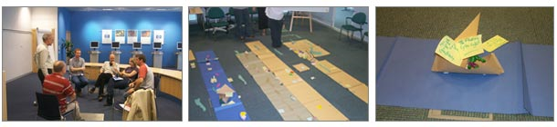
Bursary projects: November 2003-November 2004
Schminky demonstrated that it was possible to introduce technology mediated experiences into the heart of a social space without destroying the ambiance
The project gave us the incentive to explore the integration of interactive exhibition systems into the lifestyle experience of a visit to Watershed.
The aims of the bursary:
  To enable artists and multi media producers to develop their creative practice in digital media and specifically to work with mobile technologies
  To explore the integration of interactive exhibition systems into the lifestyle experience of a visit to the Watershed.
  To foster creative collaborations between artists, technologists and Watershed to explore new working practices
  To develop the Mobile Bristol Infrastructure through practice based R&D
  To make digital work and practice available to audiences in the South West through seminar, presentation, exhibition and/or publication
  To support opportunities for exchange of ideas in the wider community

Slide 23

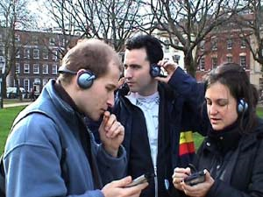
Works initially shown to an invited audience (February 2004)
Consists of two separate interactive artworks
Both Zoe and Dan used kit consisting of ipaq+gps unit to enable the ‘viewer’ to access located audio as they moved around the outdoor space.
With Zoe’s piece the screen was hidden, in Dan’s the screen displayed images to draw the users attention to a particular location.

Slide 24
Daniel Belasco Rogers’ description:
  As you walk down a street, do you wonder if it can remember everything that happened on it? Can bricks and mortar really record sound vibrations from the past and if so would you be able to hear yourself? A description of this place as if you were someone else is an exploration into siting personal histories in geographical locations such as Queen Square, to form the tapestry of experience, and how the viewer can use the technology to peel back the city's layers, revealing those personal stories of first kisses and car crashes.
Zoe Irvine’s description:
  This piece takes as its points of departure the filmic sensation of using a walkman and Queen Square’s recent history as a venue for open air cinema screenings. The viewer of the work navigates the physical landscape in which there are lingering fragments of film soundtracks which have both been shown there; the Matrix and Moulin Rouge. As the viewer/listener first walks around the soundscape it takes the form of an auditory archaeological dig but as the viewer moves further the sounds begin to merge and transform taking on ideas of DJ culture and plunderphonics.

Slide 25

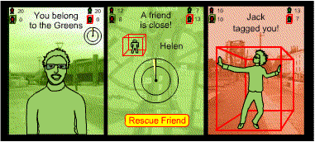
Multiplayer game experiment (May 2004)
CitiTag is a wireless, location based multiplayer game
Designed to enhance spontaneous social interaction
Integrates virtual, “gamespace” presence with physical
Players tag players on opposite team and are freed by friendly players
Urban space becomes a playground and everyone is a suspect.

Slide 26

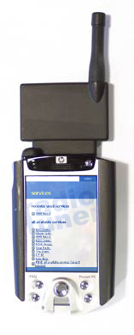
Fielded Summer 2004
Demonstrate DAB’s capability to send multimedia data alongside existing audio services. The data will complement the audio with: album images, interviews with the artists and interactive games. These will be triggered by the broadcaster.
Demonstrate conditioning of the audio by inserting downloaded sound clips at certain points in the playback. The sound clip that gets played could be chosen based on context provided by sensors, for example location.
Add in a low bandwidth backchannel allowing users to provide feedback to broadcasters, for example to vote for their favorite artist or song.
Add in a high bandwidth backchannel (possibly 802.11), making it possible to download content over the Internet. EG an advertiser could broadcast an advert that contains a link to their website. This could be viewed within the confines of the GWR-branded browser.

Slide 27
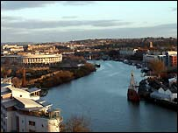
BBC Festival of Nature Walk
Ran for one week in October 2004
Participants were provided with satellite navigation equipment, a small screen and a pair of headphones
Multimedia content is triggered based on the users location
Content provided by local experts

Slide 28

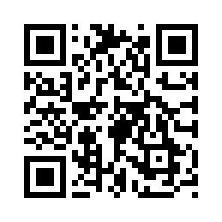

Active Print / I Can Read You
    Active Print started development in June 2003
    I can read you game was demonstrated May 2005
    Active Print allows camera equipped devices to read a barcode like symbol, then pull content from the web based on that information
    I can read you was a team based gather the clues game using Active Print

Slide 29
Conclusions

Slide 30
Conclusions
As first large scale experiment in Urban Computing, the Mobile Bristol project was a success.
Project was broad in scope and tried to explore all facets of Urban Computing
While some aspects have been dated by changes in technology, most basic concepts remain sound
Multi-user participation is far more prevalent in the Mobile Bristol project than most current applications
Notes:
GIS software utilizes point of interest to detect service stations. Also that uploading is done via cellphone internet service

Slide 31
Questions?

