Slide 1
Technology Probes: Inspiring Design for and with Families
Research Topic Analysis
Written By:
Hilary Hutchinson, Wendy Mackay, Bosse Westerlund
April 2003
Presented By: Matt Catron
EEL6788
Spring 2010
University of Central Florida

Slide 2
Inspiration for this Research
“Bowling Alone” – Robert Putnam
Technology has lead us to a loss of “social capital”
Activity | % Change in Last 25 Years
Attending Club Meetings | 58% drop
Family Dinners | 43% drop
Having Friends Over | 35% drop
www.bowlingalone.com

Slide 3
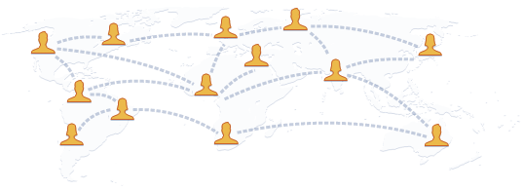
Inspiration for this Research
HomeNet Study (Carnegie Mellon)
Technology isolates family and friends
Has also increased daily stress levels
Can be positive when used for communication with family and friends
http://homenet.hcii.cs.cmu.edu/
http://www.facebook.com/

Slide 4
What does this mean?
Conflicting information presents the question:
“What is the value of computer technology as it permeates our lives???”
It is important to study how technology can be used to support communication in everyday life

Slide 5
Goals of this research
“Design and understand the potential for new technologies that support communication amongst diverse, distributed, multi-generational families ”
This research is part of the interLiving project
Design and deploy 2 technologies, messageProbe and videoProbe
Studies include families from US, Sweden, and France

Slide 6
Challenges
Find a design strategy which allows family members to be key participants in the design
Typical Approach:
1st Interview Families
2nd Create a design
3rd Test and see what they liked / disliked
At the same time, family participants cannot become the designers themselves
The solution is to use “technology probes”

Slide 7
What are Technology Probes?
Probe – “An instrument to find out about the unknown”
Technologies which are “simple, flexible, and adaptible”
Used for co-designing technologies along with users
This is a multidisciplinary area of study

Slide 8
Disciplines Involved
Discipline | Why its needed
Social Science | “Understanding the needs and desires of users in a real-world setting”
Engineering | “Field testing the technology”
Design | “Inspiring users and researchers to think about new technologies”

Slide 9
Social Science
Data collected is not ‘unbaised’
The technology probe should and will interact with the users’ behavior
Also, the users interpretation of the technology over time is important

Slide 10
Engineering
They must work (in a real world setting)
Although it may be a rapidly prototyped device, it is more than just a demonstration
Minor details are important

Slide 11
Design
Flexibility and adaptability are important
Allow users to come up with their own uses after a period of time
Probes must be open-ended, allowing users to freely decide how best to use them
Future ideas can incorporate these findings

Slide 12
How a probe is different from a product
Feature | Probe | Prototype
Functionality | Simpler | More complex
Flexibility | Open-ended | More focused
Usability | Not so important | Primary concern
Logging | A primary goal | Maybe, but secondary
Design Phase | Appear Early | Appear Later

Slide 13
interLiving Project
Main goal is to experiment with different design methodologies
Particularly with families and individuals within a family
http://interliving.kth.se
http://interliving.kth.se/finaldeliv/interLiving-brochure-low.pdf

Slide 14
messageProbe
Digital post-its in a zoomable space
Multiple users can access it at the same time from different places
Contains just an LCD tablet and pen
Limited to just a few family members
Interface was a minimal as possible, to most closely relate to pen and paper

Slide 15
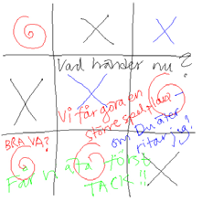
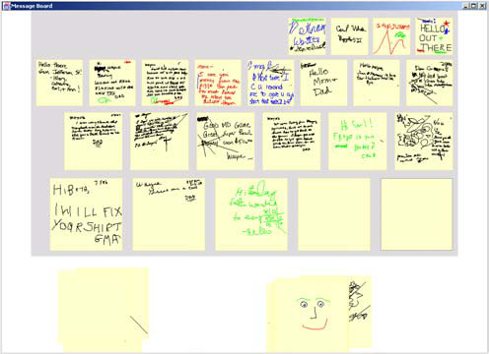
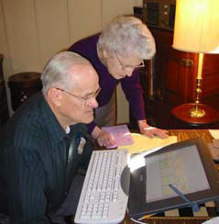
messageProbe

Slide 16
messageProbe

Slide 17
Being Deployed
USA Family
Father was the only one who regularly used it
Mother preferred to just use the phone
Kids were too busy to check it
Grandfather would write on pen and paper 1st because there was no delete function
Swedish Families (2)
Woman tended to make use of this much more than men
Kids played games such as connect-the-dots
All families suggested a visual or audio cue when new post-its become available

Slide 18
messageProbe Conclusions
Helpful in revealing communication patterns and technology needs/desires
Many messages involved thing like coordinating to run errands and get stuff done. Possibility for future research

Slide 19
videoProbe
Monitor with a camera and remote
Pictures can be taken and viewed across the network
Remote can be used to browse images
Pictures ‘fade’ over time and eventually disappear

Slide 20
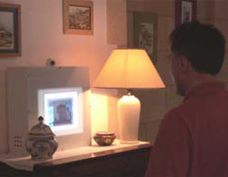
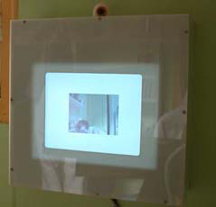
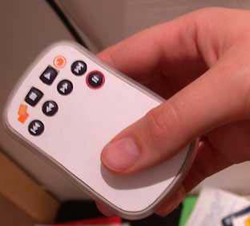
videoProbe

Slide 21
Why not real-time video?
Real-time video is tough to implement in a home application (2003)
Still images support both synchronous and asynchronous communication
This also requires family members to interact with the probe

Slide 22
Being Deployed
French Families (2)
Mostly used to make a funny face and send the picture
Sometimes they would take pictures of hand written messages to send

Slide 23
Future Work
messageProbe and videoProbe helped indentify two areas for further study:
Family coordination:
Study participants had ideas for this, including:
Shared calendars embedded into the fridge and on cellphones.
Voice activated key chains to display schedule
Playful interaction
Future prototypes should continue to encourage this type of behavior

Slide 24
Conclusions
Technology probes are a promising design tool
Help to reveal practical needs and playful desires
Provided real-life use scenarios
Introduced families to new types of technologies

Slide 25
Pros and Cons
GOOD
BAD
“Technology Probe” is a great way to identify a need
Also, provides great ideas for fulfilling that need
Outdated research examples. Technology has been revolutionized several times in the last 7 years.

Slide 26
Suggestions for Improvement
Encourage the use of this in industry in addition to in research and in academia
Use of current technologies can be just as beneficial as developing new technologies.

Slide 27
Questions?

