Slide 1
VISIBLE ENERGY UFO
“A smart grid solution to manage home energy consumption”
Victor Velez
EEL6788
Feb 15 2010

Slide 2
OVERVIEW
Background
What is VISIBLE ENERGY UFO?
Load Management
Stand-by Energy mode
Components of VISIBLE ENERGY UFO
Goals of VISIBLE ENERGY UFO
How does it work?
Demo
Future Development
Video
Question
Resources

Slide 3
Background
The current lower grid is reaching its limitations. The world will need by 2050 the double of energy we are consuming now and smart-grid technology will be needed to increase efficiency, reliability, and security, as well as to reduce the environmental impact of supplying the electrical power needs of modern society in an era of rising costs.

Slide 4
What is Visible Energy UFO?
Smart home energy management system that allows consumers to take control of their energy consumption.
By helping customers to use less energy during peak times, and encouraging them to participate in demand-response programs , which are called Load Management
By offering ways to remotely turn appliances on and off and stop them from draining power on standby mode (consumption: from 7% - 40% of household electricity)
Computers, - Game Consoles - cell-phone chargers
DVD/VCR players, - DVRs - Microwaves

Slide 5
load management
What is it?
Load management is a way of deferring some electricity use (load) from peak-demand periods to a time when there is less demand for electric energy. Electric water-heaters, central air-conditioners, electric heat pumps and dual-fuel furnaces are appliances whose load can be managed with very little, if any, customer inconvenience. Most customers won't even know when this load is being managed.
Average on Power interruption on central AC is every 30 minutes for 7.5 minutes
Ratepayers get discounts for helping utilities prevent outages. (Progress Energy ≈ USD$ 12.00 per house: AC, Pump, Water heater)
It will reduce peak demand and save money every month.
The demand for electricity varies every hour of the day and every day of the year.

Slide 6
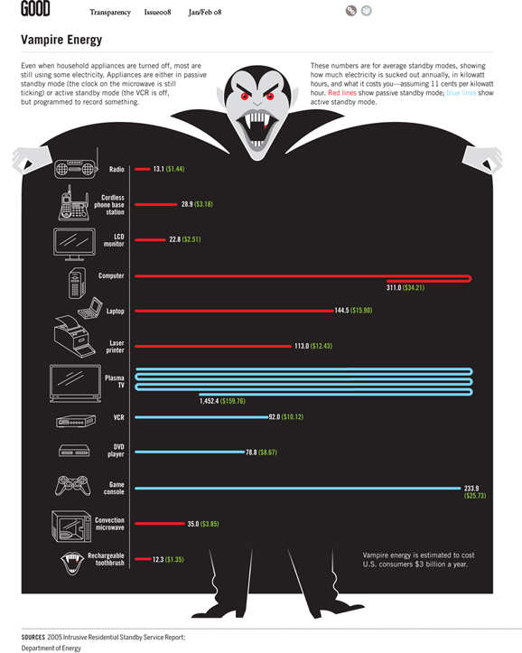
Standby mode energy losses

Slide 7
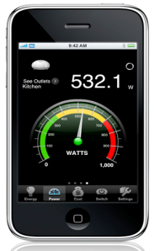
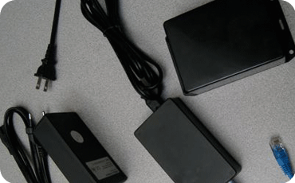
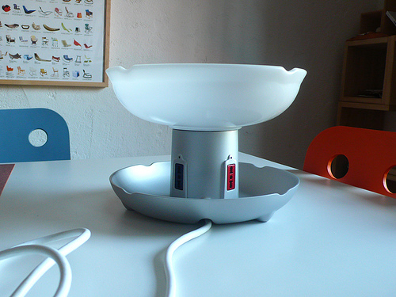
Components and Technical Specifications
iPhone or iPod Gateway Smart Powerstrips
American:
4 Outlets : 110-120 volts each
Frequency : 60 Hz
EU:
4 Outlets : 250 volts each
Frequency : 50 Hz
Application : 0.5 Mb
iPhone OS 2.2 or later

Slide 8
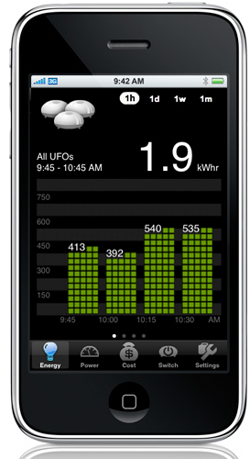
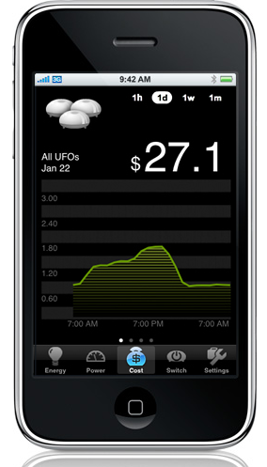
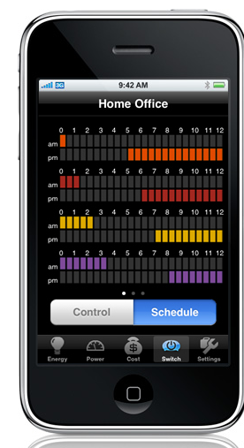
Goals of Visible Energy UFO
To monitor and show homes energy consumption in real time or in the last day(s), week(s) or up to 2 months.
kW
USD $
To control and schedule ON/OFF
of connected appliances remotely
to smart powerstrips.

Slide 9
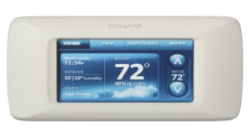
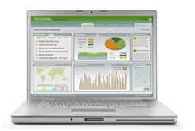
HOW DOES IT WORK?
Gateway
Energy Management System
Powerstrips
Home Area Network
Local Area Network
HAN
LAN
EMS
It holds relevant energy consumption and management data to be used by the user. Powerstrips can connect, through the EMS, using a broadband connection to the back-end network.
It uses a technology of radio-controlled switches.
The electricity used by each of its four electrical outlets is measured and logged during usage.
Internet
Energy Management System
TV
Internet
Powerstrip
Computer
Powerstrip
Powerstrip
HAN
HAN
Warm Air Furnace
iPhone
iPhone
Appliances
Water Heater
A/C unit

Slide 10
How powerstrips kill standby energy
Power source
Power supply
Load
A
Cell phone Charger
Cell phone
Power source
Power supply
Load
B
Secondary load
Main load
Plasma TV, VCR
Power source
Power supply
Load
C
Cell phone Charger
Cell phone

Slide 11
DEMO

Slide 12
What is coming soon?
Smart circuit breaker

Slide 13
Adv/Desadvantages
Advantage
It is easy to install and operate
It is open to the final user and is an alternative to be used by the utility-route.
Disadvantages
Software application and hardware interface are not open to third-party developers.
Smart Grids are expected to take longer term to spur the kind of transformation that the internet has already brought to the way we live, work, play and learn.
Powerstrips and other elements are expensive.

Slide 14
Other iPhone Apps to manage energy consumption
Tendril Vantage Mobil – Available in 2010
- Text-messages updates
- More graphs
- Carbon emissions – user’s energy use
Control4’s My house UI
Agilwaves
Greenbox
Green Energy Options

Slide 15
VIDEO
http://www.youtube.com/watch?v=F1_CQGJ1Jdo&feature=player_embedded

Slide 16
Resources
Standby Power and How to Limit it:
http://www.iea.org/textbase/nppdf/free/2000/blipinthenight01.pdf
Visible Energy: Fighting Vampires With UFOs
http://earth2tech.com/2009/04/04/visible-energy-fighting-vampires-with-ufos/
The best future power mix still includes fossil fuels
http://green.venturebeat.com/2010/01/12/sdforum-the-best-future-power-mix-still-includes-fossil-fuels/
Visible Energy Inc.
http://www.visiblenergy.com/products/homedevice/ufo.html

Slide 17
Questions?

Slide 18
THAN YOU

