Slide 1
Towards Privacy-Sensitive Participatory Sensing
K.L. Huang, S. S. Kanhere and W. Hu
Presented by Richard Lin Zhou

Slide 2
Overview
Significance of Privacy Sensitiveness
Earlier Developments (Tessellation)
Microaggregation
Combining both techniques (Hybrid V-MDAV)
Gaussian Perturbation

Slide 3
Significance of Privacy-Sensitiveness
Participatory sensing application requires personal information
Relies on altruistic participation
Users needs to be assured of their privacy not being violated

Slide 4
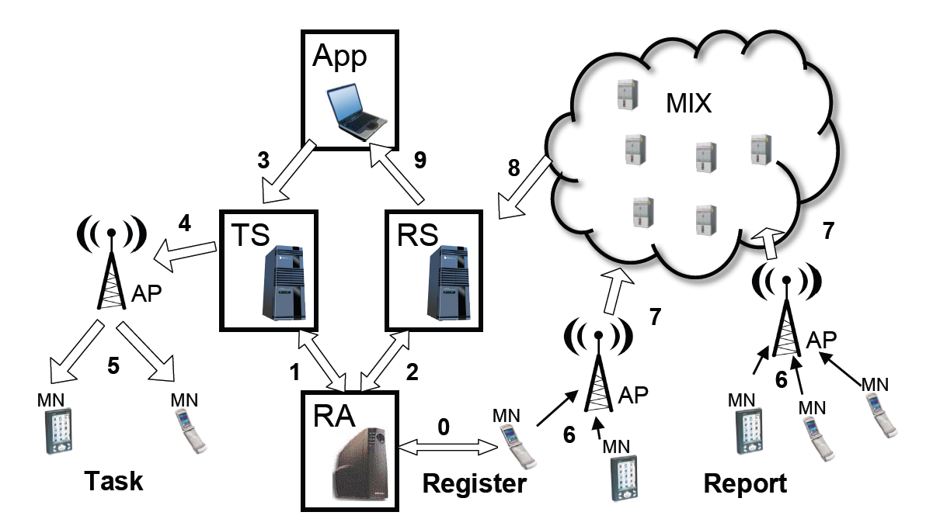
Earlier developments
Anonysense (Tessellation)
  Presented earlier by L. Tussing
  Divide users into groups of tiles.
  Generalization guided by the principle of k-anonymity.

Slide 5
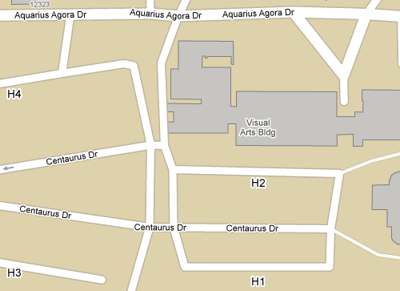
Limitations of Tessellation
Not suitable for application that require fine-grained information.
  Application that collects traffic information
    Reports generated for different intersections associated with the same Tile ID.
    Not useful for information purposes.

Slide 6
Modified Tessellation
To allow calculation of distance by points
Report the center point of the Tile rather than Tile ID

Slide 7
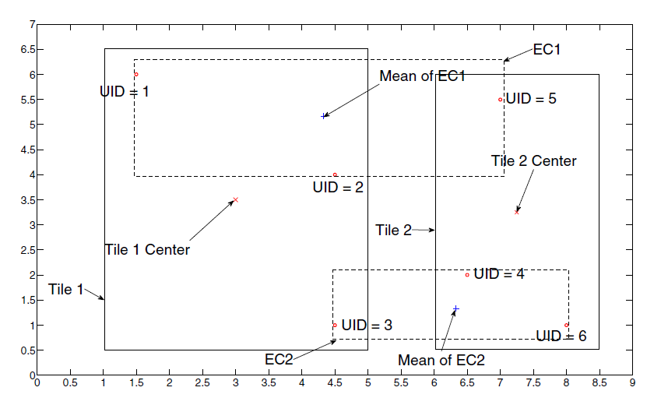
Limitations of Tessellation
Petrol Watch

Slide 8
Microaggregation
Used for implementing database disclosure control
No generalization nor suppression of the values of an attribute
Replaces the values with the mean of the Equivalence Classes (EC) in which the record is found
Member similarities often quantified by the Information Loss (IL) metric
Maximum Distance to Average Vector (MDAV) widely recognized as one of the most efficient heuristics to date.

Slide 9
Maximum Distance to Average Vector (MDAV) Algorithm
Fixed Sized Algorithm
Variable class size version: V-MDAV
Involves two principal successive operations
  Equivalence Class (EC) generation
    Clusters users who exhibit high geographic similarities in groups of k
    Ensures that k-anonymity is enforced
  EC extension
    Merge geographically close users with an existing EC

Slide 10
V-MDAV
Petrol Watch

Slide 11
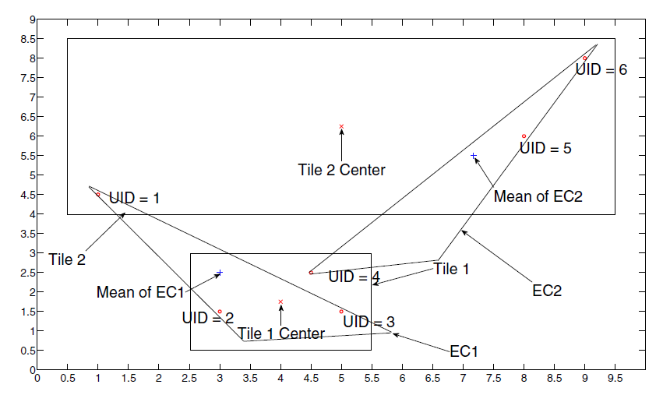
Cases that V-MDAV Not Performing

Slide 12
Tessellation V.S. M-MDAV
V-MDAV enables the application to make better decisions when the user distribution across different areas is consistent, as in
In areas with dense distribution of users, Tessellation performs better.
So which to use?

Slide 13
Combine Tessellation and V-MDAV
Hybrid V-MDAV
  If the number of users within the cell exceeds k, then MT is used
  Otherwise, the algorithm switches to V-MDAV

Slide 14
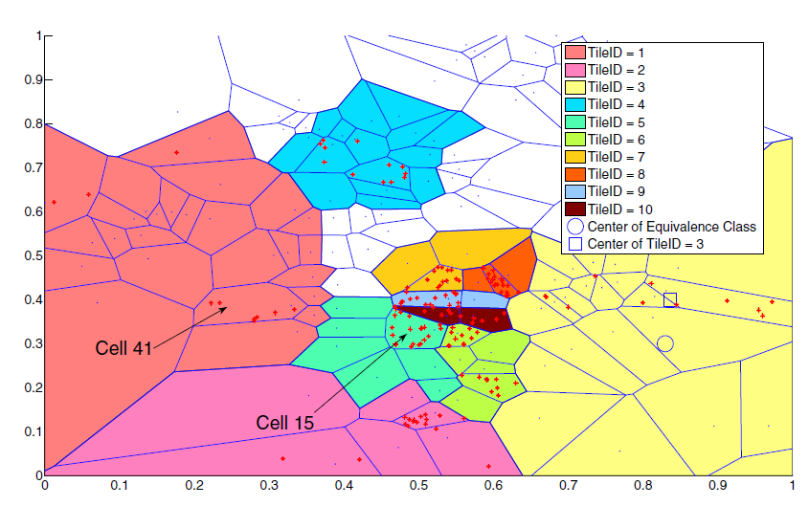
Experiments

Slide 15
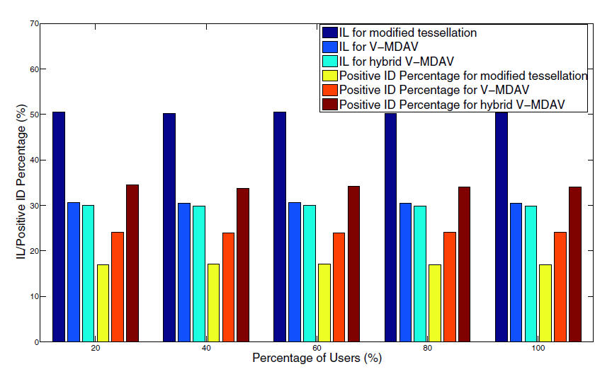
Evaluation

Slide 16
Gaussian Input Perturbation
Previous methods assume the existence of a trusted third-party server, which is aware of the true locations of the participating users.
If this server is compromised, the users’ privacy is at risk
Solution:
  Adding a random Gaussian noise with mean μ and standard deviation σ to the X and Y
  Perturbed location:
  p: scaling variable

Slide 17
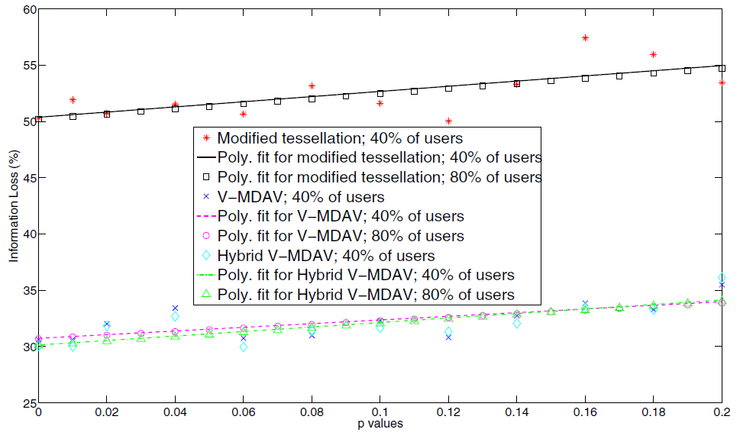
Impact of Gaussian Perturbation

Slide 18
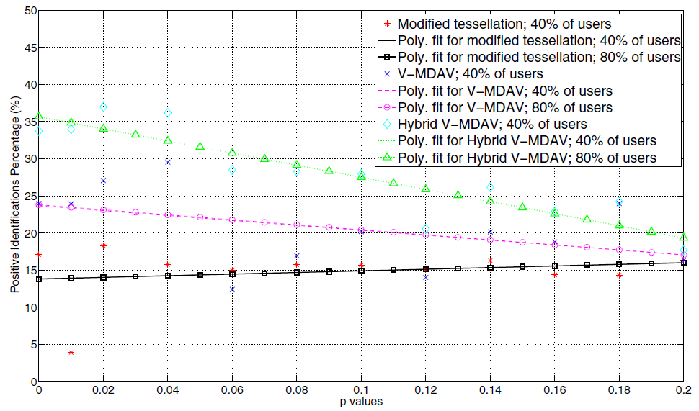
Impact of Gaussian Perturbation

Slide 19
Conclusion
Hybrid V-MDAV combines the positive aspects of tessellation and microaggregation.
Improves Positive Identification by 100%
Decreases Information Loss by 40%
Gaussian Perturbation added extra layer of privacy protection

