Slide 1
Automatic Collection of Fuel Prices from a Network of Mobile Cameras
Tristan Gibeau

Slide 2
Outline
Introduction
History & Background
System Design
Computer Vision Algorithms
Evaluation & Prototype Testing
Future Developments
Conclusion & Thoughts

Slide 3
Introduction

Slide 4
Introduction
Fuel Prices
  In the past they have been very flexible
  No way to see who has the cheapest prices
  What to say they will not go back up!

Slide 5
Solution…
Keep track of current fuel prices via mobile network of cameras
  Developed by
    University of New South Wales, Sidney, Australia
      Y.F. Dong
      S. Kanhere
      C.T. Chou
    Portland State University, USA
      N. Bulusu

Slide 6
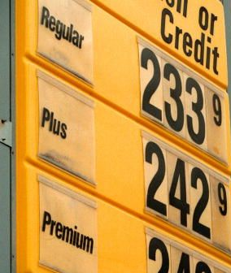
Focus
How do we collect the fuel prices?
  Develop a system of Wireless Sensor Networks (WSN)
    Key Features
      Mobile Camera
      Global Positioning System (GPS)
      Geographic Information System (GIS)
  Collect fuel price images
    Road side service station billboard signs

Slide 7
Critical Key Element
Computer Vision Algorithm
  Extracting Fuel Prices from images
    Segmentation
    Dimensions & Histogram Comparison
    Character Extraction & Classification
  Necessary component of the system

Slide 8
Foundations
Important Elements of Successful Software
  Easy use of software for end user
    Uploading
    Sharing
    Searching Data
  Low cost for usage
    Uploads & Downloads
Notes:
This paper follows the first one. Mention this is also the foundations utilized by YouTube, Wikipedia, and Facebook.

Slide 9
History & Background

Slide 10
History & Background
Similar types of projects
  USA
    GasBuddy
    Gaswatch
  UK
    Fuelprice
  Australia
    Motormouth
    Fuelwatch

Slide 11
GasBuddy, Gaswatch, & FuelPrice
Participatory Sensor Network
  Workers and Volunteers update prices
Covers both US, Canada, & UK (FuelPrice)
  Search by state, province, city, or address
  View service stations via maps
iPhone & Smart Phone integration
Problems
  Manual Collection
    Data may be wrong, out of date, or just not available
Notes:
Mention for problems that the prices change a different times of day

Slide 12
Motormouth & Fuelwatch
Similar to GasBuddy, Gaswatch & FuelPrice
  Focus on major cities in Australia
Backed and Sponsored by the Australian Government
  Keeps prices regulated
Problems
  Still manual entry
  Lack of some service stations not offered

Slide 13
System Design
Ideal Configuration

Slide 14
Ideal Configuration
Two Key Features
  Fuel Price Collection
  User Query
Utilize a WSN with SenseMart
  SenseMart uses existing infrastructure
    Help cut down on cost
Hardware
  Mobile Smart Phone
  GPS
  GIS
Remote Server
  Price Detection Algorithm
Notes:
Mention that this is only an ideal configuration, their paper focus mainly on computer vision algorithm.
Mention that I will also go thru a step by step process of the system

Slide 15
Fuel Price Collection
Images taken from mobile phone automatically
  Triggered by proximity of service station
    Utilized by GPS & GIS software running on device
When in proximity
  GIS software initializes photo trigger event
    Series of photos are taken
Photos are then uploaded to remote server
  They are then processed by price detection algorithm
    Computer Vision Algorithm
  GPS & service station are uploaded as well
Notes:
GIS software utilizes point of interest to detect service stations. Also that uploading is done via cellphone internet service

Slide 16
User Query
Fuel Prices Storage
  Database setup with user interface
  Old fuel prices are kept for history
User Query
  User initializes query via
    Web page
    Mobile Application
    Short Message Service (SMS)
Notes:
Mention for old fuel prices they are kept in history to see the trends of gas prices

Slide 17
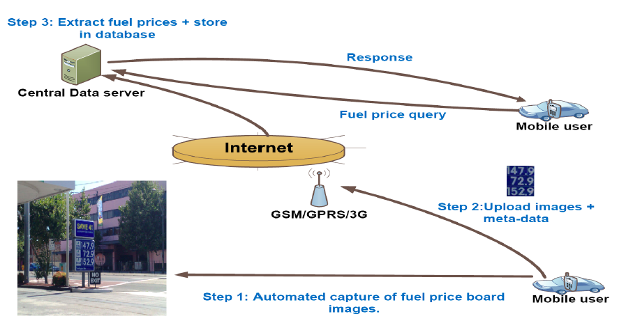
Ideal System Diagram
Notes:
Go thru each step

Slide 18
System Design
Prototype & Computer Vision Algorithm

Slide 19
Prototype
Developed First
  Ensure that the critical components work
Data Gathering
  Images of service station fuel price billboards
Computer Vision Algorithm
  Select & Clean up image for segmentation
  Segment out billboard from image
  Detect fuel prices
Notes:
Talk about how the group project leaders wanted to ensure that detection of fuel prices was possible
Mention as mention before about gathering images of billboards,

Slide 20
Computer Vision Algorithm
Little History
  Detecting items in images is complicated
    Blurry, out of focus, motion sensitive and low light
    Items may appear like others
      Similar color or shape
    Target blind spots
      Things may block the view of target
        Trees, people, cars, signs, and so on…
  Developing an algorithm that is perfect
    IMPOSSIBLE!!!!
Notes:
Mention that you took classes specifically in this subject, no matter how much work you put into it, the system will not be perfect.

Slide 21
Fuel Price Detection
Segmentation & Color Thresholding
  Programmed with two sign types
    Mobil & BP
  Segment out the billboard color configuration
    This allows the algorithm to ignore everything else
    Based on Red, Green, & Blue (RGB)
      Hue, Intensity, and Saturation (HIS)
Dimension & Histogram Comparison
  Utilize what is known about the price area
    Compare the dimensions of the fuel prices
    Analyze the histogram to see if it has the same trend
Notes:
Mention this is the first step
BP is green, and Mobil is Blue ← Mention this

Slide 22
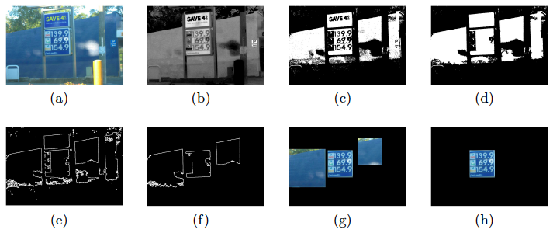
Step by Step of Segmentation
Notes:
Step by Step
Original image
Separate image in RGB Spectrum
Apply color thresholding
Segment out the color we want, Mobil Blue in his respect
Get dimensions of the segments
Grab the dimensions that follow a price billboard sign size
Image with segmentations
Final image after histogram comparison is done

Slide 23
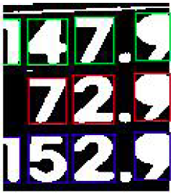
Character Recognition
Utilizes Feedforward Backpropagation Neural Network (FFBPNN)
  Extraction of characters
  Classification by a neural network
Character Extraction
  Binary Image Conversion
  Bounding box algorithm
    Construction of feature vectors
  Recognition
    Trained from other sample fuel price boards
Notes:
Notice how the bounding boxes are different colors, this depicts the fuel type
Mention for recognition that the sample images have the character stored in them. The algorithm then is able to use that data to properly identify

Slide 24
Evaluation &
Prototype Testing

Slide 25
Evaluation and Prototype Testing
52 Image Set
  3 BP Service Stations
  5 Mobil Service Stations
Imaging Devices
  5 Megapixel Nokia N95 Mobile Phone
  4 Megapixel Canon IXUS 400 Camera
  Mounted by passenger in vehicle
Testing Images based on
  Distance
  Weather (Sunny or Cloudy)
  Daylight Disparities

Slide 26
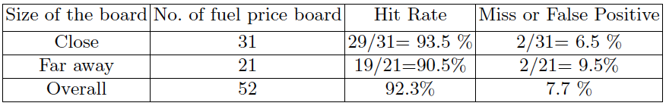
Results
Fuel Detection Algorithm Results – Billboard
15/52 image set were blurry or out of focus
  Algorithm did not detect properly
Positive Detection: 33 Images
  15 Mobil & 18 BP
  330 Characters & 99 Fuel Prices
Notes:
Detecting the proper Fuel Price is determined as a 3 or 4 numeric characters

Slide 27
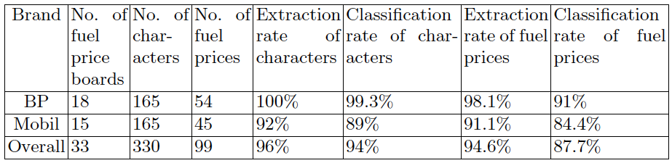
Billboard Breakdown
Service Station Fuel Billboard Results
Notes:
Notice how the Mobil Classification rate is lower due to the white boarder of the price board being reported as a character

Slide 28
Future Developments

Slide 29
Future Developments
Develop and test the ideal system
  Test both GPS and GIS integration
Move the image processing to the mobile phone
  Help reduce the overhead between the client and server
Enhance Fuel Price Detection Algorithm
  Support for more service station chains
  Integrate with GIS
    Such as Street View with Google Maps
Notes:
Street view with google maps: to be able to detect prices of gas stations for local areas.

Slide 30
Conclusion & Thoughts

Slide 31
Conclusion
Ideal
  Good use of wireless sensor networks
  First use of an WSN for consumer pricing information
  Help make users aware of current gas prices
  Make prices more easily updated
Prototype
  87.7% successful detection of fuel prices

Slide 32
Thoughts
Adapt the system to work with current GIS
  Integrate into Google Maps
    Display current prices of service stations
  Integrate with GPS & GIS providers
Creates more competition between service stations
  May reduce the prices of fuel
Work with service stations to supply their current prices
  Build infrastructure to integrate with service station computer system
Notes:
Adapt the system to work with current GIS: be able to have prices displayed on Garmin GPS devices
Create more competition between service stations: This may create a better competition between service station chains, espeically if they know there prices are readily available on the internet.

Slide 33
Questions?

