Slide 1
CarTel
Mark Mucha
University of Central Florida
EEL 6788
Professor: Dr. Lotzi Bölöni

Slide 2
What is CarTel?
A distributed sensor computing system
  Important and emerging category of sensor networks
    Mobile
    Involves heterogeneous sensor data
  Driven by a “technology push”
    Flood of underlying hardware components
  Also driven by “application pull”
    Demand for similar applications
Reusable data management system for querying and collecting data from intermittently connected devices.
Distributed, mobile sensor network, and telematics system.

Slide 3
CarTel Goals
Provide a simple programming interface
  Easy for application developers, easy to write as web applications
Handle large amounts of heterogeneous sensor data
  Types of sensors isn’t constrained
  Easy to integrate new sensors
  Provide local buffering and processing on mobile nodes
Handle intermittent connectivity
  Primary mode of network access for mobile CarTel nodes is opportunistic wireless [Bluetooth, Wi-Fi, etc.]

Slide 4
What does CarTel do?
Allows applications to
  Collect Data
  Process Data
  Analyze Data
  Visualize Data
CarTel uses sensors on automobiles and Smartphones
Uses wireless networks opportunistically
  Wi-Fi, Bluetooth, cellular

Slide 5
Technology Push
Ubiquitous cheap, embedded, sensor-equipped computers and mobile phones
  Phones
    iPhone
    Droid
  Other hardware
    Routers (modifiable, running Linux)
    Netbooks

Slide 6
Why not?
Over 600 million automobiles worldwide
  A lot of potential for sensor data
  Current generation of cars have 100+ sensors
  Resource-rich
    Can support relatively robust computation and communication systems
Cars would be natural collectors of the following info
  Traffic Monitoring and route planning
  Preventative maintenance and diagnostics of cars
  Civil Infrastructure monitoring
  Monitoring of driver preferences (radio stations, shopping, etc.)

Slide 7
Mobile Sensors on Vehicles
Examples
Environmental Monitoring
Civil Infrastructure Monitoring
Automotive Diagnostics
Geo-Imaging
Data muling
My Ideas
  Rank a Driver
  Law enforcement applications

Slide 8
How is CarTel used?
Commute and Traffic Portal
  See the data @ icartel.net
Traffic mitigation
  Using predictive delay models and traffic-aware route planning algos
  iPhone Application
Pothole Patrol (P²)

Slide 9
How is CarTel used?
Fleet testbed
  CarTel deployed on 27 car fleet of Boston area limo company.
  Link
Wi-Fi Monitoring
  Link
  Monitor urban Wi-Fi connectivity
  290 driving hours found over 13,000 access points in a year’s time

Slide 10
How is CarTel used?
On-board automotive diagnostics & notification
  Uses ODB-II interface (standard, made mandatory for all cars sold in the US in 1996 [source] )
Monitor and report
  Emissions
  Gas mileage
  RPM
Long term view of car performance
Comparison against other cars

Slide 11
How is CarTel used?
Cars as Mules
  CafNet (“carry and forward network”)
    Data delivery between nodes that aren’t typically connected
  Deliver data to internet servers from mobile sensors with short-range radio connectivity on the CarTel node

Slide 12
Reinventing the wheel?
Static sensors
  Can provide the same data the designers of CarTel have expressed interest in
  Great for a high traffic area, not so for back roads and most residential areas
  Hard to get coverage over a large area
    Some sensors are very expensive
      Static might not be an optimal use of the asset

Slide 13
Environmental Monitoring
Mobile chemical and pollution sensors
Cover a larger geographical area with fewer sensors compared to static sensors
Chemical and pollution sensors are costly, so covering a larger area with fewer sensors would be preferred

Slide 14
Civil Infrastructure Monitoring
Monitor state of roads & bridges
Detect vibration, potholes, and black ice

Slide 15
Automotive Diagnostics
Obtain information from vehicles onboard sensors
Aid in making preventative maintenance preventative
Compare diagnostics

Slide 16
Geo-Imaging
Cameras attached to cars
Mobile phone cameras (location tagged video/images)

Slide 17
Data Muling
Cars (and people) = the mules or “delivery networks” for remote sensornets
Data sent to Internet servers

Slide 18
Networking
CafNet (main component, more later)
Cabernet
  Fast end-to-end connectivity across set of changing Wi-Fi access points
  Usable network even with short connection times (a few seconds)
dpipe
  Delay-tolerant pipe
  Allows producer and consumer to transport data across intermittent connection

Slide 19
CarTel: 3 main software components
AutoPortal
CafNet
ICEDB
2 common abstractions
  Pipes
  Databases

Slide 20
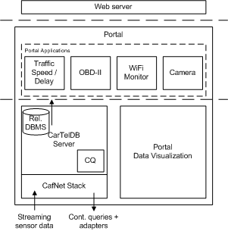
Block Diagram
source

Slide 21




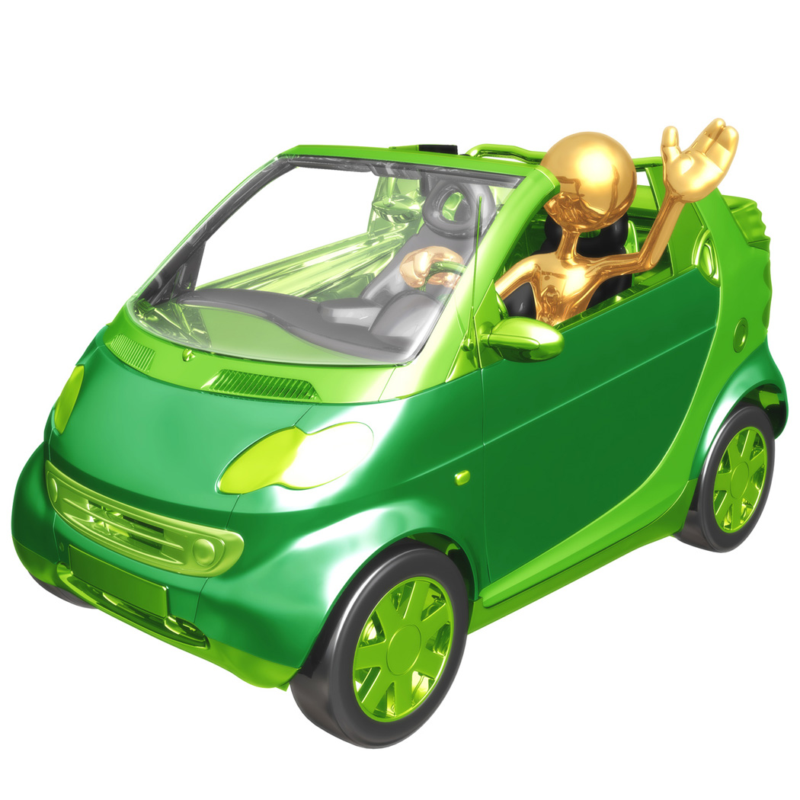
CarTel Architecture
ICEDB Server
Portal
Clients
Internet
Open Wireless
Access Point
Ad-hoc
network
User’s Wireless
Access Point
ICEDB Remote

Slide 22
CarTel: AutoPortal
AutoPortal
  Server software
  Provides
    Data management
    Visualization
    Web-based querying
  Requests data from remote nodes
  Aggregates reports from nodes to get high level view of conditions, providing visualization of collected data

Slide 23
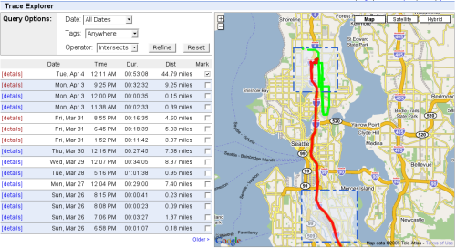
CarTel: AutoPortal

Slide 24
CarTel: CafNet
A networking infrastructure for carry-and-forward networks
  Leverages variable and intermittent network connectivity
  Extends reach of traditional networks by the routing of data over a wide array of high latency and unreliable links
  Mobility of network medium is a strength, not a weakness
  Delay-tolerant stack
  Mobile data muling
  Data transfer across an intermittent network connection

Slide 25
CarTel: CafNet
App 1
…
App N
Transport Layer
Registers data to be transmitted
Delivers incoming data
Request data from the application
Notifies application of successful delivery
Network Layer
Notifies transport layer of free buffers
Schedules data for transmission
Selects routes
Buffers data for transmission
Mule Adaptation Layer
Provides uniform neighbor discovery
Device Driver
Device Driver

Slide 26
CarTel: ICEDB
Device-level data management infrastructure
Collects, pre-processes, and prioritizes information on remote nodes running CarTel software.
Schema auto-adjusted based on available sensors in the car.
Stream-processing engine responsible for data aggregation and processing queries.
Query selects sensor and rate of data acquisition

Slide 27
CarTel: ICEDB
Query results are streamed across intermittent connection
Local prioritization (FIFO, random, threshold, bisect prioritization schemes)
Summarization queries (global prioritization)
Built on Postgresql
Adds continuous queries
  Rate n
  Every n
More Info

Slide 28
CarTel: ICEDB
Example: Continuous query
SELECT carid, traceid, time, location FROM gps
WHERE gps.time BETWEEN now()-1 mins and now() RATE 5 mins

Slide 29
CarTel: ICEDB
Example: Local Prioritization
With limited connection times, data must be prioritized locally
Two added statements: PRIORITY and DELIVERY ORDER
SELECT carid, traceid, time, location FROM gps
WHERE gps.time BETWEEN now()-1 mins and now() PRIORITY 2

Slide 30
CarTel: ICEDB
Example: Global Prioritization
With limited connection times, data must also be prioritized globally
Added statement: SUMMARIZE AS
SELECT …
EVERY …
BUFFER in bufname
SUMMARIZE AS
SELECT f1,f2,…,fn FROM bufname
WHERE pred
GROUP BY f1,f2,…,fn

Slide 31
CarTel: Pothole Patrol
P² (Pothole Patrol)
  CarTel + Machine Learning to auto classify road surface conditions
  CarTel node with 3-axis acceleration and GPS sensors
  Gathers location tagged vibration data @ 400 Hz
Deployed on 10 taxis in the Boston area
Analysis algorithms calibrated with human perception of road surface quality
Able to predict 75% of bad surface conditions as reported by drivers
One week of driving
  4,800 bad surface locations

Slide 32
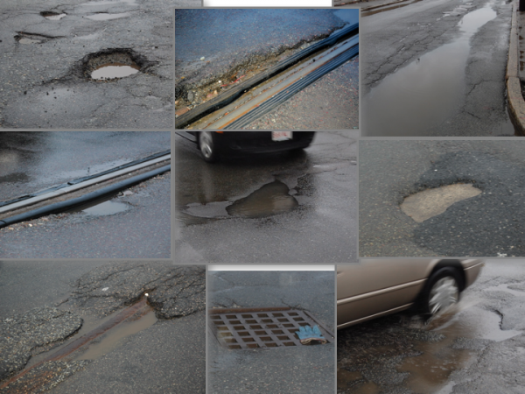
CatTel: Pothole Patrol
Road surface issues detected by Pothole Patrol

Slide 33
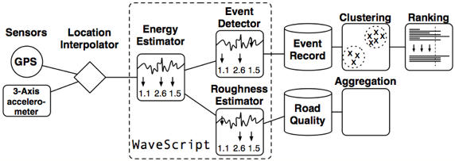
CarTel :Pothole Patrol

Slide 34
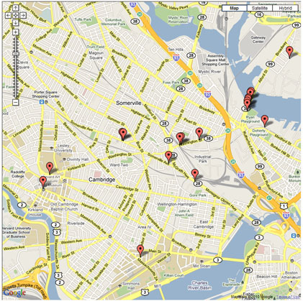
CarTel: Pothole Patrol
Avoid this bridge
Bad surfaces mapped out

Slide 35
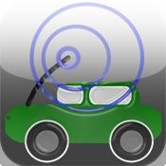
iCarTel (iPhone Application)
“iCartel is a free 3G or 3GS application that will help you reduce the time you spend stuck in traffic. iCartel, based on the MIT CarTel ("Car Telecommunications") research project, builds on a community approach to delivering reliable traffic information and helping users plan around it.”

Slide 36
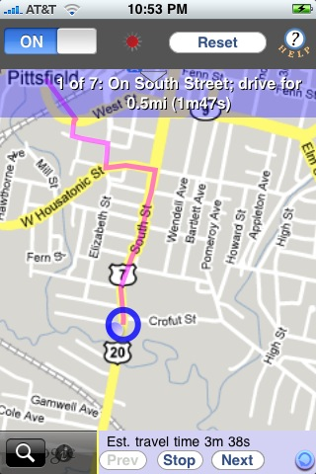
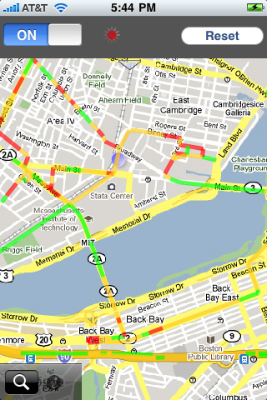
iCarTel

Slide 37
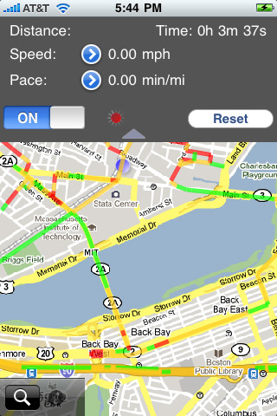
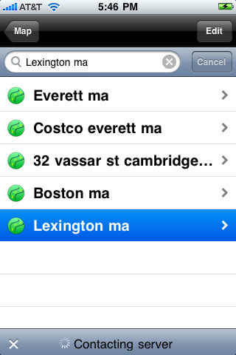
iCarTel

Slide 38
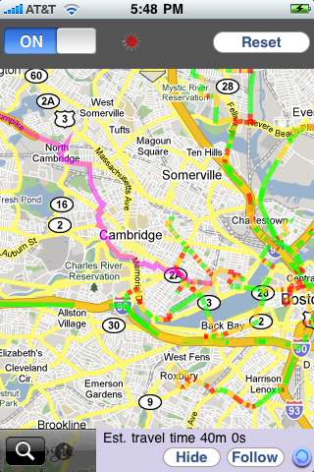
iCarTel

Slide 39
Questions?

Slide 40
Resources
CarTel website
CarTel: A Distributed Mobile Sensor Computing System
  Bret Hull, Vladimir Bychkovsky, Yang Zhang, Kevin Chen, Michel Goraczko,
  Allen Miu, Eugene Shih, Hari Balakrishnan and Samuel Madden
  MIT Computer Science and Artificial Intelligence Laboratory

