Slide 1
CNT 6707
Advanced Computer Networks
Fall 2021

Slide 2
About the instructor
Prof. Damla Turgut
Contact details:
  HEC 316 [Online], (407) 823-6171, Damla.Turgut@ucf.edu (preferred)
  Office hours: Tu,Th 12pm-1:15pm [Online]
  http://www.cs.ucf.edu/~turgut/
Research interests:
  Wireless networks (ad hoc, sensor, underwater sensor, vehicular, social, etc)
  Edge/cloud computing, Augmented Reality (AR)
  IoT (smart home, smart healthcare, etc)

Slide 3
Grading
Research paper presentations: 40%
Research paper reviews and feedback: 25%
Project: 35% [development vs. survey paper]

Slide 4
Subject matter of the class
In this class we survey the current state of the art in networking
While we will cover all areas of networking, we focus in special on
  wireless networks
  IoT (smart cities, smart grids, smart healthcare, AR/VR)
  sensor networks
  edge / fog networks
We will read recent papers from top conferences and journals in the field
  The material we cover is usually not yet in textbooks

Slide 5
What background do I need?
You will need basic understanding of networking concepts at the level of an undergraduate class or intro graduate level class.
This is not the right class if you haven’t heard of IP, TCP, routing, MAC layer etc.
  You took at UCF: CNT 3004 or CNT 5008 – you are good to go
  Other equivalent classes – you are also good to go
  Equivalent knowledge acquired through other means should be probably ok.

Slide 6
ML and artificial intelligence
A significant trend in networking is about the application of recent results in machine learning and artificial intelligence
Many (but not all) the papers you need to read will have some ML/AI components.
But we are still looking at the networking aspects!
We won’t delve deeply into the ML/AI aspects, except in the sense of using them as tools.

Slide 7
Do I need ML/AI expertise?
No!
  You don’t need to write AI/ML code
  You don’t need to understand the math
  You might need to recognize what different ML/AI components do (e.g. classification, optimization, etc.)
Many of the papers we will read were the result of a multi-disciplinary collaboration between a networking expert, an AI expert and possible domain experts
  In this class you are the networking expert
If you took an ML and/or AI class at UCF, online or other institutions you might recognize some of the concepts

Slide 8
How do I read advanced networking papers?
Papers at top level conferences can be challenging to read
  Among other things, the multidisciplinary nature means that you have sections written by different specialists…
  Intimidating amount of math…
  New terms and definitions…

Slide 9
Don’t panic!
You don’t have to understand everything.

Slide 10
Questions you need to understand when reading a paper
Proceed systematically by reading such that we find answers to some questions
These are also the same topics that your presentations should contain
  Origin of the paper
  Network setting
  What is being improved
  What is the improvement technique
  When is the improvement applied
  How was the paper evaluated?
  Afterlife of the paper
  Personal view on the contributions

Slide 11
Origin of the paper
Where is the a paper coming from?
  Research lab
  University
  Company?
Is the lab / authors famous? If yes, for what?

Slide 12
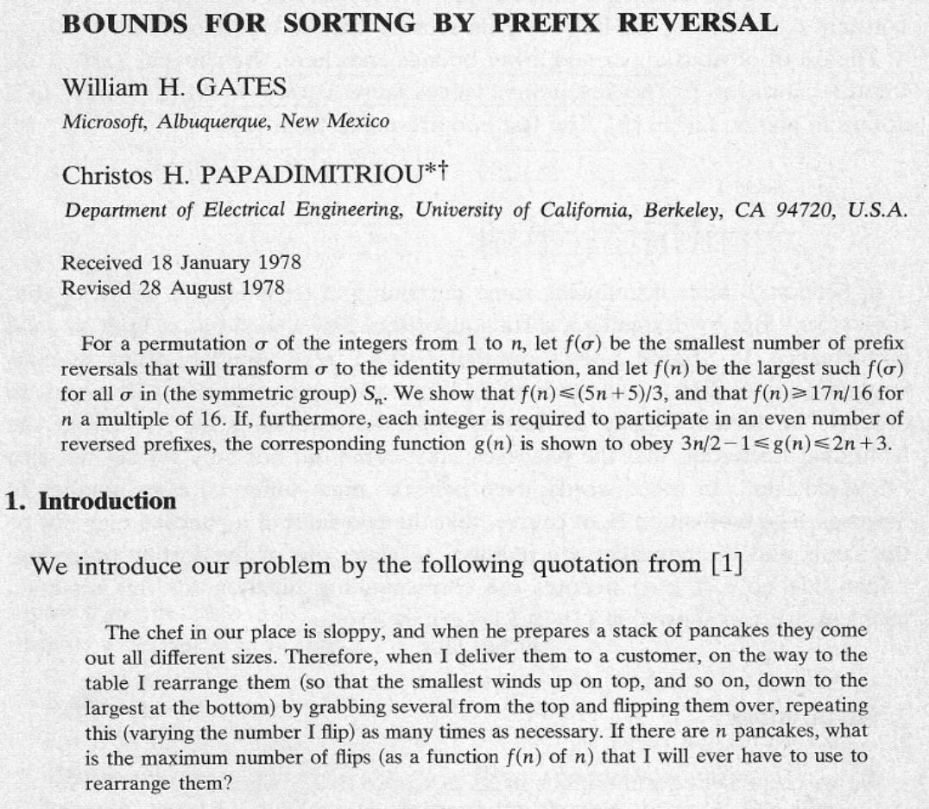

Slide 13
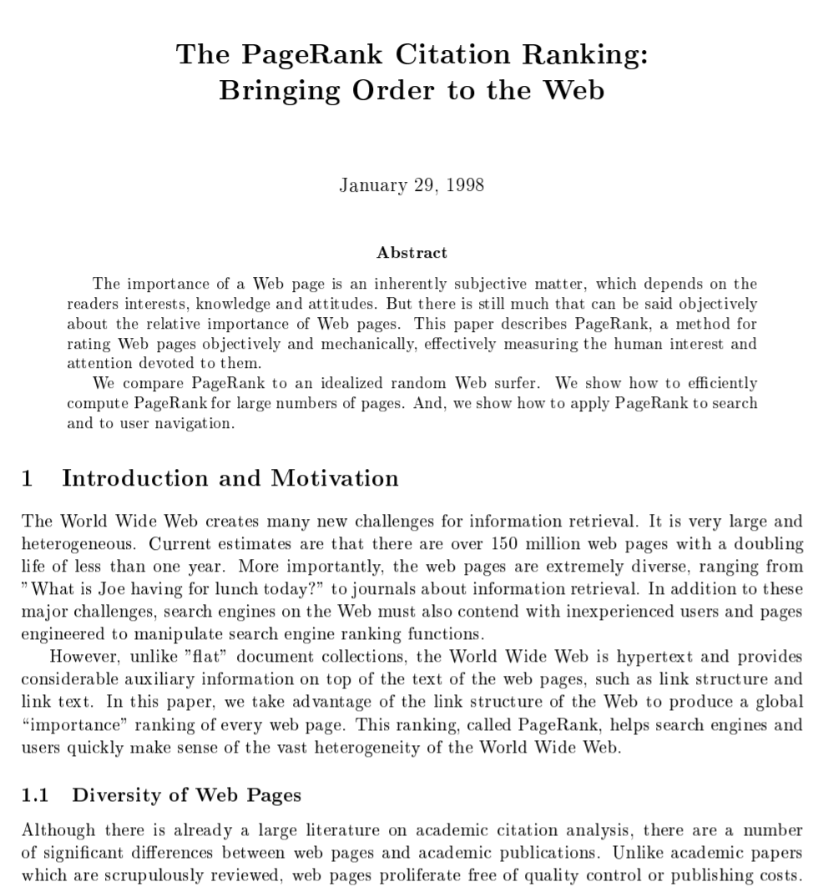
Page, Lawrence, Sergey Brin, Rajeev Motwani, and Terry Winograd. The PageRank citation ranking: Bringing order to the web. Stanford InfoLab, 1999.

Slide 14
Network setting
These are networking papers, so there is some kind of network in the picture.
What type of network the paper considers?
  Wired network
  Wireless network (WiFi)
  Cellular network
  Sensor network
  Vehicular network
  Internet of Things (IoT)
  Edge/fog networks
  Hybrid system of multiple networks
If the paper considers a specific application area such as healthcare, industrial settings etc. you want to identify it here as well.

Slide 15
What is being improved?
Most papers provide some kind of improvement compared to the state of the art.
  There is a very small number of papers which introduce completely new application areas.
  But most new protocols etc. are introduced in order to improve some parameters within an existing application.
What is the network (or other) parameter that is being improved?
  Bandwidth
  Latency
  Reliability
  Energy consumption
  Cost
  Privacy
  User satisfaction

Slide 16
What is the improvement technique?
What is the technique used by the work to improve the chosen parameter(s). These will be often AI/ML techniques
  new network protocol (MAC, routing)
  Search
  Linear / non-linear optimization
  Deep neural network
  Game theory
  Genetic algorithm
  Other (what?)
You do not need to develop an in-depth understanding of this technique
  But see next slide.

Slide 17
Discussion about the improvement technique
This is where the paper might be hard to read!
  Also, puzzled listeners when you make your presentation
If the improvement technique is not obvious, you should do at least some superficial research on it, and add 1-2 slides about it into the presentation
  E.g. if the technique is genetic algorithms, briefly explain what are they.
Look for resources that introduce the technique for non-specialists (e.g. Wikipedia, intro classes, youtube videos, blog entries on Medium.com). Try to find the clearest, most straightforward description and summarize them on one/two slides. For instance:
https://towardsdatascience.com/introduction-to-genetic-algorithms-including-example-code-e396e98d8bf3

Slide 18
When is the technique applied
When is the improvement technique applied:
  Before the system is run
    For instance, static paths, planning techniques
  During runtime
    E.g. routing or MAC protocols
  After execution
    For instance, for analyzing the logs.
A related question: where is the improvement code running
  On the routers, hosts, IoT devices, user desktop, cloud?

Slide 19
How was the paper evaluated?
In order for us to believe the claims of the paper, we need to see how it was evaluated. This often involves comparison with other techniques.
There are several ways to evaluate the claims:
  With theoretical proofs
  In handcrafted simulation
  In a publicly available simulation framework
  Testbed
  Real world deployment
Related question: what does the paper compares against?
  Strong claim: current best techniques
  Weak claim: our technique is better than random

Slide 20
The afterlife of a paper
Especially if the paper is older, it is useful to investigate its impact.
  For instance, the Bill Gates paper is a mathematical curiosity.
    Gates, William H., and Christos H. Papadimitriou. "Bounds for sorting by prefix reversal." Discrete mathematics 27, no. 1 (1979): 47-57., citations: 369
  The Larry Page / Sergey Brin paper describes the algorithm which built Google.
    Page, Lawrence, Sergey Brin, Rajeev Motwani, and Terry Winograd. The PageRank citation ranking: Bringing order to the web. Stanford InfoLab, 1999. citations: 13,841
How do we evaluate impact?
  Number of citations (look it up on scholar.google.com)
    be aware of the publication year, new papers might not have a lot of citations
  Was it deployed? Where? How wide?
  Is it the basis of follow-up work?

Slide 21
Personal view
What is your opinion about the paper? Do you find it impressive?
  Brilliant idea
  Impressive amount of experimental work
  Deep theoretical work
  Convincing practical application
  Impressive improvement
Or maybe you are not impressed?
  Results slightly better than random?
  Comparison only with variations of the proposed algorithm?
  “Proof by intimidation” – excessive amount of math, mostly definitions, obscuring the real problem.
  Contrived, unrealistic problem setting?

Slide 22


