Slide 1
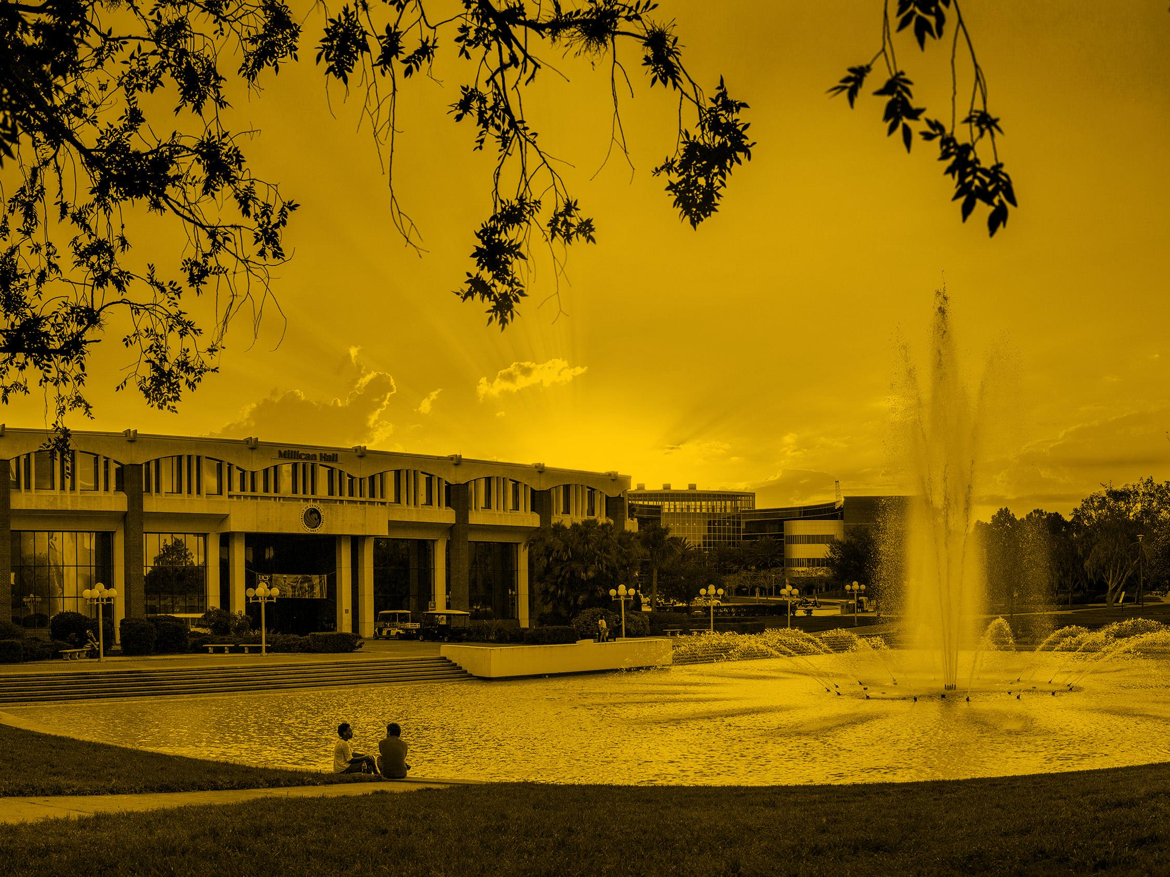

Challenges of IoT - the expected and the unforeseen
Damla Turgut
Professor
Computer Science Dept., University of Central Florida

Slide 2
Internet of Things – The vision
Objects of our day-to-day life, connected to the internet and each other
Improve everyday objects
Better functionality, availability, performance, ease of use
A logical next step for the evolution of the internet beyond “computers”

Slide 3
The roots of the IoT vision
Related to other visions of computation
  Pervasive computing
  Ubiquitous computing…
  The focus is on the “internet” part, we expect the vision’s benefits mainly from the connectedness, not from any computation that might be performed
As technology, shares the technical requirements of other fields that emerged since 2000
  Mobile networks
  Ad hoc networks
  Sensor networks
The term IoT was coined in 1999 - 18 years ago
  If it would be a human, IoT would have a right to vote!

Slide 4
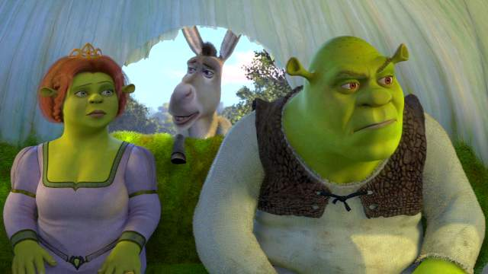

IoT: Are we there yet?

Slide 5
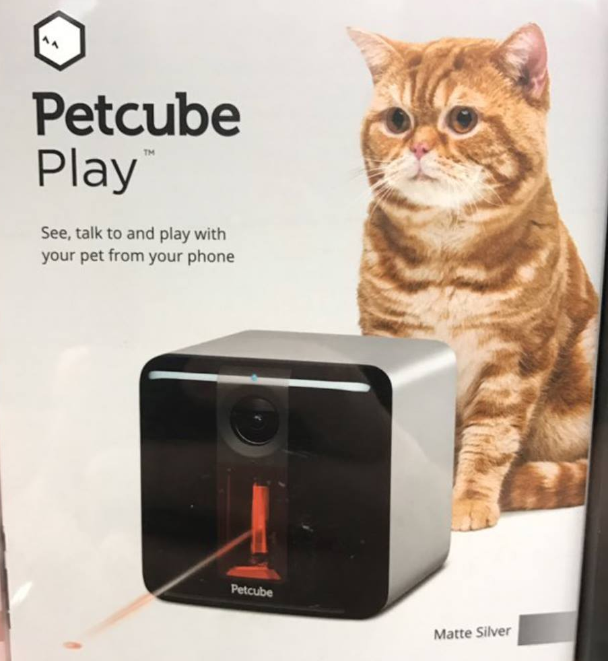
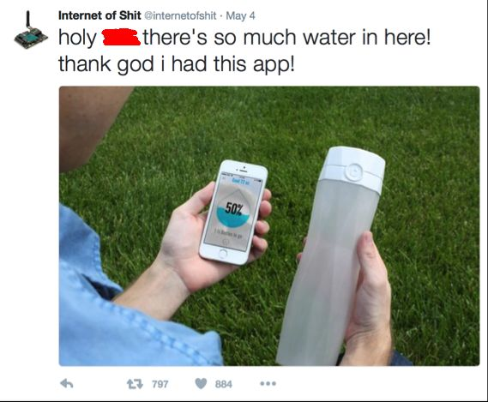
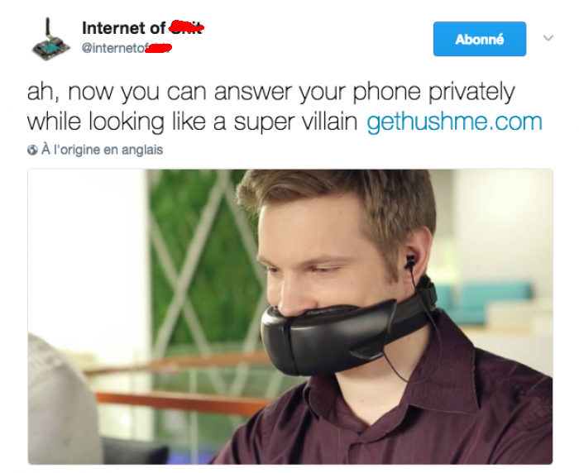
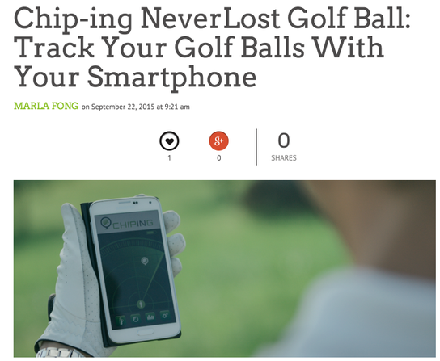
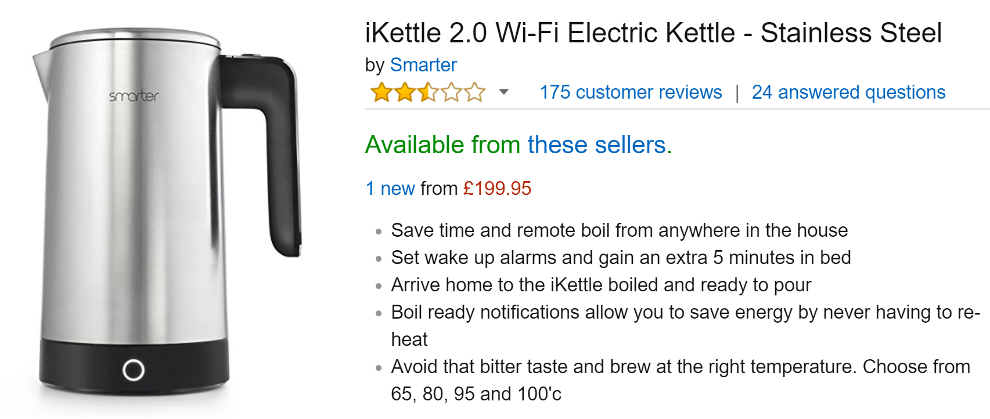
We have the Internet of Useless Things

Slide 6
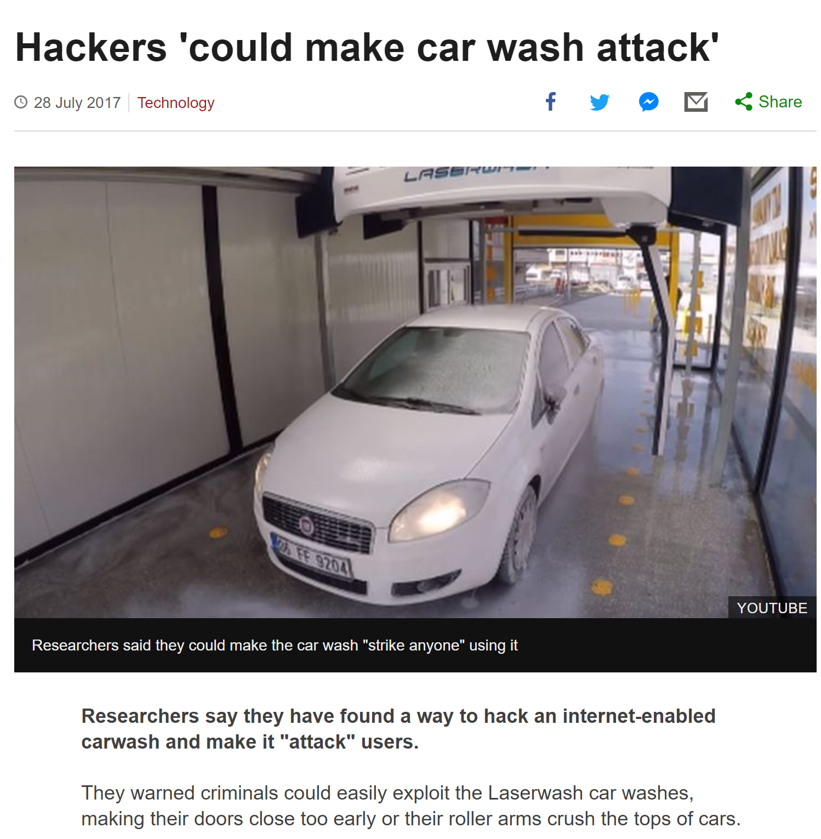
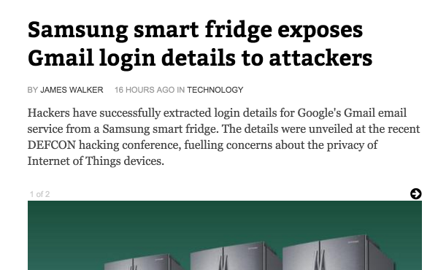
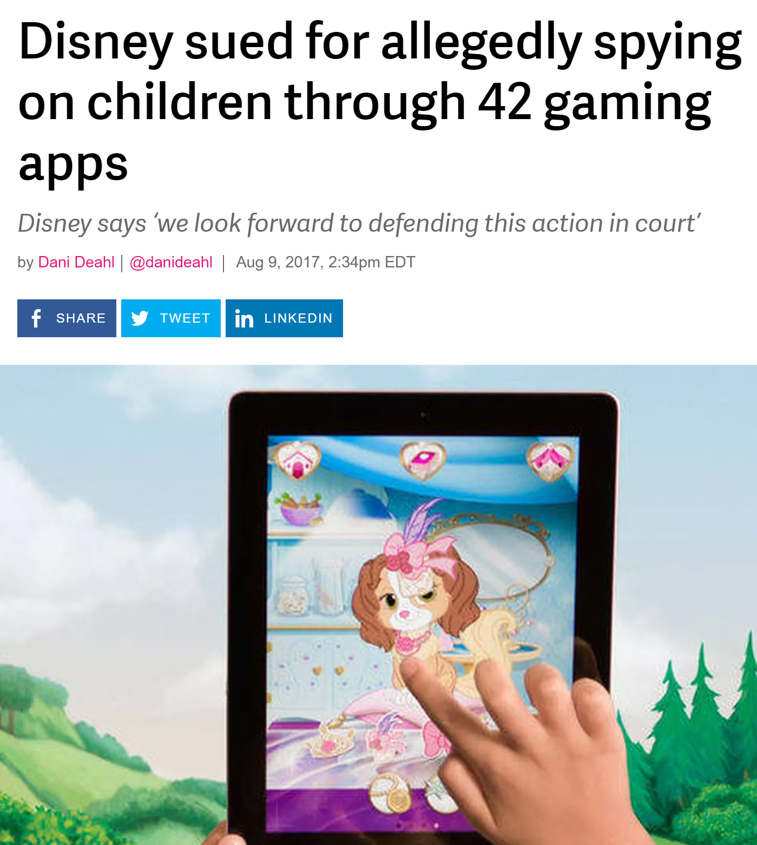
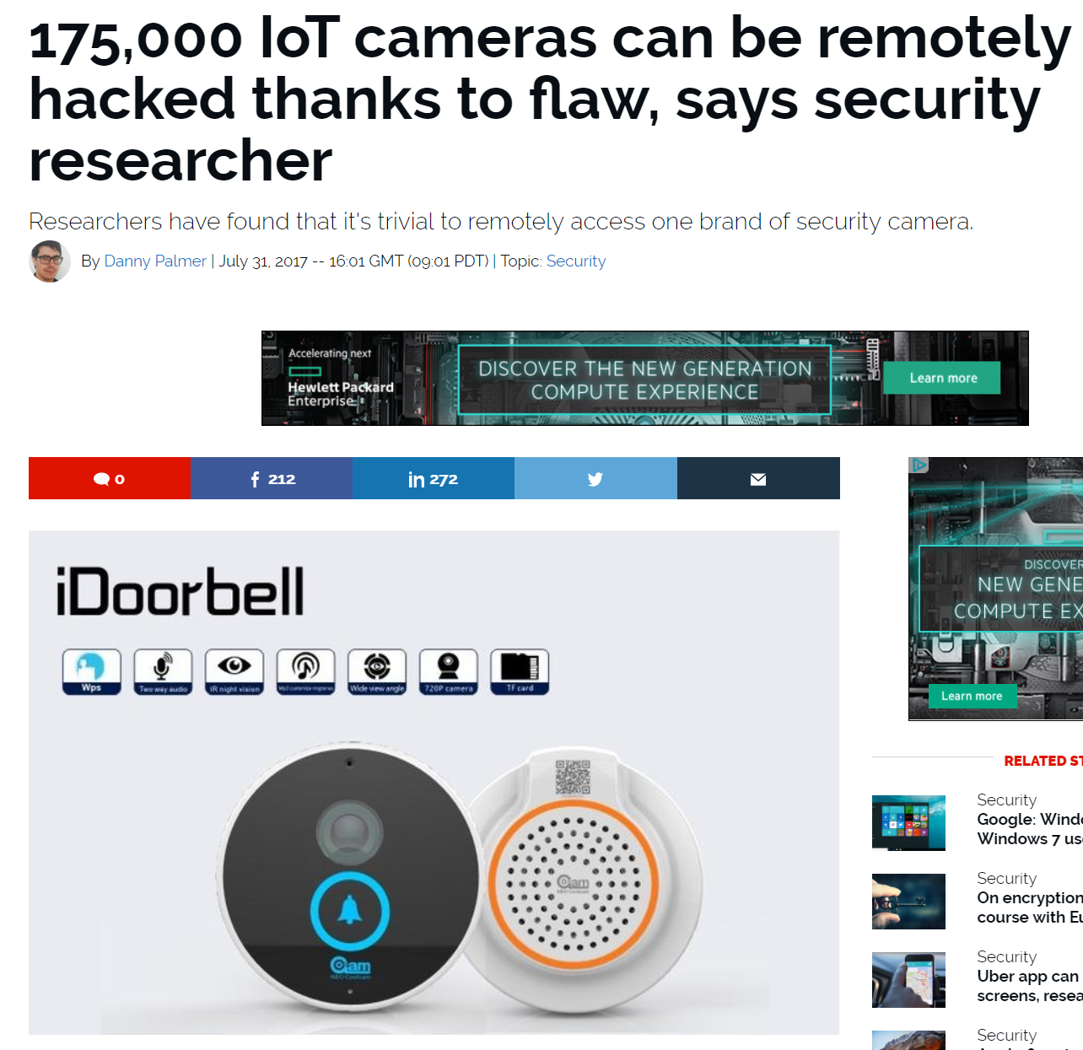
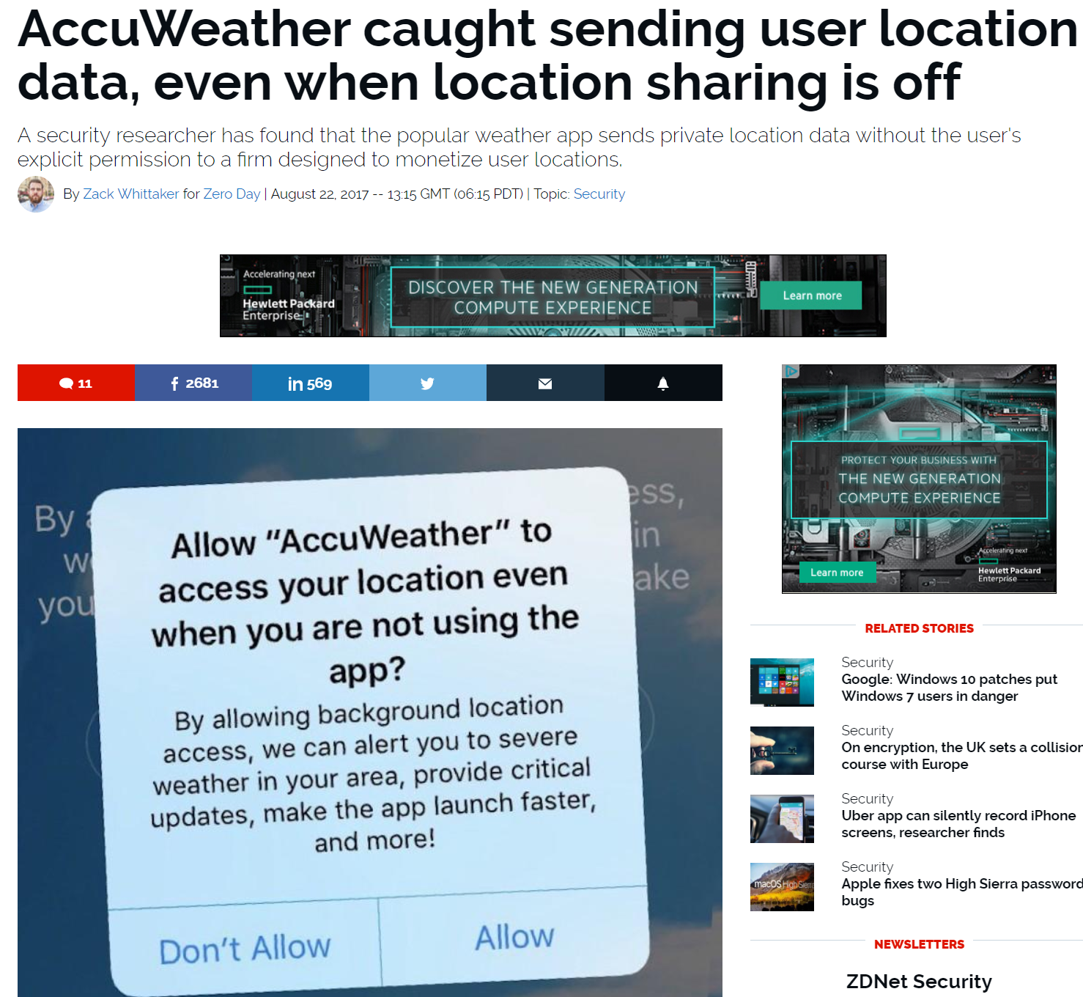
The Internet of Dangerous Things

Slide 7
This talk is about challenges to IoT
What challenges were solved
What still remain…
Who’s responsibility is to solve them?
  Industry?
  Academia?
  Society? / Government?
What opportunities and responsibilities exist for academic researchers

Slide 8
Challenges of IoT
There are challenges we have foreseen and
  … they turned out to be easier than we thought (hurray!!!)
  … they turned out to be solvable (hurray!!!)
  … turned out to be harder than expected…
There are challenges we did not expect
  System problems
  Economic problems
  Operation: day two!

Slide 9

Challenges that turned out to be easier than we thought
Establishing communication between devices
  Essentially, solved.
  Why it was easy: technologies developed for other purposes (Bluetooth, WiFi, LTE) were adapted to IoT use.
  All the areas of our life are now blanketed with WiFi and LTE.
Naming and addressing
  We thought that we will run out of IPv4 addresses
  Why it was easy: it turned out that private address spaces work quite well.

Slide 10
Challenges that turned out to be easier than we thought
Power consumption
  We assumed that one of the challenges of IoT will be the energy consumption of the devices.
  Turns out that many of the compelling IoT devices are stationary
    All the Google Home, Amazon Alexa, Nest etc devices are wire powered
    For many other ones, wireless charging is a possibility.
All this doesn’t mean that there are no work left
  In fact, achieving optimization is quite often harder than “just get things working”

Slide 11

Challenges we expected to be tough, and they still are
Security
  We always knew that the security challenges of computers will be transferred into the IoT domain, and they did
  There was an assumption that this is just an expansion of the security model for computers…
Privacy
  We developed deep theoretical models of how privacy can be maintained by manipulating transferred information

Slide 12

Some unexpected challenges
The problem of value
  Lack of a killer application
  Consumer resistance
  Business model challenges
“Day two problems”
  Need for a system and competing systems
  Unpatchable IoT devices
  Upgrade paths and device obsolescence

Slide 13
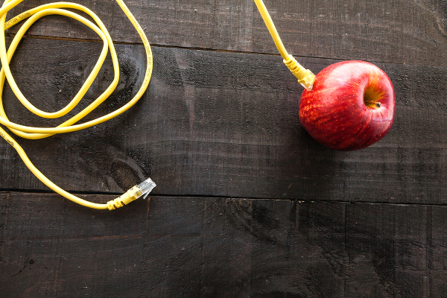
The problem of value
We can connect things to the internet
  Teapots
  Beds
  Shoes
  Waterbottles
But why should we do it?
What kind of value we gain by doing so?

Slide 14
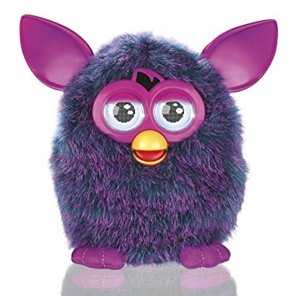
Value, cont’d: Lack of a killer application
There is no “must have” application in IoT
Personal computers had several
  Word processors, spreadsheets
  Games
  … and finally: the web browser
Smartphones had several
  SMS
  Web browser…
Internet of things
  Most popular apps are not exactly “must have”
    Smart lightbulbs
    Connected speakers
    Nest thermostat

Slide 15
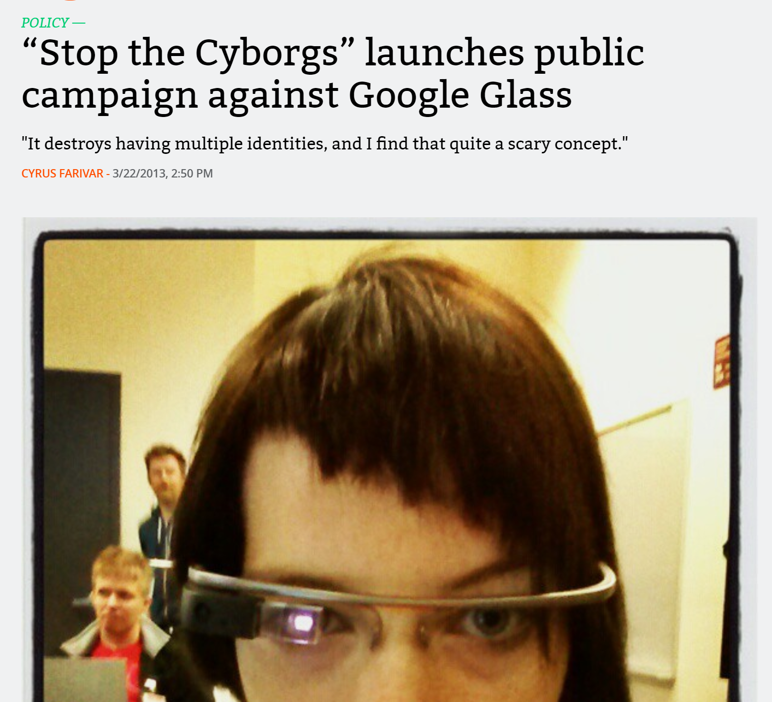

Consumer resistance
Unexpected consumer resistance to some products
Google Glass – public movement against perceived privacy issues
Juicero connected juice maker: customers dislike the fact that the company can remotely disable functionality
and many others…

Slide 16
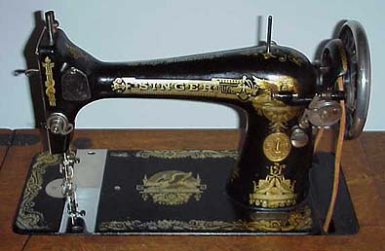
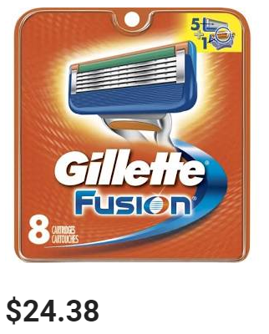
Business model challenges
Companies try to avoid the fate of Singer sewing machines
  Brisk initial business
  Machines last for many decades
  No repeat purchase
  Company goes out of business
Gillette model
  Give away the razor
  Sell the blades
  Near constant flow of income

Slide 17
Business model challenges
IoT variation:
  Give away the hardware (or sell it cheap)
  Make the hardware useless without associated software services
    Customers might not like it
    Makes it difficult to integrate into a system
  Or: make a business on collecting and monetizing customer data
    Customers might not like it
    Creates privacy issues
Can the value for privacy exchange be a reasonable business model?
  Yes, if both sides give their informed consent

Slide 18
“Day two problems”
In system administration, “day two problems” refers to the challenges that appear after a certain technology had been adopted
How do you handle
  maintenance
  failure
  updates
  obsolescence
  further technology transitions

Slide 19
Need for a “system”
The original IoT vision assumed that each thing is an independent entity connected to the internet
  We should have realized that this is a management nightmare
IoT devices need to be integrated into and managed as a system
  For instance: common user interface, updates etc.
Commercial entities are highly motivated to push their own system
  Google Home, Amazon ecosystem, etc.
  They will also prefer to keep the system logic on their own premises
  Competition among providers creates incompatible “walled gardens”
  Difficult to do academic research when the functionality is locked down to a system.

Slide 20
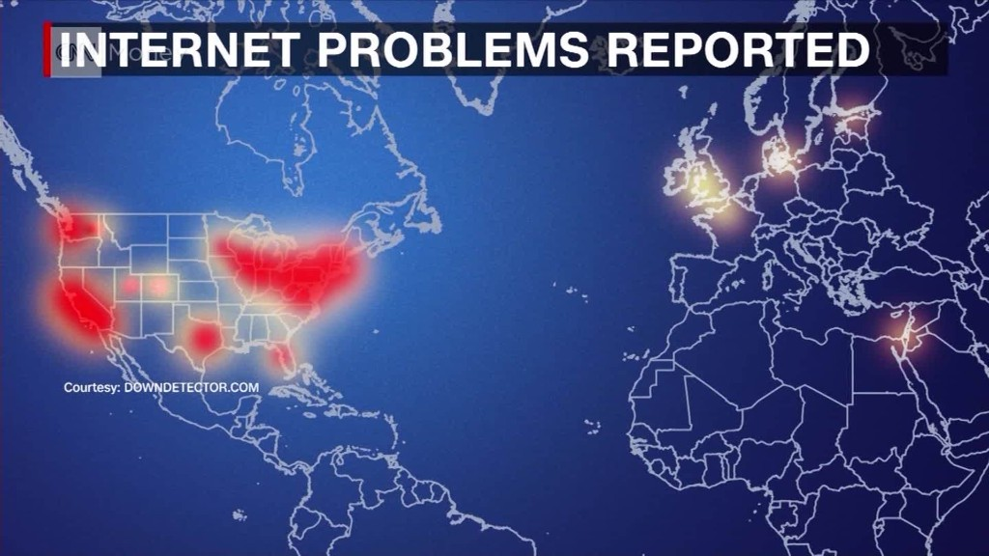
Unpatchable systems
IoT devices developed by small companies
  Poor (or "commodity") engineering, insecure default settings, the use of hard-coded (permanent) "backdoor" accounts
  No incentive to provide software patches
  Companies go out of business
  Devices stay deployed
October 2016 – major Distributed Denial of Service attack launched by discovering unpatched software devices with default passwords (such as IoT picture frames)

Slide 21
Who is going to solve the IoT challenges?
There are topics that are better suited to commercial enterprises
  Developing attractive hardware
  Create and maintain systems
  Standardize protocols

Slide 22
IoT topics better suited for academic research
Innovative networking protocols
  Researchers are not subject to market pressures of compatibility, existing deployments etc.
IoT Applications with high societal value, but not immediately profitable
Studies on the value of IoT
  Realistic modeling of the values and costs to the user
    value of service / information / time saved / convenience
    cost of privacy / attention span / lost time
  Individual companies have a conflict of interest, such evaluation can only be realistically done in academic settings

Slide 23

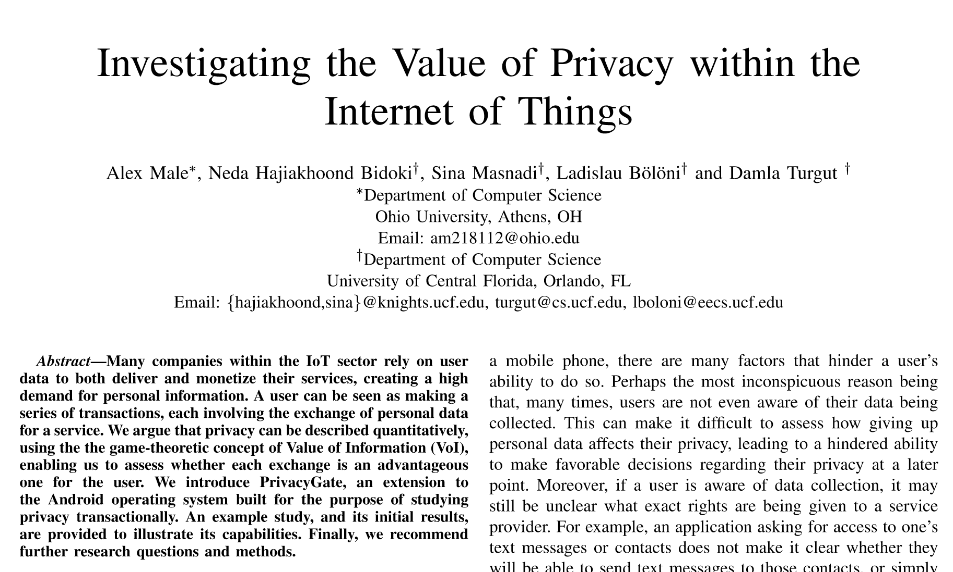
Some of the work of my group
A. Mayle, N. Hajiakhoond Bidoki, S. Masnadi, L. Bölöni, and D. Turgut. Investigating the Value of Privacy within the Internet of Things. To be presented at IEEE Global Communications Conference (Globecom 2017), December 2017.

Slide 24

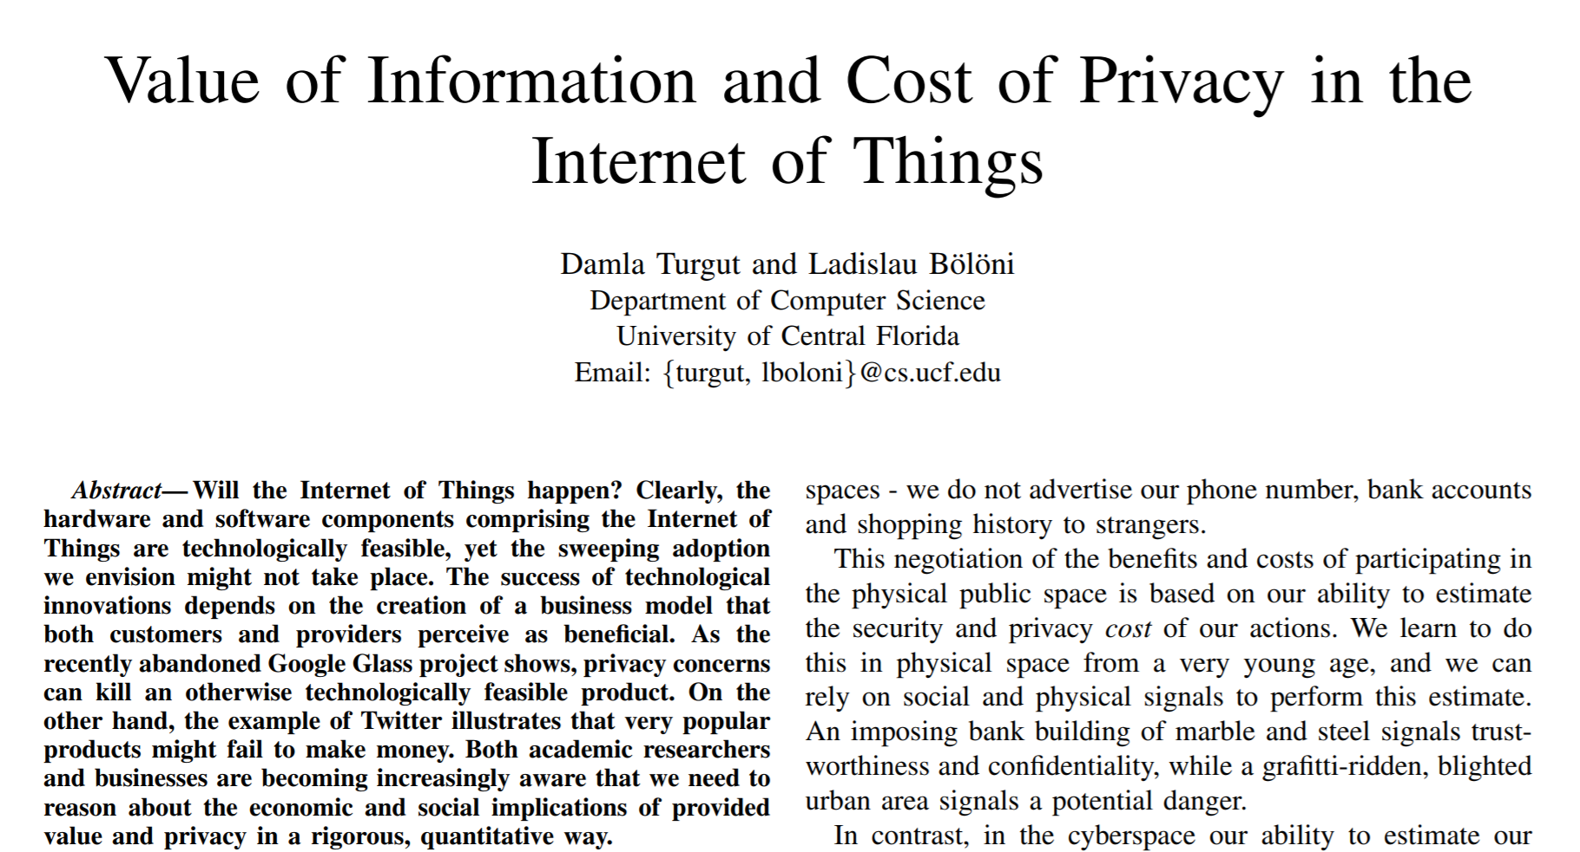
Some of the work of my group
D. Turgut and L. Bölöni. Value of Information and Cost of Privacy in the Internet of Things. IEEE Communications Magazine, 55:62–66, 2017.

Slide 25
Thank You for listening!
Damla Turgut
Professor
Computer Science Dept., University of Central Florida

