Slide 1
An Introduction on Machine Learning and Its Applications in Networking
Lecturers: Sharare Zehtabian & Siavash Khodadadeh
Spring 2020

Slide 2
Outline
Machine learning
Machine learning applications
Types of machine learning
  Supervised learning setup
    classification
    regression
  Unsupervised learning
  Reinforcement learning
Neural networks and deep learning

Slide 3
Machine learning definition
Definition by Tom Mitchell (1998): Machine Learning is the study of algorithms that
Improve their performance P
At some tasks T
With experience E
A well-defined learning task is given by <P, T, E>.

Slide 4
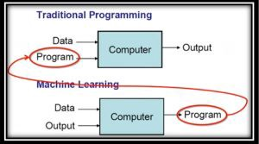
Why machine learning?
For many problems, it’s difficult to program the correct behavior by hand
Recognizing people and objects
Understanding human speech
Source: https://mc.ai/machine-learning-1100101b-lets-learn-about-learning/

Slide 5
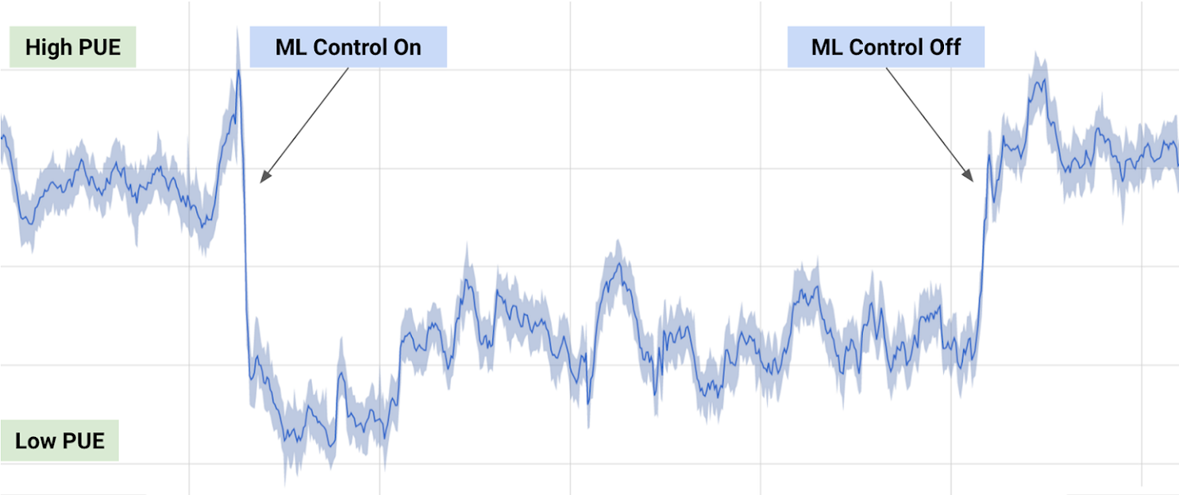
Applications in networking
Pattern recognition:
  Identifying patterns in networks traffic (e.g during a day or a week)
Anomaly detection:
  Using AI to detect anomalies in the way applications are being accessed (e.g. outlier detection at Netflix using a clustering algorithm)
Network optimization
  DeepMind AI reduced Google data centre cooling bill by 40% (PUE: Power Usage Effectiveness)

Slide 6

Applications in networking (cont’d)
Forwarding path simplification
  Could ML find a better way CRUD (Create/Read/Update/Delete) operations in networking?
Coordinating ML across edge and cloud
  Predictive caching
Intent based networking: Intelligent automation and assurance
  Let’s watch this video:

Slide 7
Types of machine learning
Supervised learning: have labeled examples of the correct behavior
Unsupervised learning: no labeled examples – instead, looking for interesting patterns in the data
Reinforcement learning: learning system receives a reward signal, tries to learn to maximize the reward signal

Slide 8
Supervised learning setup
We have a bunch of (x,y), where x∈R^{d} is the input instance and y is label
Training dataset D={(x₁,y₁),…,(x_{n},y_{n})}⊆R^{d}×C
R^{d} is the d-dimensional feature space
x_{i} is the input vector of the ith sample
y_{i} is the label of the ith sample
C is the label space
The training data pairs are drawn from some unknown distribution P

Slide 9
Supervised learning setup (cont’d)
Try to predict properties of unseen data
  Given a new sample, can we predict its properties?
Learning problem:
  Learn function h such that
  for a new pair (x, y) ~ P, we have h(x) ≈ y
Example:
  You are given the data of 900 passengers on Titanic. (n = 900)
  For each passenger, we know some information like name, age, ticket number, cabin, etc
  We want to learn from this data if there is a correlation between these features (x) and whether the passenger survived the disaster (labels)
  Now we are given a new passenger’s data and we want to predict whether he/she survives
  Label space? {survived, not survived}

Slide 10
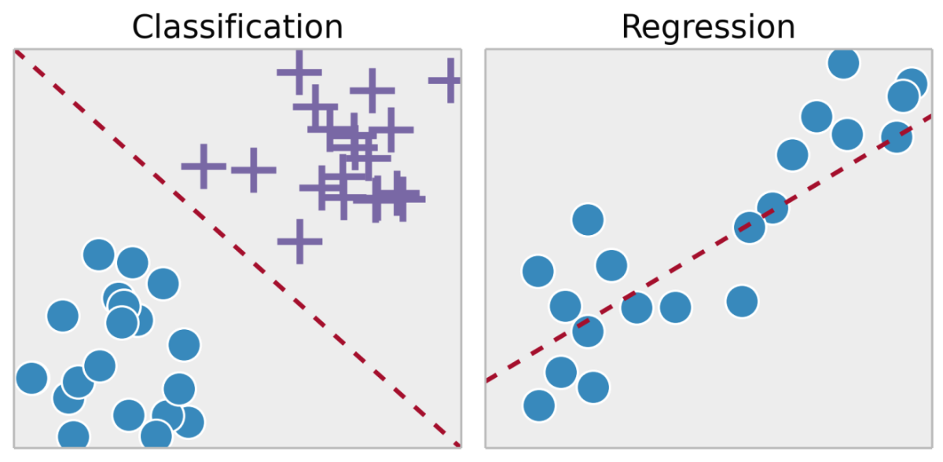
Classification vs regression
What can be our labels?
  Classification (discrete value)
    Binary classification (e.g. spam or not spam)
    Multi-class classification (e.g. dog or cat or horse or ..)
  Regression (continuous value e.g. price of a house)
ref:https://scorecardstreet.wordpress.com/2015/12/09/is-machine-learning-the-new-epm-black/

Slide 11
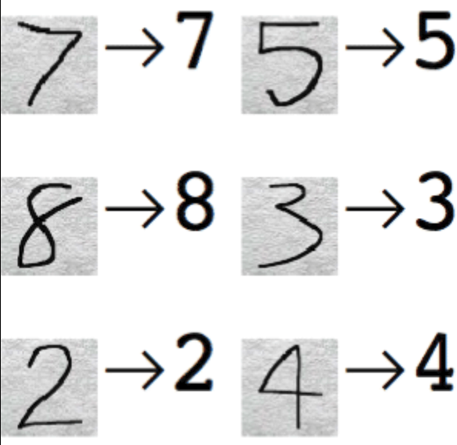
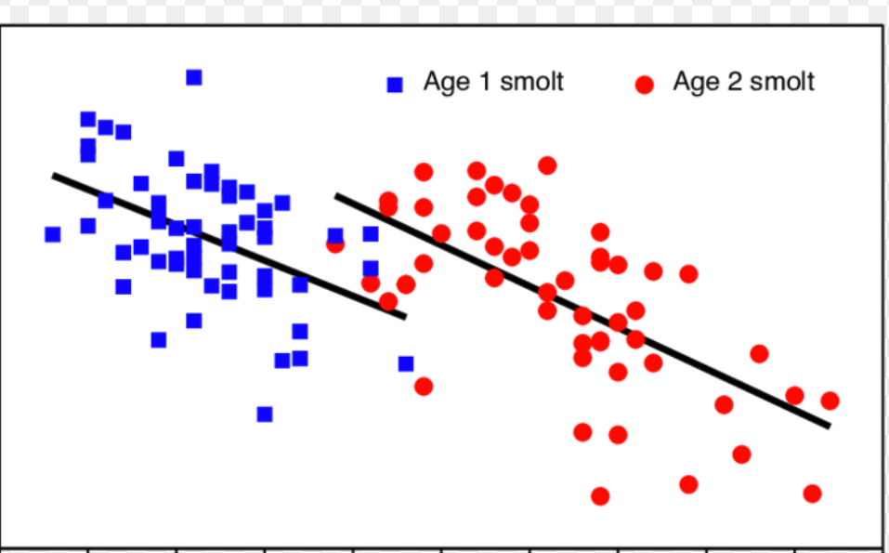
Classification vs regression (examples)
Classification example:
  Handwritten digit recognition
Regression example:
  Prediction of the length of a salmon as a function of its age and weight.
Length
Weight

Slide 12
Other Classification Tasks
Classification: given inputs x, predict labels (classes) y
Examples:
Spam detection (input: document,
classes: spam / ham)
OCR (input: images, classes: characters)
Medical diagnosis (input: symptoms,
classes: diseases)
Automatic essay grading (input: document,
classes: grades)
Fraud detection (input: account activity,
classes: fraud / no fraud)
Customer service email routing
… many more
Classification is an important commercial technology!

Slide 13
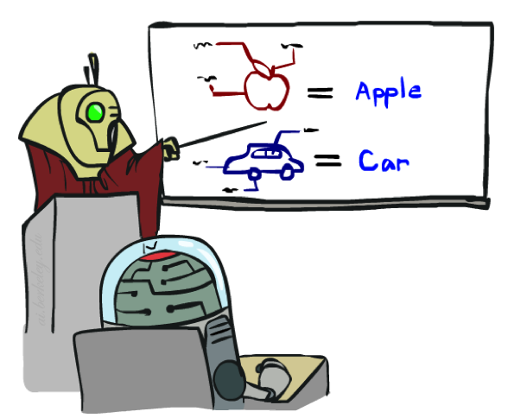

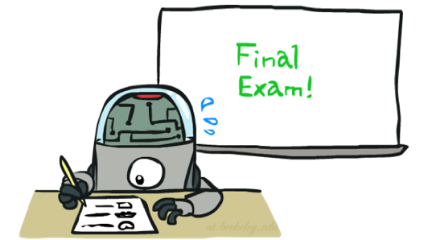
Training held-out and test data
How can we evaluate our machine learning algorithm?
  Machine learning is about learning some properties of a data set (train) and then testing those properties against another data set (test).
  The test data set is used only for evaluation and you should not use it except for that. (Do not use this data set for making any decision about the model).
Training
Data
Held-Out
Data
Test
Data
  [This image is adapted from the ones created by Dan Klein and Pieter Abbeel for CS188 Intro to AI at UC Berkeley, available at http://ai.berkeley.edu.]

Slide 14
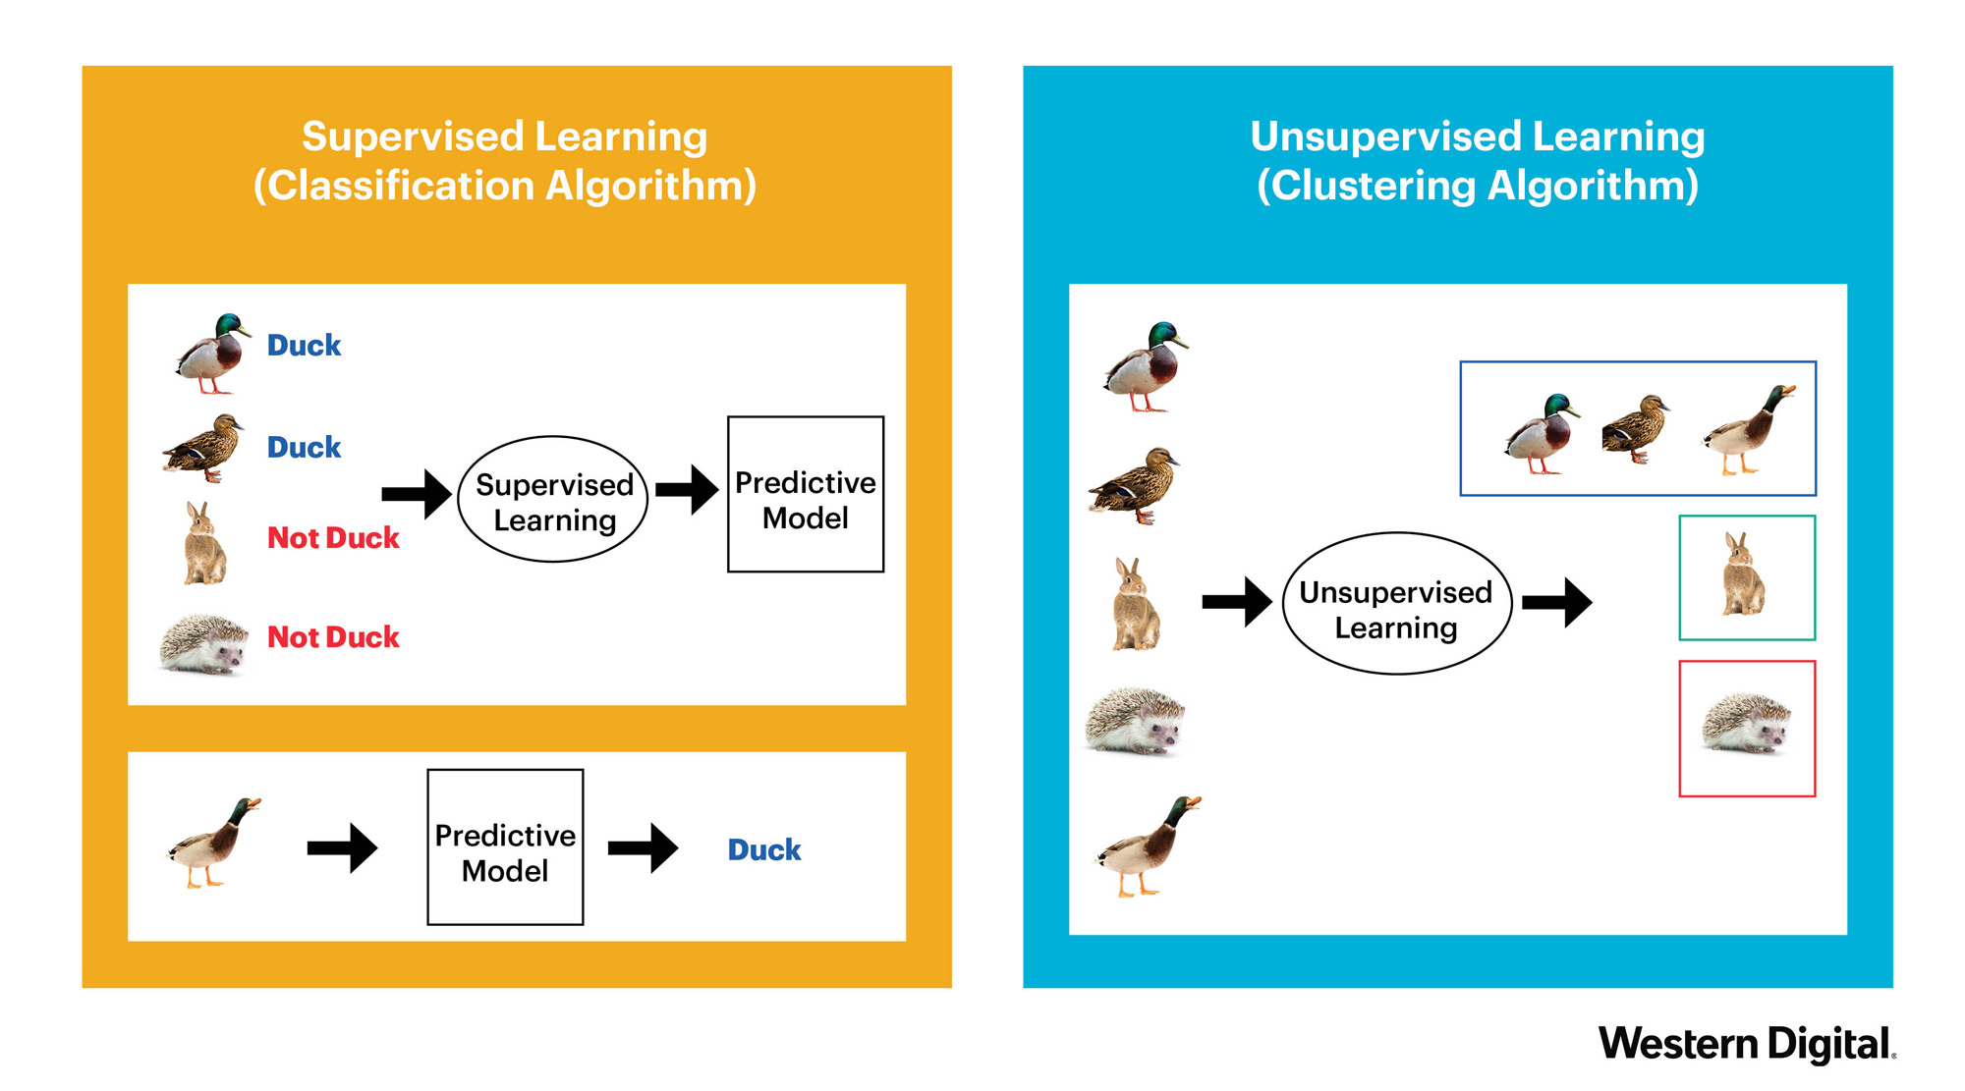
Supervised learning vs unsupervised learning
Supervised learning: in which the data comes with additional attributes that we want to predict.
  classification
  regression
Unsupervised learning: in which the training data consists of a set of input vectors x without any corresponding target values.
  clustering
  density estimation

Slide 15
More about unsupervised learning
Why unsupervised learning is important?
  Labeling data costs time and resources
    300 hours of video are uploaded to youtube every minute
What are different approaches for it?
  Auto encoders
    Encode input to a latent space and reconstruct it from there
  Generative models
    Two agents (neural networks) play a min-max game against each other

Slide 16
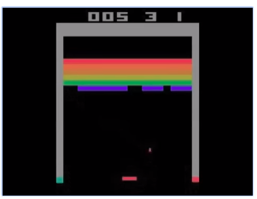
Reinforcement learning
Basic idea:
Receive feedback in the form of rewards
Agent’s utility is defined by the reward function
Must (learn to) act so as to maximize expected rewards
All learning is based on observed samples of outcomes!
Agent
State: s
Reward: r
Actions: a
Environment

Slide 17
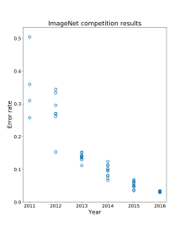
Artificial neural networks
History
  1957 Perceptron (Frank Rosenblatt)
  1969 Minsky & Papert (Perceptron book) (Funding for AI research collapsed)
  1980s Machine learning emerges (Find patterns in data, bottom-up)
  1980s Conferences for neural networks emerged
  1990 (SVM) (No paper was accepted by conferences)
  2006 (Geoffrey Hinton, Yunn LeCun, Yoshua Bengio)
    Rephrase neural networks to deep learning
  2012 Imagenet-competition (Industry-wide artificial intelligence boom)
Deep learning success
  Computational power: Data, GPUs
  Research: ReLU activations, Batch normalization, SGD
Deep learning example
  https://playground.tensorflow.org/
https://en.wikipedia.org/wiki/ImageNet

Slide 18
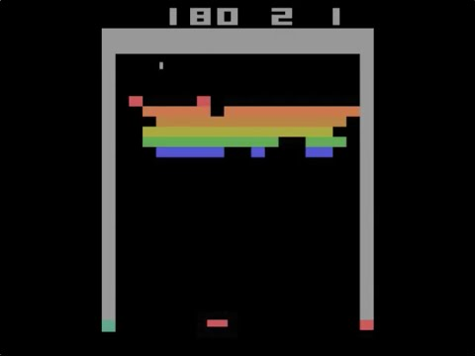
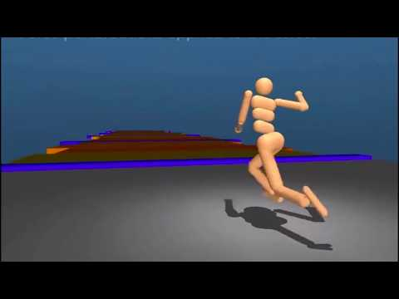
Deep reinforcement learning
Atari games
Robot locomotion

Slide 19
Conclusion
No free lunch theorem
  We can use different functions for our learning algorithm
    Decision tree
    Perceptron
    SVM
    Neural network
    etc
  We have to make assumption about the function which we use
  There is no single solution for all ML problems
Deep learning is used in many different domains
  A function
  Hard to find the rules
  Can have a good amount of data

