Slide 1
Introduction to Wireless Networks

Slide 2
Wireless Networks
Cellular Networks
Mobile Ad hoc Networks (MANETs)
Wireless Sensor Networks (WSNs)
  underwater sensor networks
  intruder tracking sensor networks
Vehicular MANETs (VANETs)

Slide 3
Wireless Networks
Cellular Architecture
- Infrastructure-based networks
- All units are fixed in location except mobile units
- BS and MSC are connected via wirelines
- Communication between BS and mobile unit is wireless
WIRELINE NETWORK
Cell
Base Station (BS)
Mobile unit
Wireless Links
Wired Links
Mobile Switching Center (MSC)

Slide 4
Wireless Networks
Mobile Ad hoc Networks (MANET)
Characteristics
- Infrastructure-less
- All nodes are potentially mobile
- Network topology is dynamic
- All nodes act as individual routers
Examples
- Disaster recovery situations
- Battle field communications
- Law enforcement operations
- Civilian applications
Objectives
- Maintain connectivity between mobile devices
- Provide congestion-free routing for multimedia traffic
- Support scalability
- Minimize memory, bandwidth and energy consumption
transmission
range

Slide 5
Sensor Networks
Wireless sensor networks consists of group of sensor nodes to perform distributed sensing task using wireless medium.
Characteristics
- low-cost, low-power, lightweight
- densely deployed
- prone to failures
- two ways of deployment: randomly, pre-determined or engineered
Objectives
- Monitor activities
- Gather and fuse information
- Communicate with global data processing unit

Slide 6
Sensor Networks
Application Areas [Akyildiz+ 2002]
Military:
  Monitoring equipment and ammunition; battlefield surveillance and damage assessment; nuclear, biological, chemical attack detection and reconnaissance
Environmental:
  Forest fire / flood detection
Health:
  Tracking and monitoring doctors and patients inside a hospital; drug administration in hospitals
Home:
  Home automation; smart environment
Other Commercial Applications:
  Environmental control in office buildings; detecting and monitoring car thefts; managing inventory control; vehicle tracking and detection

Slide 7
Sensor Networks Preliminaries
For large scale environment monitoring applications, dense sensor networks are mainly used
Sensing capabilities should be distributed and coordinated amongst the sensor nodes
Algorithms deployed should be localized since transmissions between large distances are expensive and lowers networks life time
These networks should be self-configuring, scalable, redundant and robust during topology changes

Slide 8
Research Problems in Sensor Networks
Clustering: Partitioning of the network (identification of clusterheads)
Sensor data management and monitoring
Routing: Discovering routes from source to destination; maintaining, rediscovery and repair of routes
Topology management: maintain the links and minimize the changes in underlying graph
Medium Access Control Protocols
Power conservation/energy consumption
Data fusion and dissemination of sensor data
Security
New applications for ad hoc and sensor networks

Slide 9
Clustering
Cluster-based control structures provides more efficient use of resources for large dynamic networks
Clustering can be used for: i) transmission management (link-cluster architecture); ii) backbone formation; iii) routing efficiency
Clusterheads
Resemble base stations in cellular networks, but dynamic and acts as routers
Responsible for resource allocation and maintains network topology
Aware of its cluster members and its one-hop neighboring clusterheads
Since clusterheads decide network topology,
election
of clusterheads optimally is critical

Slide 10
Link-Clustered Architecture
[Baker+, 1981a, 1981b, Ephremides+ 1987]
Reduces interference in multiple-access broadcast environment
Distinct clusters are formed to schedule transmissions in a contention-free way
Each cluster has a clusterhead, one or more gateways and zero or more ordinary nodes
Clusterhead schedules transmission and allocates resources within its cluster
Gateways connect adjacent clusters
To establish link-clustered control structure
Discover neighbors
Select clusterhead to form clusters
Decide on gateways between clusters
Cluster
Clusterhead
Gateway
Ordinary node

Slide 11
Lowest-Degree Heuristic
[Baker+, 1981a, 1981b, Ephremides+ 1987]
The node with the minimum node-id is chosen to be a clusterhead
A node is called a gateway if it lies within the transmission range of two or more clusters
Distributed gateway is a pair of nodes that reside within different clusters, but they are within the transmission range of each other
Drawbacks:
Since it is biased towards nodes with smaller node-ids, leading to battery drainage
It does not attempt balance the load for across all the nodes

Slide 12
Highest-Degree Heuristic
[Gerla+ 1995, Parekh 1994]
Computes the degree of a node based on the distance (transmission range) between the node and the other nodes
The node with the maximum number of neighbors (maximum degree) is chosen to be a clusterhead and any tie is broken by the node ids
Drawbacks:
A clusterhead cannot handle a large number of nodes due to resource limitations
Load handling capacity of the clusterhead puts an upper bound on the node-degree
The throughput of the system drops as the number of nodes in cluster increases

Slide 13
Node-weight Heuristic
[Basagni 1999a, 1999b]
Node-weights are assigned to nodes based on the suitability of a node being a clusterhead
The node is chosen to be a clusterhead if its node-weight is higher than any of its neighbor’s node-weights and any tie is broken by the minimum node ids
Drawbacks:
No concrete criteria of assigning the node-weights
Works well for “quasi-static” networks where the nodes do not move much or move very slowly

Slide 14
Weighted Clustering Algorithm (WCA)
[Chatterjee+ 2002; Turgut+ 2002, 2003]
A clusterhead can ideally support certain number of nodes: ensures efficient MAC functioning and minimizes delay and maximizes throughput
A clusterhead uses more battery power : extra work due to packet forwarding and communication with more number of nodes
A clusterhead should be less mobile to maintain same configuration and frequent WCA invocation
A better power usage with physically closer nodes: ore power for distant nodes due to signal attenuation
Calculate the combined weight W_{v} for each node
W_{v} = w₁Δ_{v} + w₂D_{v} + w₃M_{v} + w₄P_{v} for each node
Find min W_{v}; choose node v as the clusterhead
Δ_{v} = degree-difference
D_{v} = sum of the distances
M_{v} = mobility
P_{v} = power consumed

Slide 15
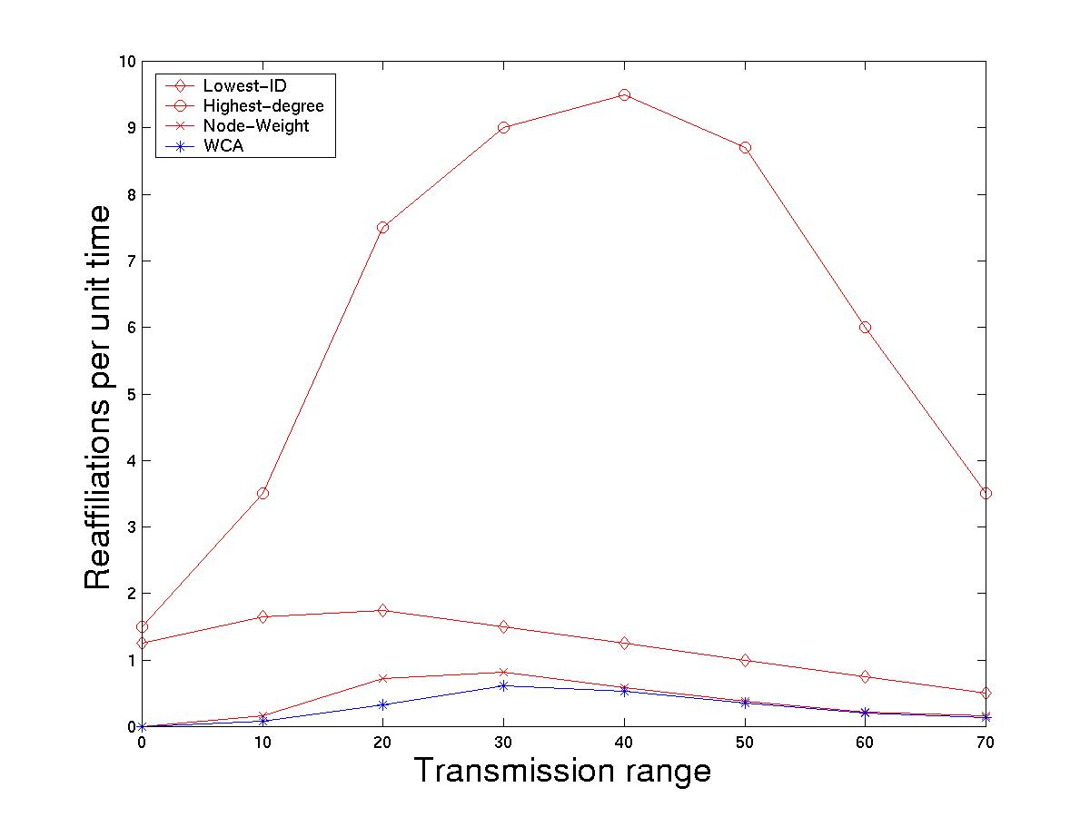
Simulation Environment
Weighted Clustering Algorithm (WCA)
[Chatterjee+ 2002; Turgut+ 2002, 2003]
System with N nodes on a 100x100 grid
N was varied between 20 and 60
Nodes moved in all directions randomly
Velocity of nodes were varied uniformly [0-10]
Transmission range of nodes was varied [0-70]
Ideal degree was fixed at = 10
Weighing factors: w₁ = 0.7, w₂ = 0.2, w₃ = 0.05 and w₄ = 0.05

Slide 16
Energy-Efficient Communication Protocol Architecture for Wireless Microsensor Networks (LEACH Protocol)
[Heinzelman+ 2000, 2002]
LEACH (Low-Energy Adaptive Clustering Hierarchy) utilizes the randomized rotation of local cluster base stations to evenly distribute the energy load within the network of sensors
It is a distributed, does not require any control information from base station (BS) and the nodes do not need to have knowledge of global network for LEACH to function
Key features of LEACH include:
  Localized coordination and control of cluster set-up and operation
  Randomized rotation of the cluster base stations or clusterheads and their clusters
  Local compression of information to reduce global communication
Considered microsensor network has the following characteristics:
  The base station is fixed and located far from the sensors
  All the sensor nodes are homogeneous and energy constrained
By performing load computation in each cluster, amount of data to be transmitted to BS is reduced. Large reduction in the energy dissipation is achieved since communication is more expensive than computation

Slide 17
Why Sensor Platforms?
Compared to analysis and simulation techniques, designing a system platform has the following advantages:
  Provides genuine executive environment: various proposed algorithms can be exactly evaluated; good way to examine existing design principles and discover new ones under different configurations
  More attention can be focused on the application-layer
  A real system platform can accelerate the pace of research and development

Slide 18
General WSN System Architecture
Constructing a platform for WSN falls into the area of embedded system development which usually consists of developing environment, hardware and software platforms.
Hardware Platform
  a) Processing unit: associates with small storage unit (tens of kilo bytes order) and manages the procedures to collaborate with other nodes to carry out the assigned sensing task
  b) Transceiver unit: connects the node to the network via various possible transmission medias such as infra, light, radio, etc.
  c) Power unit: supplies power to the system by small size batteries which makes the energy a scarce resource
  d) Sensing units: usually composed of two subunits: sensors and analog-to-digital Converters (ADCs).
  e) Other application dependent components: location finding system is needed to determine the location of sensor nodes with high accuracy; mobilizer may be needed to move sensor nodes when it is required to carry out the task

Slide 19
General WSN System Architecture
Software Platform
  a) Embedded Operating System (EOS): manages the hardware capability efficiently as well as supports concurrency-intense operations. Apart from traditional OS tasks such as processor, memory and I/O management, it must be real-time to rapidly respond the hardware triggered events, multi-threading to handle concurrent flows
  b) Application Programming Interface (API): a series of functions provided by OS and other system-level components for assisting developers to build applications upon itself
  c) Device Drivers: a series of routines that determine how the upper layer entities communicate with the peripheral devices
  d) Hardware Abstract Layer (HAL): intermediate layer between the hardware and the OS; provides uniform interfaces to the upper layer while its implementation is highly dependent on the lower layer hardware. With the use of HAL, the OS and applications easily transplant from one hardware platform to another

Slide 20
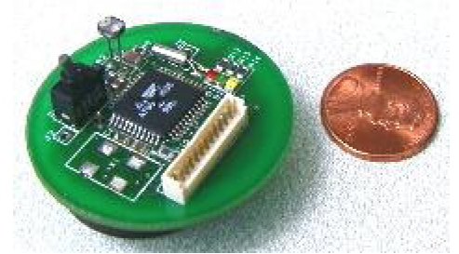
Berkeley Motes [Hill+ 2000]
Motes are tiny, self-contained, battery powered computers with radio links, which enable them to communicate and exchange data with one another, and to self-organize into ad hoc networks
Motes form the building blocks of wireless sensor networks
TinyOS [TinyOS], component-based runtime environment, is designed to provide support for these motes which require concurrency intensive operations while constrained by minimal hardware resources
Figure 1: Berkeley Mote

Slide 21
Wireless Sensor Networks for Habitat Monitoring
[Mainwaring+ 2002]
Habitat Monitoring
Habitat and environmental monitoring represent essential class of sensor network applications by placing numerous networked micro-sensors in an environment where long-term data collection can be achieved
Researchers in the Life Sciences are concerned about the impacts of human presence in monitoring plants and animals in the field conditions. It is possible that chronic human disturbance may adversely effect results by changing behavioral patterns or distributions
Disturbance effects are of concern in small island situations where it may be physically impossible for researchers to avoid some impact on an entire population (e.g., seabird colonies are extreme sensitive to human disturbance)
On Kent Island, Nova Scotia, research learned that Leach’s Storm Petrels are likely to desert their nesting burrows in case of disturbance during the first two weeks of incubation

Slide 22
Wireless Sensor Networks for Habitat Monitoring
[Mainwaring+ 2002]
Habitat Monitoring
Sensor networks advances the monitoring methods over the traditional invasive ones and deployment may be more economical method for conducting long-term studies
Sensors can be deployed prior to the breeding season or other sensitive period or while plants are dormant or the ground is frozen on small islets where it would be unsafe or unwise to repeatedly attempt field studies
A “deploy ‘em and leave ‘em” strategy of wireless sensor usage would decrease the logistical needs to initial placement and occasional servicing
This paper develops a specific habitat monitoring application, but yet a representative of the domain

Slide 23
Wireless Sensor Networks for Habitat Monitoring
[Mainwaring+ 2002]
Great Duck Island
The College of Atlantic (COA) is field testing in-situ sensor networks for habitat monitoring
Great Duck Island (GDI) is a 237 acre island located 15 km south of Mount Desert Island, Maine
At GDI, three major questions in monitoring the Leach’s Storm Petrel:
  What is the usage pattern of nesting burrows over the 24-72 hour cycle when one or both members of a breeding pair may alternate incubation duties with feeding at sea?
  What changes can be observed in the burrow and surface environmental parameters during the course of the approximately 7 month breeding season (April-October)?
  What are the differences in micro-environments with and without large numbers of nesting petrels?

Slide 24
Wireless Sensor Networks for Habitat Monitoring
[Mainwaring+ 2002]
Great Duck Island Requirements
Internet Access: the sensor networks at GDI must be accessible via the Internet since the ability to support remote interactions with in-situ networks is essential
Hierarchical Network: habitats of interest are located up to several kilometers away. A second tier of networking provides connectivity to multiple patches of sensor networks deployed at each of the areas.
Sensor Network Longevity: sensor networks that runs for several month from non-rechargeable power sources would be desirable since studies at GDI can span multiple field seasons
Operating off-the grid: every level of the network must operate with bounded energy supplies; renewable energy such as solar may be available some locations, disconnected operation is a possibility; GDI has enough solar power (service interruptions due to power loss can happen)
Management at-a-distance: remoteness of the field sites requires the ability to monitor and manage sensor networks over the Internet. The goal is no on-site presence for maintenance and administration during the field season, except for installation and removal of nodes

Slide 25
Wireless Sensor Networks for Habitat Monitoring
[Mainwaring+ 2002]
Great Duck Island Requirements
Inconspicuous operation: it should not disrupt the natural processes or behaviors under study; removing human presence from the study areas would eliminate a source of error and variation in data collection and source of disturbance
System behavior: sensor networks should present stable, predictable, and repeatable behavior at all times since unpredictable system is difficult to debug and maintain
In-situ interactions: local interactions are required during initial development, maintenance and on-site visits; PDAs can be useful in accomplishing these tasks – they may directly query a sensor, adjust operational parameters, etc
Sensors and sampling: the ability to sense light, temperature, infrared, relative humidity, and barometric pressure are essential set of measurements; additional measurements may include acceleration/vibration, weight, chemical vapors, gas concentrations, pH, and noise levels
Data archiving: sensor readings must be achieved for off-line data mining and analysis; the reliable offloading of sensor logs to databases in the wired, powered infrastructure is essential

Slide 26
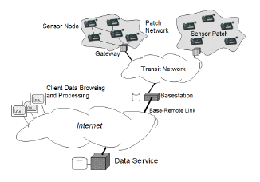
Wireless Sensor Networks for Habitat Monitoring
[Mainwaring+ 2002]
System Architecture
A tiered with the lowest level consists of the sensor nodes that perform general purpose computing and networking as well as application-specific sensing
The sensor nodes may be deployed in dense patches and transmit their data through the sensor network to the sensor network gateway
Gateway is responsible for transmitting sensor data from the sensor patch through a local transit network to the remote base station that provides WAN connectivity and data logging
The base station connects to database replicas across the internet and the data is displayed to researchers through a UI
Figure 2: System architecture for habitat monitoring

Slide 27
Energy-Efficient Computing for Wildlife Tracking: Design Tradeoffs and Early Experiences with ZebraNet
[Juang+ 2002]
Introduction
In this system, the sensor nodes collars carried by the animals under study; wireless ad hoc networking techniques are used to swap and store data in a peer-to-peer manner and to pass it towards a mobile base station that sporadically traverses the area to upload data
Motivation: how human development into wilderness areas affects indigenous species there; understand the migration patterns of wild animals and how they may be affected by changes in weather patterns or plant life, by introduction of non-native species, and by other influences
ZebraNet project is building tracking nodes that include a low-power miniature GPS system with user-programmable CPU, non-volatile storage for data logs, and radio transceivers for communicating either with other nodes or with a base station

Slide 28
Energy-Efficient Computing for Wildlife Tracking: Design Tradeoffs and Early Experiences with ZebraNet
[Juang+ 2002]
Drawbacks of the previous techniques:
Many studies rely on collaring a sample subset of animals with simple VHF transmitters
Periodically drive through and/or fly over an area with a receiver antenna, and listen for pings from previously collared animals. Once animal is found, its behavior can be observed and its observed position can be logged; however, there are limits to such studies
  data collection is infrequent and can miss many “interesting events”
  mostly limited to daylight hours, but animal behavior and movements in night hours can be different
  data collection is impossible or very limited for secluded species that avoid human contact
The most elegant trackers commercially available use GPS to track position and use satellite uploads to transfer data to a base station and these systems also suffer from several limitations
  at most a log of 3000 position samples can be logged and no biometric data
  satellite uploads/downloads are slow, expensive and high power consumption: done infrequently
  operate on batteries without recharge

Slide 29
Energy-Efficient Computing for Wildlife Tracking: Design Tradeoffs and Early Experiences with ZebraNet
[Juang+ 2002]
System assumptions
The system should work in arbitrary wilderness locations; no assumptions are made about the presence of of fixed antenna towers or cellular phone service
The system uses peer-to-peer data swaps to move the data around; periodic researcher drives bys and/or fly-overs can collect logged data from several animals
First study of mobile sensor networks protocols in which the base station is also mobile
  presumed that researchers will upload data while driving or flying by the region (no fixed base stations, antennas, or cellular service)
  GPS position samples are taken every three minutes
  One year of operation without direct human intervention
  For a zebra collar, a weight limit of 3-5 lbs is recommended
Energy tradeoffs are examined in detail using real system energy measurements for ZebraNet prototype hardware in operation

Slide 30
Directed Diffusion
[Intanagonwiwat+ 2000]
Directed diffusion is data-centric in that all communication is for named data
Data generated by sensor nodes is named using attribute-value pairs
A node requests data by sending interests for named data
Naming
Task descriptions are named (specifies an interest for data matching the list of attribute-value pairs) and also called as interest
Example task: “Every I ms, for the next T seconds, send me a location of any four-legged animal in subregion R of the sensor field.”
    task = four-legged animal // detect animal location
    interval = 20 ms // send back events every 20 ms
    duration = 10 seconds // … for the next 10 seconds
    rect = [-100, 100, 200, 400] // from sensors within rectangle

Slide 31
Directed Diffusion
[Intanagonwiwat+ 2000]
Interests
Interest is generally given by the sink node and it periodically refreshes each interest by re-sending the same interest with monotonically increasing timestamp attribute for reliability purposes to each of its neighbors
Every node maintains an interest cache where each item in the cache corresponds to a distinct interest
When a node receives an interest, it determines if the interest exists in the cache
Data propagation
A node receiving a data message from its neighbors checks to see if matching interest entry in its cache exists
  If no match exist, the data message is dropped
  If match exists, the node checks its data cache associated with the matching interest entry
    If a received data message has a matching data cache entry, the data message is dropped
    Otherwise, the received message is added to the data cache and the data message is re-sent to the neighbors
Data cache keeps track of the recently seen data items, preventing loops
By checking the data cache, a node can determine the data rate of the received events

Slide 32
Routing protocols in ad hoc networks: a survey
[Boukerche+ 2011]
Ad hoc routing protocols can be grouped into the following categories:s
  Source-initiated (reactive): the route is created when source requests a route to a destination
  Table-driven (proactive): always maintain up-to-date information of routes from each node to every other node in the network
  Hybrid: combine elements of on-demand and table-driven routing protocols
  Location-aware: assume that the individual nodes are aware of the locations of all the nodes
  Multipath: create multiple routes from source to destination (either through reactive or proactive) instead of the conventional single route discovery
  Hierarchical: build a hierarchy of nodes, typically through clustering techniques
  Multicast: the simultaneous transmission of data from one sender to multiple receivers
  Geographical multicast: a variant of multicast where the goal is to route the packets coming from a source to destinations located within a specific geographical region
  Power-aware: routing decisions dependent on the available energy of the nodes

Slide 33
Stealth Routing
[Turgut+ 2009]
Intruder Tracking Sensor Network
Sensor networks used to detect and track intruders in a geographic region
  “Interest area”
  Observations are disseminated to the sink by hop by hop transmission
Performance metric: tracking error
  Difference between the model maintained by the sink and the real location of intruders
The intruders belong to malicious and resourceful adversary
  If the adversary knows the locations of the nodes: it can avoid sensors, find and exploit blind spots, introduce fake observations, capture or compromise nodes
A node is:
  Stealthy: if the adversary doesn’t know its existence
  Disclosed: if the adversary can accurately locate the node
  Have various levels of stealth between these two extremes
How can a node loose stealth:
  Accidentally
  Through wireless transmission in the presence of the intruder
  Routing / dissemination protocols did not previously consider the issue of stealth
  The issue of stealth has been at best marginally addressed in the field of sensor networks.
Objective:
  Develop a dissemination algorithm which optimizes stealth without sacrificing the other performance parameters
Notes:
33

Slide 34
Stealth Routing
[Turgut+ 2009]
Quantifying stealth
Stealth level σ(t) as probability at time t that the node is not disclosed to the opponent
  Non disclosed node: σ(t) = 1
  Disclosed node: σ(t) = 0
  Stealth level decreases in response to transmission events
  Probability of disclosure at transmission
Try and Bounce (TAB)
A dissemination algorithm designed from the ground up to take into consideration stealth
It is based on the creation and forwarding of reports about intruder location
The local nodes maintain a local model of their environments
  Updated through a series of inferences
We will now investigate three aspect of TAB
  A. The maintenance of the local model
  B. The forwarding path
  C. The decision to make a transmission
Notes:
Stealth: there is a certain probability of disclosure at deployment, then there is a uniform accidental disclosure probability
Then, there is a probability of disclosure at every transmission pi
-Ok, so essentially this formula says that the disclosure depends on:
-whether the intruder pays attention
-the distance of the intruder (inversely, with the power of path loss in the transmission medium)
-various parameters, the transmission range, minimum power to make a detection, sufficient power to guarantee detection
(if one pays attention)
34

Slide 35
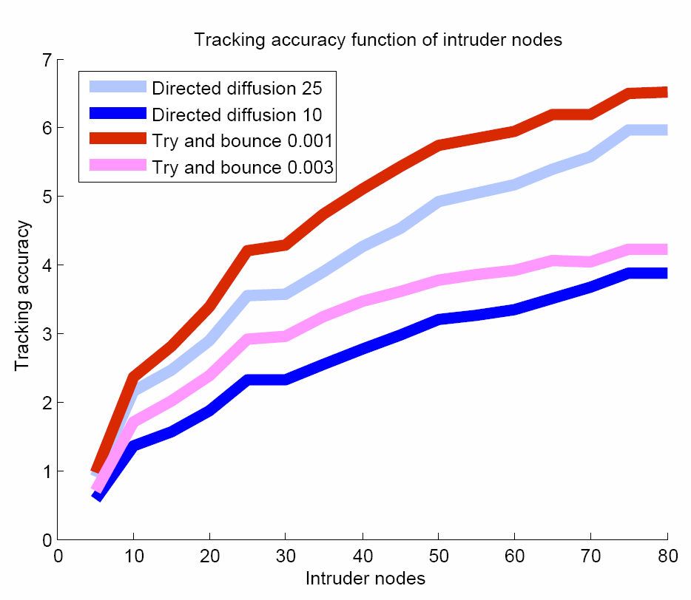
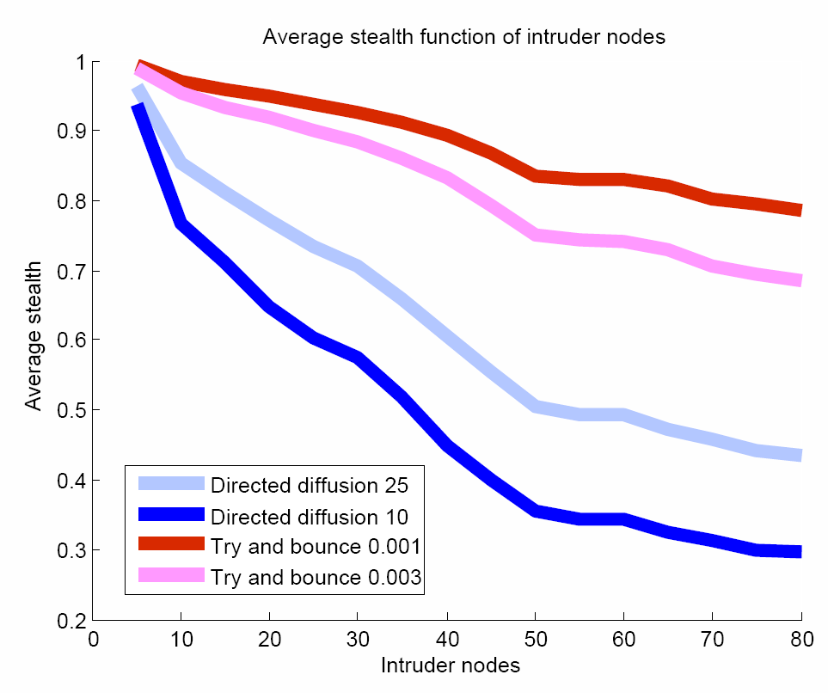
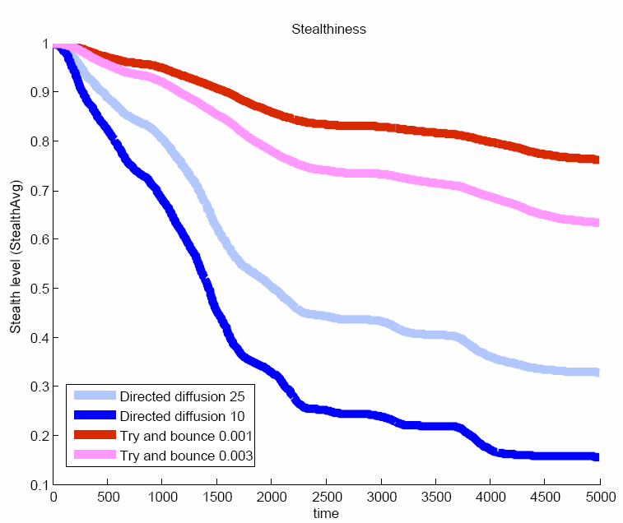
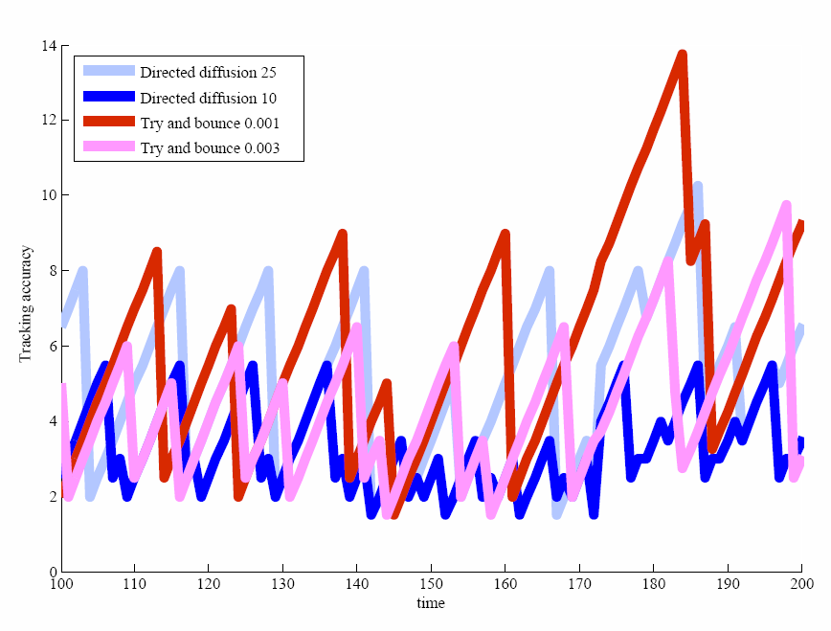
Stealth Routing
[Turgut+ 2009]
Simulation Study
Intruder tracking sensor network
  Interest area: 400x400 meters
  64 nodes
  Sensing range = 50m
  Transmission range = 50m
  Experiment time = 2hr (7200 seconds)
  10..80 intruders cross the area during the experiment
Experiment repeated for 4 different protocol / parameterization
  DD-10 directed diffusion, interval = 10 secs
  DD-25 directed diffusion, interval = 25 secs
  TAB-0.001 try and bounce, stealth loss cap = 0.001 stealth units per intruder per unit of time
  TAB-0.003 try and bounce, stealth loss cap = 0.003
Implemented all the protocols in the YAES simulator
Try and bounce (TAB): outperforms DD on the stealth + tracking accuracy combination
Notes:
It’s not difficult to achieve high stealth, just shut up and don’t submit anything. Also, with any protocol you can achieve high stealth by setting the parameter to transmit less often.
-The important thing is to achieve high stealth with high tracking accuracy.
First observation, stealth values decrease with the increasing number of intruders regardless of the chosen protocol. This makes sense since more intruders to report translates more wireless transmissions which then translates to more stealth loss
In DD, longer the reporting interval (25), higher the stealth (transmit less often)
In TAB, lower the stealth loss cap, higher the stealth
-Comparing DD and TAB, both instances of TAB scores significantly higher stealth than DD since TAB transmits as long as there is no stealth loss while DD is restricted to an time interval
35

Slide 36
Wireless Networks
Intruder tracking Sensor Networks
Managing scarce sensing resources for optimizing value of information (VoI) in intruder tracking sensor networks
  Intruder tracking system:
    large area, zones with different security needs
    multiple moving targets, different types
    There is a human customer (security guard)
  A security guard deciding which one of the two intruders to pursue entering a secure zone (e.g., Naval Warfare Office at UCF Research Park). The value of the information of the intruder being pursued by the security guard will be higher than the other intruder.

Slide 37
Wireless Networks
Underwater Sensor Networks
Autonomous underwater vehicle (AUV) visits each node for collecting data over short-distance, high data rate optical connections. Nodes need to decide when and how much data to transmit such that value of information is maximized.
Applications: visual monitoring of the oil wells. If the warning sign of possible oil spills reach the customer early enough, its value will be at the highest.
Other applications: environmental monitoring of CO₂ leakage, surveillance of national treasures under the water from being stolen, and visual monitoring of transmission pipes for structural integrity

Slide 38
References
[Akyildiz+ 2002] I. F. Akyildiz, W. Su, Y. Sankarasubramaniam, and E. Cayirci, A Survey on Sensor Networks, IEEE Communications Magazine, Vol. 40, No. 8, pp. 102-114, August 2002.
[Baker+ 1981a] D.J. Baker and A. Ephremides, A Distributed Algorithm for Organizing Mobile Radio Telecommunication Networks, Proceedings of the 2nd International Conference on Distributed Computer Systems, April 1981, pp. 476-483.
[Baker+ 1981b] D.J. Baker and A. Ephremides, The Architectural Organization of a Mobile Radio Network via a Distributed Algorithm, IEEE Transactions on Communications COM-29(11), 1981, pp. 1694-1701.
[Basagni 1999a] S. Basagni, Distributed Clustering for Ad hoc Networks, Proceedings of International Symposium on Parallel Architectures, Algorithms and Networks, June 1999, pp. 310-315.
[Basagni 1999b] S. Basagni, Distributive and Mobility-Adaptive Clustering for Multimedia Support in Multi-hop Wireless Networks, Proceedings of Vehicular Technology Conference, VTC, Vol. 2, 1999-Fall, pp. 889-893.
[Boukerche+, 2011] A. Boukerche, B. Turgut, N. Aydin, M.Z. Ahmad, L. Bölöni, and D. Turgut, Routing protocols in ad hoc networks: a survey. Computer Networks (Elsevier), 55(13):3032–3080, September 2011.
[Chatterjee+ 2002] M. Chatterjee, S. K. Das and D. Turgut, WCA: A Weighted Clustering Algorithm for Mobile Ad hoc Networks. Journal of Cluster Computing (Special Issue on Mobile Ad hoc Networks), Vol. 5, No. 2, April 2002, pp. 193-204.
[Ephremides+ 1987] A. Ephremides J.E. Wieselthier and D.J. Baker, A Design Concept for Reliable Mobile Radio Networks with Frequency Hopping Signaling, Proceedings of IEEE, Vol. 75(1), 1987, pp. 56-73.
[Heinzelman+ 2002] W. Heinzelman, A.P. Chandrakasan and H. Balakrishnan, An Application-Specific Protocol Architecture for Wireless Microsensor Networks, IEEE Transactions on Wireless Communications, Vol. 1, No. 4, October 2002, pp. 660-670.
[Heinzelman+ 2000] W. Heinzelman, A.P. Chandrakasan and H. Balakrishnan, Energy-Efficient Communication Protocol for Wireless Microsensor Networks, IEEE Proceedings of the Hawaii International Conference on System Sciences, January 4-7, 2000, Maui, Hawaii.
[Hill+ 2000] J. Hill, R. Szewczyk, A. Woo, S. Hollar, D. Culler, and K. Pister, System Architecture Directions for Networked Sensors, Architectural Support for Programming Languages and Operating Systems (ASPLOS) 2000.
[Intanagonwiwat + 2000] C. Intanagonwiwat, R. Govindan and D. Estrin, Directed Diffusion: A Scalable and Robust Communication Paradigm for Sensor Networks, Proc. MobiCOM’00, August 2000.
[Juang+ 2002] P. Juang, H. Oki, Y. Wang, M. Martonosi, L-S Peh, and D. Rubenstein, Energy-Efficient Computing for Wildlife Tracking: Design Tradeoffs and Early Experiences with ZebraNet, ACM SIGARCH Computer Architecture News, vol. 30, no. 5, December 2002 .

Slide 39
References
[Mainwaring+ 2002] A. Mainwaring, J. Polastre, R. Szewczyk, D. Culler, and J. Anderson, Wireless Sensor Networks for Habitat Monitoring, 1st ACM International Workshop on Wireless Sensor Networks and Applications (WSNA 2002), Atlanta, Georgia, September 28, 2002.
[Parekh 1994] A.K. Parekh, Selecting Routers in Ad-hoc Wireless Networks, Proceedings of the SBT/IEEE International Telecommunications Symposium, August 1994.
[TinyOS] TinyOS: a component-based OS for the networked sensor regime.
[Turgut+ 2002] D. Turgut, S.K. Das, R. Elmasri, and B. Turgut, Optimizing Clustering Algorithm in Mobile Ad hoc Networks Using Genetic Algorithmic Approach, Proceedings of IEEE GLOBECOM’02, November 2002, pp. 62-66.
[Turgut+ 2003] D. Turgut, B. Turgut, S.K. Das, R. Elmasri, Balancing Loads in Mobile Ad hoc Networks, Proc. of ICT’03, February 2003, pp. 490-495.
[Turgut+ 2009] D. Turgut, B. Turgut, and L. Bölöni, Stealthy dissemination in intruder tracking sensor networks, Proc. of IEEE LCN, October 2009, pp. 22-29.

