Slide 1
COP 4331 Recitation

Slide 2
COP 4331 Recitation
Kia Manoochehri
  kiam@knights.ucf.edu
Office Hours: 1:30-3:30 Tuesday / Thursday
  HEC 308 (The Cave)

Slide 3
Deliverables 1
Concept of Operations

Slide 4
Concept of Operations
The Current System:
  What is your project based on?
    Similar products, games, websites, etc.
  How will your project change the existing system?
    Why is your project awesome?
  What are you hoping to accomplish with this project?
    Getting an A in this class.
  Length: <1 or 2 paragraphs>

Slide 5
Concept of Operations
Proposed system <Needs>:
  List / Narrative of what your system needs:
    A mix of the two is ideal
    Not super technical
  Some “functions” of your project
    Ie if making a calendar, “Create event”
  Length: <1 paragraph to 1 page>

Slide 6
Concept of Operations
Proposed system <Users / Modes>:
  What are the classes of users?
    Trial user, user, admin, etc.
  What can each class of user do?
    Play game, open options, etc.
  Length: <1 ~ 3 sentences for each>

Slide 7
Concept of Operations
Proposed system <Operational Scenarios>:
  Explain some typical scenarios:
    “User starts the program: The program should start normally showing the start screen which consists of a title, and three buttons: Start, Options, and Exit. If the program is not able to initialize OpenGL or any other issue, it should fail gracefully, alerting the user through a dialog box.”
  Length: <1 paragraph each>

Slide 8
Concept of Operations
Proposed system <Operational Features>:
  Two lists:
    <Must Have>: A list of MANDATORY features in priority order
      ***If you do not meet these, it reflects very poorly on your group***
    <Would Like to Have>: A list of non-mandatory features in priority order
      ***Don’t make a small list of must haves and a large list of would like to haves in the hopes it makes you look better***
  Length: <As long as it takes.>

Slide 9
Concept of Operations
Proposed system <Expected Impacts>:
  What good will your project bring on the human race?
    If making a game you will help people procrastinate and enjoy life more.
  Length: <1 to 2 paragraphs>

Slide 10
Concept of Operations
Proposed system <Analysis>:
  Expected Improvements:
    If there exists something similar to your project, how is your project better?
  Disadvantages:
    Maybe someone will copy your project and take credit for it and make money off if it?
  Limitations:
    Time. Effort. Burnout. Skills. How can these factors play a role in your project?
  Risks:
    Security? You can attempt to draw on the disadvantages section as well.
  Alternatives & Trade offs:
    What is the benefit of doing X over Y?

Slide 11
Deliverables 1
Concept of Operations

Slide 12
Side note about groups

Slide 13
Side note about groups
What should I do if a group member (or two) isn’t pulling their weight?

Slide 14
Side note about groups
What should I do if a group member (or two) isn’t pulling their weight?
  Group meeting

Slide 15
Side note about groups
What should I do if a group member (or two) isn’t pulling their weight?
  Group meeting
What if they STILL won’t pull their weight?

Slide 16
Side note about groups
What should I do if a group member (or two) isn’t pulling their weight?
  Group meeting
What if they STILL won’t pull their weight?
  Email them, include the entire group
  Continue emailing and calling if no response for certain duration

Slide 17
Side note about groups
What should I do if a group member (or two) isn’t pulling their weight?
  Group meeting
What if they STILL won’t pull their weight?
  Email them, include the entire group
  Continue emailing and calling if no response for certain duration
What if they… STILL won’t pull their weight?

Slide 18
Side note about groups
What should I do if a group member (or two) isn’t pulling their weight?
  Group meeting
What if they STILL won’t pull their weight?
  Email them, include the entire group
  Continue emailing and calling if no response for certain duration
What if they… STILL won’t pull their weight?
  Contact the professor + TA directly in order to arrange a meeting to discuss the situation.

Slide 19
Deliverables 1
Project Management Plan

Slide 20
Project Management Plan
Project Overview
  Brief description of your project; no need for technical details
    Once again, what is your project?
  Length: <1 brief paragraph>

Slide 21
Project Management Plan
Reference Documents:
  Concept of Operations
    ***Please refer to the Concept of Operations for this document***
  Any other relevant documents

Slide 22
Project Management Plan
Applicable Standards <Coding>
  Give a link to a coding standard and a brief description as to why you chose this standard
    Give it some thought; you are going to be coding with others (hopefully) so you should try to stick to some kind of coding standard.

Slide 23
Project Management Plan
Applicable Standards <Documentation>
  Give a link to a documentation standard and a brief description as to why you chose this standard
    Your first two deliverables are 100% documentation and half of deliverables 3 is as well!

Slide 24
Project Management Plan
Applicable Standards <Artifact Size>
  How will you measure how BIG your project is?
    Size in kB? Length of game? Both?
  Milestones and their deadlines
  Deliverables and their deadlines

Slide 25
Project Management Plan
Project Team Organization:
  Description of your group and organizational issues
  Who is in the group + description of the individual
    Skills, talents, what their role is in the project
  How are you handling communication?
    Face to Face? Skype? Email?
  Length: <2 paragraphs + paragraph per person>

Slide 26
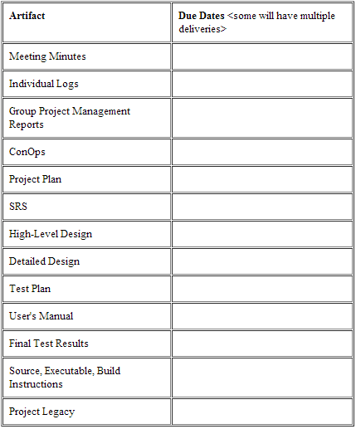
Project Management Plan
Deliverables:

Slide 27
Project Management Plan
Software Life Cycle Process:
  What process are you going to follow?
    Include a diagram
  Length: <1 paragraph>

Slide 28
Project Management Plan
Tools and Computing Environment:
  Very technical
    Operating System
    Programming languages
    Compilers
    Libraries
    Etc…
      (Include hardware and software!!!)

Slide 29
Project Management Plan
Configuration Management:
  How is your group going to handle version control?
    Who is responsible?
    Procedures?
    Will you be using some kind of repository?

Slide 30
Project Management Plan
Quality Assurance:
  What QA activities will your group do?
    Who is responsible?
    Procedures?
    How will you report your results?

Slide 31
Project Management Plan
Risk Management:
  Identify the risks associated with your project
    How will you manage this risk?
    Remember to think outside the box…

Slide 32
Project Management Plan
Work Packages, Time Estimates, Assignments:
  Breakdown the project into different components
    Individual deliverables
    Coding
    Testing
  Estimate how much time it will take to complete
  Who is responsible for each individual task?

Slide 33
Project Management Plan
PERT Chart
  Will be discussed in the lecture…
    Include the critical path, durations of activities, etc
    Should be fairly detailed

Slide 34
Project Management Plan
Technical Progress Metrics
  How will you be measuring the technical progress you make on your project?
    Number of requirements
    UML Diagrams
    Packages, classes, methods
    Memory usage, speed, file size… etc
      Choose easy to report metrics

Slide 35
Project Management Plan
Plan for tracking, control, and reporting of progress:
  What data to collect, when to collect, how and when to interpret, how and when to report it
  Example:
"At a minimum, each team member will post the following information weekly: individual time and activity log, individual status information, individual issues and problems, and individual defect log.
Each week, the project manager will: read and analyze the logs; examine the technical content of the work done to date; examine the technical progress metrics; consider the QA results; reassess the potential project risks; and take corrective action if necessary.
The project manager will issue a Project Management Report on the schedule as indicated in the deliverables section above. At a minimum, the Project Management Report will be generated every two weeks and will include the following information: 1 sentence description of overall status, 1 or 2 sentence of any planned changes to the project plan, graph of planned vs actual time, graph of planned vs actual for each technical progress metric, updated PERT chart."

Slide 36
Deliverables 1
Project Management Plan

Slide 37
Deliverables 1
Software Requirements Specification

Slide 38
Software Requirements Specification
Software to be produced:
  Describe what your project idea is
    You can reference other documents in this section
      ***Please see Concept of Operations for more details***
  Length: <1 good paragraph>

Slide 39
Software Requirements Specification
Reference documents:
  Concept of Operations
  Project Management Plan
  Any other supporting documents
    Influence for your project?

Slide 40
Software Requirements Specification
Applicable standards:
  Specific standards relating to your system
    No need to restate standards already listed in PMP
      ***Please see Project Management Plan for Coding standards***

Slide 41
Software Requirements Specification
Definitions, Acronyms, Abbreviations:
  Straightforward… but be thorough.
    API – Application Programming Interface
      “None” is valid if you don’t mention anything out of the ordinary.
  Length: <Cover everything>

Slide 42
Software Requirements Specification
Product Overview <Assumptions>:
  List ALL of your assumptions
    “assumptions about other systems this product will interface with; assumptions about the technological environment in which the product will operate (how much memory, what type of processor, ...); assumptions about availability and capability of COTS, GOTS, or other re-used products, ”
  Start getting into technical details
    What device? What OS? What version?
  Length: <Cover everything>

Slide 43
Software Requirements Specification
Product Overview <Stakeholders>:
  Me !
  Your professor
  You
  Your customers
  …Your competitors? (some people hold a negative stake in your success)
  Length: <A sentence or two for each>

Slide 44
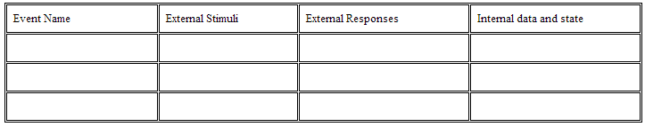
Software Requirements Specification
Product Overview <Event Table>:
  An event table identifies all the external events to which the software must respond. This is a first step in determining the required overall system functionality. The event list should be consistent with the context diagram and the interest of each stakeholder. Make sure that exceptions are considered.
  Length: <Cover EVERYTHING!!!>

Slide 45
Software Requirements Specification
Product Overview <Use Case Diagram>:
  A use case diagram for your system
    Can break it up
  Length: <Use Case Diagram>

Slide 46
Software Requirements Specification
Product Overview <Use Case Descriptions>:
  Describe typical use cases that are in the diagram
    For example: User Logs into system then logs out.
  Consider exceptions
    For example: User fails to login for X reason.
  Length: <based on UCD>

Slide 47
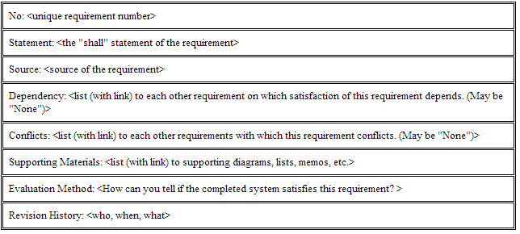
Software Requirements Specification
Specific Requirements <Template>:

Slide 48
Software Requirements Specification
Specific Requirements <Categories>:
  Functional
  Interface
  Physical Environment
  Users & Human Factors
  Documentation
  Data
  Resource
  Security
  Quality Assurance

Slide 49
Software Requirements Specification
Supporting Materials:
  How you came to the conclusions in this document
  Additional UML diagrams (preliminary diagrams)
  Notes / Memos / Comments / Concerns
  Length: <As long as it takes>

Slide 50
Deliverables 1
Software Requirements Specification

Slide 51
Deliverables 1
Test Plan

Slide 52
Test Plan
Introduction:
  Brief overview of your objective for testing
    What are you hoping to accomplish?
  Length: <1 paragraph>

Slide 53
Test Plan
Reference Documents:
  Concept of Operations
  Project Plan
  Software Requirement Specification

Slide 54
Test Plan
Description of the test environment:
  Very technical
    Hardware and software
  Who will be the testers?
    Your team vs outside testers (final users)

Slide 55
Test Plan
Stopping Criteria:
  How much testing is too much testing?
    When will you determine something is broken?
  If you find errors, how will you handle them?
  If you find no errors, how many tests will you run to confirm everything is OK?
  What does “good enough to deliver” mean to you?

Slide 56
Test Plan
Description of individual test cases:
  Include the following:
    Test objective
    Test description
    Test conditions
    Expected results
  Really important to note the following:
    You will revisit this document for deliverables 3 (actually running these tests)
    Will be held accountable for poor testing

Slide 57
Deliverables 1
Test Plan

