Slide 1



with
Some Eclipse Tricks included☺

Slide 2
What is it?
Tool for automatizing your software and test compilation also deployment
Add jar files (dependencies) by just adding some text to XML file
Compile your test cases and your software
Run your test cases
Create a jar file for your software

Slide 3
Why you need that?
Big Company job
  You may have different libraries you are using >10
  Don’t want to make human mistake for deployment
  Running test

Slide 4
Commands?
  clean: clean the generated stuff
  compile:compile your software
  test-compile:compile test classes:JUnit
  test: run the tests
  install: create jar file

Slide 5
How to install?
Create JAVA_HOME path: C:\Program Files\Java\jdk1.7.0_51
Add maven to your path: C:\Program Files\apache-maven-3.3.9\bin
Run mvn –v
https://maven.apache.org/install.html

Slide 6
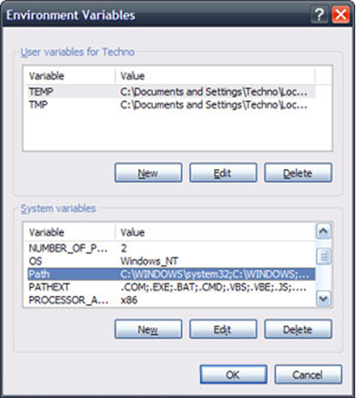
How to add path in Windows
Let me show you!
Or see this:
http://www.computerhope.com/issues/ch000549.htm

Slide 7
Install Plugin in
Help>Eclipse Marketplace
Find Maven
Install Maven Integration for Eclipse

Slide 8
Create a Project with
File>New>Other >Maven Project

Slide 9
Key Points in
groupId:PackageName
Artifact:projectname
version:1.0-SNAPSHOT

Slide 10
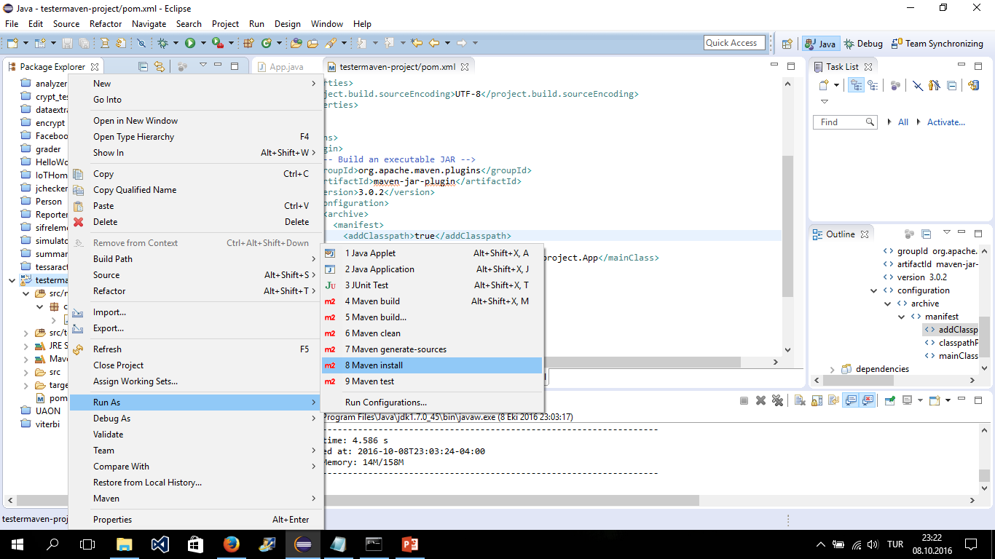

Slide 11
Creating Jar file-install
You need to add this to POM.xml
<build>
<plugins>
<plugin>
<artifactId>maven-jar-plugin</artifactId>
<version>3.0.2</version>
<configuration>
<archive>
<manifest>
<mainClass>com.somemaven.somemavenProject.App</mainClass>
</manifest>
</archive>
</configuration>
</plugin>
<plugin>
<artifactId>maven-dependency-plugin</artifactId>
<executions>
<execution>
<id>unpack-dependencies</id>
<phase>package</phase>
<goals>
<goal>unpack-dependencies</goal>
</goals>
</execution>
</executions>
</plugin>
</plugins>
<resources>
<resource>
<directory>${basedir}/target/dependency</directory>
</resource>
</resources>
</build>

Slide 12
Eclipse can also create a Jar file!
You need to clean first from Eclipse (Project>Clean)
Run or run as «Java Application»
Right click on Project
Export
You may add/not add the jar files
Done
Prepared by:
Salih Safa BACANLI
bacanli@knights.ucf.edu

