Slide 1
Software Testing Tools

Slide 2
Software Testing Tools
Functional and Regression test tools
Performance test tools
Mobile test tools
Test Management tools
Defect Management tools

Slide 3
Functional and Regression test tools
Testing of software features or retesting a product around an area where a bug was fixed.
  Selenium
  UFT/QTP
  RFT
  SoapUI
  SilkTest
  Watir
  TestComplete
  Cucumber

Slide 4
Performance test tools
The process of determining if the system meets the required specifications in terms of parameters such as speed, data transfer rate, bandwidth, throughput, efficiency or reliability.
  LoadRunner
  Jmeter
  RPT
  Silk Performer
  WebLoad

Slide 5
Mobile test tools
Appium
Silk Mobile
Calabash
MonkeyTalk
Robotium
Selendroid
UIAutomator
Frank
KIF

Slide 6
Defect Management tools
Bugzilla
IBM Rational ClarQuest
Mantis/MantisBT
BugHost

Slide 7
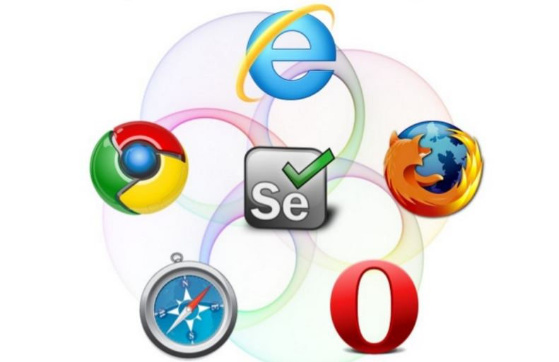
Selenium

Slide 8

What is Selenium?
It is for automating web applications for testing purposes
  creates robust, browser-based regression automation tests
  scales and distributes scripts across many environments

Slide 9
Go to http://www.seleniumhq.org/download/
Download latest version
Add Selenium jar files to your project
Download geckodriver
  For more information see “https://github.com/mozilla/geckodriver”
For demo I installed the following plugins as well :
  Firebug
  Fire path

Slide 10
Demo

Slide 11
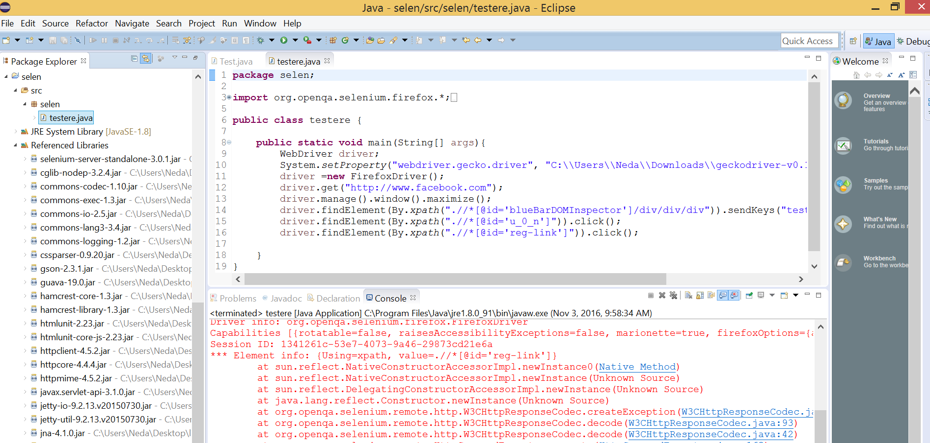

Slide 12
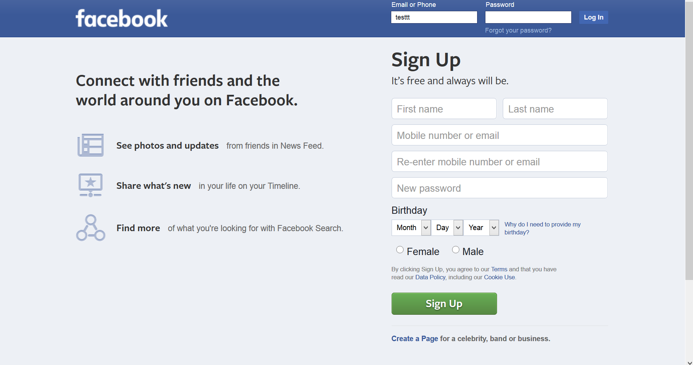
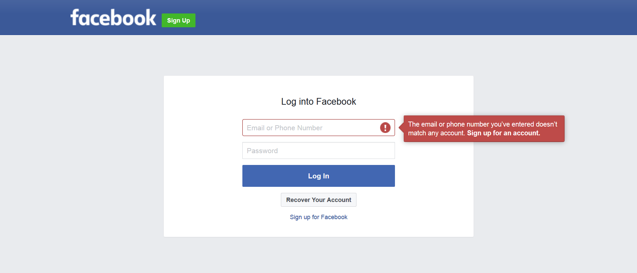

Slide 13
As you saw in the demo:
  Writing and using a complete script which considers all possible scenarios, you are able to see if every part is works fine whenever a change is made into the software. Yes, that is possible by only one click and run the script!

Slide 14
References
http://docs.seleniumhq.org/
https://www.youtube.com/watch?v=juKRybHPMwE
http://searchsoftwarequality.techtarget.com/

Slide 15

Prepared by:
Neda Haijakhoond Bidoki
hajiakhoond@knights.ucf.edu

