Slide 1
Unified Modeling Language
Use Case Diagrams

Slide 2
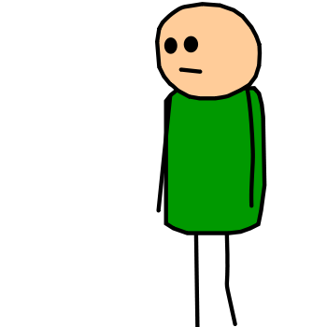
Use Case Diagram
Depicts observable, user-initiated functions in terms of interactions of the system and its environment
Describes the relationship between “actors” and use cases
An actor is something that interacts with the system
Actors

Slide 3
Use Case Diagram
A use case represents some action that takes place within the system
Represents a major required functionality of the system
Use cases are not meant to model all tasks that the system provides
They specify user views of essential system behavior
Should be a verb
Logs in

Slide 4
Use Case Diagram
Additionally:
  A large rectangle box denotes the system boundary
  A line between an actor and use case denotes that the actor participates in the use case
Logs in
Student

Slide 5
Use Case Diagram
<<include>>
  A use case includes the functionality described in the previous one
  Represented by a directed arrow having a dotted shaft, labeled with <<include>>
Pay
Fines
Check Fines
<<include>>
To Pay Fines we require to Check Fines

Slide 6
Use Case Diagram
<<extend>>
  A use case may include the functionality described in another use case
Find
Item
Borrow
Item
<<extend>>
To Borrow Item we may need to Find Item

Slide 7
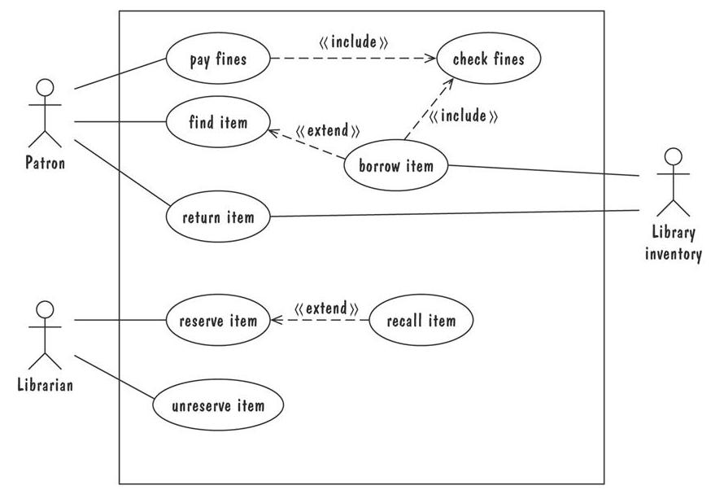

Slide 8
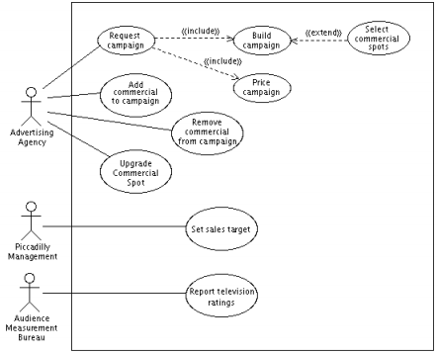

Slide 9
Finally, To draw a use case diagram:
Think of following items:
  Actors
  Use cases (Actions)
    Triggers
    Goals
    Failed conclusion
    Extensions
    Etc.
  The relation between use cases
    Include
    Exclude

Slide 10
Finally, To draw a use case diagram:
For actors:
  Give meaningful relevant names
  Put primary actors to the left side
  Actors does not interact with each other
  Put inheriting actors below the parent
For use case:
  Names begin with a verb
  Names are descriptive
  Put actions in logical order
  Place included use case to the right of the invoking use case
  Place inheriting use case below parent use case

Slide 11
References
Shari Lawrence Pfleeger and Joanne M. Atlee, "Software Engineering: Theory and Practice", 4th Edition, Prentice Hall, 2010.
Prepared/modified by
Kia Manoochehri
  kiam@knights.ucf.edu
Gurkan Solmaz
  gsolmaz@knights.ucf.edu
Safa Bacanli
  sbacanli@cs.ucf.edu
Neda Hajiakhoond
  hajiakhoond@knights.ucf.edu

