Slide 1

MoVi: Mobile Phone based Video Highlights via Collaborative Sensing
Xuan Bao
Department of ECE
Duke University
Romit Roy Choudhury
Department of ECE
Duke University
James Pittman
February 9, 2011
EEL 6788

Slide 2
Outline
Introduction
Assumptions
System Overview
Challenges
Design elements
Evaluation
Experiments and Discussion of Results
Limitations and Conclusions

Slide 3
Introduction
Basic Concepts
  Replace sensor motes with mobile phones in social settings
  Sensors in these settings will record a large amount of continuous data
  How do you distill all of the data from a group of sensors in a social setting?
  Can mobile phone sensors in a social setting be used to create “highlights” of the occasion?

Slide 4
Introduction
Basic Concepts
  Develop trigger concepts to know when to sense with phones
  Derive values for sensed data to determine which sensor is recording the ‘best’ data
  Combine system based sensor results to create Highlights of social occasions
  Compare MoVi Highlights to human created manual Highlights

Slide 5
Assumptions
To make this system work assumptions about the situation are required:
  People are wearing a camera
  People are wearing a sensor (mobile phone)
    These can be the same device

Slide 6
System Overview
The MoVi system has 4 parts
Group Management
  Analyze data to compute social groups among phones
Trigger Detection
  Scan the data for potentially interesting events

Slide 7
System Overview
The MoVi system has 4 parts
View Selector
  Pick a sensor or group with the best “view” of the event
Event Segmentation
  Extract the appropriate section of video that fully captures the event

Slide 8
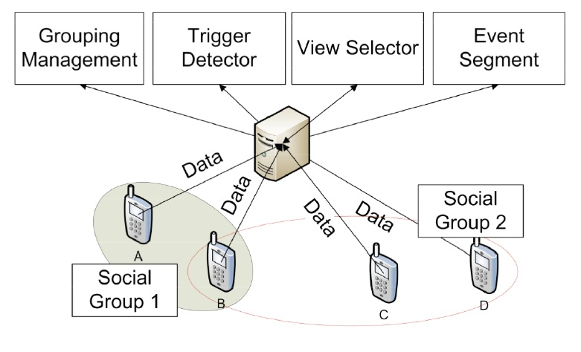
System Overview
Client / Server Architecture for MoVi

Slide 9
Challenges
Group Management
Correctly partitioning the mobile devices into groups
Identifying “social zones” to based on social context
Mapping the phones into the zones and into groups and keeping them updated

Slide 10
Challenges
Event Detection
Recognizing which events are socially “interesting”
Deriving rules to classify the events as interesting

Slide 11
Challenges
View Selection
Determining the best view from the group of sensors that witness an event
Designing heuristics to eliminate poor candidates

Slide 12
Challenges
Event Segmentation
Taking event triggers and converting them to a logical beginning & end for a segment of video
Identification and learning of patterns in social events

Slide 13
Design Elements
Social Group Identification – Acoustic
Initial groupings are seeded by a random phone playing a high-frequency ringtone periodically.
Using a similarity measure to score the phones overhearing the ringtone, ones closest to the transmitter are grouped.

Slide 14
Design Elements
Social Group Identification – Acoustic
Ambient sound is hard to classify but easier to detect than the ringtones
Authors classify the ambient sound using Support Vector Machines (SVM).
Mel-Frequency Cepstral Coefficients (MFCC) are used as features in the SVM
  This is a type of representation of the sound spectrum that approximates the human auditory system

Slide 15
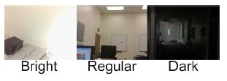
Design Elements
Social Group Identification – Visual
Grouping through light intensity
  Grouped using similarity functions similar to the ones for sound
To avoid issues with sensitivity due to orientation the classes for light were restricted to 3 types

Slide 16
Design Elements
Social Group Identification – Visual
Grouping through View Similarity
  If multiple people simultaneously look at a specific person or area they have a similar view
  Use of a spatiogram generates a similarity measure that can be extracted even if the views are from different angles.
  View similarity is the highest priority for grouping

Slide 17
Design Elements
Trigger Detection – Specific Events
Triggers derived from human activities
  Laughter, clapping, shouting, etc.
  Too many of these for the initial work
Decided to start with laughter
  Created laughter samples
  Created negative samples of conversation and background noise
Used these to derive a trigger

Slide 18
Design Elements
Trigger Detection – Group Behavior
Looking for a majority of group members to behave similarly
  Similar view
  Group rotation
  Similar acoustic ambience

Slide 19
Design Elements
Trigger Detection – Group Behavior
Unusual View Similarity
  Multiple cameras are found to be viewing the same object from different angles

Slide 20
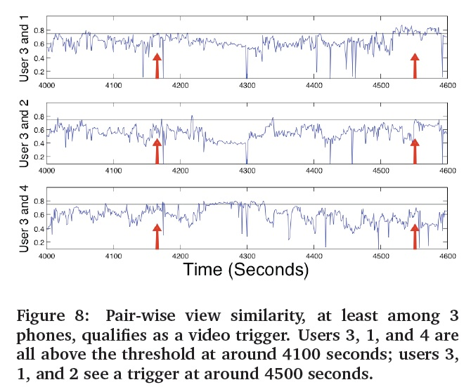
Design Elements
Unusual View Similarity

Slide 21
Design Elements
Trigger Detection – Group Behavior
Group Rotation
  Using the built in compass function of the phones you can detect when multiple members of the group turn the same direction at the same time
  Example: everyone turning when someone new enters, or toward a birthday cake in time to sing “happy birthday”

Slide 22
Design Elements
Trigger Detection – Group Behavior
Ambience Fluctuation
  When light or sound ambience changes above a threshold this can be a trigger
  When this happens across multiple sensors this is considered a good trigger, especially within a short period of time

Slide 23
Design Elements
Trigger Detection – Neighbor Assistance
Adding humans into the sensor loop
  Any time a user specifically takes a picture it is considered significant, and a signal is transmitted
  Any other sensor in the vicinity oriented in the same compass direction will be recruited as a candidate for a highlight.

Slide 24
Design Elements
View Selection
A module is required to select videos that have a “good view”
4 Heuristics are used
  Face Count
    more faces = higher priority
  Accelerometer reading ranking
    less movement = higher ranking
  Light intensity
    “regular” light is preferred to dark or overly bright
  Human in the Loop
    human triggered events will be rated highly

Slide 25
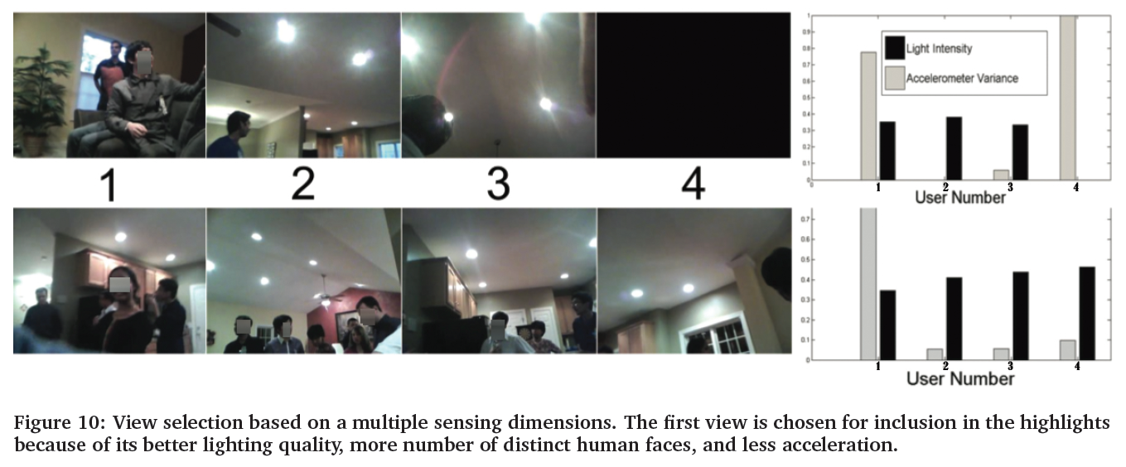
Design Elements
View Selection

Slide 26
Design Elements
Event Segmentation
The last module is necessary to identify the logical start and end of the detected events
A clap or laugh is a trigger, but the system must find the event (such as a song or speech or joke) and include that for the highlight to make sense

Slide 27
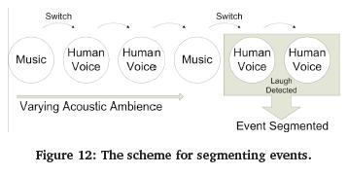
Design Elements
Event Segmentation
  Example: laughter, rewind the video to try and find the beginning of the joke. Go back to sound classification to try and find transitions

Slide 28
Evaluation: Experiments & Results
MoVi system tested in 3 experiments
  Controlled setting
  Field Experiment: Thanksgiving Party
  Field Experiment: SmartHome Tour
5 participants w/iPod Nano (for video) and Nokia N95 phones (other sensors)
Other stationary cameras

Slide 29
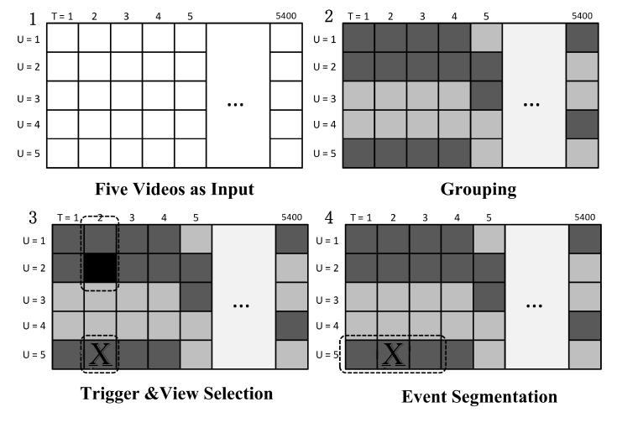
Evaluation: Experiments & Results
iPods can record 1.5 hours (5400 seconds), which results in a 5x5400 matrix of 1 second videos

Slide 30
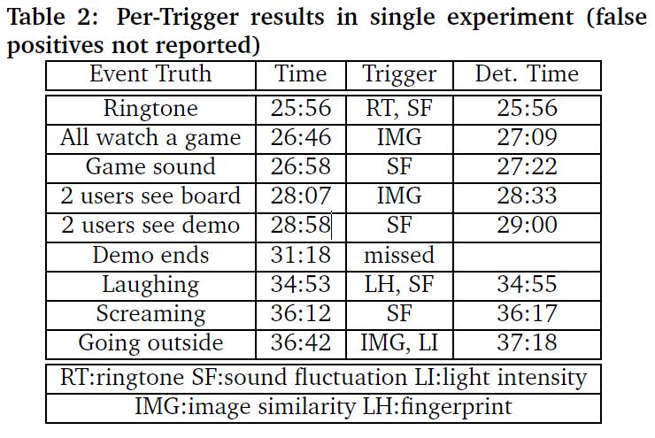
Evaluation: Experiments & Results
Control experiment

Slide 31
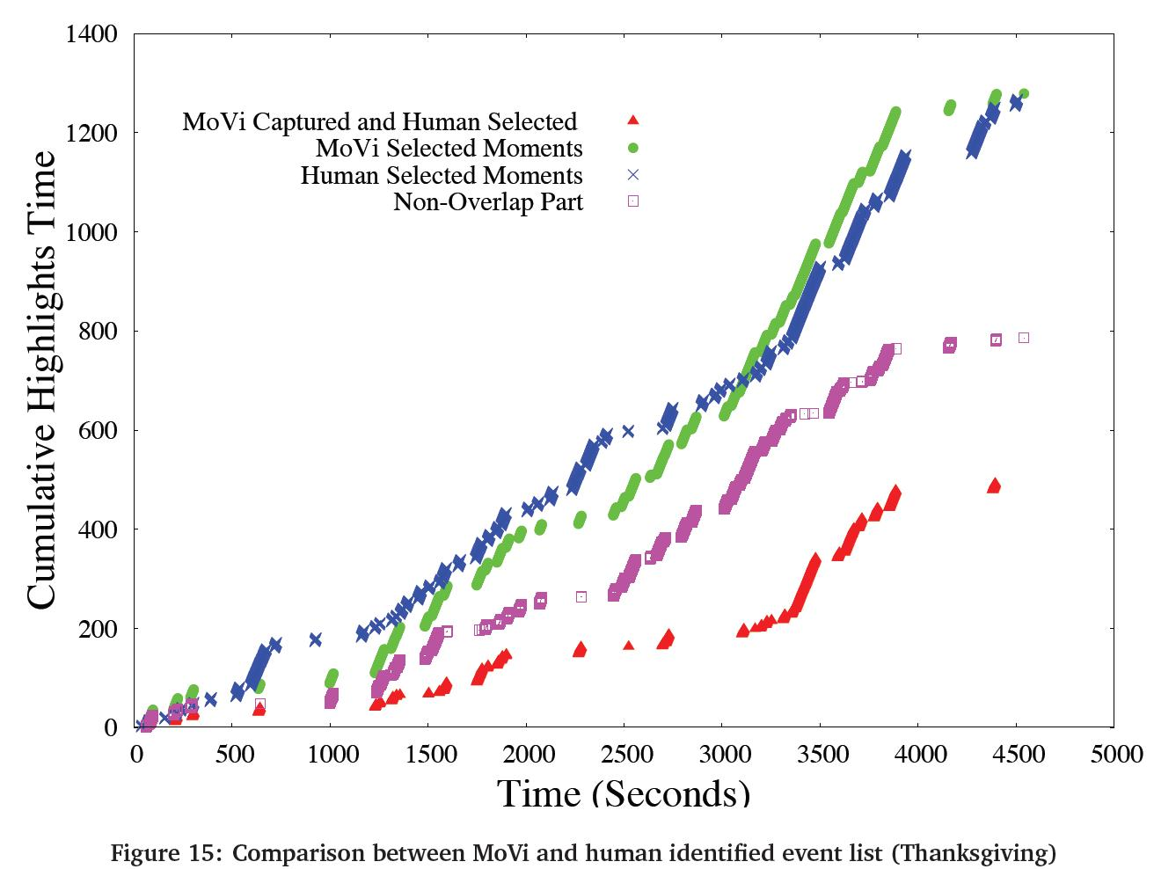
Field Experiment 1

Slide 32
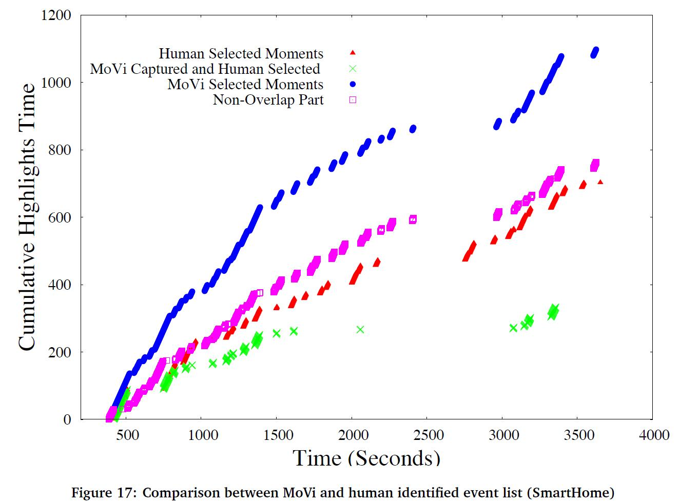
Field Experiment 2

Slide 33
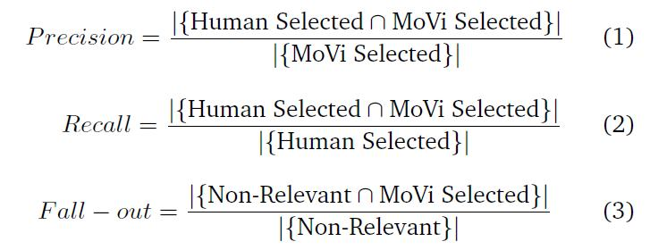
Evaluation: Experiments & Results
Uncontrolled Experiments – Evaluation Metrics
Human Selected – Picked by users (union of those event selected by multiple humans)
Non-Relevant – Events not picked by users

Slide 34
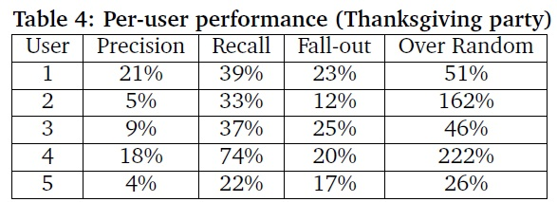
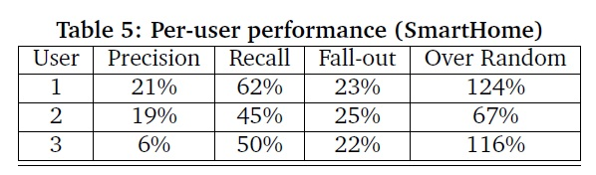
Evaluation: Experiments & Results
Overall: 0.3852 Precision, 0.3885 Recall, 0.2109 Fall-out
Overall: 0.3048 Precision, 0.4759 Recall, 0.2318 Fall-out

Slide 35
Discussion of Results
The results were quite favorable if you compare it as an improvement over random selection. (more than 100% improvement)
The subjective nature of human interest and the strict exact scoring nature of the metrics make the results reasonable but not ground breaking
That said, the concept appears sound as a first step toward a long term collaborative sensing project

Slide 36
Limitations to be overcome
Retrieval accuracy – defining human interest
Unsatisfying camera views – what if every view of a situation is bad?
Energy Consumption – constant use of the sensors greatly shortens the overall duration
Privacy – how to handle social occasions where not everyone signs on to the concept
Greater algorithmic sophistication – would like to be able to handle more options
Dissimilar movement between phones and iPods – dealing with differences in sensing based on sensor location

Slide 37
Conclusions
The MoVi system is one part of the new concept of “social activity coverage”.
MoVi is able to sense many different types of social triggers and create a highlight of a social occasion that is at least somewhat close to a hand picked result by a human
It shows promise with future increases in sophistication

Slide 38
References
http://en.wikipedia.org/wiki/Mel-frequency_cepstrum

