Slide 1

PAPER
MAUI: Making Smartphones Last Longer with Code Offload
Presenter : Miresh Shukla
EEL 6788 ADVANCED TOPICS IN COMPUTER NETWORKS
Dr. DAMLA TURGUT

Slide 2

MAUI: Making Smartphones Last Longer with Code Offload
Eduardo Cuervo#, Aruna Balasubramanian*, Dae-ki Cho $,
Alec Wolman @, Stefan Saroiu @, Ranveer Chandra @,
Paramvir Bahl @
#Duke University, *University of Massachusetts Amherst,
$UCLA, @Microsoft Research
"MAUI: making smartphones last longer with code offload,"
In Proc. of the 8th international conference on Mobile systems, applications, and services (MobiSys), 2010, pp. 49-62.
MobiSys’10, June 15–18, 2010, San Francisco, California, USA.
http://www.cs.umass.edu/~arunab/paper/maui.pdf

Slide 3
INTRODUCTION
One of the biggest obstacles for future growth of SPh(Smartphones) is battery technology.
One popular technique : Remote Execution of code.
Two approaches to meet this technique.
  To rely on programmers – to specify portion of a program, what needs to be remote?
  To use full process or full VM(Virtual Machine) migration
MAUI, a system that enables fine-grained energy-aware offload of mobile code to the infrastructure with minimal burden on programmers.

Slide 4
Continue…
MAUI, an architecture that combines the benefits of these two approaches: it maximizes the potential for energy savings.
Software used: Microsoft .NET Common Language Runtime (CLR)
Hardware : HTC Fuze with a 1340 maH battery
MAUI uses code portability to create two versions of a SPh apps(applications).
  One runs locally on the SPh
  The other runs remotely in infrastructure.

Slide 5
NEED FOR REMOTE EXECUTION ?
Today’s SPh to run sophisticated apps.
  Like Games, Video Streaming, Sensors, Online music etc.
Omni-present access to 3G connectivity.
Unlike Wi-Fi, 3G, offers Omni connections, are known to suffer from very long latencies and slow data transfers.
Computing apps are moving to the cloud.
  With cloud computing, industry is building massive infrastructure to offer highly available resources.
  Typical round-trip times (RTTs) to cloud servers are on the order of tens of milliseconds.

Slide 6
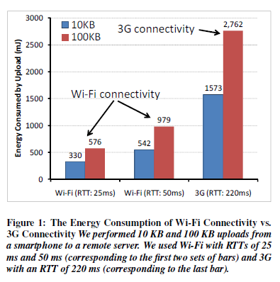
Continue…
The two main contributors to energy problem.
  limited battery capacity, and
  Increasing demand for energy-hungry applications.
How Energy Efficient is 3G for Code Offload?
A simple experiment to contrast the energy consumption of 3G vs Wi-Fi.
Setup HTC Fuze SPh do two code uploads (10 KB and 100 KB) to remote server.
Evaluated two scenarios:
SPh using Wi-Fi to reach the server (adding a 25 ms or 50 ms of queuing delay)
SPh using 3G (with a measured RTT of 220 ms).

Slide 7
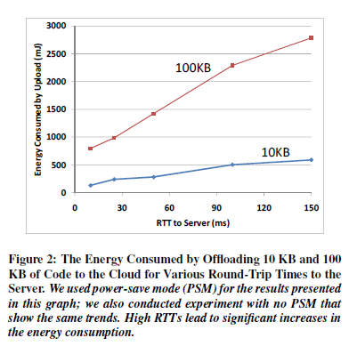
Energy consumption of Code Offload to RTT to Server
Figure 2 shows the energy consumed when offloading 10 KB and 100 KB of data with Wi-Fi using Power Saving Mode (PSM).
The energy consumption of code offload grows almost linearly with RTT.
In fact, for offloading 10 KB of code, energy consumption almost doubles when increasing RTT from 10 ms to 25 ms only, and it doubles again when RTT reaches 100 ms.
First, cloud providers should strive to minimize the latency (access time) to the cloud for mobile users.
Means, Overall Shorter RTTs = significant energy savings.
Second, the benefits of remote execution are most impressive when the remote server is nearby (RTT of 10 ms), such as on the same LAN as the Wi-Fi access point, rather than in the cloud (RTT ≥ 25ms).

Slide 8
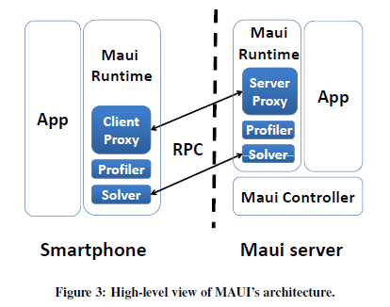
MAUI SYSTEM ARCHITECTURE

Slide 9
PROGRAM PARTITIONING
Partitioning .NET Applications
Executing the Same Code on Different CPU Architectures
Extracting Remoteable Methods Using Reflection
Identifying the State Needed for Remote Execution Using Type-Safety and Reflection
Performing Code Offload
Handling Failures
MAUI detects failures using a simple timeout mechanism.
Additional Program Modifications bring Performance Benefits

Slide 10
MAUI PROFILER
MAUI profiler measures the device characteristics at initialization time.
It continuously monitors the program and network characteristics.
Because these can often change and a state measurement may force MAUI to make the wrong decision.
Device Profiling
Today’s SPh do not offer a way to obtain fine-grained energy measurements of an application.
Instead, to measure a device’s energy consumption, they attach a hardware power meter [25] to the SPh’s battery (Figure 5). This power meter can provide fine-grained energy measurements; it samples the current drawn from the battery with a frequency of 5000 Hz.

Slide 11
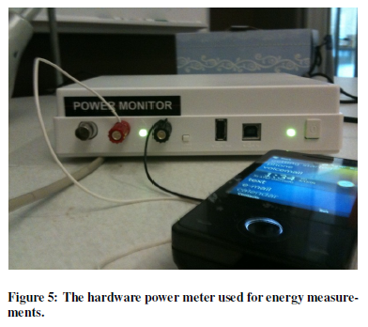
For the CPU, they constructed a synthetic benchmark that uses both integer and floating point arithmetic. They ran their synthetic benchmark
multiple times.
They found that the median error produced by the model is less than 6%, while the mean error is less than 8% and the standard deviation is 4.6%.
Program Profiling
The MAUI profiler instruments each method to measure its state transfer requirements, its runtime duration, and the number of CPU
cycles required for its execution.
MAUI uses the method’s duration and CPU cycles to estimate
the energy consumed by running the method on the SPh.

Slide 12
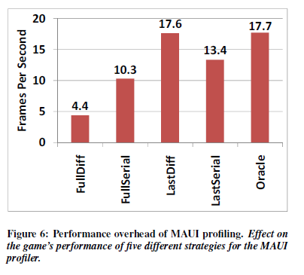
Profiling Overhead
MAUI proxies transfer incremental deltas rather than the full application state to reduce the network and energy overhead of state transfer.
They used five different strategies for profiling an interactive application (a video game).
FullDiff – Profiler uses delta calc and serialization on every call to Remote Method.
FullSerial – Profiler uses serialization only to each call to Remote Method.
LastDiff – Profiler uses delta calc and serialization on first call and then estimates.
LastSerial – Profiler uses serialization on first call and then estimates.
Oracle – Profiler knows in advance how many states will require w/o computation.

Slide 13
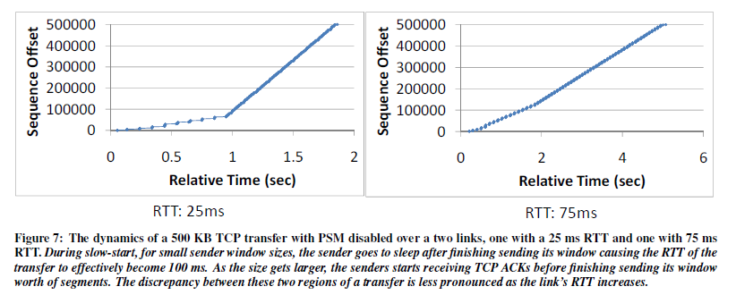
Networking Profiling
They planned to use Wi-Fi’s power-save mode (PSM) to maximize the energy savings, and planned to use network measurement tools to estimate the wireless link’s RTT, bandwidth and packet loss.
To illustrate findings they select two specific examples of a 500 KB TCP transfer over a link with 25ms RTT and one with 75ms RTT with PSM enabled.

Slide 14
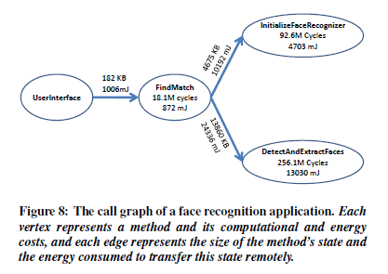
MAUI SOLVER
The MAUI solver uses data collected by the MAUI profiler as input to a global optimization problem that determines which remoteable methods should execute locally and which should execute remotely.
The solver’s goal is to find a program partitioning strategy that minimizes the SPh’s energy consumption, subject to latency constraints.
Figure 8 shows a simplified version of the call graph for a face recognition application.
Each vertex represents a method and its computational and energy costs, and each edge represents the size of the method’s state and energy consumed to transfer this stage remotely.

Slide 15
EVALUTION
Methodology
SPh: HTC Fuze running on Windows Mobile 6.5 with .NET Compact Framework v3.5
MAUI Server: Dual-core desktop 3GHz CPU, 4GB RAM running on Windows 7 with .NET Framework v3.5
The server is equipped with an NDIS intermediate driver that inserts packet queuing delays to control the RTT of the path between the SPh and the server.
They measure energy on the phone using a hardware power meter attached to the SPh’s battery. This power meter samples the current being drawn from the battery at 5000 Hz.
They evaluate MAUI’s benefits on four applications.
Three of these applications were already pre-built and running on Windows Mobile phones: a face-recognition application, a highly-interactive video game, and a chess game.
The fourth application from scratch – a real-time voice-based language translator (Spanish to English).
The language translator must use remote execution to run on the SPh because its memory resource requirements exceed those offered locally by the SPh.

Slide 16
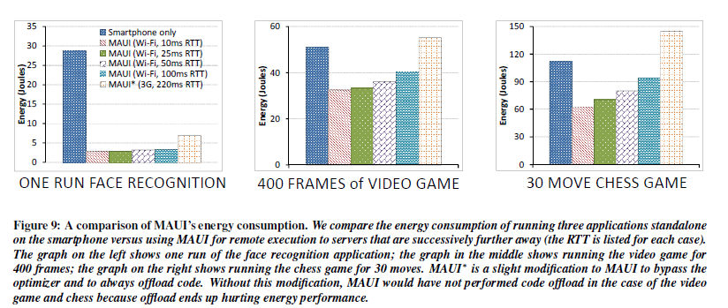
Macrobenchmarks
How Much Energy Does MAUI Save for Mobile Applications?
  Figure 9 presents a comparison of the energy consumption of three applications (the face-recognition application, the video game, and the chess game) when executing in six different scenarios.

Slide 17
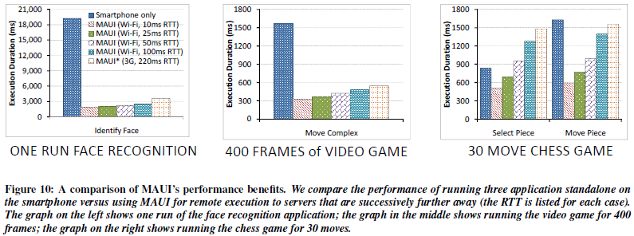
How Much Does MAUI Improve the Performance of Mobile Applications?
  They ran the applications in the same six scenarios but instead measured performance rather than energy consumption.
  They present the results in Figure 10.

Slide 18
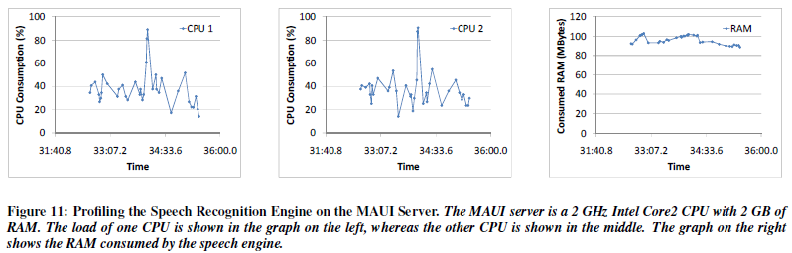
Can MAUI Run Resource-Intensive Applications?
  Figure 11 shows the memory consumption and CPU utilization over time of our translator application when running on a PC with a 2 GHz Intel Core2 CPU and 2 GB of RAM.

Slide 19
Microbenchmarks
  Now look at four microbenchmarks that characterize the behavior of both the MAUI solver and the MAUI proxy.
What is the Overhead of MAUI’s Solver?
  They instrumented the optimizer to record how long it takes to solve each instance of the Integer Linear Programming (ILP) problem.
  The solver takes 18 ms on average to solve the call graph of the chess application and 46 ms for the video game.
Does MAUI Require a Global View of the Program to Identify Offload Opportunities?
  They constructed a much simpler solver as an alternative to MAUI.
  This naïve solver considers each method separately; a method is offloaded only if its remote execution consumes less energy than its local execution.

Slide 20
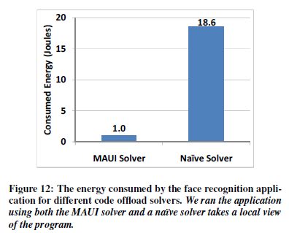
Figure 12 shows that the MAUI solver consumed two orders of magnitude
less energy than the naïve solver.
By taking a local view of each
method, the naïve solver decided to execute all methods locally,
whereas MAUI chose to offload parts of the application.
How Effective are Incremental Deltas at Reducing MAUI’s Data Transfer Overhead?
  Figure 13 shows the benefits of transferring deltas rather than the entire uncompressed state, for the video game for each subsequent execution of the offloaded method.

Slide 21
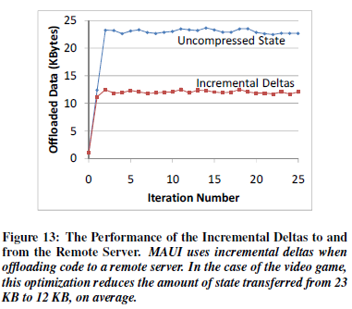
After the first two iterations, when the method is still being initialized, MAUI benefits from using incremental deltas: this optimization reduces the amount of state transferred by a factor of two from 23 KB to 12 KB.
Conclusions
MAUI, a system that enables fine-grained energy-aware offload of mobile code to the infrastructure.
MAUI uses the benefits of managed code to reduce the burden on programmers to deal with program partitioning while maximizing the energy benefits of offloading code.

Slide 22
Conclusions continue…
How to Partitions Programs, how it profiled them, and how it formulated and solved program partitioning as a 0-1 Integer Linear Programming problem.
Throughout presentation of MAUI architecture.
Results showed that MAUI’s energy savings and performance are impressive.

Slide 23
Thank you
Questions???

