Slide 1
PARTICIPATORY URBANISM
By Miresh Shukla
EEL 6788
Advanced Topics in Computer Networks (Urban Sensing)
Prof. Damla Turgut

Slide 2
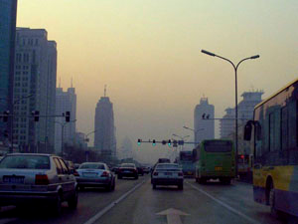
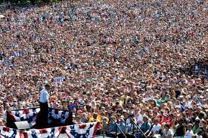
What is Participatory Urbanism?
AIR POLLUTION
TRAFFIC
POPULATION

Slide 3
Participation Urbanism is the open authoring, sharing, and remixing of new of existing urban technologies marked by, requiring or involving participation, especially affording the opportunity for individual citizen participation, sharing, and voice.
Participatory Urbanism builds upon a large body of related projects where citizens act as agents of change.

Slide 4
Participatory Urbanism presents an important new shift in mobile device usage – from Communication tool to “networked mobile personal measurement instrument”.
We explore how these new “instruments” enable entirely new participatory urban lifestyles and create novel mobile device usage models.
It is NOT a disconnected personal phone application, a domestic networked appliance, a mobile route planning application, an office scheduling tool, or a social networking service.

Slide 5
Participatory Urbanism promotes new styles and methods for individual citizens to become proactive in their involvement with their city, neighborhood, and urban self reflexivity.
Examples of Participatory Urbanism include but are not limited to: providing mobile device centered hardware toolkits for non-experts to become authors of new everyday urban objects, generating individual and collective needs based dialogue tools around the desired usage of urban green spaces, or empowering citizens to collect and share air quality data measured with sensor enabled mobile devices.

Slide 6
Our mobile devices are globally networked, speak the lingua franca of the city (SMS, Bluetooth, MMS), and are becoming the dominant urban processor.
We need to shatter our understanding of them as phones and celebrate them in their new role as measurement instruments.
Our desire is to provide our mobile devices with new “super-senses” and abilities by enabling a wide range of physical sensors to be easily attached and used by anyone, especially non-experts.

Slide 7
We argue there are two indisputable facts about our future mobile devices:
(1) They will be equipped with more sensing and processing capabilities and
(2) They will also be driven by an architecture of participation and democracy that encourages users to add value to their tools and applications as they use them.

Slide 8
Millions of us carry a mobile device such as a mobile phone with us everyday.
The only real-time environmental data it renders is a narrow slice of the electromagnetic spectrum with a tiny readout of cell tower signal strength using a series of bars.
MOBILE SIGNAL STRENGTH
(SIGNAL TO NOISE RATIO)
http://www.urban-atmospheres.net/ParticipatoryUrbanism/index.html

Slide 9
Example Air Quality Measurements
The World Health Organization estimates that 2 million deaths each year can be attributed to air pollution - that’s more deaths than those resulting from automobile accidents.
Project :
Ergo (On-the-Go Air Quality Readings delivered to your mobile device)
A simple SMS system that allows anyone with a mobile phone to quickly and easily explore, query, and learn about their air quality on-the-go with their mobile phone.
You can receive real-time air quality measurements throughout the United States on your mobile phone. Just send a text message to the phone number and you will receive the most recent EPA air quality measurement data available. You'll be able to see the air quality change throughout the day as well as forecasts for the coming days.

Slide 10
Phone# (415) 624-667X (number inactive)
Using Ergo
If you text...
a 5 digit zip code = you receive the most recent air quality reports for that area (ex. 94704)
the word worst = you receive the worst three locations in the US as currently reported (ex. worst)
daily zip time = you receive a report every day at the specified time for the given zip code. The time should be in 24-hour format and uses the time zone associated with the zip code given. (ex. daily 10011 1300) for daily air quality for New York City at 1pm Eastern Time
daily worst time = you receive a report every day at the specified time of the worst air quality in the United States. The time should be in 24-hour format and interprets the time as Pacific Time Zone. (ex. daily worst 0900 ) for daily report of worst air quality at 9am Pacific Time
daily off = stops all daily messages sent to you

Slide 11
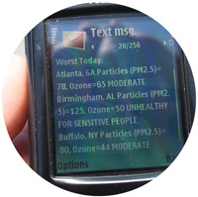
How to Interpret the Air Quality Reports
Air Quality Index Bakersfield, CA Currently @3:00 PM = 47 (GOOD) Ozone 6/4: 95 (MODERATE) Ozone 6/5: 124 (UNHEALTHY FOR SENSITIVE PEOPLE) Ozone
(Report : The actual air quality report for Bakersfield for 4 June 2007)
The system reports back the name of the city and the most recent data it is using to report the current condition. In this example @3:00PM, the Air Quality Index for Ozone is reported to be 47 for Bakersfield, California. Ozone is listed to tell you that the reading is for what is considered the major contributing pollutant for the day.
Air Quality Index (AQI) Values | Levels of Health Concern | Colors
0 to 50 | Good | Green
51 to 100 | Moderate | Yellow
101 to 150 | Unhealthy for Sensitive People | Orange
151 to 200 | Unhealthy | Red
201 to 300 | Very Unhealthy | Purple
301 to 500 | Hazardous | Maroon

Slide 12
The level of health concern from above is also included in the SMS message returned to you to aid in interpretation.
The Air Quality Index (AQI) is a standardized indicator of the air quality in a given location. It measures mainly ground-level ozone and particulate matter (i.e. small particles in the air), but may also include sulphur dioxide, and nitrogen dioxide.
Various agencies around the world measure such indices, though definitions vary. In the US, the Environmental Protection Agency (EPA) uses the above AQI classification.

Slide 13
Ergo also typically provides you with two days of forecast air quality for the zip code provided.
The other message type you can receive back is a listing of up to three of the worst air quality reporting locations in the US.
Worst Today:
Atlanta, GA Particles (PM2.5)=78, Ozone=65 MODERATE
Birmingham, AL Particles (PM2.5)=125, Ozone=50 UNHEALTH FOR SENSITIVE PEOPLE
Buffalo, NY Particles (PM2.5)=80, Ozone=44 MODERATE

Slide 14
The message will contain the name of each city followed by its two primary pollutants.
In the example above Atlanta, Georgia is reporting PM2.5=78 AIQ and Ozone=65 AQI.
Particulates, alternatively referred to as Particulate Matter (PM), aerosols or fine particles, are tiny particles of solid or liquid suspended in a gas. PM2.5 represents particles less than 2.5 micrometers in diameter.
Larger particles are generally filtered in the nose and throat and do not cause problems.
Ozone refers to ground level Ozone.
Credits : Eric Paulos

Slide 15
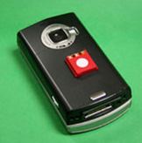
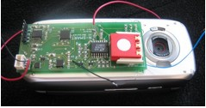
Air Sensor
Integrating simple air quality sensors into networked mobile phones promotes everyday citizens to uncover, visualize, and collectively share real-time air quality measurements from their own everyday urban lifestyles.
Using the N-SMARTS hardware from UC Berkeley we are designing hardware and software mobile systems to enable Participatory Urbanism.
What happens when individual mobile devices are augmented with novel sensing technologies such as noise pollution, air quality, UV levels, water quality, etc?
http://www.urban-atmospheres.net/Experiments/Ergo/index.html

Slide 16
Research Paper
Common Sense Community: Scaffolding Mobile Sensing and Analysis for Novice Users
Wesley Willett1, Paul Aoki2, Neil Kumar1,
Sushmita Subramanian2, and Allison Woodruff2
1 Computer Science Division, University of California, Berkeley, Berkeley, CA 94708 USA
2 Intel Labs Berkeley, 2150 Shattuck Ave, Ste. 1300, Berkeley, CA 94704 USA
willettw@eecs.berkeley.edu, aoki@acm.org,
neilkumar@berkeley.edu, sushmita.subramanian@intel.com,
woodruff@acm.org

Slide 17
Abstract
As sensing technologies become increasingly distributed and democratized, citizens and novice users are becoming responsible for the kinds of data collection and analysis that have traditionally been the purview of professional scientists and analysts.
Citizen engagement effectively, however, requires not only tools for sensing and data collection but also mechanisms for understanding and utilizing input from both novice and expert stakeholders.
When successful, this process can result in actionable findings that engage community members and build on their experiences and observations.

Slide 18
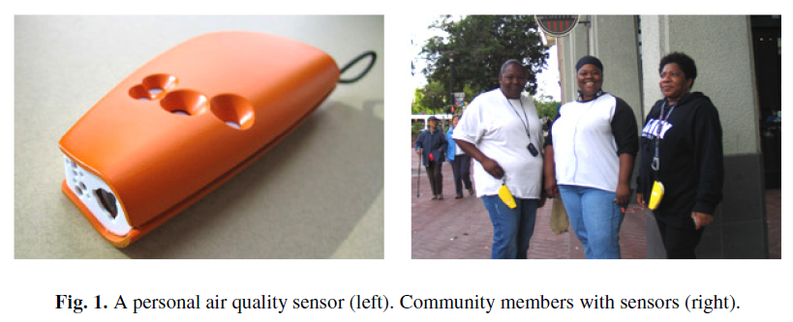
Introduction
Due to the increased availability of sensing technologies, citizens and novice users have new opportunities to pursue the kinds of data collection and analysis that were once handled almost exclusively by professional scientists and analysts.

Slide 19
Motivating Fieldwork
Method:
Over several months, they interviewed community members as well as scientists, remediation consultants, government representatives and other stakeholders in order to understand their perspectives on air quality and assess the role that technological interventions could play in their environmental decision-making processes.
14 formal, in-person interviews
approximately 30 informal interviews conducted either in person, by phone, or at community meetings

Slide 20
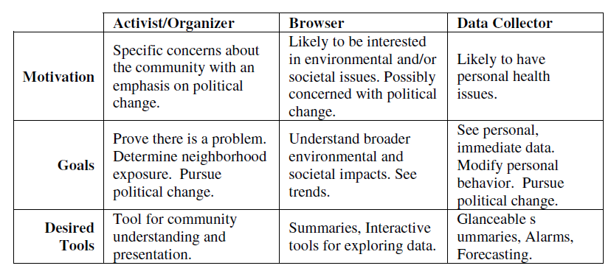
Personas:

Slide 21
Design Principles:
Based on our fieldwork, we also extracted a set of design principles for developing tools to support visual analysis of sensed data.
Some of the key issues are:
Support specific, goal-directed tasks: Participants were highly goal-oriented and motivated by specific issues.
Show local and personally relevant data: Participants were most interested in data close to their homes and other locations they frequented, rather than the aggregate regional data typically provided by current air quality monitoring solutions.
Elicit latent explanations and expectations: Community members have local knowledge and expertise, such as beliefs about sources of pollution in their neighborhood.
Prompt realizations: As mentioned above, community members have significant local knowledge that could be helpful in interpreting local environmental data.
Beware of “language” barriers: Current tools to which community members have access are technically complex and require a moderate level of scientific knowledge but such tools that target novice users should not require an understanding of such language.
“You don’t want to be inundated.” Understandably, participants did not want to be overwhelmed with unnecessary information and complexity.

Slide 22
Framework
Drawing on Personas and Design Principles, they derived a framework for describing data collection and local knowledge generation in a citizen science setting.
Framework consists of SIX steps.
1. Collect
2. Annotate
3. Questions/Observe
4. Predict/Infer
5. Validate and
6. Synthesize

Slide 24
Common Sense Community Site
Building on the framework and our design principles, we designed and built the Common Sense Community site, a suite of task-oriented mini-applications that allow community members to participate in the collaborative analysis of local air quality data.
Collecting Data: Users collect air quality data using mobile sensors designed as part of the broader Common Sense project.
Applications: To display this data, they built mini-visual analysis applications that target common, representative tasks and questions that we identified through their fieldwork.

Slide 25
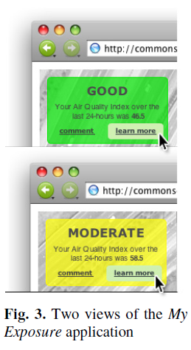
My Exposure
The first application provides a widget that helps users to answer one of the most common questions they observed in their fieldwork: “What is my exposure to a pollutant?” Many of the community members, they interviewed suffered from allergies or respiratory disease exacerbated by the poor air quality in their neighborhood, and expressed a desire for tools that would help them gauge and mitigate their exposure.

Slide 27
Tracks (Fig. B)
The Tracks application (Figure 4b) provides a simple way for novice users to observe and ask questions about pollution data from their own sensor.
Places
Users’ initial inquiries about air quality are often location-centric (“What is air quality like in my neighborhood?”
Hotspots
The Hotspots visualization (not shown) helps users identify regions with the best and worst air quality over a period of time.

Slide 28
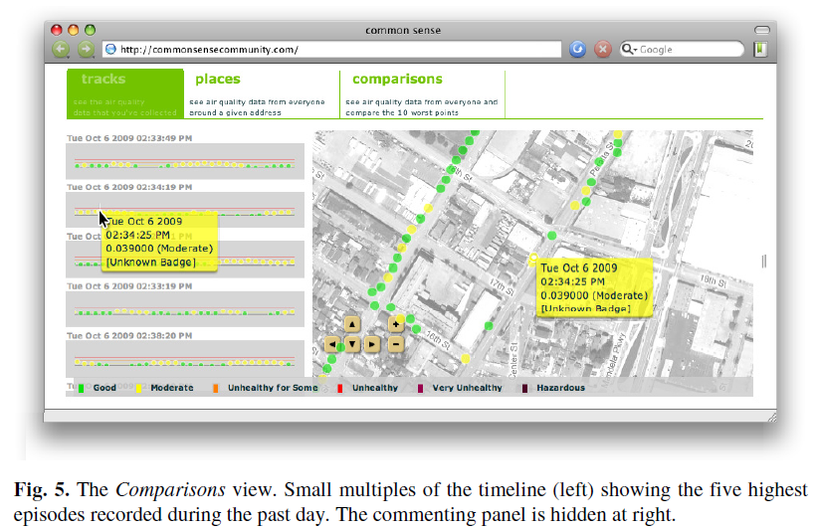
Comparisons
The Comparisons visualization is designed to support inference and help users identify repeated sources and relationships between them.
Discussions
In addition to the collapsible commenting pane that accompanies each one of the visualizations.

Slide 29
Evaluation
They deployed an early version of the site with community members in a low-income urban neighborhood with poor air quality.
Method: During their assessment, they carried out seven interviews with nine community members. They recruited participants through a local non-profit organization that focuses on environmental monitoring and awareness.
Scaffolding and Navigation Strategies: The six steps; Collect, Annotate, Question/Observe, Infer/Predict, Validate and Synthesize.
Usability: Based on their fieldwork, they were mindful in their design process of the computer literacy of the target population.

Slide 30
Discussion
Health and Personal Safety
Socializing
Exposing Preconceived Notions
Visualizations as a Catalyst for Discussion

Slide 31
Conclusion and Future work
In this paper, they have presented design principles for targeting novice users in a citizen science setting and supplied a framework that describes data collection and knowledge generation in these conditions.
Although the applications discussed here focus on air quality, monitoring of other environmental indicators including water and soil quality as well as epidemiological monitoring should be equally applicable.
As we move forward to deploy mobile sensors more broadly and develop mobile interfaces for accessing and interacting with the data, we expect to employ similar techniques and build on these frameworks and tools.
http://www.paulaoki.com/papers/pervasive10.pdf

Slide 32
References:
http://www.urban-atmospheres.net/ParticipatoryUrbanism/index.html
http://www.urban-atmospheres.net/Experiments/Ergo/index.html
Paper:
Common Sense Community: Scaffolding Mobile Sensing and Analysis for Novice Users
W. Willett, P. Aoki, N. Kumar, S. Subramanian, and A. Woodruff. Proc. Pervasive 2010, May 2010, 301-318.
Best Paper Award.
Link 1 : http://www.paulaoki.com/papers/pervasive10.pdf
Link 2 : http://www.communitysensing.org/papers.php

Slide 33
Questions???
Thank you.

