Slide 1

ucfNoiseProfiler
EEL 6788: Advanced Topics in Computer Networks (Spring 2011)
Professor: Dr. Damla Turgut
Presented By: Rene Chacon

Slide 2
General Overview of App
Android application created using Eclipse and tested via created AVD emulator running on Android Platform 1.5 and set to an API level of 3.
App is to be used when inside the perimeter of the UCF main campus to create a “Noise Profile of UCF”
App is activated manually by User and it is the option of the user to post gather noise profile information.

Slide 3
Noise Profile info
The below key components will be captured into either a GPS or XML file.
-GPS coordinates (long. and lat.)
-Noise level (decibel readings and frequency)
-Altitude (meters)
-Speed
-Direction (cardinal direction)

Slide 4
GPS
Battery Life – Cell tower triangulation is used when GPS is not available and as a means to increase resource efficiency.
Code: two necessary class imports are Location and Location Manager. Used to create a gpsLocationListener, gpsLocationManager, towerLocationListener, towerLocationManager

Slide 5
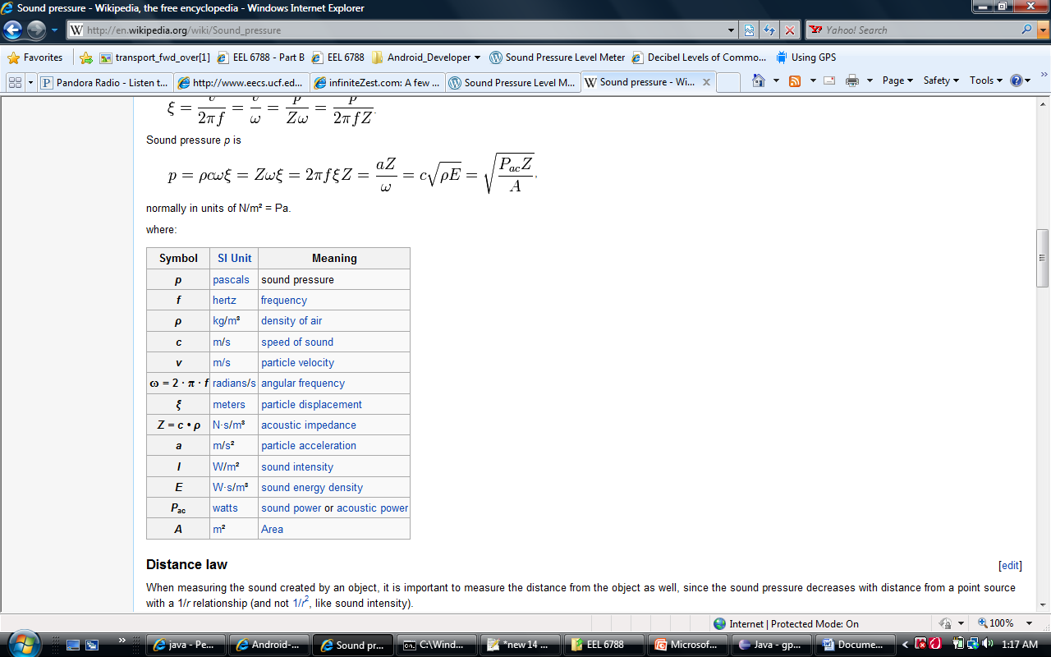
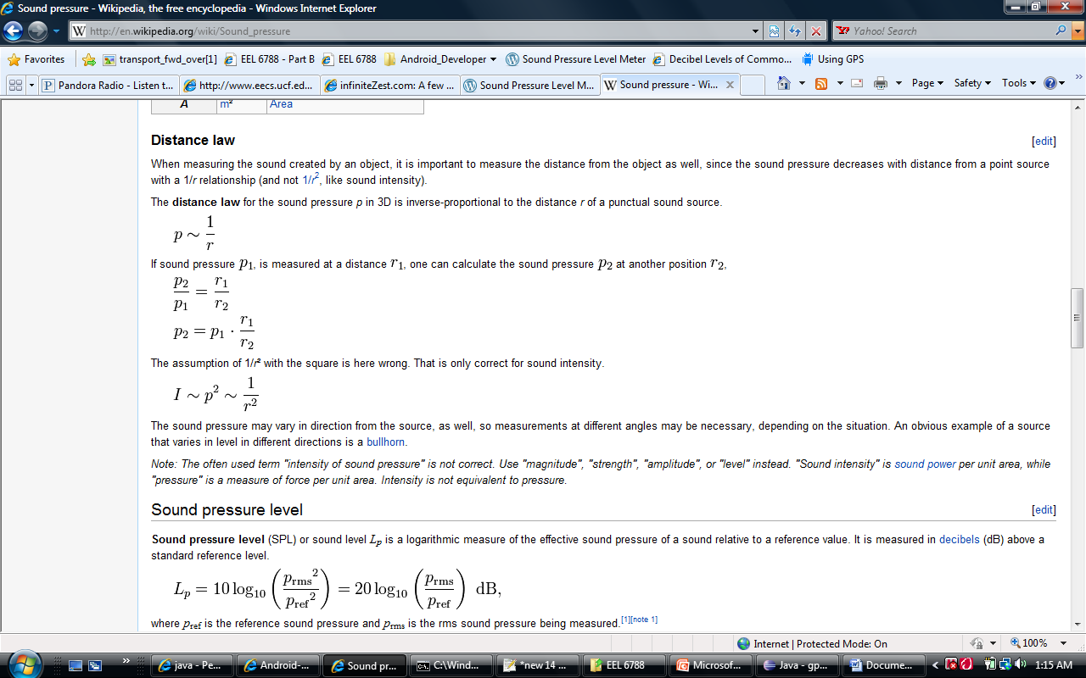
Decibel Level
The Sound Pressure Level (SPL), Lp, formula measures in decibels (dB) the effective sound pressure of a sound relative to a reference value.

Slide 6
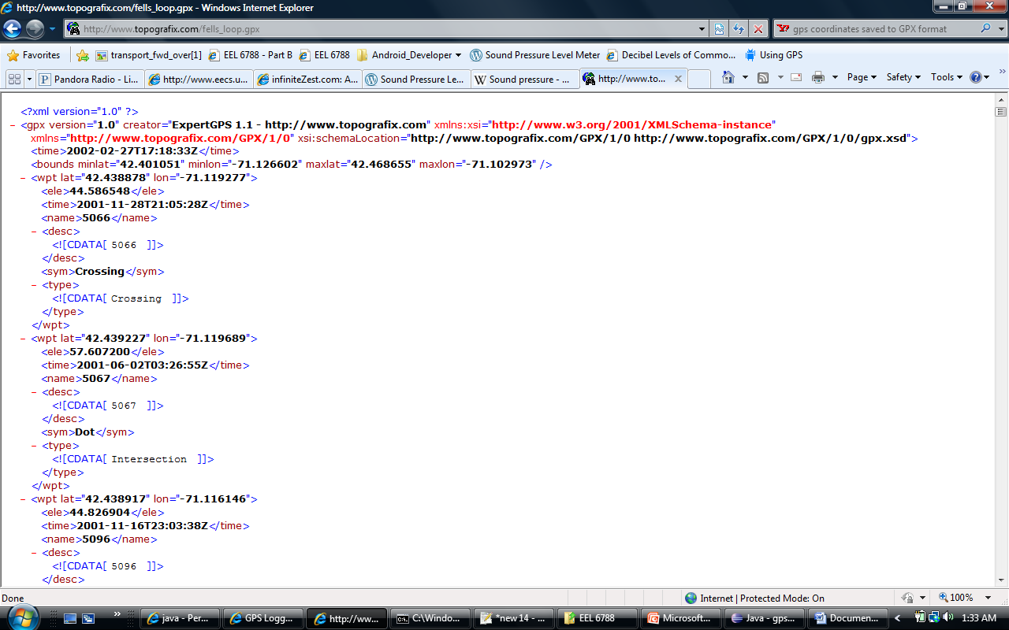
GPX format
GPX (the GPS Exchange Format) is a light-weight XML data format for the interchange of GPS data between applications and Web services on the Internet.

Slide 7
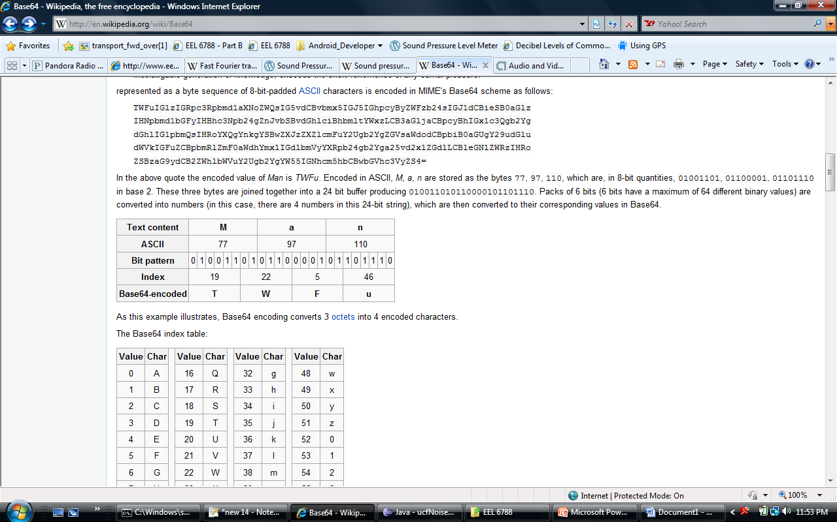
Base64 Encoding
Base64 is an encoding scheme used for the transferring of data from applications such as emails via MIME (Multipurpose Internet Mail Extensions) and storing complex data in XML.

Slide 8
Questions

